Slide 1
From AlphaFold3 to AI Facilitation
A translational computer science journey
Notes:
Opening. Introduce yourself and the arc of the talk: this is a translational computer science journey that starts with one specific tool, AlphaFold3, and ends with a general model for AI facilitation. Frame it as a hero's-journey story: a researcher need pulls us into unfamiliar territory, and what we learn reshapes the whole service.

Slide 2
It's not just about GPUs
The accelerator is one box in a much longer workflow.
Data
movement
Pre-
processing
Software Install
Scheduling
GPU
compute
Adding GPUs is the “easy*” part. The hard part is everything around them — and making it usable, schedulable, and reproducible.
*Your milage may vary
Notes:
Push back on the assumption that this is just about GPUs. The accelerator is one box in a much longer workflow: data movement, preprocessing, containers, compute, scheduling, provenance, and support all surround it. Adding GPUs is the easy part; making them usable, schedulable, and reproducible is the hard part.

Slide 3
Translational computer science
Turning researcher needs into usable infrastructure — then letting the community reshape it.
Community
need
Facilitation
insight
Infrastructure & Software change
Community
feedback
each iteration changes the tools, services, and practices
Notes:
I want to show you a story of how translational computer science enables us to support AI workflows like AlphaFold3.
Define translational computer science explicitly: turning researcher needs into usable infrastructure, then letting the community reshape it. Each iteration changes the tools, services, and practices. This loop is the engine of the whole story, keep pointing back to it.

Slide 4
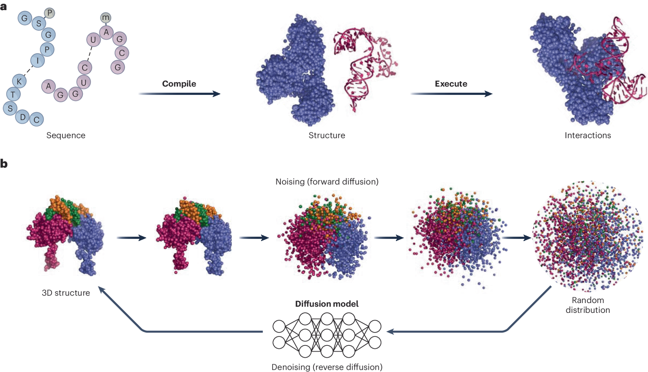

What is AlphaFold3?
AlphaFold3 is a generative ML model that predicts the structures of biomolecules.
AlphaFold3 is able to predict the structures of biomolecules, such as:
Proteins
DNA
RNA
Small molecules (ligands, drugs)
Ions and modified residues
Multi-molecule complexes
Notes:
Background on the tool. AlphaFold3 is a generative ML model that predicts the structures of biomolecules. Unlike earlier versions limited to single proteins, AF3 also handles DNA, RNA, small molecules, ions, and multi-molecule complexes. Keep this brief, the audience needs just enough to follow the compute story.

Slide 5
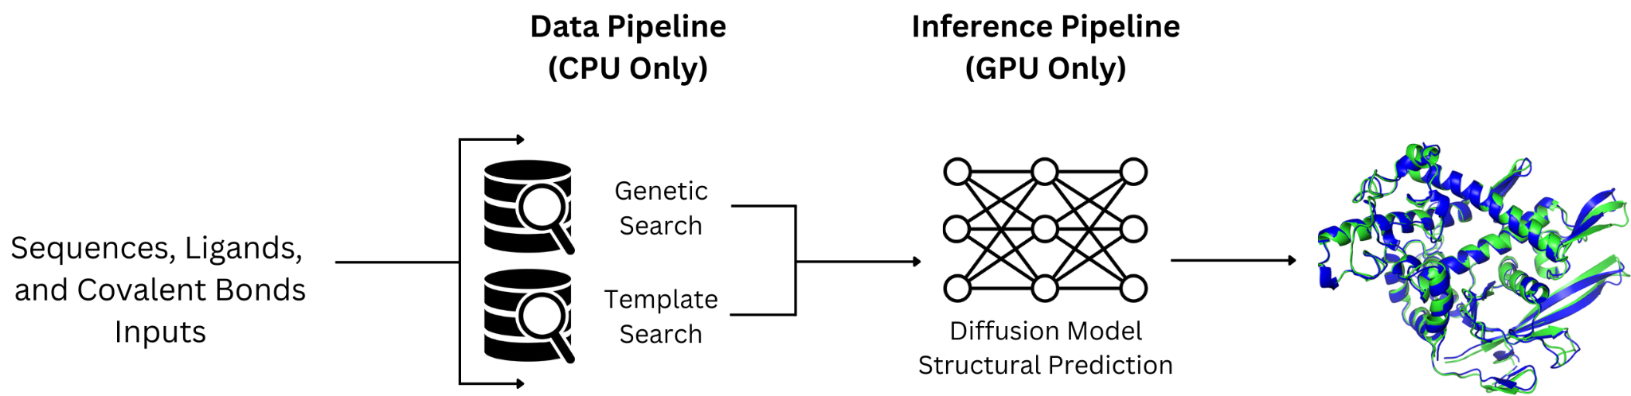
How AlphaFold3 works
Sequence and database search → alignment generation → templates → GPU inference.
Notes:
Walk through how AF3 runs at a high level: sequence and database search, alignment generation, templates, then GPU inference. The key takeaway for later: there are two very different kinds of work happening here, which the next slide breaks apart.

Slide 6
How AlphaFold3 works
Sequence and database search → alignment generation → templates → GPU inference.
Data Pipeline
Prepares alignments and inputs
Depends on AF3 Databases (~750 GB)
  Requires high disk usage
Uses only a few (<8) CPUs
Longer run times (>1hr)†
*Run times depend on the input sequence(s) size and depth of alignments
Notes:
The critical distinction: AF3 is really two steps. The data pipeline prepares alignments and inputs, CPU-bound, database-heavy, high disk, longer runtime. The inference pipeline does the structural prediction, GPU-bound, no databases, shorter. Note the asterisks: CHTC keeps a local copy of the databases, and runtimes depend on input size and alignment depth.

Slide 7
How AlphaFold3 works
Sequence and database search → alignment generation → templates → GPU inference.
Inference Pipeline
Preforms the structural prediction via model inference
Requires GPUs
No Databases requirement
Shorter run time (<1hr) *
*Run times depend on the input sequence(s) size and depth of alignments
Notes:
The critical distinction: AF3 is really two steps. The data pipeline prepares alignments and inputs, CPU-bound, database-heavy, high disk, longer runtime. The inference pipeline does the structural prediction, GPU-bound, no databases, shorter. Note the asterisks: CHTC keeps a local copy of the databases, and runtimes depend on input size and alignment depth.

Slide 8
AlphaFold3 arrives at CHTC / OSPool
The first question was simple:
Can researchers run AlphaFold3 here?
The first question was simple:
Can researchers run AlphaFold3 here?
The deeper question became:
Could we support it?
Notes:
The call begins. AF3 arrives at CHTC and OSPool. The first question was simple, can researchers run it here? But the deeper question quickly became: could we actually support it? That gap between 'can run' and 'can support' is the tension that drives the rest of the talk.

Slide 9
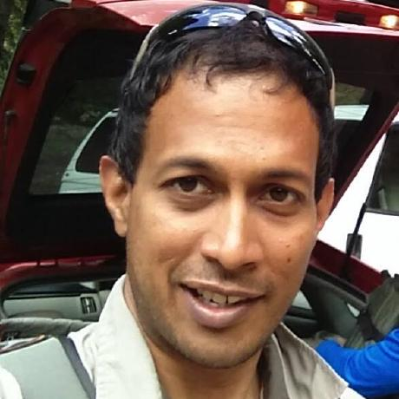
The implementation we inherited
Sameer D’Costa
GLBRC
A repo from a fellow UW–Madison researcher. It worked — by shipping the entire database to every job.
AlphaFold3 Databases
databases transferred
with every job
Batched job
Runs on CHTC only
many alignments bundled into one job resulting in longer runtimes
+ very large per-job
disk allocation
local cluster with the
disk to hold 750 GB
— not realistic on the OSPool
Researcher repo
(UW–Madison/GLBRC)
~750 GB databases
Room for Improvements
Limited to CHTC
Not OSPool-Friendly
Large per-job disk allocations
Transfers cumbersome & failure
prone
Notes:
Describe the implementation we inherited, a repo from a fellow UW-Madison researcher. It worked, but only by shipping the entire 750 GB database to every job, batching alignments together for long runtimes, and requiring a huge per-job disk allocation. That meant it ran on CHTC only, not realistic on the OSPool.

Slide 10
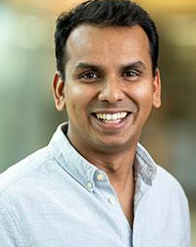

The call to adventure: a researcher’s large complex
We have a very large multi-chained protein structure I want to predict using AlphaFold3. Each chain is ~998 aa and we want to predict the 11-, 12-, and 24-mer of the structure.
Raison Dsouza – Morgridge
Notes:
The researcher request that launched the adventure. A lab had a very large multi-chained Flock House Virus structure, each chain about 998 amino acids, and wanted to predict the 11-, 12-, and 24-mer complexes. Read this in the researcher's voice; it's the concrete need that exposes every limit.

Slide 11
The call to adventure: a researcher’s large complex
OOOF… Those are pretty big complexes. Let’s see what we can do!
Raison Dsouza – Morgridge
Notes:
Our honest first reaction: those are big complexes, let's see what we can do. Convey that we didn't have a ready answer. This is the moment of stepping into the unknown.

Slide 12
The limits of our scope of support become visible
These structures pushed past our scope of knowledge — and exposed where support ran out.
GPU memory
Runtime
Large complexes exceeded single-GPU memory (>140 GB of vRAM)
Jobs ran long and unpredictably
Job shape
Support confidence
CPU / GPU / disk needs were unclear up front
Hard to tell a user what would actually work
Notes:
Where support limits became visible. These structures pushed past our knowledge. GPU memory: large complexes exceeded a single GPU, over 140 GB of vRAM. Runtime: long and unpredictable. Job shape: CPU, GPU, and disk needs unclear up front. Support confidence: hard to tell a user what would actually work.

Slide 13
Inheriting the AlphaFold3 repo
The repo proved AlphaFold3 could run. Running and supporting are different things.
Unclear job shapes
Large database handling
Previous AlphaFold3 Setup
Runtime variability
Memory pressure
GPU scheduling constraints
Documentation gaps
Repeated expensive preprocessing
Ownership of the material
Notes:
Reframe the inherited repo. It proved AF3 could run, but running and supporting are different things. List what was unresolved: unclear job shapes, large-database handling, runtime variability, memory pressure, GPU scheduling, doc gaps, and repeated expensive preprocessing. We also had to take ownership of the material.

Slide 14
Supporting AlphaFold3 at CHTC / OSPool
The first question was simple:
Can researchers run AlphaFold3 here?
The deeper question became:
How do we better support it?
Notes:
Transition slide. The question evolves from 'can researchers run AF3 here?' to 'how do we better support it?' This is the threshold into the trials section, the real work of facilitation begins now.

Slide 15
Trial 1: understanding job shapes
To guide users, we first had to characterize how an AlphaFold3 job actually behaves.
CPU
GPU
Memory
Disk
Runtime
core counts that actually help
device + memory required
peak RAM under load
scratch + database footprint
hours, highly variable
A job’s “shape” — not the GPU alone — determines where it can run and whether we can support it.
Notes:
Trial 1: understanding job shapes. To guide users we first had to characterize how an AF3 job actually behaves across five dimensions: CPU cores that actually help, GPU device and memory, peak RAM, disk for scratch and databases, and highly variable runtime. The punchline: a job's shape, not the GPU alone, determines where it can run and whether we can support it.

Slide 16
Predicting vRAM before the job runs
AlphaFold3's inference vRAM scales with token count — so we modeled it as a minimum-vRAM estimator.
Token count
vRAM estimator
Minimum vRAM
sequence length +
complex size
(the AF3 input)
fit from benchmark runs:
tokens → peak vRAM
(a simple predictive model)
the floor a job needs
before it will run
without OOM
Right-size the GPU
Fewer OOM failures
Predictable scheduling
match each job to a GPU with enough memory
catch jobs that won't fit before they launch
turn vRAM from a guess into a known requirement
Job shape became a number we could compute — the foundation for routing AF3 to the right GPU.
Notes:
A concrete deliverable from trial 1: predicting vRAM before the job runs. AF3 inference vRAM scales with token count, so we fit a simple estimator from benchmark runs that maps tokens to peak vRAM. That gives us a minimum-vRAM floor, lets us right-size the GPU, cut OOM failures by catching jobs that won't fit before launch, and make scheduling predictable.

Slide 17
The call to adventure: a researcher’s large complex
We ran the numbers. Looks like your 11-, 12-, and 24-mer complexes will require ~190, 210, and 425 GB of vRAM each. We don’t have GPUs of that capacity, but we can give unified virtual memory at try!
Raison Dsouza – Morgridge
Notes:
Back to the researcher. Using the estimator, we told them their 11-, 12-, and 24-mer complexes would need roughly 190, 210, and 425 GB of vRAM each. We had no single GPU that large, but we could try unified virtual memory. Land the tension here: the honest 'we don't have that, but here's an idea.'

Slide 18
The ordeal: pushing past limits with unified memory
When a structure needs more memory than a single GPU has, the job simply cannot run — until the memory model changes.
Structure needs more memory than a single GPU holds — the job fails.
GPU memory + system memory are pooled. Structures that overflowed one GPU now fit — trading some speed for reach.
BEFORE
AFTER — UNIFIED MEMORY
unified memory
The catch in a multi-tenant setting
Unified memory needs a contiguous block — hard to get while neighbors are running.
So, we drain and prioritize the node until the UVM job matches; remaining partitioned resources then backfill with other jobs.
How a UVM job lands:
drain
prioritize
match
backfill
Notes:
The ordeal: pushing past limits with unified memory. When a structure needs more memory than one GPU holds, the job simply cannot run, until the memory model changes. Unified memory pools GPU memory plus system memory, so structures that overflowed one GPU now fit, trading some speed for reach. The catch in a multi-tenant setting: unified memory needs a contiguous block, which is hard to get while neighbors are running.

Slide 19
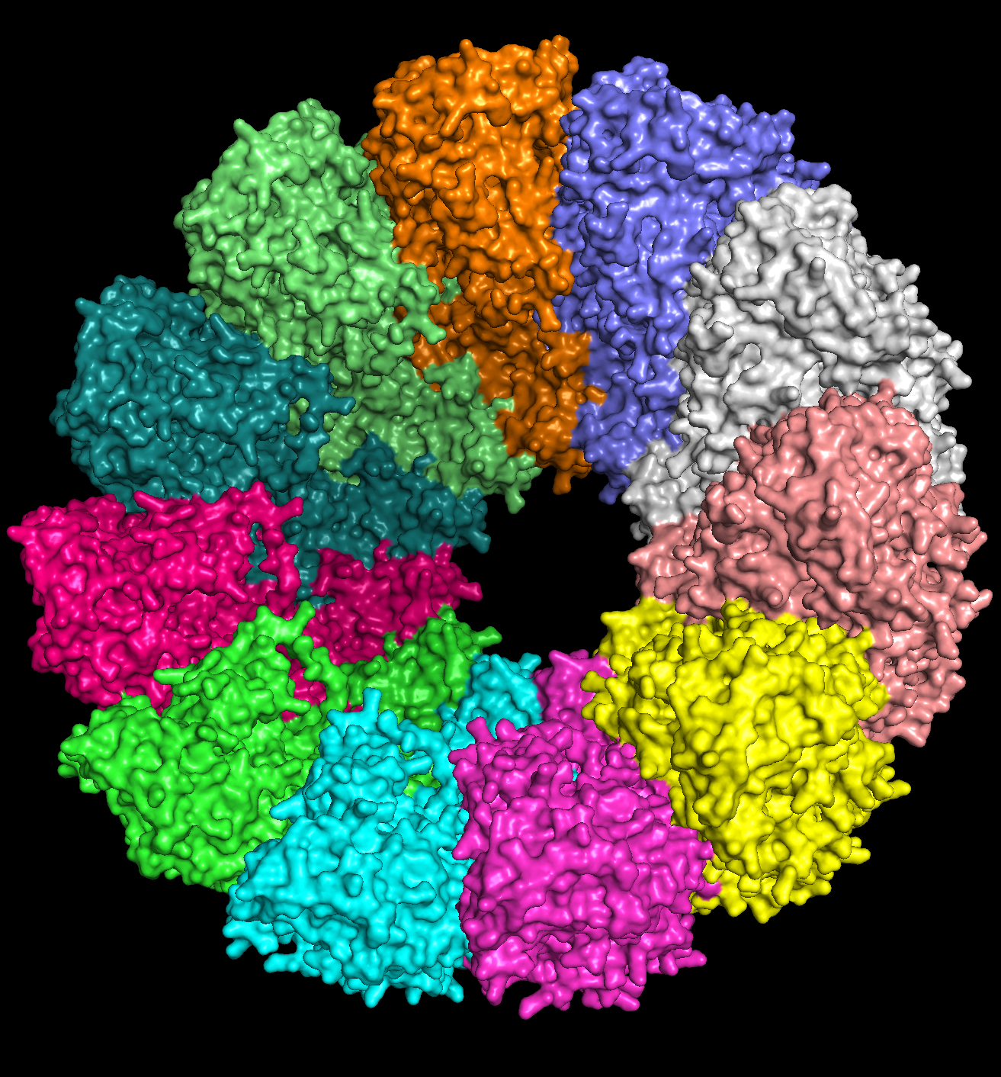
Victory!

Slide 20
The victory: Raison’s structures become supportable
The win was not one solved case. It was redrawing the line between impossible, unsupported, and supportable with care.
Impossible
Supportable with care
Supported as Self-Service
A hard physical limit — genuinely cannot run.
Raison’s jobs started here.
Can run with direct RCF intervention and assistance
Raison’s 11-, 12-, and 24-mer now live here.
Can run as a self-service job without RCF/Admin intervention
★
Ultra-large structures moved across the boundary →
Facilitation moved the boundary — cases weren’t possible we can now support.
Notes:
The victory. The win was not one solved case, it was redrawing the line between three categories: impossible (a hard physical limit), supportable with care (runs with direct RCF intervention), and supported as self-service (no admin needed). Raison's jobs started as impossible; the 11-, 12-, and 24-mer now live in supportable-with-care. Facilitation moved the boundary.

Slide 21
Trial 2: understanding the data problem
AlphaFold3 depends on large reference databases — and moving them again for every job does not scale. Significant barrier to running AlphaFold3 on the OSPool.
AF3 reference
databases
~ 750 GB
every job,
every user,
every site
Wasted transfer, wasted storage, slower starts — the data, not the GPU, becomes the bottleneck.
moved again
and again
Facilitation insight: the dataset itself should be treated as a property of infrastructure.
Notes:
Trial 2: understanding the data problem. AF3 depends on roughly 750 GB of reference databases, and moving them again for every job, every user, every site does not scale. It's a major barrier to running on the OSPool. Wasted transfer, wasted storage, slower starts: the data, not the GPU, becomes the bottleneck. The facilitation insight: the dataset itself has to be treated as infrastructure.

Slide 22
Data-as-a-Resource
Treat data as a schedulable resource of the execution point.
Match each job to machines that already hold its data.
RESOURCE POOL
Machine · has data
Machine · no data
JOB SUBMITTED
MATCHMAKING
Requests
dataset
Matches job to
machines holding
the data
Machine · no data
Machine · has data
Machine · has data
Machine · no data
Data locality becomes a matchmaking property — HTCondor sends work to where the data already lives.
Notes:
The solution: data-as-a-resource. Treat data as a schedulable resource and match each job to machines that already hold its data. Data locality becomes a matchmaking property: the scheduler sends work to where the data already lives, not the other way around. Walk the flow: job submitted requests a dataset, matchmaking finds machines holding it, the job runs only on those.

Slide 23
Data-as-a-Resource
Generalizing beyond AlphaFold
Each job declares the dataset it needs. The scheduler matches it to machines that already hold that data.
RESOURCE POOL
JOB A
Machine · AlphaFold3
Machine · AlphaFold3
AlphaFold3 job
SCHEDULER
JOB B
Machine · COCO
Machine · COCO
COCO job
Matches each job
to machines with
its dataset
JOB C
Machine · No dataset
Machine · No dataset
No-data job
One pool may have many datasets: AlphaFold3 jobs land on AF3 machines, COCO jobs on COCO machines, and data-agnostic jobs run anywhere.
Notes:
The same idea generalizes beyond AlphaFold. Each job declares the dataset it needs and the scheduler matches it to machines that already hold that data. One pool, many datasets: AF3 jobs land on AF3 machines, COCO jobs on COCO machines, and data-agnostic jobs run anywhere. This is the moment the AF3-specific fix becomes a reusable pattern.

Slide 24
Sharing datasets with OSPool users
Proven at one site today — we want to partner with you to share your locally hosted datasets with OSPool jobs.
HOSTED LOCALLY
WE'RE LOOKING TO CONNECT WITH SITES
Contributing site
Locally hosted datasets
OSPool
AlphaFold3
COCO
shares data
availability
Routes user jobs to sites that hold the data
Your site — Share your hosted locally datasets
Serves local researchers
On-site researchers submit jobs against
the same local data
Interested in contributing? If your site already hosts reference datasets, sharing them with OSPool turns local data into shared capacity. Reach out to a Research Computing Facilitator!
Notes:
A direct ask to the room: sharing datasets with OSPool users. It is proven at one site today; we want partner sites to host these datasets locally and share them with OSPool jobs. Walk the diagram: a contributing site hosts AlphaFold3 and COCO datasets locally, serves its own researchers, and OSPool routes other users' jobs to sites that hold the data. The call to action: if your site can host these datasets, talk to us, same pattern, more capacity for everyone.

Slide 25
Benchmarking the support envelope
Benchmarking turned scattered troubleshooting into a map of what we could actually support.
Easy to support
Supportable with guidance
Edge of support
Standard single-protein predictions
Larger complexes
Very large multimers
Modest sequence sizes
Deeper alignments
GPU-memory limited
Fits comfortably in GPU memory
Needs job-shape tuning
Long / variable runtime
Predictable runtime
Some hand-holding on resources
Outcome not guaranteed
Notes:
Benchmarking the support envelope. Benchmarking turned scattered troubleshooting into a map of what we could actually support, three tiers. Easy to support: standard single-protein predictions, modest sizes, fits in GPU memory, predictable runtime. Supportable with guidance: larger complexes, deeper alignments, needs job-shape tuning. Edge of support: very large multimers, GPU-memory limited, long variable runtime, outcome not guaranteed.

Slide 26
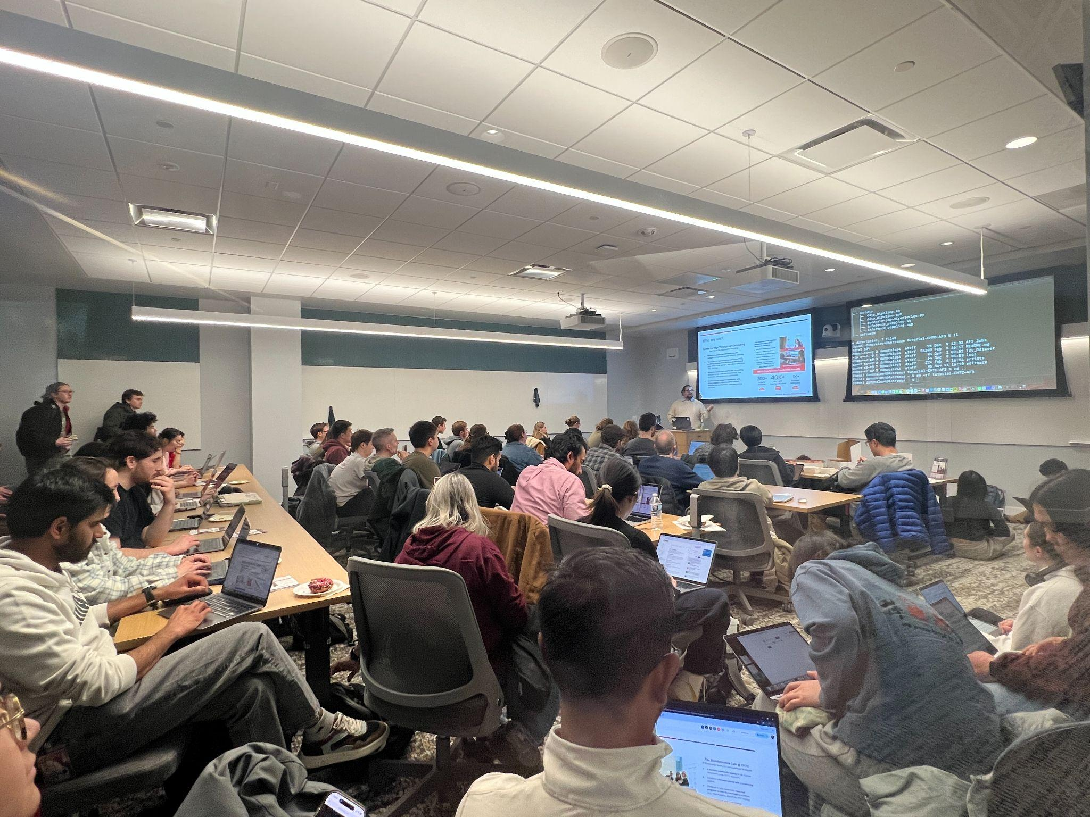
New allies: the community shows up
75+
attendees at the one of the largest CHTC training to date — with people standing along the walls and sitting on the floor.
Demand for these workflows was real — and bigger than we expected.
Notes:
New allies: the community shows up. Over 75 attendees at one of the largest CHTC trainings to date, people standing along the walls and sitting on the floor. Demand for these workflows was real, and bigger than we expected. This is the turn from a single researcher's problem to a community-scale opportunity.

Slide 27
The community changes the question
Users didn't want one-off predictions. They wanted to ask bigger questions.
“Can we screen many molecule–molecule interactions?”
High-throughput screens
Hundreds to thousands of predictions, not one
Molecule–molecule interaction studies
Systematic exploration of binding and complexes
Reusable workflows
Pipelines they can run again and share
The question shifted from “can it run?” to “how can we do this at scale?” — and that reshaped the facilitation model.
Notes:
The community changes the question. Users didn't want one-off predictions, they wanted to ask bigger questions, like can we screen many molecule-to-molecule interactions. Three shifts: high-throughput screens of hundreds to thousands, systematic molecule interaction studies, and reusable workflows they can run again and share. The question moved from can it run to how can we do this at scale, and that reshaped the facilitation model.

Slide 28

The adventure continues: high throughput protein-protein interaction screenings
We want to run 180K pairwise protein-protein interaction screenings using AlphaFold3.
Kavi Mehta – UW Madison
Notes:
The researcher request that launched the adventure. A lab had a very large multi-chained Flock House Virus structure, each chain about 998 amino acids, and wanted to predict the 11-, 12-, and 24-mer complexes. Read this in the researcher's voice; it's the concrete need that exposes every limit.

Slide 29
The adventure continues: high throughput protein-protein interaction screenings
Now that’s some real high throughput AlphaFold!
Let’s give it a try!
Kavi Mehta – UW Madison
Notes:
The researcher request that launched the adventure. A lab had a very large multi-chained Flock House Virus structure, each chain about 998 amino acids, and wanted to predict the 11-, 12-, and 24-mer complexes. Read this in the researcher's voice; it's the concrete need that exposes every limit.

Slide 30
Trial 3: understanding repeated preprocessing
The same expensive alignments get regenerated over and over — especially as users scale up.
One-off prediction
Scaling to many predictions
Generate alignment → run inference once. The cost is paid a single time.
The same alignments are regenerated for every related run — the expensive CPU/database step repeats needlessly.
users scale up
compute ✓ once
recompute
then reused, not repeated
paid again every job
If preprocessing is reusable, it should be computed once — not regenerated by every job.
Notes:
Trial 3: understanding repeated preprocessing. The same expensive alignments get regenerated over and over, especially as users scale up. For a one-off prediction you generate the alignment and run inference once, the cost is paid a single time. But scaling to many predictions, the same alignments are regenerated for every related run, so the expensive CPU and database step repeats needlessly. The insight: if preprocessing is reusable, it should be computed once, not regenerated by every job.

Slide 31
The AlphaFold3 cached alignment library
Compute each alignment once, store it, and let every later prediction reuse it.
Prediction A
AF3 cached
alignment library
New sequences
compute once
reused by
Prediction B
alignments / MSAs / intermediates
Prediction C
The intermediate product becomes a reusable resource — not disposable work.
Notes:
The AlphaFold3 cached alignment library, the solution to that repetition. Compute each alignment once, store it, and let every later prediction reuse it. New sequences are computed once into the cached library, then reused by prediction A, B, C, and so on. The intermediate product, the alignments and MSAs, becomes a reusable resource instead of disposable work.

Slide 32
Use case: many-to-many screening
Mehta Lab
Screening every candidate against every target means N × M predictions — the combinatorics, not the model, become the challenge.
20k Human candidates
9 Viral targets
N × M
180,000 predictions
Candidate 1
Target 1
Candidate 2
Target 2
~20k
Human Protein
Candidate 3
Target 3
9
Viral Protein
… Candidate N
… Target M
↻ The cached alignment library computes each sequence's alignment once — and reuses it across every pairing.
Notes:
Same screening problem, now with a concrete collaborator: the Mehta Lab. Reinforce the combinatorics framing, this is the real-world case the next slide pays off. Briefly: every candidate against every target, N times M predictions.

Slide 33
The library collapses the compute
Mehta Lab
Same per-job profile — ~4 cores, ~60 minutes each. Only the job count changes.
WITHOUT THE LIBRARY
WITH THE LIBRARY
180,000
20,009
alignment jobs (N × M = 20,000 × 9)
alignment jobs (N + M = 20,000 + 9)
≈ 720,000 core-hours
4 cores × 60 min × 180,000 jobs
≈ 80,000 core-hours alignments
≈ 15,000 core-hours post-alignment processing
each alignment computed once, then reused
≈ 160,000 fewer alignment jobs · ~87% less alignment compute and wall time
Notes:
The payoff. The cache library collapses the compute: each job keeps the same modest profile, about 4 cores and roughly 60 minutes, and only the job count changes. The point: we turned an intractable combinatorial cost into linear scaling. This is the Mehta Lab result made concrete.

Slide 34

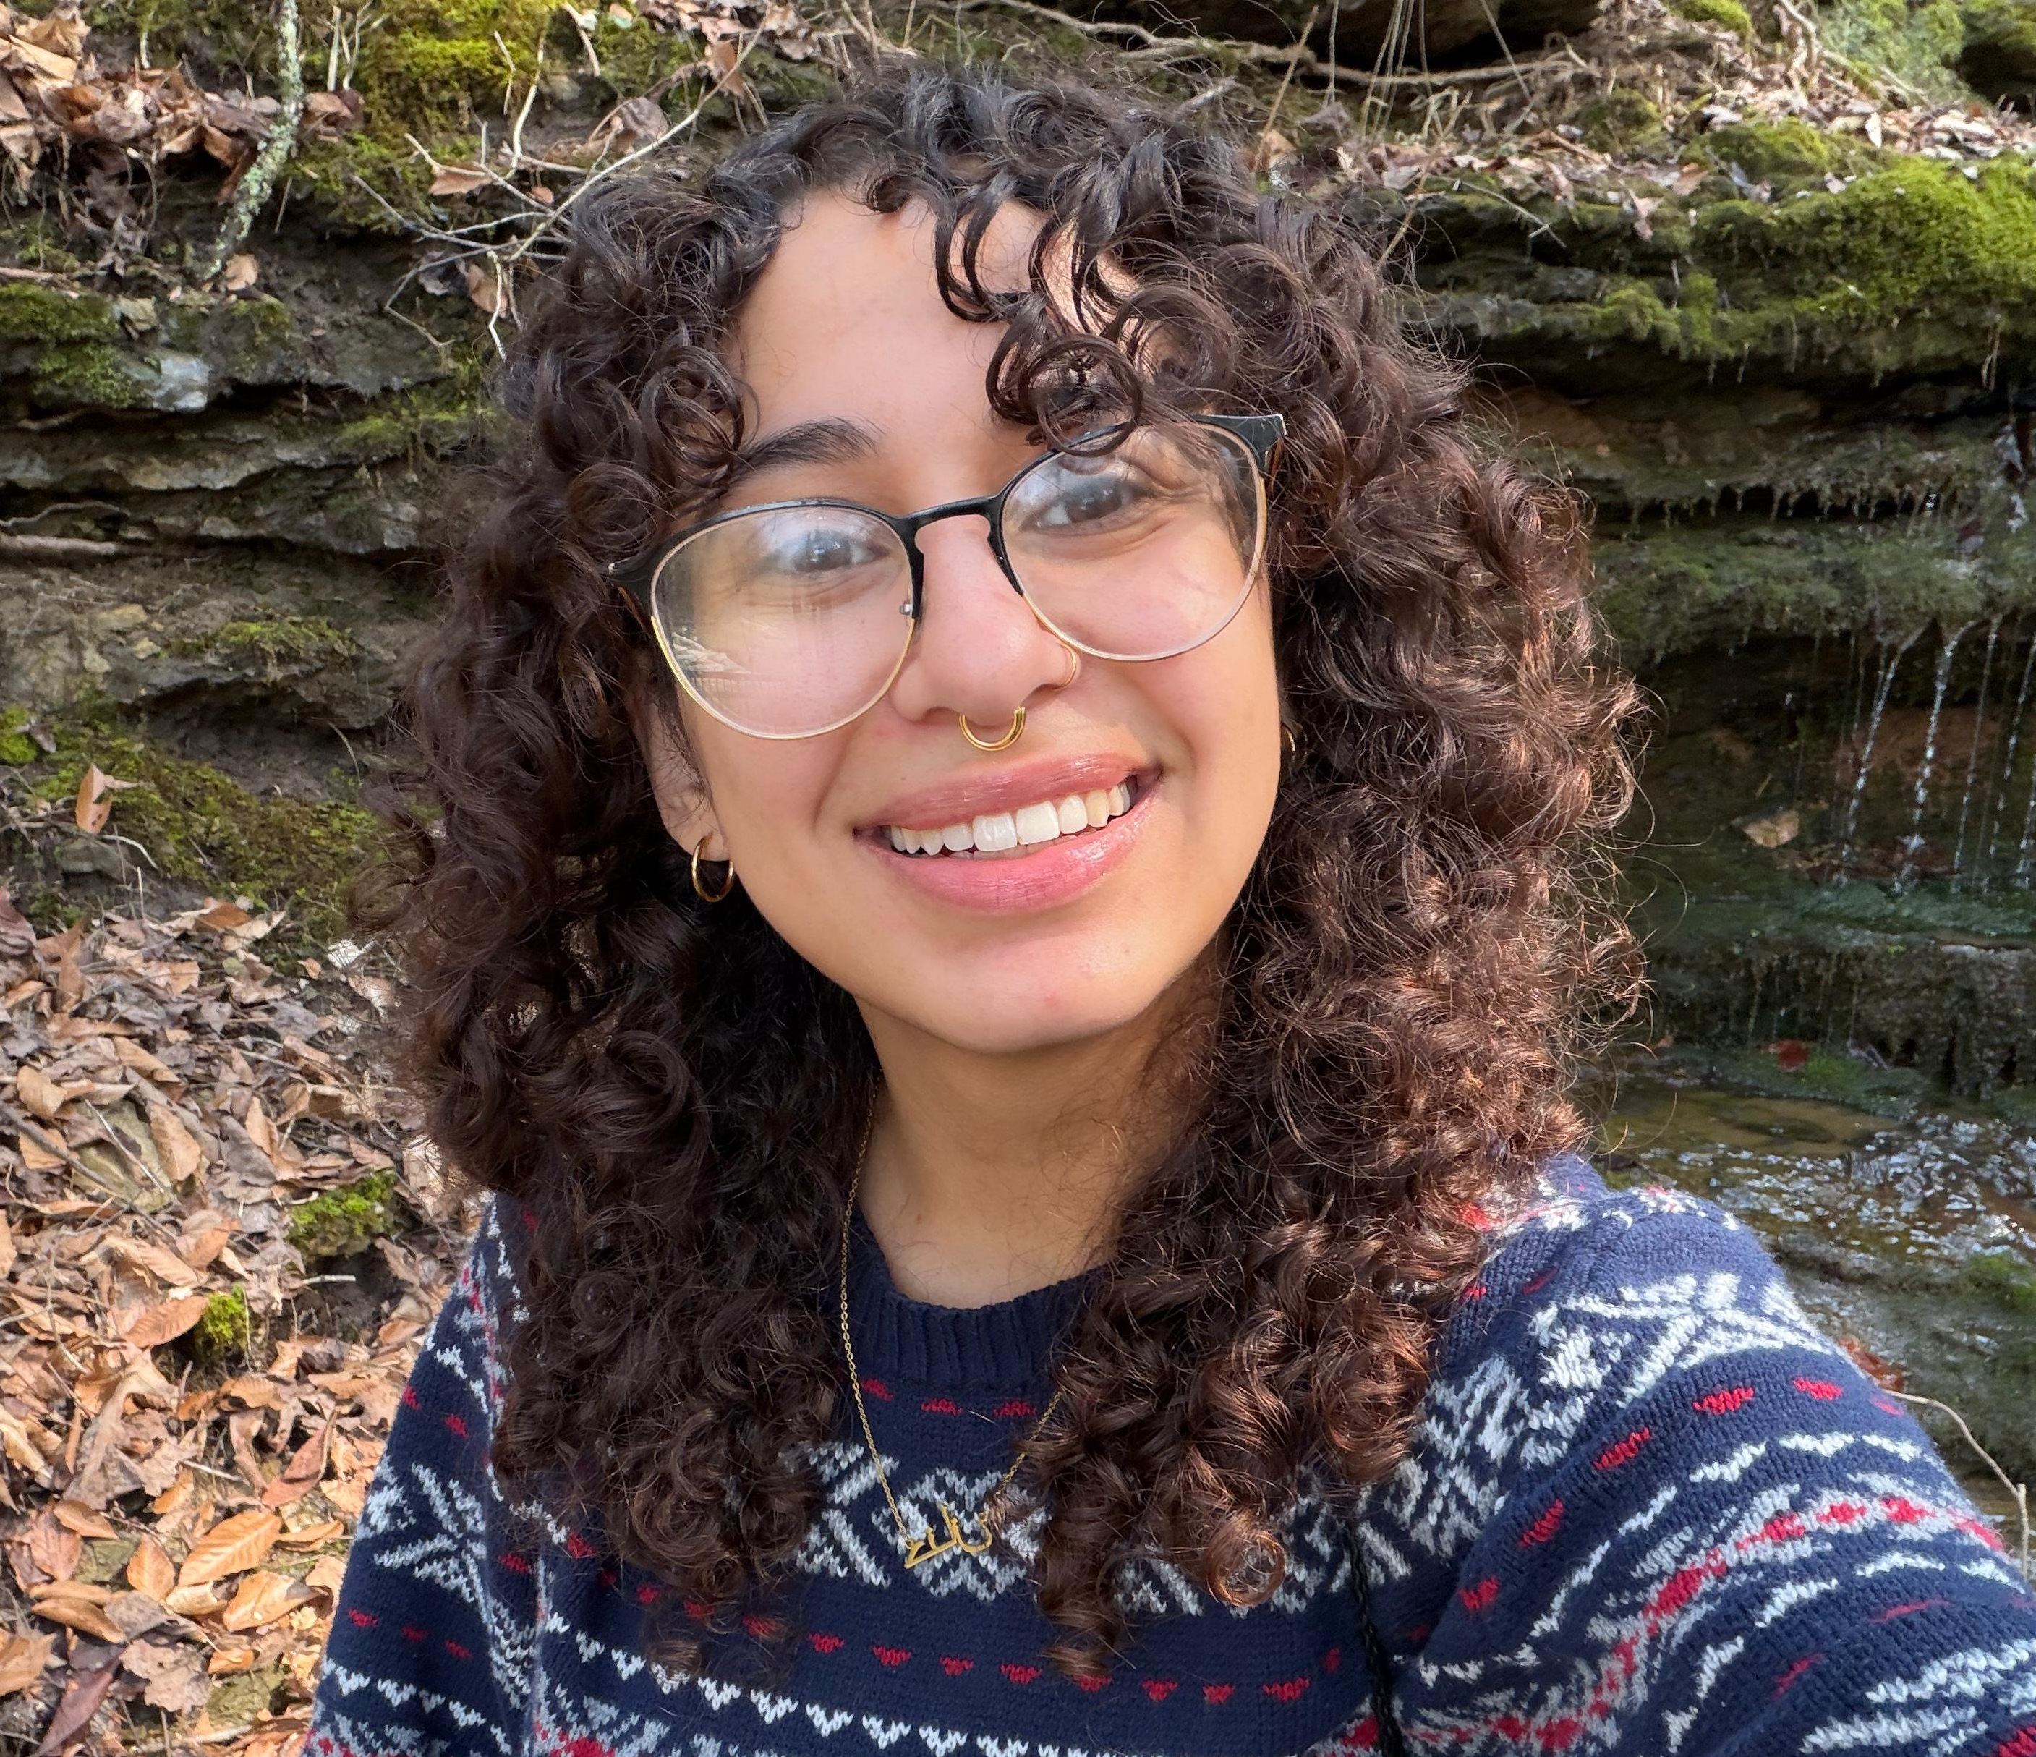
Making the previously impossible routine
When the combinatorics stop being the limit, researchers can ask questions that were simply off the table before.
ENABLING RESEARCH
Hannan Shabaan — Molecular mechanics of cnidarian–algae endosymbiosis
1,000,000,000
65,000
possible protein–protein pairings
≈ 25,000 anemone × ≈ 40,000 symbiont proteins
alignments with the library
(N + M, computed once and reused)
A screening that no cluster could support becomes a screen a single graduate student can run.
Notes:
Making the previously impossible routine. Tell Hannan Shabaan's story: cnidarian-algae endosymbiosis, roughly a billion possible protein-protein pairings, about 25,000 anemone times 40,000 symbiont proteins. With the library it becomes N plus M, about 65,000 alignments computed once and reused. The line that lands: a screen no cluster could support becomes a screen a single graduate student can run.

Slide 35
The AlphaFold3 cached alignment library
Compute each alignment once, store it, and reuse it across every prediction that needs it.
AS OF JUNE 8, 2026
410K alignments cached
342K
10K
29K
unique protein sequences
source organisms
community-contributed records
N + M
~89%
once
alignments instead of N × M
less alignment compute & wall time
computed per sequence, then reused
Notes:
Library summary slide. Hit the headline numbers as of June 3, 2026: N plus M instead of N times M, about 89 percent less alignment compute and wall time, computed once per sequence then reused. Scale: 339K unique protein sequences, 10K source organisms, 430 community-contributed records, 382K alignments cached. Emphasize the community contribution piece, the library grows as people use it.

Slide 36
Current status and early impacts
Where our AlphaFold3 support stands today.
526,776
75+
Live
Next
Jobs ran on CHTC and OSPool by 70 users
attendees at the flagship training
Pre-staged dataset + alignment caching in use
extending the access on the OSPool
Early, but real — and already reusable beyond the first researcher.
Notes:
Current status and early impact. Where the service pattern stands today: 526,776 jobs run on CHTC and OSPool by 70 users; 75-plus attendees at the flagship training; pre-staged dataset plus alignment caching is live; next step is extending access on the OSPool. Frame it honestly: early, but real, and already reusable beyond the first researcher.

Slide 37
Supporting AlphaFold3 required facilitation patterns that translate
The work evolved from helping individual jobs run into building service patterns the whole community can reuse.
Workflow-aware facilitation
Data as a resource
Caching & Reusing Artifacts
Meaningful docs & training
Support the whole pipeline shape, not just the GPU step.
Treat large reference datasets as shared infrastructure, not per-job baggage.
Compute expensive intermediates once; reuse them across jobs and users.
Turn one-off troubleshooting into durable guidance and examples.
Notes:
Zoom out: from supporting jobs to building reusable infrastructure. The work evolved from helping individual jobs run into building service patterns the whole community can reuse. Name the four patterns: data as a resource, caching and reusing artifacts, workflow-aware facilitation, and reusable docs and training. These four are the through-line for the rest of the talk.

Slide 38
Translational computer science
Turning researcher needs into usable infrastructure — then letting the community reshape it.
Community
need
Facilitation
insight
Infrastructure & Software change
Community
feedback
each iteration changes the tools, services, and practices
Notes:
Define translational computer science explicitly: turning researcher needs into usable infrastructure, then letting the community reshape it. Each iteration changes the tools, services, and practices. This loop is the engine of the whole story, keep pointing back to it.

Slide 39
Translational computer science
Turning researcher needs into usable infrastructure — then letting the community reshape it.
I need to run 100s of thousands of AlphaFold3 jobs
Community
need
Facilitation
insight
Infrastructure & Software change
Community
feedback
each iteration changes the tools, services, and practices
Notes:
Define translational computer science explicitly: turning researcher needs into usable infrastructure, then letting the community reshape it. Each iteration changes the tools, services, and practices. This loop is the engine of the whole story, keep pointing back to it.

Slide 40
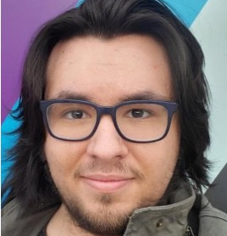
Translational computer science
Turning researcher needs into usable infrastructure — then letting the community reshape it.
The core limiting factor is unnecessary alignment recalculation
AlphaFold3
Alignment
Library
Community
need
Facilitation
insight
Infrastructure & Software change
Community
feedback
each iteration changes the tools, services, and practices
Notes:
Define translational computer science explicitly: turning researcher needs into usable infrastructure, then letting the community reshape it. Each iteration changes the tools, services, and practices. This loop is the engine of the whole story, keep pointing back to it.

Slide 41
Translational computer science
Turning researcher needs into usable infrastructure — then letting the community reshape it.
It worked!
My jobs ran in finished time!
Community
need
Facilitation
insight
Infrastructure & Software change
Community
feedback
each iteration changes the tools, services, and practices
Notes:
Define translational computer science explicitly: turning researcher needs into usable infrastructure, then letting the community reshape it. Each iteration changes the tools, services, and practices. This loop is the engine of the whole story, keep pointing back to it.

Slide 42
From AlphaFold3 to AI facilitation
Supporting the next generation of AI-enabled research will require translational computer science: continuous feedback between researchers, facilitation, software, data, and infrastructure professionals.
community need → facilitation insight → infrastructure change → community feedback
Notes:
The thesis restated as a closer for this section: from AlphaFold3 to AI facilitation. Supporting the next generation of AI-enabled research will require translational computer science, a continuous feedback loop between researchers, facilitation, software, data, and infrastructure professionals. Read the loop one more time: community need to facilitation insight to infrastructure change to community feedback.

Slide 43
Acknowledgements
With thanks to the CHTC and PATh teams, the OSG Consortium, our collaborating researchers, and the AlphaFold3 user community — whose questions and feedback shaped this work at every step.
This material is based upon work supported by the National Science Foundation under Grant No. 2030508. Any opinions, findings, and conclusions or recommendations expressed in this material are those of the author(s) and do not necessarily reflect the views of the National Science Foundation.
Notes:
Acknowledgements. Thank the CHTC and PATh teams, the OSG Consortium, collaborating researchers, and the AlphaFold3 user community whose questions shaped this work. Note the NSF support under Grant 2030508. Keep this brief and warm.

Slide 44
What AlphaFold3 taught us about
AI/ML facilitation
1
AI/ML workloads are rarely just accelerator workloads.
2
Large datasets need to be treated as infrastructure.
3
Preprocessing and intermediate products can be reusable.
4
Community feedback should shape the service model.
Community feedback becomes facilitation insight
5
Facilitation produces patterns, not just fixes.
Translational CS: need → insight → infrastructure → feedback
Notes:
Five lessons AlphaFold3 taught us about AI/ML facilitation. Walk them: one, AI/ML workloads are rarely just accelerator workloads. Two, large datasets need to be treated as infrastructure. Three, preprocessing and intermediate products can be reusable. Four, community feedback should shape the service model. Five, facilitation produces patterns, not just fixes. These are the takeaways you want the audience to remember.

Slide 45
Deploying to the OSPool
From a local workflow to a distributed service pattern — reusable beyond one cluster.
Shared databases + alignment library
Researchers
submit jobs, get structures
Jetstream2 Site Contribution
OSPool sites
The same facilitation patterns extend from one cluster to a shared, distributed service.
Translational CS: need → insight → infrastructure → feedback
Notes:
Deploying to the OSPool. We're taking this from a local workflow to a distributed service pattern, reusable beyond one cluster. Shared databases plus the alignment library, contributed via Jetstream2, served out to OSPool sites where researchers submit jobs and get structures. The same facilitation patterns extend from one cluster to a shared, distributed service.

Slide 46
Deploying to the OSPool
From a local workflow to a distributed service pattern — reusable beyond one cluster.
Jetstream2 Site Contribution
Shared databases + alignment library
Researchers
submit jobs, get structures
Site
Site
OSPool sites
The same facilitation patterns extend from one cluster to a shared, distributed service.
Translational CS: need → insight → infrastructure → feedback
Notes:
Same OSPool deployment story, expanded to show multiple contributing sites feeding the pool. The point: as more sites host the datasets locally, capacity grows for everyone while the pattern stays identical. This is the scaling vision.

Slide 47
Why one data reuse layer is not enough
Caching and mounting the database helps — but the expensive alignments are still recomputed every time.
Layer 1 · Reference databases
CACHED/STAGED
Large, static, shared. Solved by staging and site caching.
Layer 2 · Alignments & intermediates
REDONE
Per-input, expensive, reusable. Still regenerated on every run.
The next layer to cache is not data we move — it is work we repeat.
Translational CS: need → insight → infrastructure → feedback
Notes:
Why one data reuse layer is not enough. Make the distinction clear: Layer 1 is the reference databases, large, static, shared, already solved by staging and site caching. Layer 2 is the alignments and intermediates, per-input, expensive, reusable, but still regenerated on every run. The next layer to cache is not data we move, it is work we repeat. This sets up the alignment library as the key contribution.

Slide 48
AlphaFold3 Databases
databases transfer
with every job
Researcher repo
(UW–Madison)
~750 GB databases
Limited to CHTC — not OSPool Friendly
Batched job
many alignments bundled into one job
+ very large per-job disk allocation
Large per-job disk allocations
Runs on CHTC only
needs local disk for 750 GB — not feasible on the OSPool
Transfers cumbersome & failure-prone
Translational CS: need → insight → infrastructure → feedback
Notes:
This is the original inherited setup as a reference diagram: a researcher repo with roughly 750 GB of databases transferred with every job, batched jobs with very large per-job disk allocations, runnable only on CHTC because it needs local disk for 750 GB, not feasible on the OSPool. Transfers were cumbersome and failure-prone. Use this to remind the audience of the starting constraints before showing what changed.

Slide 49
Site-level data caching
Stage the database once per site — every local job reuses it.
reused locally — no re-download
Local job 1
AF3 reference
database (origin)
Site cache
resident dataset
staged once
Local job 2
Local job 3
Each site pays the data cost once; every job after that is fast and cheap.
Translational CS: need → insight → infrastructure → feedback
Notes:
Site-level data caching, the first half of the fix. Stage the database once per site, and every local job reuses it, no re-download. Each site pays the data cost once; every job after that is fast and cheap. This is Layer 1 solved.

Slide 50
AlphaFold3 MSA Cache Library — Read & Write-Back Flows
AF3 Job · CHTC execute node
AF3 Cache API · FastAPI
https://149.165.170.71.sslip.io
data_pipeline.sh — orchestrator
3
2
POST /v1/query
DB
1
cache_lookup.sh — read-path helper
POST /v1/uploads/request
cache_upload.sh — write-back helper
4
POST /v1/uploads/{id}/complete
4
run_alphafold.py — AF3 data pipeline
3
1
Postgres
msa_sequences
msa_cache_entries
msa_ingestions
view: msa_cache_lookup
6
reads/writes af_input/*.json, af_output/<name>/<name>_data.json
6
2
5
5
7
KEY CONTRACTS
Identity = (seq_hash, source, db_version)
Normalize: "".join(seq.split()).upper() + sha256 — any drift = silent miss
Retention: access-based; idle_ttl_days → stale → reaped after REAP_GRACE_HOURS
Auth: X-API-Key on /v1/*; admin key on /v1/admin/*
TLS: self-signed → curl -k
OSDF / Pelican Object Store
osgaf3_store1
osgaf3_store2
osgaf3_store3
osgaf3_store4
immutable .a3m · pelican://<store>/msa-cache/<seq_hash>/<source-slug>/<ingestion_id>.a3m
A · LOOKUP (read path) ①→⑥
B · WRITE-BACK / CONTRIBUTE ❶→❼
Translational CS: need → insight → infrastructure → feedback
Notes:
Backup architecture slide if anyone asks how the MSA cache actually works. Walk it only if time and audience interest allow: the AF3 job on a CHTC execute node runs a data pipeline orchestrator with read-path and write-back helpers, talking to a FastAPI cache service backed by Postgres and an OSDF/Pelican object store. The takeaway is that the cache is a real, queryable service, not a folder of files.

Slide 51
AlphaFold3 MSA Cache Library — Read & Write-Back Flows
AF3 Job · CHTC execute node
AF3 Cache API · FastAPI
https://149.165.170.71.sslip.io
data_pipeline.sh — orchestrator
1
3
2
POST /v1/query
DB
2
cache_lookup.sh — read-path helper
POST /v1/uploads/request
run_alphafold.py — AF3 data pipeline
5
POST /v1/uploads/{id}/complete
4
cache_upload.sh — write-back helper
3
Postgres
msa_sequences
msa_cache_entries
msa_ingestions
view: msa_cache_lookup
6
reads/writes af_input/*.json, af_output/<name>/<name>_data.json
6
1
2
AF3 Job returns the completed output JSON
5
5
7
OSDF / Pelican Object Store
User / Access Point
submits the AF3 job and receives the completed prediction back
osgaf3_store1
osgaf3_store2
osgaf3_store3
osgaf3_store4
af_output/<name>/<name>_data.json + predicted structure
immutable .a3m · pelican://<store>/msa-cache/<seq_hash>/…
A · LOOKUP (read path) ①→⑥
B · WRITE-BACK / CONTRIBUTE ❶→❼
Translational CS: need → insight → infrastructure → feedback
Notes:
Same MSA cache architecture, alternate view of the read and write-back flows. Use whichever of these two backup slides fits the question. Emphasize the write-back path: jobs not only read from the cache, they contribute new alignments back, so the library grows with use.

Slide 52
Data-aware scheduling
Send the job to where the data already lives — not the other way around.
Site WITH dataset staged → job runs here
Match on
data location
AF3 job
(needs the dataset)
Site without dataset → skipped, no data movement
Placement, not transfer: the schedule respects where data already is.
Translational CS: need → insight → infrastructure → feedback
Notes:
Closing backup: data-aware scheduling in one line. Send the job to where the data already lives, not the other way around. Sites with the dataset staged run the job; sites without it are simply skipped, with no data movement. Placement, not transfer. End by tying back to the central theme: facilitation moved the boundary of what is possible, and the patterns we built outlast the first researcher who walked in the door. Thank the audience and open for questions.

Slide 53
The ordinary world is changing
AI/ML workloads are reshaping what researchers bring to research computing.
Data-heavy
Accelerator-aware
Containerized
Workflow-complex
Large reference datasets and inputs
GPUs, memory, and placement matter
Complex software environments
Multi-stage, repeated pipelines
Notes:
Set the scene, the 'ordinary world.' AI/ML workloads are changing what researchers bring to research computing. They're data-heavy, accelerator-aware, containerized, and workflow-complex. This isn't a one-off; it's a structural shift. Introduce the loop we return to all talk: need, insight, infrastructure, feedback.

Slide 54
It's not just about GPUs
The accelerator is one box in a much longer workflow.
Data
movement
Pre-
processing
Containers
GPU
compute
Scheduling
Trust &
provenance
Docs &
support
Adding GPUs is the “easy*” part. The hard part is everything around them — and making it usable, schedulable, and reproducible.
*Your milage may vary
Notes:
Push back on the assumption that this is just about GPUs. The accelerator is one box in a much longer workflow: data movement, preprocessing, containers, compute, scheduling, provenance, and support all surround it. Adding GPUs is the easy part; making them usable, schedulable, and reproducible is the hard part.

Slide 55
Translational computer science in practice
Community needs didn't just get solved — they reshaped how we run the service.
Researcher
need
Facilitation
insight
Infrastructure
change
Next
iteration
New needs
surface
Community
use
The loop never closes — each iteration leaves reusable patterns behind.
Notes:
Translational CS in practice. This is the loop made concrete: researcher need leads to facilitation insight, which drives infrastructure change, which enables community use, which surfaces new needs, which starts the next iteration. Community needs didn't just get solved, they reshaped how we run the service. The key line: the loop never closes, each iteration leaves reusable patterns behind.

Slide 56
AlphaFold3 MSA Cache Library
Read & Write-Back Flows
AF3 Job · CHTC execute node
AF3 Cache API · FastAPI
https://149.165.170.71.sslip.io
data_pipeline.sh — orchestrator
POST /v1/query
DB
cache_lookup.sh — read-path helper
POST /v1/uploads/request
run_alphafold.py — AF3 data pipeline
POST /v1/uploads/{id}/complete
cache_upload.sh — write-back helper
Postgres
msa_sequences
msa_cache_entries
msa_ingestions
view: msa_cache_lookup
reads/writes af_input/*.json, af_output/<name>/<name>_data.json
AF3 Job returns the completed output JSON
OSDF / Pelican Object Store
User / Access Point
submits the AF3 job and receives the completed prediction back
osgaf3_store1
osgaf3_store2
osgaf3_store3
osgaf3_store4
af_output/<name>/<name>_data.json + predicted structure
A · LOOKUP (read path) ①→⑥
immutable .a3m · pelican://<store>/msa-cache/<seq_hash>/…
B · WRITE-BACK / CONTRIBUTE ❶→❼
Notes:
This is the technical architecture, use it only if the audience wants depth, otherwise keep it brief. On the execute node, data_pipeline.sh orchestrates, cache_lookup.sh reads, run_alphafold.py is the AF3 data pipeline, and cache_upload.sh writes results back. It talks to a FastAPI cache service backed by a Postgres database tracking sequences and cache entries, with the actual alignment objects living in an OSDF/Pelican object store. The takeaway: it's a real cache service with a query API, a database, and object storage, not a pile of scripts.

Slide 57
What the library changes for users
The same screen goes from days of repeated preprocessing to a fast, repeatable run.
BEFORE
WITH THE LIBRARY
Regenerate alignments for every prediction
Long, variable wait before any GPU work
Cost paid again on every alignment reran and every screen
Reuse precomputed alignments instantly
Jobs start at the GPU step
Screens scale without redoing the heavy work
Only new sequences are aligned
Facilitation turned a per-job cost into a one-time, shared investment.
Notes:
What the library changes for users, the before-and-after payoff. Before: regenerate alignments for every prediction, a long variable wait before any GPU work, and the cost paid again on every screen. With the library: reuse precomputed alignments instantly, jobs start right at the GPU step, and screens scale without redoing the heavy work, only new sequences are aligned. The headline: facilitation turned a per-job cost into a one-time, shared investment.

Slide 58
Use case: many-to-many screening
Screening every candidate against every target means N × M predictions — the combinatorics, not the model, become the challenge.
N candidates
M targets
N × M
predictions
Candidate 1
Target 1
Candidate 2
Target 2
Candidate 3
Target 3
… Candidate N
… Target M
↻ The cached alignment library computes each sequence's alignment once — and reuses it across every pairing.
Notes:
Use case: many-to-many screening. Set up the problem: screening every candidate against every target means N times M predictions. The combinatorics, not the model, become the challenge. This motivates why the cache library matters so much at scale.

Slide 59
Where we go from here
AlphaFold3 is not the destination — it is the case study that taught us what AI facilitation needs to become.
Easier adoption
Easier operation
Greater trust
Broader generalization
Templates
Docs
Trainings
Examples
Shared datasets
Data and artifact caching
Flex. resource provisioning
Monitoring
Support matrices
Provenance
Trusted containers
Reproducible and reusable intermediate artifacts
Apply the same facilitation patterns to the other
AI/ML workload
Notes:
Where we go from here. AlphaFold3 is not the destination, it is the case study that taught us what AI facilitation needs to become. Walk the four directions: easier adoption (templates, docs, trainings, examples); easier operation (shared datasets, caching, flexible provisioning, monitoring, support matrices); greater trust (provenance, trusted containers, reproducible artifacts); broader generalization (apply the same patterns to other AI/ML workloads).

