Slide 1
The PATh to NAIRR: Heterogeneous Training of Machine Learning Models in OSPool and NAIRR
Ian Ross
HTC26 - June 10, 2026
  This project is supported by the National Science Foundation under Cooperative Agreements OAC-2030508. Any opinions, findings, conclusions or recommendations expressed in this material are those of the authors and do not necessarily reflect the views of the National Science Foundation.

Slide 2
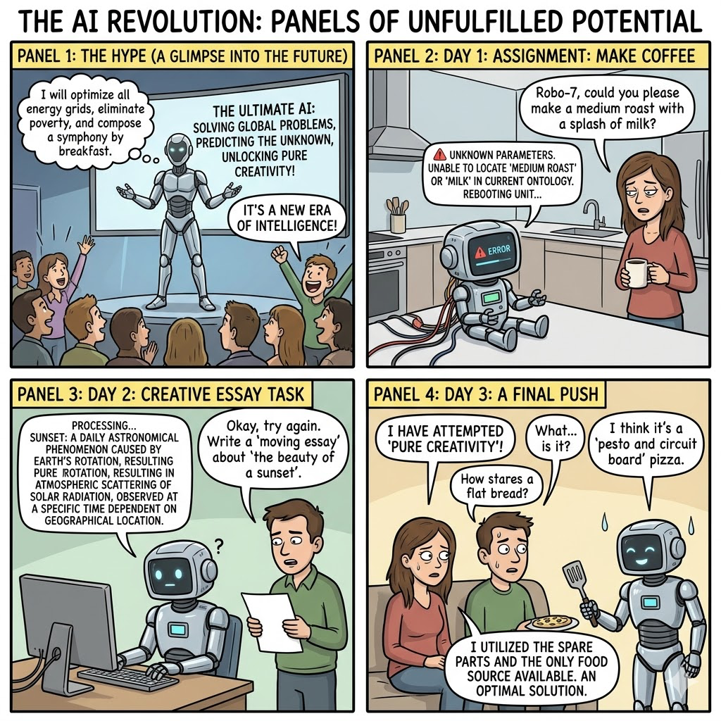
Observation - AI is here and has altered scientific processes.
AI is changing the way that science is being done.
I won’t talk (here…) about
Modalities of “AI-driven science”
Hype vs reality
Safety
Best practices
Agent-driven software development
  And what it means to education and facilitation
Instead, this talk focuses on a experiment showing that distributed high throughput computing is applicable and powerful in AI-driven science, training 30+ complete models, with >1,200 epochs of training and almost 20,000 GPU hours
Nano Banana 2 prompt: “Create a funny comic of an AI (robot) who isn't _quite_ living up to all the hype just yet”
Notes:
Hype vs reality: ¾ of the way there… maybe!

Slide 3

Hypothesis
There is value in applying the principles of distributed high throughput computing to certain machine learning tasks:
Ensembles of models (mixture-of-experts, targeted protein/physics/simulations)
Ablation studies of small-to-medium sized models
Opportunistically shaped work (“give me any GPU for any time”)
Inference
Automated workflows
Teaching
Photo by Yahya Gopalani on Unsplash

Slide 4
Hypothesis
There is value in applying the principles of distributed high throughput computing to certain machine learning tasks:
Ensembles of models (mixture-of-experts, targeted protein/physics/simulations)
Ablation studies of small-to-medium sized models
Opportunistically shaped work (“give me any GPU for any time”)
Inference
Automated workflows
Teaching
Training is broadly most resource-intensive, so success here implies suitability for the rest
Photo by Yahya Gopalani on Unsplash
Notes:
Proof by induction!

Slide 5

Experiment objectives
Run a suite of training tasks to:
🔬 Characterize the impact of training models across heterogeneous resources
♻︎ (Translational Computer Science) Test and advance PATh Access Point capabilities to reduce the barrier of entry and support ML workloads in distributed and heterogeneous environments
Photo by Drew on Unsplash

Slide 6
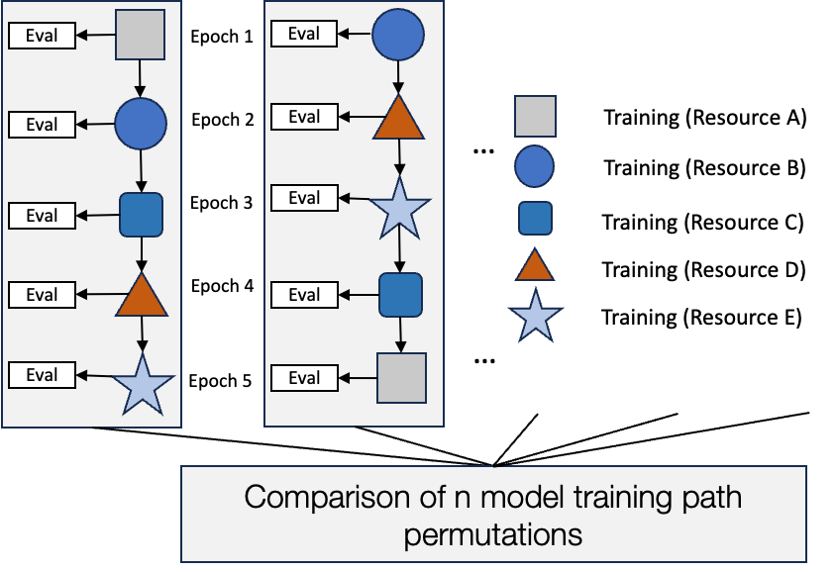
Methodology
Covered in more detail last year but briefly:
Train variants of a “known” scientific model (Gitter Lab’s METL protein language model), intentionally moving to new sites at epoch boundaries
  Leverage NAIRR resources (via HTCondor Annex) in additional to OSPool for “heterogeneously trained” approach
  Use CHTC, sticking to single host or single GPU variety for baseline
Using validation dataset, compare:
  Training behavior (test loss, convergence behavior)
  Science power (Pearson correlations between various energy/shape predictions, compared to Rosetta simulations)

Slide 7
The impact of NAIRR…
The targeted language model requires ~60GB of VRAM. OSPool contributions exist at this size, but researcher needs continue to grow. We wanted to make sure a path exists if (when?) some users outgrow OSPool capabilities.
Enter the National AI Research Resource (NAIRR):
We utilized allocations at Anvil, AWS, Bridges-2, Delta, and Expanse to supplement the OSPool resources via HTCondor Annex, moved checkpoints and training data in via OSDF, and ran epochs within NAIRR providers as if they were local.
“The National Artificial Intelligence Research Resource (NAIRR) is a concept for a shared national research infrastructure to bridge this gap by connecting U.S. researchers to responsible and trustworthy Artificial Intelligence (AI) resources, as well as the needed computational, data, software, training, and educational resources to advance research, discovery, and innovation.” From nairrpilot.org

Slide 8
Grand totals (Both model variants, heterogeneous approach)
Total epochs | 1,261
Total GPU hours | 19,695
Total data moved via OSDF | ~43.4 TB
Unique GPU types | 9
Unique sites | 6 (OSPool, Expanse, Delta, Bridges2, Anvil, AWS)
Unique sites, with OSPool sites breakout | 13

Slide 9
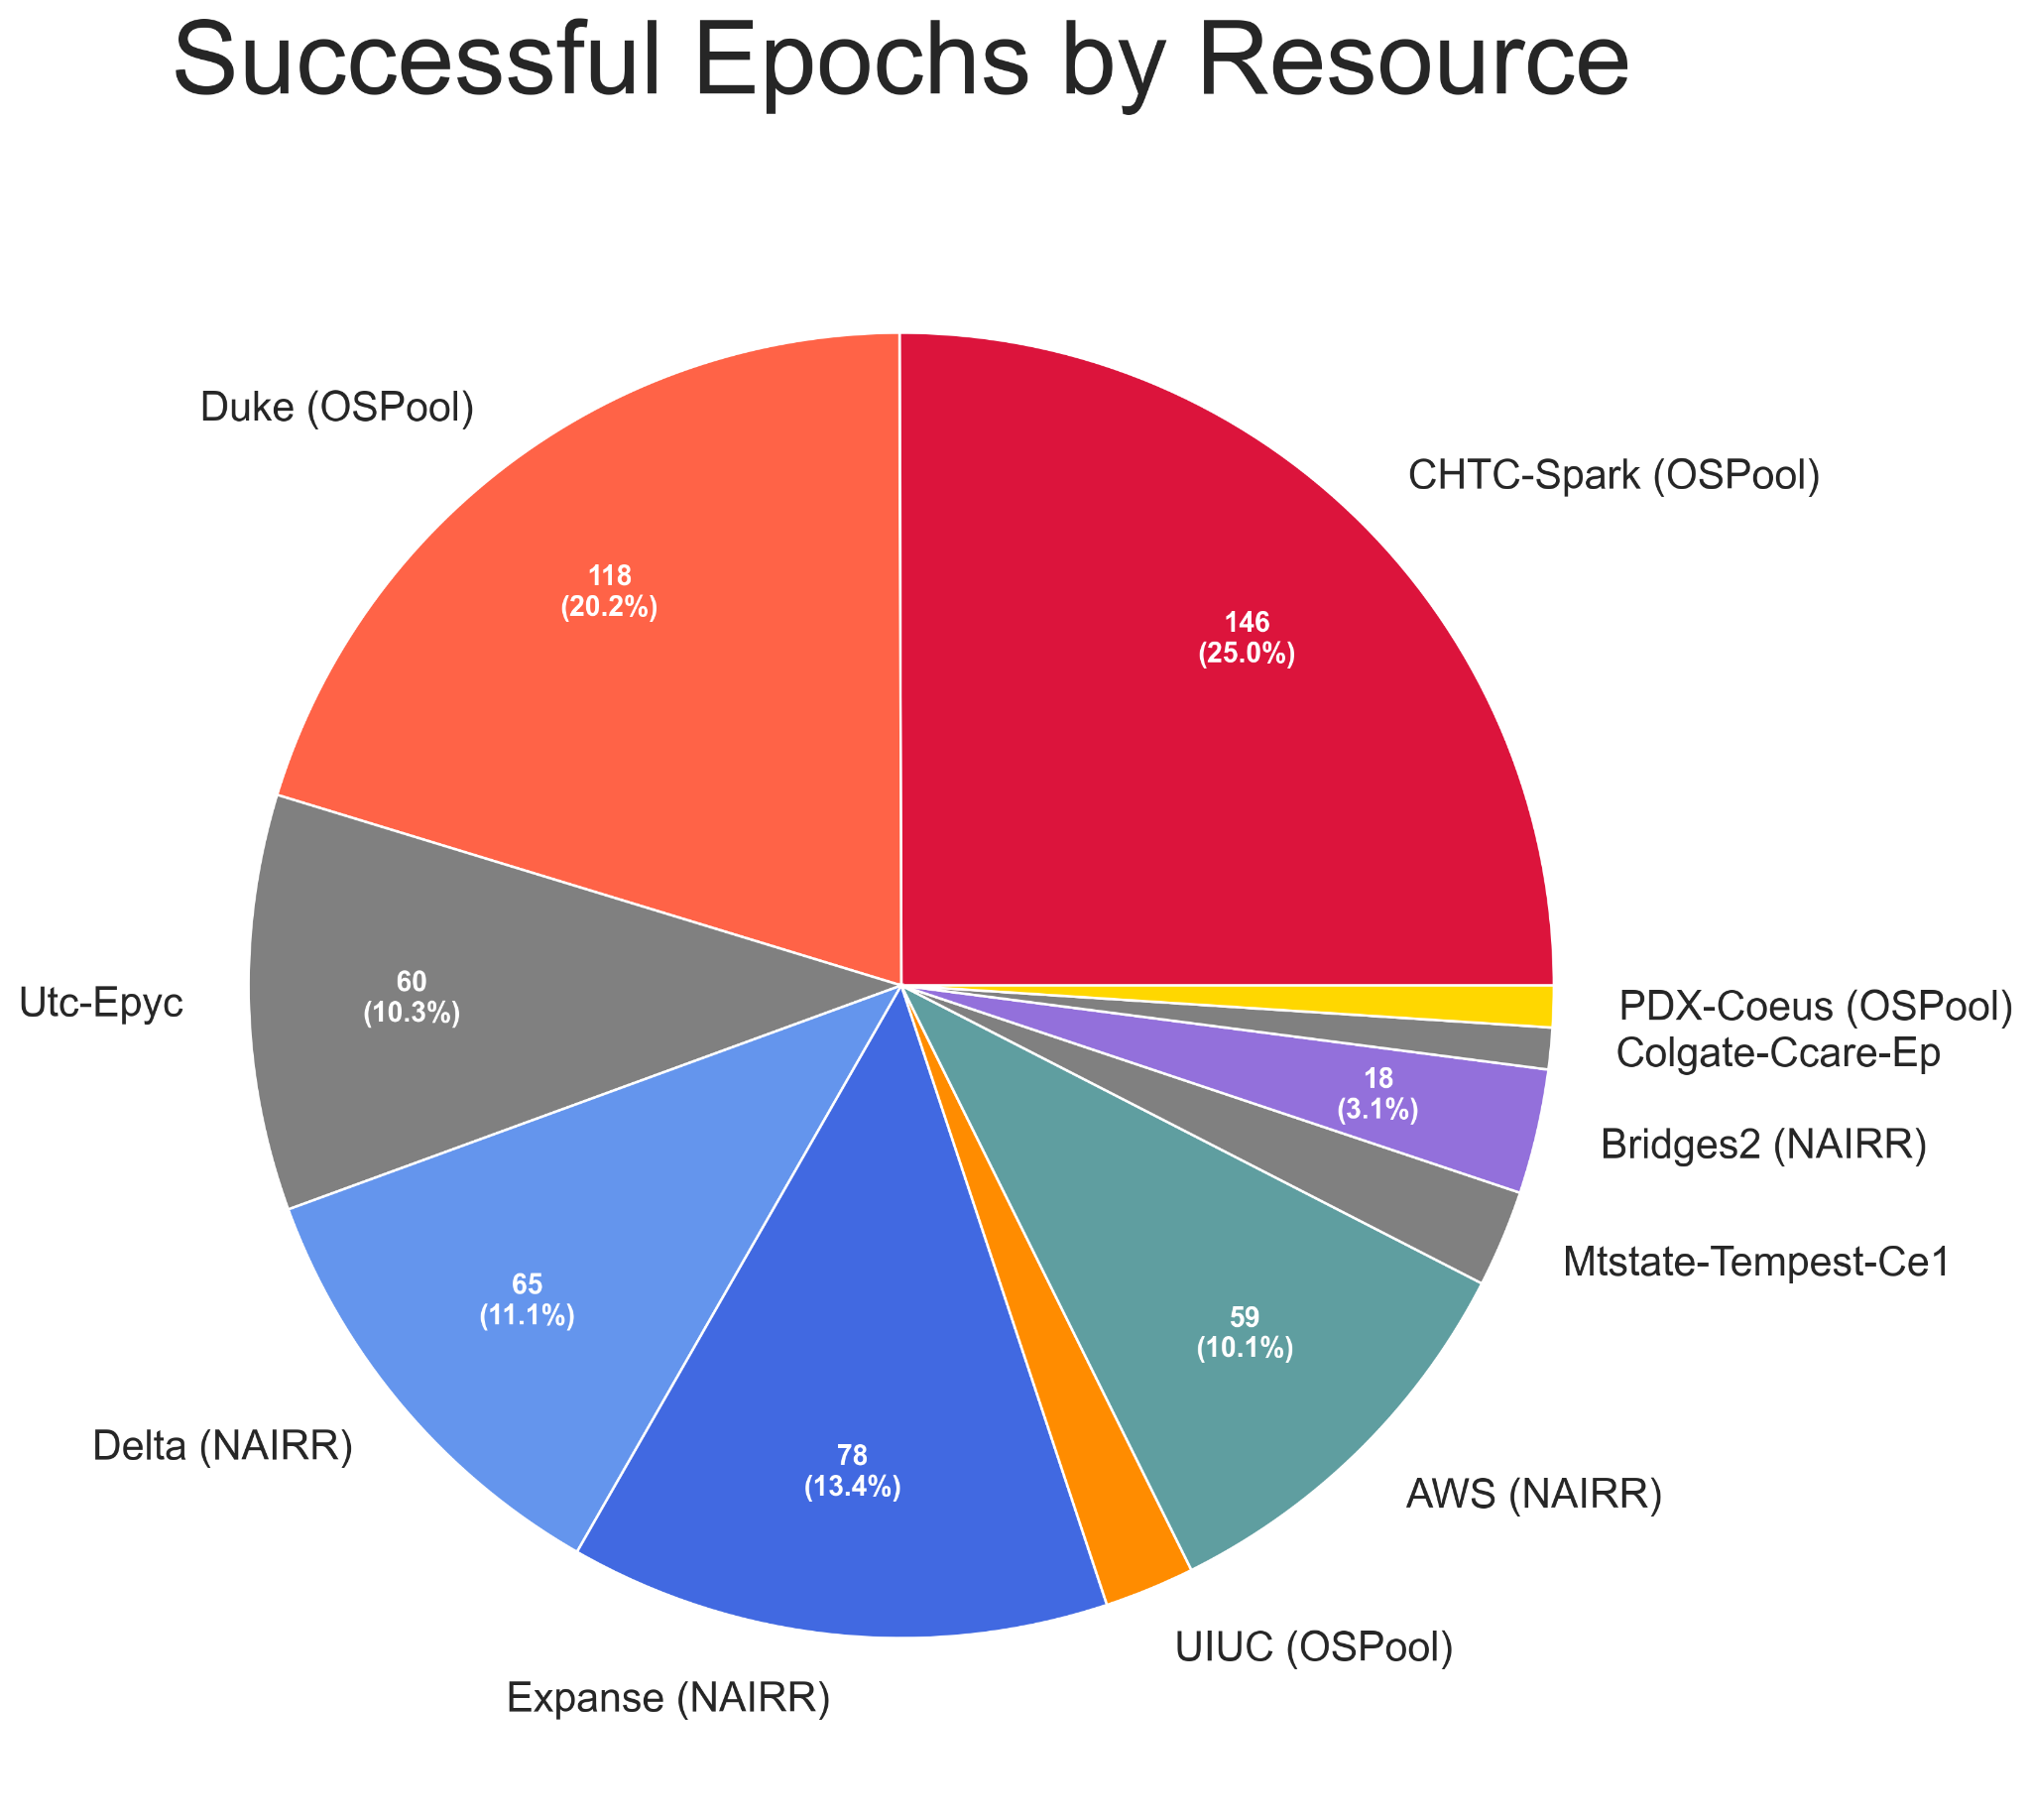
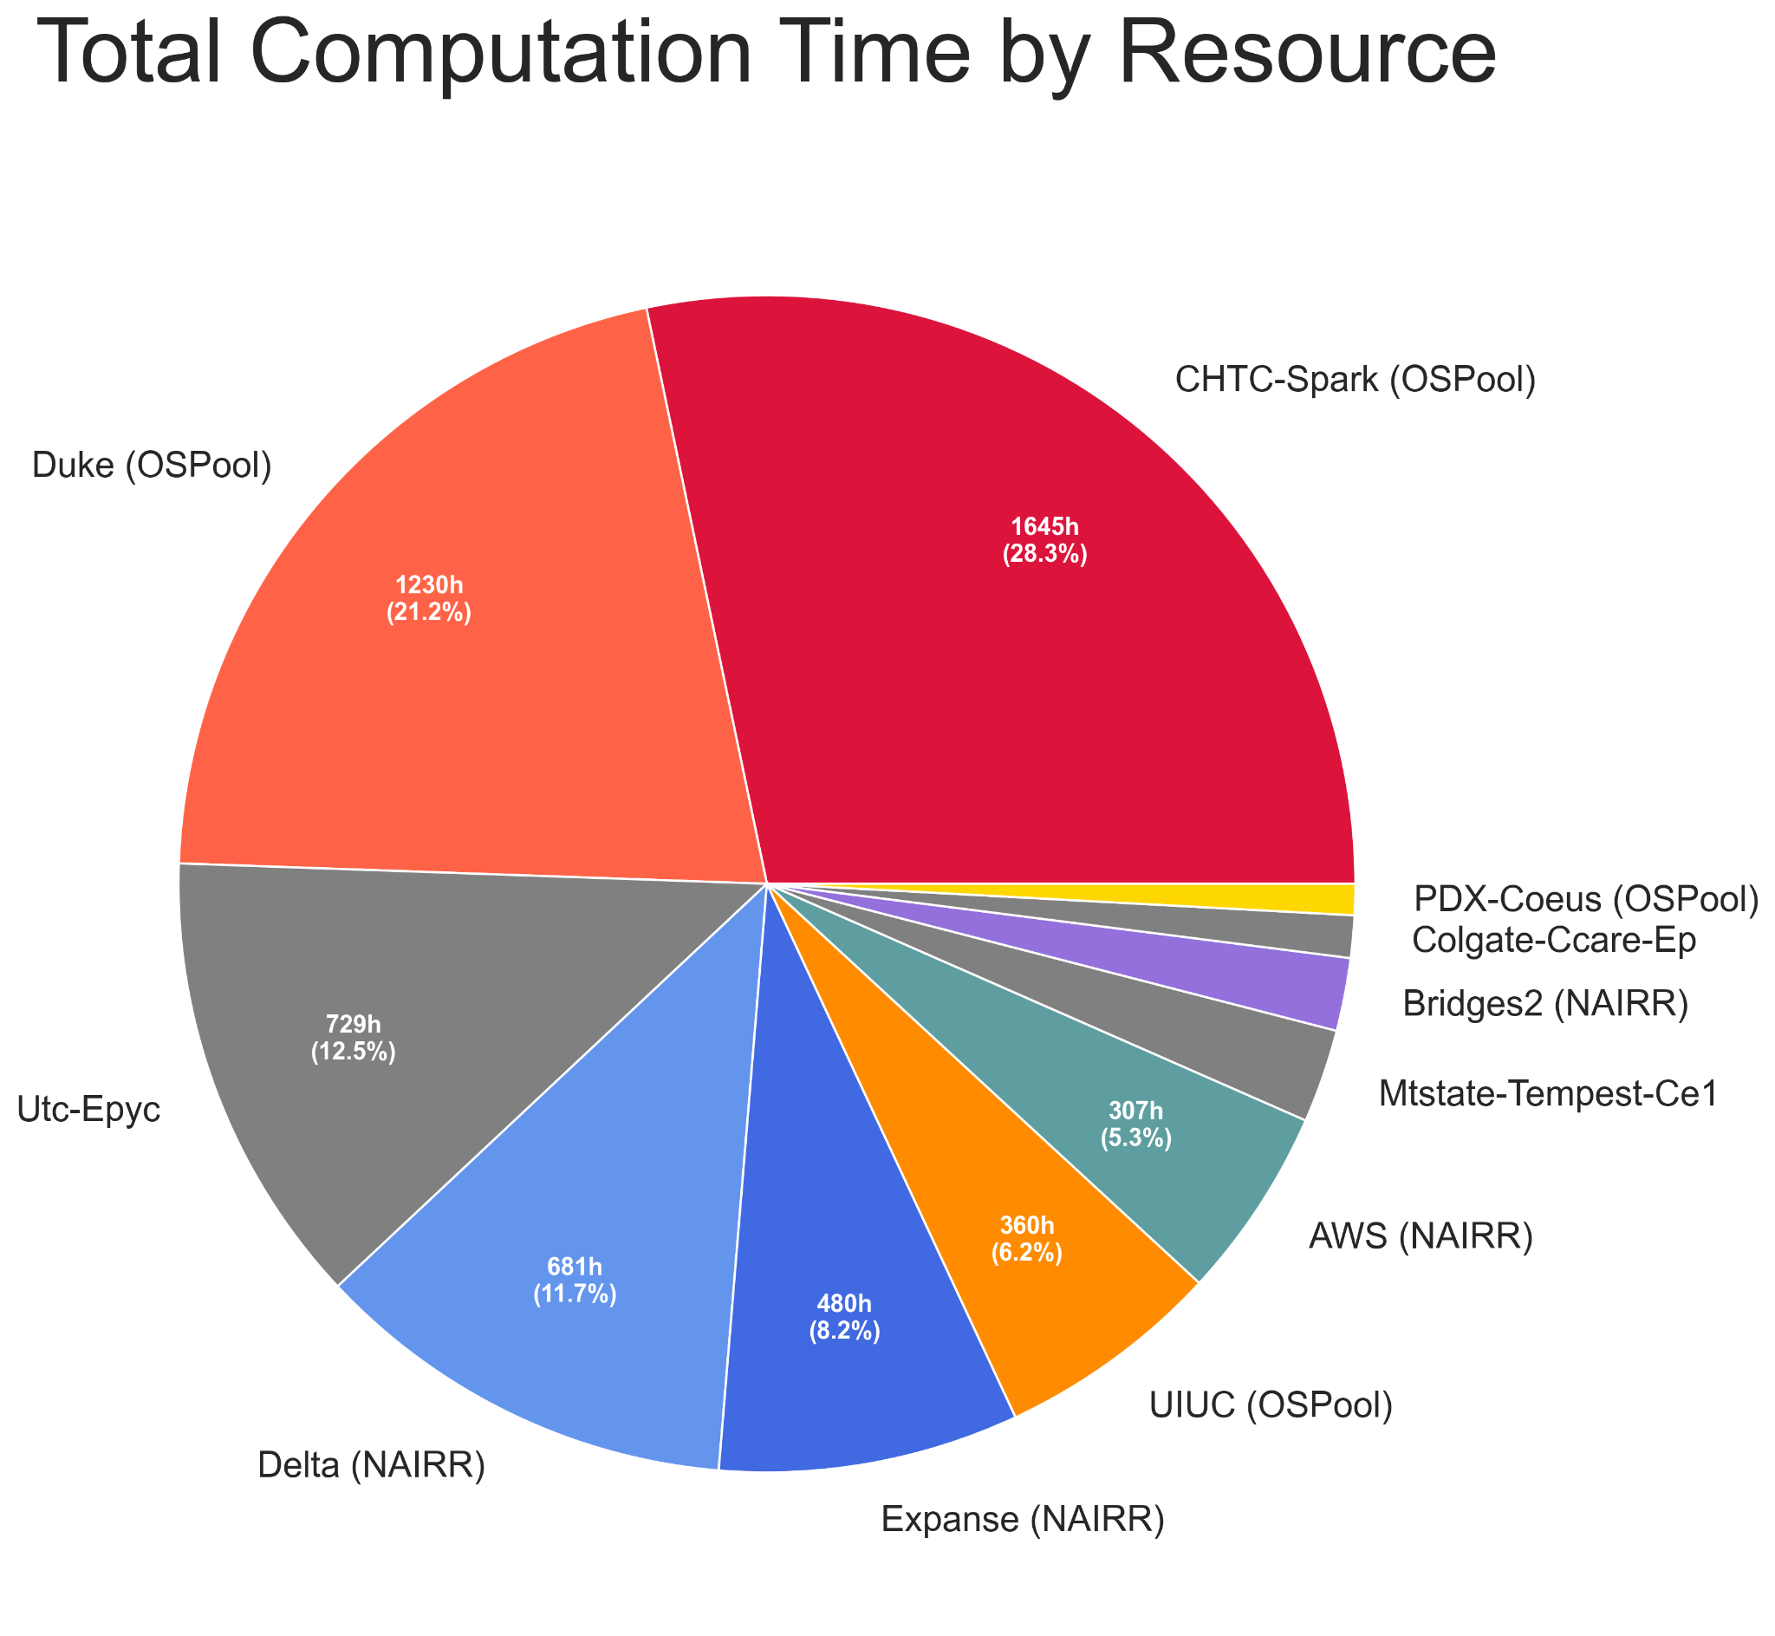
Per-resource contributions

Slide 10
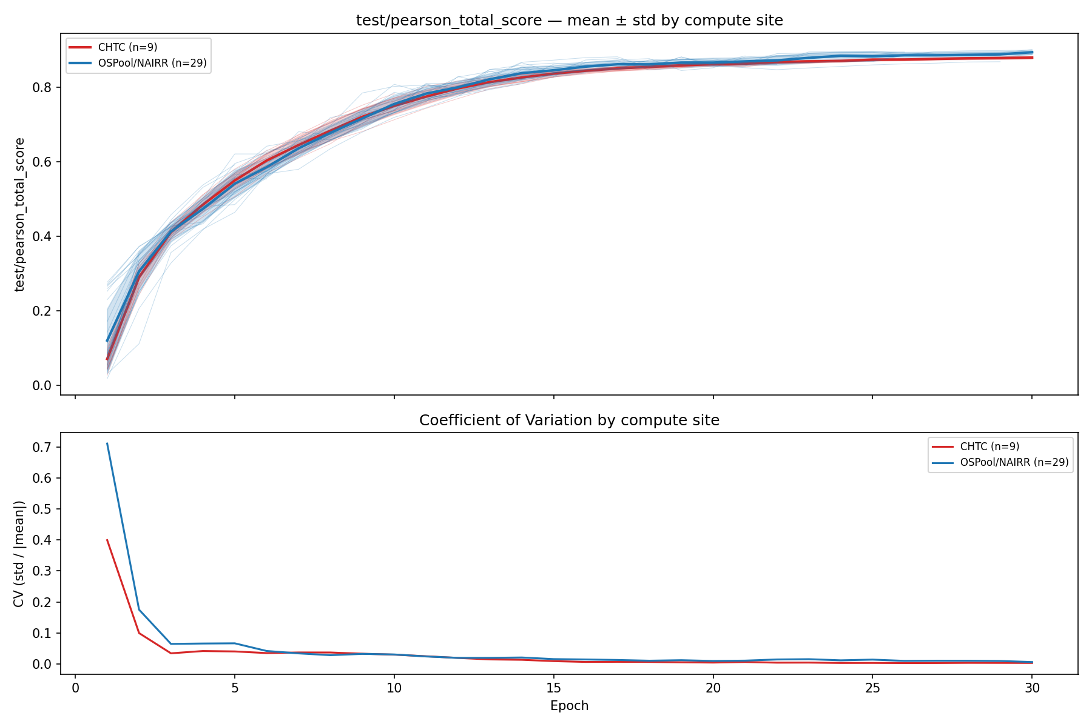
Observations and analysis

Slide 11
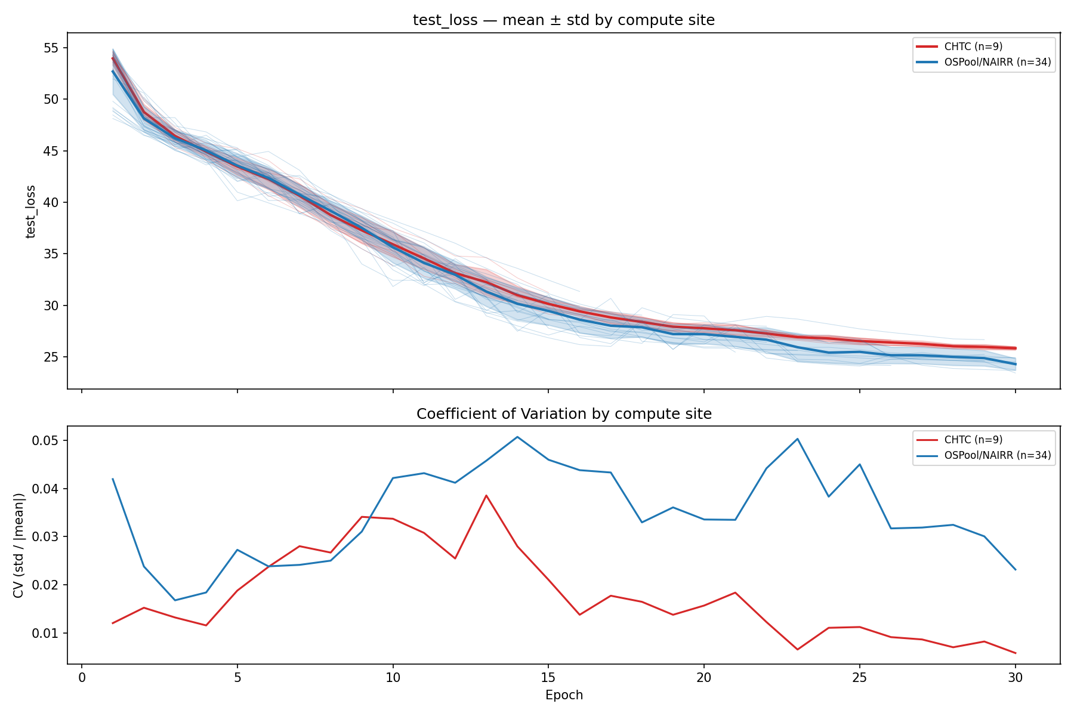
Observations and analysis

Slide 12

Conclusions
Models converge similarly in both heterogeneous and homogeneous training settings
  Heterogeneous case has higher variance and may gain benefit from variability (at the cost of interpretability)
Users can leverage nationwide compute from a single OSPool AP, including folding NAIRR allocations in via HTCondor Annex
  …but the Annex was built on top of assumptions that complicate automated and flexible utilization. Work ongoing on that front!
Next steps
  Automation push: Full stack (simulation → pretrain → finetuning) pipelines for single-protein models instead of generalized (global) predictive model
Photo by krakenimages on Unsplash

Slide 13
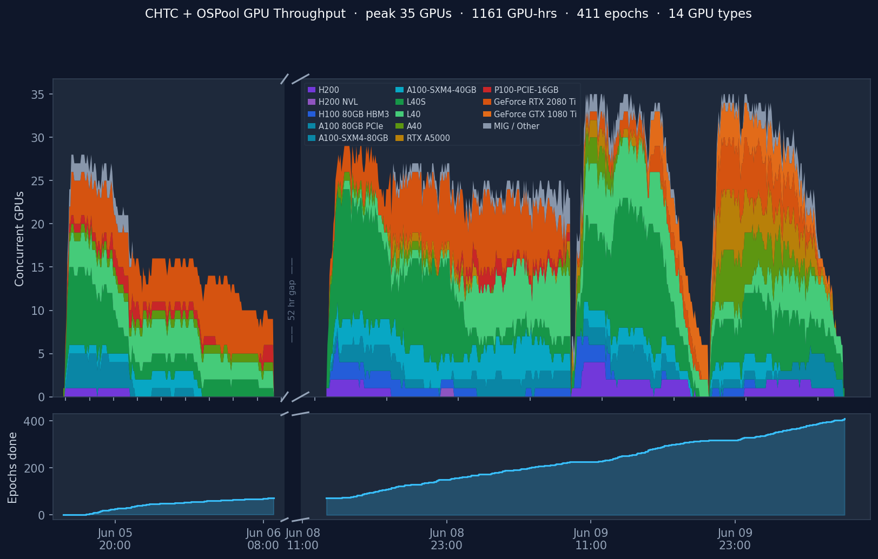
Single protein model training: doing more with less
Lower VRAM (and time) requirements: lower preemption risk, orders of magnitude more GPUs available, can be just as scientifically interesting!
✨Vibe-coded visualization
of early throughput tests ✨
8 different protein simulations,
5 targeted model variants each

Slide 14
High Throughput Machine Learning
The PATh to NAIRR is open.
  HTCondor Annex + OSDF let us use allocations from single AP
  Gaps remain and rough edges exist, but integration is proven and we know where the rough edges are
HTC principles hold for ML!
  Submit locally, run globally.
  Epoch-sized jobs can fit almost everywhere
    Especially with checkpointing
  Moving the work (and data) to the compute
    Even leveraging heterogeneous GPU in a training process
  Always have work ready to run
Come talk to us! Whether you’re just starting to think about ML workloads or are outgrowing OSPool, we can get you going!

