Slide 1
Booster rockets for Birds:
New Backends for the Pelican Origin
Justin Hiemstra
CHTC Research Software Engineer

Slide 2
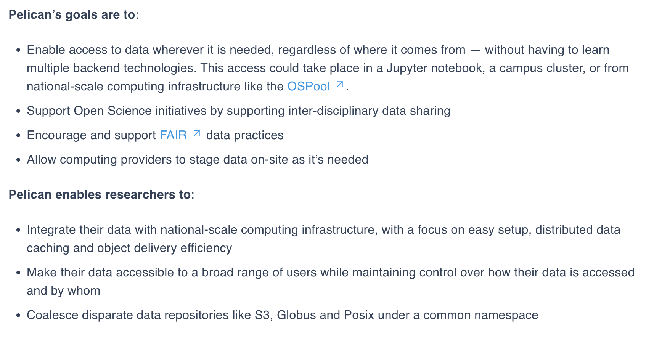
What is Pelican Here to Accomplish?

Slide 3
What is Pelican Here to Accomplish?

Slide 4
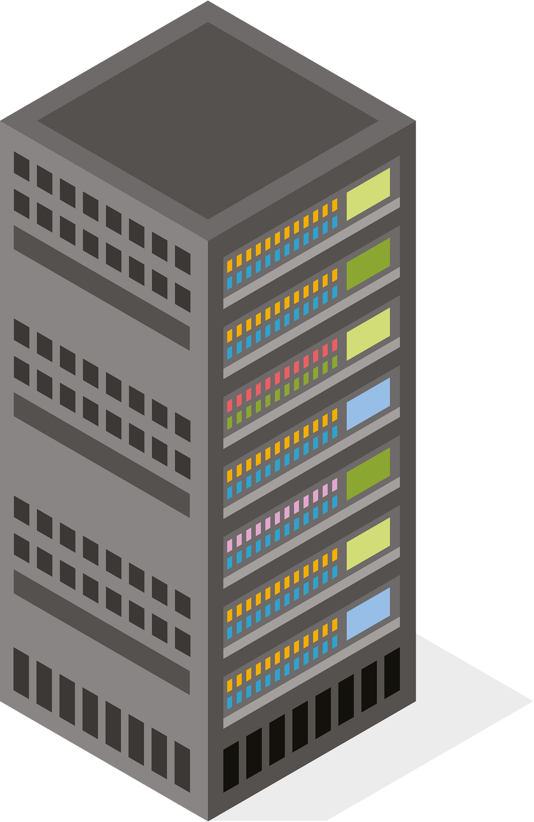


Data providers are users, too!
At its core, the Pelican Platform is a set of tools for creating/managing Data Federations. Beyond clients, our use cases dictate that:
Notes:
The second is that through combining resources under a centralized structure we unlock unified namespaces and scalability

Slide 5
Data providers are users, too!
At its core, the Pelican Platform is a set of tools for creating/managing Data Federations. Beyond clients, our use cases dictate that:
  Data providers may come and go as they like
Notes:
The second is that through combining resources under a centralized structure we unlock unified namespaces and scalability

Slide 6
Data providers are users, too!
At its core, the Pelican Platform is a set of tools for creating/managing Data Federations. Beyond clients, our use cases dictate that:
  Data providers may come and go as they like
  Data providers have the ultimate authority to choose how their data is used/distributed
Notes:
The second is that through combining resources under a centralized structure we unlock unified namespaces and scalability

Slide 7
Data providers are users, too!
At its core, the Pelican Platform is a set of tools for creating/managing Data Federations. Beyond clients, our use cases dictate that:
  Data providers may come and go as they like
  Data providers have the ultimate authority to choose how their data is used/distributed
Data providers trust that the federation won't abuse their resources.
Notes:
The second is that through combining resources under a centralized structure we unlock unified namespaces and scalability

Slide 8
Data providers are users, too!
At its core, the Pelican Platform is a set of tools for creating/managing Data Federations. Beyond clients, our use cases dictate that:
  Data providers may come and go as they like
  Data providers have the ultimate authority to choose how their data is used/distributed
Data providers trust that the federation won't abuse their resources.
And if we abuse this trust…?
Notes:
The second is that through combining resources under a centralized structure we unlock unified namespaces and scalability

Slide 9
Data providers are users, too!
At its core, the Pelican Platform is a set of tools for creating/managing Data Federations. Beyond clients, our use cases dictate that:
  Data providers may come and go as they like
  Data providers have the ultimate authority to choose how their data is used/distributed
Data providers trust that the federation won't abuse their resources.
And if we abuse this trust…?
Notes:
The second is that through combining resources under a centralized structure we unlock unified namespaces and scalability

Slide 10
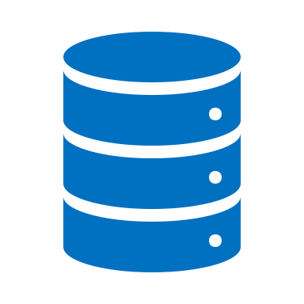


Origins
Origins play a loaded role:
Federation Central Services
Registry
Director
Object Repository
Client
Origin
Cache

Slide 11
Origins
Origins play a loaded role:
"Translation" between object repository and federation
Federation Central Services
Registry
Director
Object Repository
Client
Origin
Cache

Slide 12
Origins
Origins play a loaded role:
"Translation" between object repository and federation
Implementation of access rules (authz, throttling, etc)
Federation Central Services
Registry
Director
Object Repository
Client
Origin
Cache

Slide 13
Origins
Origins play a loaded role:
"Translation" between object repository and federation
Implementation of access rules (authz, throttling, etc)
Circuit breaker duties
Federation Central Services
Registry
Director
Object Repository
Client
Origin
Cache

Slide 14
Origins
Origins play a loaded role:
"Translation" between object repository and federation
Implementation of access rules (authz, throttling, etc)
Circuit breaker duties
Origin ↔ object repository "health" monitoring
Federation Central Services
Registry
Director
Object Repository
Client
Origin
Cache

Slide 15
Origins
Origins play a loaded role:
"Translation" between object repository and federation
Implementation of access rules (authz, throttling, etc)
Circuit breaker duties
Origin ↔ object repository "health" monitoring
Every one of these may be unique to the particular object repository!
Federation Central Services
Registry
Director
Object Repository
Client
Origin
Cache

Slide 16
Origins as Translators
Client
$ pelican object get \
pelican://osg-htc.org/some/namespace/dog-photo.jpg \
dog-photo.jpg

Slide 17
Origins as Translators
Federation Central Services
Registry
Director
Client
$ pelican object get \
pelican://osg-htc.org/some/namespace/dog-photo.jpg \
dog-photo.jpg

Slide 18
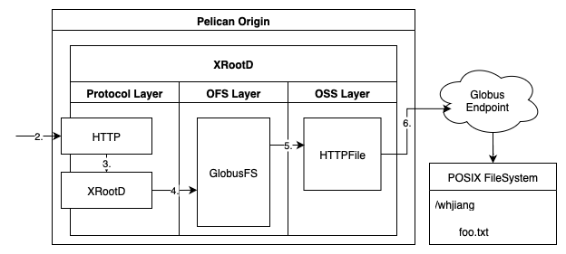
Origins as Translators
Federation Central Services
Registry
Director
Client
$ pelican object get \
pelican://osg-htc.org/some/namespace/dog-photo.jpg \
dog-photo.jpg
Diagram courtesy of CHTC Fellow alumnus William Jiang

Slide 19
Protocol Translations
Pelican verb | HTTP (client→Origin) | XRootD Internal | posix backend | https backend | s3 backend | globus backend | xroot backend
get | HTTP GET (ranged) | open + read x N + close | open + pread | HEAD + GET (ranged) | HeadObject + GetObject (ranged) | HEAD + GET (ranged) | kXR_open + kXR_read
put | HTTP PUT | open + write x N + close | open + pwrite | PUT (chunked) | CreateMPU + UploadPart x N + CompleteMPU | PUT (chunked) | kXR_open + kXR_write
stat | WebDAV PROPFIND depth=0 | stat | stat(2) | HEAD | HeadObject (+ListObjectsV2 for dirs) | Transfer API stat | kXR_stat
ls | WebDAV PROPFIND depth=1 | opendir + readdir x N | opendir + readdir | GET | ListObjectsV2 (paginated) | Transfer API ls | kXR_dirlist

Slide 20
Abstraction solves all problems… right?
Abstractions are a vital tool in software engineering. So what's the problem?

Slide 21
Abstraction solves all problems… right?
Abstractions are a vital tool in software engineering. So what's the problem?
"There are more things in heaven and earth, [Justin], Than are dreamt of in your philosophy." – Hamlet

Slide 22
Abstraction solves all problems… right?
Abstractions are a vital tool in software engineering. So what's the problem?
"There are more things in heaven and earth, [Justin], Than are dreamt of in your philosophy." – Hamlet
Differing object store and federation semantics lead to messy situations:
Pelican's hierarchical namespaces vs S3's flat buckets
POSIX partial writes vs Pelican's whole-object PUT model
Not everything can be mapped from one "philosophy" into another.

Slide 23

Origins must also translate authz
Origin
OR-specific protocol
Object
Repository
Fed
Auth
OR
Auth

Slide 24
… and other Object Repository policies
Trust Boundary
Throttling
Object
Repository
Client Requests
Origin
Egress Fees
Access Audits
…

Slide 25
… and other Object Repository policies
Trust Boundary
Throttling
Object
Repository
Client Requests
Origin
Egress Fees
Access Audits
…
We have a lot of work to do here.

Slide 26

Does it even work?
Origins provide a service to clients on behalf of data providers.
How can we tell if that service is functioning as "expected"?
Object
Repository
Origin

Slide 27
Does it even work?
Origins provide a service to clients on behalf of data providers.
How can we tell if that service is functioning as "expected"?
We use various assessments of "health" to probe this:
Director ↔ Origin transfer tests
Origin self tests
I/O monitoring
Object
Repository
Origin

Slide 28
Does it even work?
Origins provide a service to clients on behalf of data providers.
How can we tell if that service is functioning as "expected"?
We use various assessments of "health" to probe this:
Director ↔ Origin transfer tests
Origin self tests
I/O monitoring
Testing/determining the "health" of this connection is backend dependent.
Object
Repository
Origin

Slide 29
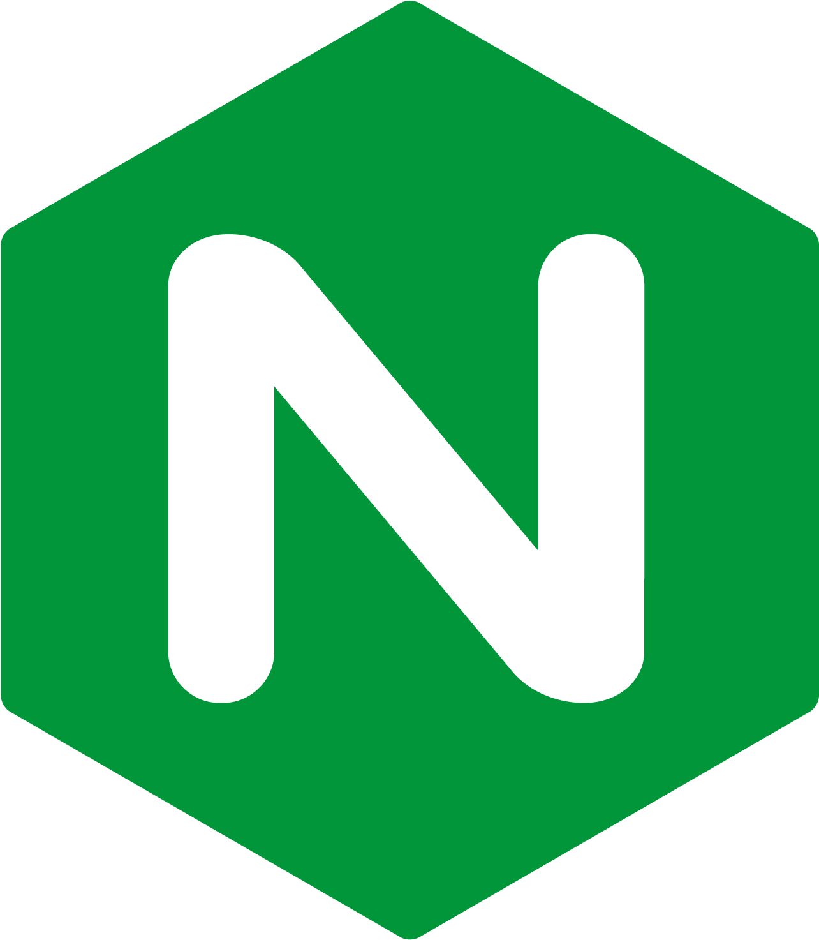

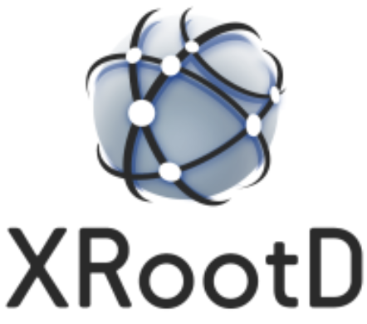

Polished & Upcoming Origin backends
Several backends are maturing from "reads work" to production-ready:
Globus, HTTPS: writes, stats, listings were the hard part – now complete
xroot: name remapping lets the federation namespace differ from the upstream XRootD layout

Slide 30
Polished & Upcoming Origin backends
Several backends are maturing from "reads work" to production-ready:
Globus, HTTPS: writes, stats, listings were the hard part – now complete
xroot: name remapping lets the federation namespace differ from the upstream XRootD layout
We're also expanding reach to data that has no API at all:
ssh backend (WIP): most HPC data lives behind SSH and nothing else

Slide 31
Polished & Upcoming Origin backends
Several backends are maturing from "reads work" to production-ready:
Globus, HTTPS: writes, stats, listings were the hard part – now complete
xroot: name remapping lets the federation namespace differ from the upstream XRootD layout
We're also expanding reach to data that has no API at all:
ssh backend (WIP): most HPC data lives behind SSH and nothing else
Rethinking the architecture with XRootD-less backends:
posixv2 is already running in production; lighter, simpler to deploy
globusv2, httpsv2 and s3v2 coming soon!

Slide 32
Caching everywhere!
The typical setup relies on federation-wide caches/staging devices
Client
Object
Store
Cache
Origin
foo
foo
foo

Slide 33
Caching everywhere!
A few years ago, we started working on "local" cache Pelican component that's meant to serve individual "clusters" or data centers
Client
Object
Store
"Local" Cache
Cache
Origin
foo
foo
foo
foo

Slide 34
Caching everywhere!
In the last year, we introduced first-class "institutional" or "site-local" caches that aren't open to all federation users.
Client
Object
Store
"Local" Cache
"Site-Local" Cache
Cache
Origin
foo
foo
foo
foo
foo

Slide 35
Caching everywhere!
We're also now exploring Origins with their own caching capabilities.
Client
Object
Store
"Local" Cache
"Site-Local" Cache
Cache
Origin
foo
foo
foo
foo
foo
foo

Slide 36
Caching everywhere!
Why do this?
Whom are these caches meant to serve?
Client
Object
Store
"Local" Cache
"Site-Local" Cache
Cache
Origin
foo
foo
foo
foo
foo
foo

Slide 37
Caching everywhere!
Local clients
Object Store
Client
Object
Store
"Local" Cache
"Site-Local" Cache
Cache
Origin
foo
foo
foo
foo
foo
foo

Slide 38
Questions?

Slide 39
Acknowledgements
This material is based upon work supported by the National Science Foundation under Cooperative Agreements OAC-2209645. Any opinions, findings, and conclusions or recommendations expressed in this material are those of the author(s) and do not necessarily reflect the views of the National Science Foundation.

