Slide 1
OrangeGrid
Cloud Workers
Bursting an HTCondor pool into external capacity without changing the researcher experience.
Same workflow. Same submit files. Same storage model.
Just more capacity when we need it.
Peter Pizzimenti | Research Computing | Syracuse University
T H R O U G H P U T C O M P U T I N G W E E K 2 0 2 6
Notes:
I'm Pete Pizzimenti from Syracuse University Research Computing. This talk is about OrangeGrid Cloud Workers, a project I built to add external capacity to our HTCondor pool while preserving the experience our researchers already know. No new workflow. No new submit files. No new storage model. Just more capacity when we need it.

Slide 2
Today's story
Why, how, what we found, and where it goes.
1
Why
2
How
3
Results
4
Future
A focused tool
Architecture overview
Performance
What's next
Why we built it
Deployment
Capacity planning
Key takeaways
Compute layer
Capacity from anywhere
Storage layer
Syracuse University
2
Notes:
I'll start with the problem and constraints. Then we'll walk through the architecture and major components. After that we'll look at economics, benchmarks, lessons learned, and where I think this approach fits.

Slide 3


A suite of tools with a focus
Different organizations have different constraints. This is the path that worked for us.
What this is
What this is not
Adds external capacity to an existing HTCondor pool
A replacement for HTCondor Annex / Glidein
Transparent to researchers
A replacement for HTCondor file transfer
Uses existing NFS home directories
A replacement for CVMFS / Pelican
Built around our environment and constraints
A universal solution
Syracuse University
3
Notes:
I want to make something clear up front. This is not a replacement for existing HTCondor mechanisms. If Annex solves your problem, use Annex. If file transfer solves your problem, use file transfer. If CVMFS solves your software distribution problem, use CVMFS. This is another menu option. Different organizations have different constraints. This is the path that worked well for us.

Slide 4




Why we built it
The situation
Requirements
Research demand is bursty
User changes nothing
Buying hardware for peak is expensive
Data follows the workload
Researchers depend on NFS home directories
Compute can come from anywhere
We are all creatures of habit
Endpoint: Linux, Docker, Internet
The goal is adding JIT capacity without bifurcating the cluster.
Syracuse University
4
Notes:
Everything in this project comes from these requirements. Researchers shouldn't care where a job runs. Researchers shouldn't know whether capacity came from campus, Azure, AWS, or somewhere else. The goal was making capacity location irrelevant.

Slide 5
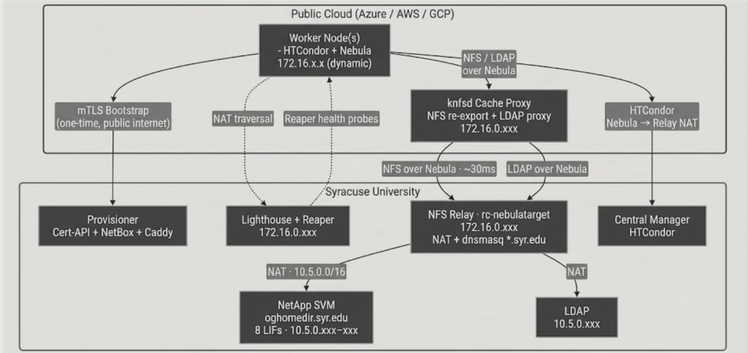
Architecture overview
The home directory path, end to end. Cloud on top, campus below.
Syracuse University
5
Notes:
This is the whole system. Follow the orange, that is the home directory path. The worker mounts its home from the cache proxy, and the cache proxy reaches campus storage through the relay over the WAN, about 30 milliseconds away. The gray is control: the worker bootstraps to the campus control plane, the provisioner, lighthouse, and central manager. The worker becomes an ordinary execute node with a real home directory already mounted. Everything else in this talk just zooms into one of these boxes.

Slide 6




Cloud worker deployment
One phone call home.
→
→
→
VM boot
Provisioner
Network
Accepting Jobs
Cloud-init
FastAPI
Nebula
Execute node
Bundle contents
Nebula certificate
Network config · NetBox
HTCondor software / creds
Identity · LDAP
Syracuse University
7
Notes:
The provisioner establishes trust. A worker arrives with a bootstrap credential. It receives everything required to become a cluster member. After that, it operates entirely over the overlay network.

Slide 7


Compute layer
Disposable compute. It boots, joins the pool, runs jobs, and disappears.
Components
Lifecycle
Execute node with on-prem parity
Nebula overlay client
→
→
Provision
Run jobs
Destroy
NFSv4.2 client / AutoFS
LDAP
One Docker Compose stack, on a node without special configuration.
Health monitoring
Syracuse University
6
Notes:
The worker stack is intentionally boring. The worker is disposable. It boots, joins the pool, runs jobs, and disappears. I wanted ordinary execute nodes, not special infrastructure.

Slide 8
Storage layer
The hard part. The home directory simply exists.
→
→
→
Worker
Cache Proxy
Campus Relays
Institutional Storage
NFSv4.2 client
Knfsd-cache-utils / FSCache
Nebula
NetApp ONTAP
Design goals
The cache fills itself when data is touched.
JIT staging available to all cloud workers
JIT staging. No user intervention.
No campus storage config changes
No workflow changes
Syracuse University
8
Notes:
This is where most of the engineering effort went. I wanted the home directory to simply exist. No staging. No user intervention. No workflow changes. The cache fills itself when data is touched. Researchers never know it happened.

Slide 9
Performance characteristics
What worked well and what didn't.
What it tests | On-prem min | Cloud avg min | Cloud vs on-prem | Why
One 20-core Blender render job | 6.48 | 6.64 | 1.0x | Same runtime
Frame-farm render throughput | 13.48 | 18.85 | 1.4x | Scheduling overhead
3-minute CPU throughput | 3.08 | 3.23 | 1.0x | Same runtime
3-minute Python startup + compute | 3.10 | 4.62 | 1.5x | Startup + metadata
3-minute R startup + compute | 3.10 | 3.98 | 1.3x | Metadata RPC
20-core node-isolated HPCC benchmark | 2.04 | 1.87 | 0.92x | Node-local CPU, memory, MPI; little NFS impact
1 GiB NFS write / read / hash | 3.13 | 1.14 | 0.36x | Local read cache / Written to dirty pages
2,000-file metadata workflow | 0.27 | 9.34 | 35.0x | WAN metadata latency
Compute-heavy workloads land at 1.0x to 1.5x
Existing researcher workflows run unchanged
Metadata-intensive workflows are the primary limitation
Syracuse University
12
Notes:
The surprise wasn't that metadata workflows suffered. The surprise was how well ordinary compute workloads performed. Blender was effectively identical. CPU throughput was effectively identical. Read down the green column, compute holds up. The two orange rows are where it bites: bulk transfer and especially metadata. The 2,000-file workflow is 35 times slower, and that is all WAN metadata latency.

Slide 10
Capacity planning MCP
Different questions, one live pricing source.
“I have $500. What's the most capacity I can rent for the next 24 hours?”
“How long should we rent cloud GPUs to clear today's HTCondor’s GPU queue?”
A M D 6 4 C P U C A P A C I T Y · S P O T
G P U Q U E U E · S P O T
Provider | Instance type | vCPUs | 24h cost
Azure | HB120rs_v3 | 3,720 | $494.98
AWS | c5.12xlarge | 2,976 | $493.61
GCP | n2d-highcpu-224 | 3,808 | $498.45
Item | Value
Current queue | 547 waiting GPU jobs
Job shape | 1 GPU, 16 vCPU, 16 GiB RAM
Runtime basis | Successful GPU job history from users: <NetIDs>
P99 runtime | ~22 hours
Recommended rental | 24 hours
Conservative rental | 30 hours
Best 24h spot estimate | Azure A10 $3.9k, AWS L4 $3.9k
Best: GCP, 3,808 vCPUs for ~$498
Once every job can start, rental time is driven by tail runtime.
Syracuse University
10
Notes:
One supporting project for Cloud Workers is PriceNet. PriceNet is an MCP server that continuously tracks cloud pricing and capacity across providers. Instead of hard-coding Azure, AWS, or GCP, I can ask: I have $500, what's the most capacity I can buy? The answer becomes provider agnostic. Capacity decisions become economic decisions.

Slide 11

Capacity from anywhere
Cloud-agnostic by design. The worker only needs to know where home is.
R U N N I N G T O D A Y
Azure
where it was built and tested
P O S S I B L E T O M O R R O W
AWS
GCP
Neoclouds
Public cloud
Public cloud
GPU specialists
Another university's cloud
Private infrastructure
Peer capacity
On-prem / lab
Syracuse University
11
Notes:
This isn't really an Azure project. Azure is just where I built and tested it. The architecture is provider agnostic. The worker only needs to know where home is. Anything that can run the worker can be capacity: the public clouds, the GPU neoclouds, OpenStack or VMware, a peer university's cloud, or your own private hardware.

Slide 12
What’s next
Where this goes from here.
1 Open to all OrangeGrid users
Graduate from beta so any SU HTCondor researcher can consume.
2 Automate cloud consumption
Use live cross-cloud pricing to drive spot bids to a budget.
Historical job and performance data to better route work to either keep on-prem or send to the cloud
3 Burst GPUs
Extend from CPU to GPU execute nodes for accelerated work.
4 Reach more clouds
Move past Azure only and prove out AWS, GCP, and a private-cloud targets.
Syracuse University
15

Slide 13

Key takeaways
Researchers do not change workflows
Capacity can come from anywhere
Compute-heavy HTC workloads perform well
Metadata-heavy workflows remain the primary limitation
Another HTCondor deployment option, not a replacement
docs.syr.edu/ResearchComputing/cloudbursting
The hard part was never getting the compute.
It was making that remote compute fit our researcher’s familiar workflow.
Questions?
Syracuse University
16
Notes:
The hard part was never getting VMs. The hard part was making those VMs look like ordinary execute nodes with a real home directory already there. That's what this project is really about. Thank you.

