Slide 1
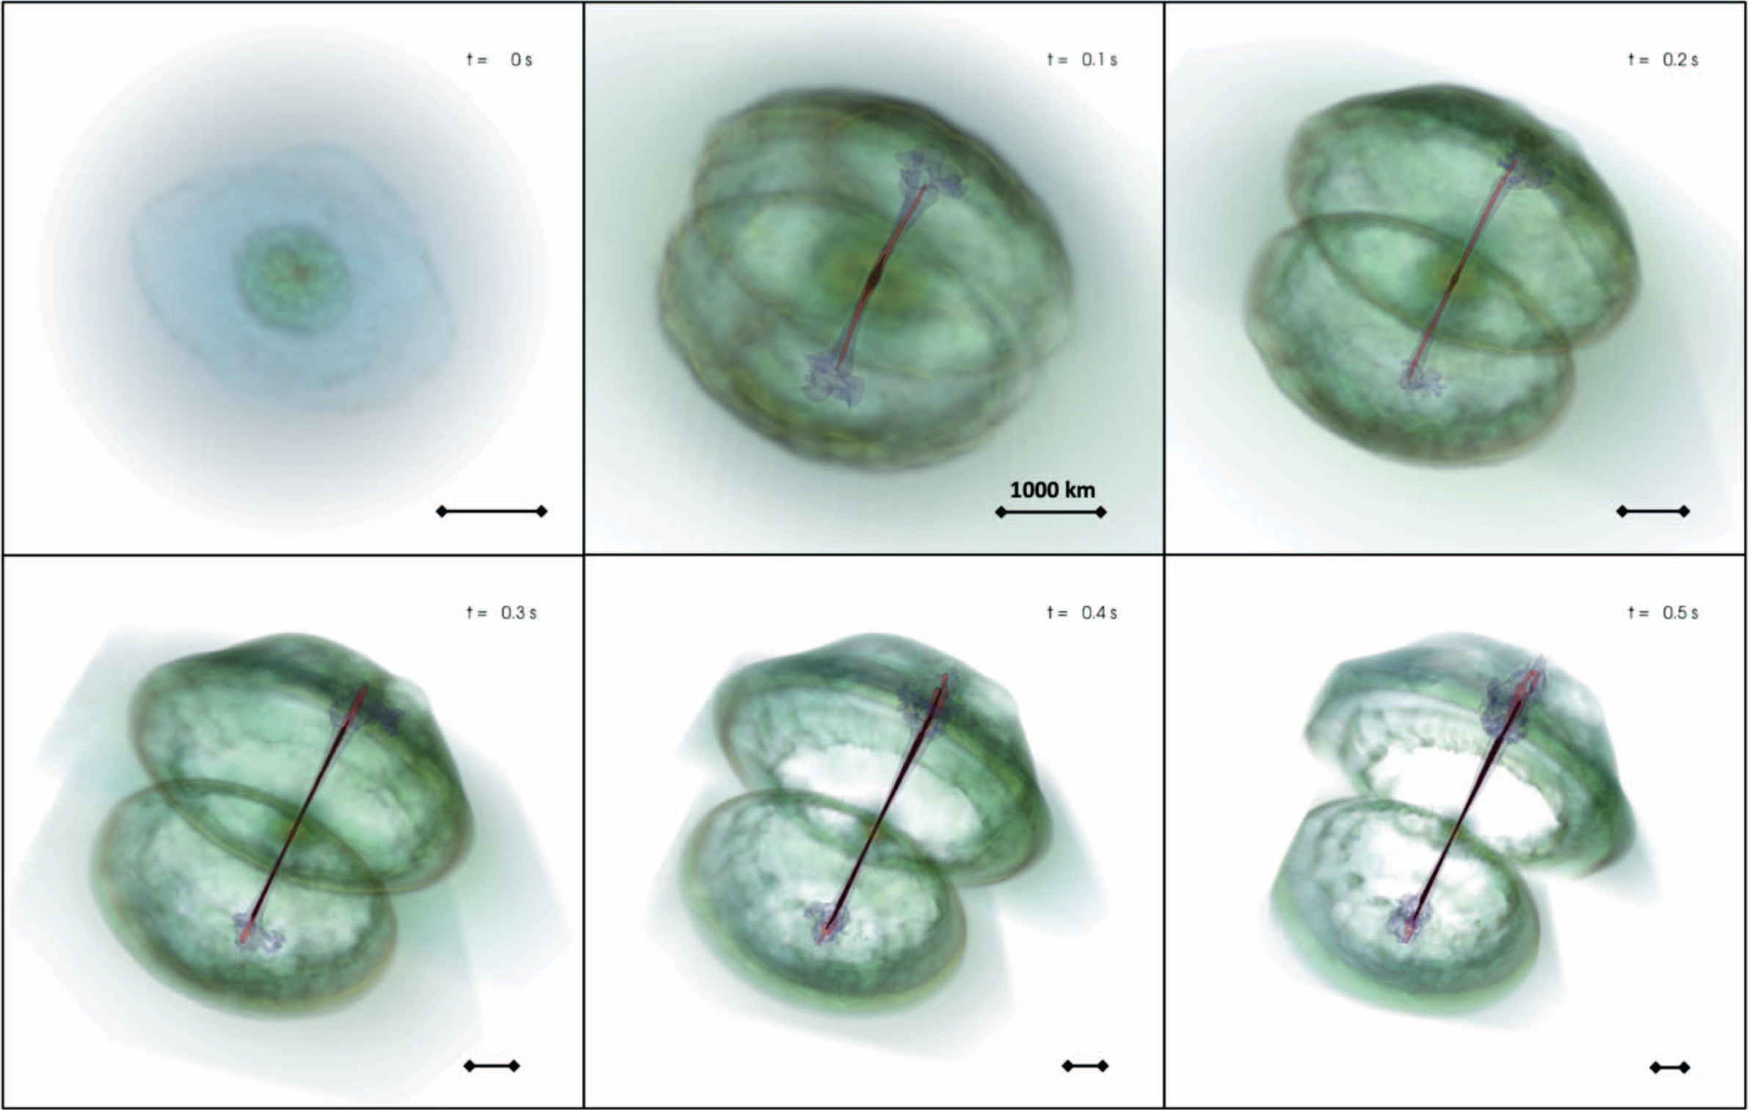
Efficient Utilization of Resources in GRB Simulations at Multiple Scales
Lazzati, Davide, Rosalba Perna, Riccardo Ciolfi, Bruno Giacomazzo, Diego López-Cámara, and Brian Morsony. 2021. “Two Steps Forward and One Step Sideways: The Propagation of Relativistic Jets in Realistic Binary Neutron Star Merger Ejecta.” The Astrophysical Journal Letters 918 (1): L6. https://doi.org/10.3847/2041-8213/ac1794.
Nathan Walker
HTC26

Slide 2
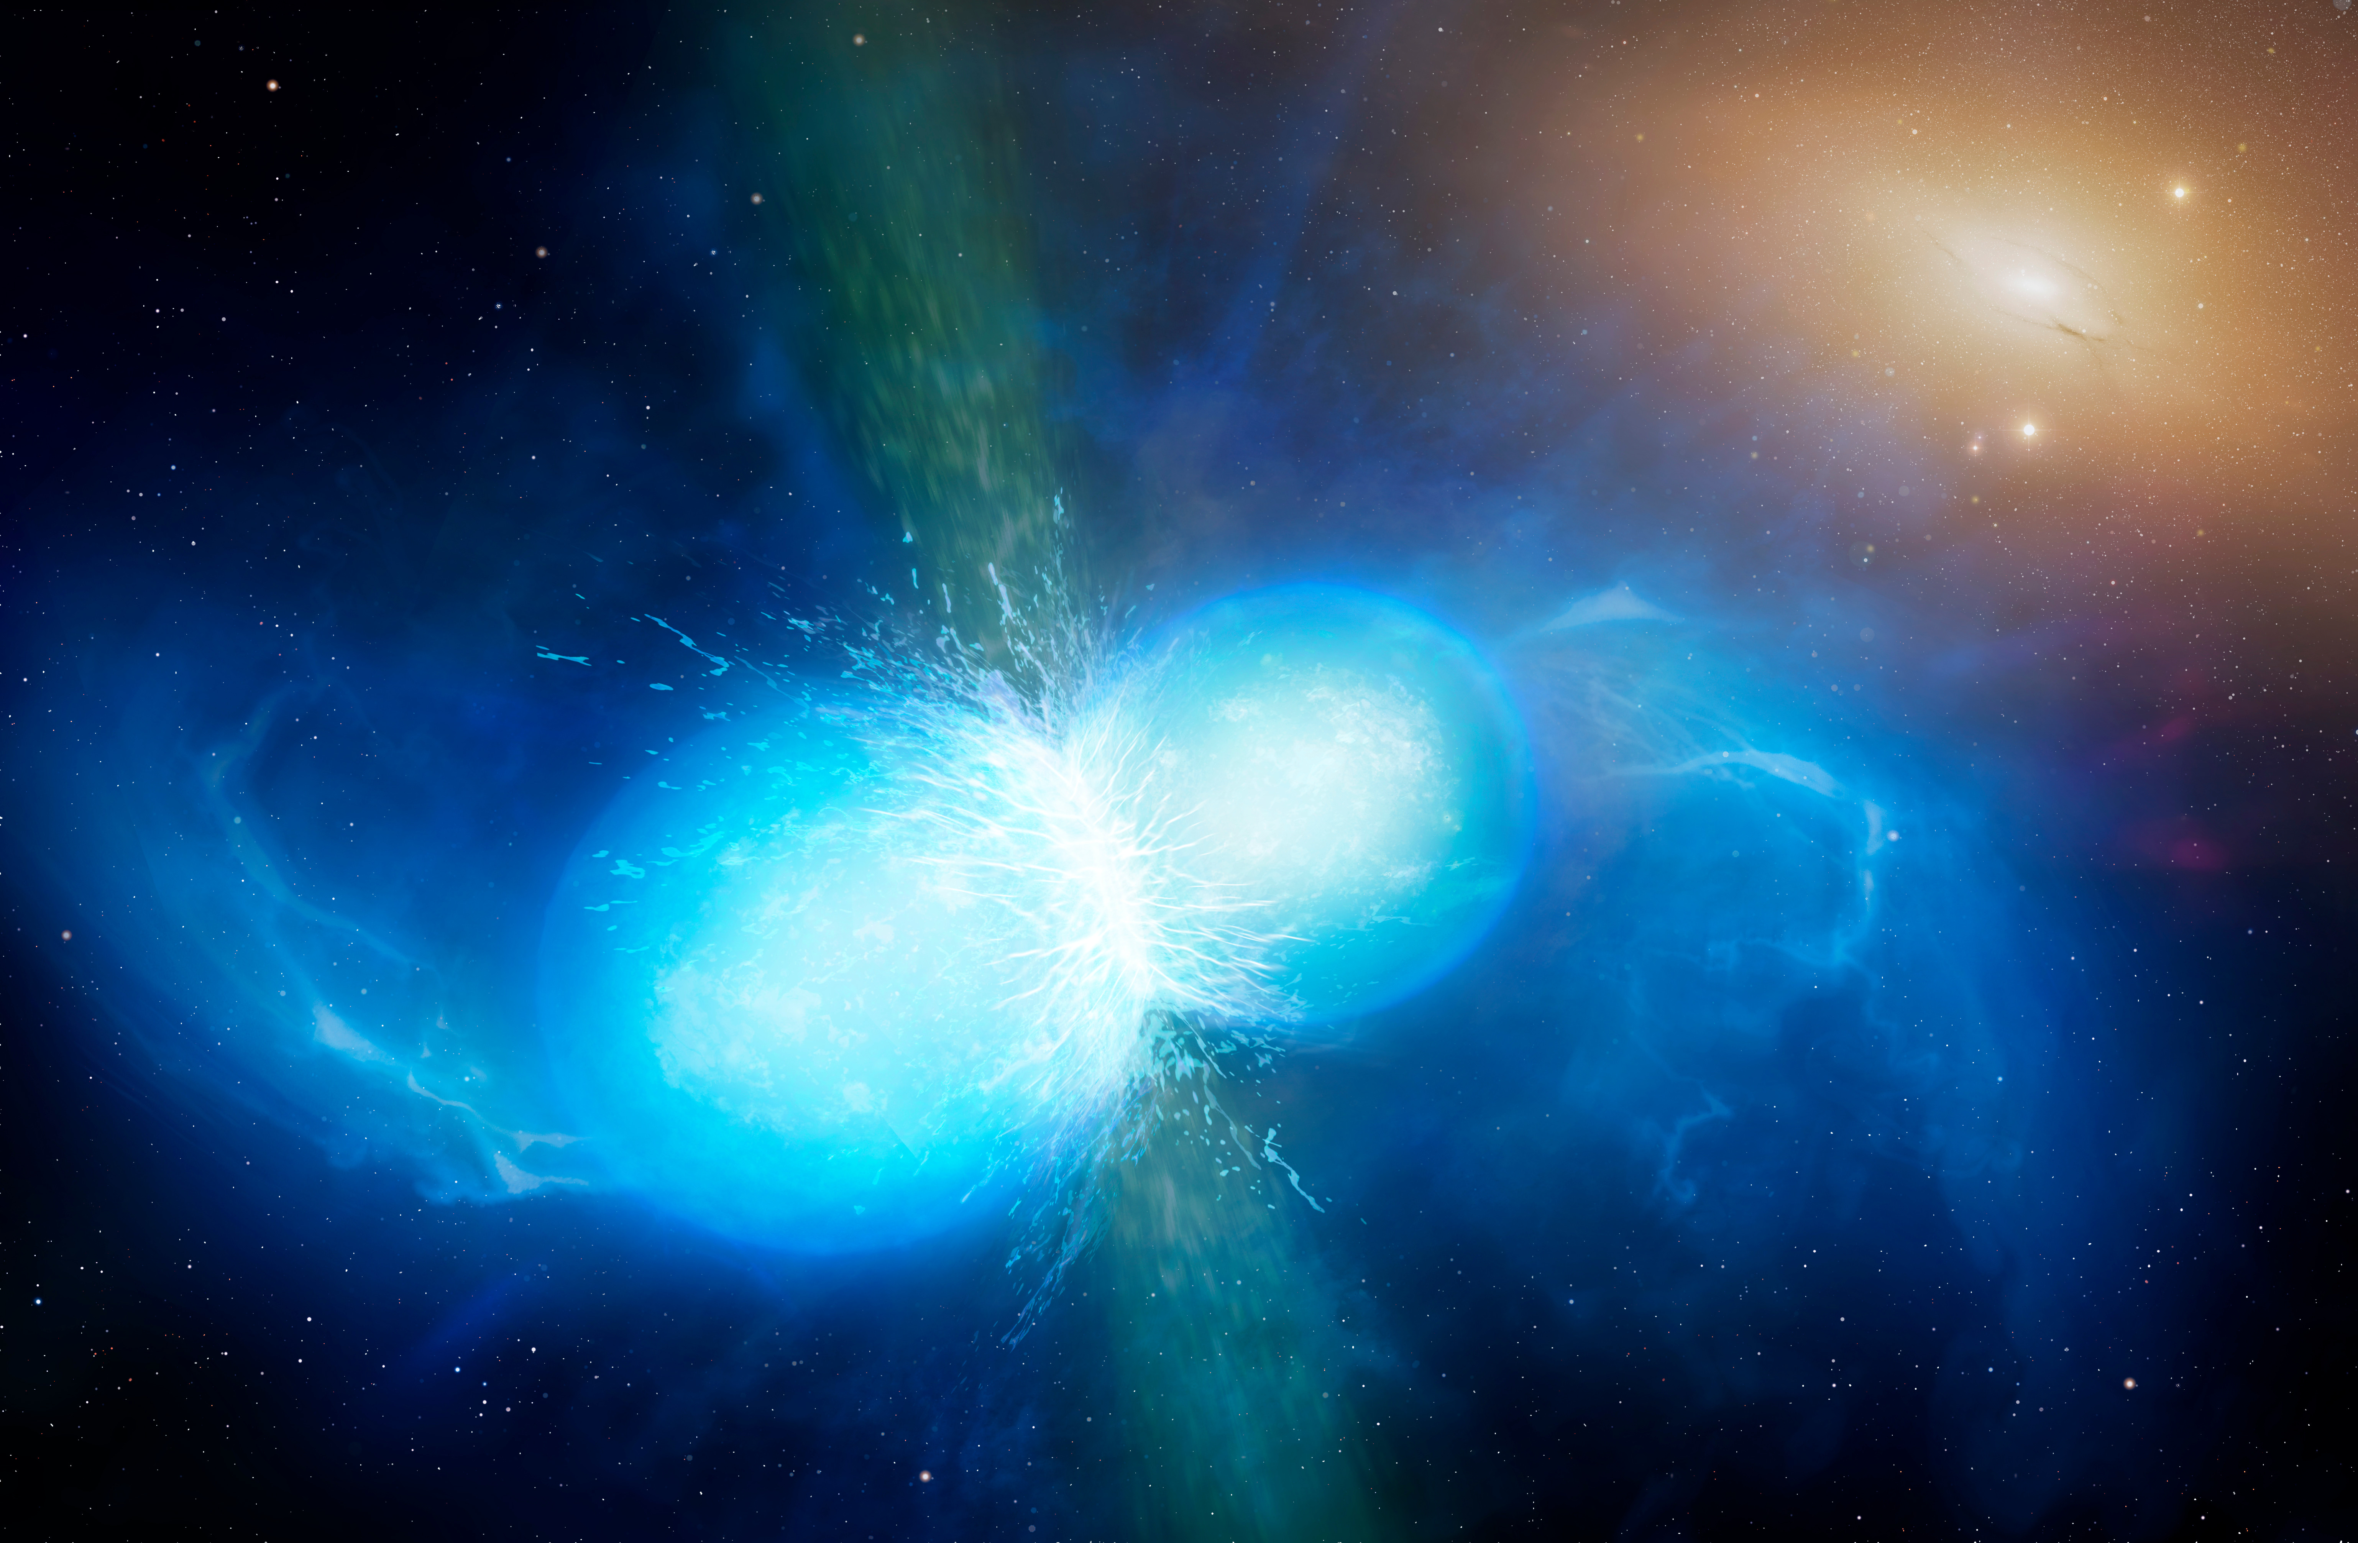
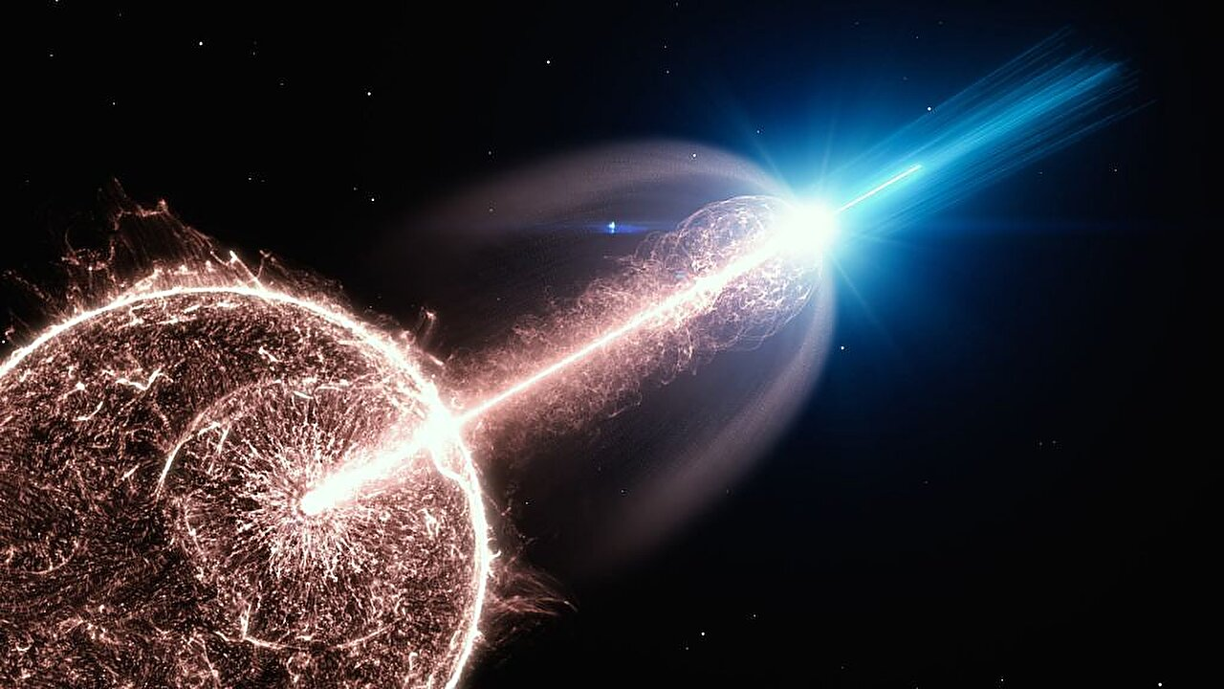
Gamma-Ray Bursts
First Discovered in the late 60s
The most energetic explosions ever observed
Elusive mystery:
  Progenitors?
  Cosmological Origin?
  Emission Mechanism?
Two classes:
  LGRBs - Supernovae
  SGRBs - Compact Object Mergers

Slide 3
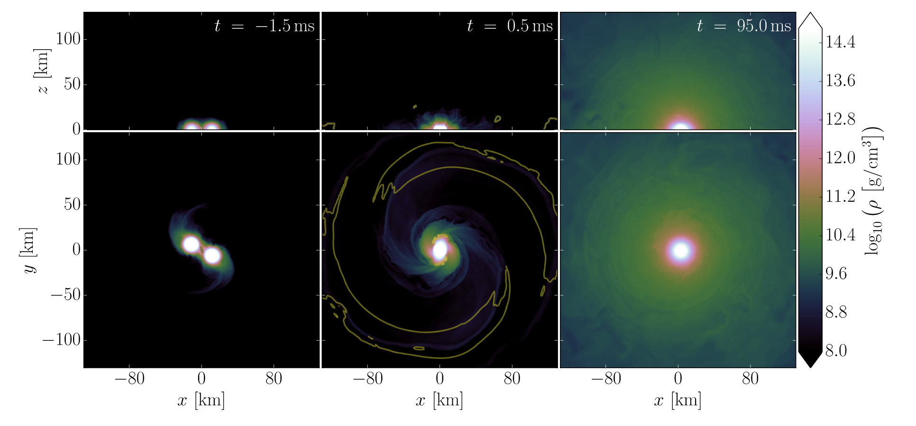
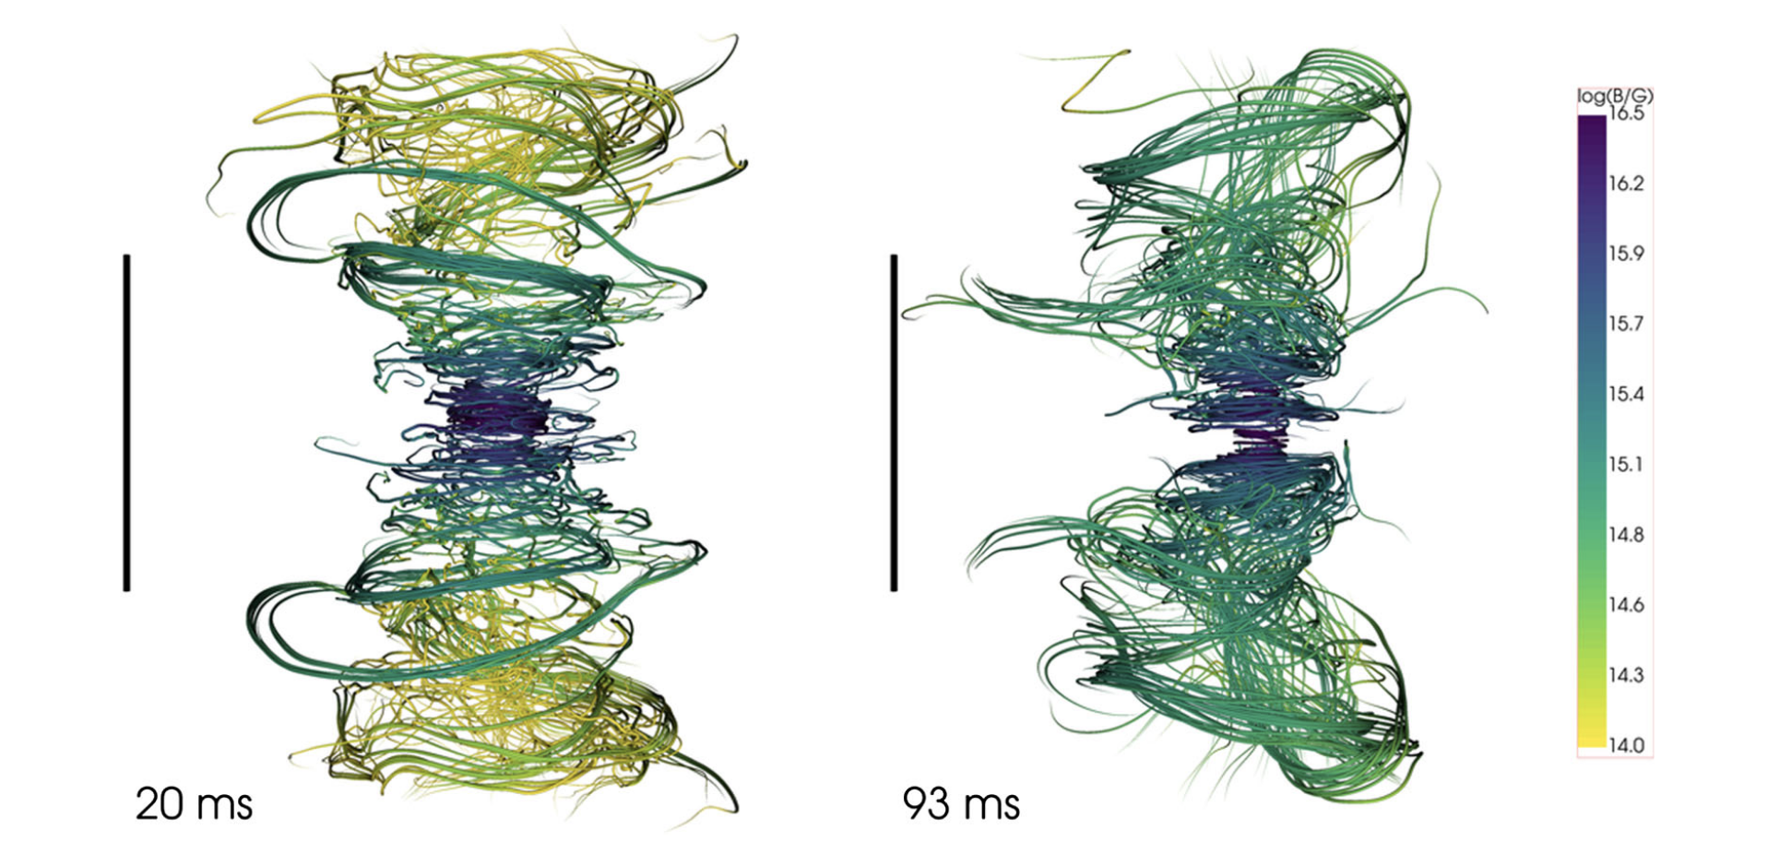
Compact Mergers
Ciolfi et al, 2019. doi:10.1103/PhysRevD.100.023005
GRMHD Simulation - Binary Neutron Star Merger (Ciolfi et al, 2019)
  Neutron star remnant collapses into a black hole
Inject a relativistic jet into merger ejecta

Slide 4
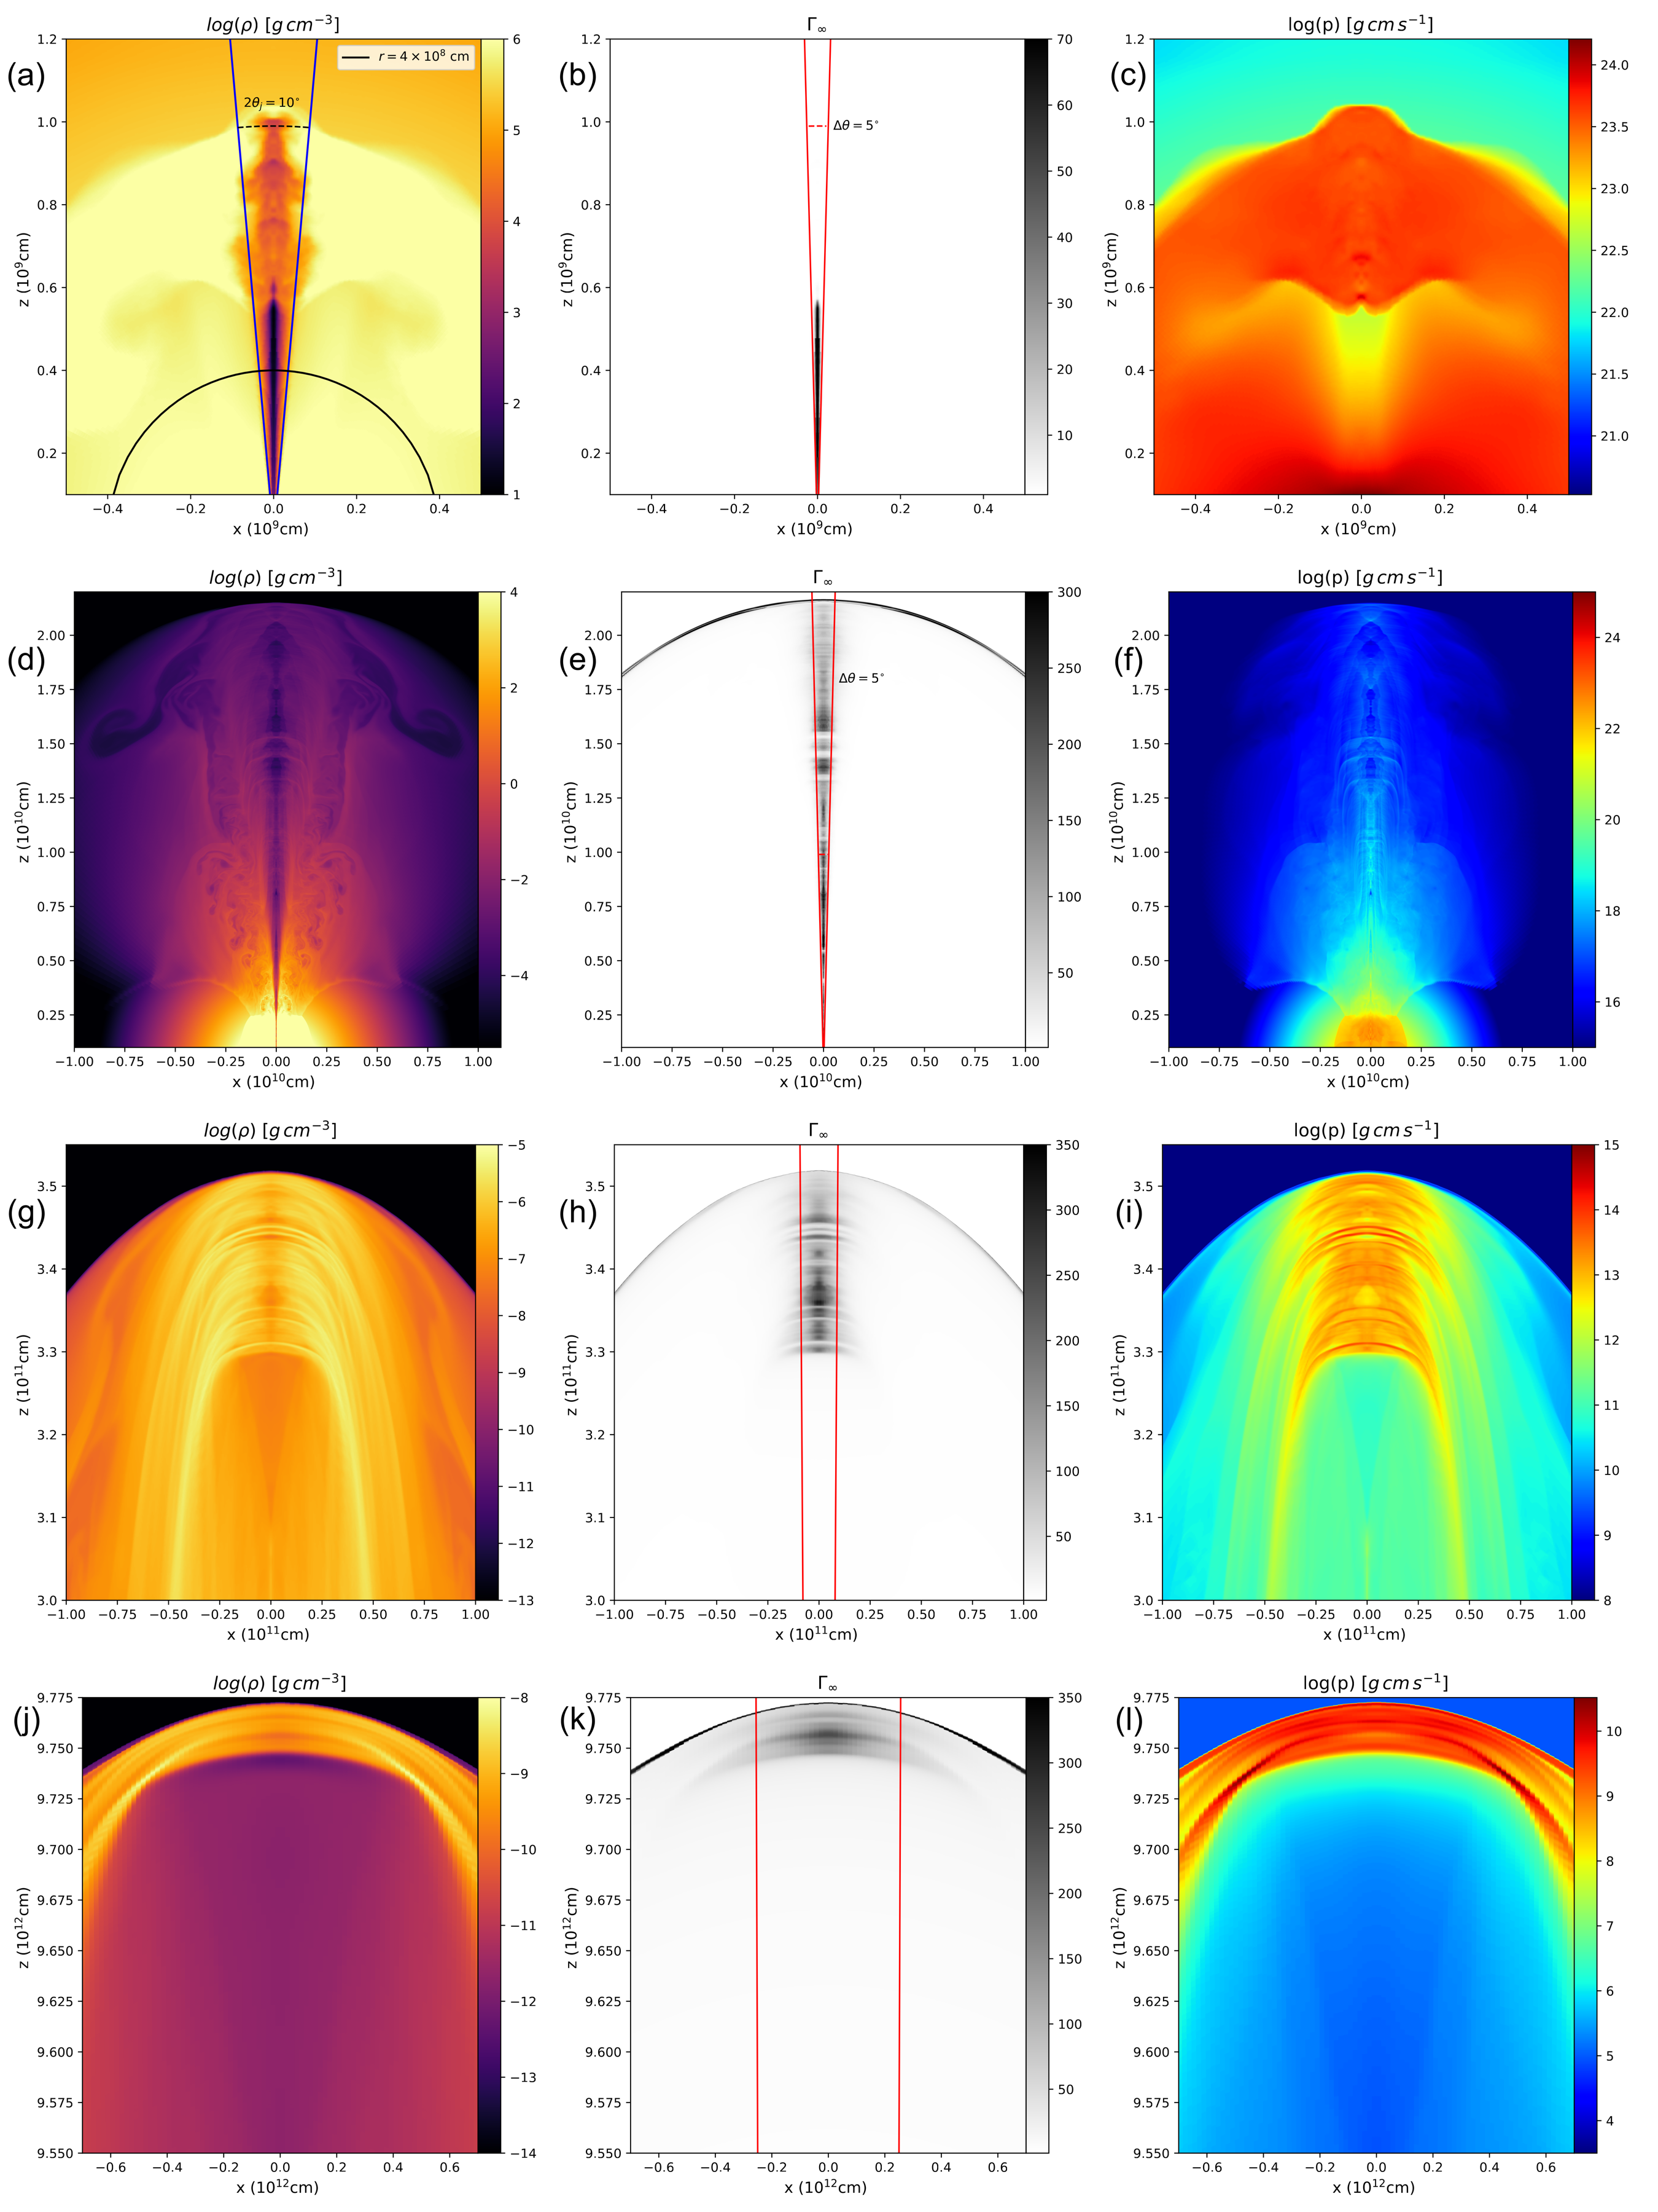
Hydrodynamics - Jet Injection and Evolution
PLUTO hydrodynamical simulation
  2D spherical coordinates
  Static grid
  Jet injection lasts ~ 2 s
The jet becomes highly structured (radially and angularly), and becomes a pancake near the photosphere

Slide 5
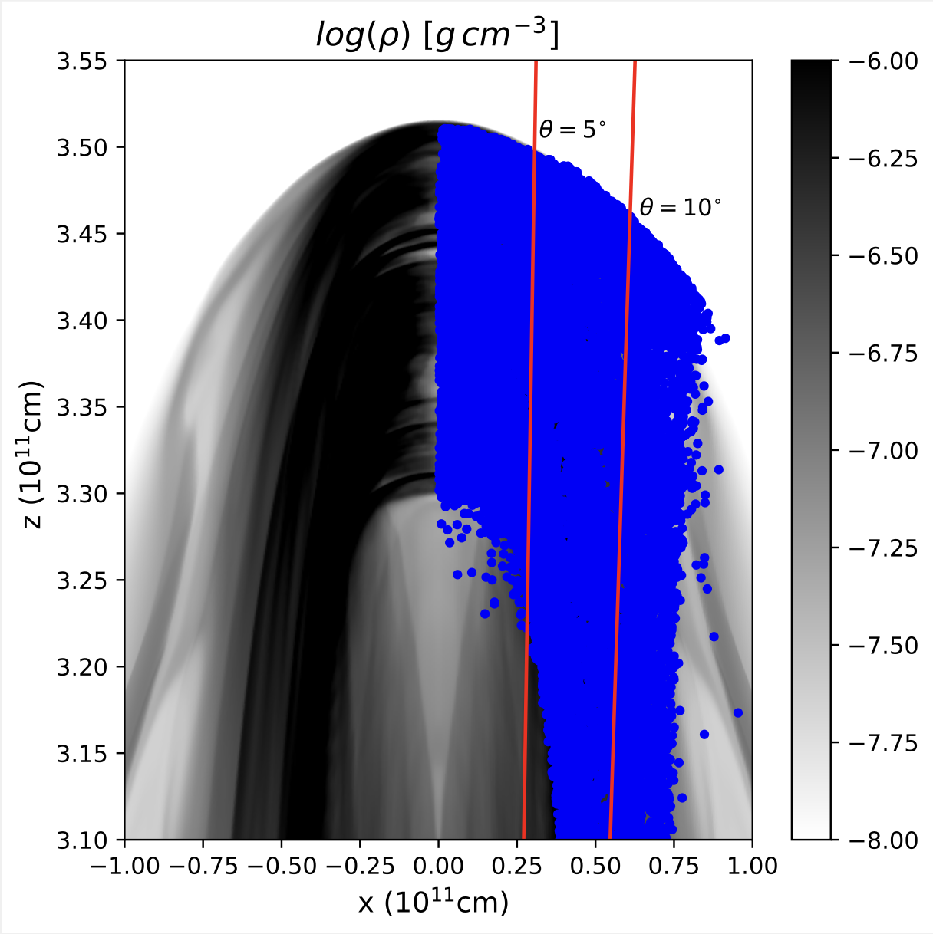
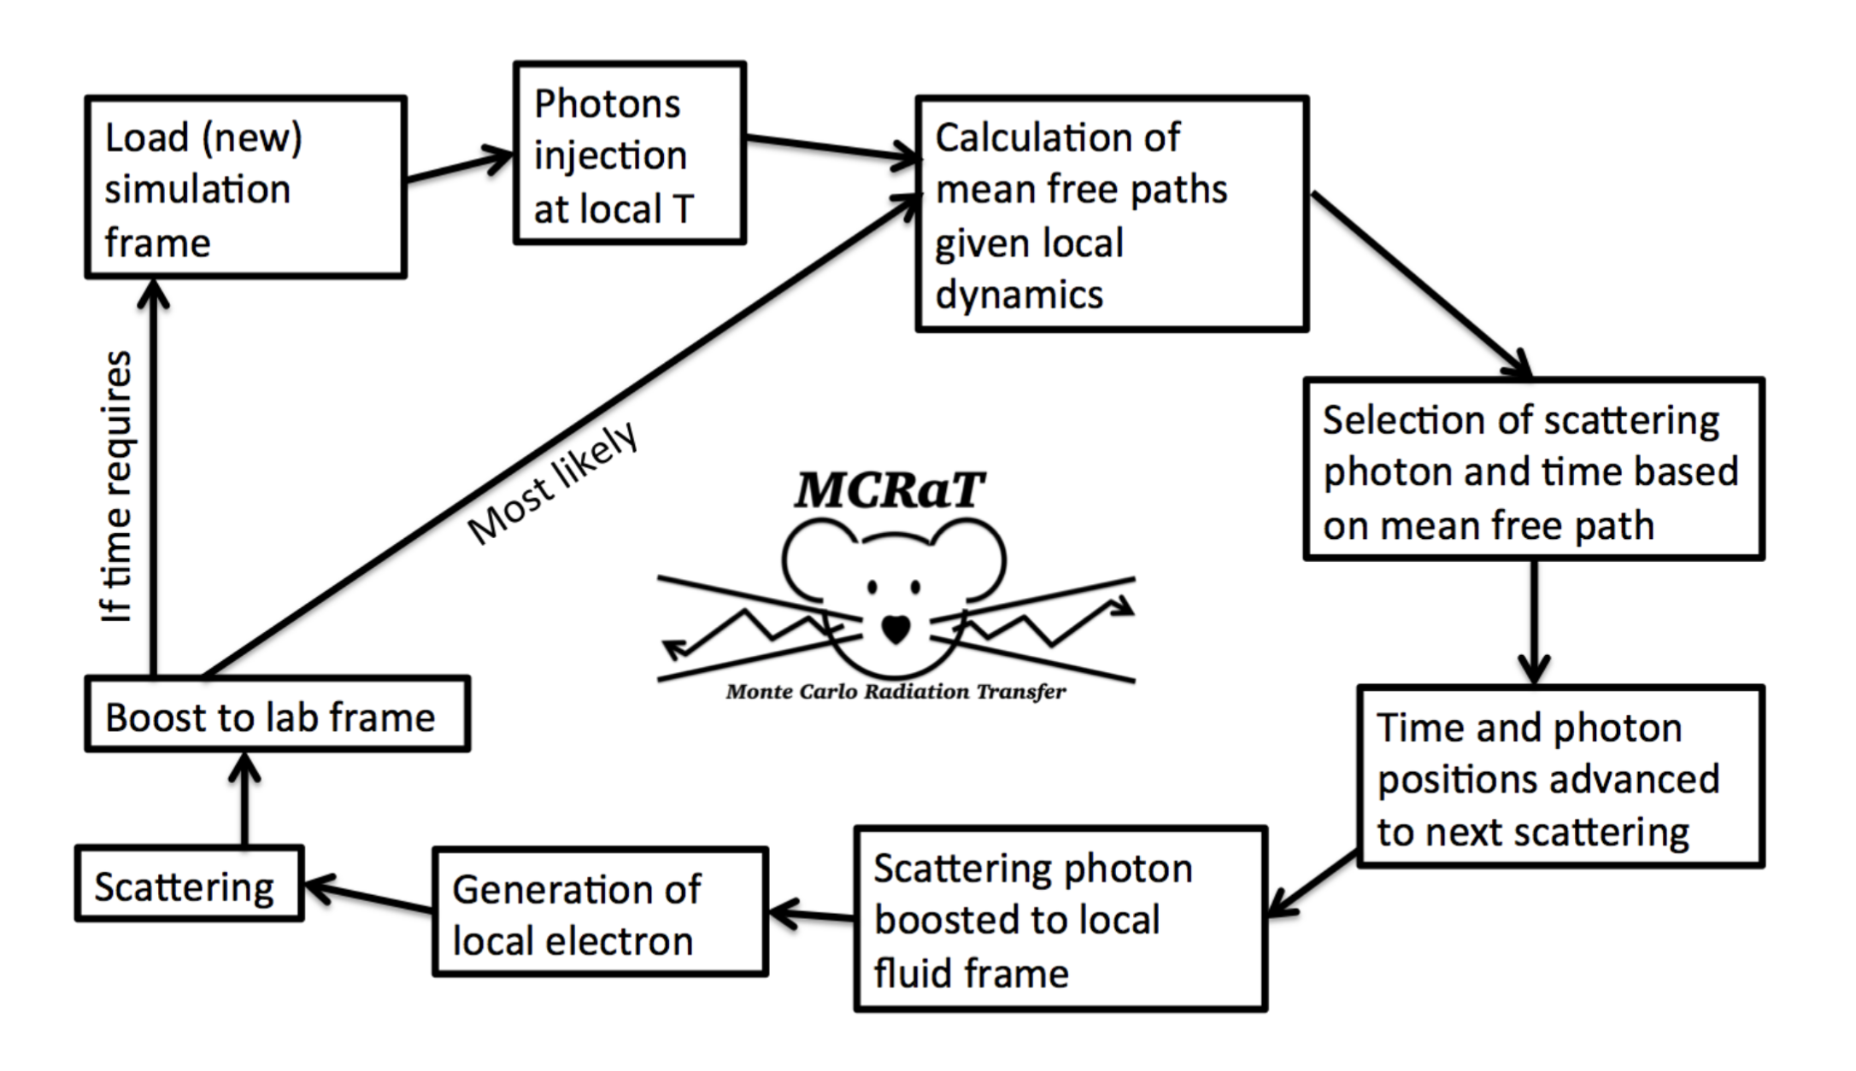
Radiation Transfer
Takes hydro frames as input
Injects and scatters photons
  Compton scatters photons with fluid (including Klein-Nishina)

Slide 6
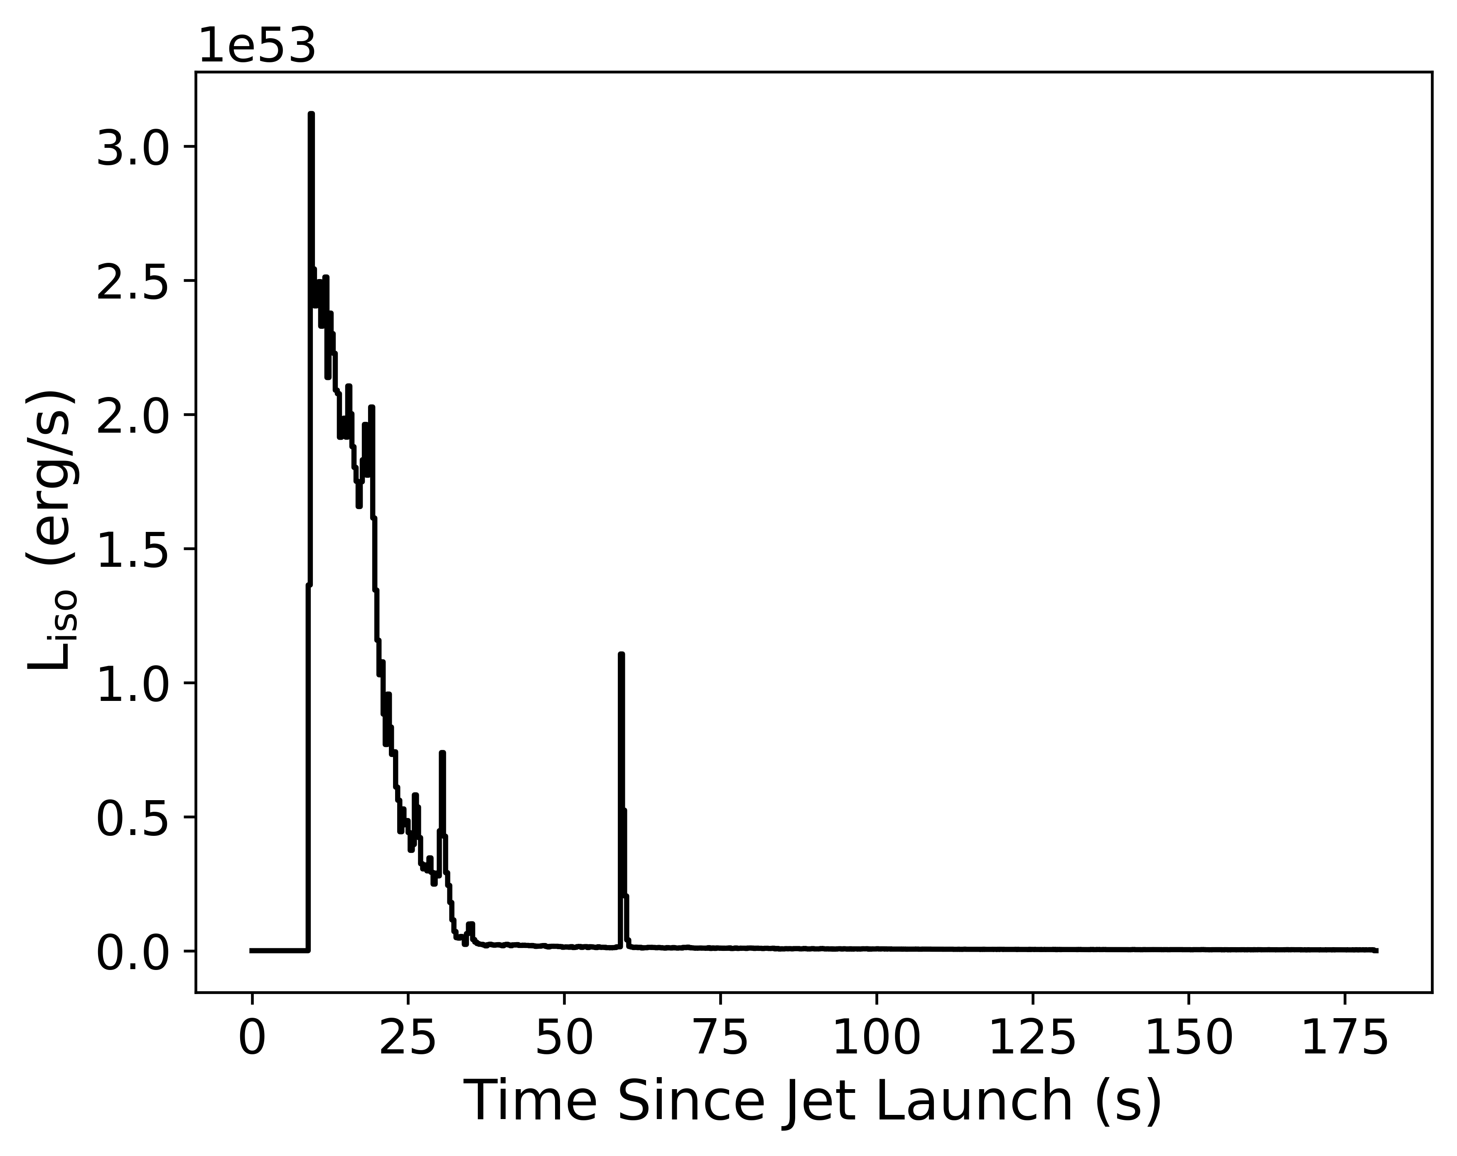
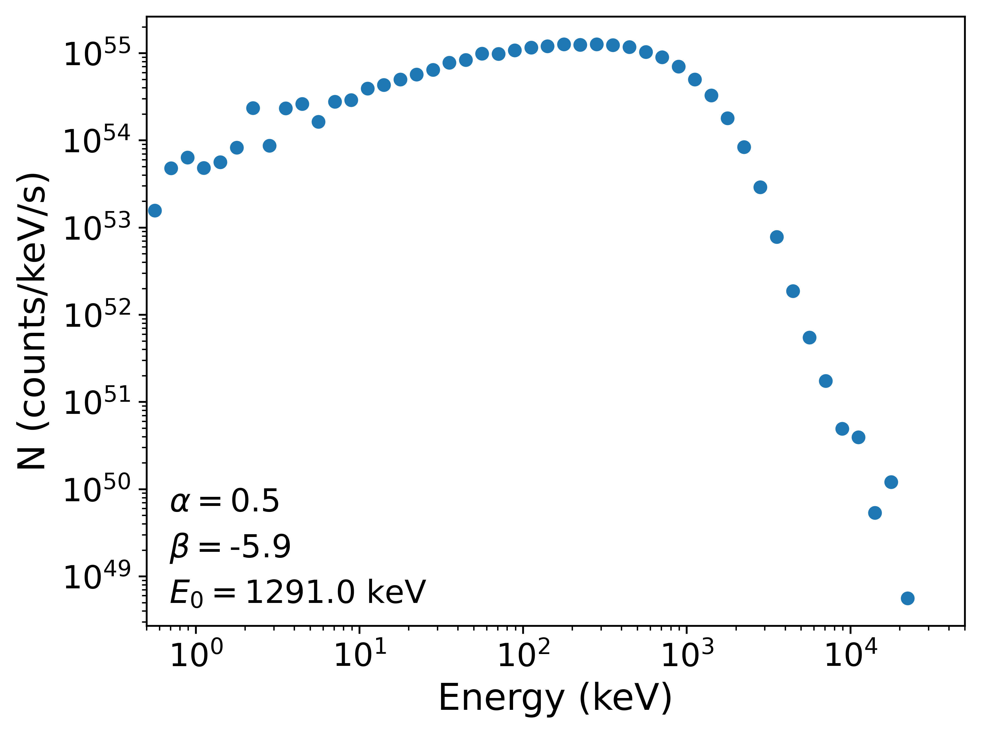
GRB Observables
Lightcurve
Spectrum

Slide 7
Modeling GRBs Involves Physics at Multiple Scales
Stellar Evolution/Compact Mergers
Compact Object Formation and Jet Launching
Jet Propagation
Radiation and Afterglow
How do we do all of this efficiently?
How do these scale?

Slide 8
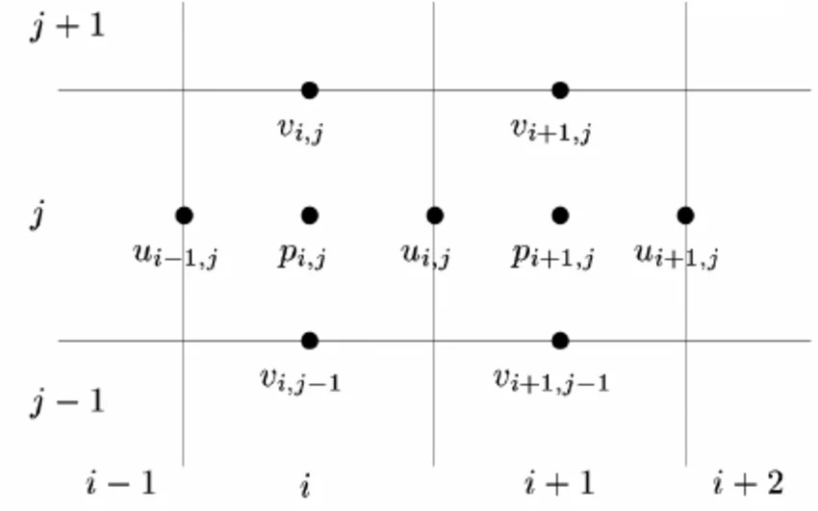




Numerical Hydrodynamics
Solve hydrodynamics on a discretized grid
$$Q^{new}=Q^{old}−\frac{Δt}{Δx}\left(F_{right}−F_{left}\right)+ΔtS_{vol}$$
Each $Q^{new}$ can be calculated independently
  Each time-step can be vectorized
$$∂_{t}Q(x,t)+∂_{x}F(Q(x,t))=S(Q(x,t))$$
$$Q=\left(\begin{aligned}q_{1} \\ q_{2} \\ ... \\ q_{m}\end{aligned}\right);F(Q)=\left(\begin{aligned}f_{1} \\ f_{2} \\ ... \\ f_{m}\end{aligned}\right);S(Q)=\left(\begin{aligned}s_{1} \\ s_{2} \\ ... \\ s_{m}\end{aligned}\right)$$

Slide 9
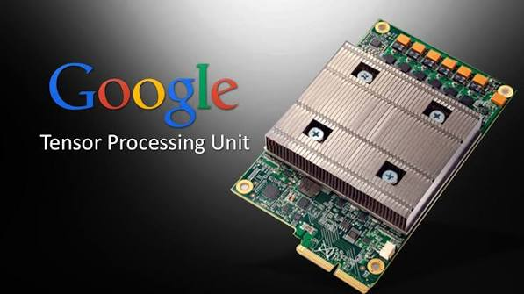
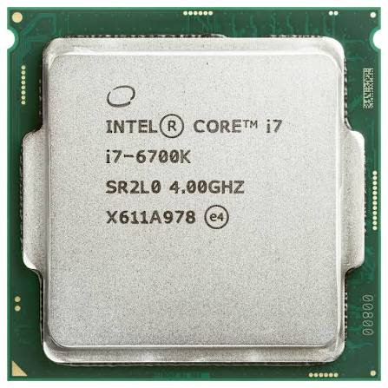
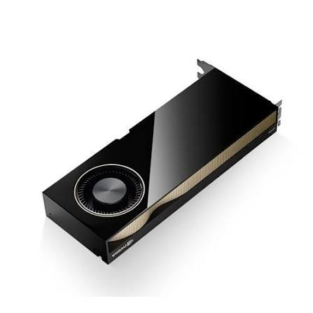
Hardware Acceleration
Run Computations on Specialized Hardware
Cut up the grid and do calculations in parallel
  TPU
    Tensor operations
  GPU
    SIMD shaders
  NPU
    Matrix operations
  CPU
    Regular computer stuff
Simulation Data

Slide 10
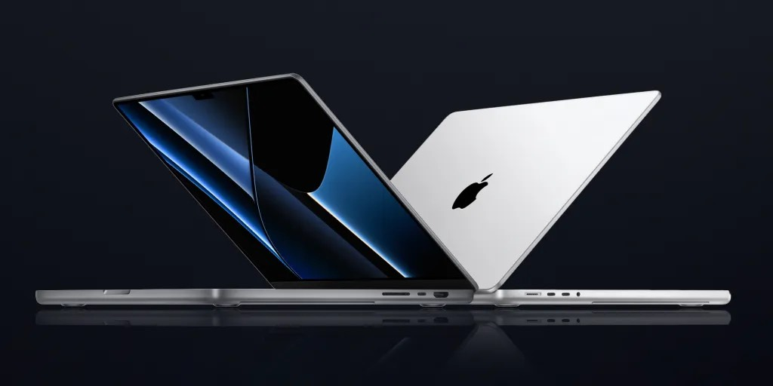

Effectively Using Resources
Scaling Up Simulations
Supercomputers and Clusters
Personal Computers
metal
cuda
mlx
mpi
openmp
jax
openacc
Apple Silicon
intel
opengl
CPU
intel
nVidia
nVidia
GPU
AMD
opencl
AMD

Slide 11
Multi-Architecture Design
Accelerator-focused vs. GPU focused
Simulation Data
Many current software is optimized for CPU or GPU
  i.e. you compile and run the entire thing on a CPU cluster or a GPU cluster
A lot of hardware has a variety of resources
  e.g. Apple Silicon:
    CPU p-cores
    CPU e-cores
    CPU vector extensions
    CPU matrix accelerators
    GPU Cores
CPU
Vector Coprocessor
Matrix Accelerator
GPU

Slide 12
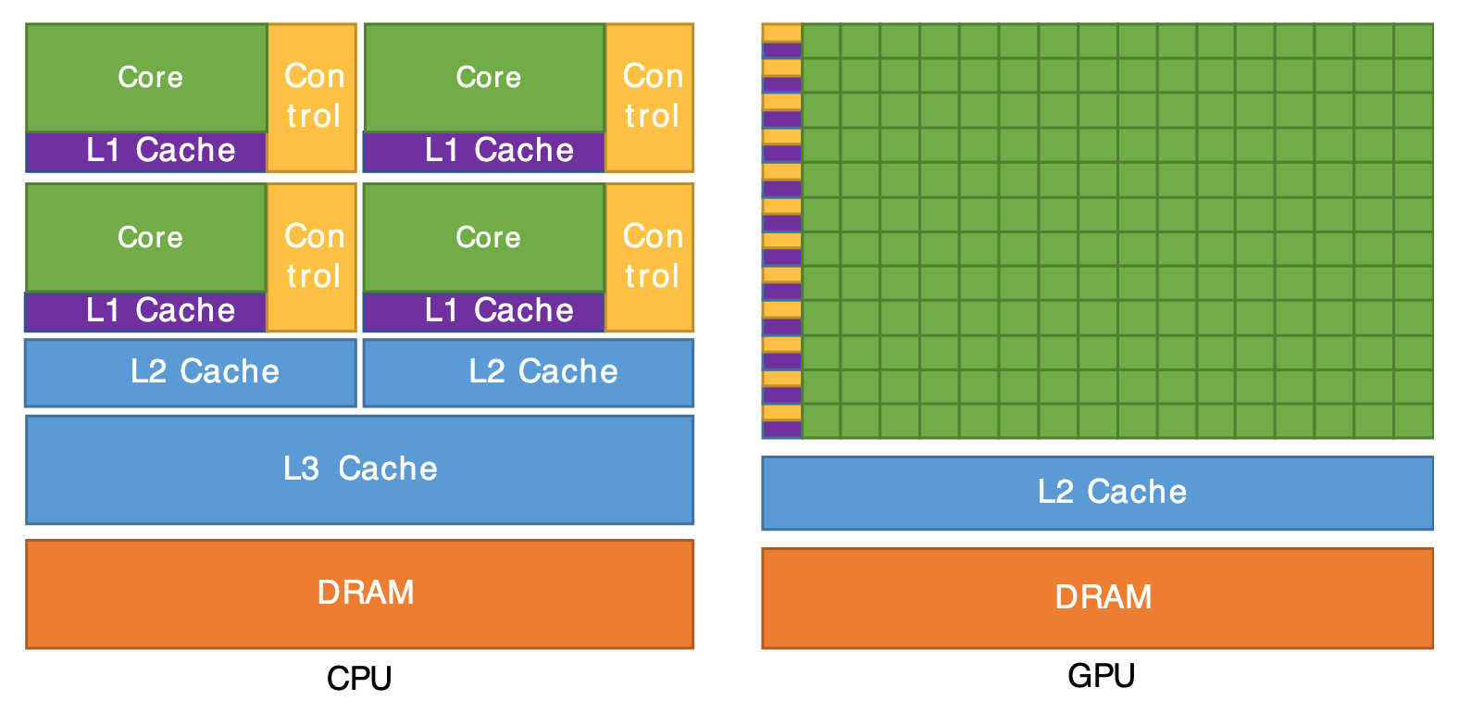
Architecture Agnostic Strategies
Which Accelerator Do We Need?
CPU cores are advanced control logic machines
  most modern CPUs also have SIMD units for vectorization
  native support for 64 bit precision
GPUs are “dumb” SIMD machines
  native support for 64 bit precision? only sometimes
    Which operations need 64 bit precision?
Hydro variables? Absolutely
AMR? Maybe not

Slide 13
Architecture Agnostic Strategies
How to implement vectorization?
Personal Computer:
  Homogenous CPU cores + GPU
  Heterogeneous CPU cores + vector extensions + GPU
Auto-vectorization: gcc -o2 or -o3
  How reliable is auto-vectorization?
  Compilers are good, but vectorizing loops is hard to automate
Explicit low-level vectorized functions BLAS, LAPACK, etc.
  cuBLAS for GPUs should make porting relatively smooth
Source Code
Compile
HPC:
  Multi-node CPU
  Single-node GPU
  Multi-node GPU

Slide 14
Conclusions
Modern GRB simulations require vast computational resources
Modern computer technologies are vast in their variety
We need to standardize software techniques to utilize different hardware/software platforms
Much of the core technology exists
We need consistency and transparency
Consider which operations need precision

