Slide 1
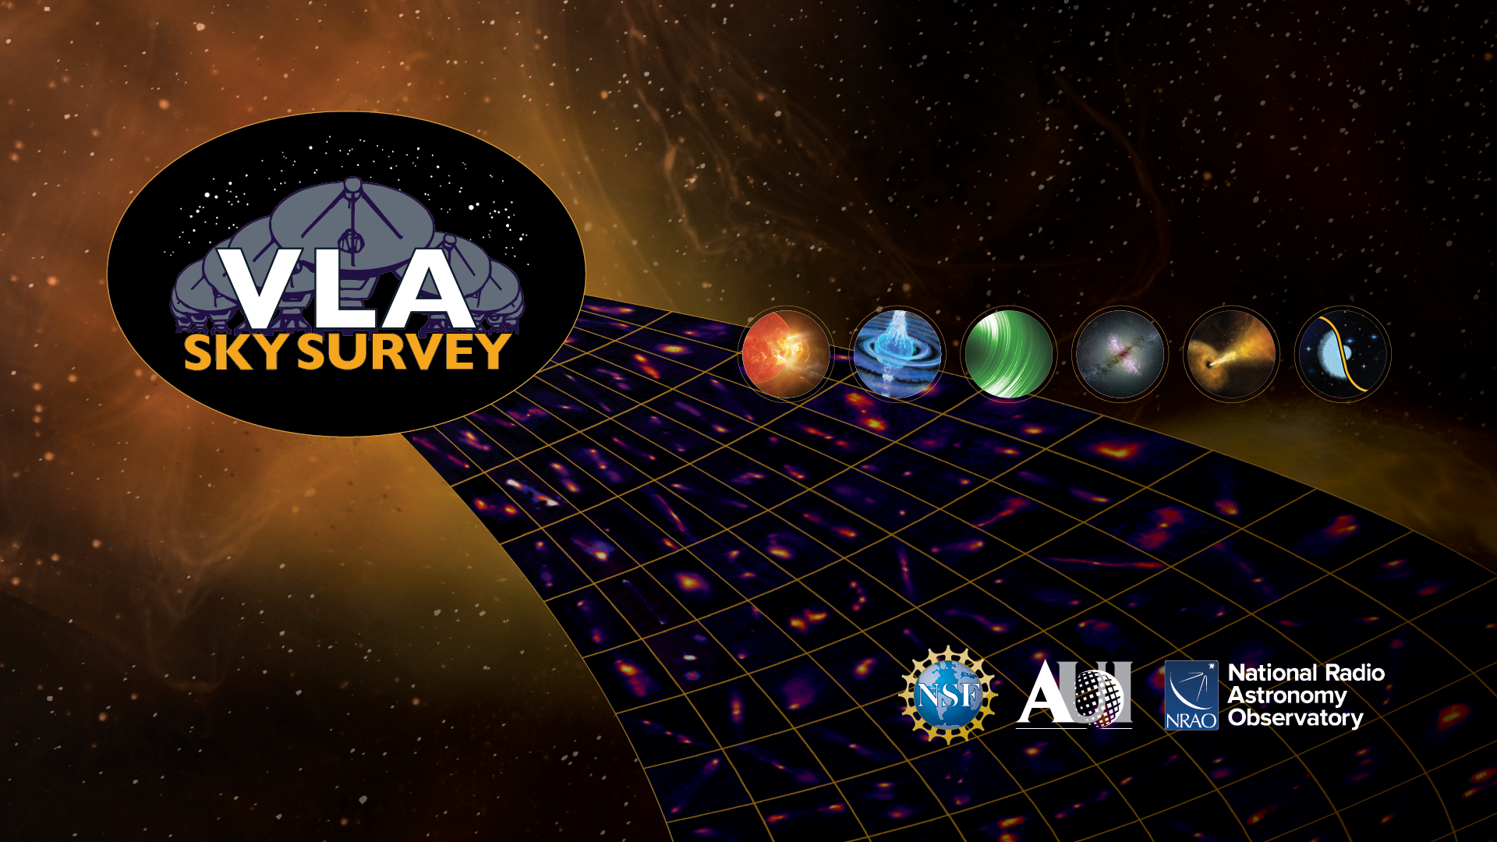
The VLA Sky Survey and multimessenger astronomy
Mark Lacy & the VLASS team

Slide 2
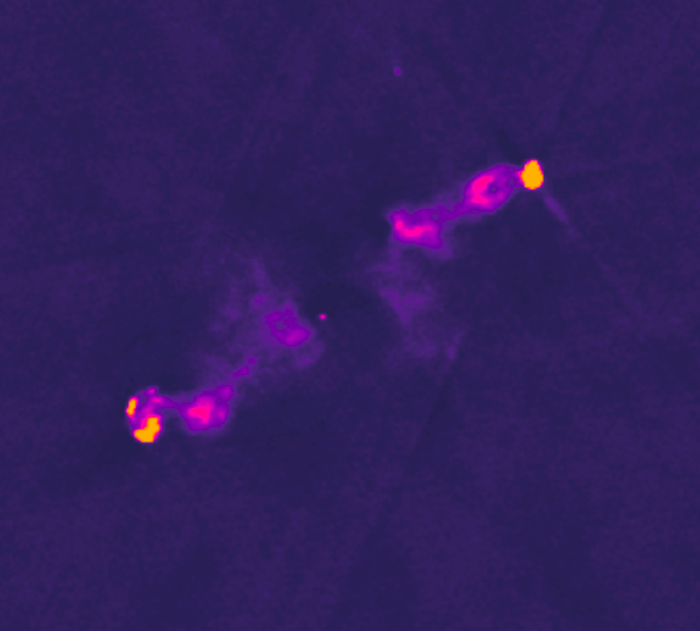
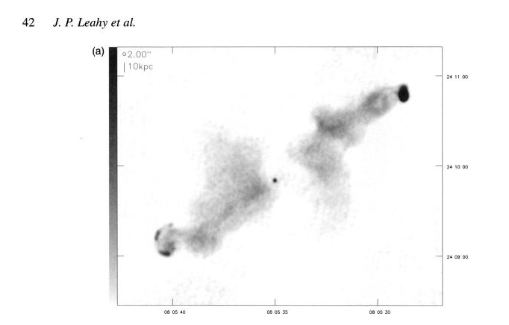

Overview
3C192 VLASS ~5s (Tasan Smith-Gandy)
Aims of VLASS:
  The Very Large Array, built in the 1970s, got a major upgrade in ~2010, allowing much larger bandwidths and thus continuum sensitivity.
  VLASS uses these enhanced capabilities to produce a survey of the whole sky visible to the telescope in the radio (2-4 GHz) that is close (2-3 arcsec) to the resolution of optical surveys.
  Include multiple epochs, a wide bandwidth and polarization information.
  Deliver images of the radio sky for use by non-expert radio astronomers.
VLA X-band ~1995;
71min (B), 17min (C), 9min (D)

Slide 3
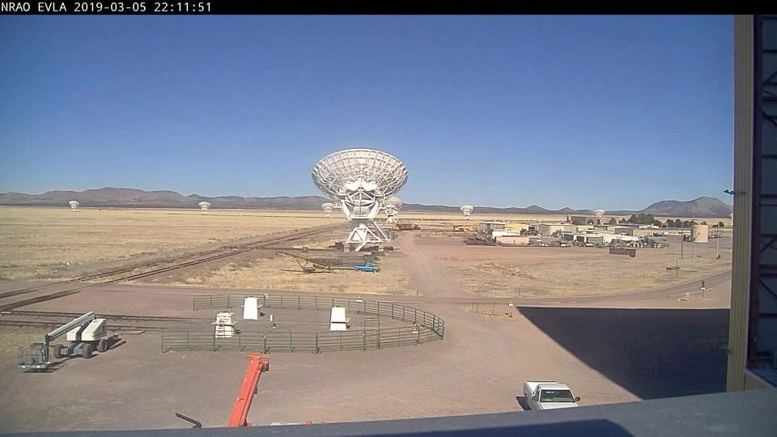
VLASS was taken in “on the fly” mode – the telescope moves in a raster pattern continuously during the observation.
(movie courtesy G, Moellenbrock).
Enables rapid coverage of the sky.

Slide 4
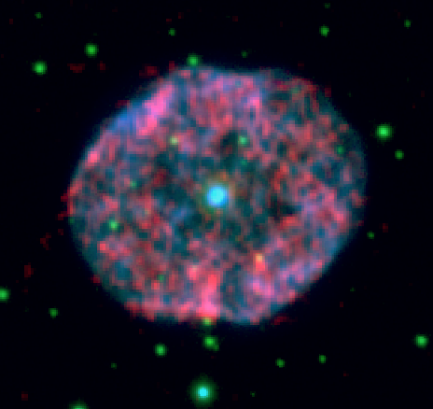
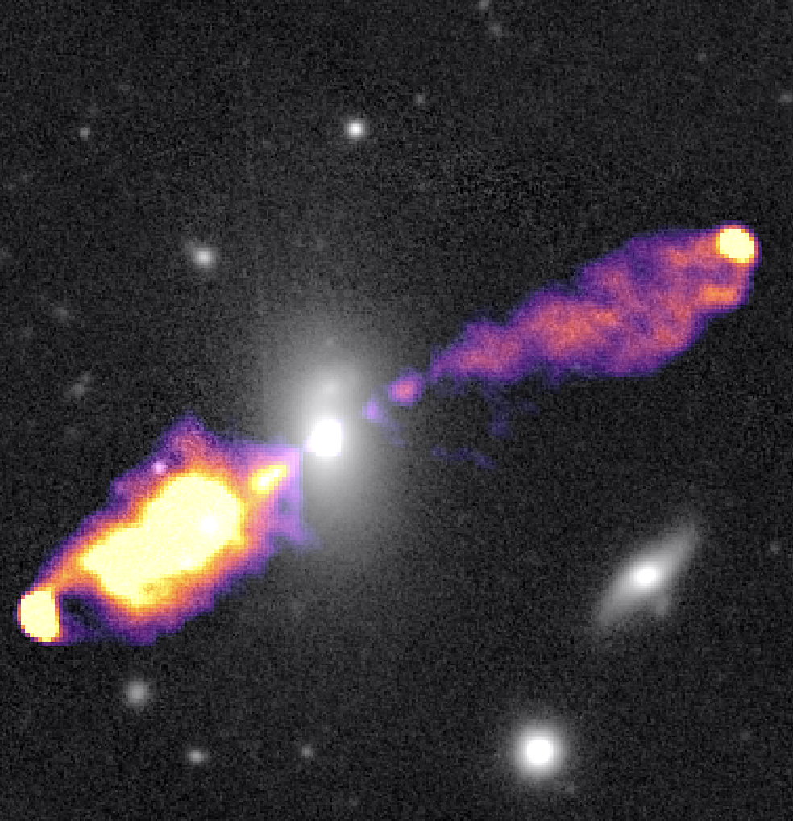
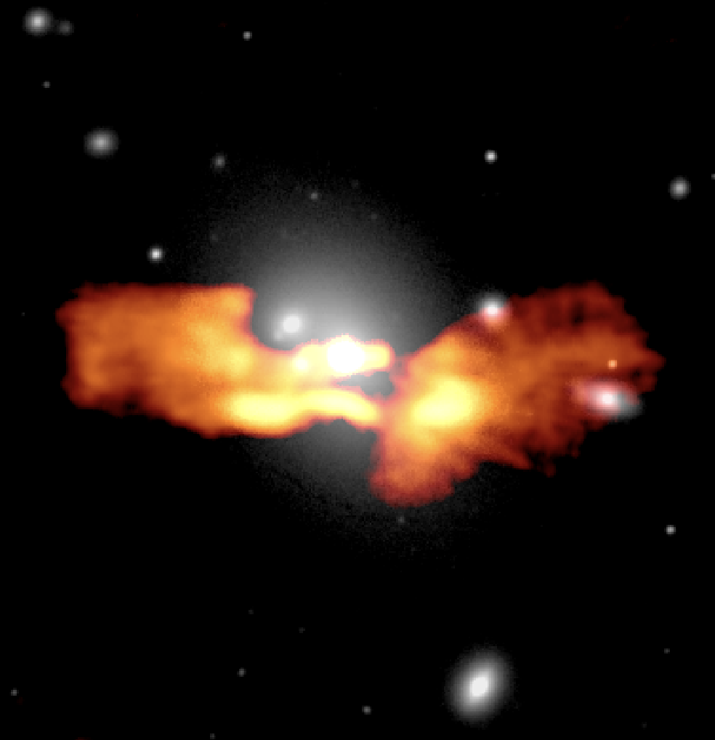
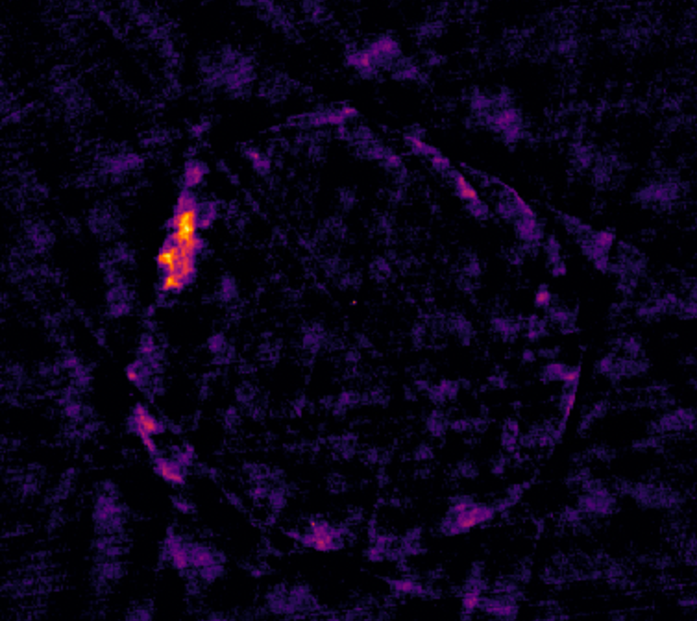
What do we see in VLASS
NGC 1555 (planetary nebula)
Radio galaxy NGC 6166
Tycho’s supernova remnant
Radio galaxy J1155+5453

Slide 5
Multi-messenger astronomy with VLASS
VLASS is most useful as a reference survey – a snapshot of the sky that can be used to compare with new data taken after an event such as a neutrino, gravitational wave or cosmic ray burst.
  New, or highly-varying objects that might be associated with such a signal can be identified.
  Higher frequency than other all-sky radio surveys.
Has also been used for statistical associations of MMA events.

Slide 6
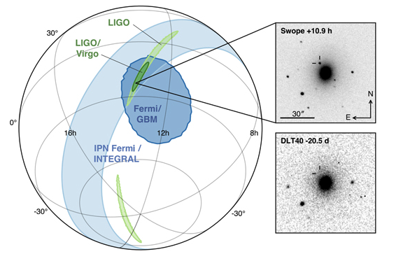
Gravitational waves
Reference survey to compare to e.g. ns-ns GW event follow-up searches.
  Unfortunately, GRB 170817A (neuton-star – neutron star merger) was only 30 microJy 40Mpc away (compared to VLASS 5-sigma ~400 microJy) so any of these would have to be within ~10 Mpc for VLASS to be useful as a reference. Also, some events may be radio-brighter.
May be able to find pulsars buried in the galactic plane for pulsar timing work.
Abbott et al. 2017

Slide 7
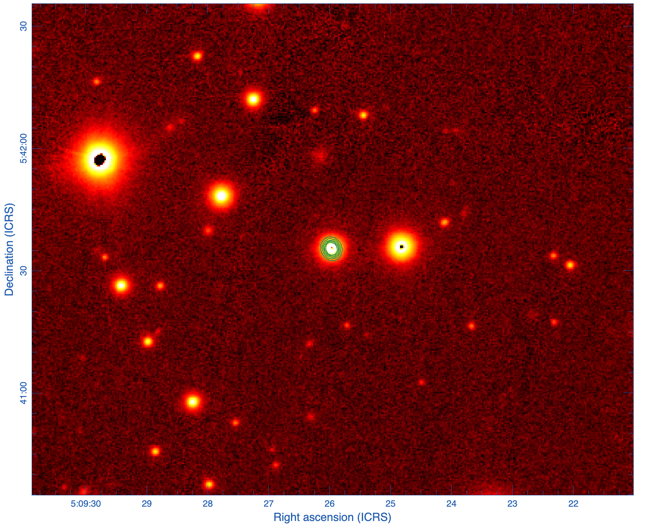
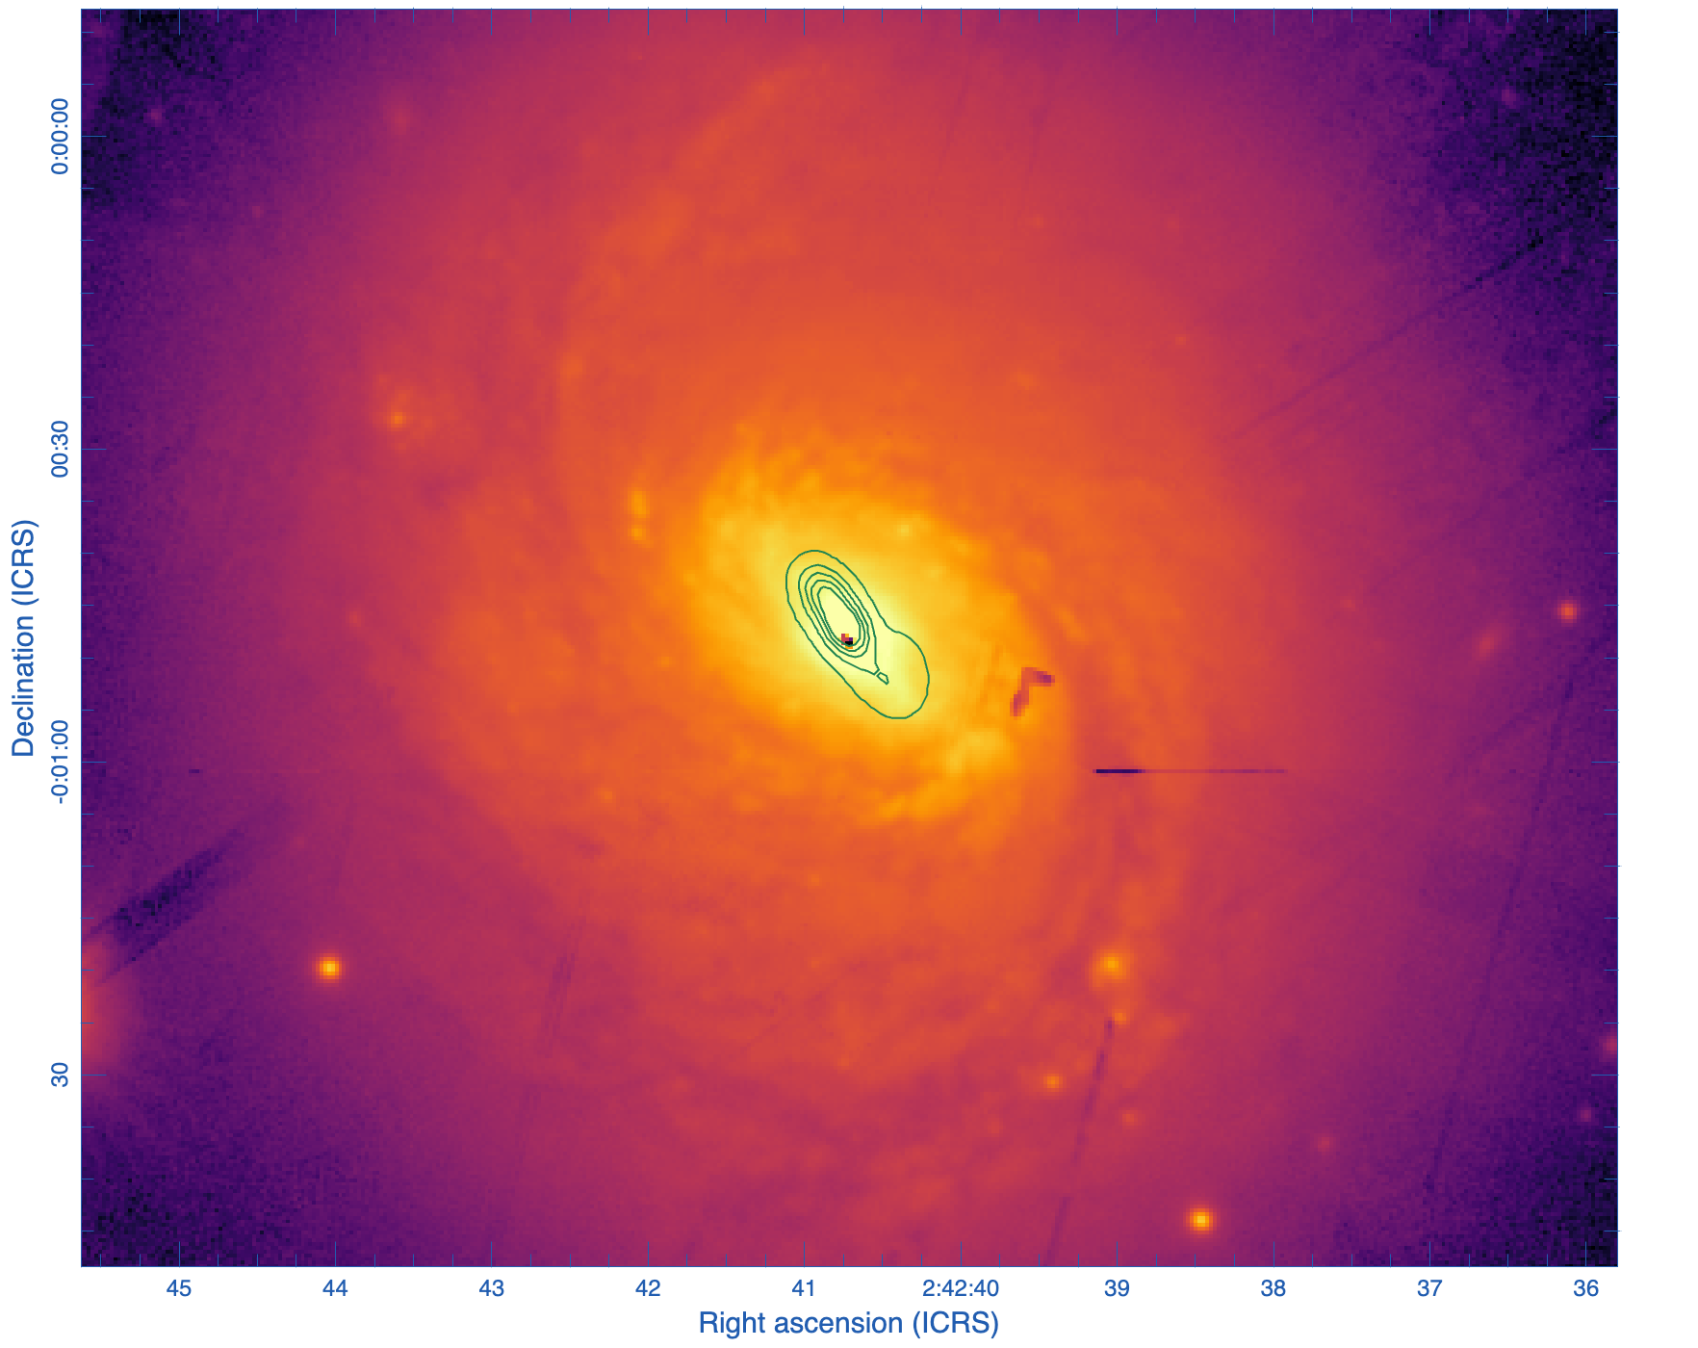
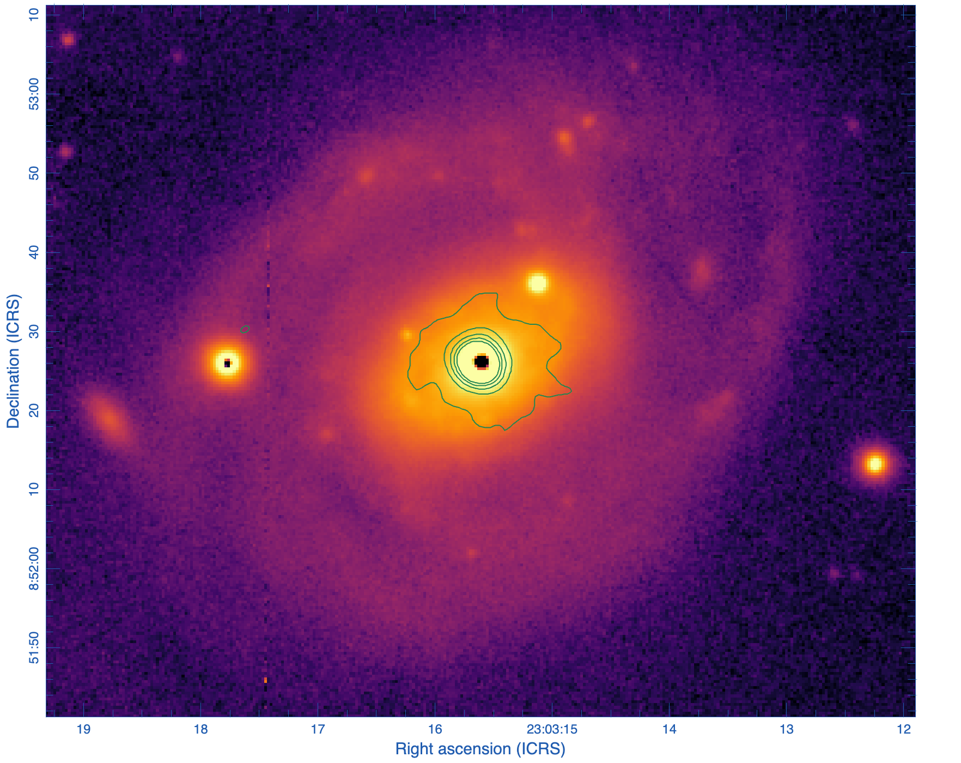
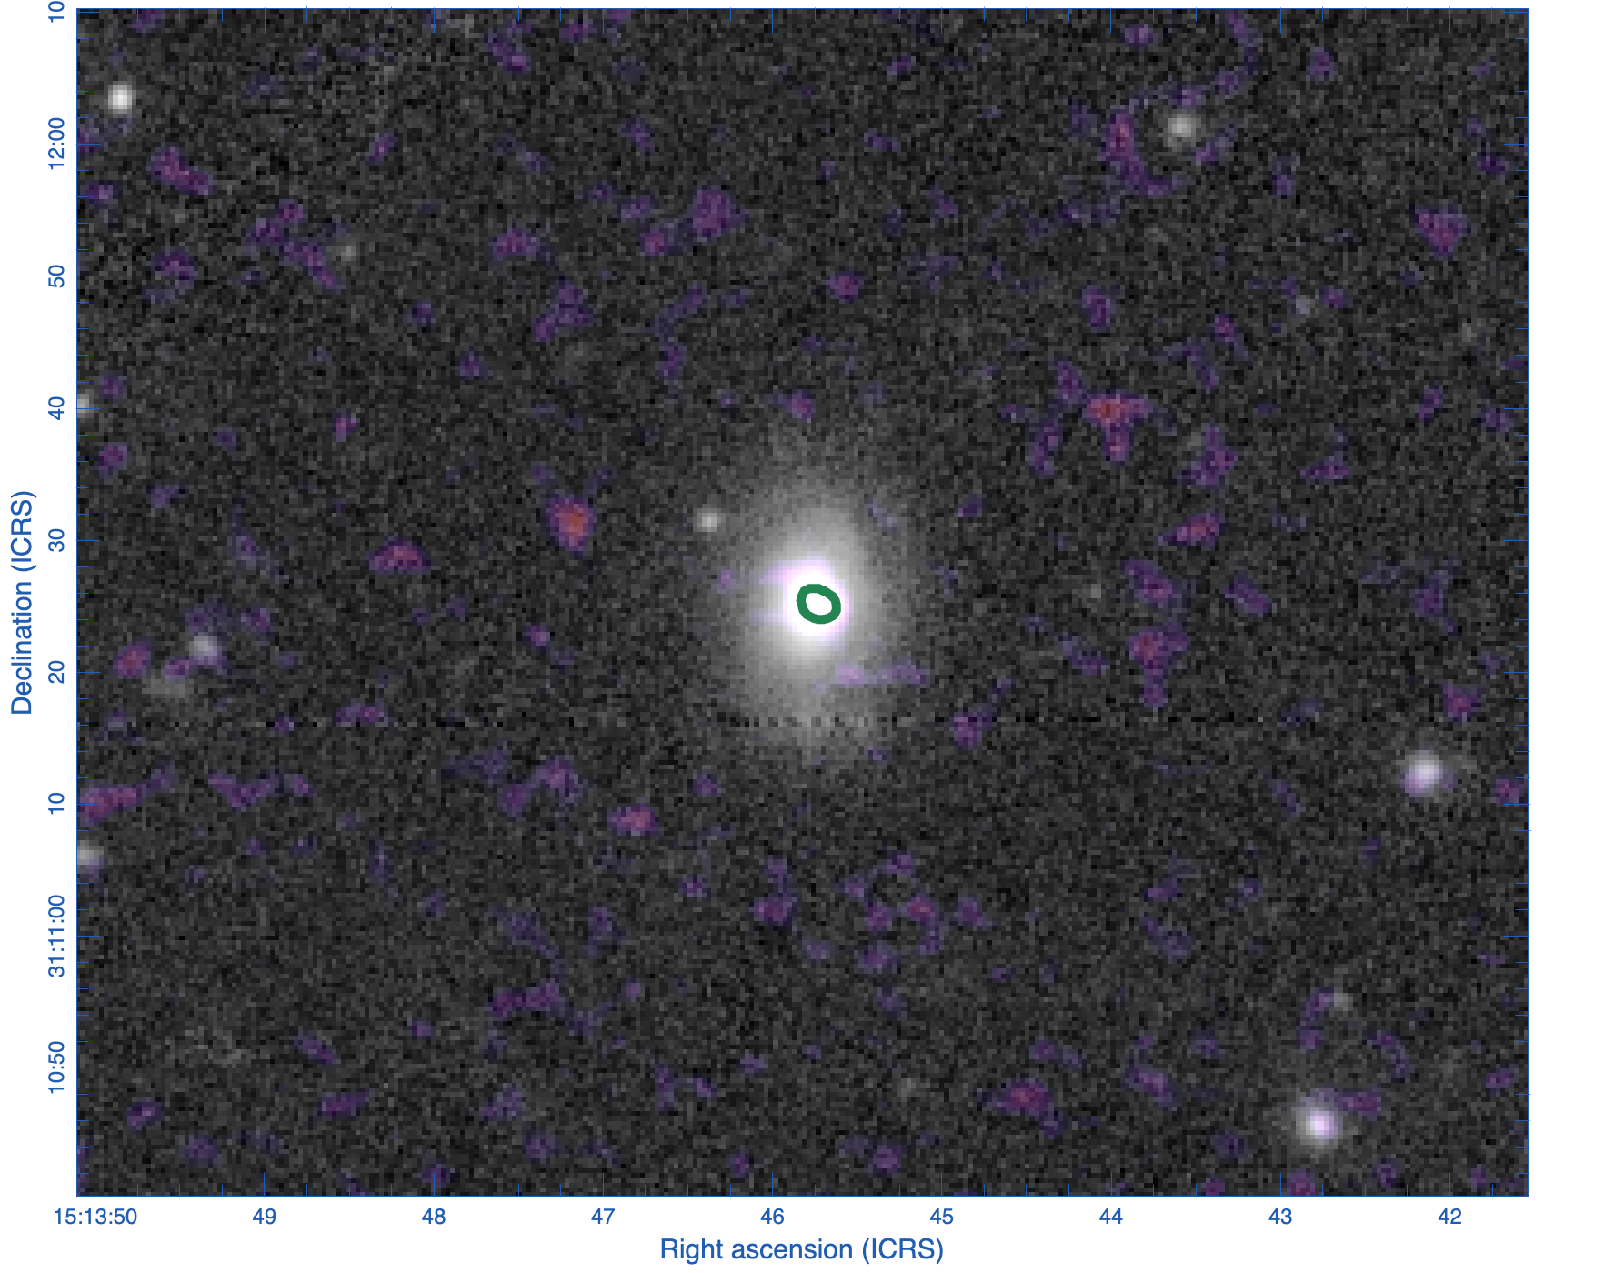
Some VLASS candidate neutrino emitters.
TXS 0506+056
Bright (2Jy) , emission
beamed towards us.
NGC 1068, bright nearby
AGN, extended, not
beamed
NGC 7469(?), nearby
AGN (2 photons)
Tidal disruption event?
(1 photon; Zhou et al. 2026)
  Typical IceCube high energy neutrino localization ~ 1 deg.
  A handful of sources have been (more-or-less) identified as candidate neutrino emitters and have a very high VLASS detection rate (though possibly biassed..)

Slide 8
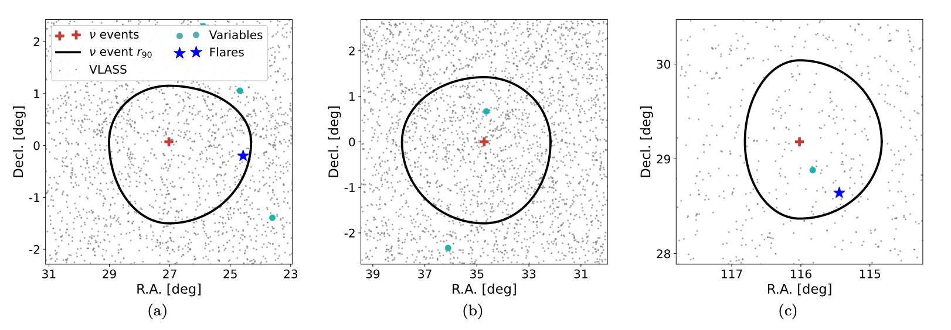
Statistical studies
Gordon et al. 2025. ~ 2-sigma association of IceCube neutrino sources with flaring VLASS radio sources.

Slide 9
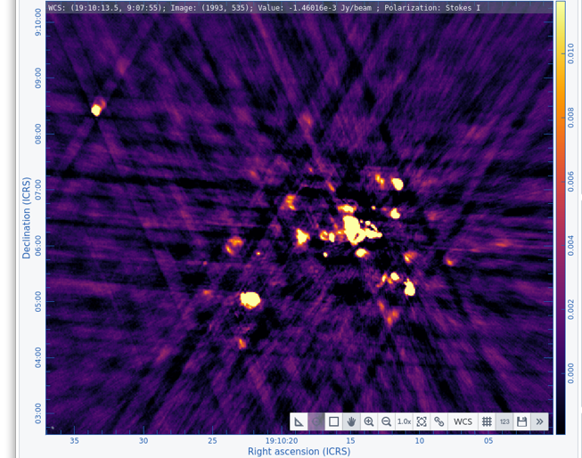
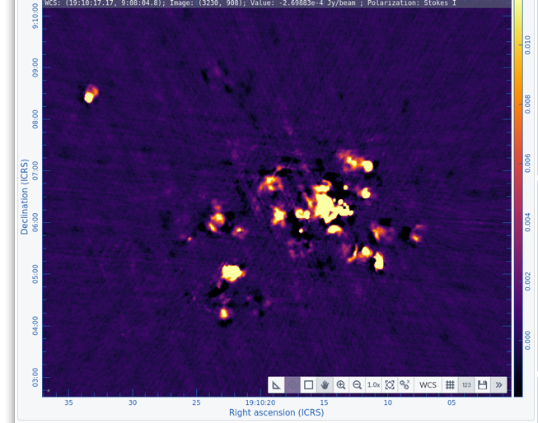
VLASS data processing
QL
“Quick Look” images were produced quite rapidly after observation (average < 2 weeks).
Higher quality images (“Single Epoch”) require much more processing.
The algorithmic and computing needs of these products have led to several year delays in making them.
Algorithmic issues now (mostly) fixed, but computing resource needs are still daunting.
SE

Slide 10
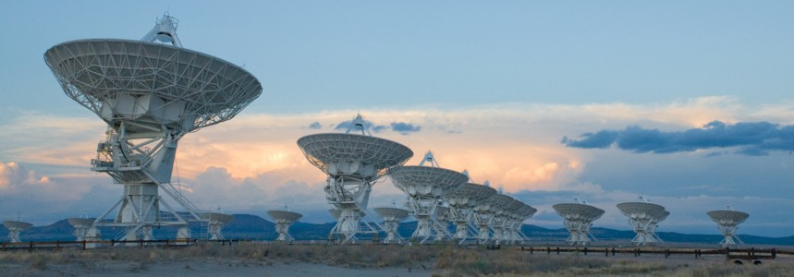

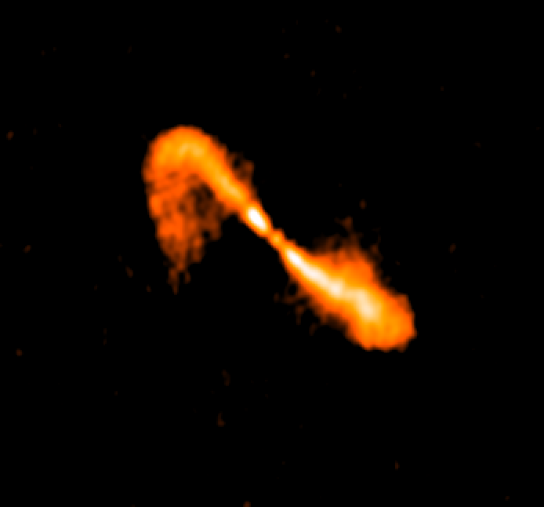
Radio interferometric imaging in one slide
Model from deconvolution is Fourier transformed back into visibilities and subtracted from data. Repeat these “major cycles” until convergence.
Signals from the VLA’s 27 antennas are cross-correlated to produce complex “visibilities” of interferometric fringes.
Major Cycle
Iteratively deconvolved in a “minor cycle”
Visibility values (phase and amplitude) are then convolved with the antenna response and interpolated onto a grid
Fourier Transform

Slide 11
Gridding
Gridding is conceptually simple, but computationally expensive.
For wide-band, wide field images such as VLASS, the curvature of the sky needs to be accounted for at low elevations, needing w-terms in a 3rd dimension (in adding to u, v in 2D), multiplies compute needs by ~x100.
GPU and parallelized CPU-based gridders take ~20-60 minutes per major cycle (with a typical VLASS image needing 50-100 major cycles (0.6-4 days) x multiple images per run.
Compared to this, the minor cycles are short (few minutes to converge per major cycle).

Slide 12
Why are VLASS (and radio interferometric datasets in general) such a bad fit to HPC?
Legacy code (CASA) was written when only small bandwidths (~100MHz) could be correlated. Did not scale well to the ~GHz bandwidths of modern facilities. More modern code is 5-10 years from production and VLA data not prioritized. Not written for parallel processing – speed up not linear with #cores. More modern code is 5-10 years from production.
A fundamental issue, difficult to overcome in any code, is the need to hold data in memory while the Fourier Transform is performed – can’t easily split the data into smaller pieces like e.g. optical detectors.
The deconvolution process is iterative, making run times unpredictable.
Need for large (~16-64GB) memory/core and long and variable run times (3-10d) make these data poor fits to traditional HPC.

Slide 13
Logistical challenges
~50% imaging jobs at NMTech
NMTech cluster (30 nodes)
Besides the amount of computation, VLASS has significant logistical challenges.
3 epochs x 35,500 images/epoch x 2 products = 210,000 imaging jobs (plus ~20% reruns).
  Data (~20GB/image, expanding to ~150GB in the pipeline) needs to be sent to remote clusters and products retrieved automatically using a workflow manager.
  Have done this with clusters we manage (DSOC & NMTech) by using HTCondor, but need to be able to use non-NRAO facilities too.
DSOC cluster (30 nodes)
VLASS manager (database & workflow)
Fully remote clusters
NRAO archive
Fully remote clusters

Slide 14
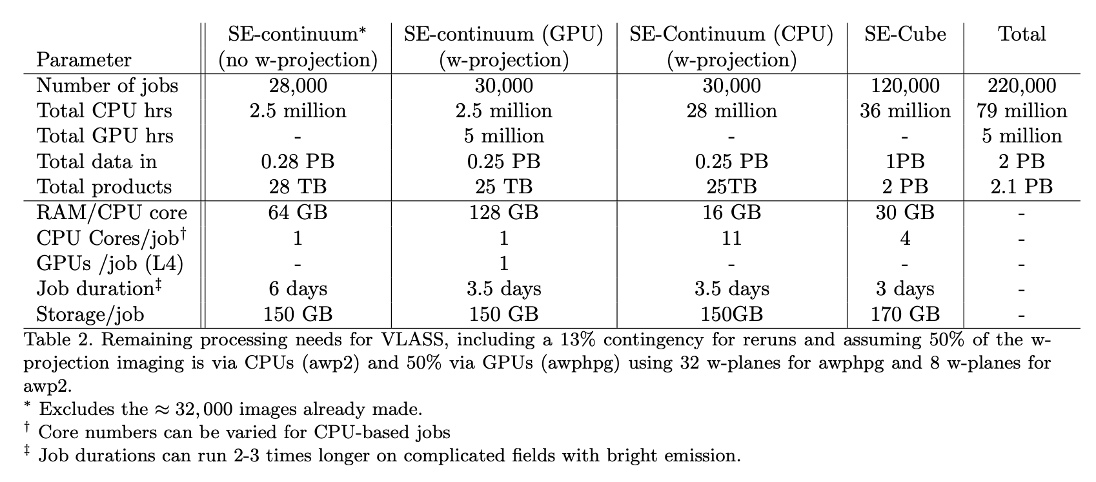
Remaining processing needs

Slide 15
VLASS and High Throughput Computing
HTC is a much better fit for VLASS than HPC.
Considerable challenges remain
  High memory/core.
  Long and unpredictable runtimes.
  Challenging logistics.
We are also very constrained with respect to available engineering effort at NRAO to help with data management and logistics.
Nevertheless, we are very keen to work with the CHTC!

