Slide 1




June 11th 2026
Thursday
OSG
Security
Team

Slide 2

Because you're tired of hearing about AI
= AI

Slide 3



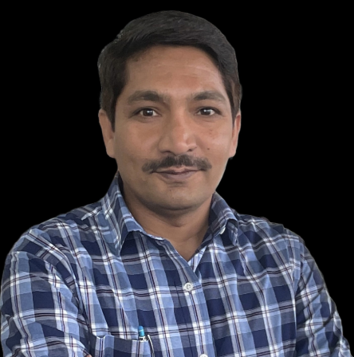
OSG Security Team
Mark Krenz
Adrian Crenshaw
Megha Moncy
Vishal Singh Bhardvaj
(Team members from IU)

Slide 4
Responsibilities
Scanning for vulns
Finding vulnerabilities relevant to the OSG consortium
Threat Intel
Monitoring emerging threats and security advisories
Community
Supporting security discussions in Slack, Ops meetings,and PATh weekly meetings
Security coordination with HTCondor, Pelican, LHC, and community services
Helping teams understand risk and prioritize fixes
Weekly Nessus scanning of OSG-managed infrastructure
~180 hosts monitored
Coordination with service owners on remediation
CVEs reviewed: 100+ per day
Deep-dive analysis: 150+ (2025), 170+ (2026 YTD)
Communications sent: 22 (2025), 43 (2026 YTD)

Slide 5


Slide 6
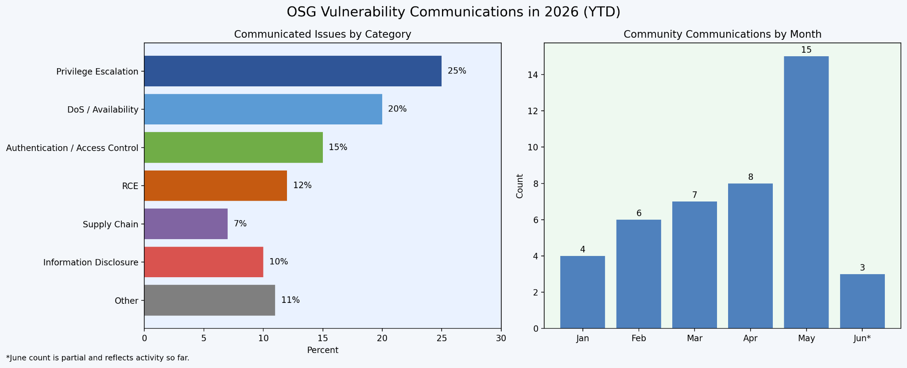
Threat Intelligence Communication
\

Slide 7
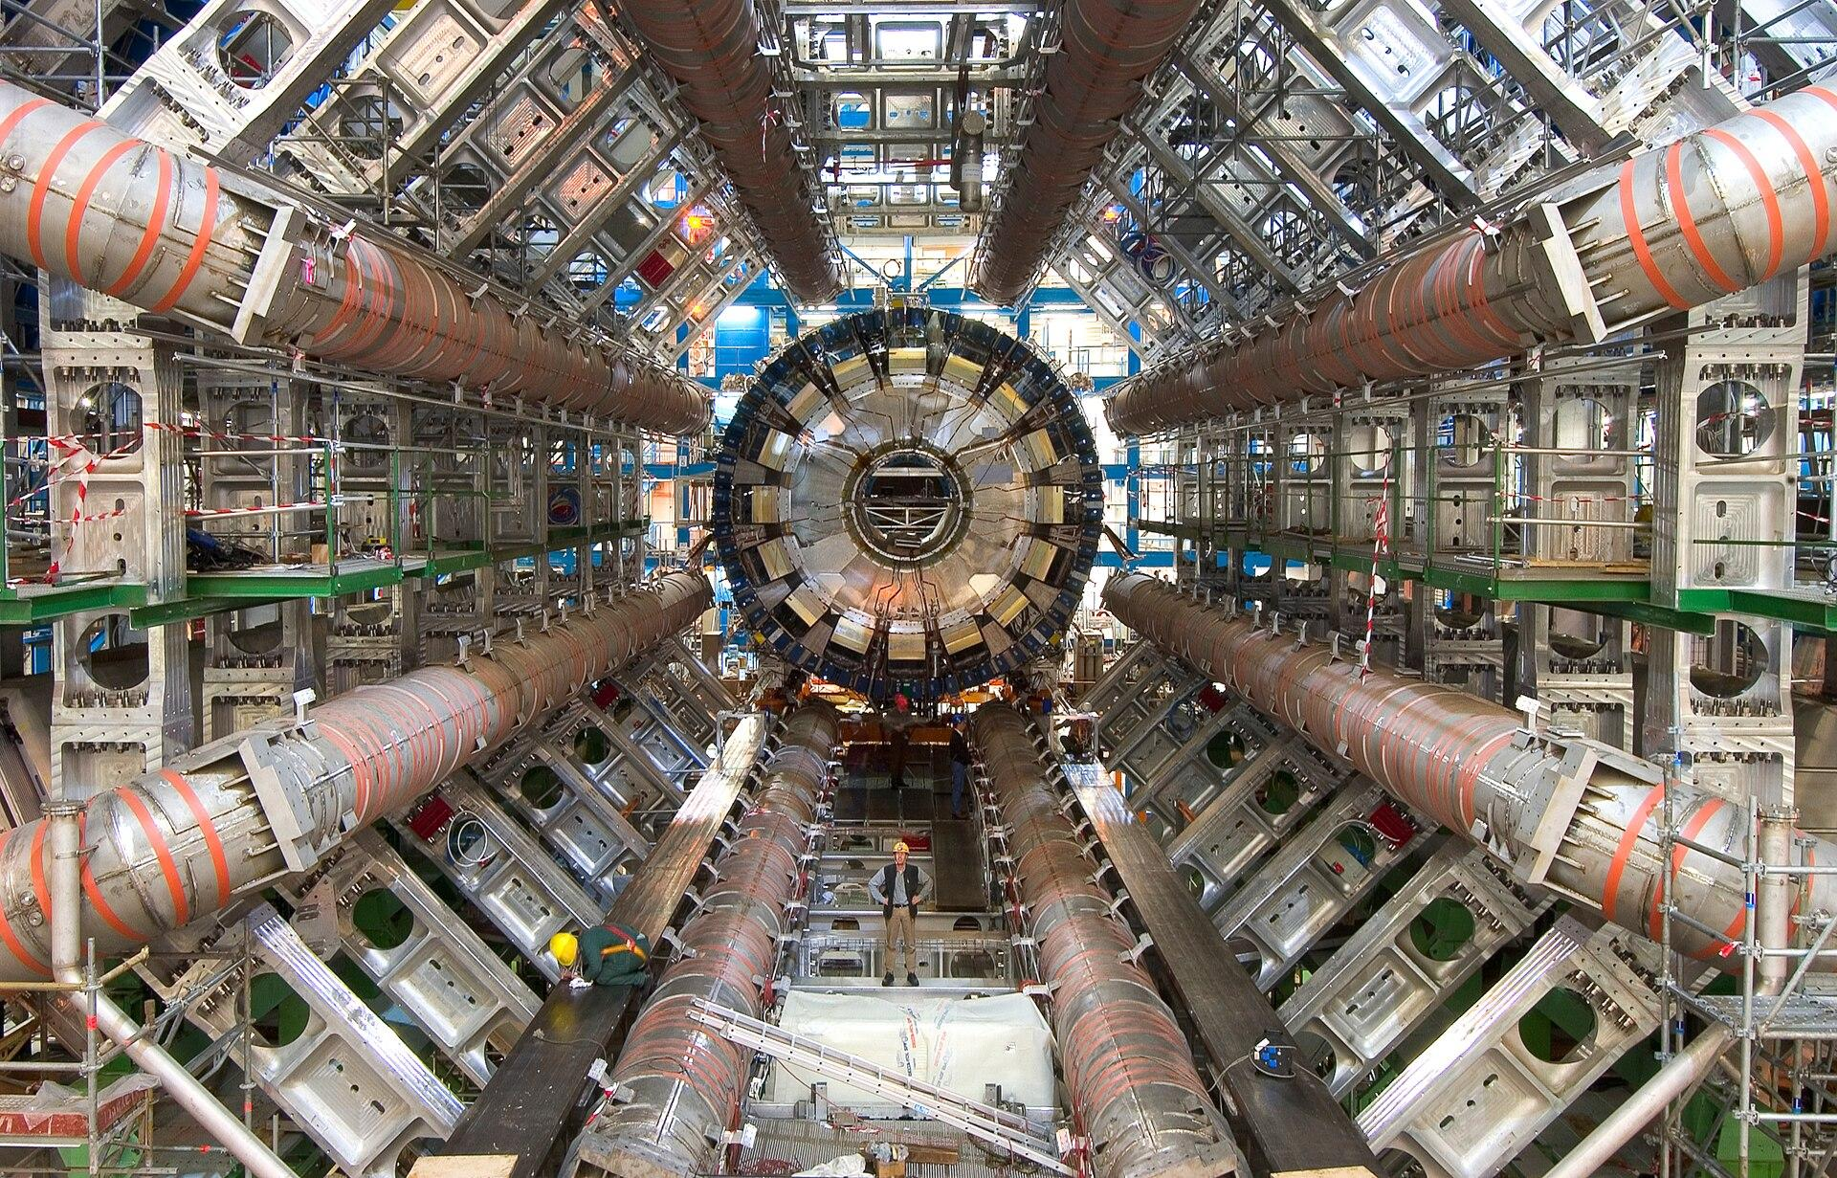

Security Exercises -
Communication & Coordination
Scope: LHC US Tier 2 sites for
ATLAS and CMS
Conducted a series of lightweight security exercises to validate secure comms
Observed response patterns.
Identified opportunities to improve
Next exercise planned for 2H 2026

Slide 8
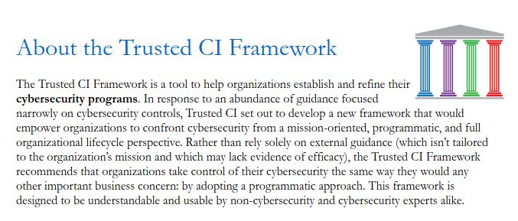
Future endeavors
Continue existing vuln scanning, vulnerability curation and announcements
Continue providing advice to rest of OSG team
Facilitate more security exercises
Evaluate OSG security program against the Trusted CI Framework

Slide 9
The AI Era
Current state of AI
Capable of more advanced and automated attacks as well as discovering new vulnerabilities. Some that humans might not have discovered
Super AI (Mythos)
Reported to be capable of finding zero days within minutes. Could flood the community with more critical vulns than we can handle.

Slide 10
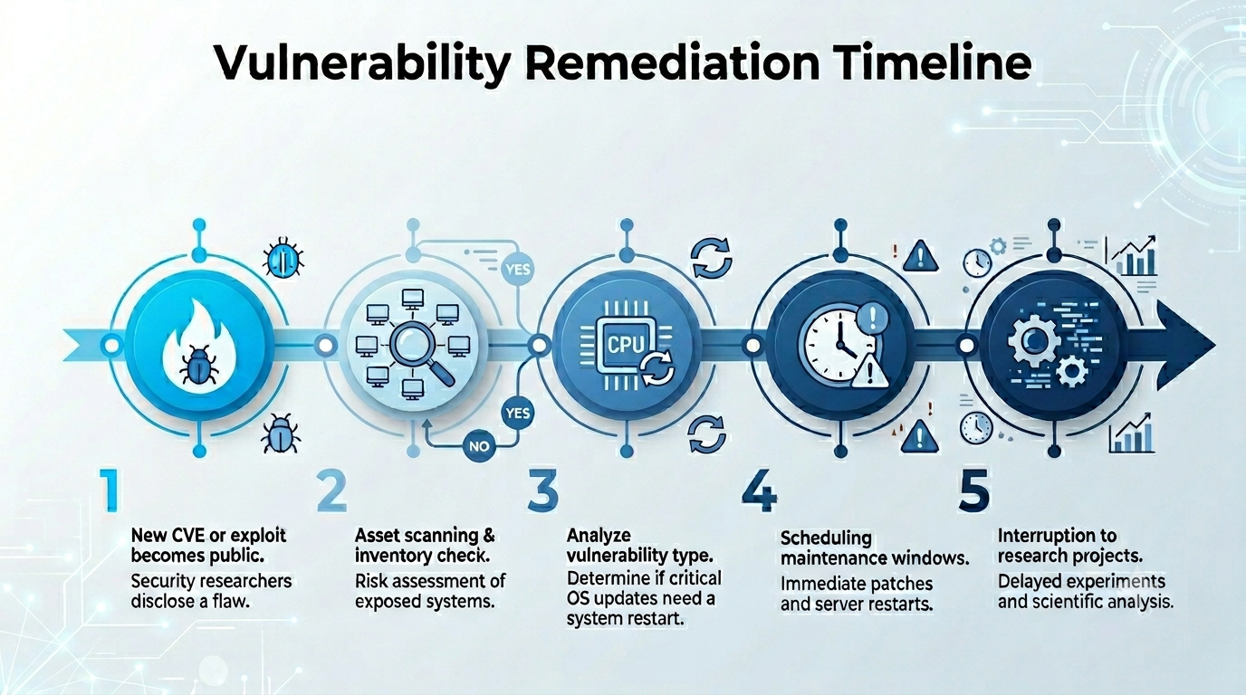
Typical remediation cycle

Slide 11
Kernel vuln patching usually requires a reboot = Downtime

Slide 12
Historical context to show how this risk has crept up on us.

Slide 13
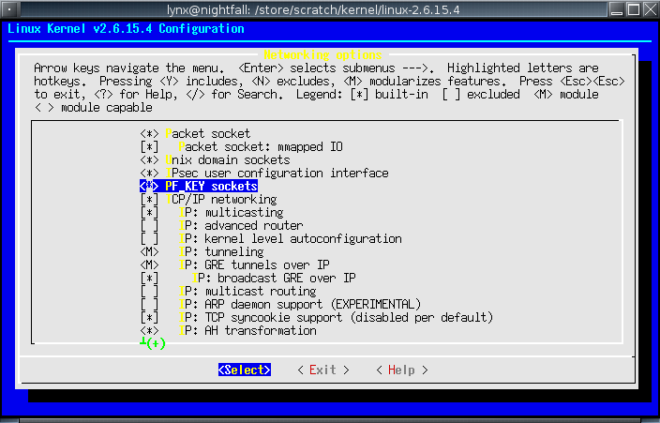
Linux make config (old)

Slide 14
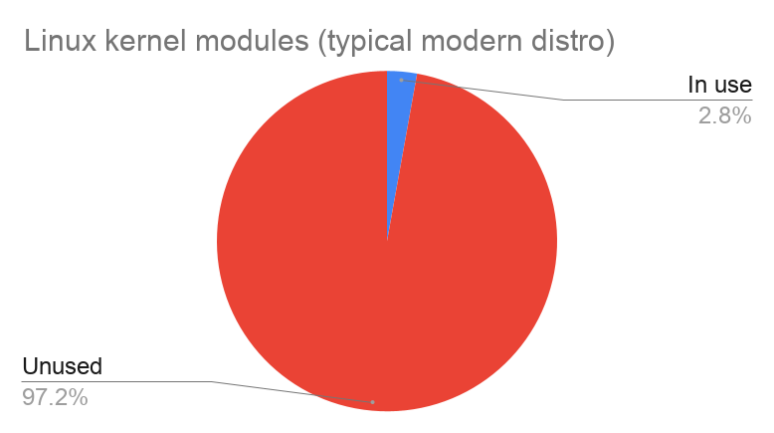
Kernel modules are attack surface
Attack surface of thousands of modules

Slide 15

Default deny policy
About 95% of kernel modules go unused
That's a huge attack surface
Maybe we could block them
One and done config

Slide 16
Tools that can be used
/etc/modprobe.d/*
ModuleJail
Modprobe-DB
Text config files
Standard interface for controlling module loading
Once hardware and use cases are stabilized, it rarely changes
Saw recent use for DirtyFrag and CopyFail vulns
https://github.com/jnuyens/modulejail/
Shell script that scans running modules and denies the rest
Still requires one time curation
https://github.com/graysky2/modprobed-db
Service that logs modules used during boot & runtime
Might catch some extra temporarily used modules

Slide 17
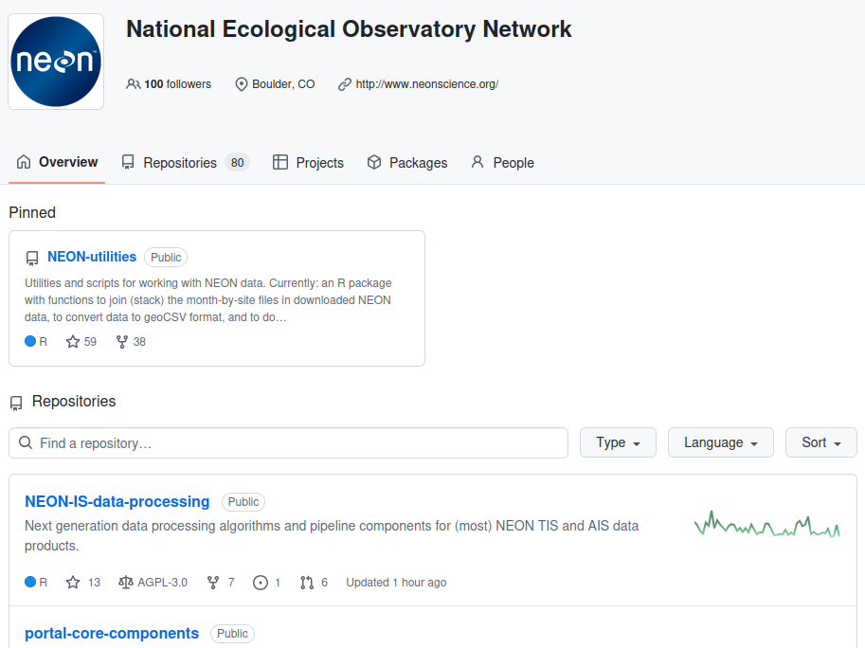
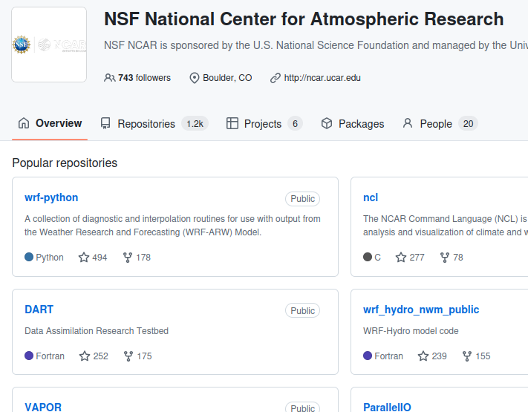
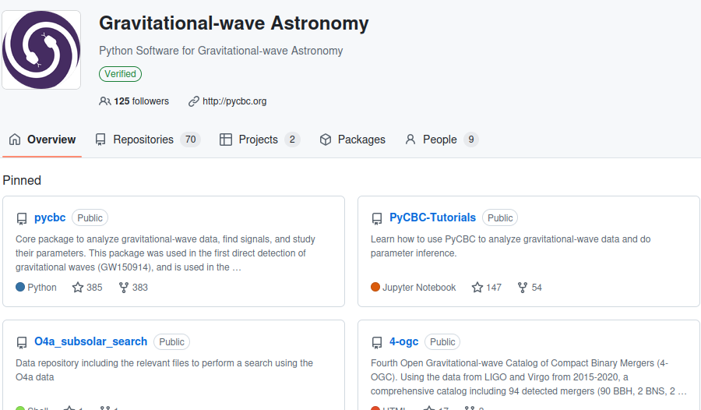
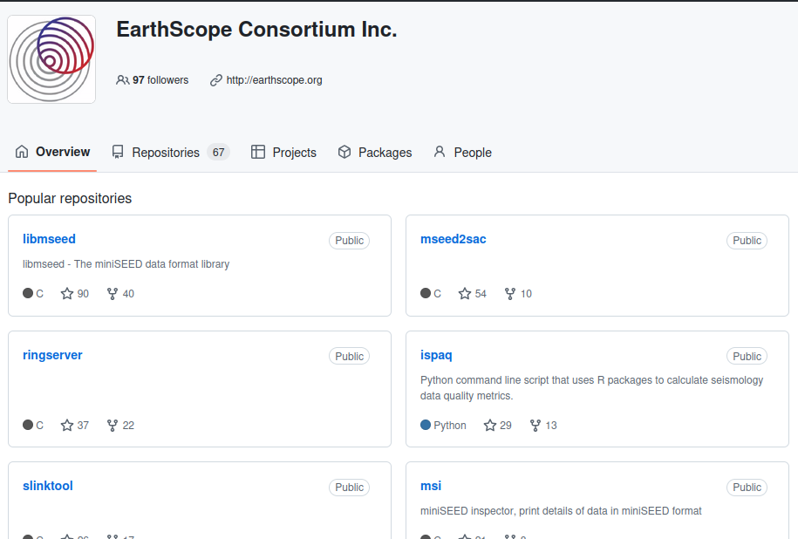
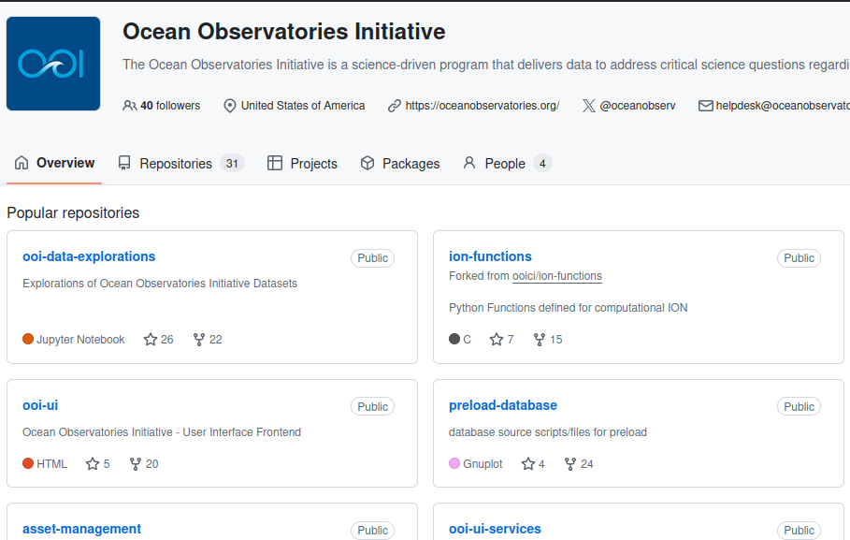
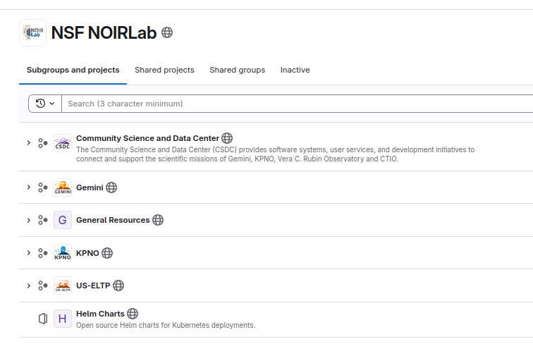
Bigger picture: Science at risk

Slide 18
Once in a generation risk
Science projects deliberately expose a lot of code and data (ie. Github, downloads, datasets, etc.)
AI-enabled vuln discovery may be pointed at science code
Super AI is on the horizon, which is maybe already here as of this week, is feared to find more as well as more complex vulnerabilities
Similar to the challenge of Y2K
Opportunity for NSF or government to step in and offer emergency response center for Science projects

Slide 19

Q&A
?

