Slide 1
Trends in campus resource planning and resource sharing
Throughput Computing 2026
Preston Smith, Ph.D

Slide 2


Slide 3
Production Function - Purdue
Institutional productivity as a function of research computing investment
Study of 20+ years of Purdue: each increment of capacity or people corresponds with an increase in output of:
Input | Publications | Earned Doctorates | HERD Expenditures ($M) | High Impact Publications
100 TeraFLOPs | 20.59 | 2.44 | 2.62 | 5.42
$100k Salaries | 137.25 | 9.43 | 12.55 | 20.19
Relative importance of factors in the model predicting:
https://doi.org/10.1007/s42979-024-02888-0
 | TF | Salaries | Other Factors
Publications | 29% | 65% | 5%
Earned Doctorates | 36% | 58% | 6%
High Impact Publications | 35% | 61% | 4%
HERD Expenditures | 32% | 63% | 6%

Slide 4


You might have questions
Does this apply at places other than Purdue?
Great question – just need as many institutions as possible to have 10-20 years of historical data about their centers.
Thanks to colleagues who were willing to share data:
  Jill Gemmill (Clemson)
  Dave Hancock and Winona Snapp-Childs (IU)
  Brian O’Shea (Michigan State)
  Jim Wilgenbusch (Minnesota)
We learned several things:
https://doi.org/10.3389/frma.2025.1449996

Slide 5
Production Function – Now with 5 R1s
Institutional productivity as a function of research computing investment
Study of 5 R1s over 10-20 years each: each increment of capacity or people corresponds with an increase in output of:
Input | Publications | Earned Doctorates | HERD Expenditures ($M) | High Impact Publications
100 TeraFLOPs | 24.63 | 1.56 | 3.10 | 4.47
$100k Salaries | 134.97 | 7.68 | 14.46 | 20.78
In some cases, the directional relationship is even stronger than original work!
Relative importance of factors in the model predicting:
https://doi.org/10.3389/frma.2025.1449996
 | TF | Salaries | Other Factors
Publications | 14% | 40% | 46%
Earned Doctorates | 9% | 25% | 66%
High Impact Publications | 15% | 40% | 45%
HERD Expenditures | 19% | 45% | 36%

Slide 6
What we learned - Historical Growth Trends
Looking ahead
Across the surveyed institutions, HPC capacity saw CAGR of 41% since 2011
  Almost Moore’s Law
Demand and usage track this as well
Knowing this curve, can we use it to project what we will need in the future?

Slide 7
Capacity Forecasting
Example - Purdue
I can combine what the growth curve suggests a then-$800M institution needs
With the actual resources we operate, and see how we stack up.
And if we become a $1bn+ University, the curve just shifts upward

Slide 8
Institutional Benchmarks
How do we know the right size of a campus CI?

Slide 9
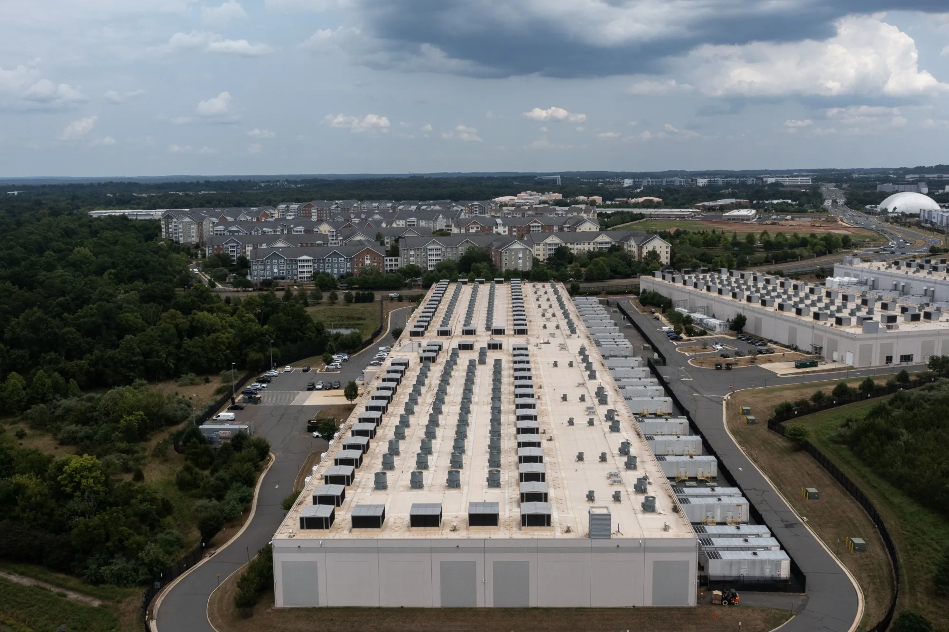
If you ask your stakeholders these days how much compute they need..
You probably hear some variation of “all the GPUs”.
Or if state policymakers or university admin talk about AI computing
Not so hot take - Capacity planning in the age of is not a fully baked science

Slide 10
Survey
Can I start to build out the dataset I wished I had earlier?
Request:
2024/25 HPC capacity in TF
  Institutionally funded/operated (excluding externally oriented systems like ACCESS-allocated ones)
Most recent general funded staffing levels for HPC operations
  Grant-funded staff excluded
  RSE (recharge) staff excluded
  Staff that might happen to report under research computing that do something else excluded
Benchmarks:
Avg TF per Respondent | 8,700
Avg RCD Salaries per Respondent | $1.98M
Avg FTE per Respondent | 19.85
Avg TF Per $1M HERD | 11.47
Avg Salary as % of HERD | 0.29%
Avg TF per Phd | 19.65
Avg Salary per PhD | $4,696
Institution sizes range from < $200m to $2bn expenditures – average of $870m
243PF in total reported

Slide 11
Results….
With approx 30 institutions…

Slide 12

Investment as a Function of Research Output
If outputs are a function of TeraFLOPs of capacity and the human capital needed to deliver it..
Can we invert the function and identify our system and people needs based on the magnitude of our institution’s production?
(The drivers of demand)

Slide 13
Compare to Reality
Example – Purdue
Salaries
HPC Capacity

Slide 14
Data Tables
Staffing Budget Model
Expenditures
Doctorates
Where does your university sit?
System Size Model
Expenditures
Doctorates

Slide 15
Knowing the Aggregate Size We Need,
How do we design and capacity plan our deployments?

Slide 16
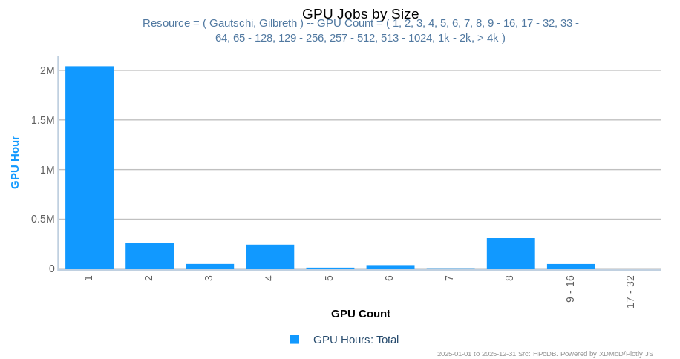
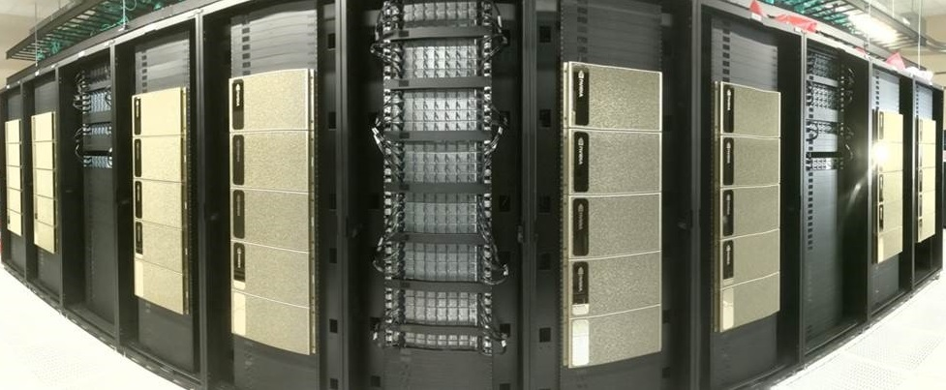
Our Observations of Usage Patterns
At Purdue…..
What the market wants to sell
What our usage looks like

Slide 17
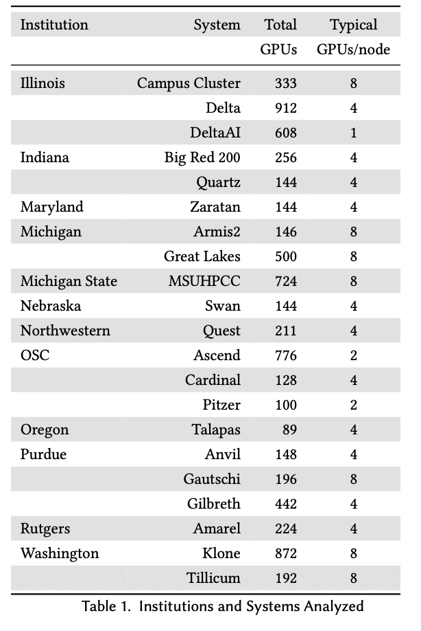

Makes Me Wonder
Is it just us?
In hallway chats, our observations sound similar to others, but no data exists….
So 12 Big 10 institutions pooled 21 machines’ 2025 usage data to see what trends we can find.
(14M+ jobs!)

Slide 18
Questions to Answer
Based on Academic Workloads
Is Purdue weird?
Can we all save money on interconnects?
Can we all save money on NVLink?
What is a sweet spot for a system design?
Watch for a deeper dive presentation at PEARC this summer!

Slide 19
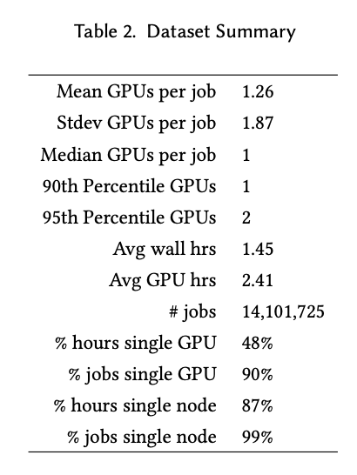
The Dataset
14M+ jobs

Slide 20
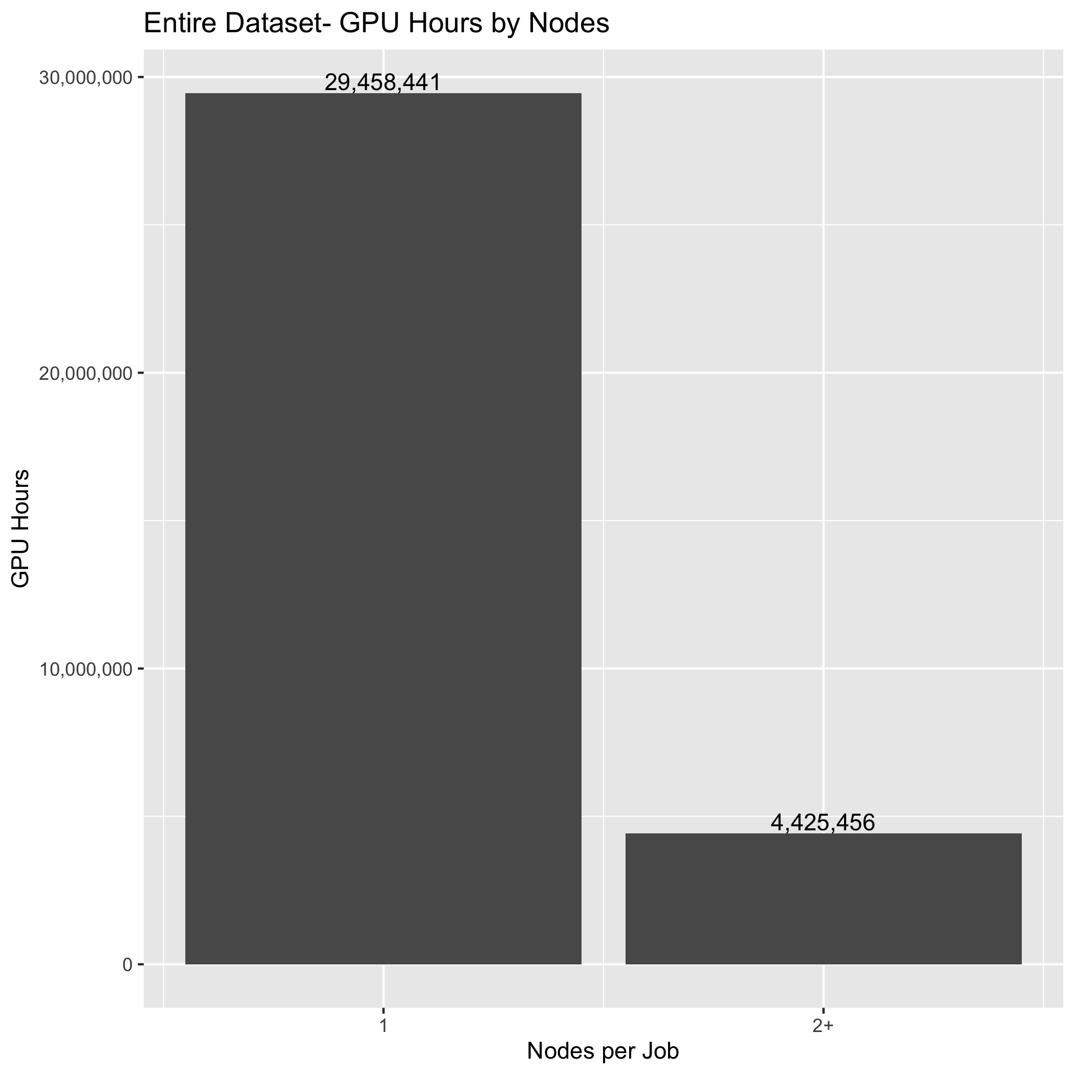
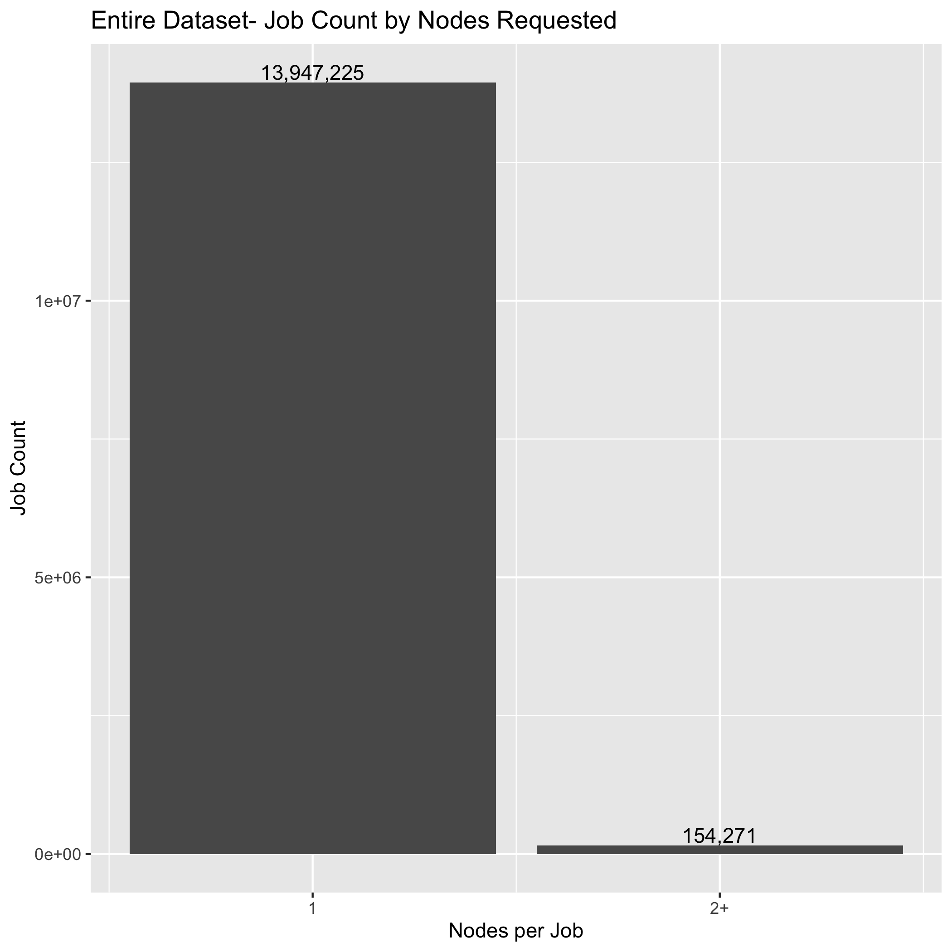
How important is a full non-blocking network?
~ Half are Delta AI’s 1 GPU/node Grace Hoppers

Slide 21
% of jobs run by job size (Institution-Level)

Slide 22
% of GPU hours by job size (Institution-level)

Slide 23
Side Effect
Fresh Data for Establishing Size Requirements, with an AI focus
 | 2024 | 2026
Avg FP64 per Respondent | 8,700 | 8,350
FP64 Per $1M HERD | 11.47 | 8.05
FP64 per PhD | 19.65 | 13.06
AI TF Per $1M HERD |  | 344.2
AI TF per PhD |  | 532
GPUs Per $1M HERD |  | .58
GPUs per PhD |  | 1
Institutions | 29 | 12

Slide 24
Zooming Out
Can we capacity plan at the ecosystem scale?
2023 HERD reported 108.7bn of expenditures from 914 institutions
Based on HERD, the model predicts 1.25 EF of FP64 capacity and $315M of people needed to support that much expenditure
Leadership Class
ACCESS/NAIRR
Campus HPC Centers
Desktop/Lab
NSF-funded on campus
Future- State/Regional
Just 6.67 PF and $1.69M of salaries per R1
4.25 EF
2 Surveys: ~8.5 PF and $1.98M of salaries average
.087 EF
If all 187 R1 institutions operate the surveyed average of ~8.5PF,
R1s alone already have 1.6EF of computing. The real total is likely higher.
???
.15 EF
NSF CC* + MRI funded capacity is .1 to .15 EF out of the 1.6 EF likely in operation on campuses today.
1.25-
1.6 EF
At the top end, NSF and DOE leadership class systems for open science total 4.25 EF of capacity. In the middle, however, the 7 NSF ACSS category 1 systems offer .087 EF of capacity to the entire nation.
4.3 EF

Slide 25
All of this Has Happened Before
And it will all happen again
I look around my campus, and there’s still plenty of DIY AI
  Inventory suggests maybe 500 GPUs in ECE and CS
Platforms like DGX Spark put Blackwell GPUs in a $4k package.
Purdue is rolling out 150+ DGX Spark around campus - in computer labs, and is ”beowulf”-ing a group of them for instruction
I now have a desire to harvest those GPU slots….

Slide 26
Tie it all together..
We’re here to talk HTC, right?
HW vendors want to sell AI factories to our states and campuses
My hot take: the key aggregate target metric is GPU count, not raw performance (within reason)
We hear anecdotes about AI sector utilization percentages
  I think an 80% utilized academic cluster is pretty typical
7600 GPUs among 12 universities, suggests that any given time, we have 1520 GPUs available
And academic GPU workloads look very HTC to me, and well-suited for opportunistic access
So - Action Time!
Should I turn on a 700+ GPU HTCondor pool at Purdue?
We are looking harder at arrangements to share resources
  Cycle sharing/allocation agreements between large peers?
  Offer internal recharge rates to smaller neighbors?
  Contribute more to OSPool?
    Push our PIs to OSPool?

Slide 27
psmith@purdue.edu

