Slide 1
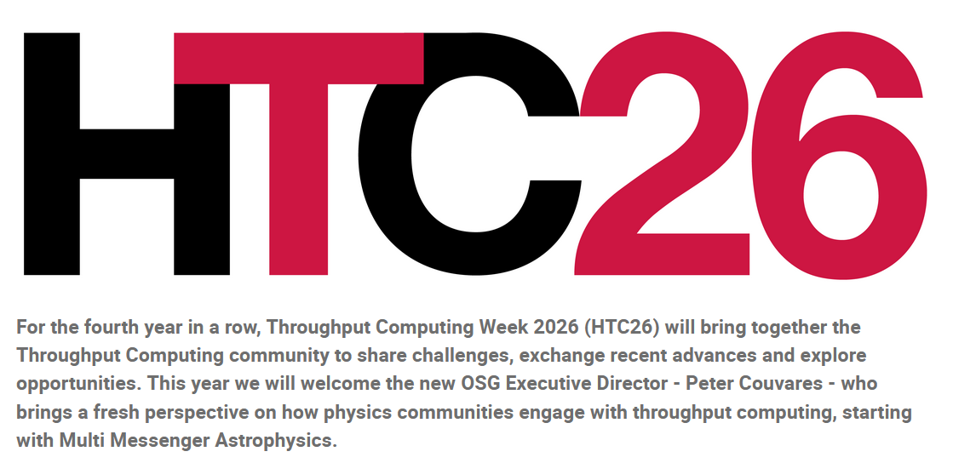
Welcome to
HTC26
Madison, WI
June 2-6, 2025

Slide 2
More than 110 in-person attendees
More than 270 remote registrations
More than 70 remote international registrations

Slide 3
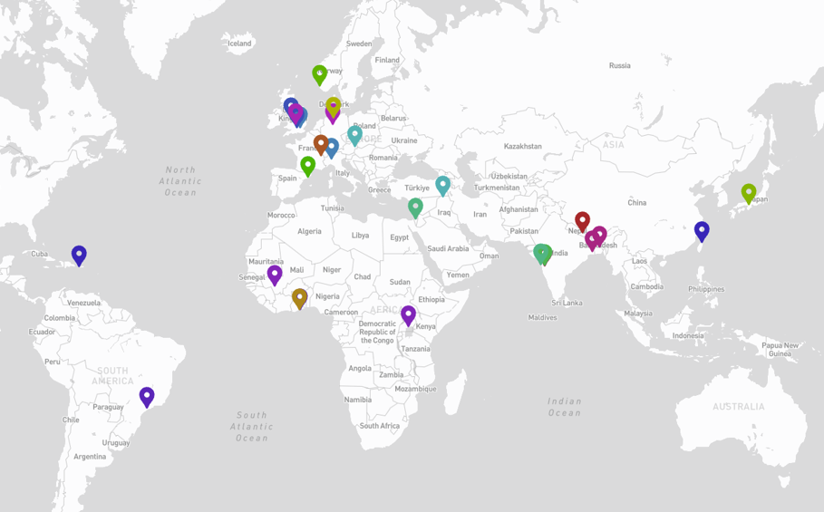
27 International institutions

Slide 4
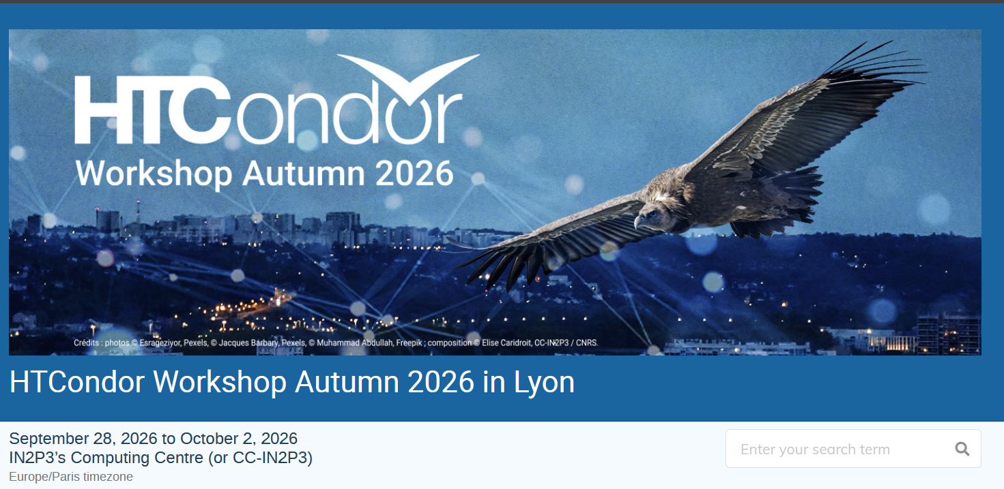

Slide 5
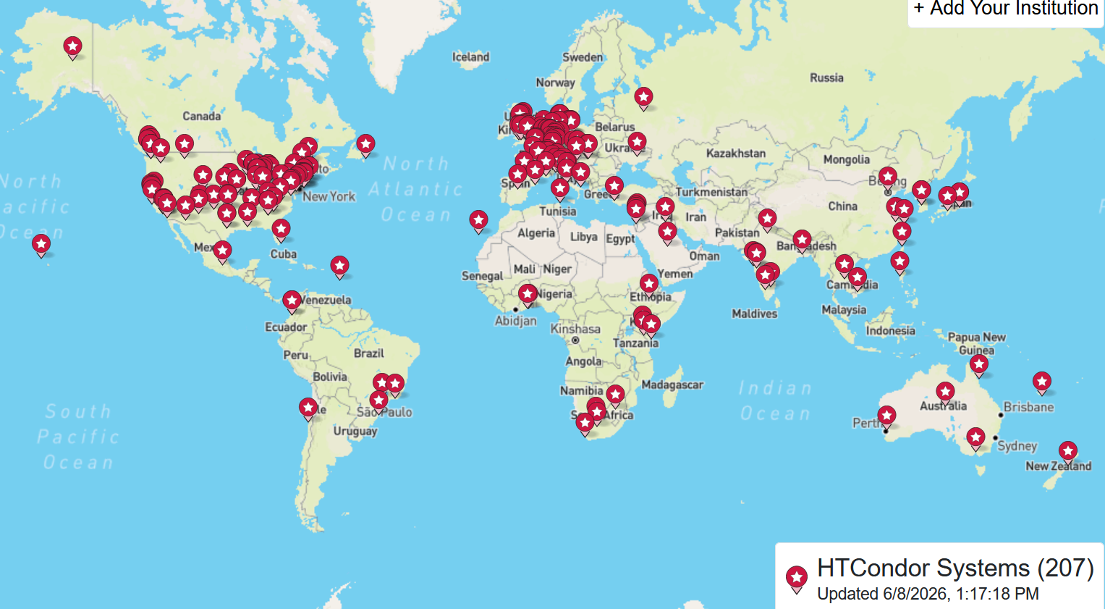

Slide 6
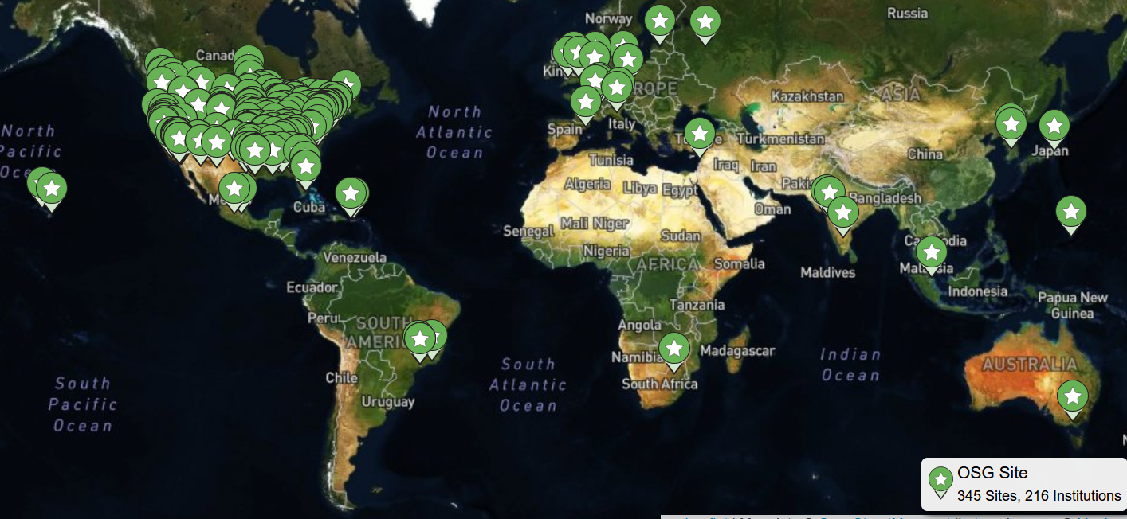

Slide 7

Thank you for joining us
Together we build a thriving
Throughput Computing community

Slide 8
TT&T –
Transition,
Trust, &
Throughput
Miron Livny
UW-Madison Vilas Research Professor
John P. Morgridge Professor of Computer Science
Director UW Center for High Throughput Computing
Technical Director of the OSG Consortium

Slide 9
Transition
(and Expemsion)

Slide 10





41 years of (HT)Condor
6 years of PATh
3 years of Pelican
21 years of OSG

Slide 11
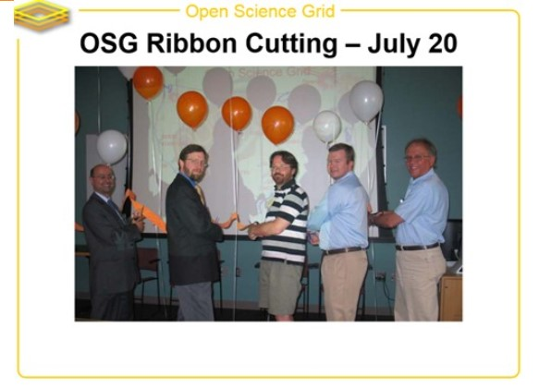
Frank Wuerthwein
Peter Couvares

Slide 12


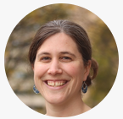
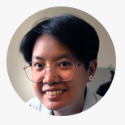
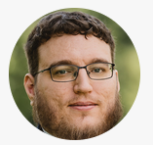
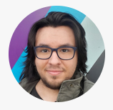
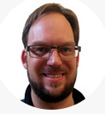
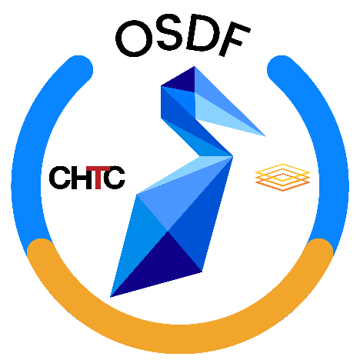
PATh
FabAID
OSFacilitate

Slide 13

School
College

Slide 14
+ Small Campuses
(teaching mission)

Slide 15





+ Multi Messenger
Astronomy (MMA)

Slide 16
Trust

Slide 17
PATh Executive Summary
“Broader Impact – We firmly believe in dHTC as an accessible computing paradigm which supports the democratization of research computing to include researchers and organizations otherwise underrepresented in the national CI ecosystem. Our work is founded on universal principles like sharing, autonomy, unity of purpose, and mutual trust.”
PATh Proposal 04/21/2020

Slide 18
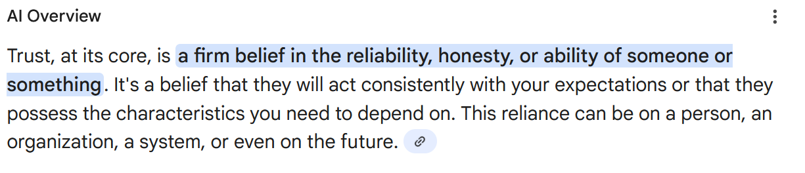
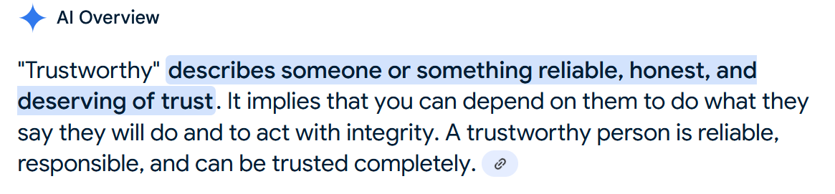

Slide 19
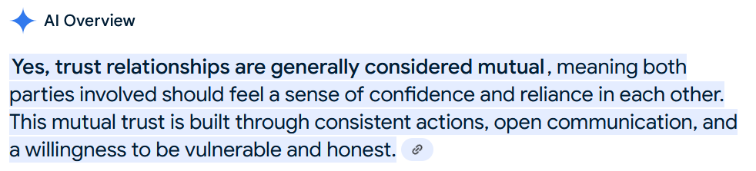
Is Trust a mutual relationship?

Slide 20

Trustworthy
Software

Slide 21
Trustworthy
Services

Slide 22
Trustworthy
Partnerships

Slide 23
(more)
Throughput

Slide 24
Challenges
Memory Allocation
Larger Input Sandboxes
(multi) Server Matching to Access Points
Support Owner Capacity Units (OCUs)
Opportunities
Shared File Systems
Manage Data Copy “jobs”
Desktop GPU “Boxes”

