Slide 1
From Per-Job Data to an Aggregated Workload Insight: A Toolkit for Profiling HTCondor Workload
Kashika Mahajan

Slide 2
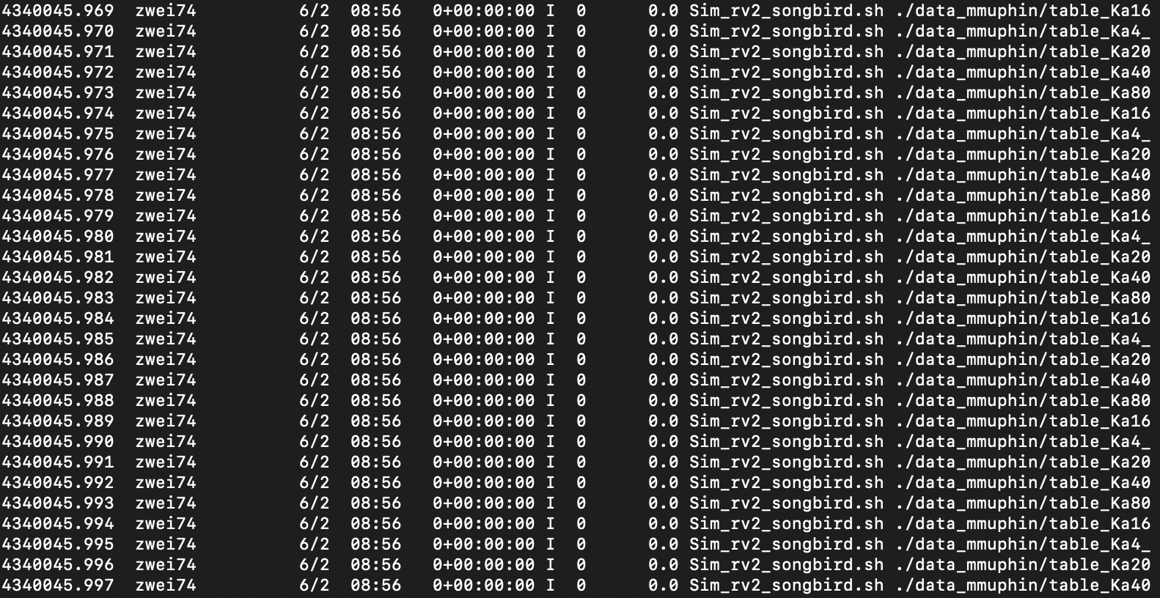


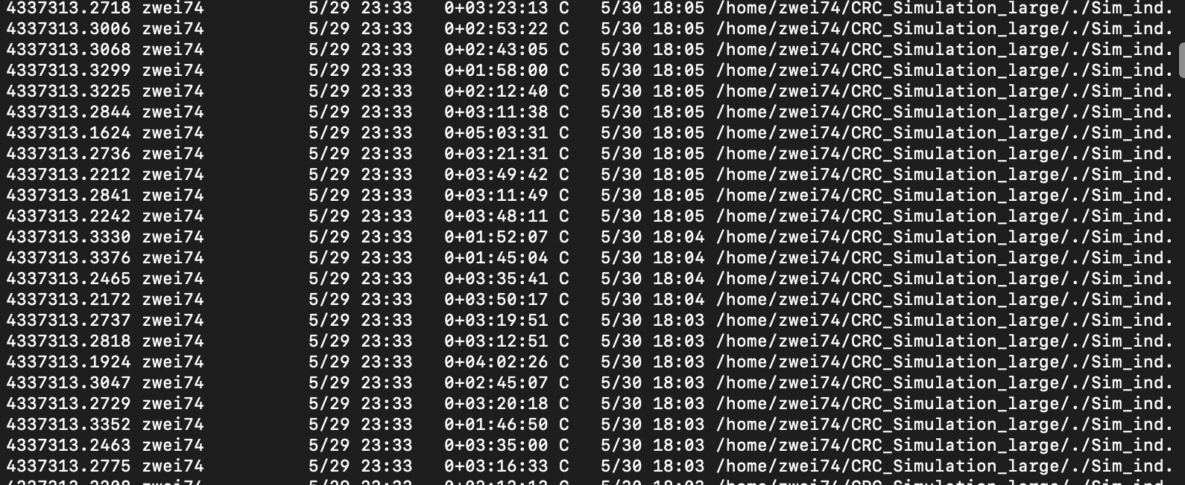

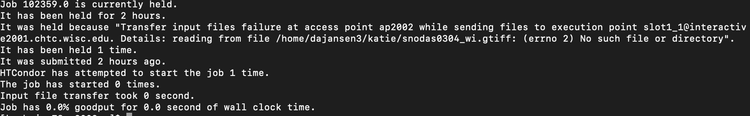
Problem
Researchers want to know how their workload is doing without having to dig for details

Slide 3


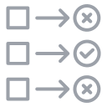
Objective of Project
Make a tool (or tools) that gives researchers simple feedback about their workload status
Visual_
Process_
Evaluative_

Slide 4
What do Researchers want to know?
Status
Time
Resources
Jobs on Hold
How is my workload doing?

Slide 5
How we are providing this information:
Status -> Dashboard
Time -> Runtime Visualizations
Resources -> Resource Utilization Report
Jobs on Hold -> Hold Classifier
How is my workload doing? Cluster Health Report

Slide 6
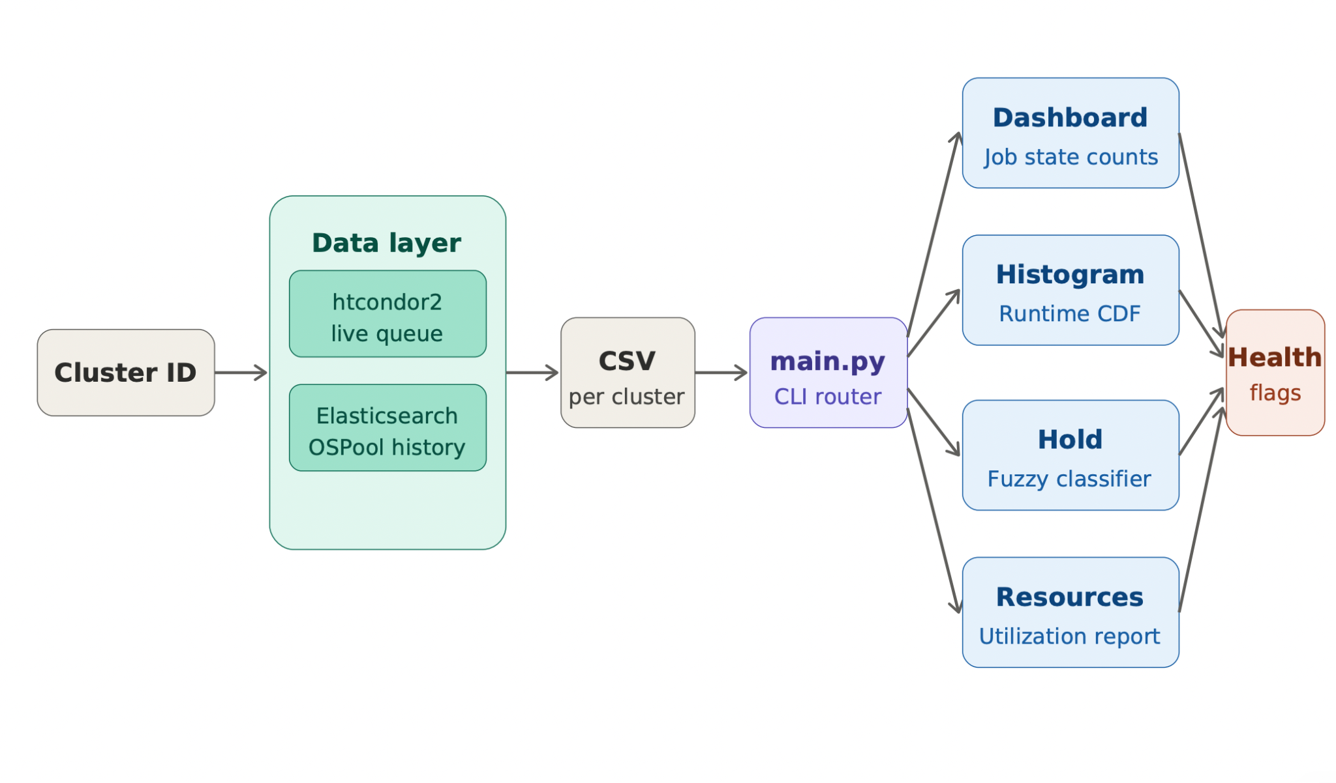

Slide 7
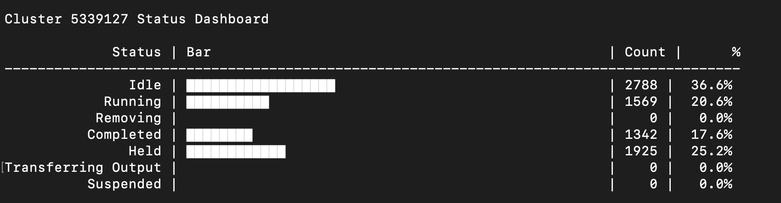
Cluster Status Dashboard
Benefits:
Visual representation of the status of their jobs
Accumulates data about jobs from both queue and history

Slide 8
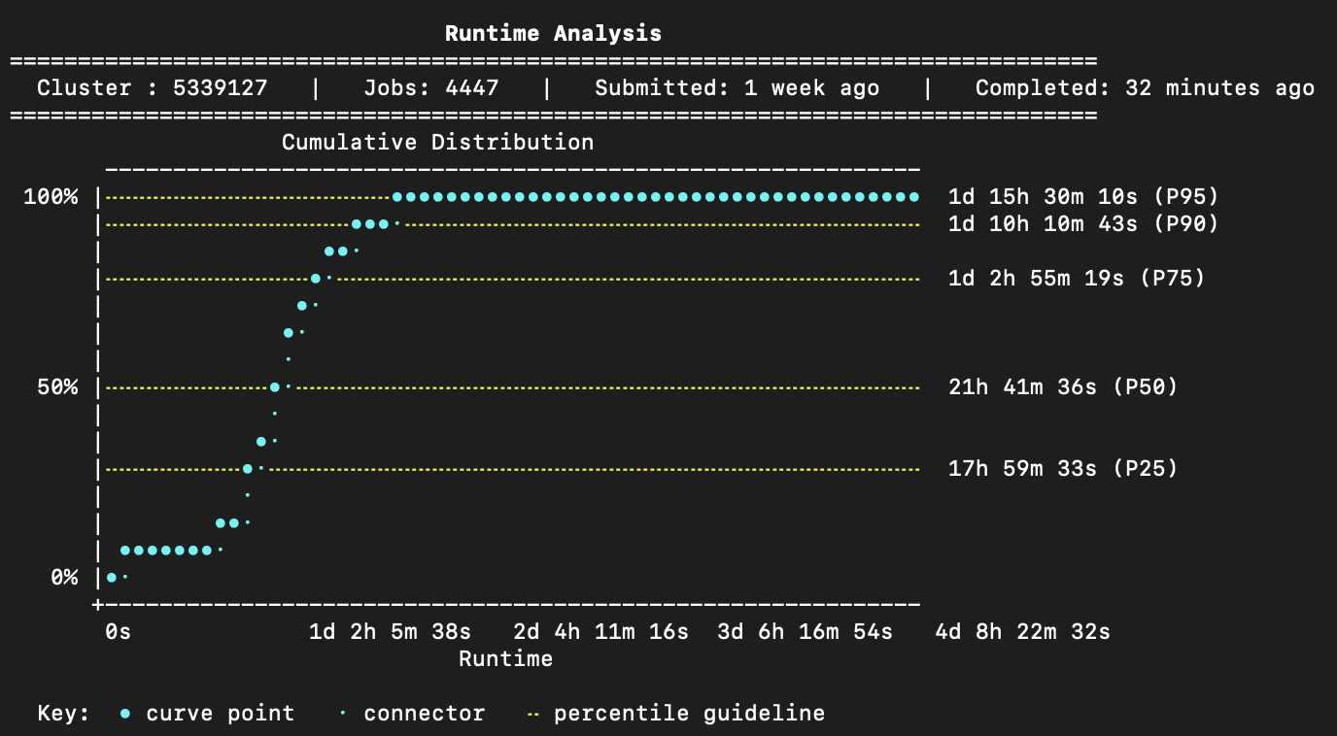
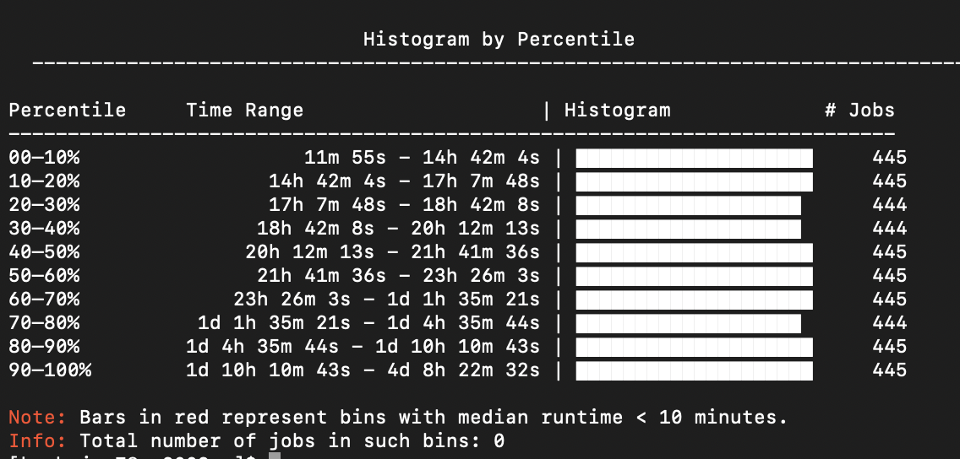
Runtime Visualization
Benefits:
Visual Feedback about runtimes of completed jobs
Helps classify trends in workloads

Slide 9
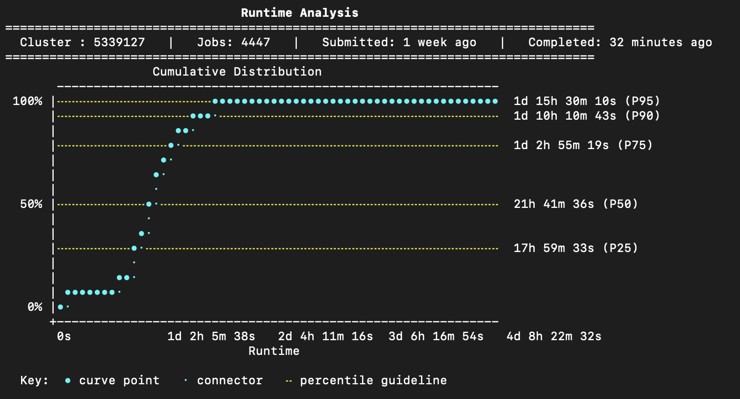

Slide 10
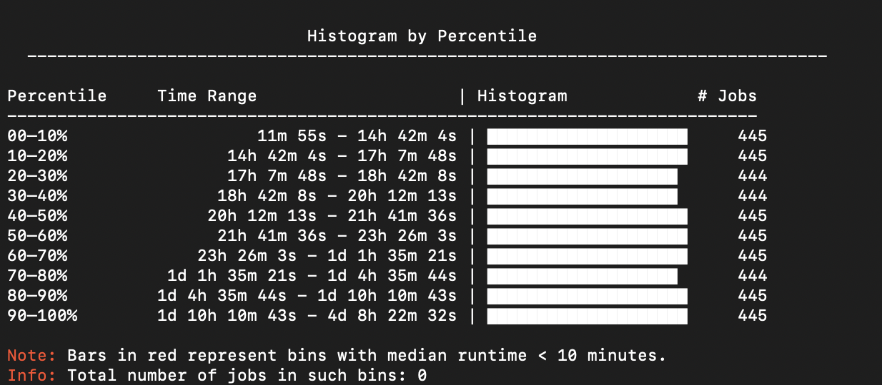

Slide 11
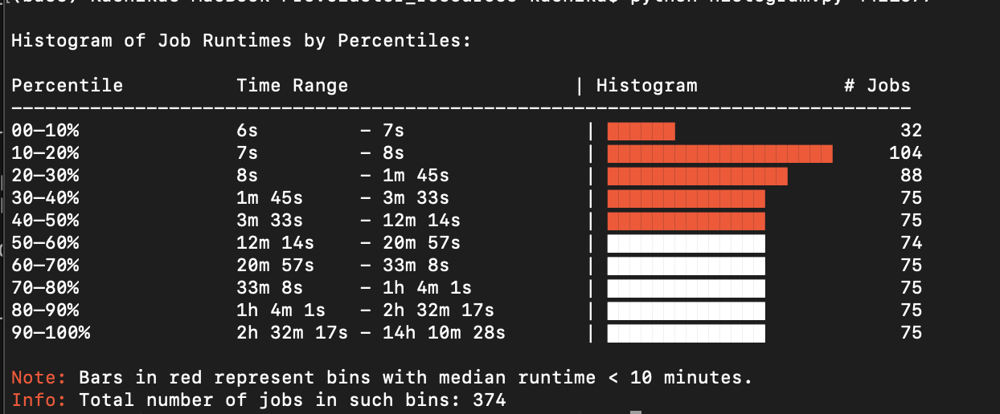
Benefits:
Binned on the basis of percentiles
Points out how many jobs have a runtime <10 mins, along with the option to print their JobIds
Can be used to understand the range of runtimes for a cluster

Slide 12
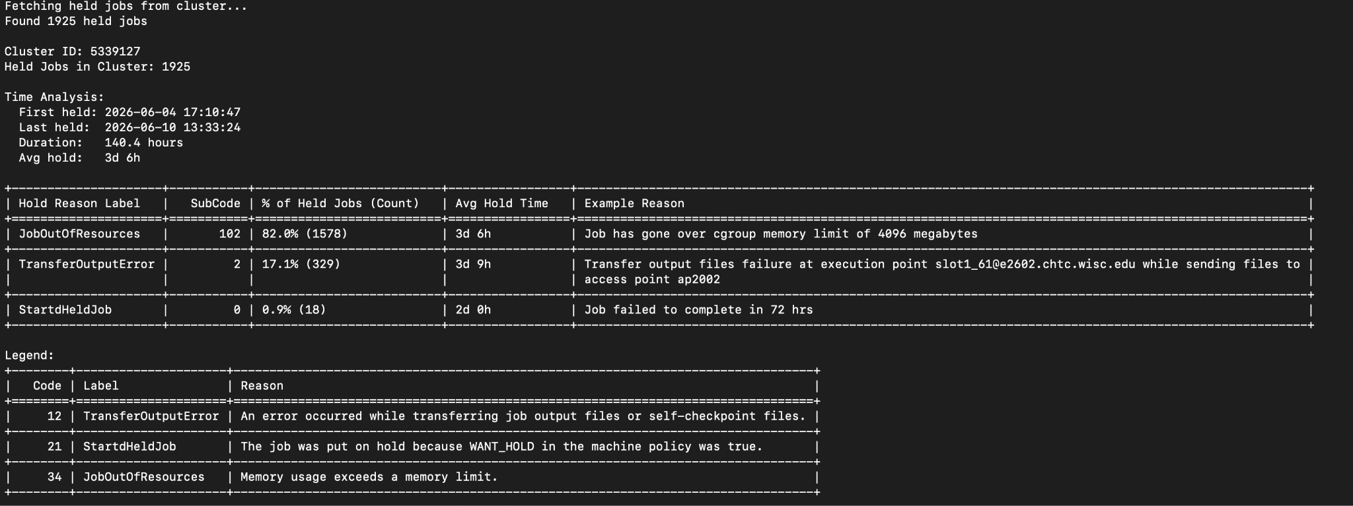
Hold Classifier
Gives a tabular summary for the held jobs, with the Hold Reason Label, Subcode, #Jobs, and an Example error message for each bucket

Slide 14
Groups jobs by HoldReasonCode and SubCode

Slide 15
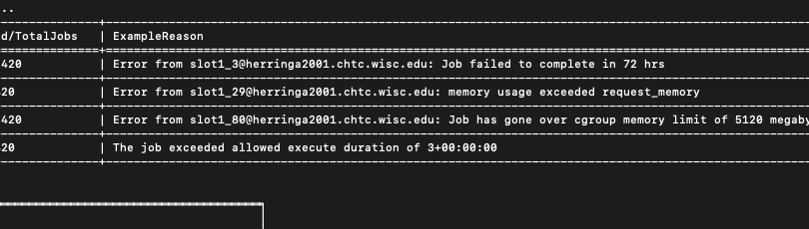
and also HoldReason (by string comparison)

Slide 16
Gives Legend of HoldReason, Label and the reason

Slide 17
Benefits:
Easy to understand summary with example error reasons for better problem solving
Adaptive to changes in the system with information being pulled from a table

Slide 18
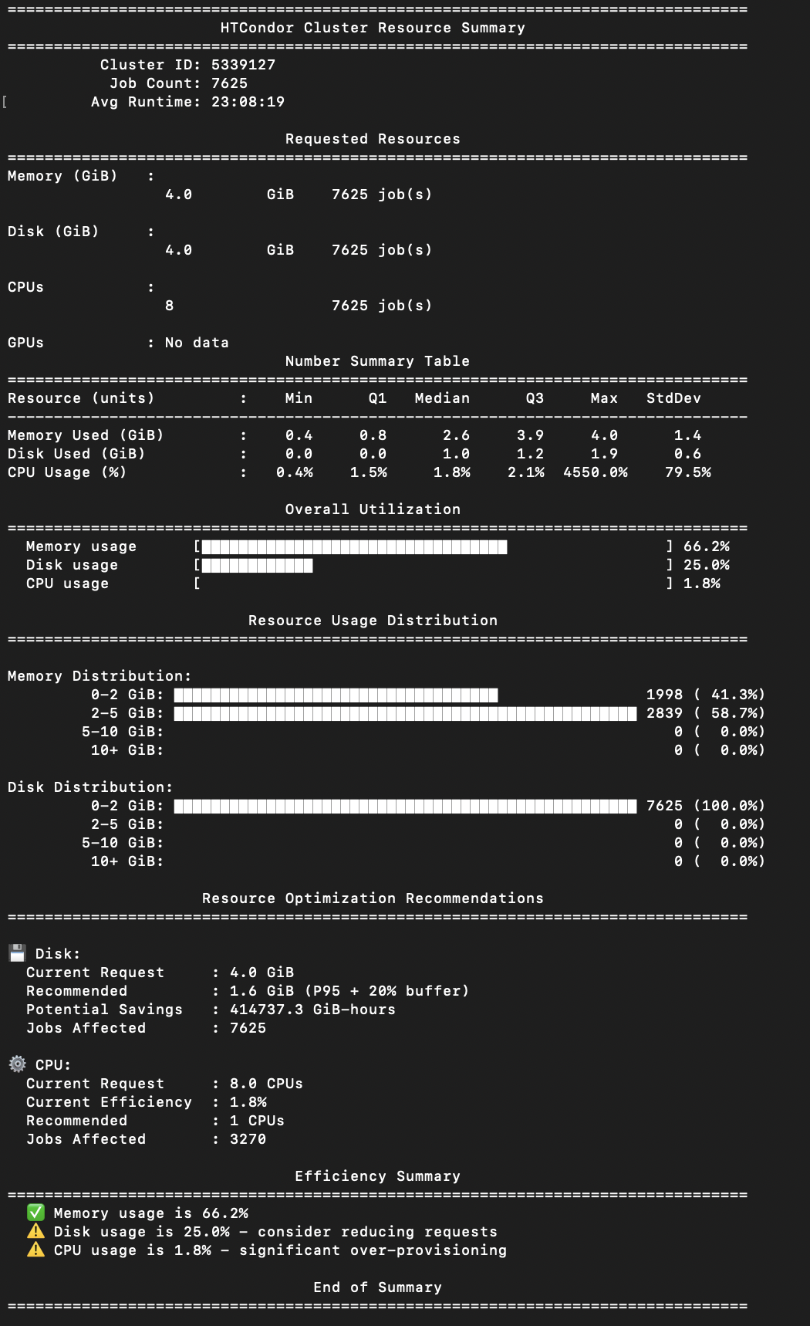
Resource Utilization Report
Gives a comprehensive report about resource request and utilisation for a cluster
Statistics
Usage Distribution
Optimization Recommendations
Efficiency Summary
Benefits:
Aggregated data from all jobs
Better resource utilization

Slide 19
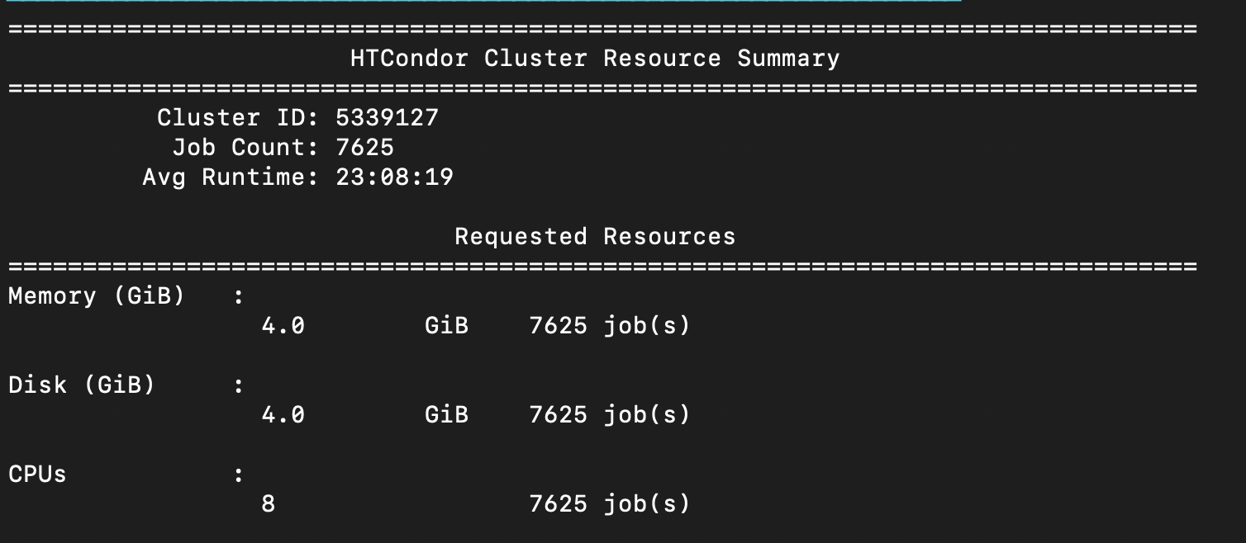
A table summarizing the resource request and the count of jobs

Slide 20
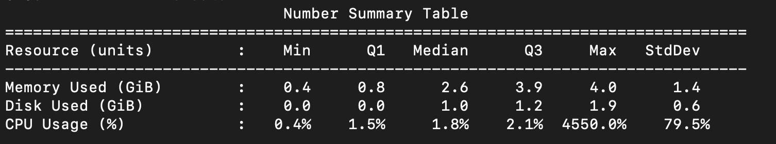
A table summarizing the resource utilization and statistics such as quantiles, and StdDev

Slide 21
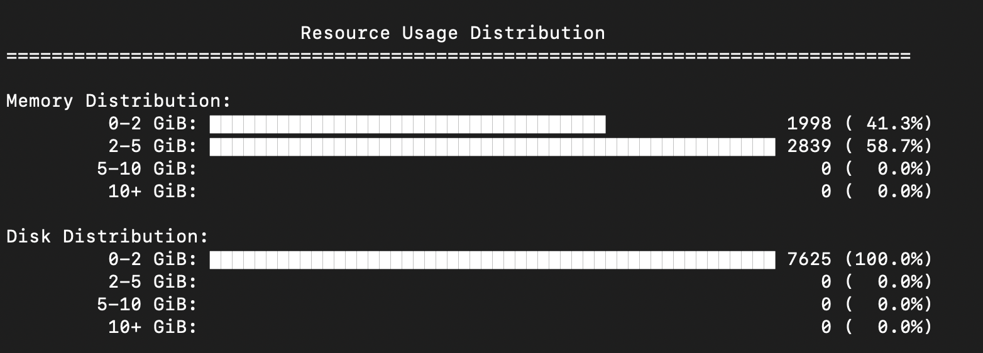
A visual representation of overall utilization

Slide 22
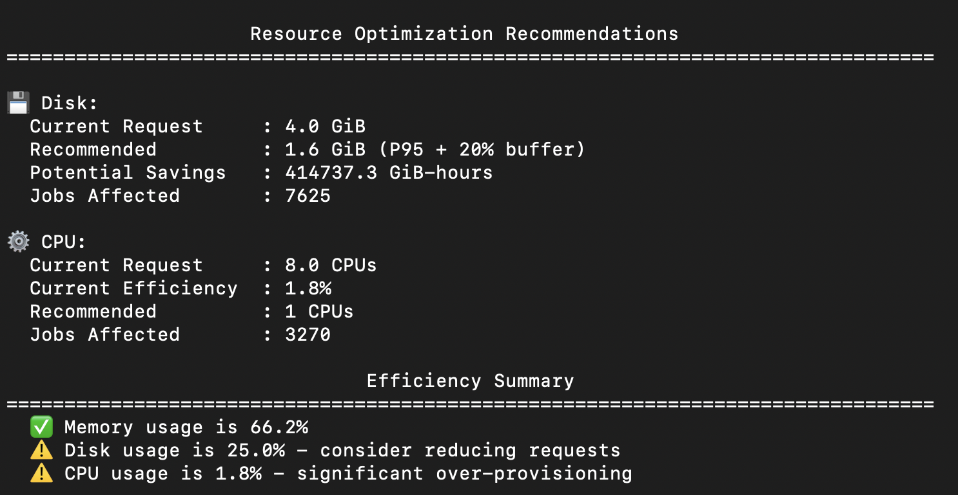
Summary and Recommendations

Slide 23
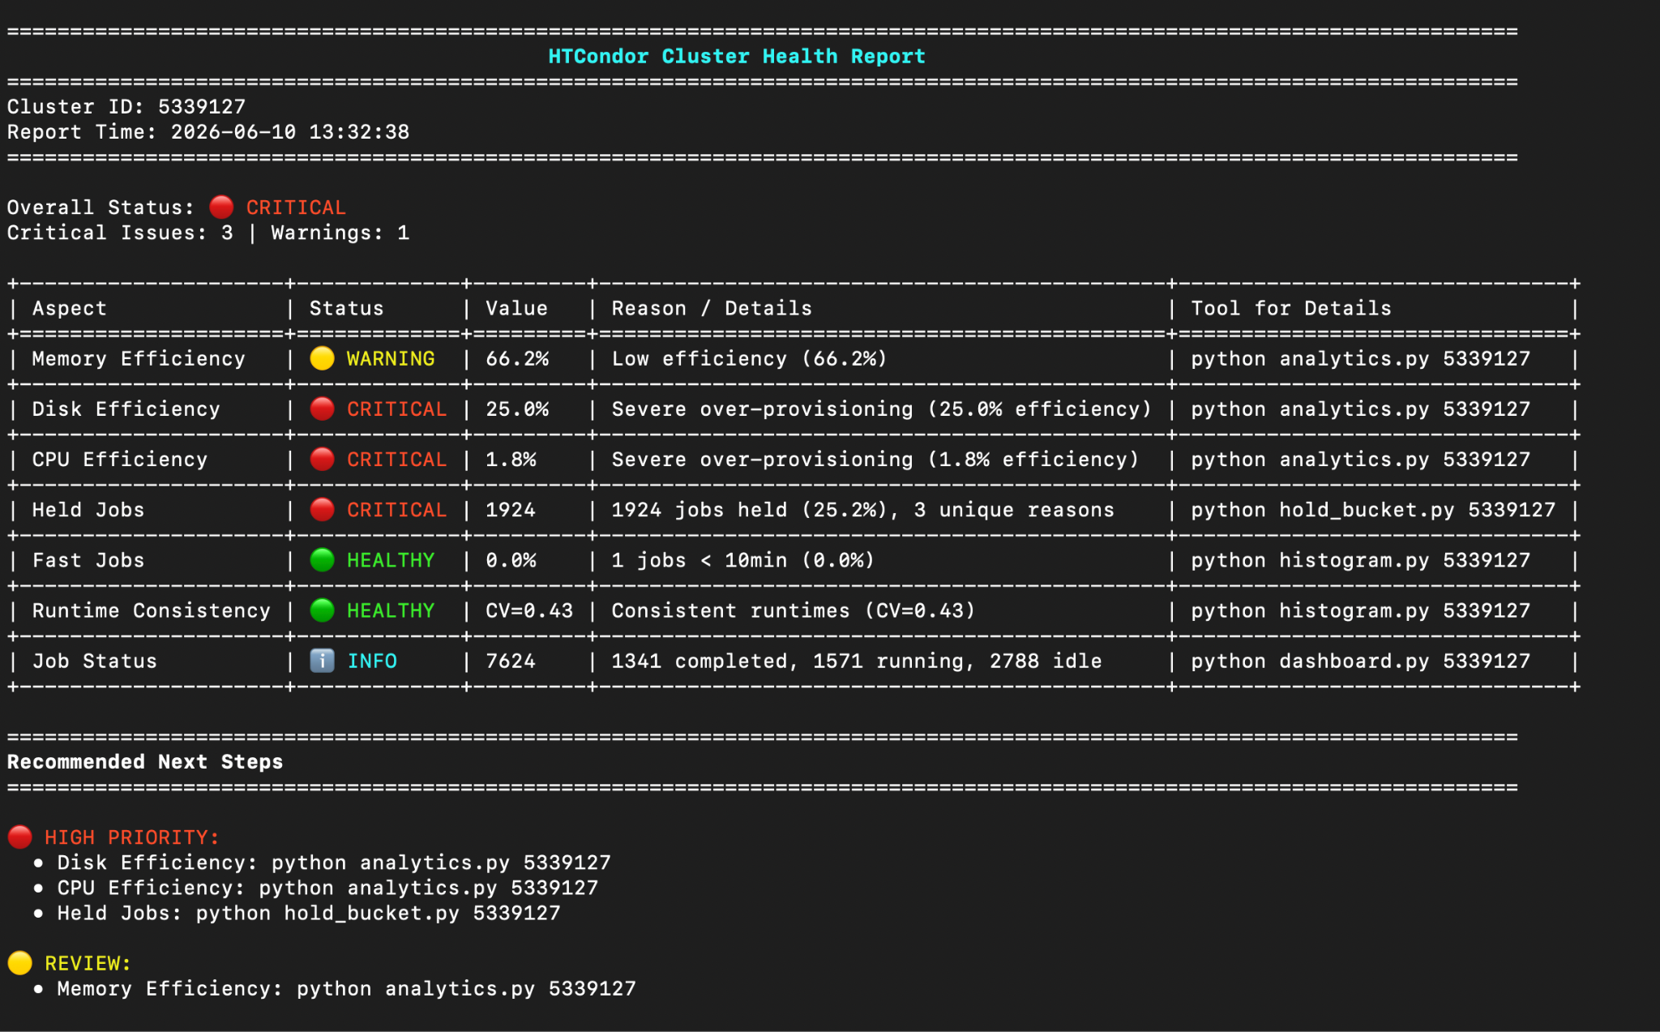
Cluster Health Report

Slide 24
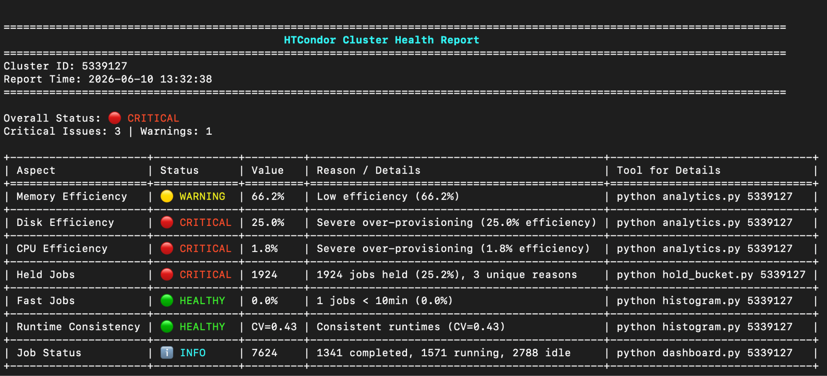

Slide 25
Next Steps
Make these tools ready for the researchers to use within HTCondor
Improve the tool on any feedback or issues we receive

Slide 26
Acknowledgements
This material is based upon work supported by the National Science Foundation under Grant No. 2030508. Any opinions, findings, and conclusions or recommendations expressed in this material are those of the author(s) and do not necessarily reflect the views of the National Science Foundation.

