Slide 1
GlideinWMS Improvements and Challenges
June 11, 2026
Marco Mambelli for the GlideinWMS team
Throughput Computing Week 2026
This manuscript has been authored by FermiForward Discovery Group, LLC under Contract No. 89243024CSC000002 with the U.S. Department of Energy, Office of Science, Office of High Energy Physics.

Slide 2


Glidein Workload Management System
GlideinWMS is a pilot-based resource provisioning tool for distributed High Throughput Computing and leveraging heavily HTCondor:
  Provides reliable and uniform HTCondor elastic virtual clusters
  Submits pilot jobs (Glideins) to heterogeneous resources via HTCondor
Distributed architecture
  Glidein
  Factory
  Frontend
Frontend
Job Queue
Glidein
Cluster
Worker
Glidein
Worker
Factory
AWS
Glidein
Worker
CE
Worker
Glidein

Slide 3
Glidein, Factory and Frontend
Glidein (Pilot): node testing and customization, starting EP
  Scouts for resources and validates the Worker node
  Customizes the Worker node
  Can manage/partition the Worker Node (space and time sharing)
  Provides a reliable and customized Execution Point to an HTCondor Pool
Factory: Glidein submission
  A Glidein Factory knows how to submit to sites
  Site entries described in the configuration (static or auto-generated)
  HTCondor does the heavy lifting of submissions: to local and remote clusters, CEs, hosted CEs, clouds, and HPC resources
Frontend: resource provisioning decisions
  Monitors jobs to see how many Glideins are needed for all managed pools
  Requests Glideins submission/removal from the Factory depending on jobs needs and available resources
  Pressure-based system
  Manages credentials and delegates them to the Factory and Glidein

Slide 4
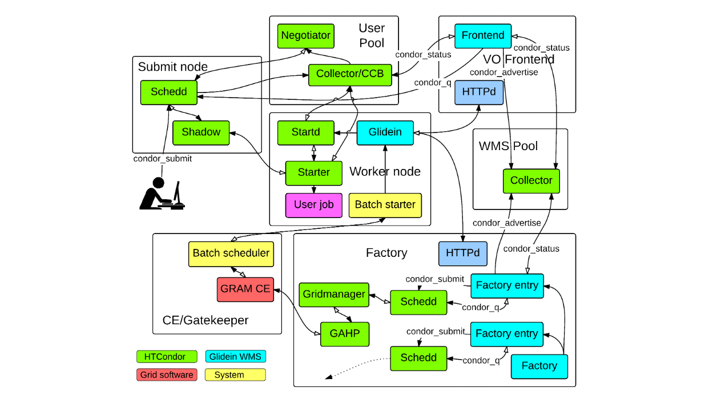
Zoom-in on HTCondor components
CM
AP
EP
HTCondor CE

Slide 5
Contained operation effort
Big VO operation (Shared Factories and CMS resources)
  About 2.5 FTE
  Most of it to develop monitoring and improve the system
VO operation (Frontend and one Pool)
  About 0.1 FTE
  Most of that is monitoring and checking on sites

Slide 6
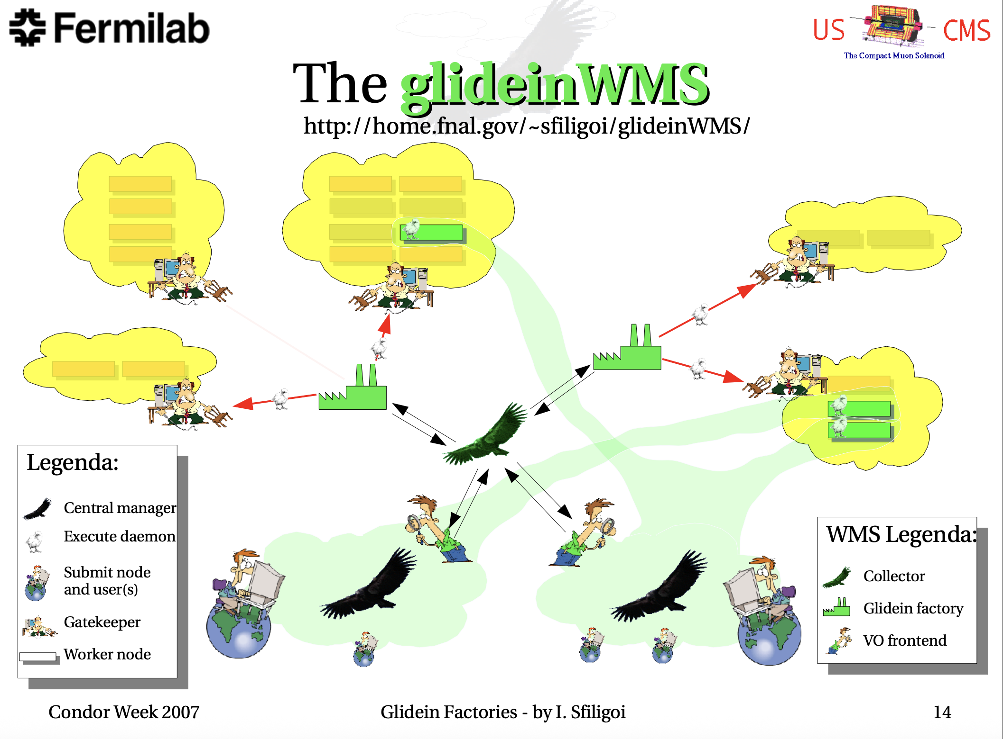
Evolved with HTCondor and Python
Thanks for the support!
Almost 20 years old (October 2006).
  CDF Analysis Facility using Glideins (2005)
  Used for CMS analysis and production,
  later FIFE and DUNE
  RPM package, later also container
v2 and v3 (2009-12) monitoring, Python logging
and new Factory API
v3.5 (2019) Factory using a single user (no more condor switchboard)
v3.7/v3.7.1 (2020) Token demonstrator
  HTCondor token-auth->IDTOKENS+SciTokens
v3.9/v3.9.3 (2020) Python 3
Thanks to VDT and OSG!
  https://research.cs.wisc.edu/htcondor/CondorWeek2007/presentations/igor_GlideinFactories_final.pdf

Slide 7
Current/next steps
v3.11 (2025) New credentials model and generators
v3.11.5 (2026) On-demand CVMFS provisioning
v3.11.6 (2026) condor_ssh_to_job in containers
v3.11.6 (2026) Support for more HPC resources

Slide 8
Glidein Submission via HTCondor
2006 HTCondor Pool (vanilla universe)
2006 Grid (HTCondor-G/GRAM CE gt2, then gt5 - grid universe, gt2/gt5) up to HTC 9.x
2006-16 Batch systems (grid universe, batch (pbs, lsf, sge, or slurm)
2009-21 NorduGrid ARC CE, then v1 and finally REST (grid universe, arc)
2014-16 AWS, OpenStack/OpenNebula (grid universe, ec2)
2014 Remote cluster, aka BOSCO (ssh bridge - grid universe, batch and remote_cluster)
2015 HTCondor-CE/HTCondor-C (grid universe, condor)
2016 GCE (grid universe, gce)
2019 Azure (grid universe, azure)
2019 Split-starter and Lumberjack for no network HPC (only prototypes, no production)
2026? More HPC sites
  NERSC Superfacility API
  Integrated Research Infrastructure (IRI) API
  Globus Compute

Slide 9
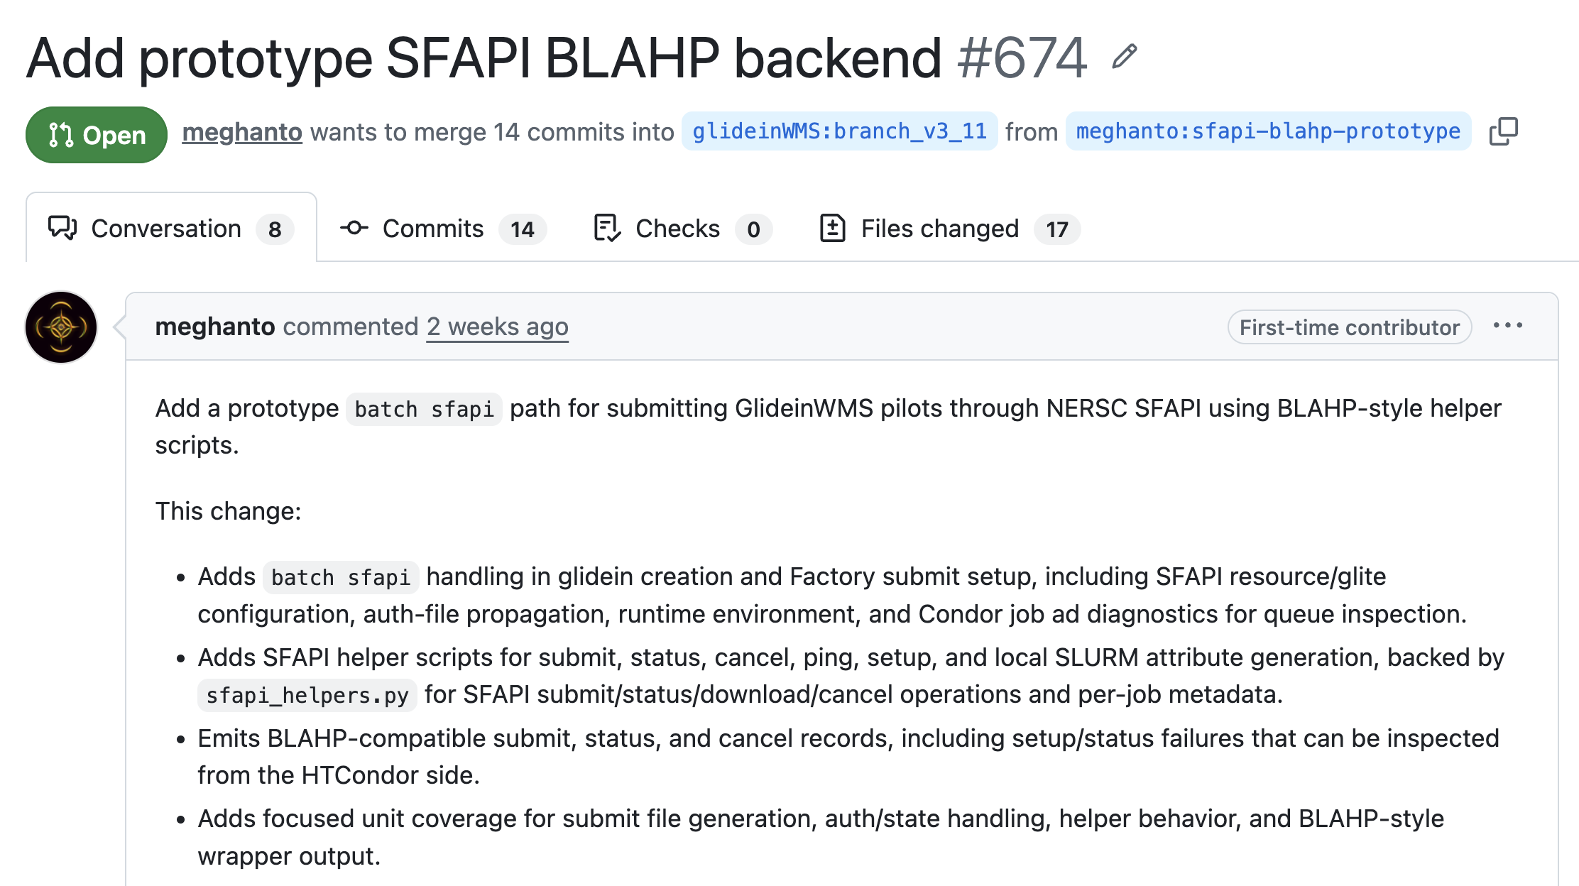
SuperFacility API support
Used already for monitoring allocations,
need to start using it for job management
Code under development by
Meghanto Majumder
Thanks to the Pegasus team for sharing
documentation and reference implementation
  https://pegasus.isi.edu/docs/5.1.3-dev.0/user-guide/deployment-scenarios.html#nersc-perlmutter-via-sfapi
  https://pegasus.isi.edu/docs/5.1.3-dev.0/reference-guide/nersc-sfapi-submission.html
Test from development machines at Fermilab to Perlmutter at NERSC
Name OpSys Arch State Activity LoadAv Mem ActivityTime
slot1@glidein_1709526_362407216@x1306c7s6b0n1h0.chn.perlmutter.nersc.gov LINUX X86_64 Unclaimed Idle 0.000 515140 0+00:00:00
Total Owner Claimed Unclaimed Matched Preempting Drain Backfill BkIdle
X86_64/LINUX 1 0 0 1 0 0 0 0 0
Total 1 0 0 1 0 0 0 0 0

Slide 10

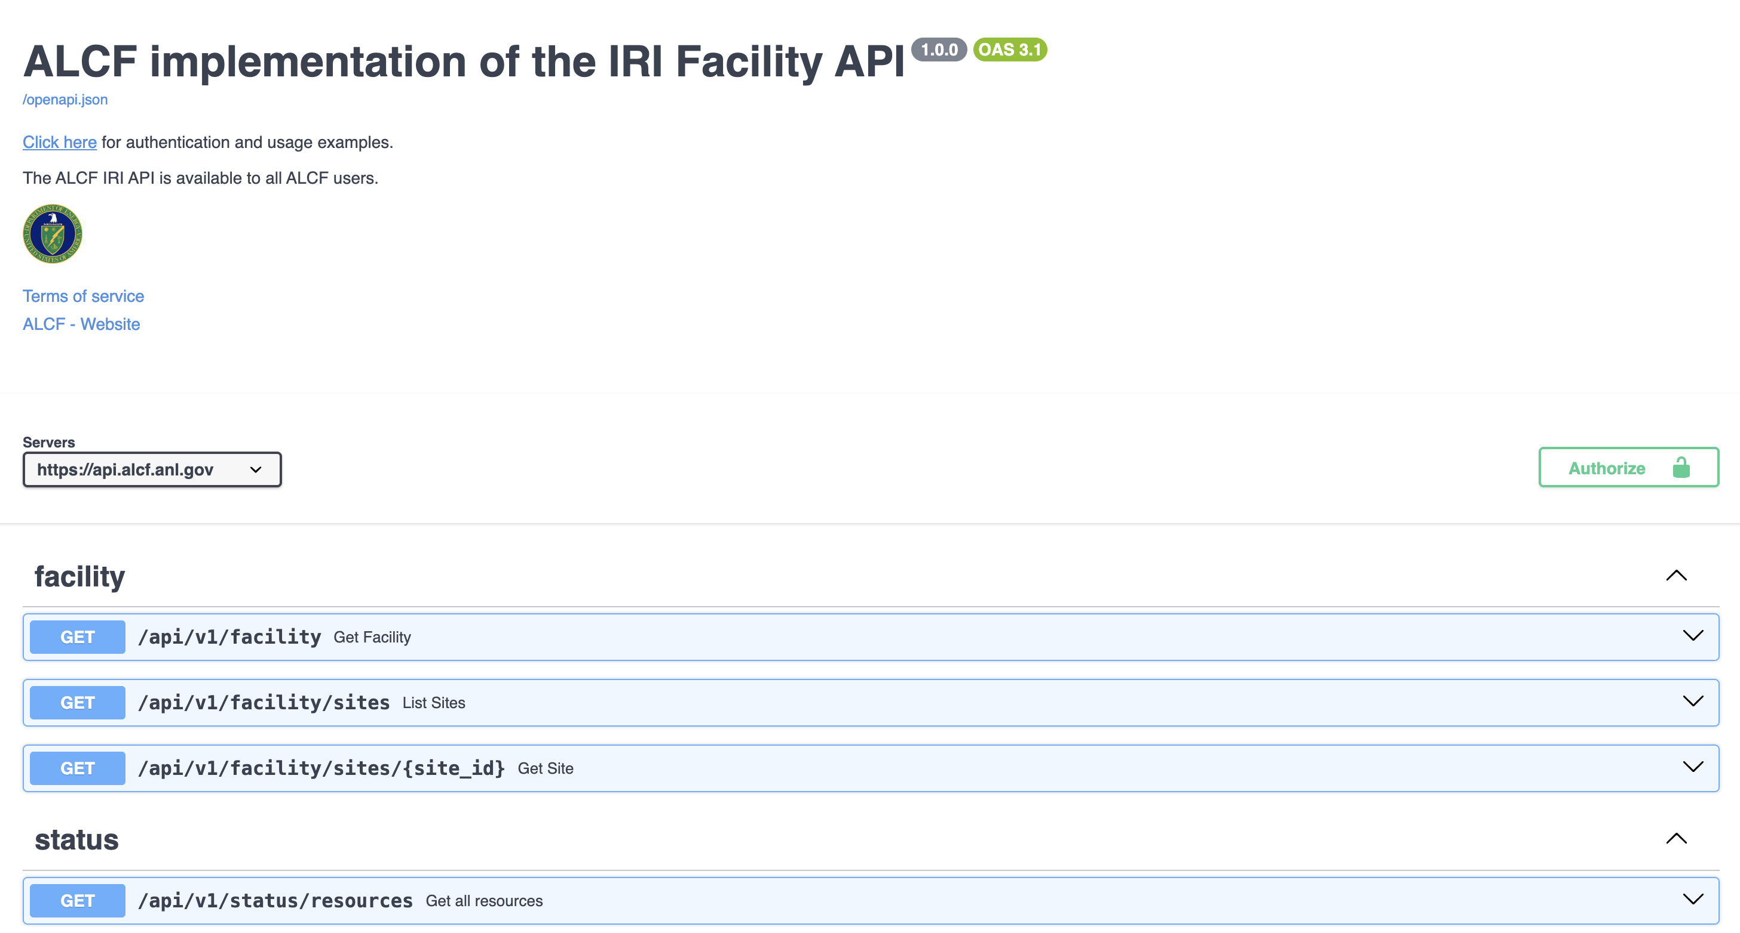
Integrated Research Infrastructure (IRI) API
Common API to submit and monitor ASCR facilities
(ALCF, OLCF, NERSC)
https://github.com/doe-iri/iri-facility-api-python
Planning to run some tests at least at NERSC
  Using ALCF will add connectivity problems
Long term ask is for HTCondor to support the IRI API

Slide 11




On-demand CVMFS provisioning
VOs specify CVMFS requirements
Resources may have CVMFS available
cvmfsexec used to provision CVMFS on-demand when required and not available
  Different cvmfsexec options used depending on OS and capabilities
    cvmfsexec (mode 2 and 3)
    mountrepo/umountrepo (mode 1) – nonstandard mountpoint
  System and VO-defined list of repositories
Apptainer allows to bind the repositories on the well-known /cvmfs mount point

Slide 12
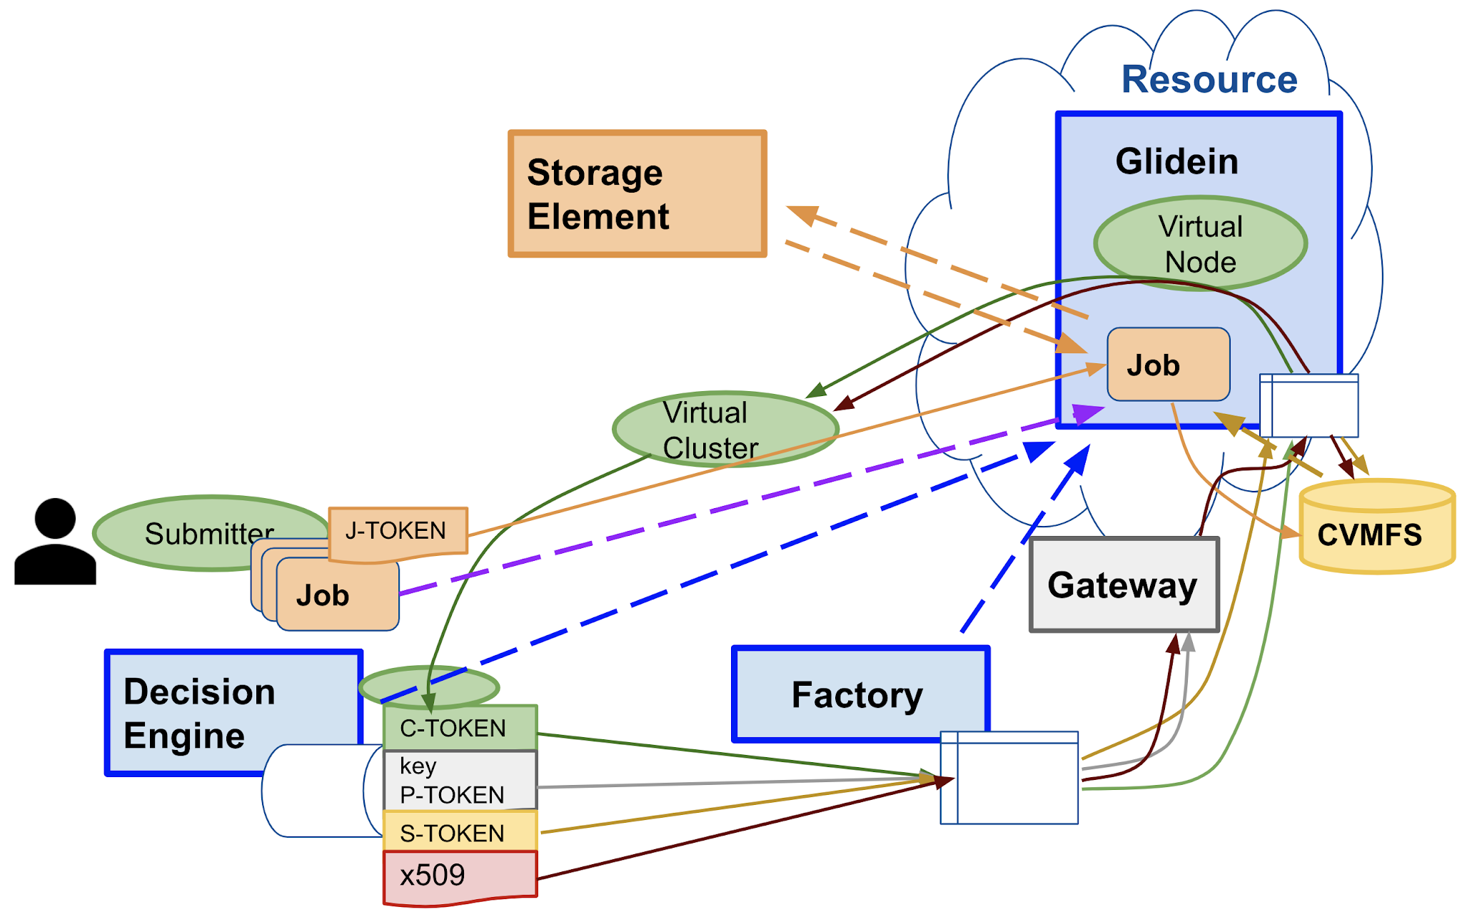
New credentials and generators (v3.11)
Multiple credentials and parameters
  Frontend:
  Factory: auth_method=“scitoken,grid_proxy;projectid;vmid”
<credentials>
<credential absfname="/opt/gwms/credentials/pilot.scitoken" purpose="request"
security_class="frontend" trust_domain="grid" type="scitoken"/>
<credential absfname="dynamic_credential.py" purpose="payload"
security_class="frontend" trust_domain="grid" type="generator"/>
</credentials>
<parameters>
<parameter name="ProjectId" type="generator" value="dynamic_parameter.py"/>
<parameter name="VMId" type="static" value="DEBUG_VM"/>
</parameters>

Slide 13
Easier configuration with generators - old
Project ID is “allocation1” for SiteA, “allocation2” for SiteB, not needed otherwise
<security …
<credentials />
</security>
<group name="main" enabled="True">
<config ignore_down_entries="True" ramp_up_attenuation="3">
...
</config>
<match match_expr="True" start_expr="True" policy_file="/path/to/python-policy-file">
<factory query_expr="(GLIDEIN_Site!="SiteA) && (GLIDEIN_Site!="SiteB)” >
<match_attrs />
<collectors />
</factory>
<job query_expr="True">
<match_attrs />
<schedds />
</job>
</match>
<security>
<credentials>
<credential absfname="/etc/osg/tokens/my_token.scitoken" security_class="frontend"
trust_domain="OSG" type="scitoken" />
</credentials>
</security>
<attrs />
<files />
</group>
<group name="group1" enabled="True"> …
<match match_expr="True" start_expr="True" policy_file="/path/to/python-policy-file">
<factory query_expr="(GLIDEIN_Site=="SiteA)”>
<match_attrs />
<collectors />
</factory>
<job … />
</match>
<security>
<credentials>
<credential absfname="/etc/osg/tokens/my_token.scitoken" security_class="frontend"
trust_domain="OSG" type="scitoken" project_id="allocation1" />
</credentials>
</security> …
</group>
<group name="group2" enabled="True"> …
<match match_expr="True" start_expr="True" policy_file="/path/to/python-policy-file">
<factory query_expr="(GLIDEIN_Site=="SiteB")">
<match_attrs />
<collectors />
</factory>
<job … />
</match>
<security>
<credentials>
<credential absfname="/etc/osg/tokens/my_token.scitoken" security_class="frontend"
trust_domain="OSG" type="scitoken" project_id="allocation2" />
</credentials>
</security> …
</group>

Slide 14
Easier configuration with generators - new
Project ID is “allocation1” for SiteA, “allocation2” for SiteB, not needed otherwise
<security …
<credentials>
<credential absfname="/etc/osg/tokens/my_token.scitoken" security_class="frontend" trust_domain="OSG" type="scitoken" />
</credentials>
<parameters>
<parameter name="ProjectId" type="generator" value="EntryConditionGenerator”
context=“{‘discriminator’=‘name’, dict={‘SiteA’:’allocation1’, ‘SiteB’:’allocation2’}, default=‘’} />
</parameters>
</security> …
<group name="main" enabled="True">
<config ignore_down_entries="True" ramp_up_attenuation="3">
...
</config>
<match match_expr="True" start_expr="True" policy_file="/path/to/python-policy-file">
<factory query_expr=”True">
<match_attrs />
<collectors />
</factory>
<job query_expr="True">
<match_attrs />
<schedds />
</job>
</match>
<security>
<credentials/>
</security>
<attrs />
<files />
</group>
Shorter!
No duplication and consistency problems

Slide 15
Also with new credentials and generators
Refactoring of the code
Easy to define custom generators in Python
IdTokenGenerator to customize the tokens to join the cluster
Self-signed SciTokens for testing
  Generates SciTokens according to the VO desires and uses its key to sign them
  Advertises the public key with standard OAuth 2.0 authorization server metadata RFC
  Just add a couple of lines in the CE mapfile
Robust renewal of tokens missing
  Problem when CM restarts – Glideins cannot rejoin the pool
Credential
Token
X509Cert
RSAKey
Text
Generator
SciToken
IdToken

Slide 16
GlideinWMS simplifies resource provisioning
Glidein based Workload Management System used in production for 20 years
Aiming to improve the provisioning and simplify operations
Currently
  Providing access to more HPC resources
  Making CVMFS available on all nodes
  Simplifying operations around credentials and submit parameters
Thanks to the Condor team for all the support, we will keep requesting more performance and features to scale and satisfy GlideinWMS stakeholders’ requests
  Support of more HPC resources using IRI API and similar
  Credential renewal mechanism working for all resources

