Slide 1




Auto-regulating Input Files that Save Time when Jobs Fail
Daily Precipitation File Analysis with Item-level retries in an HTCondor / DAGMan pipeline when files are missing
Benjamin FitzGerald
PhD student, Hydroclimate Extremes Research Group (Dr. Daniel Wright)
HTCondor Week

Slide 2
Storm Transposition and Rainfall-runoff modeling
Engineers design dams, bridges, and floodplains for rare storms (the 100- or 1,000-year event). A rainfall-runoff model turns a storm into the flood it produces, so it needs rainfall estimates far out in the tail.
The observed record is short, so its biggest storm is nowhere near a 1,000-year event. Stochastic storm transposition (SST) extends the record, by moving observed storms
Spatial L-Moments of Annual Maxima (SLAM) is a workflow for creating the transposition domain
An Observed Extreme Storm
1000-year event
The same storm transposed over the watershed
Streamflow
Transposition domain
Time
SST shifts real storms to many positions over the basin, building a larger synthetic set of extreme events than the short record alone
This work has been used in FEMA’s modernization of National Flood Insurance Program’s Rate Maps

Slide 3
SLAM-SST Pipeline
Whole process could be run for any basin and gridded precipitation dataset
Run for each basin (this study: ~215 basins)
Run for each duration ( this study: 6, 24, 72 hour)
Repeated for each domain type (this study: x3)
Point Precipitation to Watershed Average (WA)
WA Annual Maxima Calculation
L-Moment Calculation
P-Value Calculation and SLAM Domian Drawing
RainyDay SST Catalog Creation and Rainfall Estimation
17,000 daily precip files
Sorted into batches with user defined 15 days per job (+1000 jobs)
Must analyze every grid cell (50,000)
Jobs batched based on longitude (25 jobs)
Once per basin/duration
Can output multiple domains
One job per year
(x 47 years)
Once per domain

Slide 4
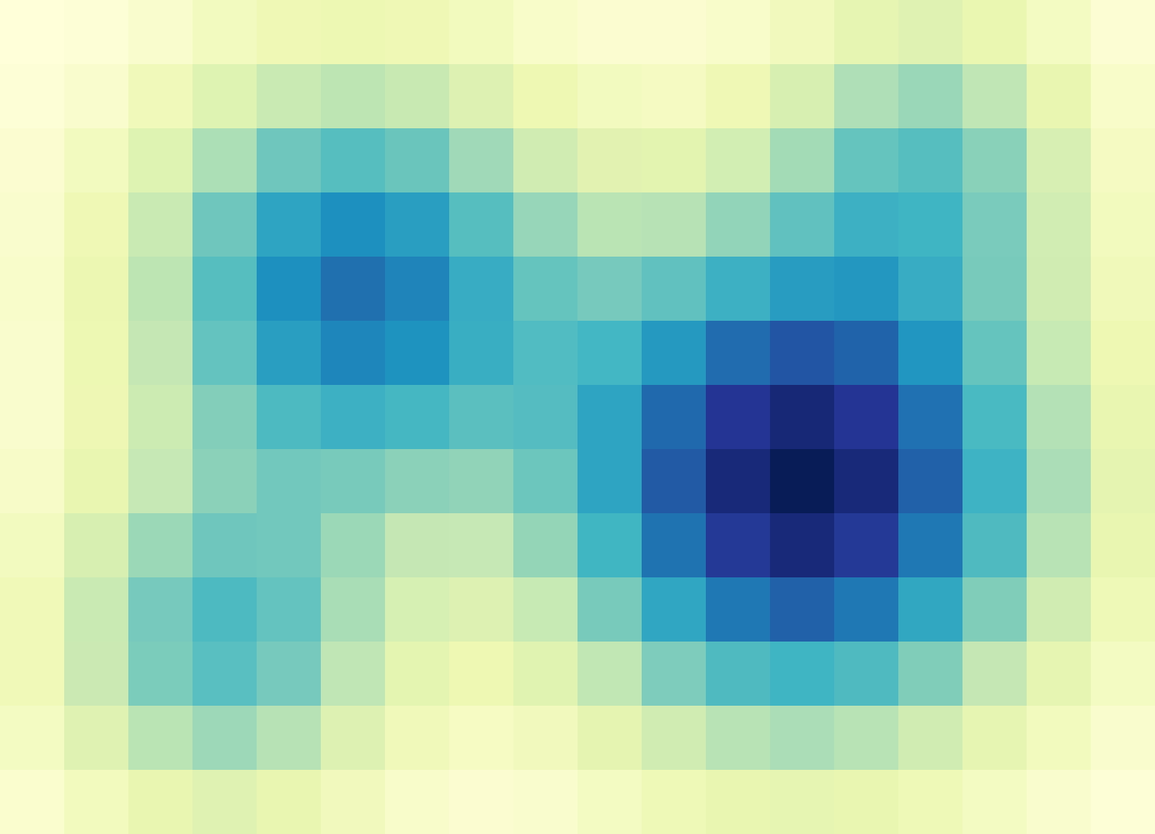
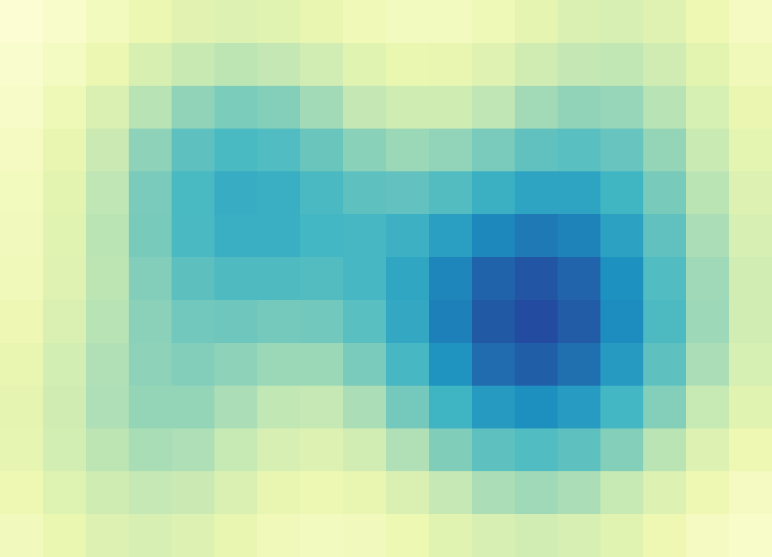
What Point Precipitation to Watershed Average Precipitation (PP2WAP) job computes
Jobs: Watersheds [215] x 400,000 hours of precip data
1-hr Accumulation Precipitation Map
1-hr Watershed Average Precipitation Map
Calculate watershed average precipitation at every possible transposition location. Store in output file.

Slide 5
Submit Files
Original Submit file piece:
transfer_input_files = Other inputs,
AORC.$(Day1).Precip.nc,
AORC.$(Day2).Precip.nc,
AORC.$(Day3).Precip.nc,
AORC.$(Day4).Precip.nc,
AORC.$(Day5).Precip.nc, …
…
queue Day1, Day2, Day3, Day4, Day5 from dates.csv
Problems:
What if I’m using a different data resolution and need more or less than 5 files per job?
What if our total files isn’t divisible by 5?
What if I need to rerun a select number?
We can manage submit files and
we can manually or automatically populate the .csv file.
But is there a way to have 1 submit file that works with any number of inputs per job?
dates.csv:
Day1, Day2, Day3, Day4, Day5
01011979, 01021979, 01031979, 01041979, 01051979
01061979, 01071979, 01081979, 01091979, 01101979
01111979, 01121979, 01131979, 01141979, 01151979
…

Slide 6
Dynamic input submit files
Remove transfer_input_files from Submit File and add:
queue transfer_input_files from PP2WAP_Input.txt
PP2WAP_Input.txt:
AORC.19790101.precip.nc, AORC.19790102.precip.nc, …, WS.shp, PP2WAP.py
AORC.19790101.precip.nc, AORC.19790102.precip.nc, …, WS.shp, PP2WAP.py
AORC.19790101.precip.nc, AORC.19790102.precip.nc, …, WS.shp, PP2WAP.py
…
PP2WAP_Input.txt is generated by a script that would take user input over what files are necessary, how many to batch per job
Just allows you to use same job scripts (.sub, .sh, .py) with different batch sizes (useful for different resolution dataset and when rerunning portion).
Could also be used to run different inputs (i.e watershed shapes) and python scripts for same job

Slide 7
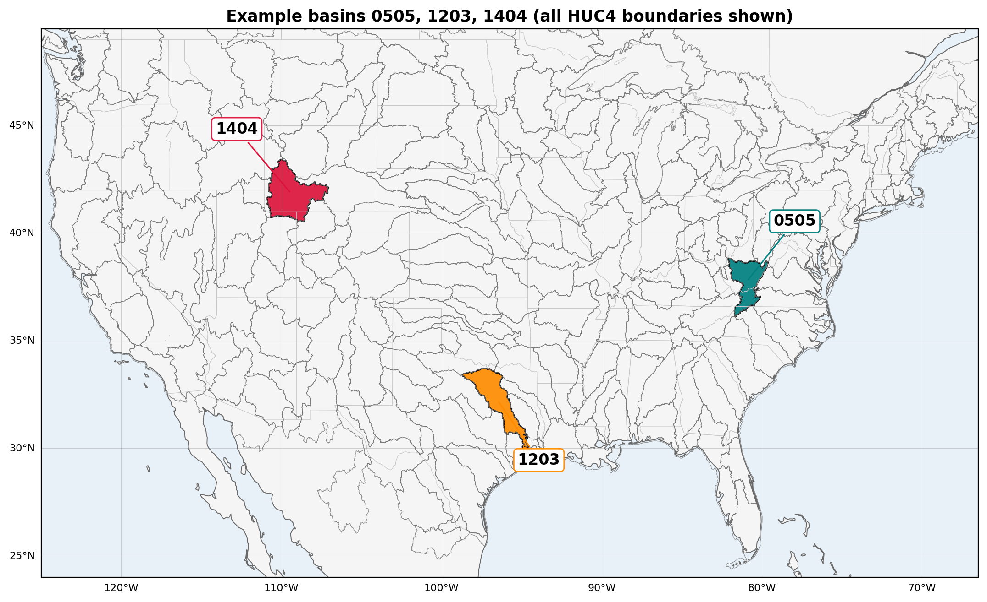
SLAM-CONUS with DAGman
SLAM-CONUS: Goal to create transposition domains for all 215 HUC4 basins
Hard to manually run per basin workflow with proper error checking for 300,000 PP2WAP jobs
DAGman breaks up pipeline into a series of nodes and manages pre-processing, running jobs and post-processing.
Issue:
We need to have the complete processed dataset and sometimes outputs go missing

Slide 8
Original Workflow
Manual Workflow
(Entering each script and monitoring for completion)
With shift to DAGMan, can’t manually check before telling it to move on.
DAGMan has some capabilities for covering jobs failing (retry, submit file max_retries, periodic_release)
No transfer_output_files line in submit file
Pre-Script:
Create input file list
Submitted Job:
Run PP2WAP over file list
Can manually alter file list to only rerun missing days
Check for missing daily WAP.nc files
Post-Script:
Create annual TAR balls
Move on to Annual Maximum Calculation

Slide 9
The pattern
PP2WAP_Input.txt:
AORC.19790101.precip.nc, AORC.19790102.precip.nc, …, WS.shp, PP2WAP.py
AORC.19790101.precip.nc, AORC.19790102.precip.nc, …, WS.shp, PP2WAP.py
AORC.19790101.precip.nc, AORC.19790102.precip.nc, …, WS.shp, PP2WAP.py
…
1,143 Lines for 17,136 daily files
DAGMan Workflow
Pre-Script:
Create input file list based on existing files
Edit PP2WAP_Input.txt:
AORC.19830714.precip.nc, AORC.20010322.precip.nc, …, WS.shp, PP2WAP.py
…
1 Lines for 2 daily files
Retry
Submitted Job:
Run PP2WAP over file list
If missing any
1. First run: the PRE script writes every item that still needs doing, and skips any whose output is already on disk (unless over-write flag).
2. On a retry: if a .retry flag is present, the PRE script keeps the shortened file as it is, then clears the flag.
3. POST script: it checks the outputs. If any are missing, it rewrites the file to just those items, creates the .retry flag, and exits non-zero so DAGMan retries the node.
  If no shrinking file, DAGMan retries nodes with all files
Remove existing outputs from list
Post-Script:
Create annual TAR balls
Move on to Annual Maximum Calculation

Slide 10
The same scripts in every stage
The same PRE and POST logic runs in all five stages. Only the unit of work changes:
Stage | Item unit
PP2WAP | Daily Precip files
AMC | one year
LMC | Longitude chunk
CLMPV | one domain
RDCatalog | one year

Slide 11
Final Thoughts
Cautions:
The set of job codes needs to be written to be compatible with files given.
  If processing code is looking for AORC.YYYYMMDD.nc but input_file.txt can give C404.YYYYMMDD.nc
An empty queue file does not submit zero jobs. queue x from <empty file> submits one job with x empty. When a stage is finished, I write a DONE line and exit early, or that one job ends up held.
Summary:
Have each batch stage read its list of work from a file.
The PRE script fills that list from what is missing on disk. The POST script trims it to the failures.
Benjamin FitzGerald· bfitzgerald4@wisc.edu · Thank you. Questions?

