Slide 1



What's new in the
HTCondor Software Suite (HTCSS) ?
What's coming up?
HTC26 – Madison, WI – June 2026
Todd Tannenbaum
Center for High Throughput Computing
University of Wisconsin-Madison

Slide 2
Our Email Lists Are Moving!
We’ve moved!
Good news: you don’t have to lift a finger.
All current subscribers are imported automatically — no need to re-subscribe.
Old address will forward to new address
Move Date: June 22nd 2026
These three lists are moving:
htcondor-users@cs.wisc.edu → htcondor-users@g-groups.wisc.edu
htcondor-world@cs.wisc.edu → htcondor-announce@g-groups.wisc.edu
htcondor-security@cs.wisc.edu → htcondor-security@g-groups.wisc.edu

Slide 3
New defaults v25 might be surprising
Python API (bindings) v1 being dropped -> long live v2 !
import htcondor2 as htcondor
System Swap space (virtual memory) will not be used for jobs on the EP by default
Dropping support for multiple queue statements in a single submit file
(Use queue foreach, etc.)
Partitionable Slots enabled by default (instead of static partitioning)
The job’s executable will no longer be renamed to ‘condor_exec.exe’
GPU discovery is enabled on all Execution Points by default

Slide 4
HTCondor v26.x
Currently at HTCondor v25.11
HTCondor v25.14 will likely be the v26 release candidate
HTCondor v26 expected ~Sept 2026
  Platforms added to supported list:
    openSUSE 16.0
    Ubuntu 24.04 on arm64 (for the NVIDIA DGX workstation!!)
    Ubuntu 26.04 on amd64 and arm64
  Platforms removed from supported list:
    openSUSE 15.6 - End of Life: 2026-04-30
    Debian 12 (Bookworm) - End of Life: 2026-06-10
    Ubuntu 22.04 (Jammy Jellyfish) - End of life 2027-04-01

Slide 5
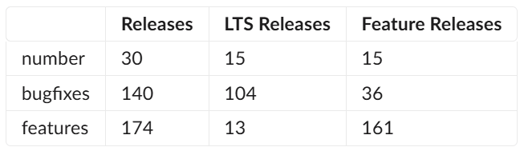
Since HTC25…

Slide 6
Highlights on the web, full details in the Manual
Highlights:
https://htcondor.org/htcondor/release-highlights/
Details:
https://htcondor.readthedocs.io/en/latest/version-history/index.html
Documented all the new features / mechanisms that have been added at each version
Notes about "gotchas" when upgrading from major version X to Y
condor_upgrade_check : tool to evaluate your current setup for incompatibilities before an HTCondor upgrade

Slide 7
On Tuesday, Christina said “understanding what is happening in a distributed system is hard….”

Slide 8
What is happening? What has happened?
Job Event Log (e.g. log = file.log)
ClassAds : key=value pairs
  Job ClassAds
  Slot ClassAds
  Service (Daemon) ClassAds
Where do I find all these lovely ClassAds live?
  Active Job Database (AP schedd) : condor_q, etc
  Archived Job Database (AP history files) : condor_history, etc
  HTCSS Central Manager and CE Collectors: condor_status, condor_ce_status, etc

Slide 9
1. Active Job Database
Jobs still active in the AP – “condor_q”
(could run now or in the future)
(still in core in the schedd)

Slide 10
Active Job Database
New -aaf flag: Append Auto Format
We encourage custom job/slot attributes
You can always show with –af
  condor_q –af // condor_status –af
If you want all usual + custom, -aaf

Slide 11
Example of the “-aaf” flag
… and an Idle job in “Cooldown”
$ condor_q –nobatch –aaf MyProject
ID OWNER SUBMITTED RUN_TIME ST CMD MyProject
772.0 someone 6/1 01:40 0+04:51:36 R run ImportantProject
772.1 someone 6/1 01:40 0+01:21:33 Ic run ImportantProject
772.2 someone 6/1 01:40 0+00:00:00 I run ImportantProject

Slide 12
condor_watch_q improvements
condor_watch_q improvements for viewing DAGMan jobs
condor_watch_q now prioritizes displaying rows with jobs still active in the Access Point queue.
  Options to have tool stop displaying rows of completed jobs after a specified amount of time
Press any key to exit rather than just CTRL-C

Slide 13
htcondor noun-verb enhancements
htcondor joblist report (incorporating Kashika’s work – see talk)
htcondor dag status
htcondor dag resources
htcondor dag histogram

Slide 14
htcondor dag status <dagid>
$ htcondor dag status 223
DAGMan Job 223.0 [simple.dag] has been running for 52 days 04:12:46.
DAG has submitted 382 individual job(s), of which:
45 are running.
10 are idle.
0 are held.
162 have completed successfully
DAG has failed nodes but will continue until all possible work is finished: 5 nodes failed.
10 nodes waiting to begin.
24 nodes running.
[###########=======----------------] 34% complete.
Notes:
Sample output from "htcondor dag status", to see status about a DAGMan job….

Slide 15
htcondor dag resources <dagid>
$ htcondor dag resource 1234.0
NODE_NAME JOB_ID STATUS MEM_USAGE REQ_MEM STARTS REMOTE_HOST
batch_D5AEL7_1 7172.0 Running 1465 4096 2 slot1_59@e4056.chtc.wisc.edu
batch_E6PBW7_1 7118.0 Running 1465 4096 3 slot1_66@e4075.chtc.wisc.edu
Total 2 jobs; 2 running, 0 idle; avg memory utilization: 35.8%

Slide 16
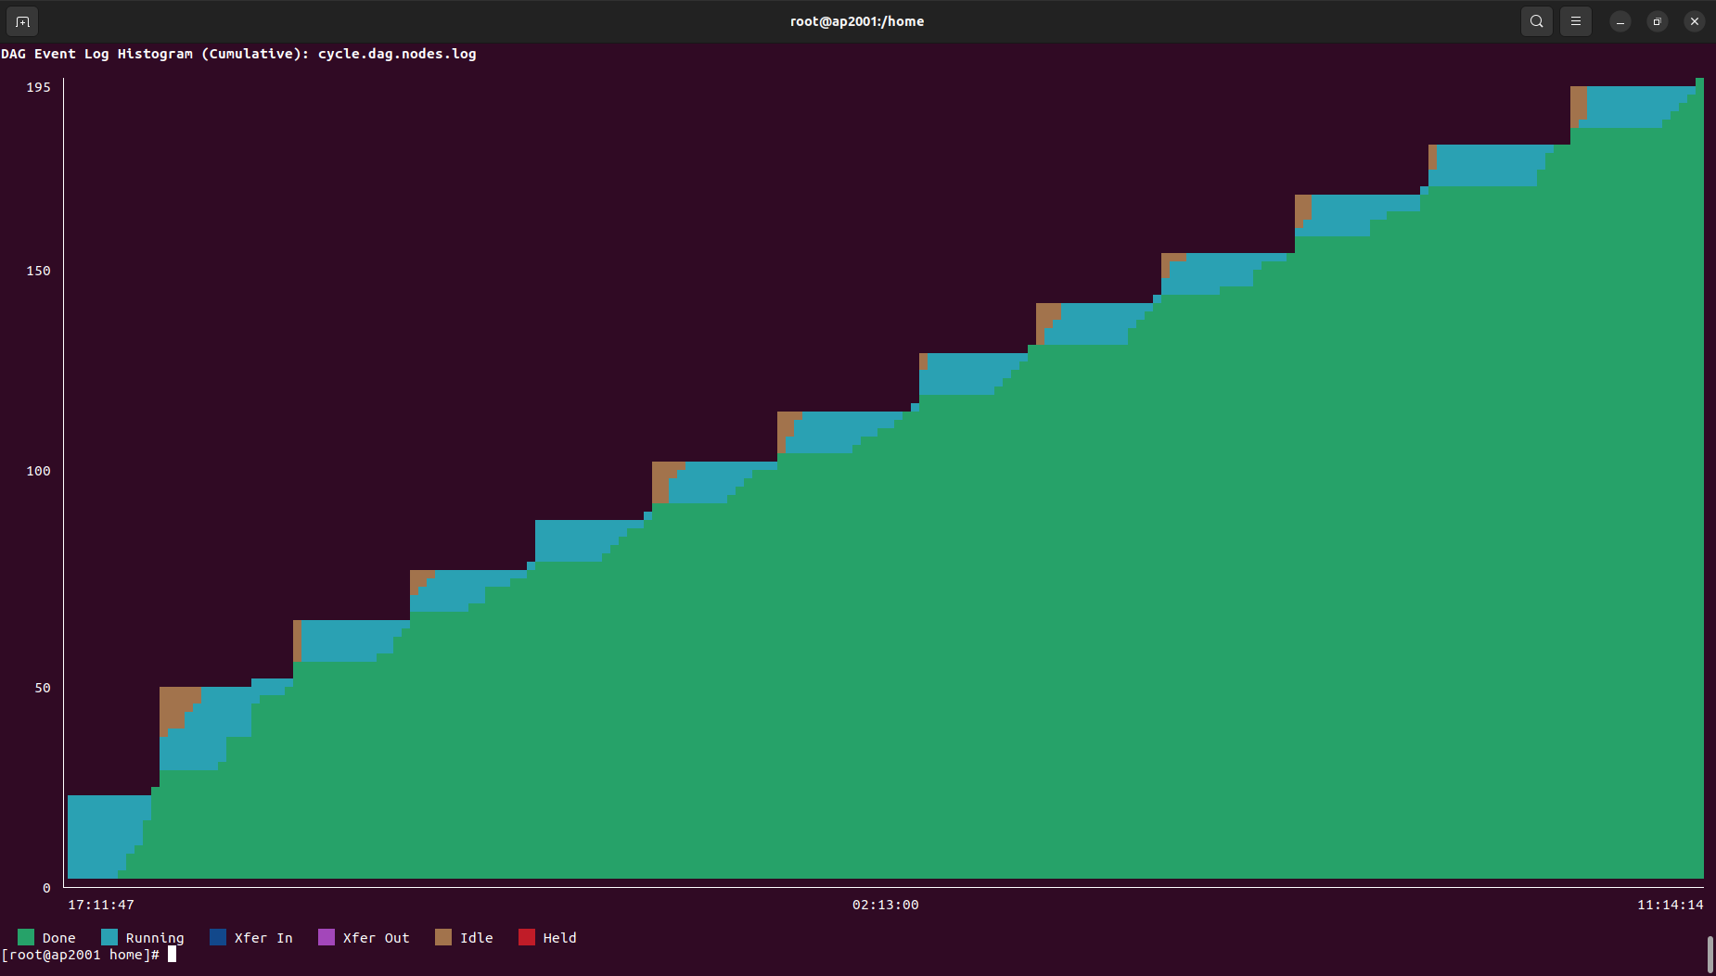
htcondor dag histogram

Slide 17
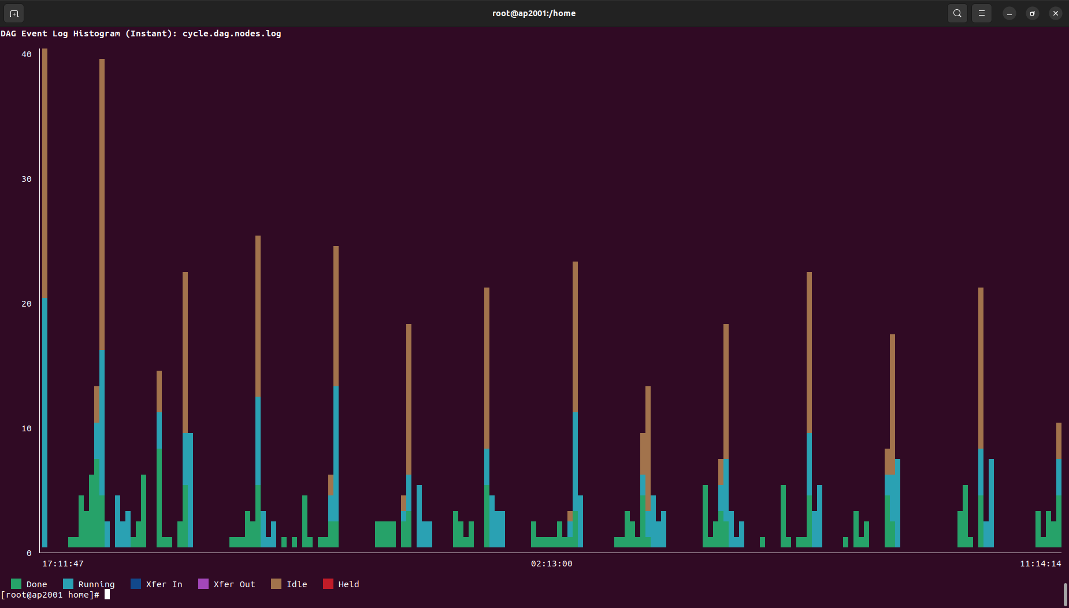
htcondor dag histogram --instant

Slide 18
condor_rm -transfer
condor_rm –transfer
  Removes the job, sends it to the archive
  But first transfers the sandbox
    Not to spool, but to the final transfer spot
    (including non-cedar protocols)

Slide 19
2. Archived Job Database
Snapshot at the AP of job classads for jobs that have
left the Running state
Typically use “condor_history” to access

Slide 20
Archived Job Database
Issues:
Very slow for old jobs
Hard to make any aggregates
Garbage collection: all info re old jobs is eventially removed
Hurts effectiveness of other tools meant to improve user experience
Accessing history is difficult because condor_history must parse flat files sequentially to find specific job data.

Slide 21
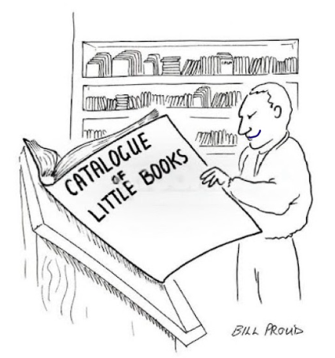
Archive Librarian
New daemon at the Access Point responsible for maintaining an index of archived job records (w/ SQLite).
Allows tools that access the archive (e.g. condor_history) to quickly locate specific job records when given specific job ids rather than sequentially scanning flat archive files.
Keeps some (small amount) job info around after garbage collection
Easily enable by setting use feature:librarian in configuration of HTCSS Access Point
See Final Report by CHTC
Fellow Sandhya Nayar
https://chtc.cs.wisc.edu/fellowships/reports/2025/sandhya-nayar.html

Slide 22
condor_adstash
Replicates ads in an Archived Job Database to ElasticSearch / OpenSearch
Improvements
  New: Option to use a projection (i.e. allow-list) of attributes
  Upcoming: Option to use an ignore (i.e. deny-) list of attributes
  Upcoming: More robust index mappings and settings
    Use existing index mappings' field properties to coerce data types
    Only update mappings on new, known "CamelCase" fields
    Options to supply your own custom field properties and dynamic templates
    Continue populating existing, unknown "lowercase" keyword fields
    Index unknown fields by default (e.g. machineattr fields)
    Correctly map nested ClassAds (e.g. TransferInputStats, NumVacatesByReason, etc.)
    Automatically increase the index field limit as needed (warn if > 5,000 fields)
Notes:
Previous behavior was to use hardcoded lists of attributes to coerce data types, which could conflict with the existing mappings if these lists were ever changed between versions. These lists still exist, but they are only used to update the existing mappings when the attributes don't already exist in the mappings. The mappings themselves are now the source of truth for typing.
Indexing unknown fields increases disk usage but we've learned the hard way that we almost always want to be able to search or aggregate on at least some of these fields, particularly any MachineAttr fields that our AP configs add, but there are others (like when we added and started testing automatic memory request increase features).
We also learned the hard way that it's easy to hit the default index field limit (1,000) because people can add anything to their job ClassAds. All it takes is one user adding a custom attr one time to permanently add a new field to the index.

Slide 23
3. HTCSS Central Manager Collector and/or CE Collectors
Live information about the pool or site
ClassAd for every slot, every daemon, every active user
Typical tool: condor_status

Slide 24
Q: How many slots are running a job?
A: Count slots where
State == Claimed
(and Activity != Idle)
How?

Slide 25
Obvious solutions aren’t the best
% condor_status
slot7@ale-22.cs.wi LINUX X86_64 Claimed Busy 0.990 3002 0+00:28:24
slot8@ale-22.cs.wi LINUX X86_64 Claimed Busy 1.000 3002 0+00:14:13
slot1@ale-23.cs.wi LINUX X86_64 Unclaimed Idle 0.920 3002 0+00:00:04
…
condor_status | grep Claimed | grep –v Idle | wc –l
  Output subject to change, wrong answers, slow
condor_status –l | grep Claimed | wc –l
  Wrong answers, really slow

Slide 26
Use constraints and projections
From
condor_status [-startd | -schedd | -master…]
–constraint <classad-expr>
–autoformat <attr1, attr2, …>
Where
Select
condor_status -startd \
-cons 'State=="Claimed" && Activity!="Idle"' \
-af name | wc -l

Slide 27
Q: How many CPU cores are being utilized?
Sum the Cpus attribute for each slot that is Claimed and Busy:
% condor_status -startd \
-cons 'State=="Claimed" && Activity!="Idle"' \
-af Cpus | less
1
1
4
4
…
% condor_status -startd \
-cons 'State=="Claimed" && Activity!="Idle"' \
-af Cpus | st
N min max sum mean stddev
9053 1 40 10410 1.1499 1.39239
Simple Statistics from command line
https://github.com/nferraz/st

Slide 28
Graph of CPU utilization over time
Could have a cron job run every minute…
#!/bin/sh
echo `date`, ; condor_status \
-cons 'State=="Claimed" && Activity!="Idle"' \
-af Cpus | st --sum
What if you have hundreds or thousands of metrics?
  COLLECTOR_QUERY_WORKERS = 5000?
How about query the collector just once per minute for all attributes needed to compute all metrics?

Slide 29
condor_gangliad
condor_gangliad queries a (set of) condor_collector(s) once per minute
  use feature:ganglia
condor_gangliad has config file to filter and aggregate attributes from the ads in the condor_collector in order to form metrics
Forwards these metrics to Ganglia, which
stores these values in a database and provides graphs
over the web

Slide 30
condor_metricd
condor_metricd queries a (set of) condor_collector(s) once per minute
  use feature:metricd
condor_metricd has config file to filter and aggregate attributes from the ads in the condor_collector in order to form metrics
Gives these metrics to Ganglia or Prometheus, which stores these values in a database and provides graphs over the web (should there be other back ends?)

Slide 31
condor_metricd, cont
Supports
  Gauges
  Counters (including aggregates of counters)
  Labels
Prometheus exporter on http port 9618 by default
  Honors ALLOW_READ ip address limiting
  http basic auth
  Can specify a different port (and proxy it with NGINX etc)

Slide 32
Example metric definitions
[
Name = "CpusInUse";
Aggregate = "SUM";
Value = Cpus;
Requirements = State=="Claimed" && Activity!="Idle";
TargetType = "Machine";
]
[
Name = "CpusNotInUse";
Aggregate = "SUM";
Value = Cpus;
Requirements = State!="Claimed" || Activity=="Idle";
TargetType = "Machine";
]

Slide 33
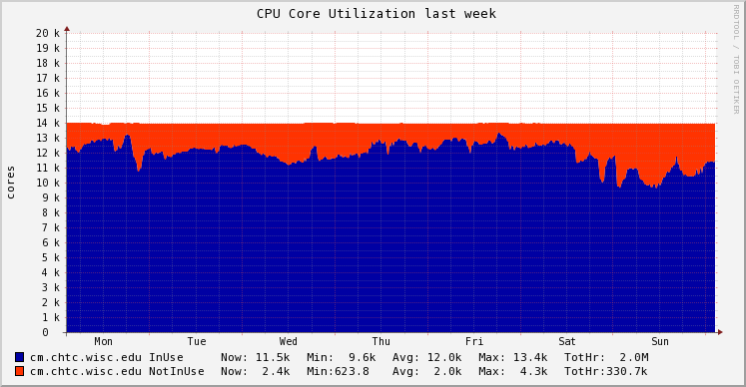
Voila!

Slide 34
Why are cores not in use?
[
Name = "CpusNotInUse_LowMemory";
Aggregate = "SUM";
Value = Cpus;
Requirements = State=="Unclaimed" && Memory < 1024;
TargetType = "Machine";
]
[
Name = "CpusNotInUse_Draining";
Aggregate = "SUM";
Value = Cpus;
Requirements = State=="Drained";
TargetType = "Machine";
]

Slide 35
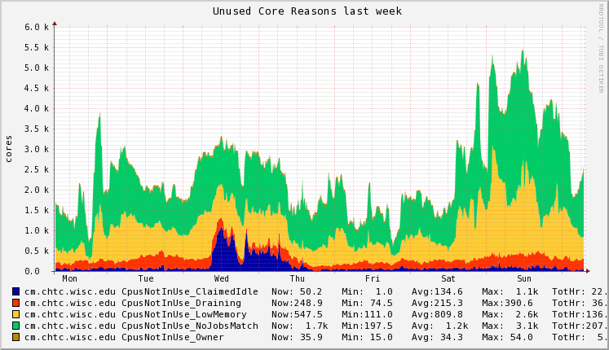
Unused Core Reasons

Slide 36
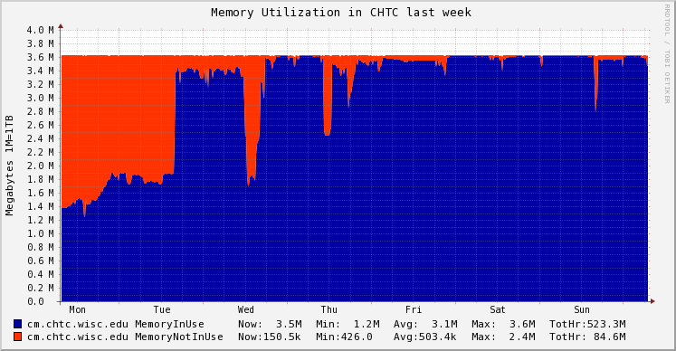
Memory Provisioned
[
Name = "MemoryInUse";
Aggregate = "SUM";
Value = Memory;
Requirements = State=="Claimed" && Activity!="Idle";
TargetType = "Machine";
]
[
Name = "MemoryNotInUse";
Aggregate = "SUM";
Value = Memory;
Requirements = State!="Claimed" || Activity=="Idle";
TargetType = "Machine";
]

Slide 37
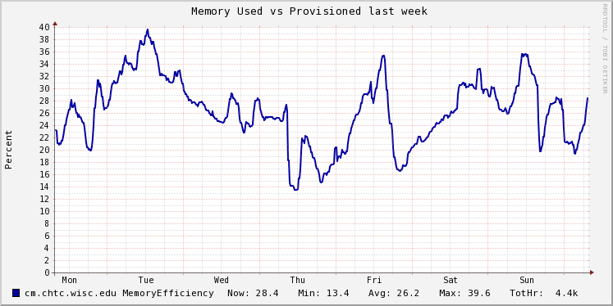
Memory Used vs Provisioned
Define MemoryEfficiency metric as:
[
Name = "MemoryEfficiency";
Aggregate = "AVG";
Value = real(MemoryUsage)/Memory*100;
Requirements = MemoryUsage > 0.0;
TargetType = "Machine";
]

Slide 38
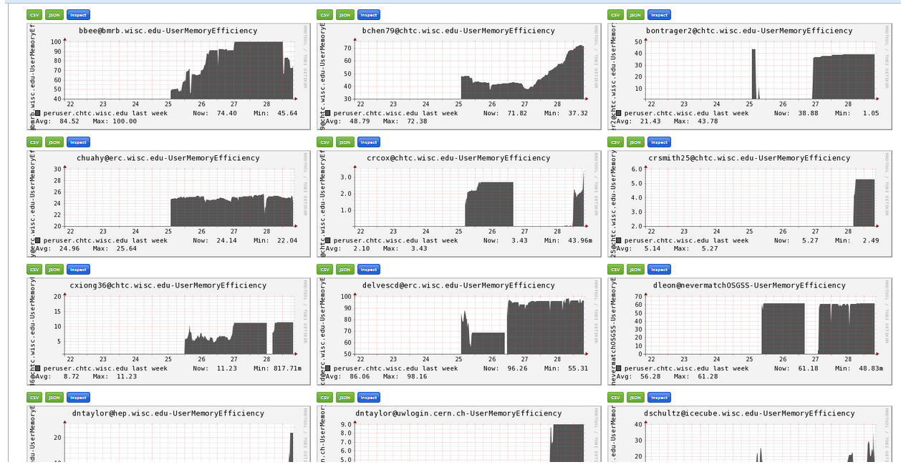
Example: Metrics Per User
[
Name = “UserMemoryEfficiency”
Labels = {“user”,RemoteUser};
Ganglia_Name = strcat(RemoteUser,"-UserMemoryEfficiency");
Title = strcat(RemoteUser," Memory Efficiency");
Aggregate = "AVG";
Value = real(MemoryUsage)/Memory*100;
Requirements = MemoryUsage > 0.0;
TargetType = "Machine";
]

Slide 39
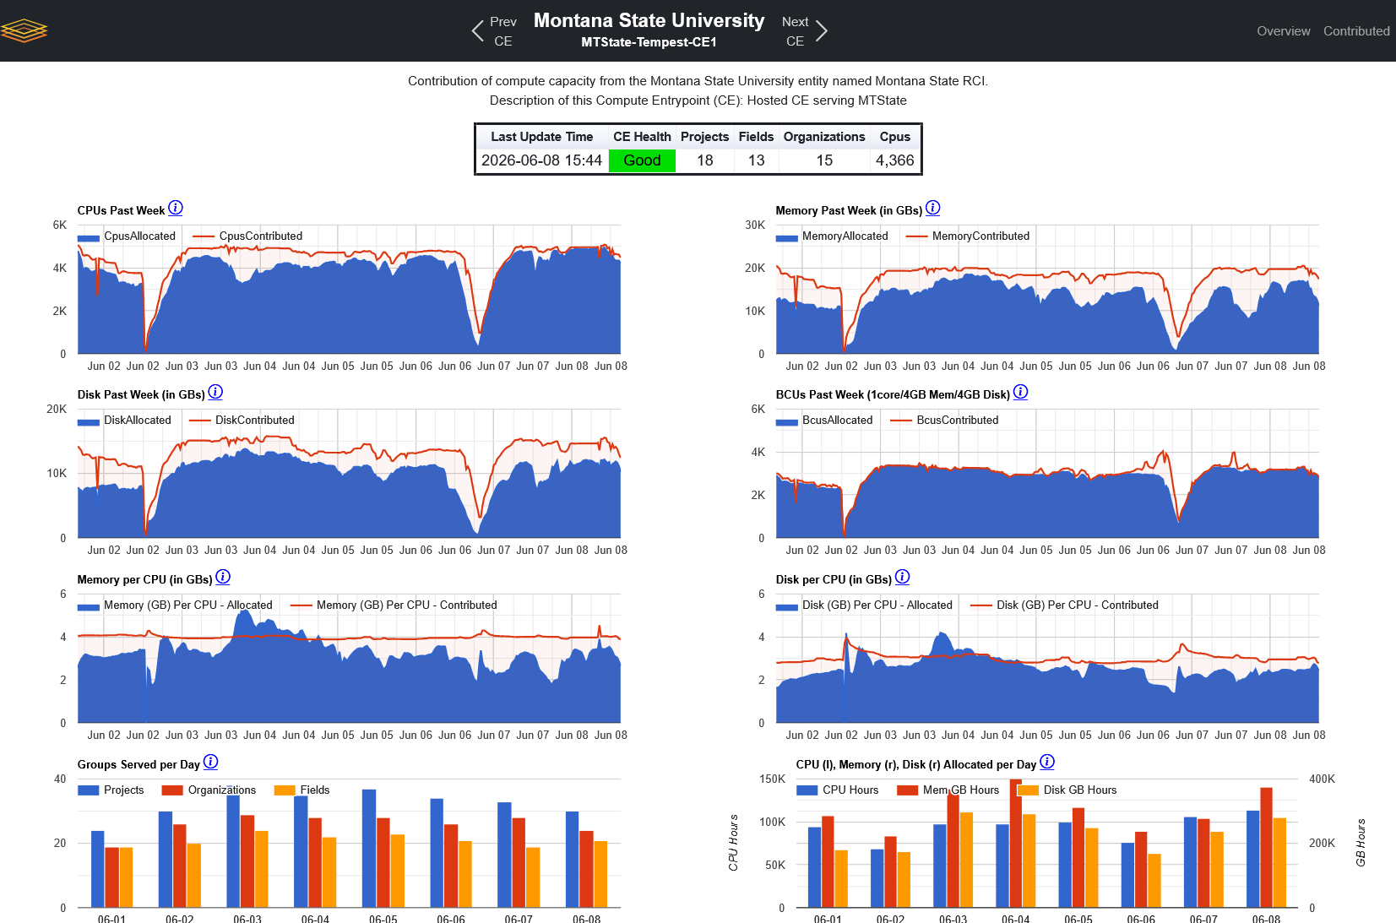
CE Dashboard

Slide 40
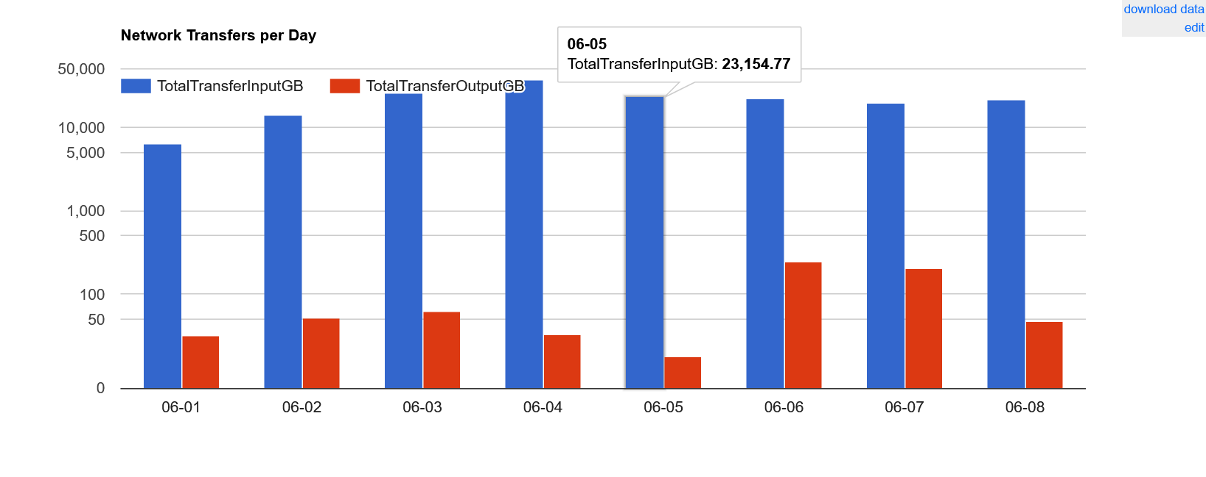
CE Dashboard

Slide 41
floor and ceiling leasing
$ condor_userprio –setceiling todd 12 \
–duration 3600
$ condor_userprio –cancelsetceiling todd
$ condor_userprio –setfactor todd 3 \
–duration 3600
$ condor_userprio –cancelsetfactor todd

Slide 42
Owned Capacity Units (OCU) preview
OCU is an "owned" slot with a defined set of resources (e.g. 1 GPU, 8 CPUs, 32GB Memory, …)
  Owner can always quickly start using the slot
  Non-owner can opt in, but will get preempted if owner returns
  If EP hosting the slot disappears, AP works to replace it
  Useful for GPUs, etc.

Slide 43
HTCondor Annex Changes:
Glidein an EP to any Slurm Cluster
“htcondor annex create” used to present a menu of NSF HPC Sites
  NCSA, SDSC, Purdue, …
Now “htcondor annex create” gives you a tarball file
  Transfer this file to your Slurm login node
  Untar it – inside is a README: run a tool, sbatch submit, profit!
    Jobs placed on the AP tagged with the name of the Annex will run
  All logs available to the user
Why the change?

Slide 44


Gliding into DOE sites
Grid Universe Enhancements
Support for NERSC SuperFacility REST API
  remote interface to Perlmutter HPC
  Initial code contributed by Karan Vahi (Pegasus)
Support for Flux scheduler
  Used at Lawrence Livermore National Laboratory
  Initial code contributed by Ian Lumsden
Support for IRI (Integrated Research Infra) REST API (upcoming)
# Flux support was added as part of work supported by the US National Science Foundation
# under Grant No. 2530461, 2513101, 2331152, 2223704, 2138811, and 2103845.
#
# Flux support was also added under the auspices of the U.S. Department of Energy by
# Lawrence Livermore National Laboratory under Contract DE-AC52-07NA27344
# and was supported by the LLNL-LDRD Program under Project No. 24-SI-005.

Slide 45
Common Input Data
Amount of job input is growing
  Container Images (.SIF files)
  AI/ML Data
Often many of the same files occur across all jobs
  … in a Job List (cluster)
  … in a DAG workflow
executable = myjob.exe
container_image = kitchenSink.sif
output = out.$(Process)
queue 1000

Slide 46
Moving Input Today
Execution Point
Slot 1 → Job 55.0
Slot 2 → Job 55.1
Slot 3 → Job 55.2
Access Point
Send/Store kitchenSink.sif
Send/Store kitchenSink.sif
Send/Store kitchenSink.sif
Bad for the network (esp WAN)
Bad if EP has more compute than storage

Slide 47
Pelican Local Cache on the EP
Object Store
Cache files coming from OSDF (Pelican) on the EP
use feature:PelicanCache(size of cache)
Works with a glidein EP as well. Voila!!
Origin
Cache
HTCSS EP
+
EP Pelican Cache

Slide 48
Pelican Local Cache on the EP
Object Store
Cache files coming from OSDF (Pelican) on the EP
use feature:PelicanCache(size of cache)
Works with a glidein EP as well. Voila!!
Origin
Cache
What’s the Bad News?
  Admin must fragment EP Disk Space
  What about data transferred without Pelican?
    Files from the AP (HTCondor File Transfer / CEDAR)
    Files from Web Server URLs / HTTP
  Data Stored twice! Need double the EP disk space
    One copy in EP Pelican Cache, then copied to job slot scratch dir
  AP knowledge not captured
HTCSS EP
+
EP Pelican Cache

Slide 49
HTCSS Support for Common Files
Shares common files between jobs in the same job list (cluster) and/or jobs in the same DAG.
    Transfers them only once regardless of protocol
    Makes only one copy on-disk (if possible…)
    Controlled by the AP.
What does the user do? In the JDL:
  transfer_common_files = xxx, yyy, …
  container_is_common = True | False
What does HTCSS do?

Slide 50
Moving Input Today
Execution Point
Slot 1 → Job 55.0
Slot 2 → Job 55.1
Slot 3 → Job 55.2
Access Point
Send/Store kitchenSink.sif
Send/Store kitchenSink.sif
Send/Store kitchenSink.sif
Bad for the network (esp WAN)
Bad if EP has more compute than storage

Slide 51
HTCSS Support for Common Files
Execution Point
Data Slot 1 → Files for 55
Slot 1 → Job 55.0
Access Point
Send/Store kitchenSink.sif

Slide 52
HTCSS Support for Common Files
Execution Point
Data Slot 1 → Files for 55
Slot 1 → Job 55.0
Access Point
Send/Store kitchenSink.sif
Hard-link
common
input files
from the
data slot!

Slide 53
HTCSS Support for Common Files
Execution Point
Data Slot 1 → Files for 55
Slot 1 → Job 55.0
Slot 2 → Job 55.1
Slot 3 → Job 55.2
Access Point
Send/Store kitchenSink.sif
Hard-link
common
input files
from the
data slot!

Slide 54
Dealing with Over Provisioning of Resources
New Retry Request feature – now for both disk and memory.
Try the first, if resource exceeded, re-run with the next value.
request_memory = 1GB
retry_request_memory = 4GB
request_disk = 1GB
retry_request_disk = 10GB,40GB

Slide 55
What is MCP (Model Context Protocol)?
An open standard that lets AI assistants talk to your tools and data.
Think of it as a “USB-C port for AI” — one connector, many systems.
The AI app (the host) connects through MCP to lightweight servers.
Each server exposes tools, data, and prompts in a common format.
Build a server once — any MCP-aware assistant can use it.
AI Assistant (Host)
MCP — one open protocol
MCP Server
MCP Server
MCP Server
Files / Data
APIs
HTCSS
(next slide)

Slide 56
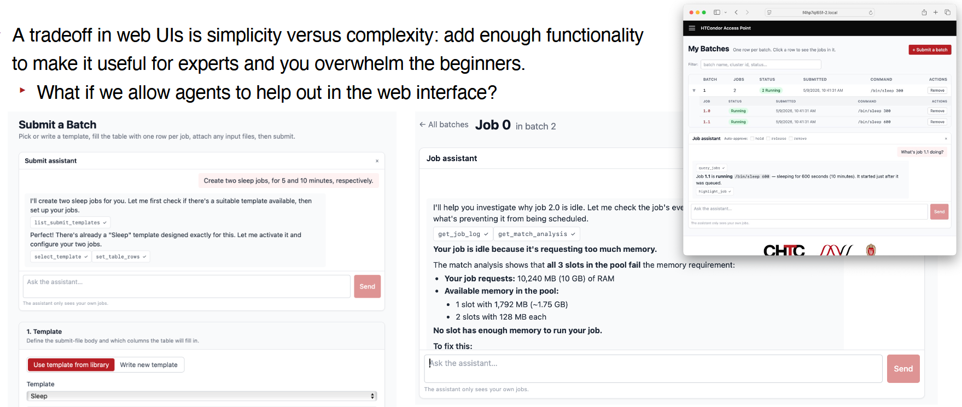
Exploring HTCSS MCP
Easy to embed an agent into a web page
- … but UX challenges to go beyond AI “slop”
See Brian B’s talk from yesterday
See Girodon S’s talk from yesterday
See Ilija V’s talk tomorrow

Slide 57

Open OnDemand
Investigate (and improve?) Open OnDemand integration with HTCondor AP

Slide 58
Reproducible Builds
Helps against supply chain attacks (e.g. xz)
Required by Debian (encouraged by EL)
You should be able to make bitwise identical binaries as we ship

Slide 59
Reproducible builds are hard
FILE macro in fatal exceptions:
ERROR "This should never happen" at line 2624 in file /home/todd/CONDOR_SRC/src/condor_status.V6/status.cpp
ERROR "This should never happen" at line 2624 in file ./src/condor_status.V6/status.cpp
Build Date in condor_version
  $ condor_version
      $CondorVersion: 27.8.1 2028-03-31
Other headaches
https://reproducible-builds.org/
Which date?

Slide 60
Container improvements
Local universe uses cgroups by default
Optionally enforces if Request_Memory set
condor_ssh_to_job works in more places
with usernamespaces and non-root condor
Can't work work non-root condor and setuid apptainer
Container universe now supports AMD HIP/ROCM

Slide 61
condor_dag_checker (teased last year)
Lint DAG files before execution for validity
  Correct command syntax
  Check for parse errors
  Check for references to undefined nodes
  Check for valid node dependencies
  Check for cycles in DAG structure
  Check for infinite recursive DAG file inclusion
  [Optional] Check valid JDL specified (best effort similar to condor_submit –dry-run)
  [Optional] Verify Pre/Post scripts exist
Get useful DAG statistics

Slide 62
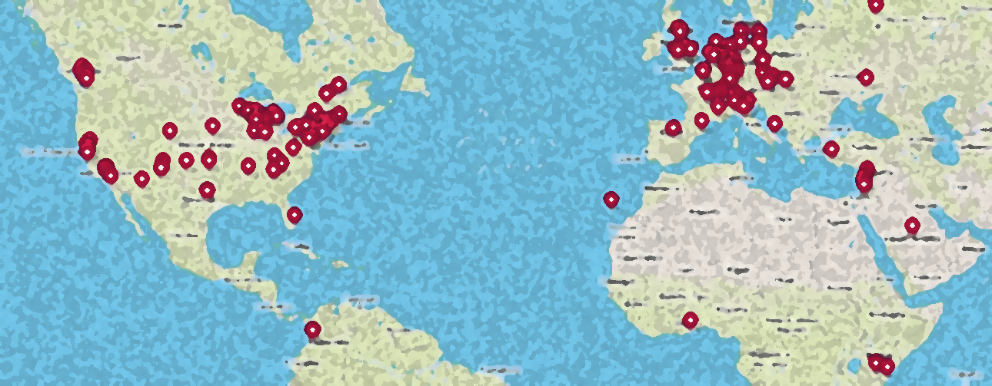
Thank You!
Please add your institution
to our world map of HTCondor Users at:
https://htcondor.org/user-map
and click "Add Your Institution" on upper right
This work is supported by NSF under Cooperative Agreement OAC-2030508 as part of the PATh Project. Any opinions, findings, and conclusions or recommendations expressed in this material are those of the author(s) and do not necessarily reflect the views of the NSF.

