Slide 1

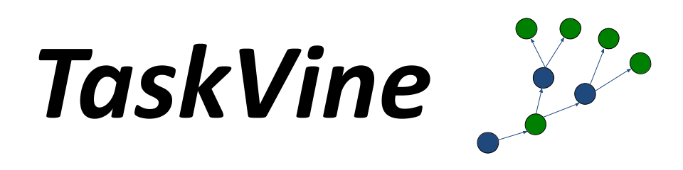
Wrangling Massive Task Graphs with Vine Reduce
Ben Tovar and Douglas Thain
University of Notre Dame
Throughput Computing
University of Wisconsin
11 June 2026

Slide 2
Wrangling Massive Task Graphs
From Workflows to Task Graphs
Task Graphs with TaskVine
But What Happens at Large Scale?
Hierarchical Reduction with Vine Reduce
Lessons Learned and What's Next?

Slide 3
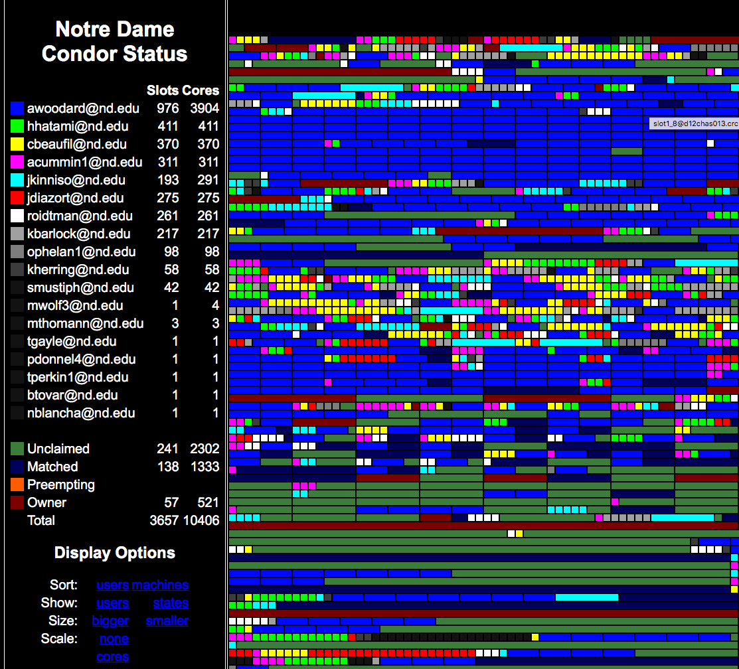
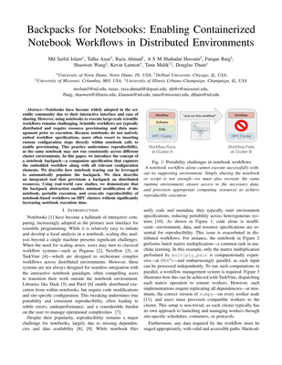
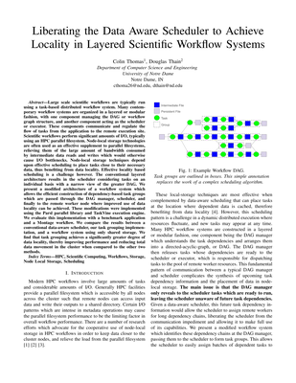
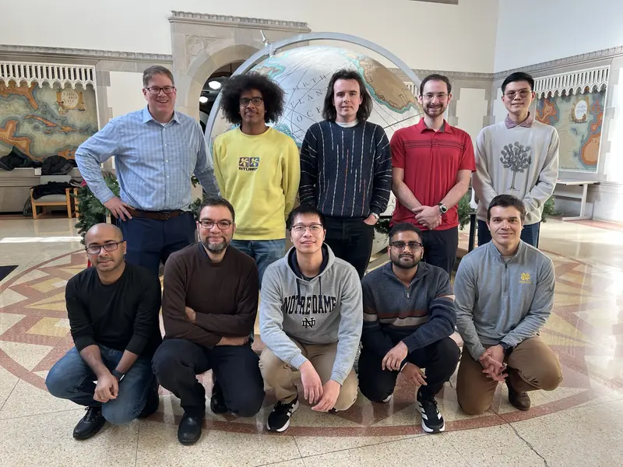
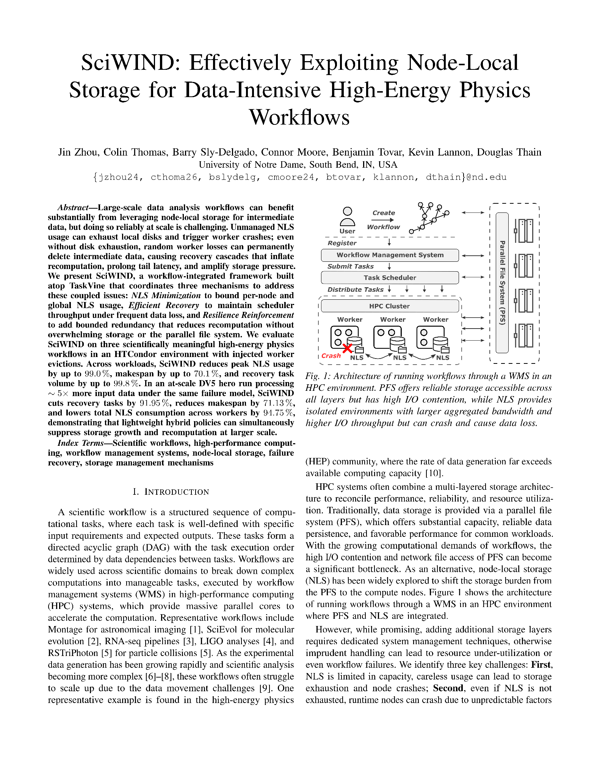
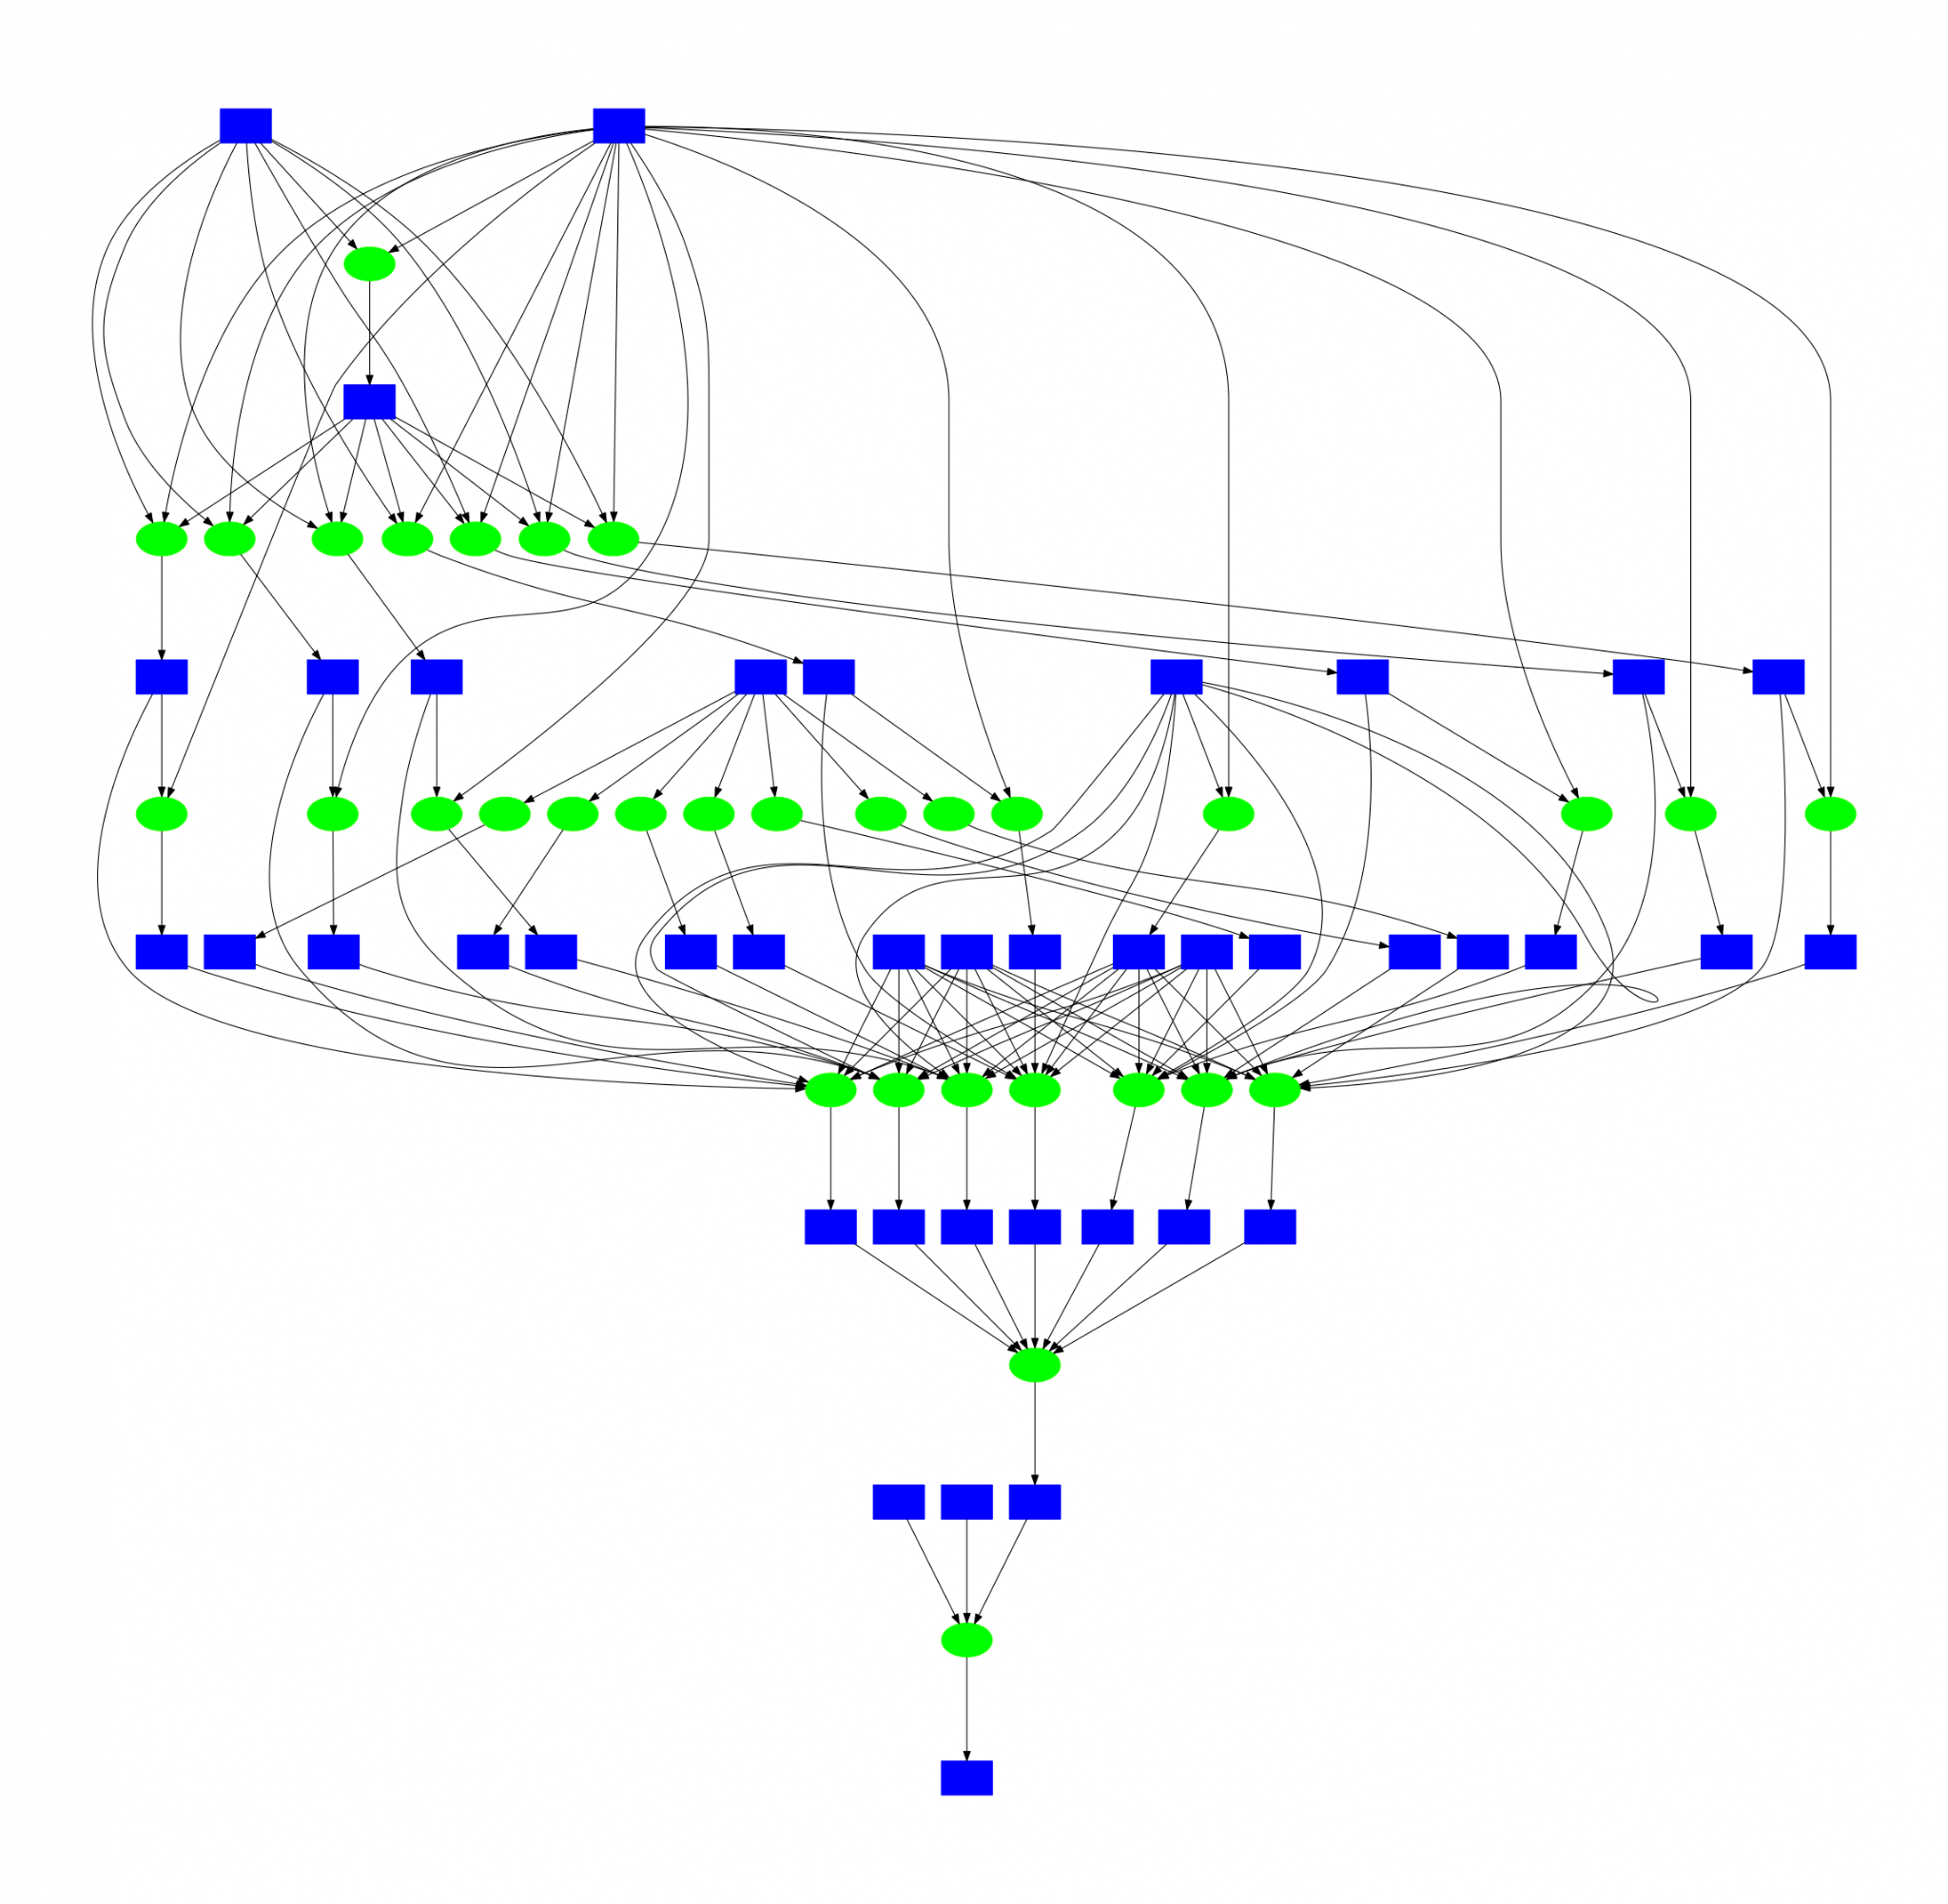
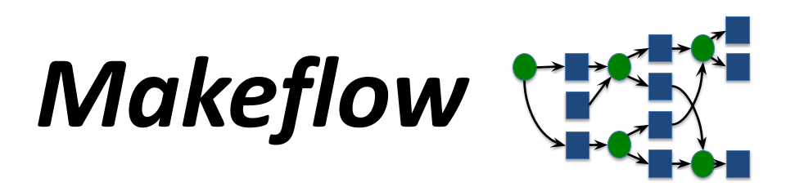



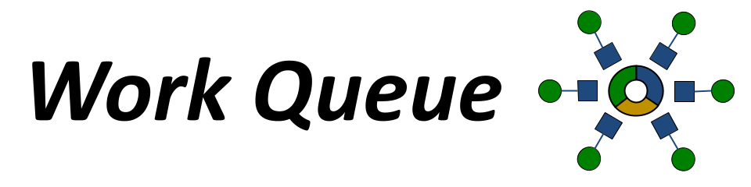
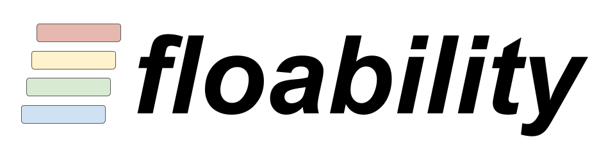
The Cooperative Computing Lab
http://ccl.cse.nd.edu

Slide 4
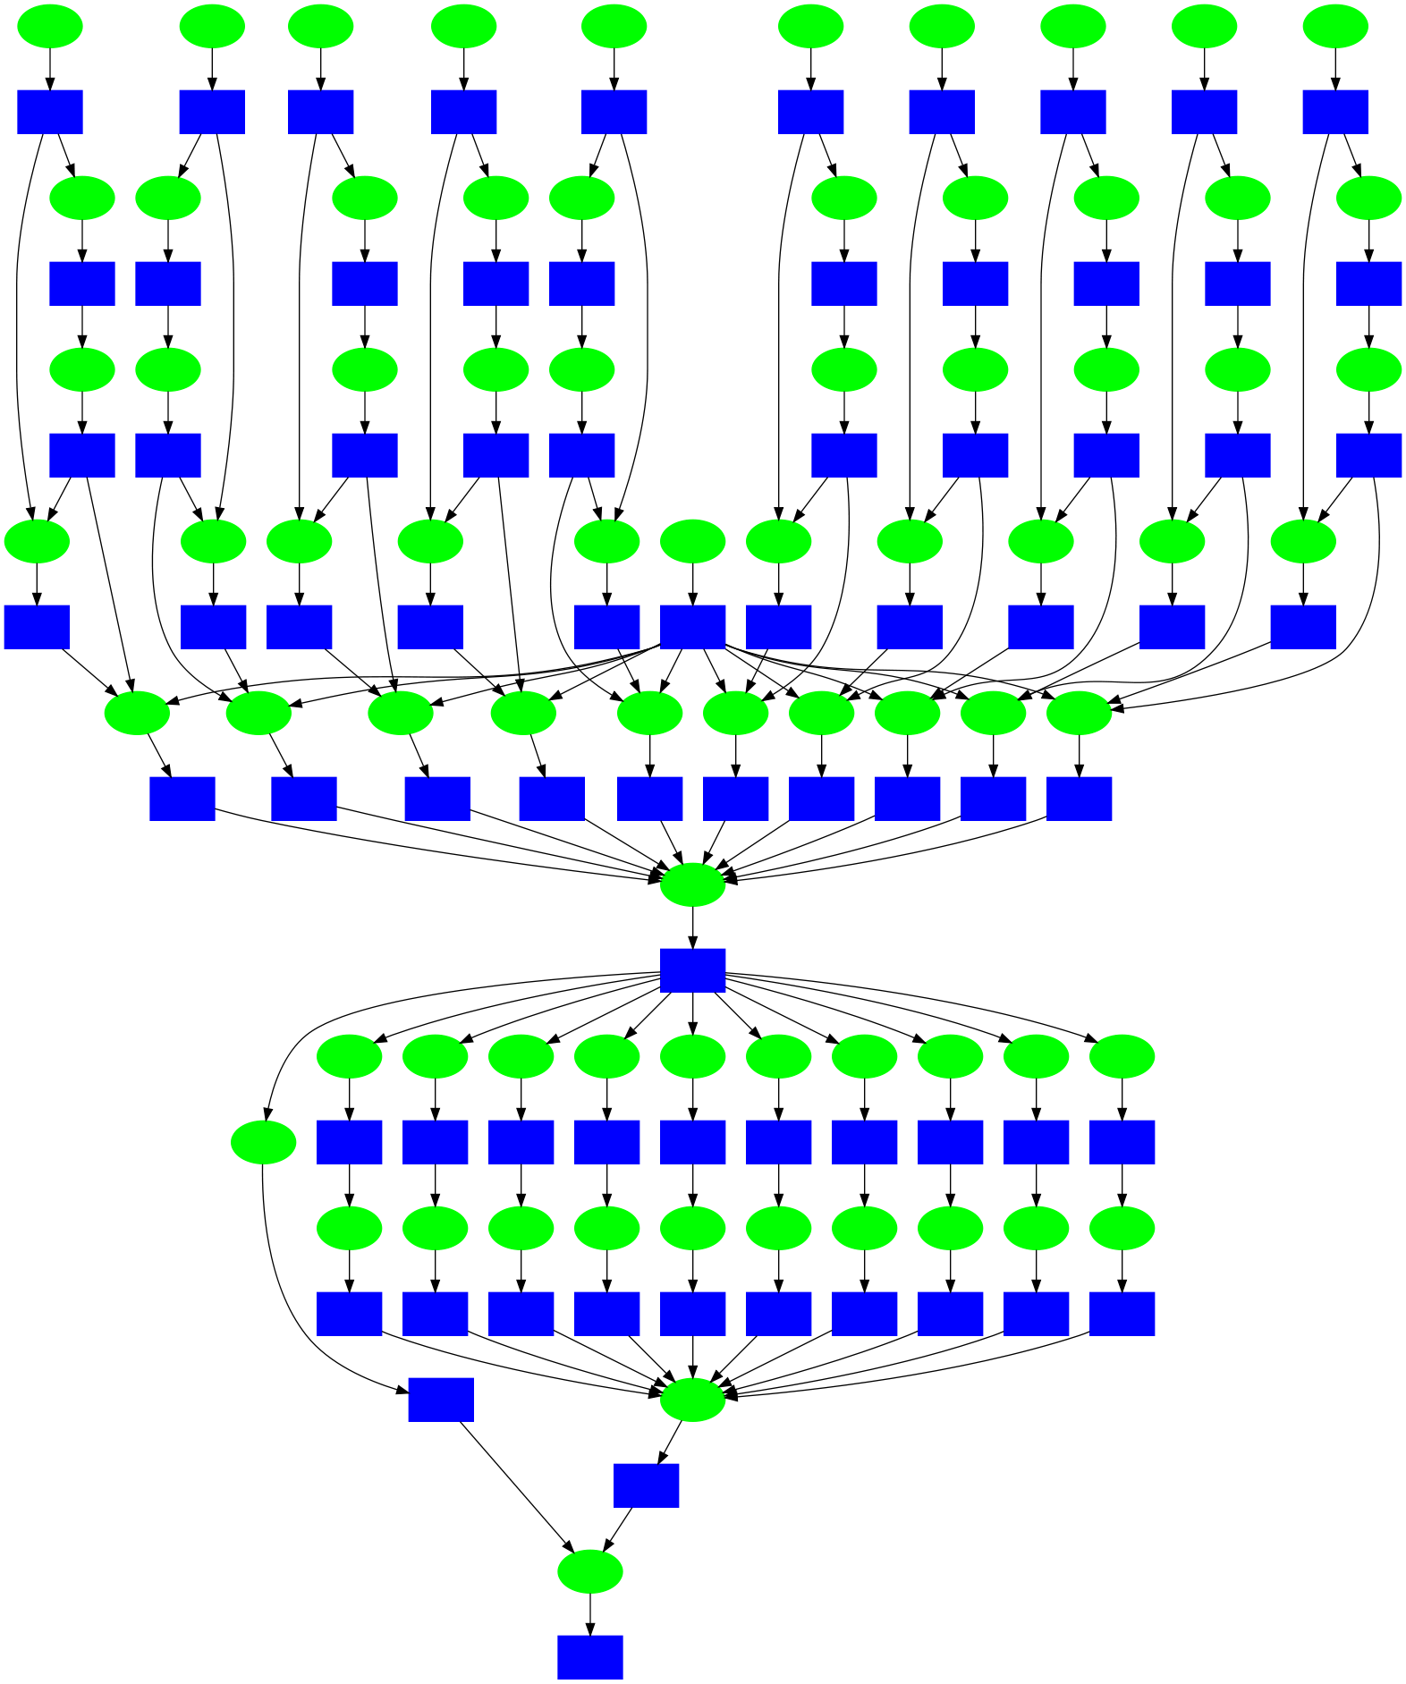
Everyone Knows About Workflows
End User
Conventional Workflow Systems
Each green square an executable program to be run via Unix fork/exec. (mins to hours)
Each blue square a file in the filesystem accessed via Unix. (MB to GB)
End user writes out the individual nodes and sees the entire graph.
A workflow manager puts the jobs in order and submits them to HTCondor.
Workflow
WMS
HTCondor

Slide 5
Task Graphs are a Variation on Workflows
End User
End user writes a dataflow program in a
familiar programming language.
Each green circle a function to be called with arguments. (sec-min)
Each blue square a data item to be
accessed in memory by a function. (KB-GB)
The graph is generated automatically, and the user (often) does not view or manipulate it.
Manager dispatches tasks to workers.
Workers are deployed on a batch system.
Data Flow Program
Workflow
Manager
Workers
Batch System

Slide 6


Task Graphs are a Variation on Workflows
End User
End user writes a dataflow program in a
familiar programming language.
Each green circle a function to be called with arguments. (sec-min)
Each blue square a data item to be
accessed in memory by a function. (KB-GB)
The graph is generated automatically, and the user (often) does not view or manipulate it.
Manager dispatches tasks to workers.
Workers are deployed on a batch system.
Dask
Workflow
TaskVine Manager
TaskVine Workers
HTCondor

Slide 7
Dataflow Programming in General
dataset
a = dataset("/path/…").split(n)
a0
a1
a2
a3
b = a.map(f).reduce(g)
c = a.reduce(g)
f
f
f
f
d = h(a,b)
t0
t1
t2
t3
# nothing happens until:
print (d)
g
g
g = Task()
g.add_input(t0)
g.add_input(t1)
…
g.add_output(r)
c
h
b

Slide 8
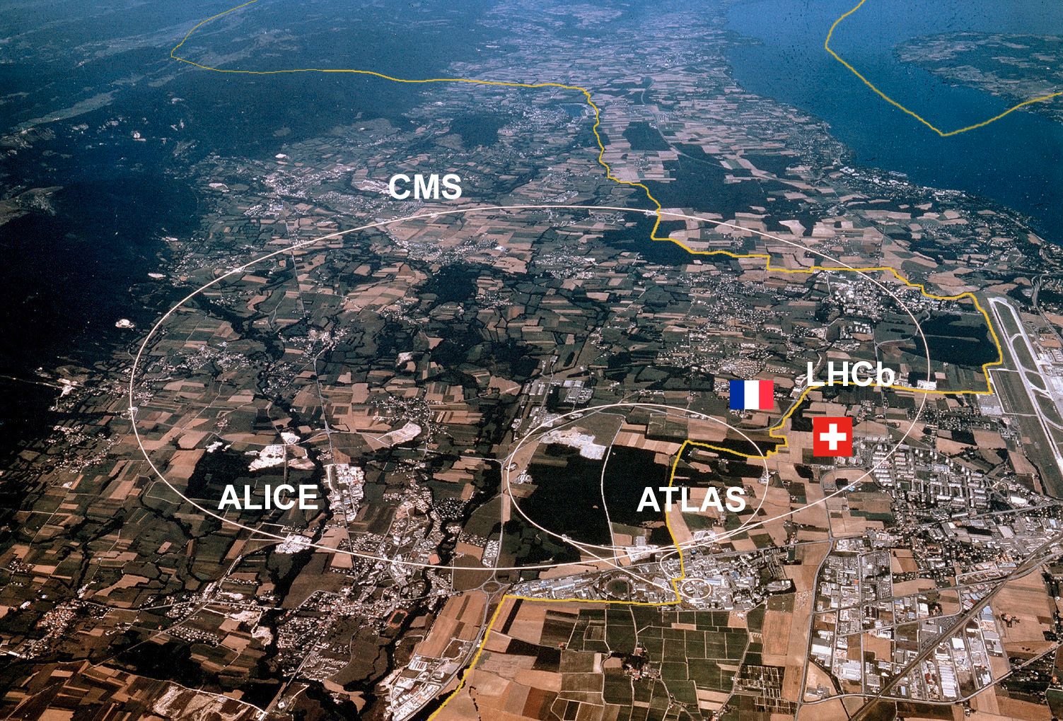
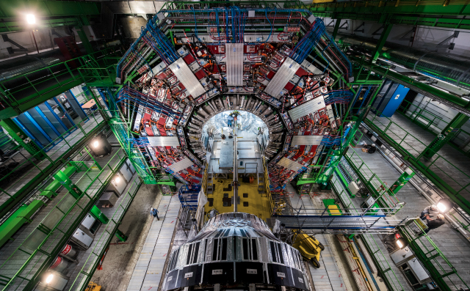
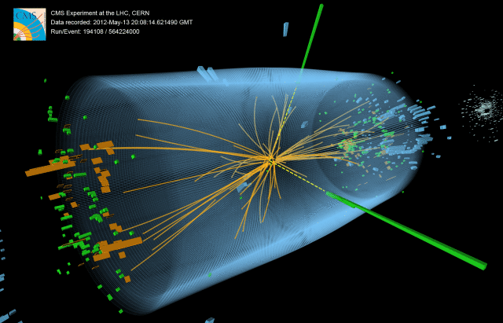
Example: CMS Experiment at the LHC
1. Theory
2. Experiment
The Compact Muon Solenoid (CMS) is one of four experiments at the Large Hadron Collider (LHC). The LHC generates proton beams that collide and generate new subatomic particles in order to learn new physics interactions and discover new particles. (e.g. Higgs Boson)
CMS observes 30M collisions ("events") per second, resulting in several PB of useful data each year. Physicists must write analysis code to sort through these events, select "interesting" categories, compute derived properties, and summarize new physical interactions.
Rapid iterative development in Python using well known numeric toolkits (numpy, pandas, etc).
Potential to execute with extreme parallelism on clusters with thousands of nodes!

Slide 9

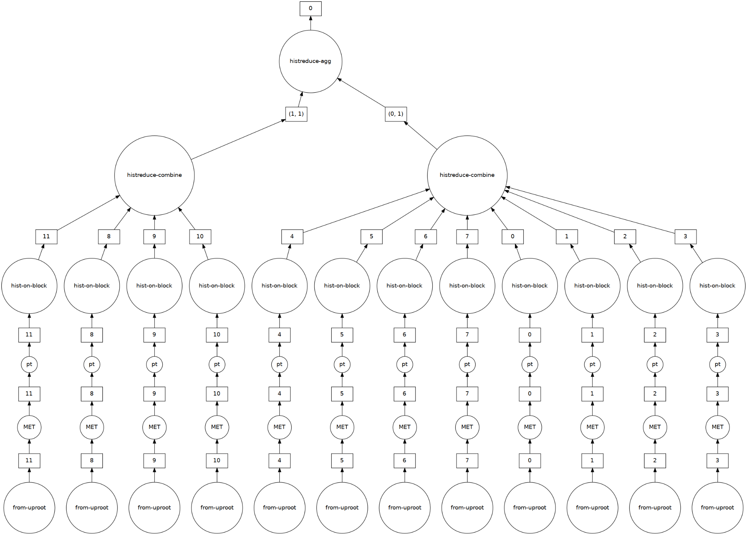
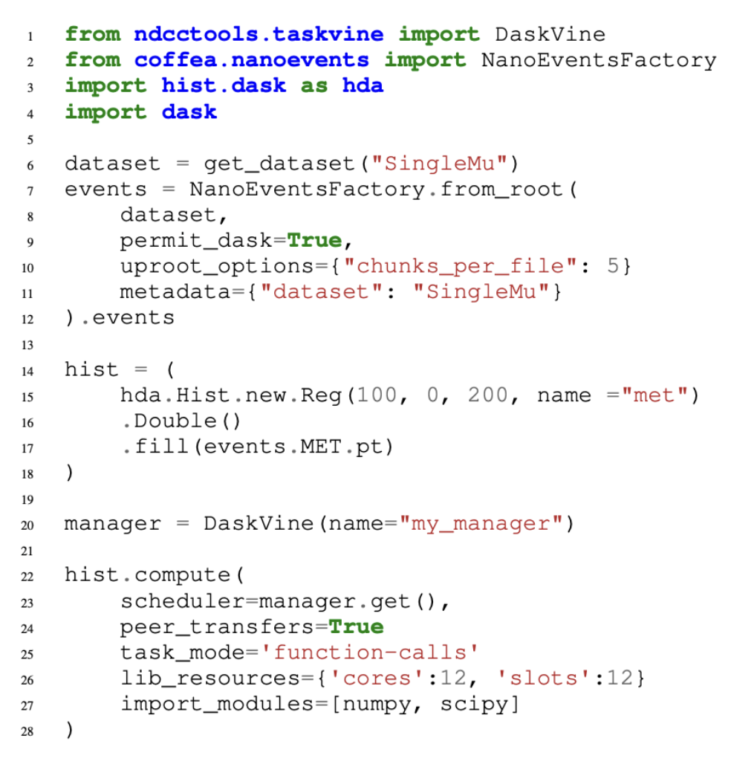
CMS Data Analysis Apps with Dask
Dask is excellent at scale-up on one node (CPU/GPU)
…. but not very stable at scale-out to the cluster.

Slide 10
TaskVine is a scheduler for data intensive, high throughput,
large scale, task graphs on opportunistic resources:
Slice up cores/memory/gpus arbitrarily among tasks.
Automatically choose task resource allocations.
Intermix Unix tasks and FaaS ("serverless") tasks.
Maintain data on the workers, schedule for locality.
Handle failures/retry of workers, tasks, transfers, etc.
Integrates effortlessly with HTCondor as a resource provider.

Slide 11
Dask + TaskVine Architecture
End User
HTCondor Pool
TaskVine
Worker
TaskVine
Worker
Other
App
Dask Program
Workflow
Other
App
TaskVine
Worker
TaskVine
Worker
Shared
Filesystem
Remote
Services
S/W
TaskVine Manager
Files
Files
Files
Data

Slide 12
TaskVine Worker
Application
TaskVine Worker
TaskVine Worker
RAM
CPU
0
CPU
1
GPU
0
GPU
1
tasks
results
f₃
Manager
f₅
url
sd698d
temp
xyz123
file
su3g2n
file
bc98a
file
rockn3
Each task runs in a sandbox with a private file namespace and an allocation of cores, memory, disk, and gpus
Three different kinds of tasks can exist simultaneously and interact with each other:
Unix Executables
Library Tasks
Function Call Tasks
data.tar.gz
input.txt
config
args
T
L
invoke
F
output.txt
stdout.txt
results
Task 1 - Unix Executable
Task 2 - Persistent Library
Task 3 - Function Call

Slide 13
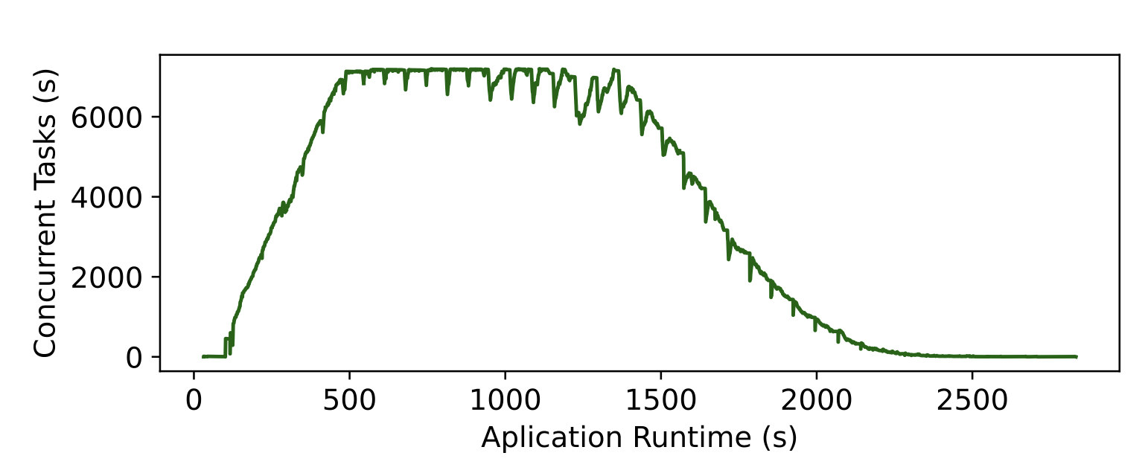
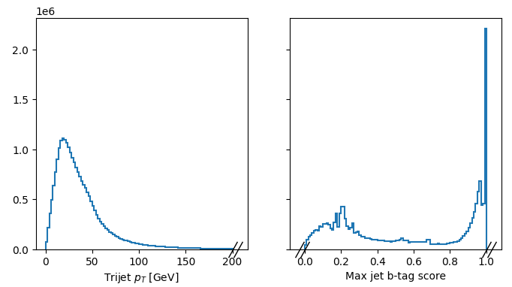

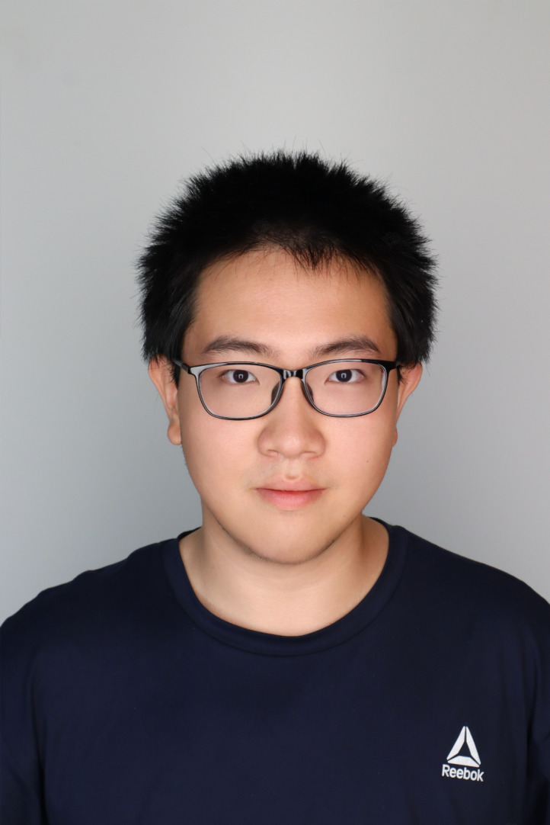
Task Graph Execution with TaskVine
DV5 data analysis program generated task graph of 185,000 tasks, running on 7000 cores done in 41 minutes.
Barry Sly-Delgado, Ben Tovar, Jin Zhou, and Douglas Thain,
Reshaping High Energy Physics Applications for Near-Interactive Execution Using TaskVine,
ACM/IEEE Supercomputing, pages 1-11, November, 2024. DOI: 10.1109/SC41406.2024.00068

Slide 14
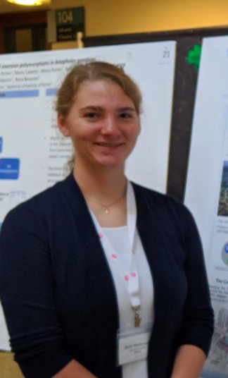
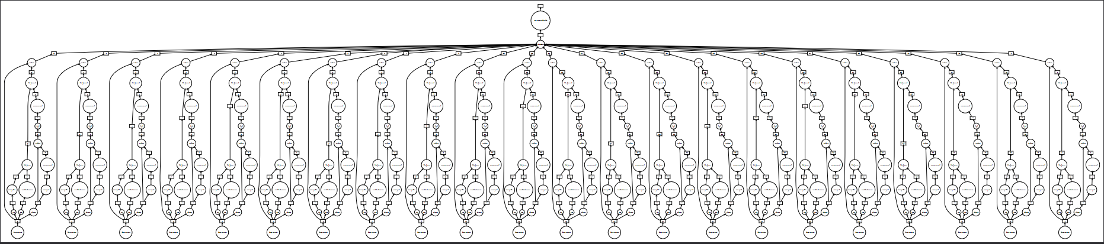
Let's go even larger!
(multiply this graph by 419X to get the full task graph.)
Kelci Mohrman (UFL)
Cortado data analysis application:
419 datasets, 19631 files, 14TB, 12 billion events
Generating the complete Dask graph the simple way
takes 20 hours even before execution starts!

Slide 15
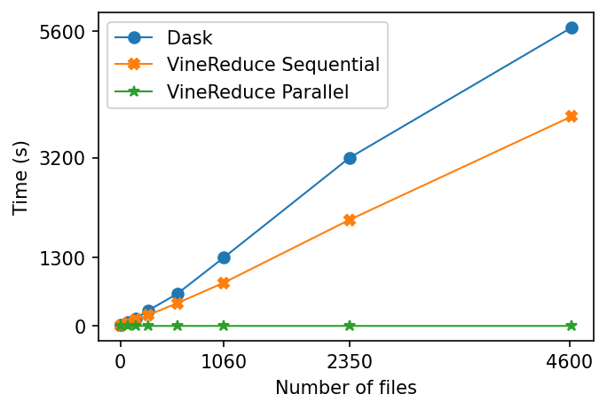
Problem: Setup Time is Atrocious!
Just creating the graph starts to rival the distributed execution time!
(Maybe we can optimize this by a constant factor, but it's still going to be large.)
(Ignore this line for now.)

Slide 16
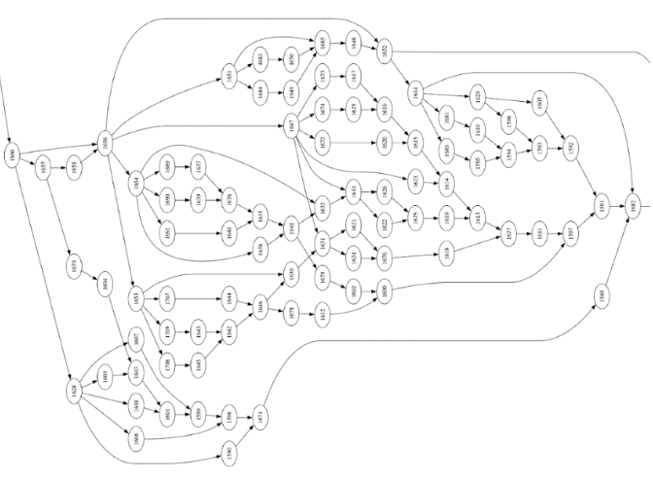

Insight: There is a Hierarchical Structure!
Dataset 1
Dataset 1
P
Dataset 2
Dataset 1
P
Dataset 2
physics events
. . .
A
H
processed data
Dataset N
Dataset 1
P
Dataset 2
physics events
. . .
A
H
H_{F}
processed data
A
P
Dataset 2
physics events
. . .
A
H_{N}
processed data
P
P
This task graph is actually a Map-Reduce.
… of Map-Reduces
… of O(1000) node task graphs.

Slide 17
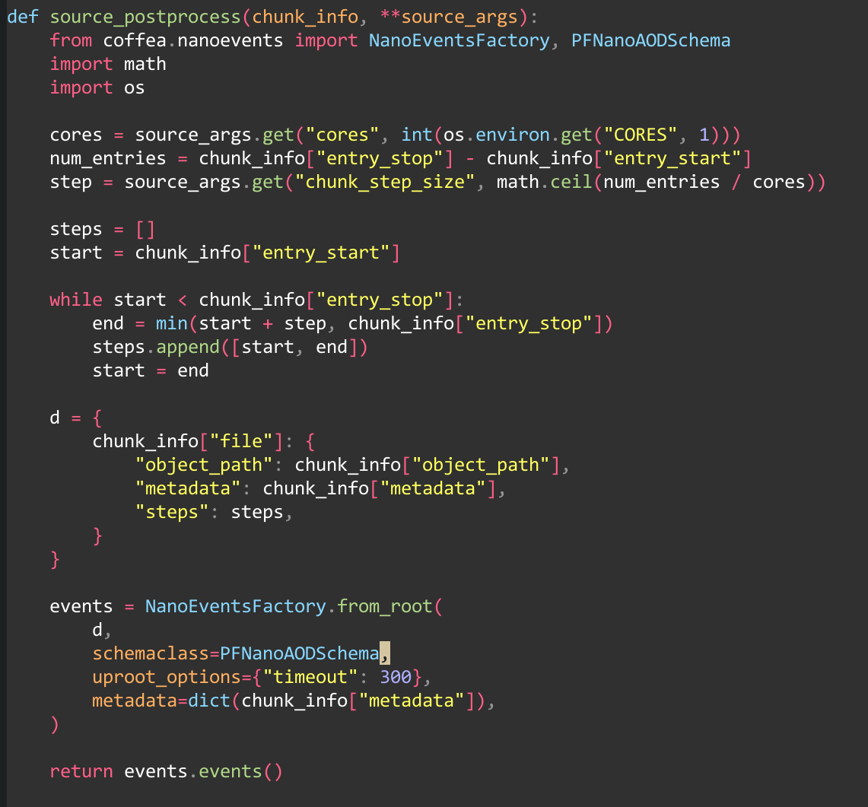
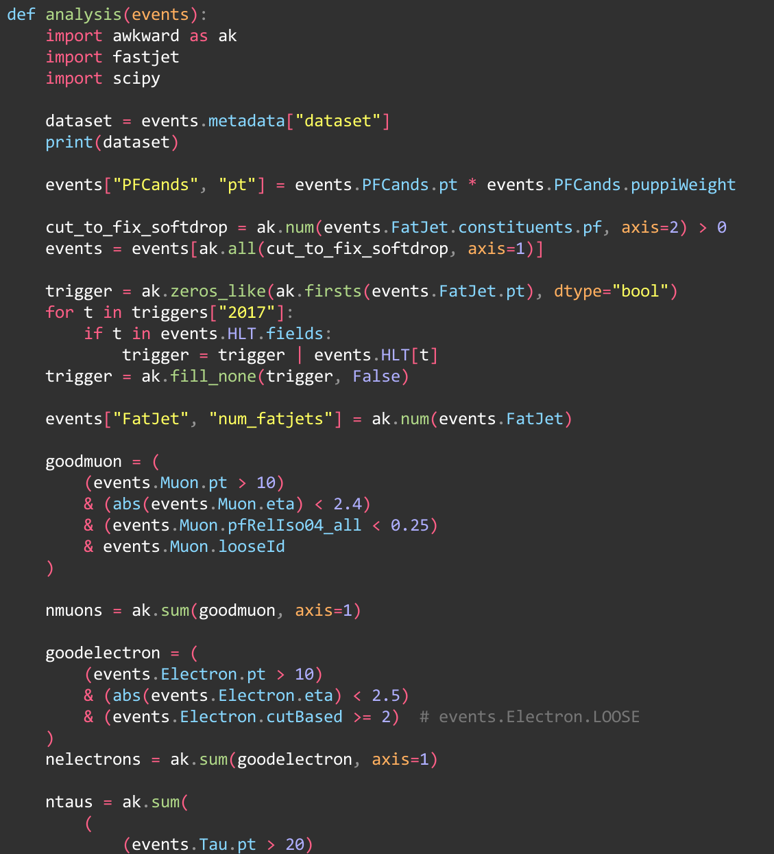
VineReduce API
def preprocess(dataset_info, **kwargs):
# break the dataset into chunks
def postprocess(val, **kwargs):
# compute the properties of each chunk
def processor(x):
# a data parallel Dask program
def reducer(a, b):
# commutative / associative function
vr = VineReduce(
mgr, data,
preprocess, postprocess,
processor, reducer )
Key Idea:
User provides the functions and data.
VineReduce materializes the graph as needed, with the leaves generated on the workers themselves.

Slide 18
Conventional Application
VineReduce Application
Generate Complete Graph for Application
Generate Abstract Representation
DAG Scheduler
VR Scheduler
d
d
d
d
r
p
p
All Datasets
done
running
pending
One Dataset
Release Fine Grained Tasks to Scheduler
Generate Variable Sized Subgraphs Specs
Task Scheduler
Task Scheduler
Schedule Fine Grained Tasks to Workers
Dispatch Subgraphs Specs as Tasks to Workers
Worker Node
Worker Node
Worker Node
Worker Node
Worker Node
Worker Node
Dask Local
Dask Local
Dask Local

Slide 19
Advantage 1: Setup Time Disappears
Just creating the graph starts to rival the distributed execution time!
(Maybe we can optimize this by a constant factor, but it's still going to be large.)
(most) graph construction delegated to the workers!

Slide 20
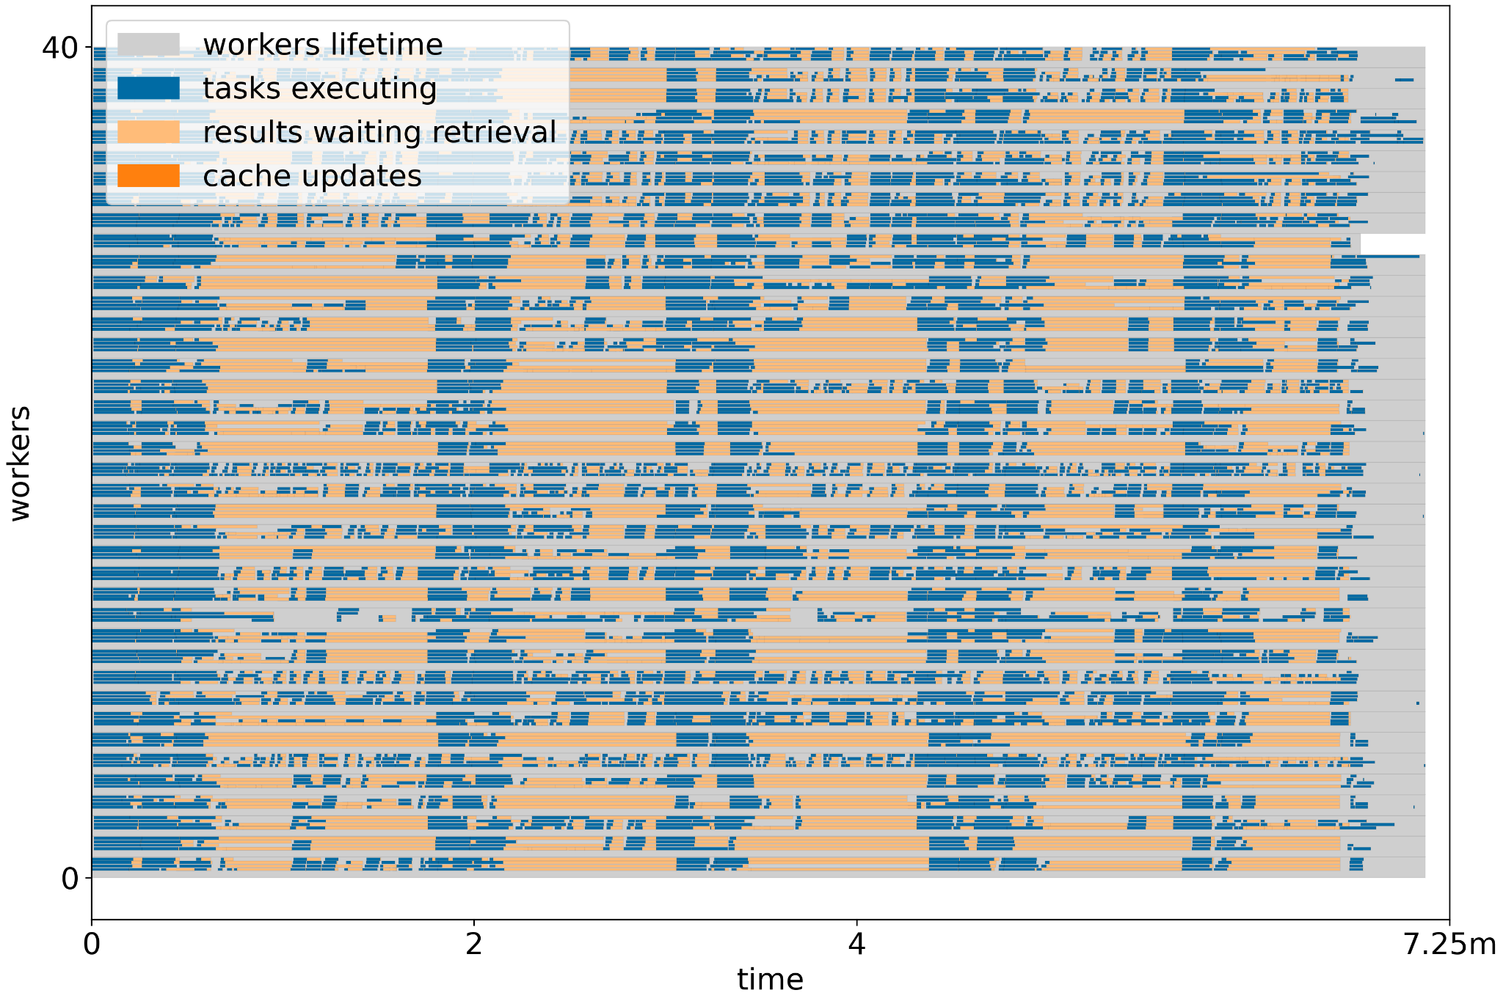
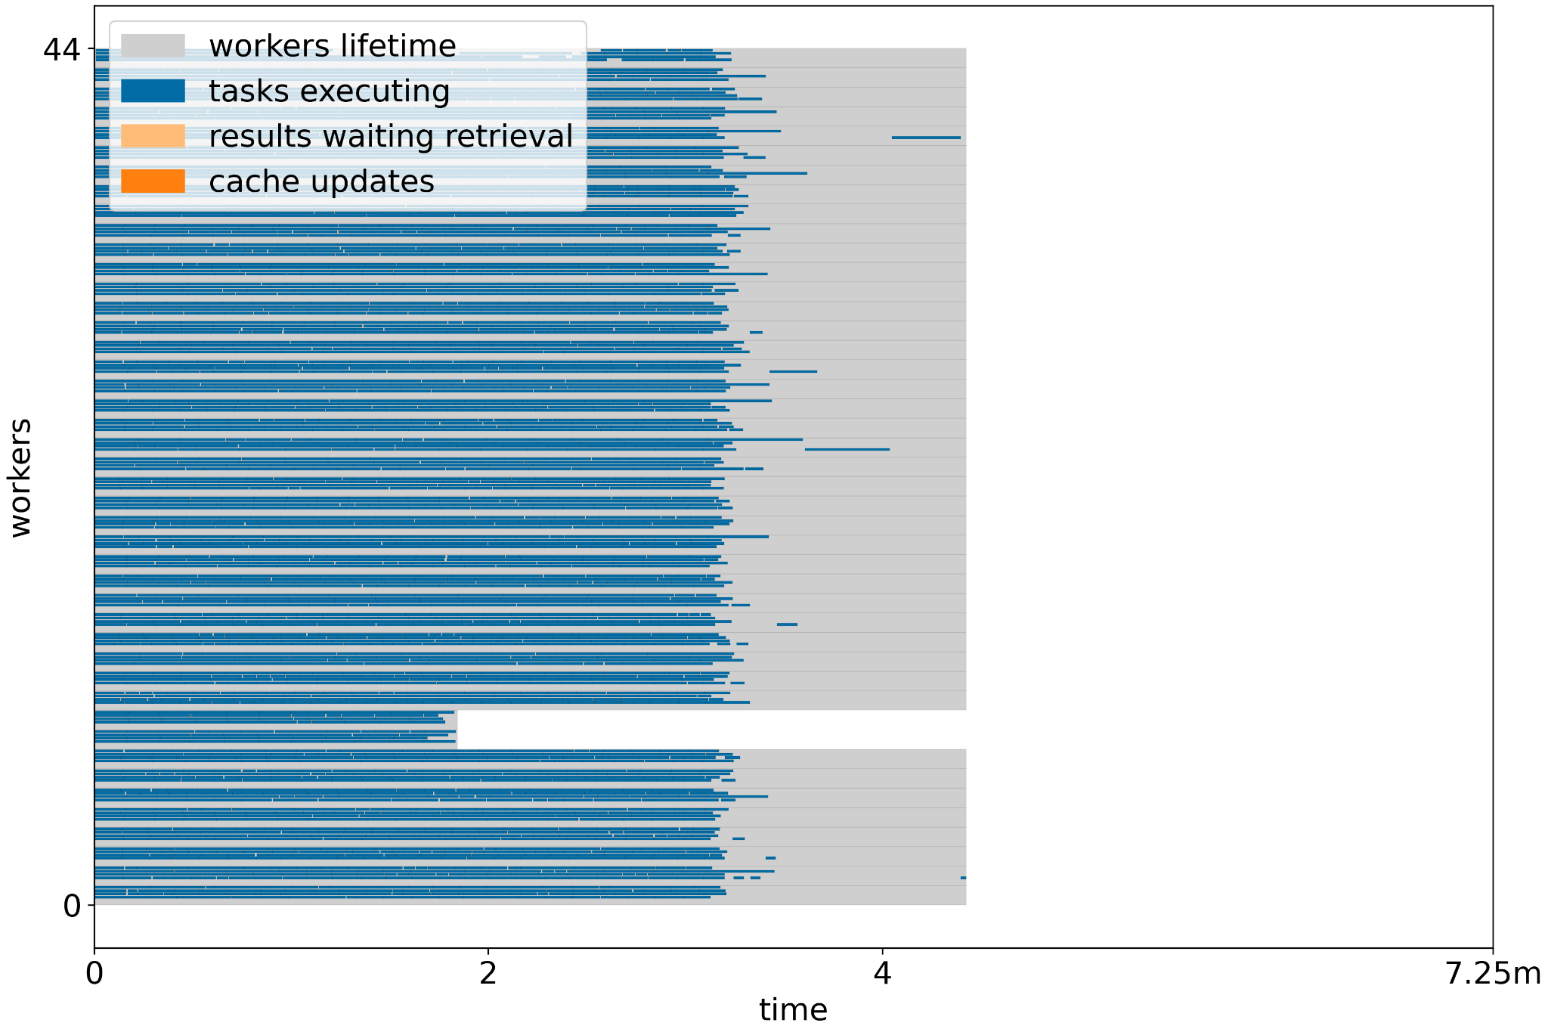
Advantage 2: Workers Tightly Packed

Slide 21
Impact on Cortado Data Analysis App:
(multiply this graph by 419X to get the full task graph.)
Kelci Mohrman (UFL)
Cortado data analysis application:
419 datasets, 19631 files, 14TB, 12 billion events
Generating the complete Dask graph the simple way takes 20 hours even before execution starts!
VineReduce with Cortado runs from setup to completion on on 250 8-core nodes (1600 cores) in 5.5 hours.

Slide 22
Ruminations
Important to match hardware and software hierarchies.
  Was the software designed with the HW in mind?
VineReduce is a static framework.
  Can we identify dispatchable subdags dynamicaly?
Programming Language Theory:
  Eager/lazy evaluation, generators, functionals…
Distance Between Intent and Program is Increasing:
  Prompt -> LLM -> FP -> DAG -> Tasks -> Workers

Slide 23

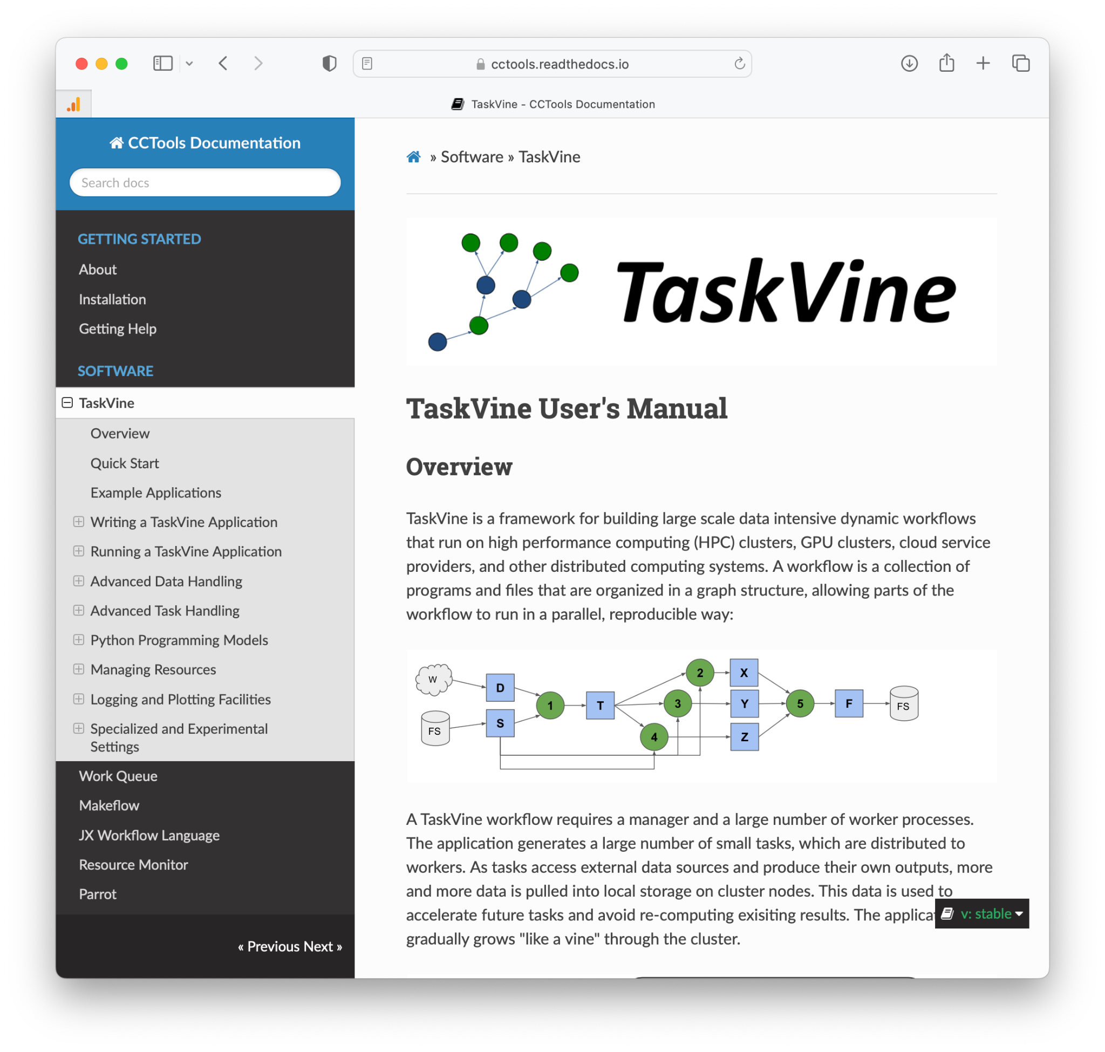
Give TaskVine a Try!
This work was supported by
NSF Award OAC-1931348
https://cctools.readthedocs.io
TaskVine is a component of the Cooperative Computing Tools (cctools) from Notre Dame alongside Makeflow, Work Queue, Resource Monitor, etc.
Release 7.17 made in May 2026.
Research software with an engineering process: issues, tests, manual, examples.
We are eager to collaborate with new users on applications and challenges!
conda install -c conda-forge ndcctools
‹#›

Slide 24
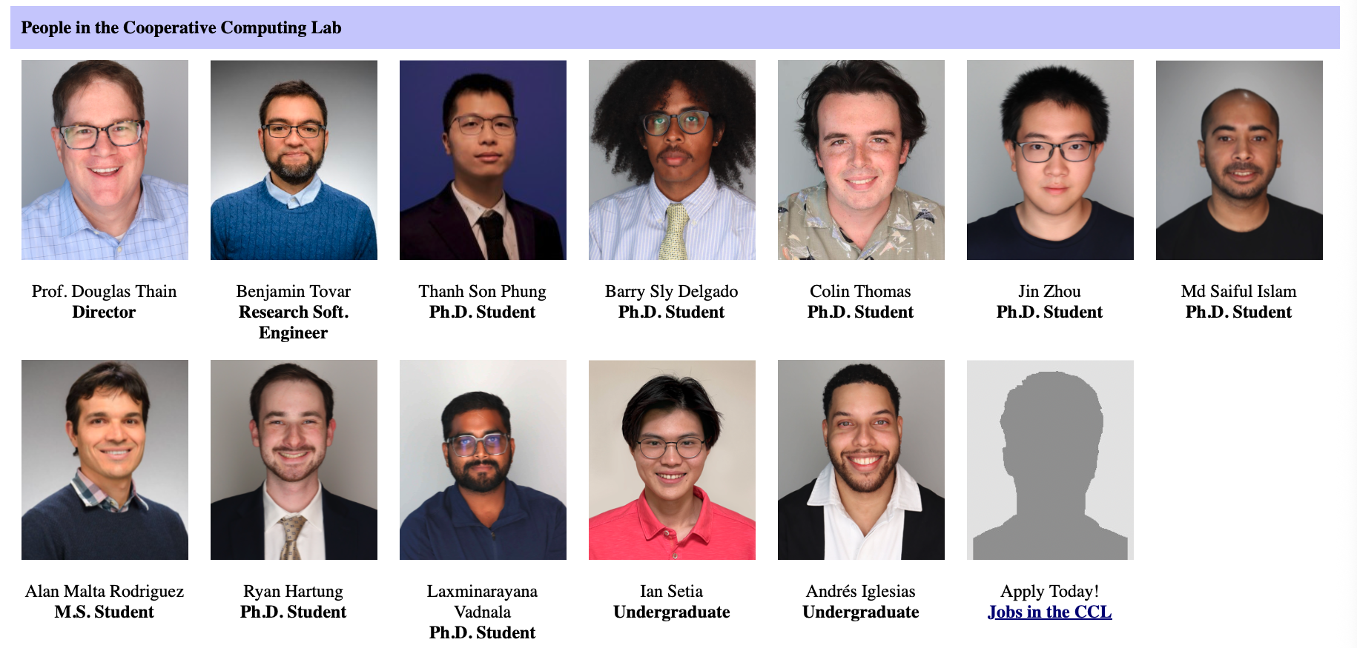
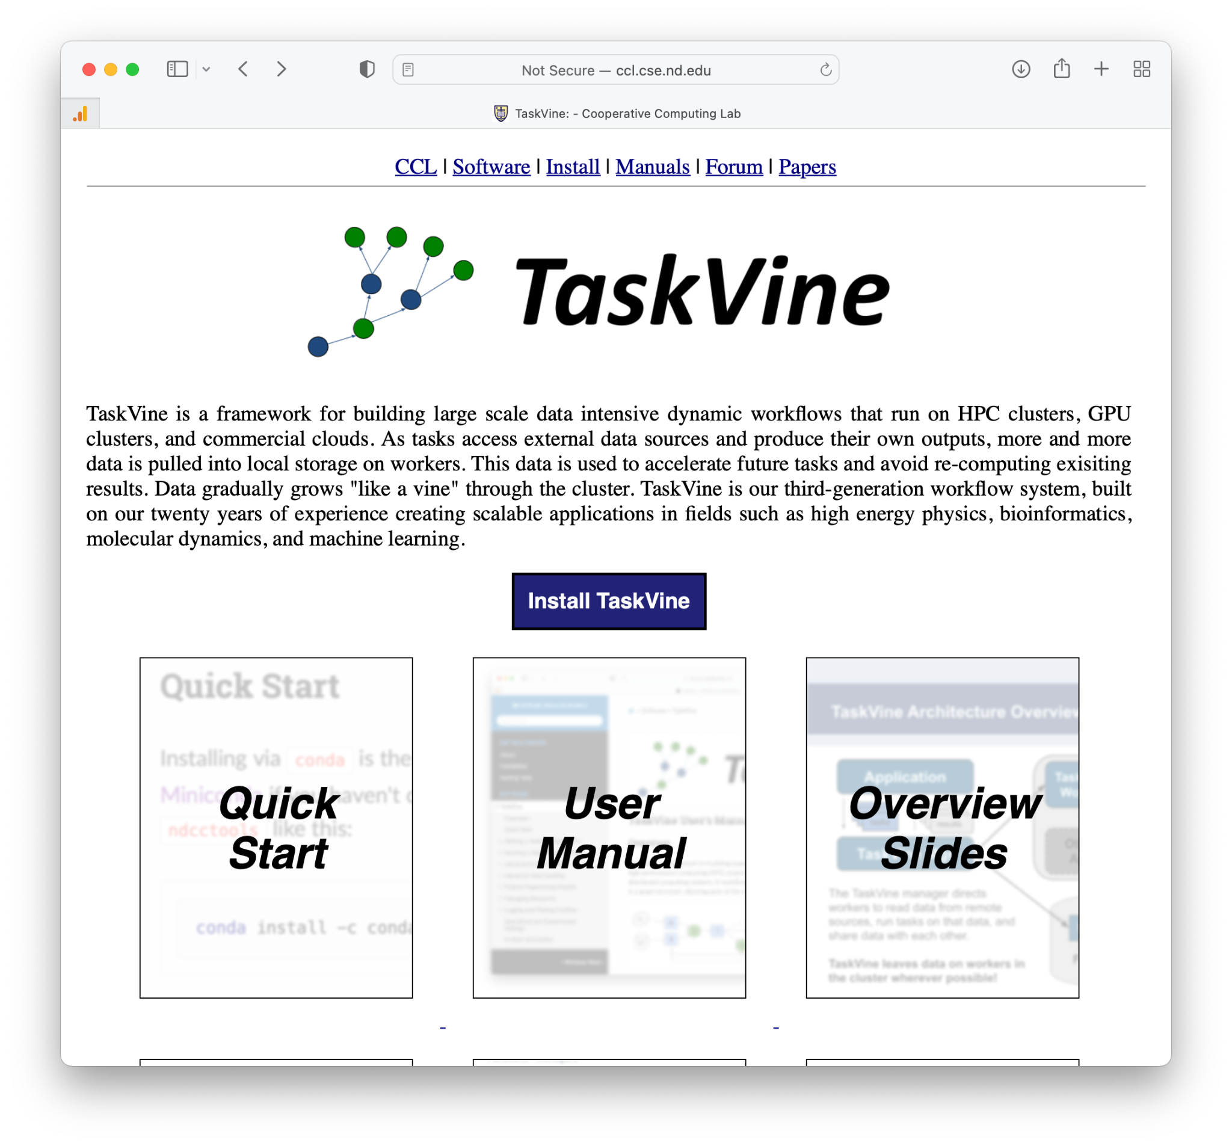
For more information…
This work was supported by
NSF Award OAC-1931348
CCL Staff and Students
https://cctools.readthedocs.io
https://ccl.cse.nd.edu
conda install -c conda-forge ndcctools

