Slide 1
HTCon-Door
Opening Your HTC Cluster to the World via Open OnDemand
By: Cole Bollig
Software Developer for CHTC
Throughput Computing 2026

Slide 2

Background
Who am I?
Why this matters?
What is this presentation about?
CHTC developer for the HTCondor Software Suite
Open OnDemand is a separate project/technology
Report of Open OnDemand’s integration with HTCondor and other exploratory projects into utilizing Open OnDemand for High Throughput Computing
Notes:
I explored the OOD integration with HTCondor
Not a tutorial for OOD or presentation on OOD

Slide 3
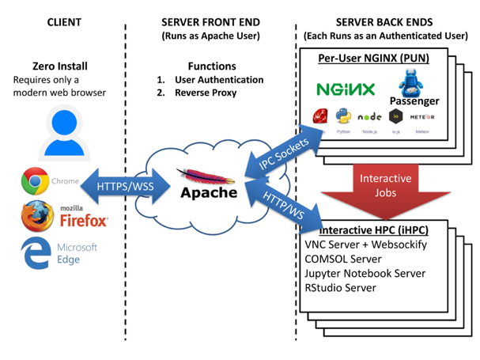
Background: Open OnDemand (OOD)
Developed by Ohio Supercomputer Center
Goal: Make all their supercomputing resources available to users anywhere at anytime with no client-side installation
Users simply access via a web browser
Provides ‘applications’ to interact with compute clusters
Open OnDemand Website
Open OnDemand Architecture Diagram
Notes:
Point out/briefly explain diagram
Mention idea of a web UX/UI rather than traditional terminal ssh’d into remote system with CLI input/control

Slide 4
Background: OOD Apps
Passenger Apps
Functionality executed by the Per User NGINX (PUN)
Filesystem management
Cluster status information
Job composer
Shell access to submit host
Interactive Apps Functionality launched as a job to the compute cluster
Jupyter Notebooks
Virtual Desktop
MATLAB
VS Code
HTCondor Annex?
Dozens More…

Slide 5

HTCondor Adapter
Adapter: Software part of OOD that knows how to speak one type of batch system (i.e. slurm, Kubernetes, LSF, etc.)
New HTCondor Adapter (current state)
  Released in v4.0.0 of OOD (January 27, 2025)
  Community contributed
  No documentation
  Experimental
Easy to configure OOD to point to an HTCondor pool AP with the new adapter

Slide 6
Bad News

Slide 7


Issue: Broken Job Composer
This is fine because Job Composer is officially deprecated
The issue is a mismatch of in expected & provided job information
  Bugs in the HTCondor Adapter
  Issue for other Apps
  Difficult to debug

Slide 8

Issue: Submit Description Disconnect
OOD jobs are comprised of scripts + additional batch options
This works for batch systems such as Slurm where batch options are engrained within the job script
HTCondor works with submit description files
  Where to find job executable to run
  Additional job information
  The list of jobs to execute
Users are unable to provide extra job information via submit descriptions since it expects an executable

Slide 9
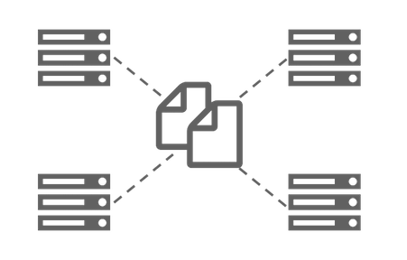
Issue: Assumption of Shared Filesystem
No way to describe file transfer
  OOD Adapter will actually stomp any defined input transfer
HTCondor only has one input file list
  Non-modular: no multi-source composition
Interactive Apps are comprised of multiple scripts
  Only a wrapper script would be transferred
  Wrapper references other scripts with absolute paths

Slide 10
Real World Examples

Slide 11
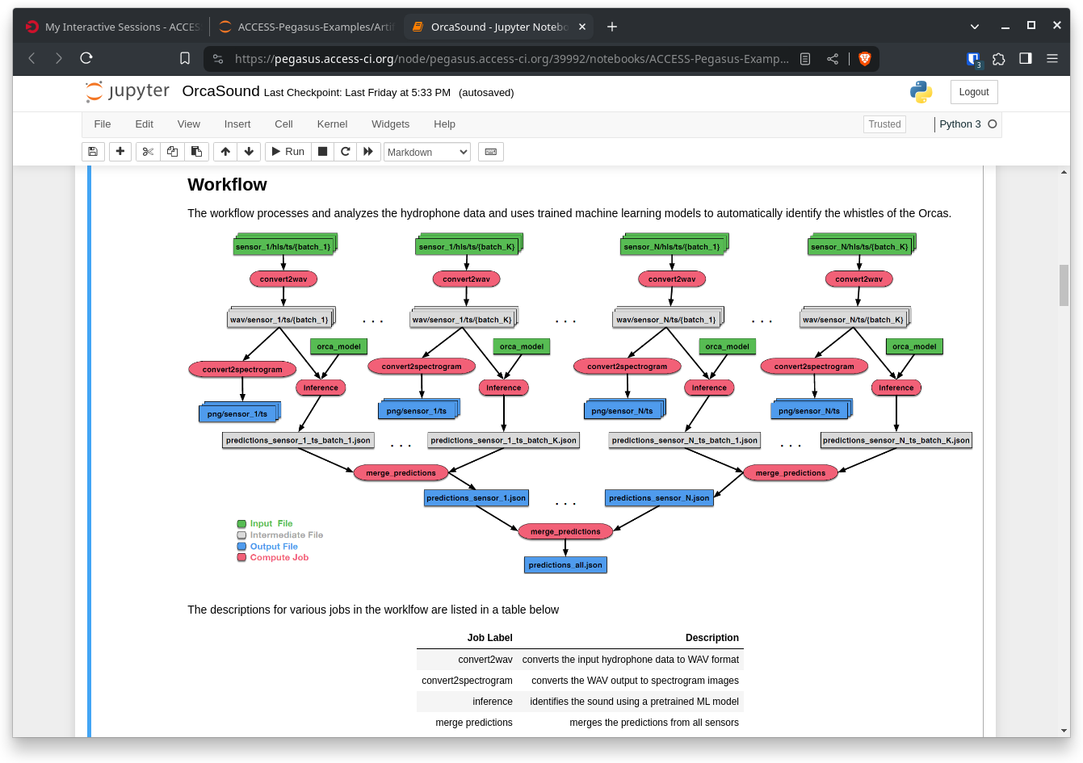
ACCESS Pegasus - https://pegasus.access-ci.org
ACCESS user authenticated via ACCESS IdP
Jupyter Notebooks for workflow development, execution, debugging
HTCondor AP, with many options to use allocations.
  TestPool
  HTCondor Annex (ACCESS HPC sites)
  Jetstream2 Image (ACCESS Cloud)
  OSPool
  pegasus-glidein (campus clusters)
Supported by NSF #2138286
Notes:
ACCESS Pegasus is a hosted Pegasus workflow system for the ACCESS community.
The big picture: A user logs in with their ACCESS credentials, opens a Jupyter notebook, and submits jobs through a single HTCondor access point that can transparently route work across HPC clusters, cloud VMs, campus machines, and the national OSPool — all depending on availability and allocation.
Super node with OOD/HTC-AP/Slurm
Big for demo-ing since everyone already has ACCESS account
Production service

Slide 12
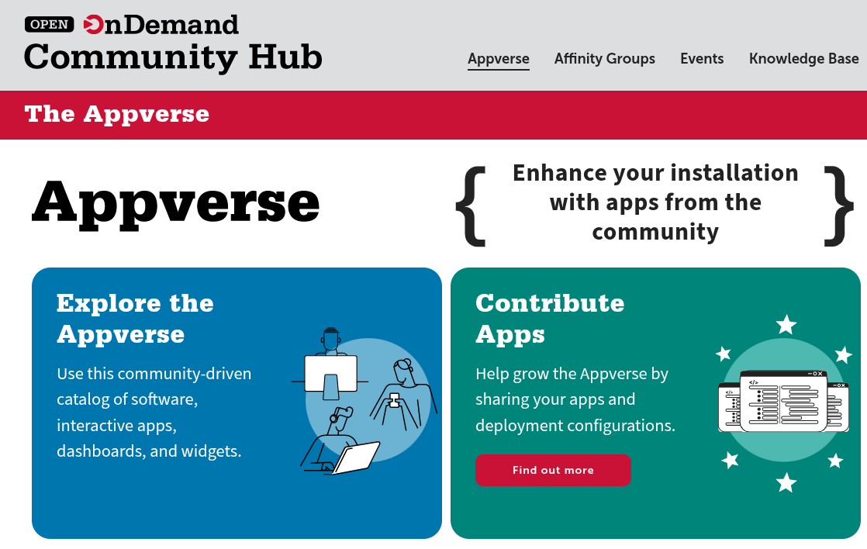
Pegasus+HTCondor in OOD Appverse
“Apps make it easy to add software to your Open OnDemand instance. Repositories hold the code and setup details to make that happen. If you’ve built an app, share your repo with the community—open source is all about working together and avoiding duplicate effort!”
Pegasus team is working on an app for Pegasus+HTCondor to deploy on HPC resources.
When launched on a HPC worker node, will start a Jupyter notebook, personal HTCondor (translates jobs to Slurm) and set up an environment for Pegasus workflows.
https://openondemand.connectci.org/appverse
Notes:
Another effort Pegasus team is doing to reach out to the ACCESS and OOD HPC communities, is creating an OOD app in the new Appverse. This will be a recipe for deploying Jupyter, a minicondor and Pegasus as a single app in OOD.
Software instillation recipes
- A user will start this specialized Jupyter notebook on a worker node in the cluster. HTCondor will start automatically, and can be used either as a translation layer to Slurm (glite), or as a manager for resources on that worker node, for example a GPU.
- The motivation for this work is to make it easier to deploy Pegasus and dependencies on HPC clusters.

Slide 13
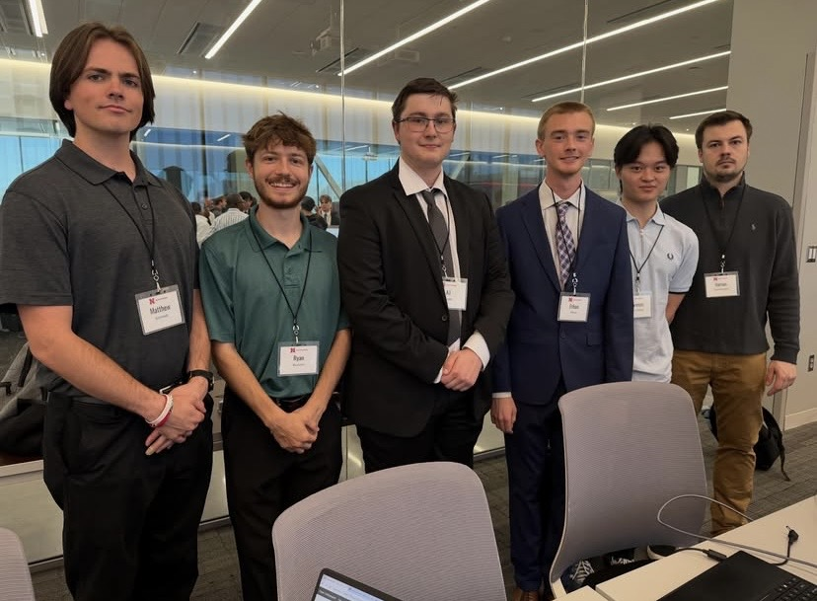
Alphafold on NRP Nautilus
Work done by CS capstone team at University of Nebraska – Lincoln
---------------------->
Open OnDemand
Web Browser
1
Shared FS
Interactive App
NRP Nautilus Cluster
(Kubernetes)
User connects to OOD
User places Alphafold batch job to AP via OOD interactive app
Watchdog sees job pressure in queue
Watchdog starts pilot EP in k8s pod
Schedd spawn's shadow
Input file transfer
Job executes
Output file transfer
HTCondor Access Point
Pod
2
condor_schedd
3
watchdog
4
Pod
Pod
Pilot Job
(HTC EP)
6
7
5
Shadow
8
Notes:
Used OOD -> HTCondor -> NRP to overcome file transfer issues with OOD Kubernetes adapter issues (users unable to mount a local directory to node)
HTCondor is ‘middleman’
Required changes to HTCondor adapter
Functions like mini OSPool with job pressure and EP pilots

Slide 14
Launching an HTCondor Annex
Open OnDemand
CHTC Spark Cluster
(Slurm)
Annex Tarball
Shared FS
Pilot Job
(HTCondor EP)
User creates annex at AP
User interacts with OOD
  Copy annex tarball from AP to OOD host
  Launch annex via interactive App
Slurm job starts executing and launches pilot EP
EP connects back to AP
2a
2b
Interactive App
Web Browser
3
HTCondor AP
2
1
4
Notes:
Future plans: Ephemeral AP in Kubernetes with web server to not require user to manually copy annex tarball

Slide 15

What’s next?
Potential for accessing HTC resources directly via OOD
  Some simple bugs that need patching
  Some fundamental differences in ideology
Hopefully, community interest
  High interest -> more investment
  Get feedback on functionality
  Even code contribution
Potentially more interaction between developers (OOD & CHTC)
Docker Playground of Open OnDemand and Mini-Condor
Full Report on Open OnDemand HTCondor Adapter

Slide 16
Funding Acknowledgements
This work is supported by NSF under Cooperative Agreement OAC-2030508 as part of the PATh Project. Any opinions, findings, and conclusions or recommendations expressed in this material are those of the author(s) and do not necessarily reflect the views of the NSF.

