Slide 1
Authorizing Remote Placement with the PlacementD
Mátyás (Mat) Selmeci
Throughput Week 2026

Slide 2
What is Remote Placement?
The ability to submit, remove, hold, get results of, or otherwise manipulate your jobs on an Access Point, without shell access on the Access Point

Slide 3
Why Remote Placement – the Admin View (1)
Access Point is a shared resource
Easy to misuse it – examples:
  Filling up `/tmp` with program output or container builds
  Remote VSCode sessions using CPU and memory
  AI agents using CPU and memory
No feedback on the stress you're putting on the machine
Misuse hurts other users

Slide 4
Why Remote Placement – the Admin View (2)
curl root-exploit-of-the-week.sh | bash
Rash of local privilege exploits make locking down access more appealing

Slide 5
Why Remote Placement – the User View
Don't want to cause trouble
Unfamiliar environment
  Missing favorite tools
  No GUI – shell only
VSCode remote access "feels like" your local machine

Slide 6
Challenges with Remote Placement
Getting the tools
Configuring the client
Copying data to/from the AP
Authorization <- the focus of this talk

Slide 7
Auth Needed for Remote Placement
User needs a credential which the AP accepts for running job management commands
Credential should be short-lived to limit damage if it gets compromised
User should be able to get the credential by themselves

Slide 8
PlacementD and Placement Tokens
Added "Placement Daemon" (PlacementD) that creates Placement Tokens
Placement Tokens are short-lived (~1 day) credentials that the AP accepts for job management tasks
The PlacementD works together with a web application so it can use Single Sign On to get an identifier for the user
OAuth2 Device Flow clients let the user start a request from a command-line or Jupyter Notebook

Slide 9
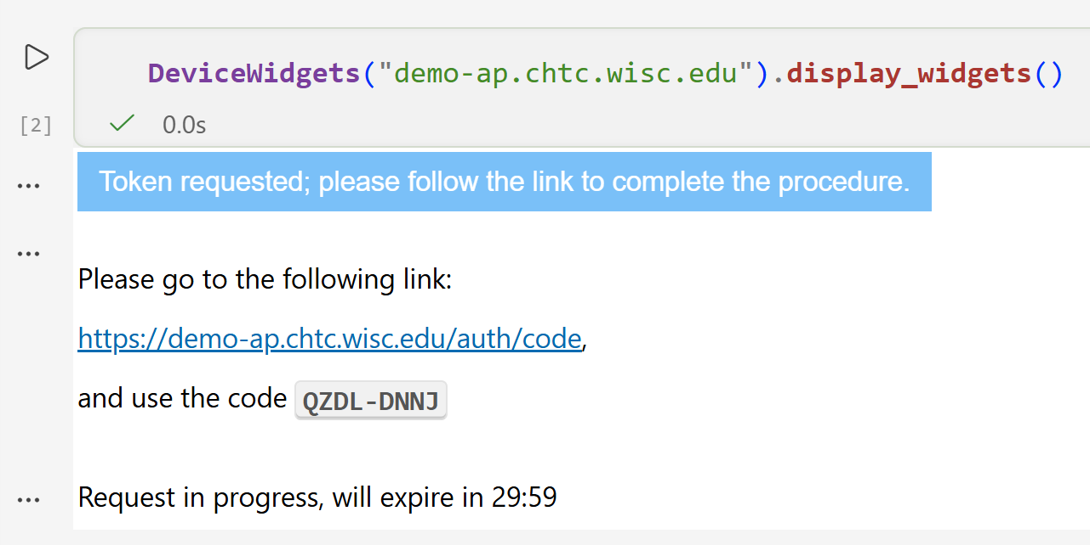
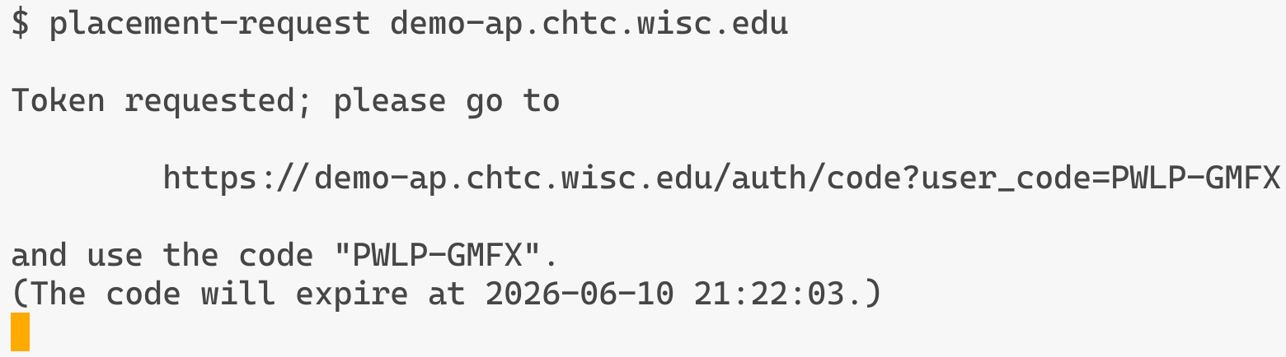
Device Flow (1)
CLI client
Jupyter Notebook widget client

Slide 10
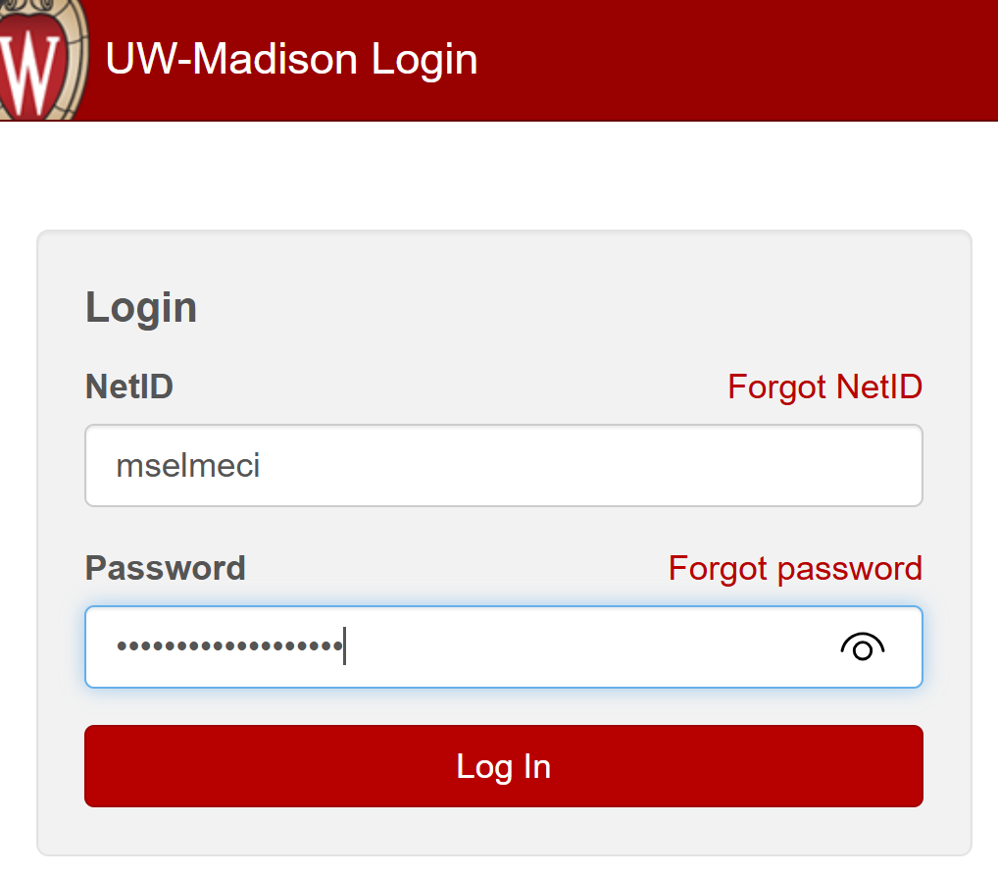
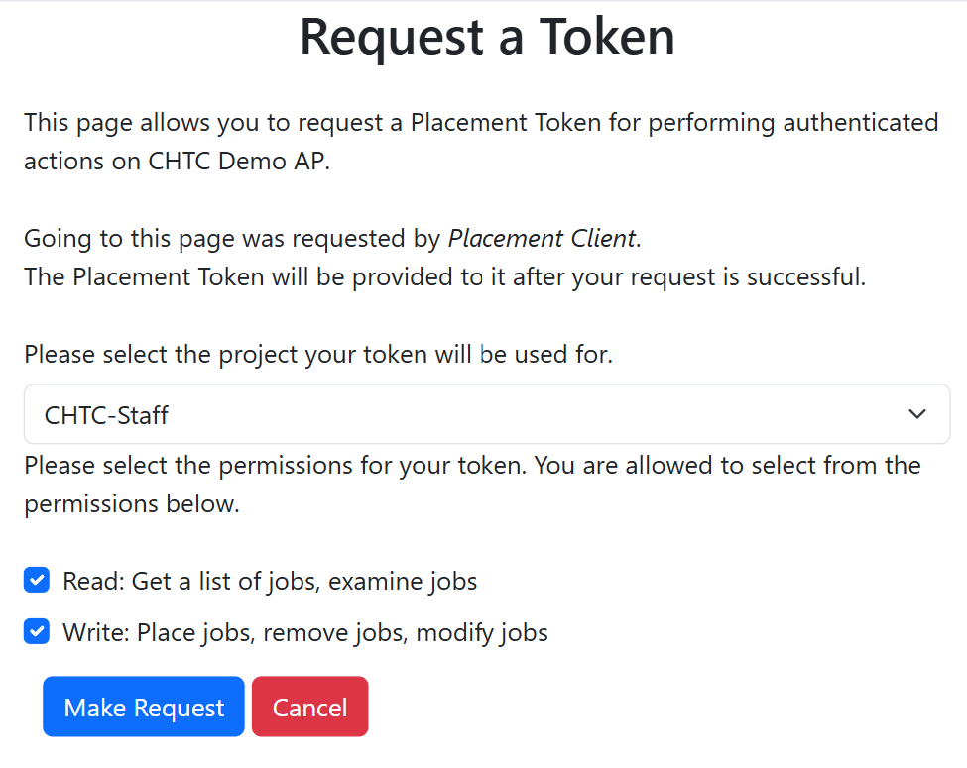
Device Flow (2)

Slide 11
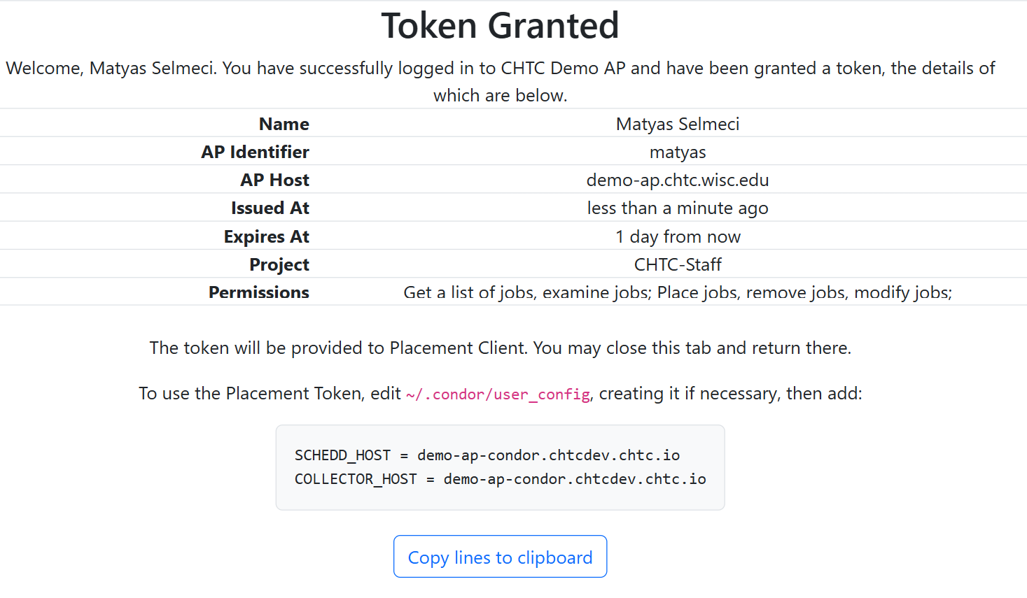
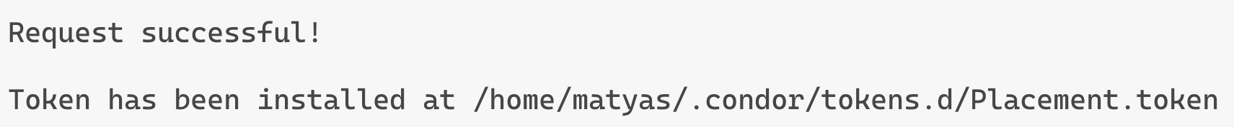
Device Flow (3)

Slide 12
First-Class Projects (1)
Placement Tokens can be linked to "Projects"
A token selected for project A can only be used to place jobs that have `project_name="A"`
Frequent use case – now a first-class entity in the SchedD

Slide 13
First-Class Projects (2)
Projects, like users, have their own records and statistics
  TotalCompletedJobs, CompletedJobsCpuTime, etc.
Projects, like users, can be "suspended", keeping jobs from being placed or starting
Provides an extra level of tracking and management

Slide 14
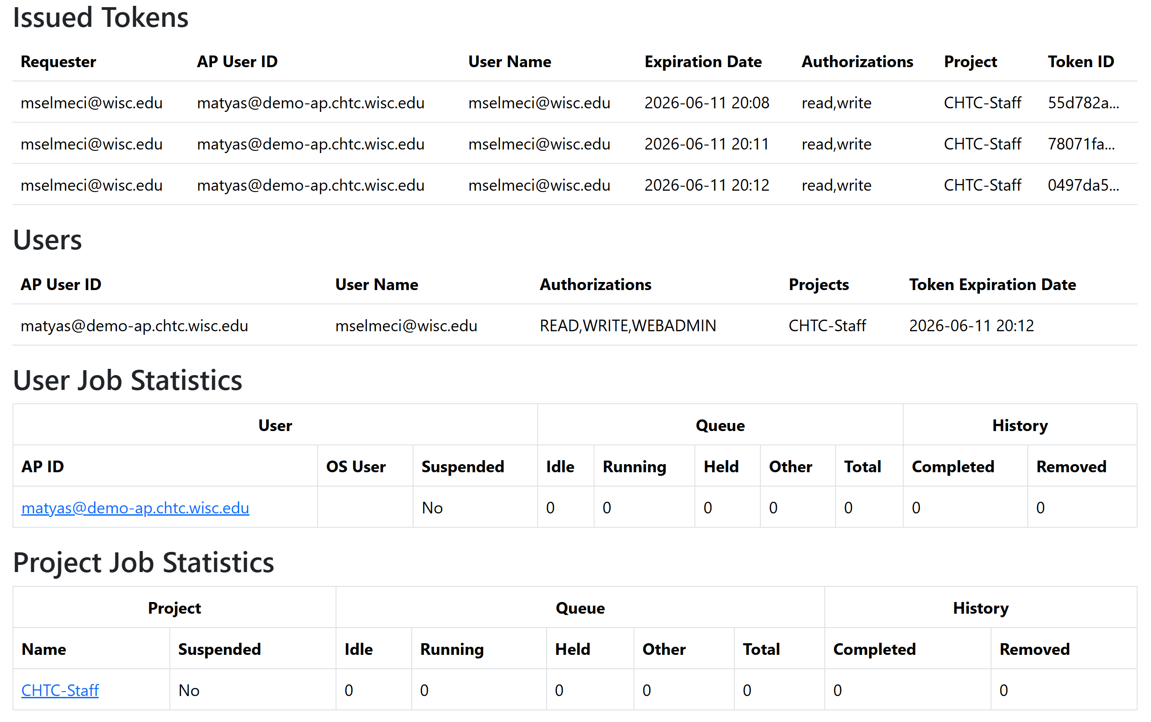
Admin Overview

Slide 15
Summary
Giving users shell access on an Access Point can be dangerous
Remote placement provides a way to let users get their work done without shell but requires approachable auth
PlacementD can solve auth problem by issuing short-lived credentials with a Single Sign-On-backed identifier
Device Flow client can make credential acquisition straightforward for the user
First-class projects give admins multi-level control over authorizing job placement

Slide 16
Acknowledgements and thanks
Todd Tannenbaum
Jaime Frey
TJ Knoeller
Miron Livny
This work is supported by NSF under Cooperative Agreement OAC-2030508 as part of the PATh Project. Any opinions, findings, and conclusions or recommendations expressed in this material are those of the author(s) and do not necessarily reflect the views of the NSF.

