Slide 1
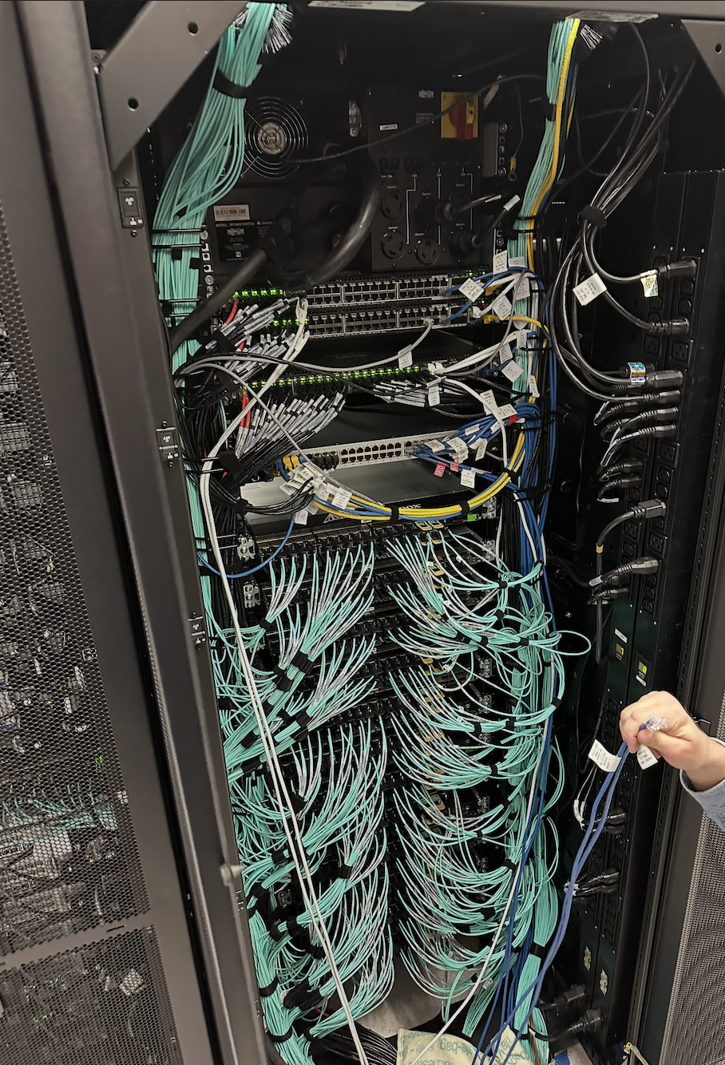
Community-Operated Cyberinfrastructure (CI) Resources
HTC’26 • June 10, 2026
Stephen Deems, sdeems@internet2.edu
Internet2 - Research Engagement

Slide 2
About (The Presenter + The Presentation)
Entire career spent working with the research and educational communities utilizing CI
  Joined Internet2 in January 2026 after 13+ years at Pittsburgh Supercomputing Center within Carnegie Mellon University
  Was the lead investigator for ACCESS Allocations project and the Allocations Team lead for the NAIRR Pilot.
Internet2 is a member-driven research and education (R&E) technology non-profit.
  R&E network, eduroam, InCommon, NET+, …
    We work and advocate for the collective benefit of the U.S. R&E community.
Objectives:
  Highlight the ever-expanding number of resources available for the U.S. community to leverage at little or no cost to campuses.
    (Many in this room may know of them, but some might not…)
  Provide a crash course that can inform you and members of your campus / organization.
  Illuminate some of the other people behind CI.

Slide 3
Community-operated Cyberinfrastructure
Federal agencies, research teams, and open-source software developers make a wide range of resources available to the nation’s R&E community.
Cyberinfrastructure (CI)
Open-Source Software & Science Gateways
Federally Funded Computing
Data Storage
Networking & Security
Notes:
This presentation describes some of the (mostly) free-to-you options available to the researchers and educators on your campus. Most campuses already have research that extends into this national cyberinfrastructure, and if you don’t know, your faculty and students are likely eligible.

Slide 4
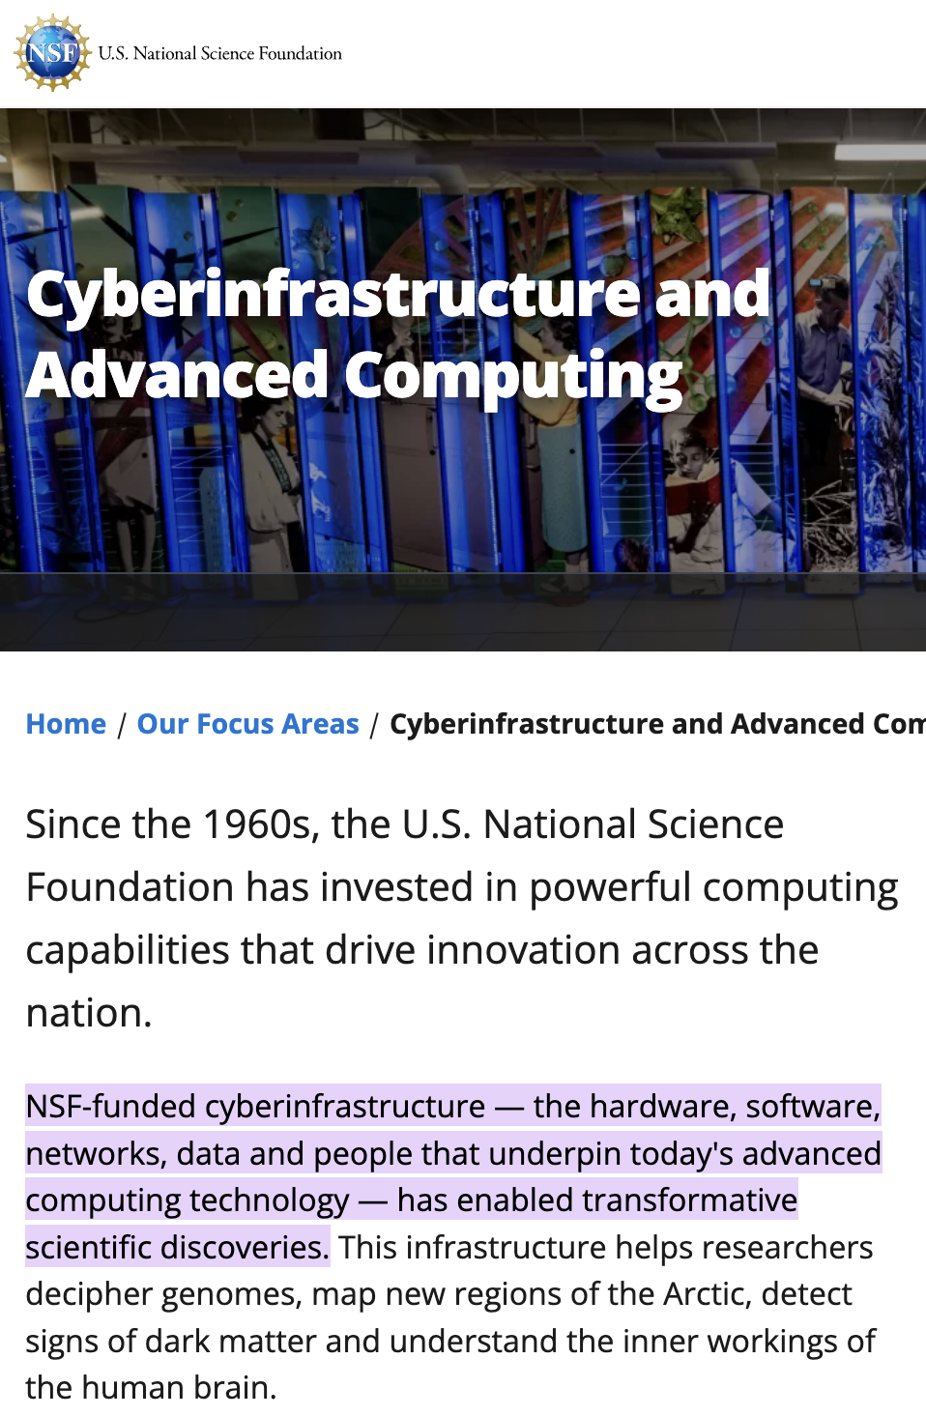
Cyberinfrastructure (CI)

Slide 5
Cyberinfrastructure Professionals
Datacenter
  Technicians, Engineers, Plumbers, Electricians
Operations
  System Administrators, Network Engineers, Security
Account Management/Accounting
User Support
  Front-line technical assistance to users
Scientific Support
  Research Scientists, Technical Consultants
Communications
  Technical writers, Web Developers
Project Management
Education, Training, Workforce Development
Business Office & Administration
Librarians

Slide 6













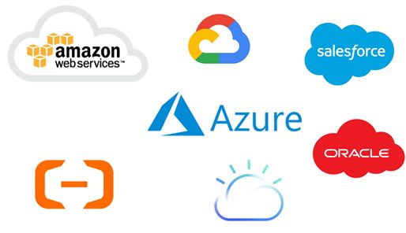










A Robust Ecosystem of Services and Support for Researchers and Campuses
Networks, Data Transfer, & Security
Domain-Specific Toolkits and Data Workflows
Training and
CI Professional Communities
Data Repositories & Storage
Scalable Computing
Programs

Slide 7
Open-source Software
& Science Gateways
Unlike centralized, campus-wide enterprise software, many researchers and domains rely on bespoke, community-developed software.

Slide 8
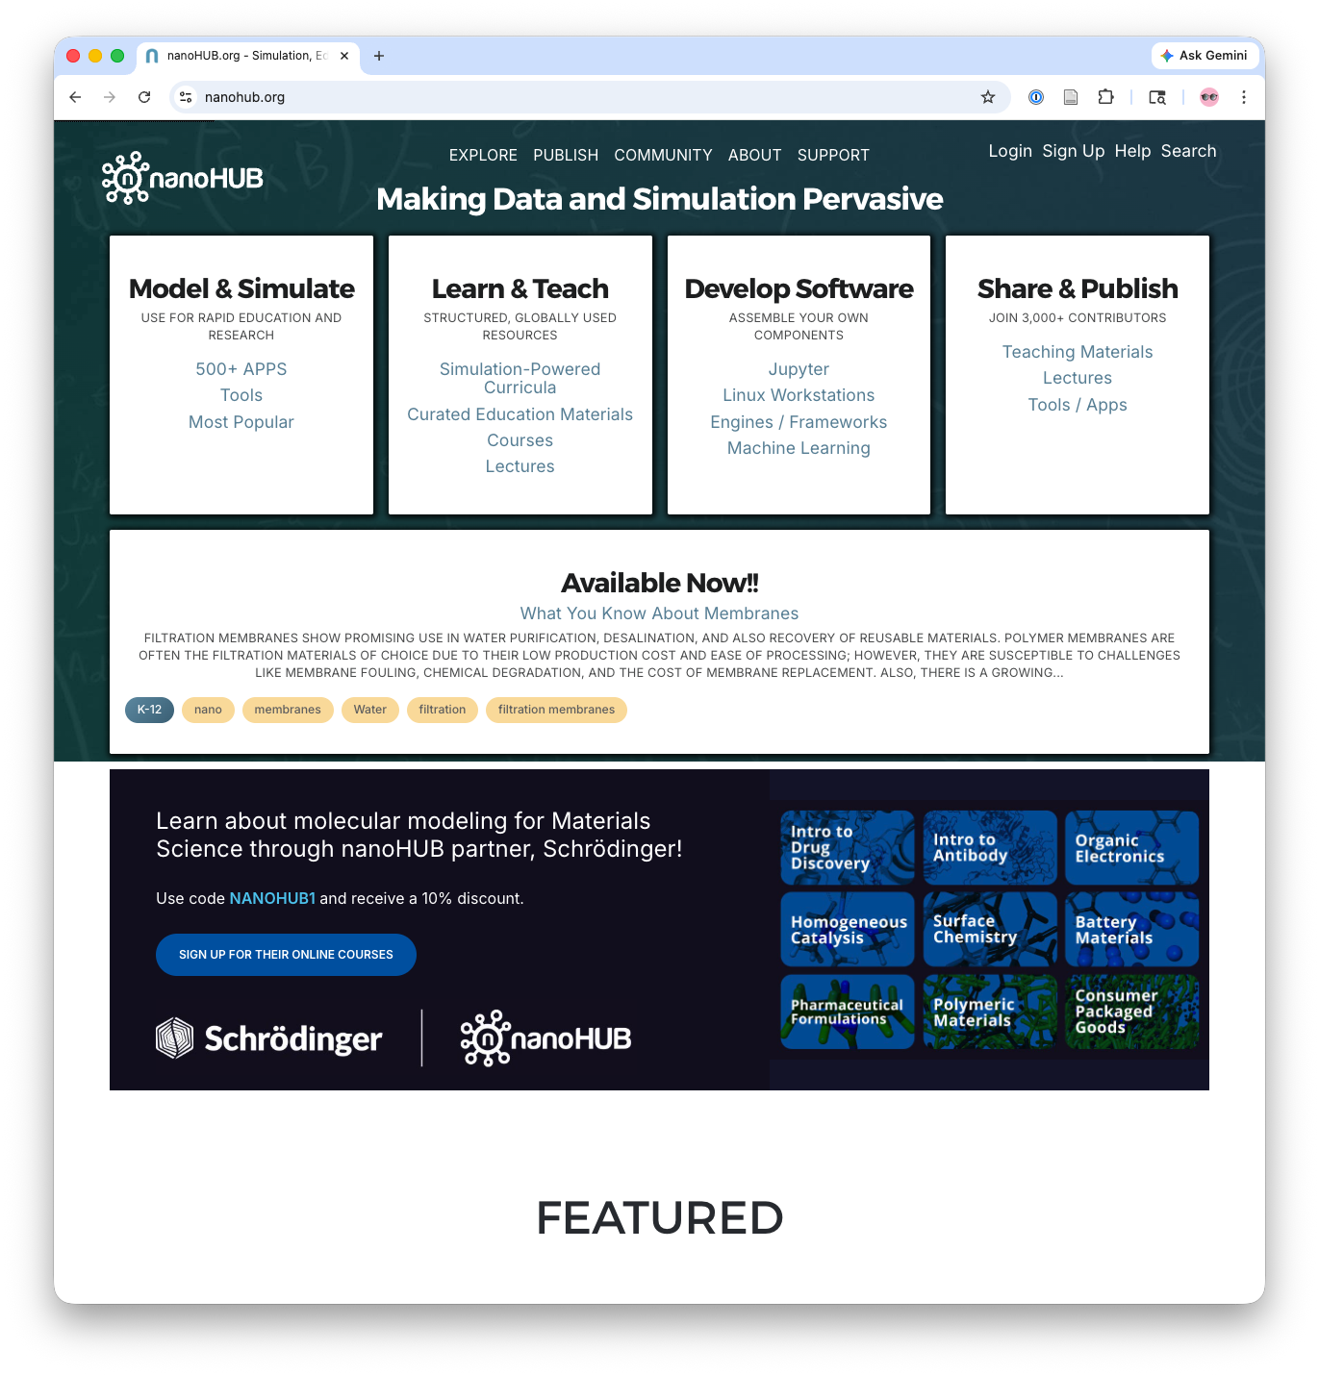

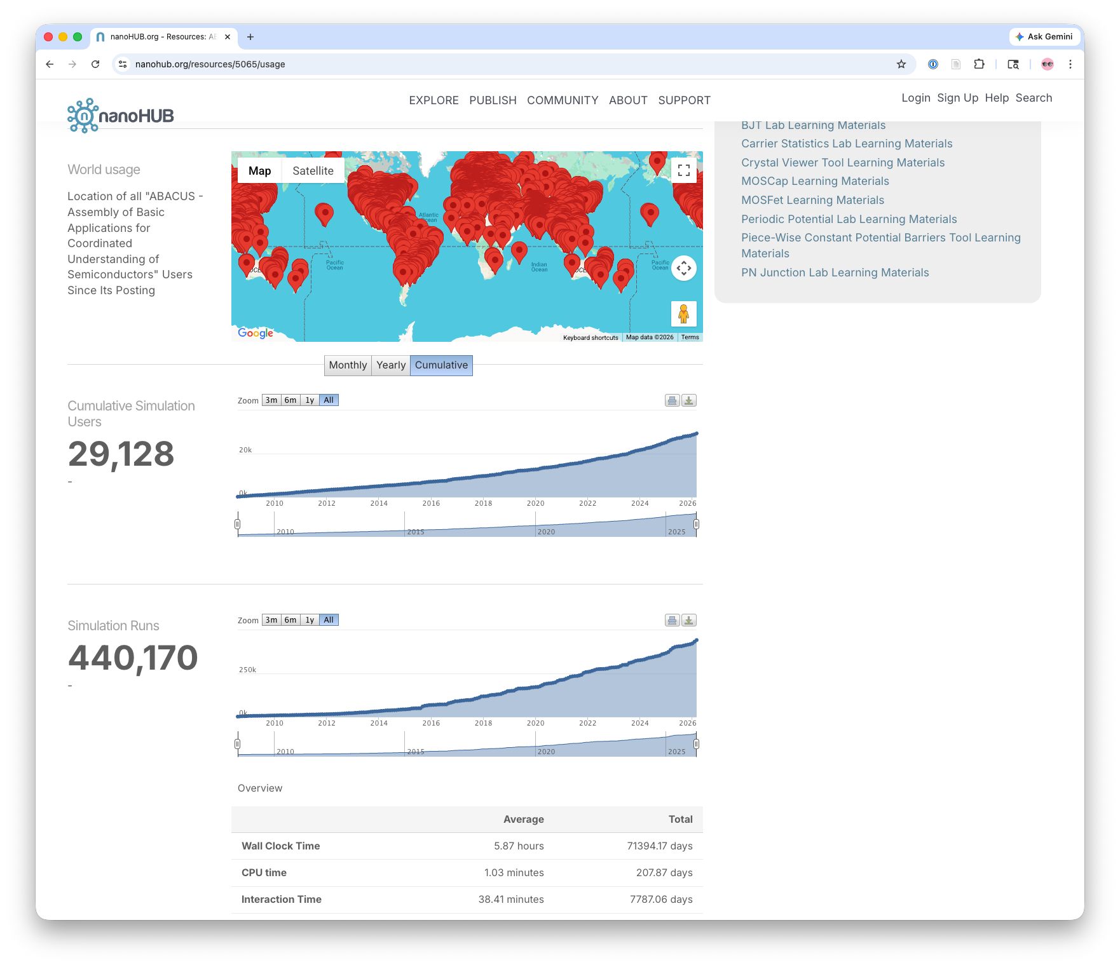
Science Gateways
User-friendly web-based portals or platforms developed by a community that provide researchers and educators with access to advanced computing resources, data, software, and tools.
Designed by domain experts for domain experts
Support for common compute tasks and workflows
More than 600 active gateways “in the wild”
  https://operations.access-ci.org/resources/gateway_discovery
  https://sciencegateways.org/
nanohub.org

Slide 9



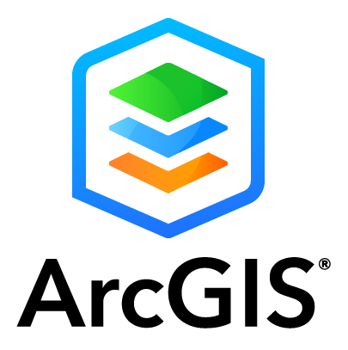
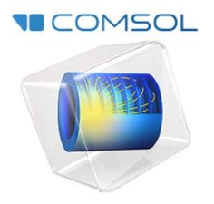

Research Software is often open-source
A lot of these packages are pre-installed on NSF-funded compute
Researchers will find software on their own. Campuses can support some of these, but other resources may have more experience actually using them.
Generalizable coding & data analysis
  Open-Source: Python, Julia, c/c++, Jupyter, R, Octave (Matlab alt), AI/ML models, and so on
  Commercial: Matlab licenses (procure + support)
Domain-specific software
  Most are open-source or free to download for academic use, with documentation for installs.
  Commercial examples: ArcGIS, Ansys, Comsol …

Slide 10

Federally-
Funded Computing
NSF and other agencies fund a wide range of research cyberinfrastructure resources to support R&E—usually at no cost to your researchers or your campuses.

Slide 11







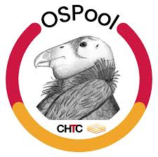



Federally Funded Computing Resources
Cloud(-like) Environments
High-Throughput Computing
High-Performance Computing
TYPE
VMs and interactive notebooks
numerous independent tasks
larger/longer interdependent tasks
RESOURCE
and more …
Research or Classroom purposes
AI-ready (most include GPUs)
USE CASES
JupyterHub-ready
Support for Jupyter Notebook
Local Hardware Integration Options
via simple sign-up
ACCESS
via Allocation (NSF-funded resources)
via agency
via Allocation (+tokens,commercial compute)

Slide 12

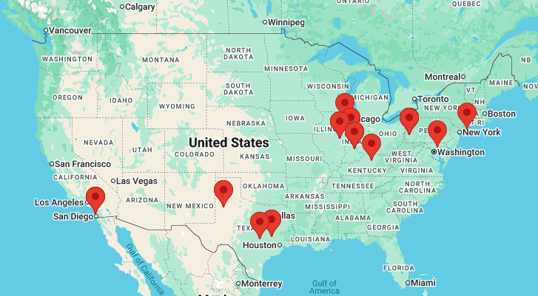
NSF ACCESS
Dozens of ACCESS resources provide a range of hardware, resource types, scale, and support beyond the capacity of a single campus.
NSF has a 40-year history of programs providing some of the most powerful computers in the country for open science. • access-ci.org
These resources have installed software, user support, and working (temporary) data storage.
The ACCESS CONECTnet among the resource provider sites is provisioned over Internet2.

Slide 13
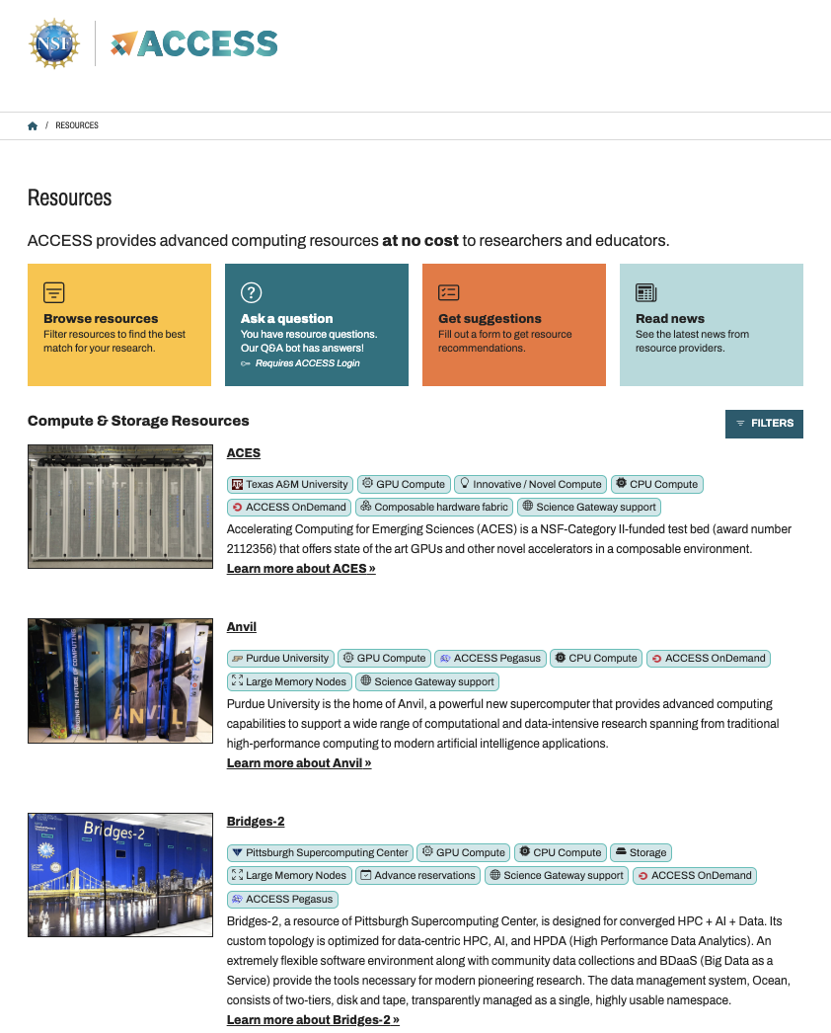
ACCESS Resources
Computing systems
  Varying core counts & memory sizes
  Cloud resources (persistent services)
Accelerators
  GPUs, vector processors, FPGAs
Data storage systems
  Object, tiered
Data repositories
Software & workflow managers
High performance networking
CI Professionals & support tools
System performance monitoring
Browse all available resources: https://allocations.access-ci.org/resources

Slide 14
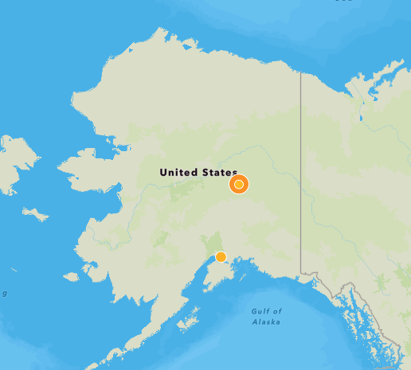
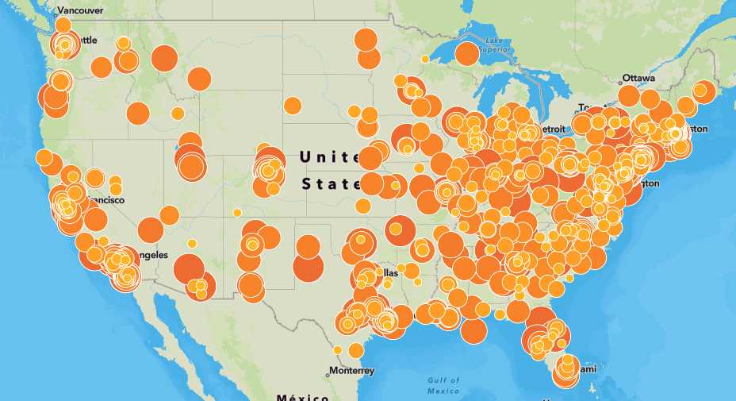


NSF ACCESS projects
Researchers and instructors from your campus may already be using ACCESS resources.
Find current projects from your campus: allocations.access-ci.org/current-projects
Over 40k active accounts on ACCESS resources as of last year
Notes:
Explore — Best option to get started fast and check out the possibilities • classroom use • abstract only
Discover — Great option to get started quickly on a modest-scale project • some classes • one-pager
Accelerate — Best for those with some experience and ready to start in earnest • three-pager
Maximize — Sky’s the limit • experienced HPC users • semi-annual opportunities • 10-page proposal & supporting documentation

Slide 15



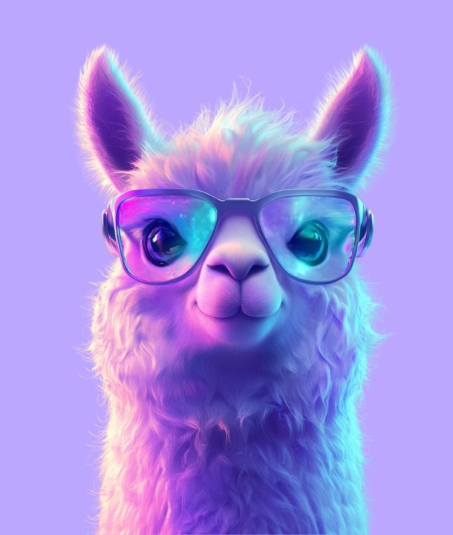
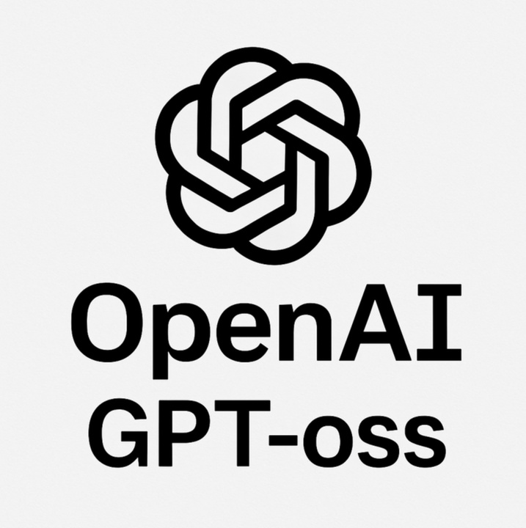
Bonus ACCESS to open-source LLMs
Jetstream-2 Hosted LLMs @ Indiana U
llm.jetstream-cloud.org
Hosted access to Llama 4 Scout, DeepSeek-R1, and GPT-oss.
No allocation necessary. Just login with your ACCESS ID. (Register for a free ACCESS ID at access-ci.org.)
AnvilGPT @ Purdue U
anvilgpt.rcac.purdue.edu
Hosted access to versions of Llama, Mistral, GPT-oss, and Qwen.
No allocation necessary. Submit an ACCESS help ticket for access. After that, just login with your ACCESS ID.

Slide 16

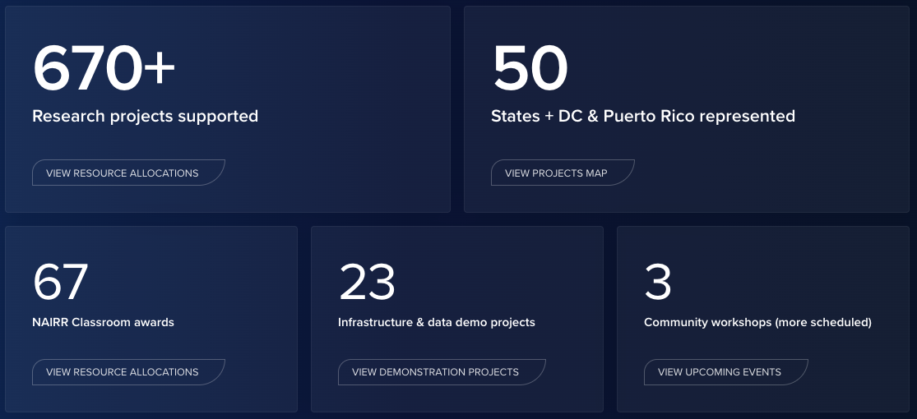
NAIRR — National AI Research Resource
Computing, data, models, and learning resources
Nationally funded and commercial cloud resources
For US-based research developing or applying AI methods, and for teaching AI methods
The NAIRR Pilot launched January 2024 and is transitioning to the “full NAIRR.”
nairr.org
nairr.org
Internet2 supports NAIRR communications and allocations, and has organized the first two NAIRR Annual Meetings.

Slide 17
NAIRR Resources
While there is some overlap with ACCESS resources, NAIRR also has a number of unique resources, including from the private sector. Unique agency options in blue text.
GPU/CPU resources
Anvil • Bridges-2 • Delta / DeltaAI • Expanse • Frontera • Lonestar6 • Vista
Specialized compute / Other
ACES • ANL AI Testbed • FABRIC • PATh • Neocortex • NSDS Secure Compute Environment • PNRP • Sage • Voyager
Private Sector Partners
Anthropic • Cerebras • Databricks • Eleuther AI • Hugging Face • Lexset • OpenMined • SambaNova • Vocareum • Voltage Park • Weights & Biases
Cloud resources
Chameleon • Jetstream2 • NIH Cloud Lab • CloudBank (AWS, Google, Azure, IBM)

Slide 18
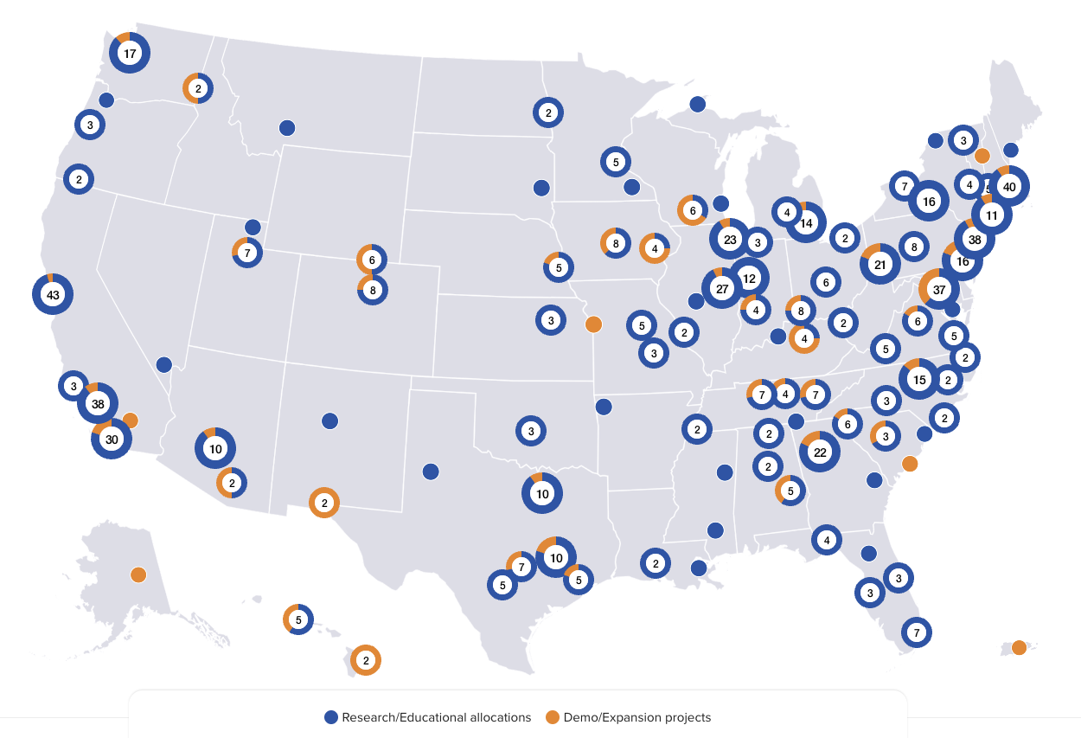
NAIRR Projects
Use of NAIRR is increasing as the pilot moves to “full NAIRR.” AI research on NAIRR and elsewhere increases the demand for access to AI-ready datasets.
While there is some overlap with ACCESS resources, NAIRR also has a number of unique resources, including from the private sector.
See who from your campus already is using NAIRR resources: nairrpilot.org/projects/awarded

Slide 19


Which to choose?
Long-term research and educational initiatives
All project types
  not explicitly AI-related
Mainly CPU, GPU, Storage resources
Most (83%) projects approved in ~1 business day
  Accounts on resources available in ~3 days
Short-term projects with a quick path to results
AI-focused projects only
  should align with current focus areas: https://nairrpilot.org/opportunities/allocations
Diverse set of resources
Requests take ~a few weeks for review and processing

Slide 20


Distributed Computing Platforms
Connect local computing and data storage resources into these platforms to combine dedicated capacity with shared, national capacity.
OSG / Open Science Pool
National Research Platform (NRP)
OSG supports long-range data sharing via the Open Science Data Federation, and the Open Science Pool of high-throughput computing capacity from
100+ campus systems.
osg-htc.org
A computing platform for interactive and long-range automated workflows, distributed across 50+ campuses. Internet2 provides networking and data storage support.
nationalresearchplatform.org
The OSPool and OSDF are operated by the NSF PATh project, and cross-integrate with NRP.

Slide 21
Even more options at NSF and beyond
Internet2 connects not only NSF-funded sites but also agency research centers and national labs from DOE, NIH, NASA, NOAA, USDA, and more.
NSF Leadership Class Computing Facility — Building the largest NSF-funded supercomputer dedicated to open science.
NSF NCAR — Dedicated to the Earth system sciences, with global models producing large-scale outputs.
DOE — NERSC, Argonne, and Oak Ridge offer some of the largest systems available to academic researchers.
NASA & NOAA — coordinate with your program officers

Slide 22
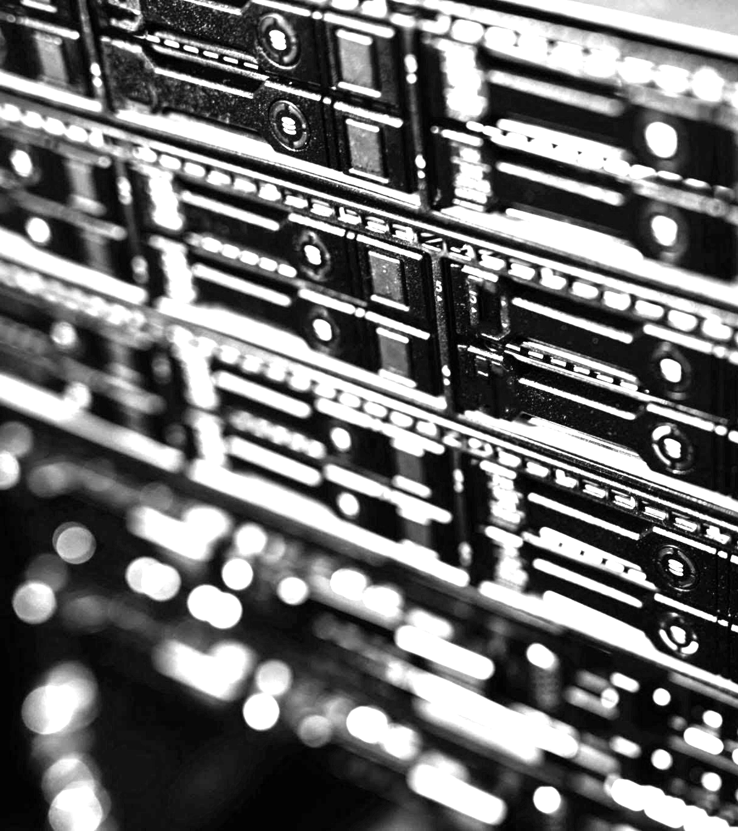
Data Storage
Most research projects need beyond-desktop data storage.
Projects must meet agency and publication requirements for data stewardship and publication.
Some options exist for in-progress project data storage.
University librarians are incredibly helpful in this area.

Slide 23
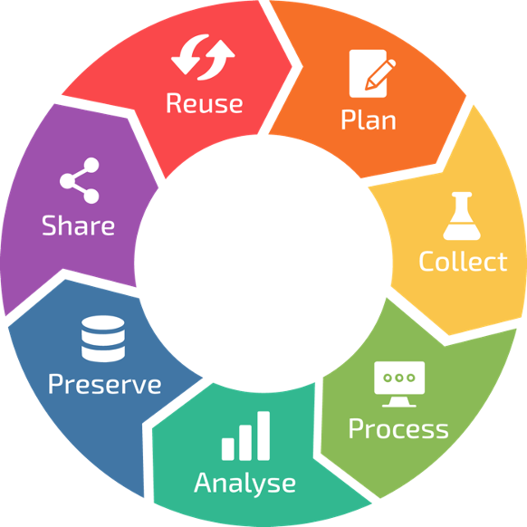

“Working” Data Storage and Management
Most projects need beyond-desktop options for authoritative data and collaboration. Researchers require support for data management practices. Librarians are key!
For larger files and/or total data
Open Storage Network for data collaboration
(no-cost via NSF ACCESS)
Commercial cloud
(CloudBank via NSF ACCESS)
Caching infrastructure for commonly access data
Open Science Data Federation (OSDF)
Storage facilities are attached to most federally funded computing resources

Slide 24
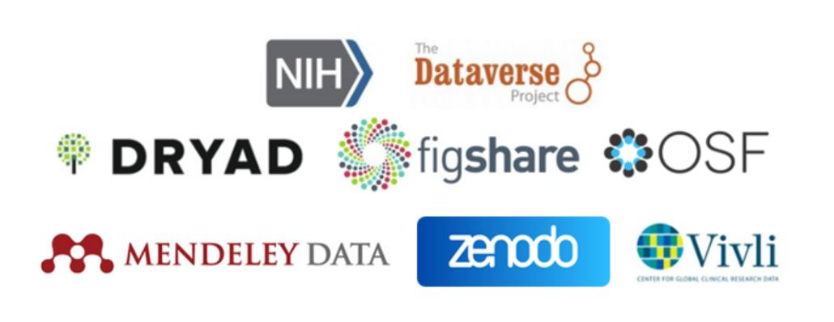
Preserve or publish ‘final’ datasets
Grants and journals increasingly require published data products. Librarians can help faculty to find the right repositories. Campuses with larger research portfolios may provide a generalist repository or archive services.
Repository of repositories: www.re3data.org
Example publisher requirements: www.nature.com/sdata/policies/repositories
Listing of NIH-funded repositories:
www.nlm.nih.gov/NIHbmic

Slide 25
Individual vs. institutional
The options described so far are primarily designed to serve individual researchers or projects.
Relying on free, per-researcher decisions could lead to a data management process that is difficult to manage at an institutional level.
Two major open-source products for institutional data repositories ➜
DSpace — dspace.org — Community-supported for 20+ years, thousands of installations. DSpace registered service providers offer pre-built solutions.
CKAN — ckan.org — Non-profit supported solution, 20 years active. Used worldwide by governments and enterprises. 250+ community- built extensions.

Slide 26

Networking & Security
Today’s AI and data-intensive research relies on the ability to access and move data between storage and computing resources.
Notes:
Supporting this need to move large-scale data, Internet2 and the state and regional RENs provide the nation’s research and educational cyberinfrastructure backbone.

Slide 27

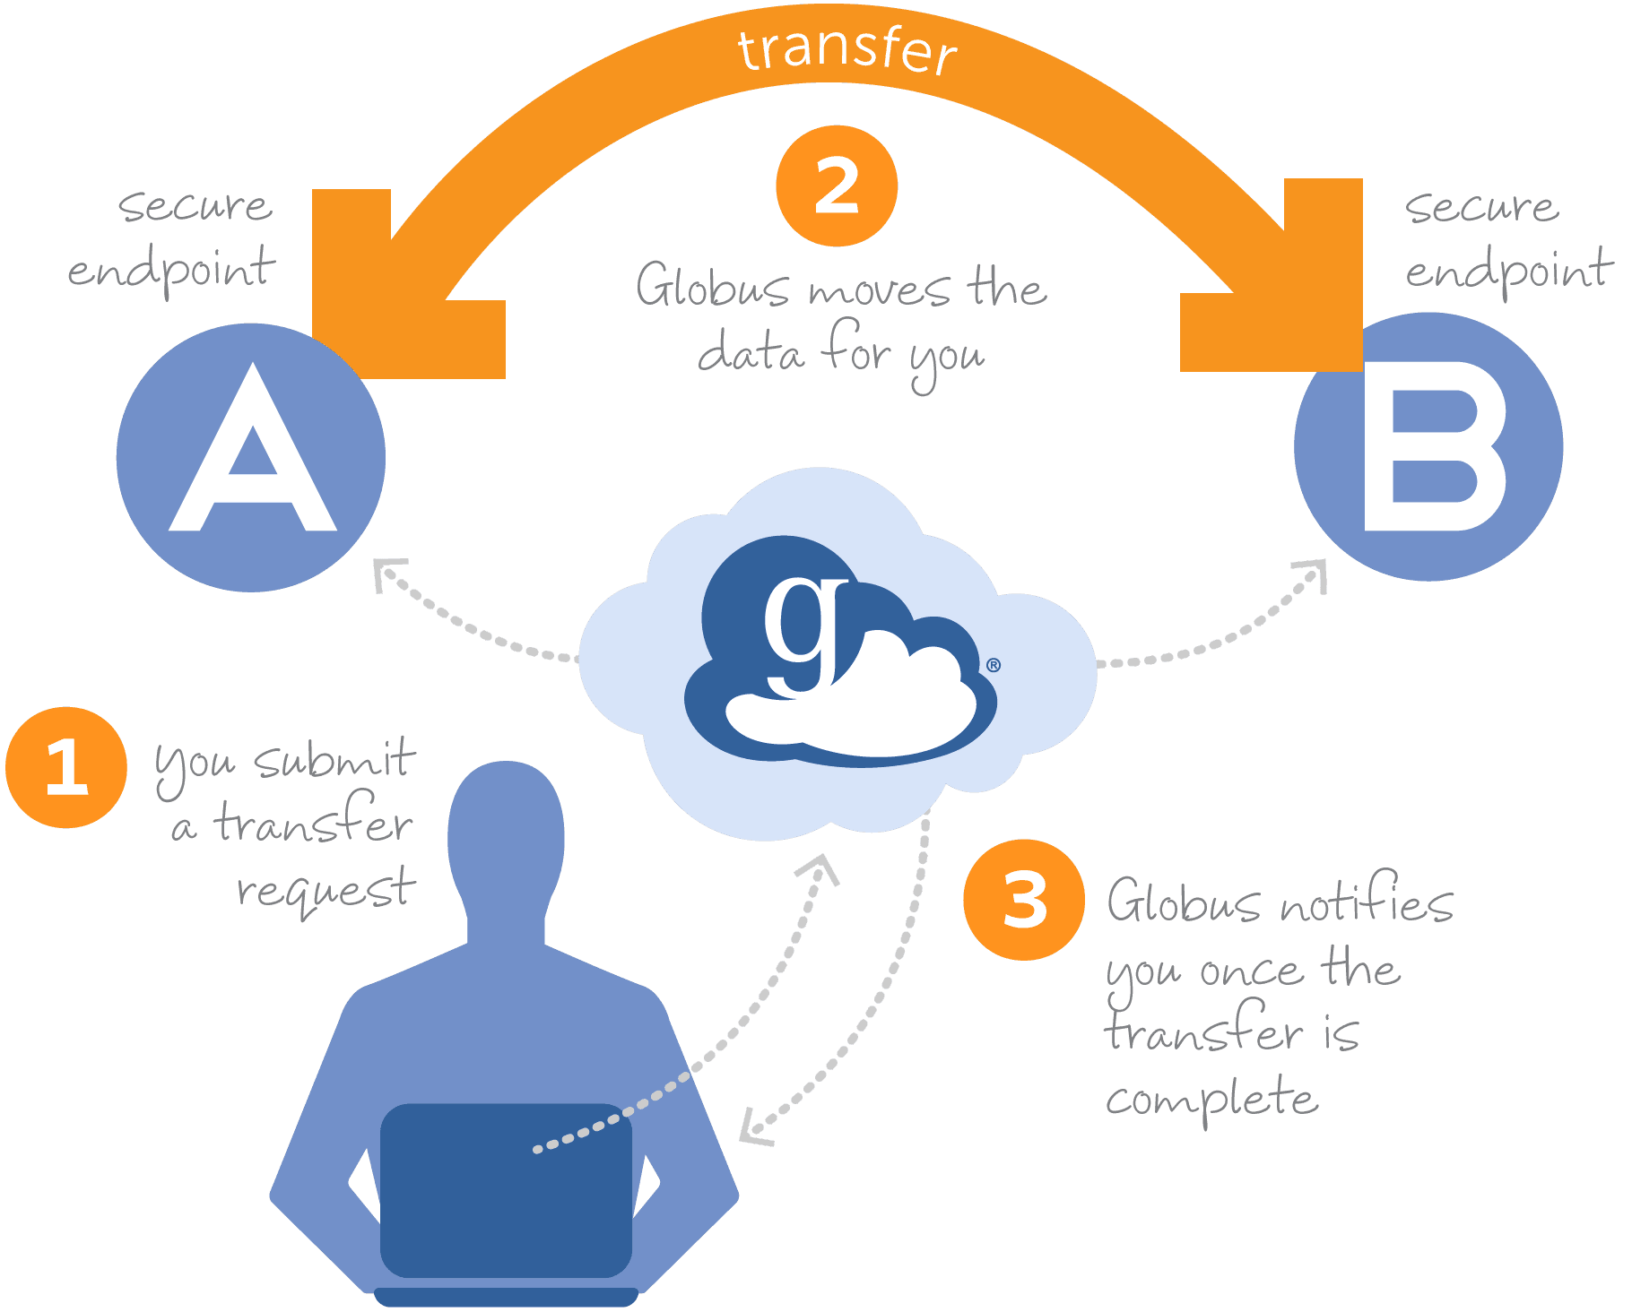
Data Transfer
With nearly 800,000 users in 80+ countries, Globus is the de facto standard for managing large-scale research data movement.
Individuals can use Globus for free to move data between Globus endpoints and personal devices.
Campuses can pay to establish Globus endpoints on local computing and data systems, and to optimize network use.
globus.org
Globus is part of the Internet2 NET+ program, selected following an Internet2 RFI for data migration tools.

Slide 28



Security for R&E Cyberinfrastructure
Research cyberinfrastructure may require more flexibility, or more controls, with established services and communities to support your campus efforts.
NIH requirement for controlled data repositories by January 2027.
NSF research security policies have introduced new requirements and resources.
InCommon & Identity Proofing
Stay tuned for several informational sessions
Security Monitoring as-a-service
OmniSOC’s ResearchSOC
TrustedCI — NSF CI Center of Excellence providing example policies and advising
RRCOP — Regulated Research Community of Practice, with more than 380 institutions represented

Slide 29
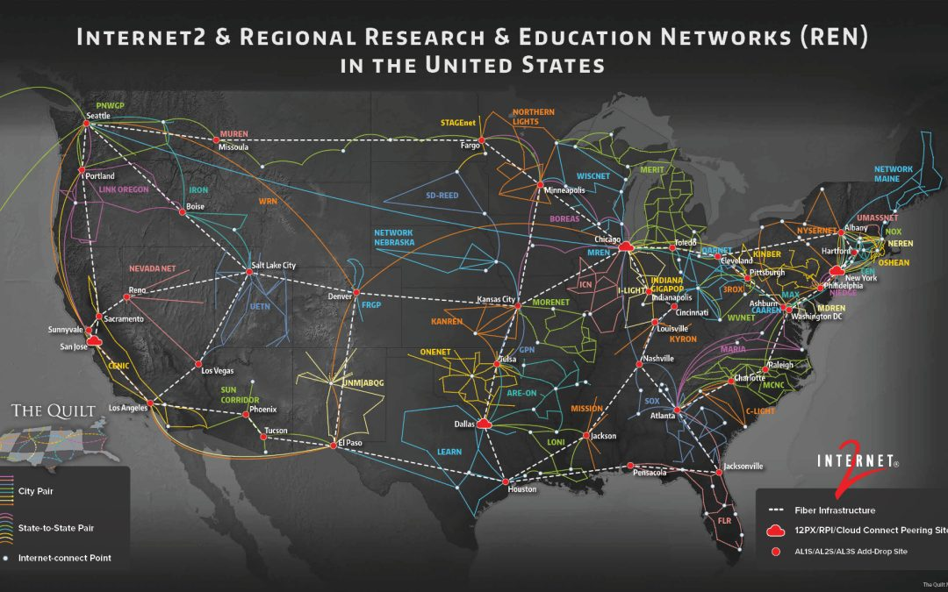
Networking — Connecting All of R&E
The Internet2 backbone connects:
R&E institutions
(beyond higher ed)
national computing and data resources
major commercial resources (e.g., commercial cloud)
40+ regional R&E networks (RENs) extend the network to thousands of organizations nationwide, connecting campuses like yours.

Slide 30
Call to Action:
Community-operated Cyberinfrastructure
While they are low- or no-cost to campuses, these community ecosystems have campus impacts, including growing needs for data storage, data transfer, researcher support, and agency compliance.
The emergence of AI is accelerating these changes.
Sign up
Request a project
Tell a colleague
Point these resources to your departmental staff

Slide 31
Thank you!
Contact:
Stephen Deems
sdeems@internet2.edu

