Slide 1
Facility Priorities During LS3
Fred Luehring (Indiana University)
Kaushik De (UT-Arlington)
9 June, 2026
US ATLAS @ HTC26

Slide 2
Discussion Topics
Meeting the pledge
Purchasing priorities
Infrastructure upgrades
Dell common pricing
Storage and compute server purchas
Common tools

Slide 3
Meeting the Pledge
No hardware funding during I&C
  Meet 2027 and 2028 pledge with end of CA funding in 2026
  Purchases must be “completed” by Jan 31, 2027
  Possibility of NCE
Each site needs to take account of retirements
Assume flat CPU pledge
Slight increase in storage pledge
US T2 pledge now equal for each of 4 sites
Continue x2.2 for CPU, x1.2 for storage
  Should we change x2.2 to x2.0?

Slide 4
Purchasing Priorities
Highest priority is infrastructure.
  Must cover infrastructure needs for the foreseeable future using the lump sum funding from the end of CA funds.
    Network (ideally with 400G to the WAN
      Too early to do 400G at some sites.
    Power, Cooling
    Servers that run the sites
  Infrastructure can disable the part or all of a site if it fails.
Second priority is storage servers
  Failing storage can disrupt may jobs because data is spread over many servers.
    Causes us to retire storage at no more than 7 years.
    Also adding storage to an existing site takes time and effort.
Last priority is compute servers
  Failing CPU is far less disruptive than failing storage
    We often run cmpute more than 10 years
    Easy to add more compute to an existing site.

Slide 5
Infrastructure Upgrades
Can we pool together network purchases for T2’s?
  Will we get better Dell pricing if we add infrastructure to CPU and storage purchases
Sharing of ideas about equipment to buy
In general try to get the universities to pay for as much infrastructure as possible.
  The willingness of the universities to pay varies depending on site.

Slide 6
Dell Common Pricing
Leverage large end of CA purchases by T2 sites
  Need to push Dell to move quickly
    We need to tell Dell a the purchase size.
      And stick to that amount of spending.
      I am leery of doing this until NSF releases the funding.
    Need some dedicated meetings?
Can we use T1 also in negotiations?
  This is tricky because the T1 has DOE funding and different (stricter) purchasing rules

Slide 7
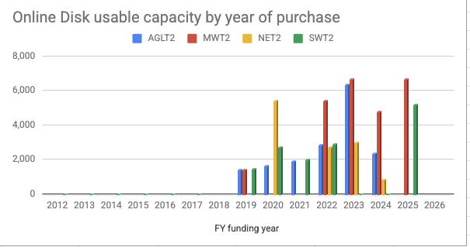
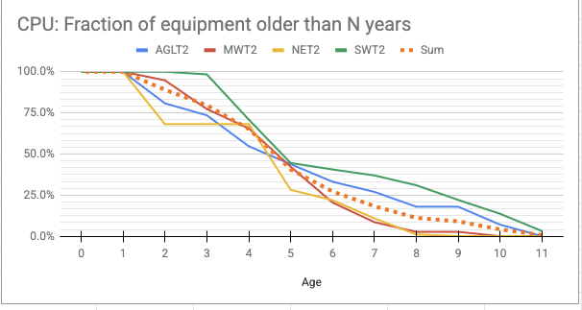
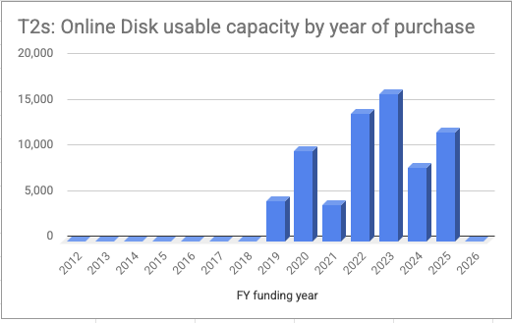
Storage Server Age
We are currently in reasonable shape but things will be tough the start of HL-LHC without purchases now.

Slide 8
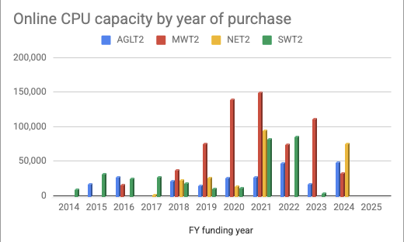
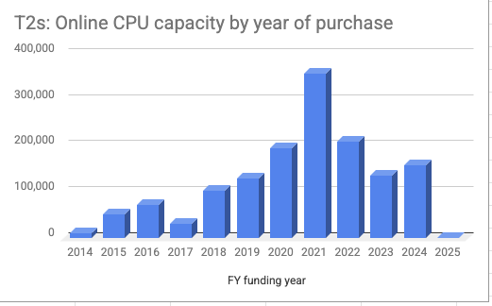
Compute Server Age
We are currently in reasonable shape but things will be tough the start of HL-LHC without purchases now.

Slide 9
Server Purchasing Considerations
Andre Sciaba gave an excellent presentation at HEPiX on recent hardware trends:
  https://indico.cern.ch/event/1471803/contributions/6966459/attachments/3280524/5862278/Hardware%20Technology%20in%20the%20AI%20era%20-%201.0.pdf
I covered much of the benchmarking in the talk at last Friday’s procurement meeting:
  https://docs.google.com/presentation/d/1BG3f3G3Xaiu8BUUIH5d4DOaiSyR0nX6kWGKxNXio3Nc/edit?slide=id.g3e87592a3c7_0_92#slide=id.g3e87592a3c7_0_92

Slide 10
Storage Considerations
Basically we’re stuck on the storage costs because of the age of our storage.
  The costs are up for $48/usable TB to about $100-$110/usable TB for SAS HDD.
    We need to consider buying 28 disks per R760xd2 storage server instead of the usual 24 disks but we need to make sure that this does not cause significant reduction in transfer speeds.
  When buying from Dell, 20 TB HDDs give the lowest cost per TB ignoring the infrastructure costs of need more servers than if we bought the servers with 24 TB HDDs.

Slide 11
CPU Considerations
CPU server cost is driven by memory and solid state storage costs.
  AI demand has driven memory cost up by a factor of 3-4.
  Andre Sciaba found that CPU prices are flat.
Kevin Casella at BNL points out that because of these costs, we should turn of hyper-threading and buy servers with half as much memory and storage.
  Hyper-Threading gains at most 33% more production from a CPU and if we pay 4 times as much for the memory/storage this does not make economic sense.
    In making this calculation, one must account for the costs of the additional infrastructure needed: racks, PDUs, and network ports.
Nominally we want 3 GB of memory and 30 GB of storage per job slot. These are soft requirements.

Slide 12
Common Tools
Do we have fabric commonality to make common tool development worthwhile?

