Slide 1
Fabrics and Storage for USATLAS
Oszkar Tarjan, Computing and Data Sciences
Scientific Computing and Data Facilities
6/9/2026
Notes:
I’m working in the group which is responsible for compute nodes.

Slide 2
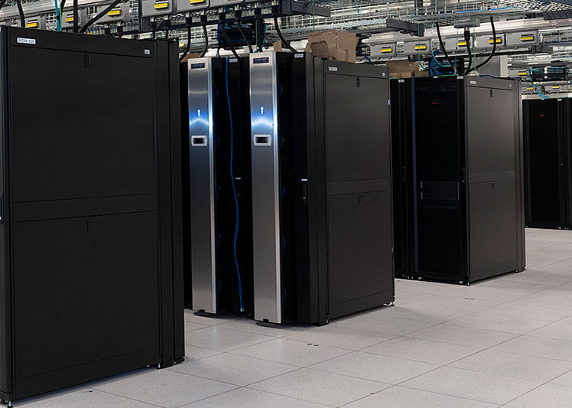
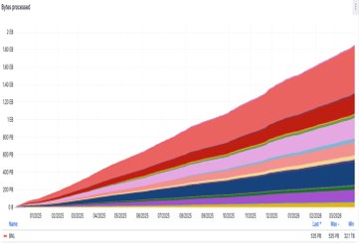
Fabrics
ACAS pool:
  317 nodes
  31.6K CPU cores
  104 TiB RAM
  ~460k HEPSCORE23
  Special: 4 ARM nodes, 2 GPU nodes
sPHENIX
  1206 nodes
  134k CPU cores
  511 TiB RAM
  2M HEPSCORE23
Shared Pool
  487 nodes
  41.2k CPU cores
  126 TiB
  ~516k HEPSCORE23
Infrastructure nodes:
  78 nodes
  1.02k CPU cores
  4 TiB
1.8 EB
Data processed (in PB)
ATLAS Tier-1 Centers
Jan 2025 – April 2026
BNL : 535+PB
Notes:
Acas pool >300 nodes ~31k CPU cores
sPHENIX 1206 nodes >130k CPU cores
Shared pool >480 nodes >40k CPU cores
Infra ~80 nodes. These infra nodes are mostly VMs. I’m focusing on them on the next slides.

Slide 3
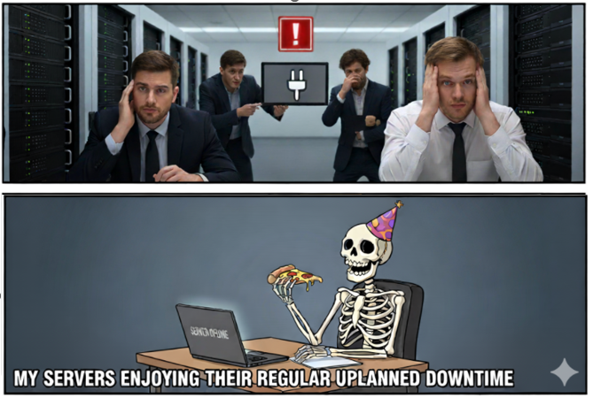
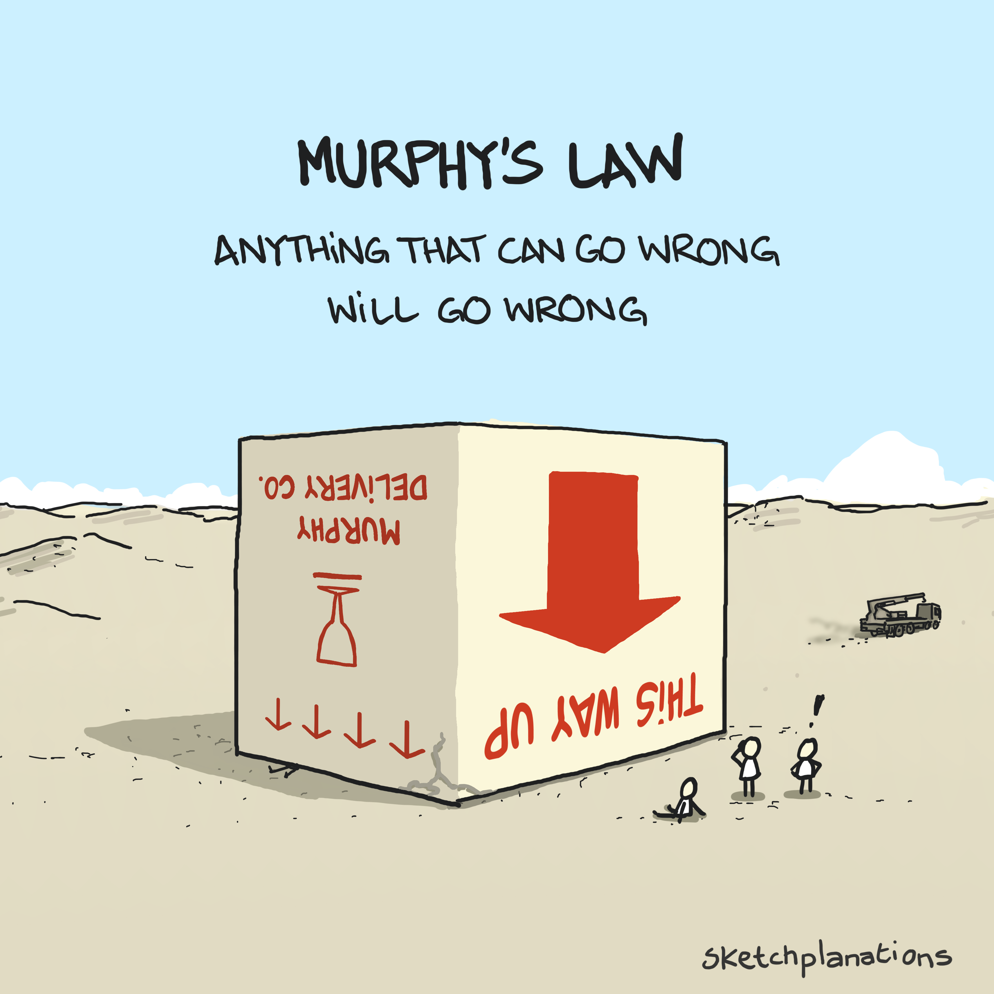
What we don’t want to see
Notes:
Murphy’s law is powerful. But not powerful enough to keep servers running when Power Station goes out.
Users shouldn’t be the ones who notify us about outage

Slide 4
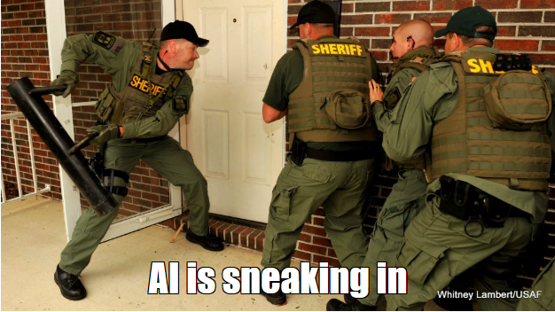
Infrastructure node types
HTCondor infra (CM, CE, Submit, Gate keepers)
User nodes (dev, prod)
CVMFS write
Monitoring (monitor01, Zabbix, Grafana, Victoria Metrics/Logs, AI anomaly detection)
Jhub, Jupyter
DB (mysql, postgres)
Central Reconstruction Service
Jenkins
Notes:
Mention the list.
Let me tell you a story when a power station went out unexpectedly during a maintenance. I lost my SSH access while I was working on a node. Monitoring wasn’t reliable and I thought we lost network when I saw a few hundreds of nodes to be unavailable. MM went out. Network team was on call, they complained about users who complained about missing MM. Went to the Datacenter and realized the truth. As soon as I got the confirmation that Power is back, I’ve powered on ~800 nodes manually.
Improvements to follow. Monitoring alerts without flooding us. Gradual remote powering of the nodes.

Slide 5
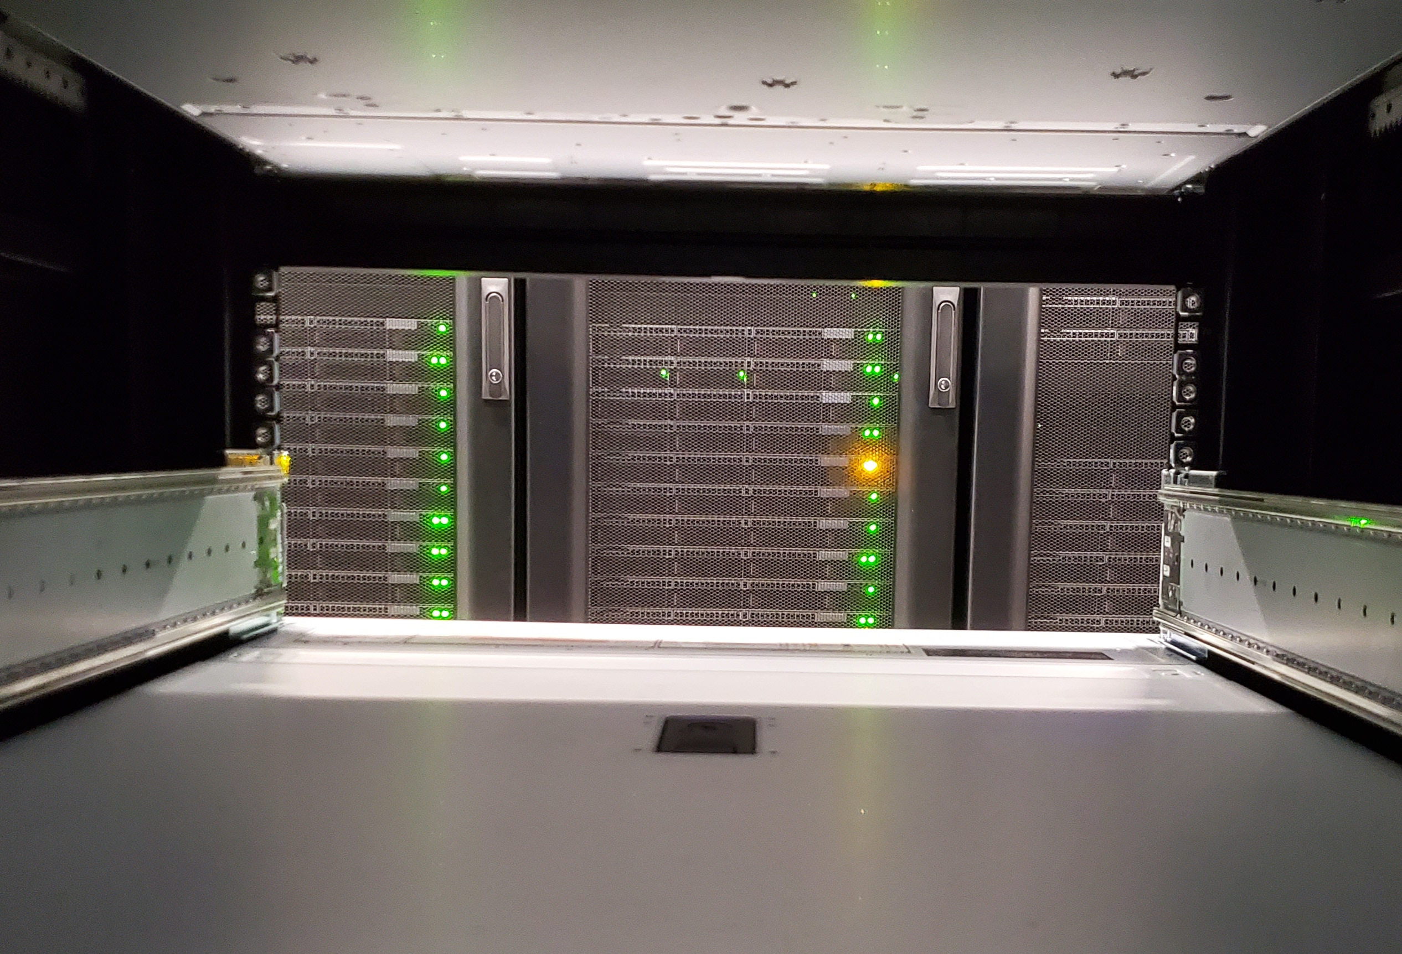
Further infrastructure services
Sysmanagers (OoB)
Foreman
Puppet
Cobbler
OpenShift
Proxmox
SSH gateways
NTP
Mattermost
MkDocs
COmanage-registry
OpenSearch
Nextcloud
Globus
Roundcube Webmail
Nlyte
Etc.
Notes:
Further automation is the deployment of the nodes.
We are using cobbler repository to have locked local repos and deploying the nodes with foreman and puppet combo. As you could see there are other services which are being used to help researchers and our professionals
A few words about them.
Let’s see what we have on storage side!

Slide 6

ATLAS migrated from Lustre to dCache and GPFS
storage servers were moved into dCache
user files went from Lustre to GPFS
  GPFS has better performance for small files (MB scale)
  parallel storage and quicker access to small files
IO performance is similar between GPFS and Lustre regarding big files
Notes:
dCache fronts the tape access. dCache internal pools are ZFS

Slide 7
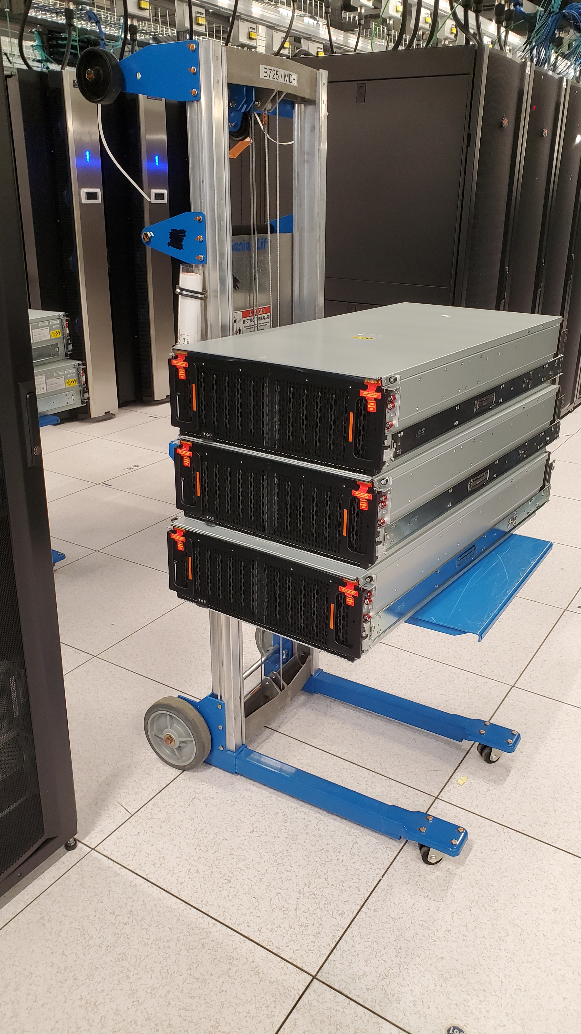
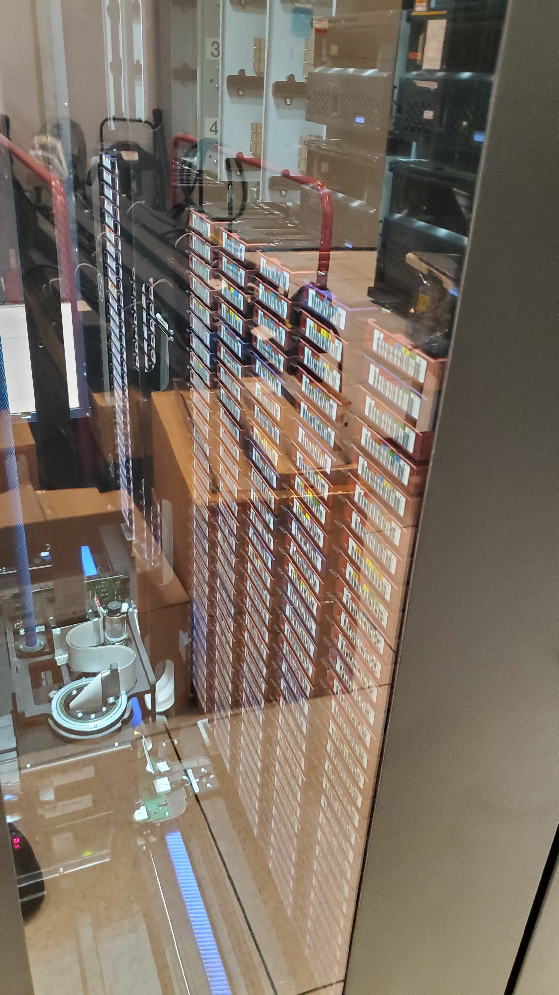
US ATLAS Storage at BNL
GPFS
  Size: 1.1 PB
  Amount of files: ~7.5M
CVMFS (locally maintained!)
  Size: 4TB
  Repo source is only 139GB
dCache
  Size: ~67 PB on disk, ~126PB on tape
  Amount of files: ~ 167M (disk and tape)
HPSS
  Data repacks: 3900 LTO6 tapes -> LTO8
  Sustain data rate: 7.5 GB/sec
Notes:
GPFS storage is over 1PB
CVMFS repository is locally maintained (atlas.sdcc.bnl.gov) to help customize our US ATLAS shared Tier 3. This repo source is only 139 GB in size, of our currently used 4 TB staging area and 2 TB source storage on our Stratum Zero.
dCache ~173 PB
HPSS: Repacking data to new tape technologies allows the retirement of old tape resources and reduce the maintenance costs.
Let me show the next migration
---
Stratum Zero is CVMFS's software source control server, where the original code is maintained
All *.sdcc.bnl.gov repositories are maintained on our Stratum Zero server
All global repositories, including ours, are replicated to Stratum One servers. This is where the clients get the repositories from.

Slide 8
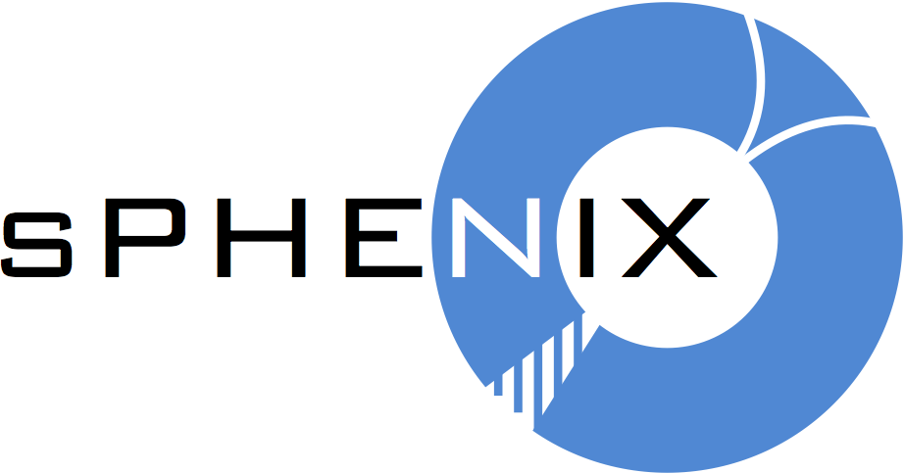
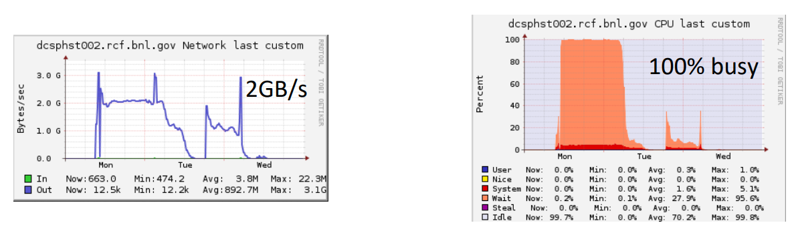
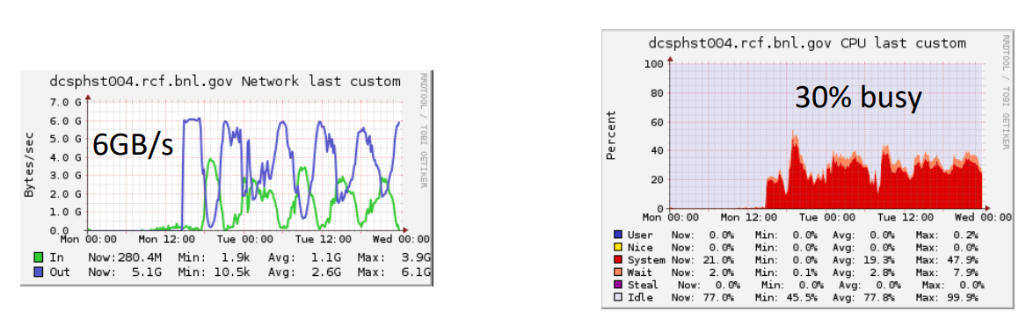
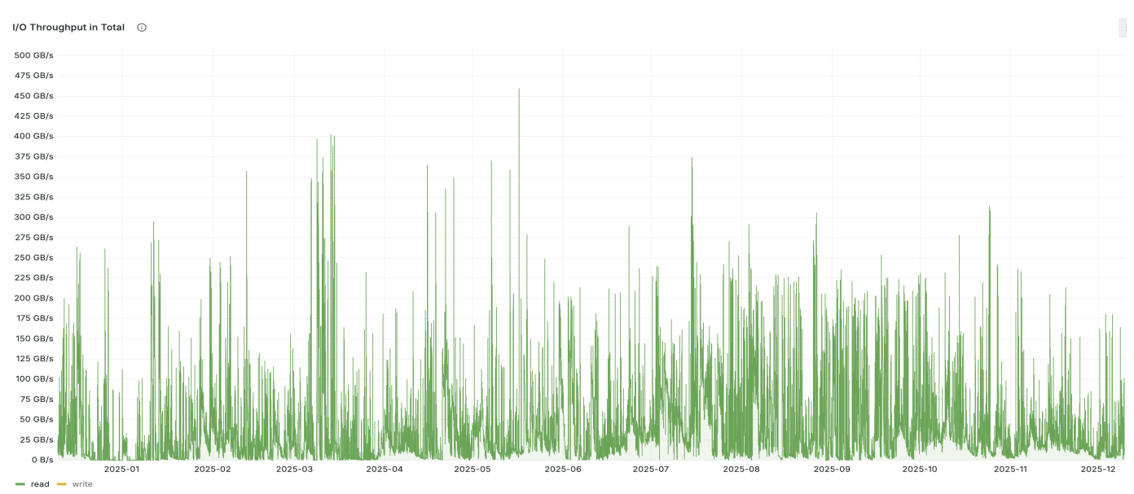
sPHENIX migrated from dCache to Lustre
  Cause of the migration:
    dCache servers were 100% busy (90% wait)
    2GB/s per server
  Observations with Lustre:
    Data rates for >130k running jobs:
      observed 350GB/s reads over hourlong periods, looks like we did hit 450GB/s)
      3.5GB/s – 6GB/s writes per server (Total peak: 260GB/s)
    Storage size
      Free capacity in Total: 8.7PB
      Used capacity in Total: 6.11PB
Notes:
sPHENIX suffered with the dCache performance and decided to migrate to Lustre.
It improved the storage access and capable of serving their >130k running jobs. IO wait times got reduced write speed doubled
They did hit 450GB/s peak usage

Slide 9
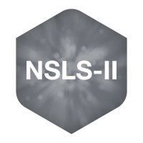
NSLS2 migrated to NetApp
Cause:
Issues due to millions of small files.
GPFS and Lustre require high-effort ongoing maintenance. NetApp is closer to a turn-key appliance.
Cost implication was $6M for 6 PB.
Peak throughput with NetApp measured thus far:
14.5 GB/s (~120 Gbps)
History:
"First light" in 2014: Instrument-local storage (mostly GPFS) without centralized access or management
c. 2020: Migration to Lustre managed by SDCF, née SDCC
  Grew to three Lustre appliances, ~3 PB usable capacity each
Now–2027: Migration to NetApp appliance + Azure for additional capacity
(Some details omitted for simplicity.)
Notes:
The other migration was recent. NSLS2 had the same performance problem as ATLAS with the small files. They decided to invest into NetApp appliances.
It was a $6M investment.
Would it make sense for ATLAS to do the same migration? That is a good question. Probably it won’t happen.

Slide 10

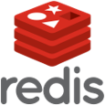


Furthermore, NSLS2 is interested in
Caches, e.g. Redis
Databases, e.g. PostgreSQL, DuckDB
Blob stores
  NetApp provides an S3-compatible interface to Storage Grid
Would migration to NetApp make sense for ATLAS?

Slide 11
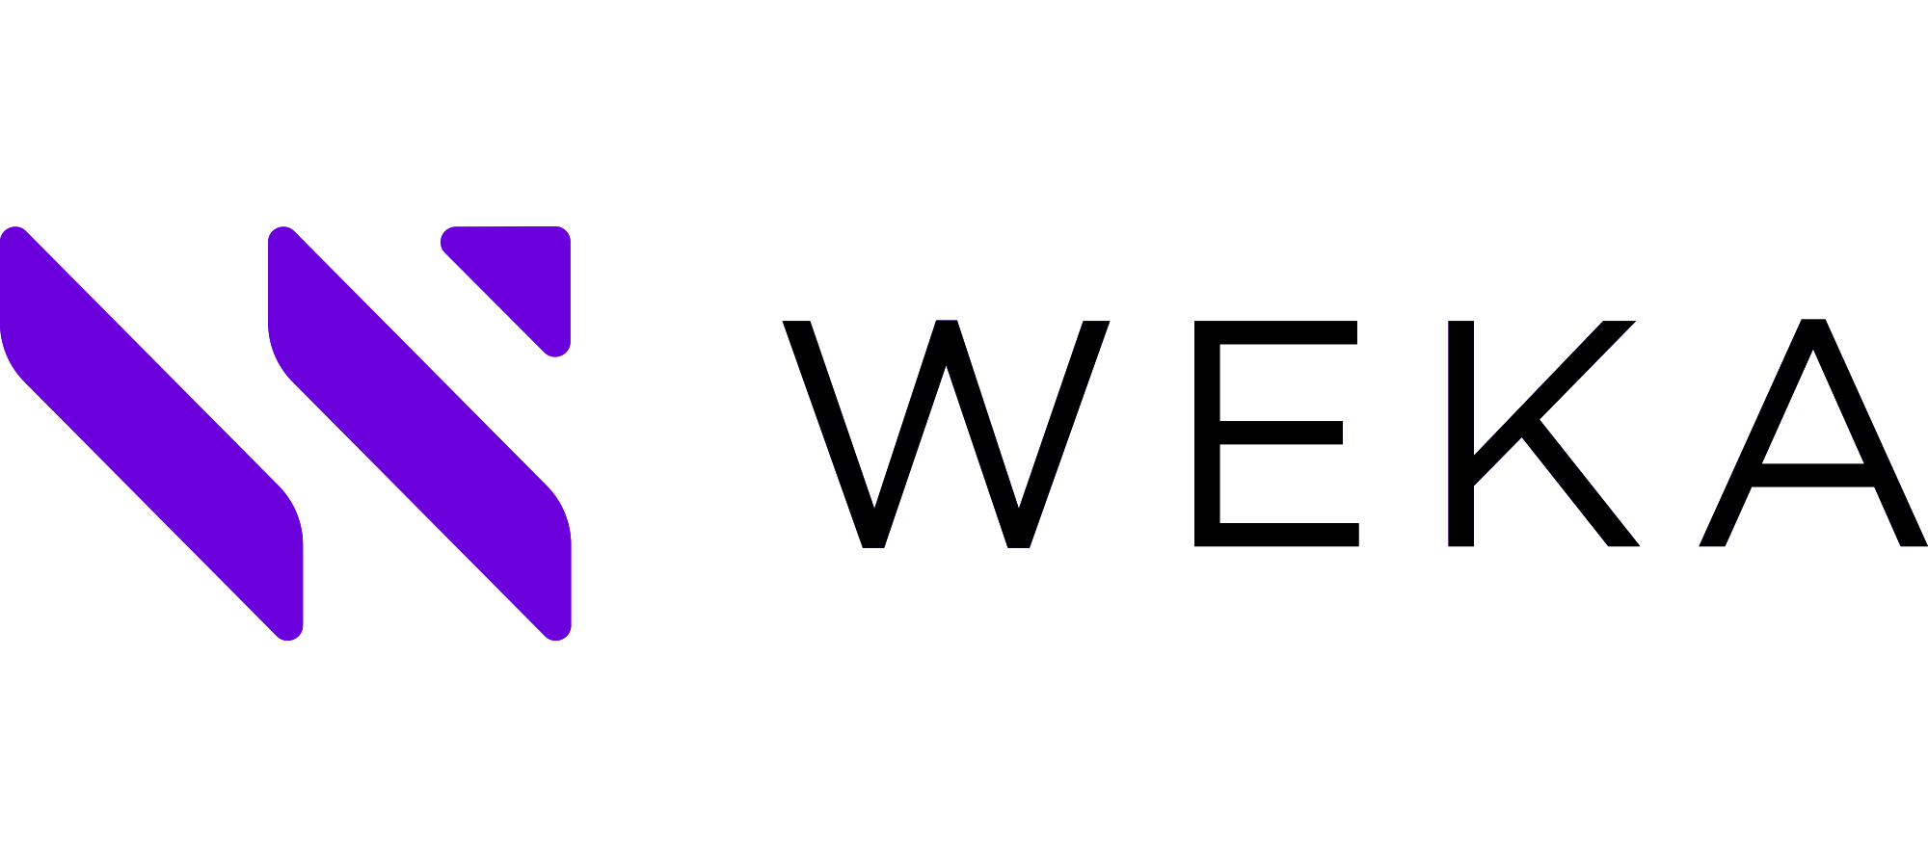


Storage possibilities investigated by SCDF
Preliminary discussions to the new storage solutions:
WekaIO
  Strong partnership at SLAC
  Great reliability, performance and scalability
  Simplicity (eg intuitive/powerful command line) and flexibility (eg file system resizing)
  S3 Protocol Gateway: allow customers to read/write to the SDFData file systems
Distributed Asynchronous Object Storage (DAOS)
  Major filesystem on Aurora (at ALCF) with 230PB
  Multi-tenant Storage pooling
  Data Protection with Self Healing (supports wide range of data protection schemes)
  Native support for Datasets
EOS
  Scale-out data storage architecture
  Multi-protocol (XRootD, HTTPS, FUSE, NFS access planned) and Multi-authentication (each protocol see the same set of data)
  EOS was conceived to streamline and simplify service operations
  Storage tearing based on: Performance, Costs, Access frequence
Notes:
Preliminary discussions about other storage options are in progress to get understanding of their features and capabilities to support new programs as HiLumi-LHC and EIC

Slide 12


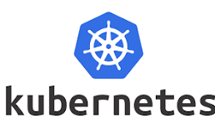
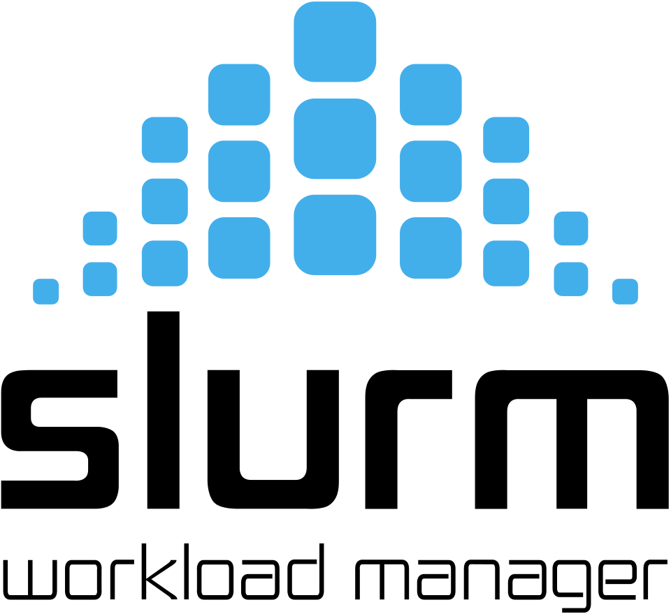


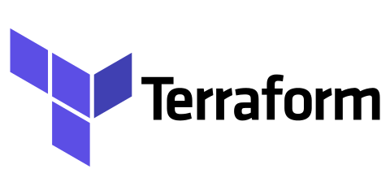
Heterogeneous deployments
ATLAS
  GCP (managed Kubernetes cluster)
TREASURE
  AI model development
  GCP (managed Kubernetes cluster)
EIC
  Running simulations (GdfidL)
  GCP (slurm cluster)
FCC
  GCP (HTCondor)
ePIC
  GCP (managed Kubernetes cluster)
Cluster Toolkit
Notes:
We had a recent presentation at Confab where we demonstrated heterogenous workflows for American Science Cloud community.
Thanks to Google we are researching to include further workflows into our portfolio using Google Cloud resources.

Slide 13
Acknowledgement, questions
Thanks to:
BNL SCDF Staff
Special Thanks to:
Alexei Klimentov, Ofer Rind,
SCDF IT Fabric team
  Matt Cowan, Costin Caramarcu,
  Thomas Smith, Kevin Casella,
  Zhihua Dong, Shigeki Misawa

