Slide 1



CHTC
UW CS
Dynamic Job Lease Optimization in HTCondor
Khyathi Vagolu
Collaborators:
Prof. Josiah Hanna (UW-Madison)
Todd Tannenbaum, Greg Thain (CHTC Team)
Dynamic Job Lease Optimization in HTCondor
Notes:
Hello everyone! Hope you’re enjoying attending different conferences here. I’m Khyathi, a Masters student at UW Madison. I wish I could be there to present in person but Im still grateful to have gotten the opportunity to take part in HTC26.
This work is part of an independent study under the guidance of Professor Josiah from the CS department at UW Madison, and it has been an exciting collaboration with Todd and Greg from the core HTCondor team.
Today, on a very high level, my work is going to be about how we can use AI to understand and debug HTCondor. More specifically, I will be talking about how Job Lease duration can be optimized in HTCondor. We’ll get into what that means very quickly but this is an effort to understand this distributed system and see where we can cut down on any machine usage costs. Note that is project is in its nascent stages and most of the work done so far is on simulated data and we aim to start working on real data.

Slide 2


Motivation: What happens under the hood?
AP (Access Point) runs condor_schedd which spawns the Shadow process.
EP (Execution Point) runs condor_startd which spawns the Starter process.
Heartbeats over the network pipe keep the job lease alive and active.
When the connection breaks, HTCondor enters a reconnection window (static, 40 minutes).
AP (Access Point)
EP (Execution Point)
Shadow Process
condor_schedd
Starter Process
condor_startd
RPC Heartbeats
Dynamic Job Lease Optimization in HTCondor
Notes:
Let’s look at how HTCondor handles this internally under the hood. When you submit a job, you do it at the Access Point, or AP. The AP runs the condor_schedd daemon, which spawns a dedicated process for your running job called the Shadow. The Shadow acts as the job's agent back at home base.
On the other side, the Matchmaker assigns your job to an Execution Point, or EP. The EP runs the condor_startd daemon, which spawns a process called the Starter to actually run your code. While your job runs, the Starter sends periodic RPC heartbeats over the network pipe back to the Shadow. This is the cord that keeps the job alive. But what happens when that pipe breaks?
When the network connection drops and the Shadow stops hearing heartbeats, HTCondor doesn't immediately give up. It enters a reconnection window governed by a static parameter

Slide 3
Problem Statement: Job Lease Timeout
"Why is my job suddenly idle or terminated?" - CHTC User
The Challenge
Common pain: Unexpected terminations or long idle states
Massive scale: Thousands of diverse jobs
Network disruptions are a constant at scale
Current solution: 40-min static lease timeout
The Objective
Minimise the number of jobs terminated or CPU cycles wasted
Can we do better than a static lease timeout?
Dynamic Job Lease Optimization in HTCondor
Notes:
Let’s look at the core problem we are tackling, and it starts with a question almost every CHTC user has asked at some point: 'Why is my job suddenly idle or terminated?'
When you are dealing with a massive distributed system like ours—where thousands of highly diverse jobs are being scheduled every single day across a massive, heterogeneous landscape of machines—this is a incredibly common pain point.
// You log in to check your queue, and you find your job has unexpectedly died, or it's been sitting in an idle or suspended state for what feels like an eternity.
The reality is that at this scale, network disruptions and worker node failures are a feature, not a bug. Routers drop packets, links flake, or machines completely crash. Currently, HTCondor handles this by relying on a static lease timeout—currently set to 40 minutes—before it officially abandons a job.
But at our scale, a one-size-fits-all static window creates a massive efficiency problem, and countless CPU cycles are being completely wasted while machines sit around waiting for endpoints that are never coming back.
So, our main objective is simple: We want to minimize the number of terminated jobs and eliminate these wasted CPU cycles. And the central question we are asking is: Can we do better than a static lease timeout?

Slide 4
The Trade-off: Idle Time vs. Job Failures
Operational Penalties
Over-Waiting: Slots tied up for machines already dead.
Under-Waiting: Killing 10-hour job for 5-sec transient blip.
Static Baseline (T) = 40 minutes
Resource & Financial Impact
Machine Idle Time
Job Failure Costs
Dynamic Job Lease Optimization in HTCondor
Notes:
When the network connection drops and the Shadow stops hearing heartbeats, HTCondor doesn't immediately give up. It enters a reconnection window governed by a static parameter: the Job Lease Duration, which we will call $T_4$. By default, this is set to a static 40 minutes.
This static value forces a brutal system trade-off. Right now, HTCondor is waiting a stubborn 40 minutes for endpoints that might reconnect in under a second—or endpoints that are completely dead and will never come back. When a node experiences hard hardware failure, that slot stays tied up in a zombie state for 40 minutes, causing massive machine idle time. On the flip side, if we blindly slash that timeout to something short like 2 minutes, we run the risk of prematurely killing a job that has been running for 10 hours just because of a temporary 3-minute network blip. When you scale this across thousands of jobs, this guessing game costs tens of thousands of wasted compute-hours per month.

Slide 5
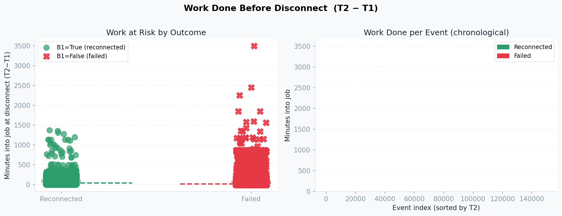

Understanding the scale from real Shadow Reconnect Logs
Job Outcomes (Reconnect Count)
Frequency of Disconnects
24.5k
15.5k
Failed Survived
1 Disconnect 79 Max
Work Done Before Disconnect (min)
Policy Scorecard: Static T4 = 40 min
Wasted Wait: 3,180 Hours
Work Lost / Failure: 85.9 Min
Disconnects / Job: 4.19
77.3%
Success Rate
Dynamic Job Lease Optimization in HTCondor
Notes:
"Now, let’s look at the real-world HTCondor logs to see the actual scale of this problem.
The Pie Chart shows a major split: 66% of disconnects successfully recover, but 34% fail entirely.
The Bar Chart translates this to raw impact: while 15,536 jobs survived their drops, a 24,551 jobs failed.
The Histogram shows the network volatility—most jobs see 1 or 2 disconnects, but some get hammered by up to 79 disconnect events.
So this isn't an edge case. We are looking at tens of thousands of jobs actively disrupted by network behavior.
Slide: The Hidden Cost of the 40-Minute Baseline
On paper, the 87.3% reconnection success rate looks great. But look at the actual operational costs: we have accumulated 3,180 hours of completely wasted machine idle time waiting on dead endpoints. Because of this long window, the mean work lost per failure is 85.9 minutes.
The last slide shows when these disconnects happen during a job’s lifecycle. It plots the duration a job was running before the disconnect hit. some lost over 3,500 minutes of already-completed CPU work simply because they timed out and had to restart from scratch.
This directly motivates our move toward dynamic timeouts. A valuable job that has been running for days deserves a longer, more protective timeout window. A job that disconnects 2 minutes after starting does not—and holding that slot for 40 minutes is an active waste of cluster resources."

Slide 6
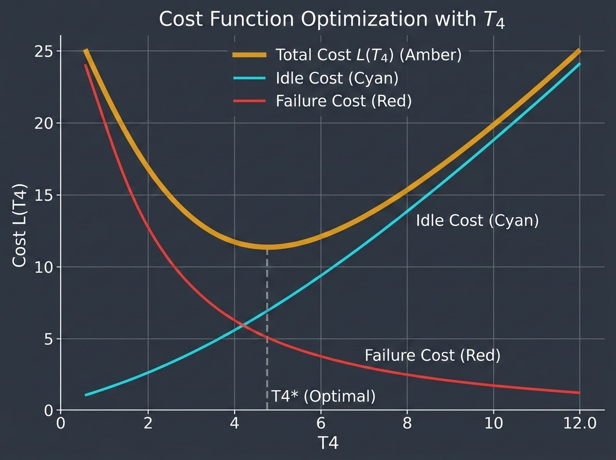
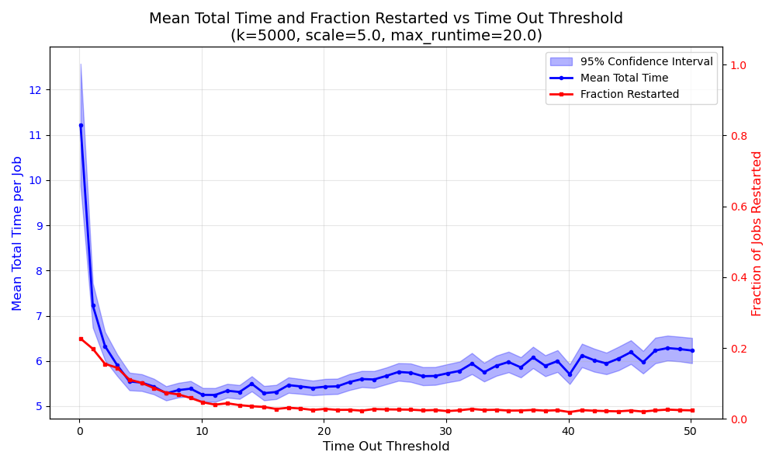
Simulation Data: Cost vs. Lease Duration
Theoretical Simulation
Minimize Total Cost function: Minimize L(T)
Variables: I(T) (Idle time), F(T) (Failure probability)
L(T) = C_idle * E[I(T)] + C_fail * E[F(T)]
Simulation parameters
K = 5000 jobs/batch Pareto
Fault Injection: Uniform 0-20
Max Retries: 10
Reconnections: 10 % permanent failure
Sweeping Bounds: [0.1, 50.0]
Dynamic Job Lease Optimization in HTCondor
Notes:
Our research began by formulating a mathematical loss function over the timeout value, to minimize this exact trade-off.
The loss balances two competing costs: the machine idle time spent waiting fruitlessly on a dead endpoint, versus the job failure penalty of losing completed CPU work if we cut the timeout too short.
To establish a baseline ground truth, we built a discrete-event simulation that tries to mirror the exact of our distributed infrastructure.
Instead of treating all jobs equally, we modeled a realistic workload of 5,000 jobs per batch using a heavy-tailed Pareto distribution. This captures the true cluster dynamic where a few massive, long-running jobs consume the majority of resources. We injected random connection failures uniformly across their runtimes.
For the network recovery behavior, we introduced a split: 10% permanent failures—meaning the endpoint is permanently dead—while the remaining 90% are transient network blips that recover following an exponential delay with a 5-second scale parameter. If a job times out, it faces a penalty and is forced to restart, with a cap of 10 maximum retry attempts.
By running a brute-force sweep across timeout thresholds from 0.1 to 50 seconds, we mapped the shape of this system trade-off, capturing the two extremes: a low timeout results in lots of job restarts, while a high timeout wastes slots on dead nodes.

Slide 7
Machine Learning Techniques
Can we use Reinforcement Learning?
Learning the best action through trial and error by interacting with an environment, observing a cost, and adjusting a strategy.
The Sample-Efficient Path
Leveraging structural advantages of a single, bounded parameter.
No Neural Networks Needed
Bypass complex architectures for direct optimization.
Bayesian Optimization
The True Optimum in a handful of trials
Production Constraints
✕ Data Inefficiency: Standard RL needs 1000s of steps
✕ Risk: Cannot test arbitrary bad values on real jobs
Dynamic Job Lease Optimization in HTCondor
Notes:
Now, how do we learn this optimal threshold on a live system?
Learning the best action purely through trial and error—by interacting with an environment, observing a cost, and adjusting a strategy—is the definition of Reinforcement Learning, or RL.
However, standard RL algorithms are notoriously data-inefficient. They require thousands of exploratory steps to learn a policy. On a live production cluster, we cannot afford to test thousands of arbitrary, bad timeout values on real user jobs.
Fortunately, our problem has a massive structural advantage. Because we are optimizing a single, bounded parameter, we can bypass complex RL neural networks. Instead, we can use a highly sample-efficient form of reinforcement learning that finds the true optimum in just a handful of real-world trials.
And that brings us directly to Bayesian Optimization.

Slide 8
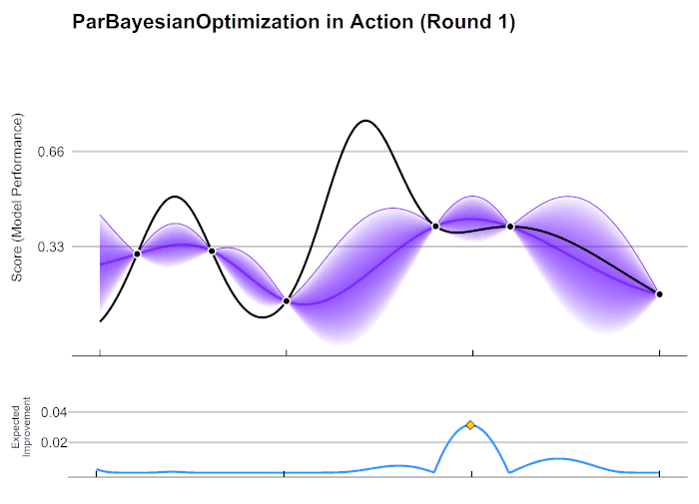
Bayesian Optimization: Modeling & Trade-offs
Bayesian Optimization uses Bayes' Theorem to combine prior beliefs with new data
Gaussian Process: A probabilistic model mapping the complex loss landscape with predictive uncertainty.
Acquisition Function: A decision rule that balances Exploration (searching high-variance areas) vs. Exploitation (refining known optima).
High Efficiency: Reaches global optima in a handful of steps instead of thousands of brute-force trials.
α(x) = E[max(0, f(x*) - f(x))]
Dynamic Job Lease Optimization in HTCondor
Notes:
At its core, Bayesian Optimization is a mathematical strategy used to optimize expensive, black-box functions when you don't know their underlying formula. Instead of blindly guessing, it uses Bayes' Theorem to combine our prior beliefs about the system with new data points as we collect them. It builds a statistical model that acts as a proxy for our real-world system, allowing us to guess where the optimal value might be before we actually run an expensive experiment.
In our case, it builds this probabilistic model using a Gaussian Process to map our unknown timeout loss function.
As you can see on the slide, the model maintains a predicted average cost curve alongside a shaded area representing our uncertainty. To pick the next timeout value to test, it uses an algorithm called an acquisition function. This function mathematically balances two things: Exploration, which means testing timeouts in areas where we have very little data to see if a better solution is hiding there, and Exploitation, which means focusing on regions where the model already predicts the cost is lowest.
Instead of running thousands of risky, brute-force trials across the cluster, Bayesian Optimization allows us to find the globally optimal timeout value in just a handful of real-world steps

Slide 9
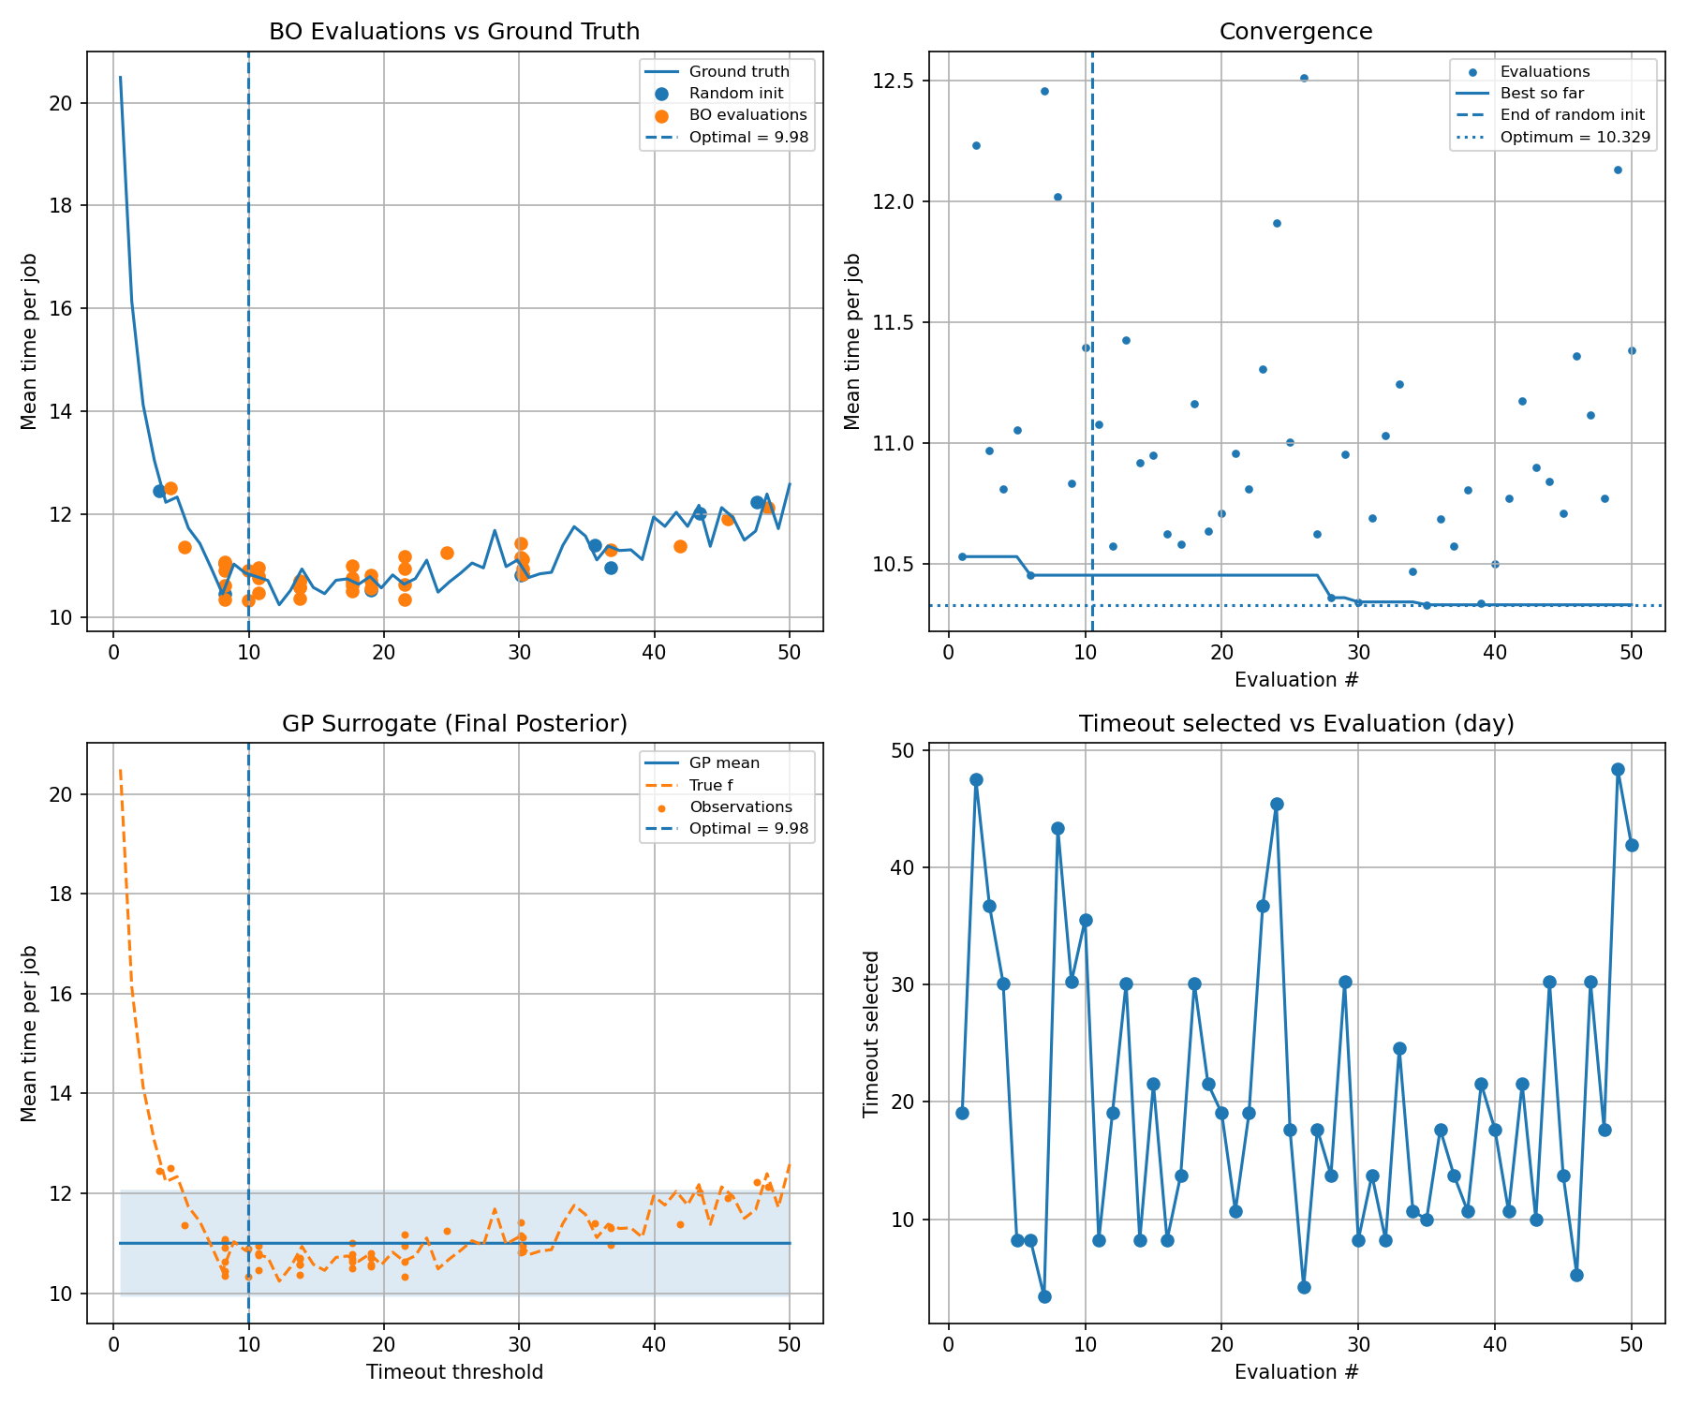
Simulation Results: Bayesian Optimization
BO Evaluations vs Ground Truth: BO focuses sampling near the true objective minimum
Convergence: After random initialization, the best value flatlines near the optimum (~9.98) within ~30 iterations
GP Surrogate: The model learns an approximation with uncertainty bands narrowing as samples accumulate
Exploration vs. Exploitation: Exploration settles into repeated selection of near-optimal values (~10) with occasional exploration
BO starts with random exploration, builds a surrogate model, and progressively focuses on the optimum
i.e. finding the best timeout threshold in far fewer evaluations than a grid search.
Dynamic Job Lease Optimization in HTCondor
Notes:
Let’s look at the actual simulation results across these four plots to see exactly how Bayesian Optimization performs.
Top-Left (Evaluations vs. Ground Truth): The solid curve is our true cost function. The blue dots are the random starting samples, but notice the orange dots—the optimizer quickly stops guessing wildly and focuses its sampling directly around the true minimum.
Top-Right (Convergence): This tracks the best value found over time. The vertical dashed line shows where the random phase ends and BO takes over. It instantly flatlines right at the true optimum, showing full convergence in just about 30 steps.
Bottom-Left (GP Surrogate): This is the AI’s internal map of the system. The shaded band shows its uncertainty. Notice how that band pinches down and becomes incredibly narrow right at the optimum where it has confidently learned the system behavior.
Bottom-Right (Timeout Selected per Iteration): This shows the exact thresholds picked at each step. Early on, it explores the full range vertically, but over time it stabilizes and repeatedly locks onto the optimal value of 10.
The takeaway: Instead of a risky, brute-force grid search across your cluster, Bayesian Optimization builds a smart statistical map and locks onto the perfect timeout threshold in just a handful of trials."

Slide 10
Future Directions: Context-Aware Features & Adjustments
Real-System Deployment: Safely transitioning from simulation data to active learning on the live CHTC cluster (In Progress).
Context-Aware Adaptation: Engineering features to evaluate if optimal timeouts should depend on specific Job or Execution Point (EP) characteristics.
Continual Learning Framework: Moving beyond a static one-time fix to study how the optimal threshold shifts over time as cluster dynamics change.
Dynamic Job Lease Optimization in HTCondor
Notes:
As we look ahead, our concrete future directions focus on moving this theoretical framework directly into production infrastructure. We have broken this down into three key milestones:
First, deploying the learning mechanism on the real system, which is currently in progress. We are actively transitioning from our discrete-event simulation data to live cluster testing, allowing our Bayesian Optimization model to safely sample and adapt timeout parameters based on real-time operational feedback.
Second, we want to make the optimization context-aware. Instead of looking for a broad cluster-wide average, we are exploring feature engineering to see if the optimal timeout value should dynamically change depending on the specific characteristics of the job or the Execution Point. For instance, should a high-memory, long-running job get a longer, more protective lease than a lightweight, transient script? Does a historically unstable EP require a shorter timeout?
Finally, we are looking at this through the lens of continual learning. A major open question we want to answer is whether there is a single, universal timeout value that always works, or if the ideal threshold is a moving target. Because cluster workloads, user behaviors, and network conditions naturally shift over weeks and months, our goal is to determine if the system needs to constantly run a low-overhead learning loop to adapt as the environment evolves.
We are incredibly excited about these steps toward making HTCondor truly context-aware of its own network environment.

Slide 11
Thank you!
Moving from hardcoded parameters to AI driven optimization.
Contact Information
Khyathi Vagolu: vagolu@wisc.edu
Josiah Hanna: jphanna@cs.wisc.edu
Todd Tannenbaum: tannenba@cs.wisc.edu
Greg Thain: gthain@cs.wisc.edu
Dynamic Job Lease Optimization in HTCondor
Notes:
To wrap things up: by moving away from hardcoded, static parameters and leveraging targeted, low-data machine learning techniques like Bayesian Optimization, we can significantly reduce wasted compute resources while protecting user jobs from transient network failures.
I want to extend a massive thank you to Josiah, Todd, and Greg for their incredible support and collaboration on this work. If you are an administrator interested in these logging frameworks, a developer who wants to talk optimization, or a user who just wants to learn more about how this will impact your job workflows, please reach out to any of us! We would absolutely love to discuss it with you. Thank you, and I’ll open up the floor for any questions!

Slide 12

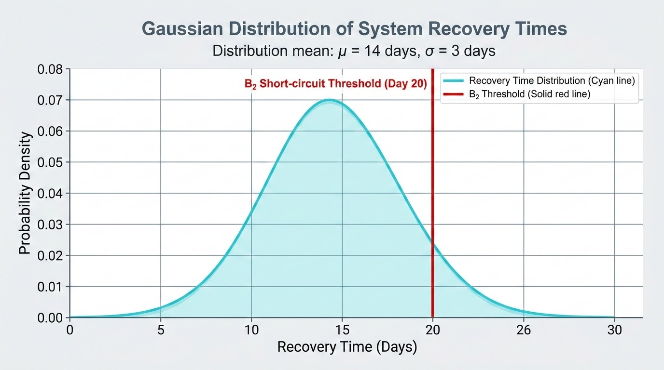
Exploratory Data Analysis: Tracking and Short-Circuits
B_2 identifies if the starter is definitively dead based on threshold breaches.
Acts as a 'short-circuit' feature by halting recovery logic if terminal state is reached.
Optimizes system resources by preventing redundant reconnection attempts.
Recovery Mapping Distribution
T_1 (Start) = [Timestamp]
T_2 (Last Heartbeat) = [Timestamp]
T_3 (Reconnection) = [Timestamp]
B_2 (Critical Flag) = [Binary_State]
Active Tracking
B_2 Short-Circuit
Dynamic Job Lease Optimization in HTCondor
Notes:
And finally we’re moving towards understanding real systems data. Working alongside Todd and Greg, we've designed a custom, time-unique log rotation mechanism that emits granular records every single time a disconnect occurs between an AP and an EP.
The log tracks when the connection was first established T1, the precise epoch timestamp of the last successful RPC heartbeat T2, whether reconnection succeeded B1, and how long it actually took T3.
Crucially, it also captures a boolean flag, B_2, which indicates if the starter process on the remote machine is definitively known to be dead.
If B2 is True, our data tells us that the probability of reconnection is exactly zero.

Slide 13

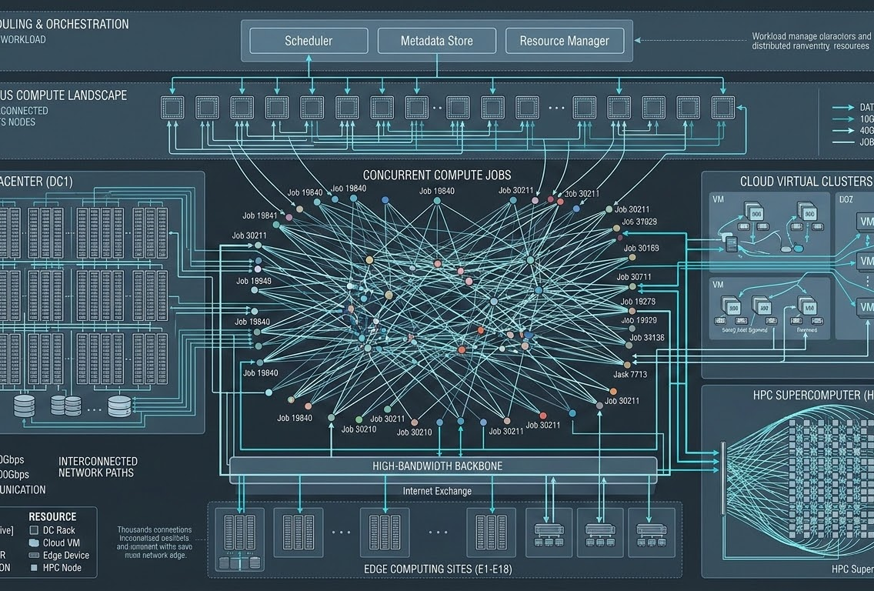
The Reality of Scale at CHTC
CHTC processes thousands of daily jobs with high heterogeneity.
Network Reality: Distinguish transient network blips from permanent hardware failures.
"Why is my job suddenly idle or terminated?"
- User Pain Point
Khyathi Vagolu | June 7, 2026
Dynamic Job Lease Optimization in HTCondor

Slide 14
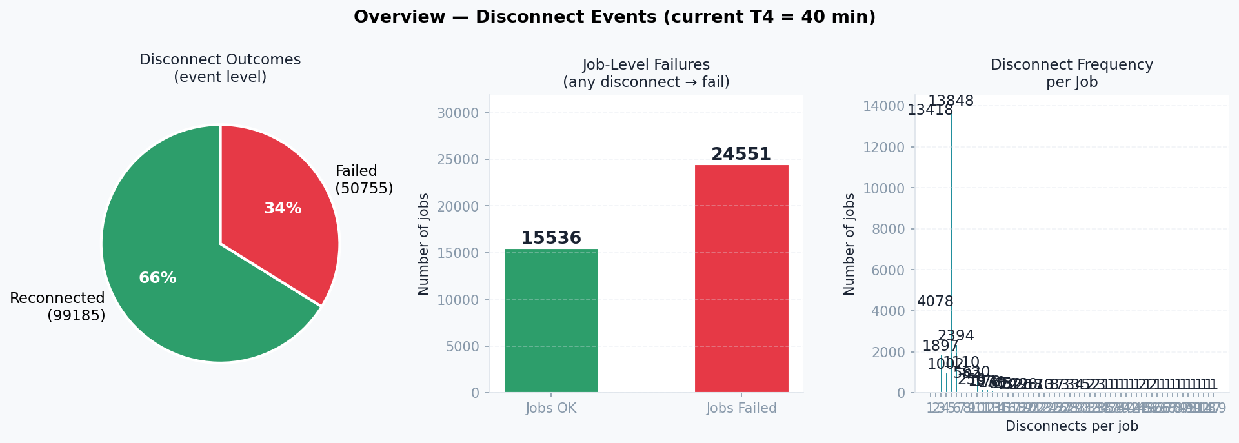
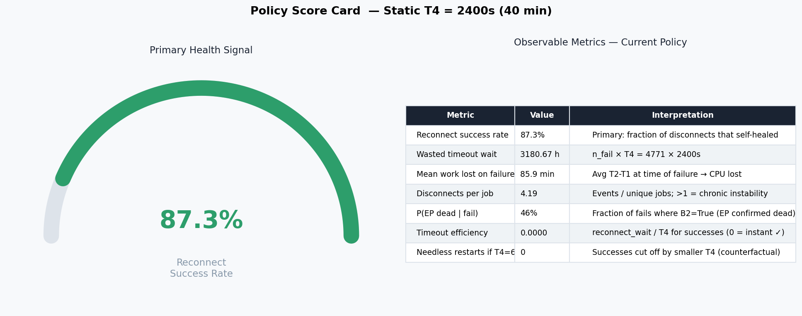

Slide 15

Theoretical Simulation
Minimize Total Cost function: Minimize L(T₄)
Variables: I(T₄) (Idle time), F(T₄) (Failure probability)
Simulation Data: Cost vs. Lease Duration
L(T) = C_idle * E[I(T)] + C_fail * E[F(T)]
Total Cost L(T)
K = 2000 | MAX_RUNTIME = 20s | SCALE = 5s
P_INF_RECONNECT = 10% | N_ITER = 40
M_MAX_RESTARTS = 10
T4_BOUNDS = [0.5s, 50.0s]
Decision Variable: T (Lease Duration)
Khyathi Vagolu | June 7, 2026
Dynamic Job Lease Optimization in HTCondor
Notes:
Our research began with a rigorous theoretical analysis of this exact trade-off. We formulated the problem as a formal mathematical loss function, $L(T_4)$, which we want to minimize.
The loss consists of two competing terms. The first term is the cost of machine idle time, $C_{idle}$, multiplied by the expected time a machine sits waiting fruitlessly when a reconnection ultimately fails. The second term is the cost of a job failure, $C_{fail}$, which is heavily dependent on how long the job has been running, multiplied by the probability that a timeout occurs before a viable reconnection happens. There is a mathematically optimal $T$ value hidden in this landscape. The question is: how do we find this value in a real-world, messy distributed system where we don't know the exact underlying probability distributions of network drops? And we wanted to see if there is a simple machine learning technique that can be used to solve this problem.

Slide 16

Gaussian Distribution: Modeling Infrastructure Data
Modeling infrastructure data blips and failures using a Gaussian distribution.
Capturing variance and frequency of network anomalies within distributed systems.
Statistical modeling enables predictive resource allocation and lease optimization.
● Normal Ops
● Anomalies (Tail)
f(x | μ, σ²) = [1/√(2πσ²)] * e^[-(x-μ)² / 2σ²]
Khyathi Vagolu | June 7, 2026
Dynamic Job Lease Optimization in HTCondor

Slide 17

SGD to Model Timeout Parameter
Standard SGD
Requires differentiable gradients
Assumes smooth landscapes
GAP
Infrastructure Reality
Non-differentiable functions
Noisy & black-box data
1. Compute Gradient
Find local loss slope
2. Update Params
Step toward minimum
Infrastructure Failure
Gradients cannot be computed on discrete, noisy data.
Dynamic Job Lease Optimization in HTCondor
Notes:
Now, as machine learning researchers, our first instinct might be to throw standard, gradient-based optimization at this—specifically, Stochastic Gradient Descent, or SGD.
If you aren't familiar with SGD, think of it like walking down a smooth hill foggy afternoon: you can't see the bottom, but you can feel the slope under your feet, so you just take steps in whichever direction goes downward until you hit the lowest point. It’s the engine behind almost all modern AI because it’s incredibly efficient at fine-tuning parameters step-by-step.
But in practice, we found that SGD is completely unsuited for this problem. Why?
Because distributed infrastructure networks do not give us a smooth, predictable hill to walk down. We don't have a mathematical formula where we can easily calculate a slope. Instead, our loss landscape is a highly noisy, sparse 'black box'. The only way to evaluate even a single timeout setting is to actually deploy it on real machines, run real user jobs, and wait 40 minutes to see if they successfully reconnect or fail. You can't calculate a smooth gradient on a network crash—and that is why we had to look beyond standard neural network training methods.

