Slide 1
Site Status Update
Jixia Li
2026/01/20

Slide 2
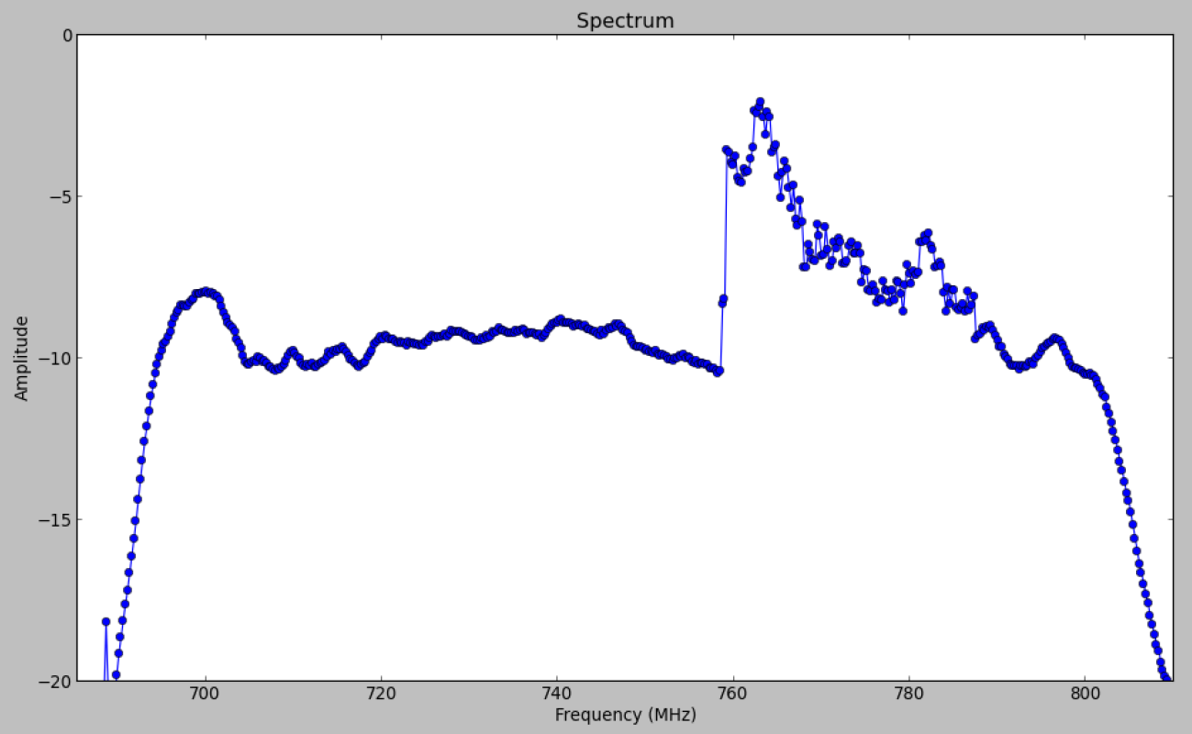
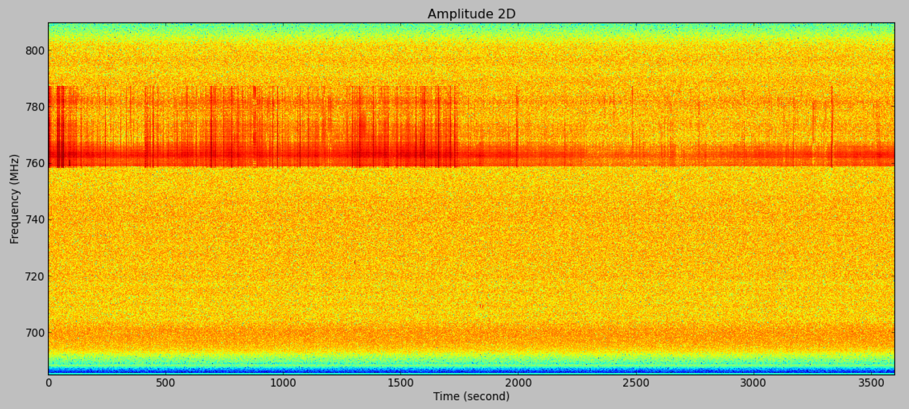
RFI @ 758MHz—788MHz
RFI from Ming99 is shutdown, then we see different RFI sources.
On: 8 am to 2am (next day)
Off: 2 am to 8 am

Slide 3
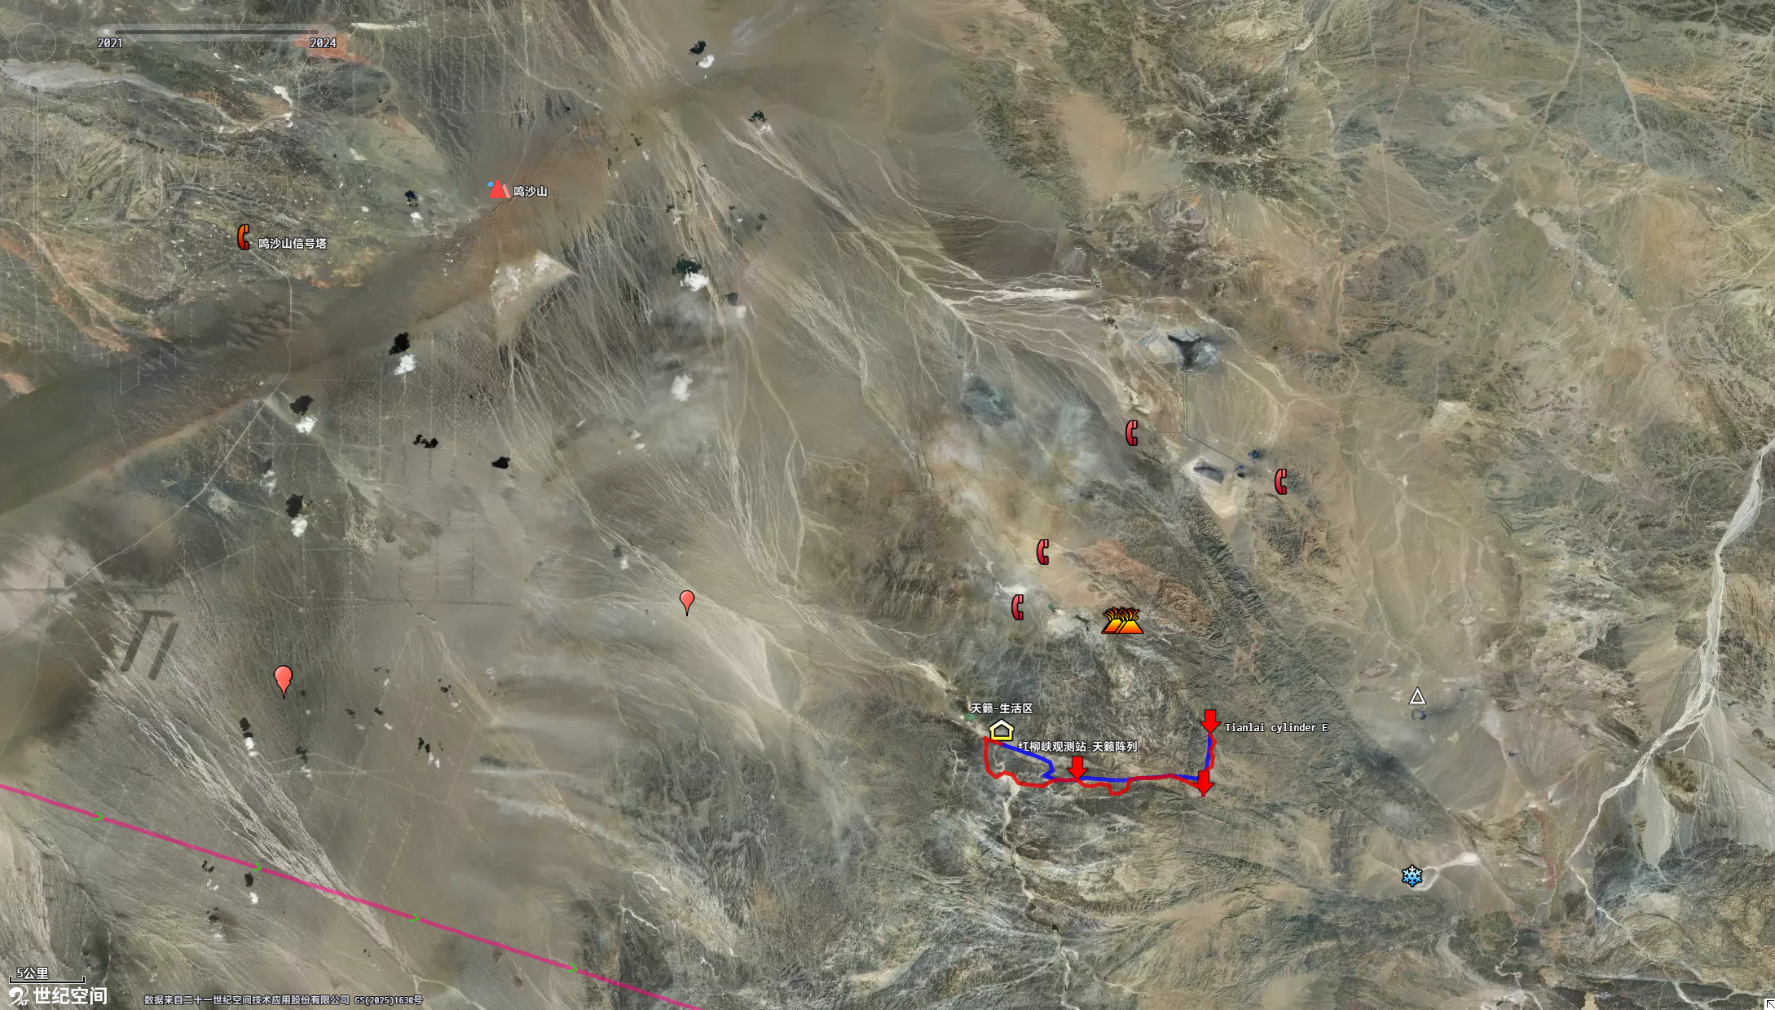
Ming99
Mobile Tower
66km Away
Tianlai
Although, the RFI from Ming99 gets weaker, it looks impossible to fully mitigate.
Need more work to figure out other RFI sources nearby.

Slide 4
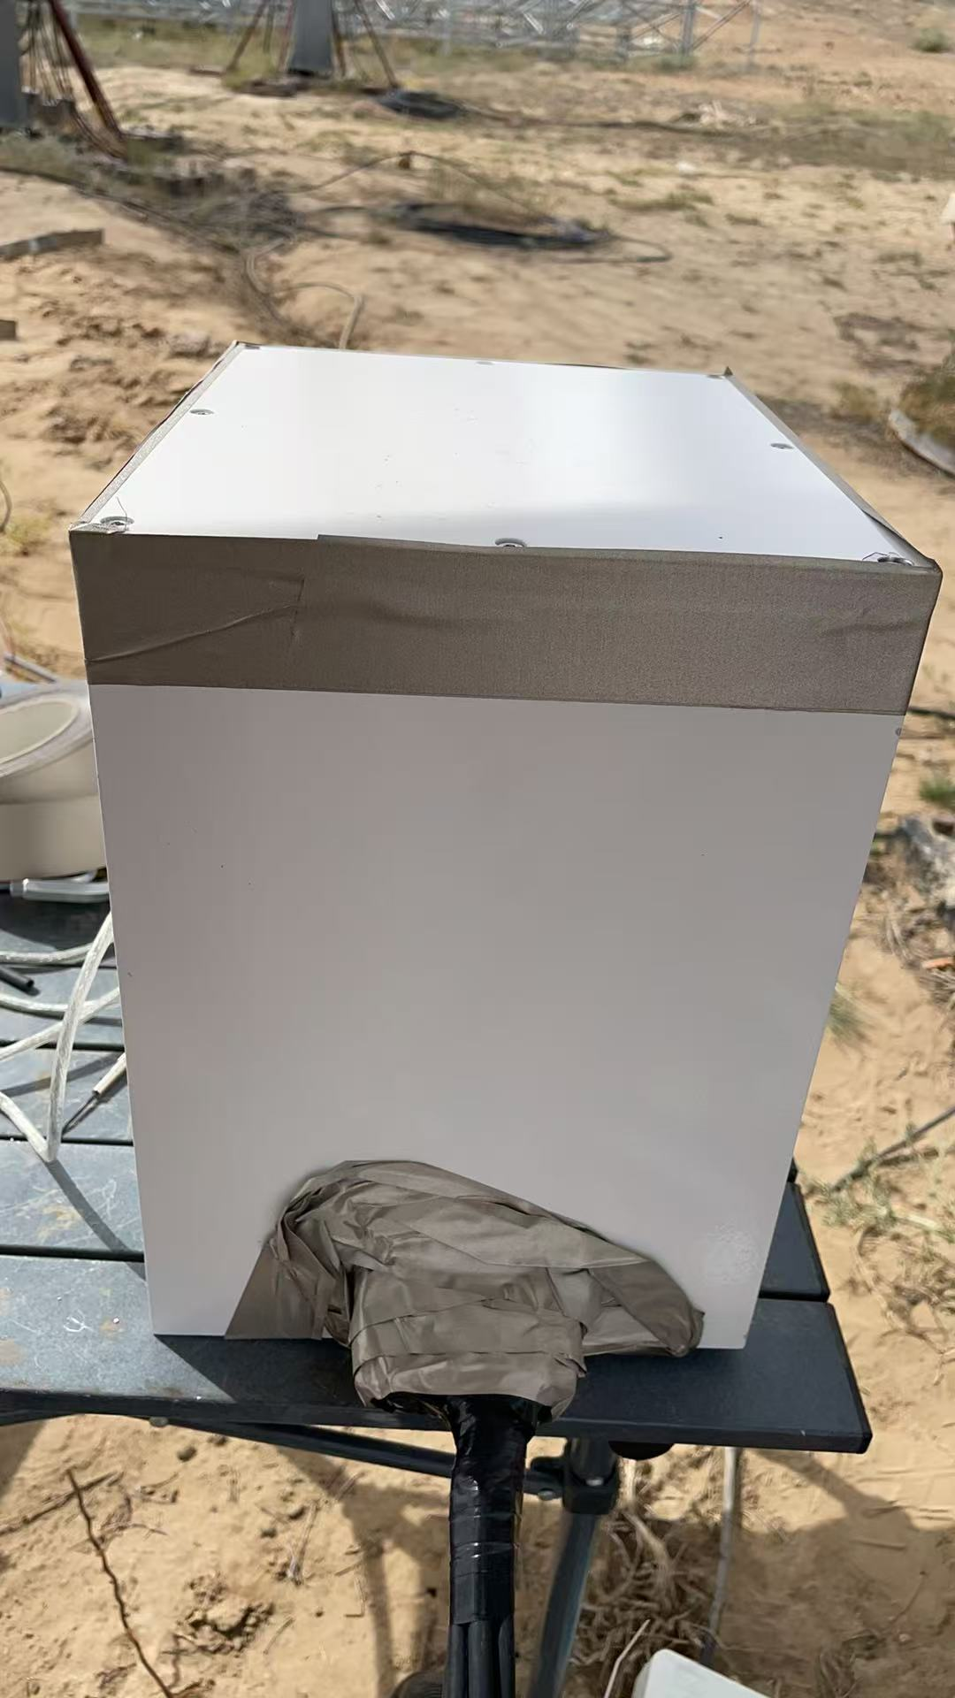
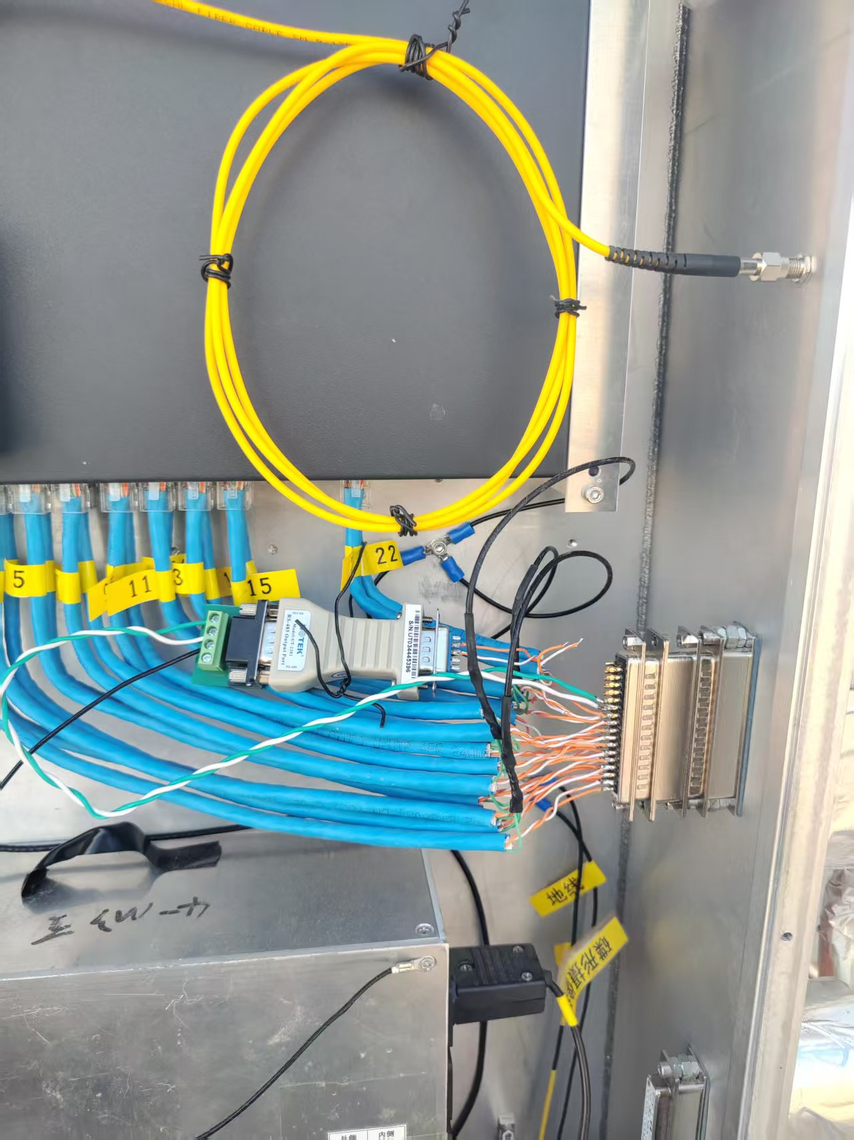
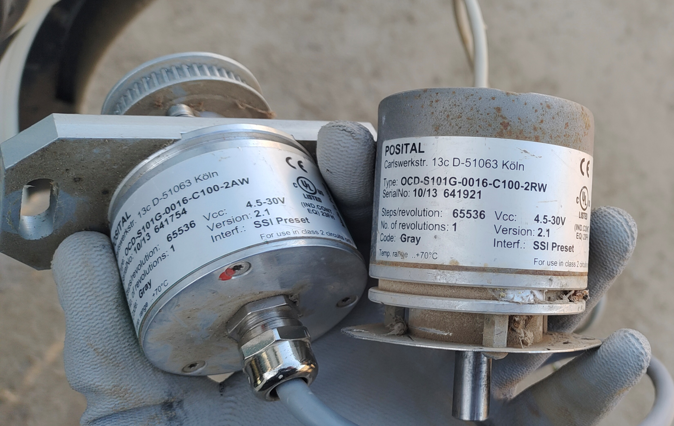
Dish antenna EMI control upgrading
Made EMI shielding box for central control devices.
Made boxes for control devices of each antennas too, but failed. It turns out to be the encoder of the dish that generates the strongest RFI.
Model: OCD-S101G-0016-C100-2RW
New encoder has no RFI but its enclosure is different from the old ones, so need a longer time to finish than expected.
Currently, dish antennas cannot move.
Central control box
Dish antenna box
POSITAL IXARC absolute Singleturn encoder

Slide 5
Cylinder Correlator (RoachGPU)
Need to upgrade GPU servers.
  Some GPU servers are hard to boot up due to DDR3 memory problem.
New server has been proved practical when developing RoachGPU correlator.
Original servers
13yrs old
Supermicro 16 CPU cores
DDR3 64GB
Cent OS 7.9
New servers
5 yrs
Dell R730 24 CPU cores
DDR4 ≥128GB
Rocky Linux 8.10, better compatibility to latest GPU drivers.

Slide 6
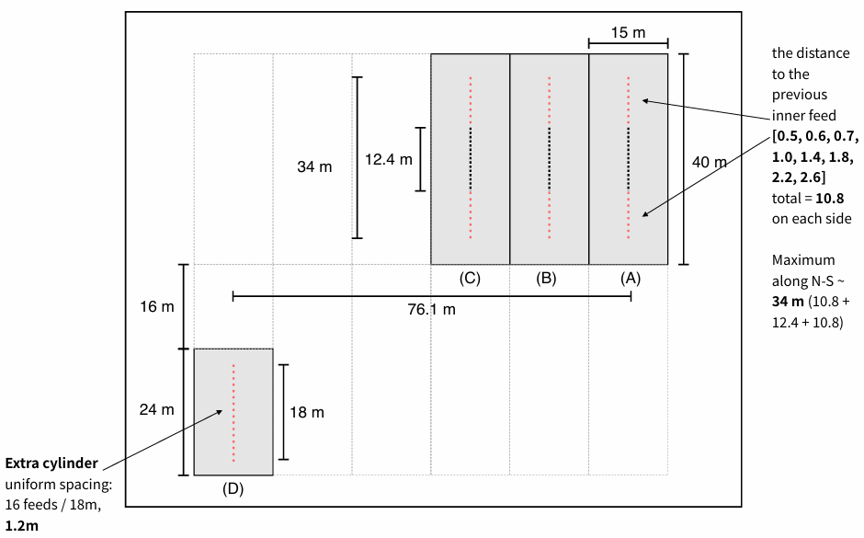
Others
Feeds, LANs, feed RF cables, Optic transmitter and their DC power supplies, AC powers cables, optic receivers for expanded cylinder A,B,C were installed in summer.
  Red dots indicate the new expanded feeds.
Electronics for cylinder D,E,F will be installed this summer.
Mixers are in production.
FRB backends are in developing.
Image by Kaifeng YU

