Slide 1
Discussions on Tianlai Upgrade

Slide 2
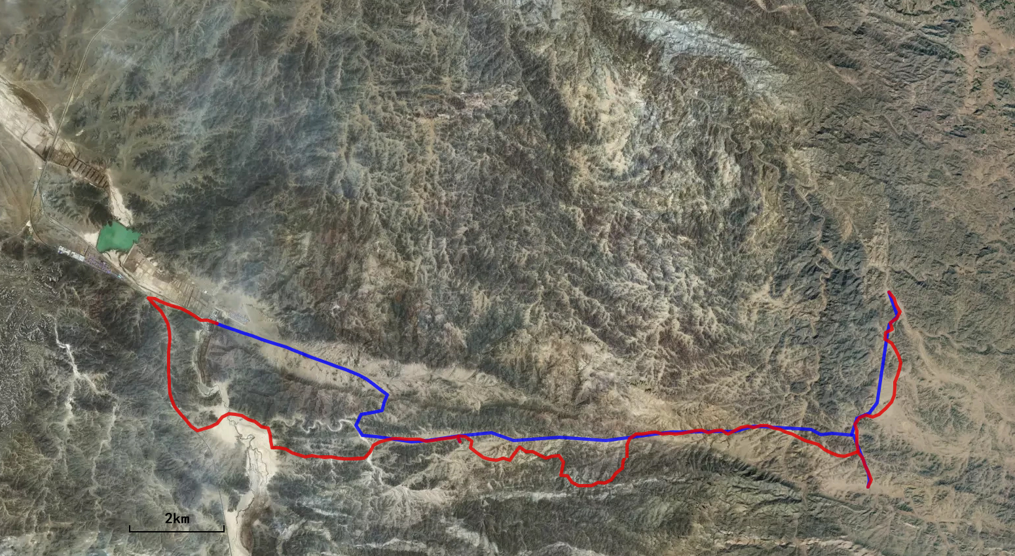
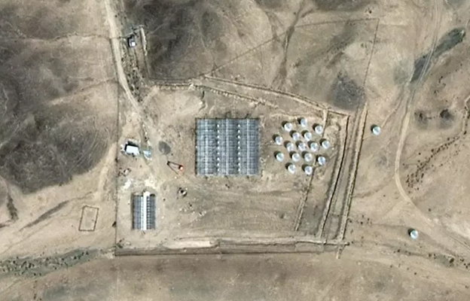
Cylinder
C B A
Dish Array
Cylinder D
Cylinder E
Station
House
Site G1
Site G2
Main Site
Cylinder F

Slide 3
Array Feeds
Current Cylinder Array :
A: 31
B: 32
C: 33
Current Dish Array
16
Proposed Upgrade
A: 31+16=47
B: 32+16=48
C: 33+16=49
D: 16
E: 16
F: 16
+2 Dishes

Slide 4
Data Acquisation System (DAQ)
Current Cylinder Array :
Correlator (192 inputs, 4s)
FRB backend (192 inputs, 2x96 beam, 0.098ms resolution)
Current Dish Array:
Correlator (32 inputs, 1s)
FRB backend (32 inputs, 2x16 beam, 0.098ms resolution)
Upgrade Cylinder Array :
FRB backend :288 inputs from ABC, 2x144 beam+ 96 outtrigger
Correlator(money?): 320 inputs from ABCD
Upgrade Dish Array:
Correlator (32+4 inputs, 1s)?
FRB backend (32+4 inputs, 2x16 beam, 0.098ms resolution)?

Slide 8
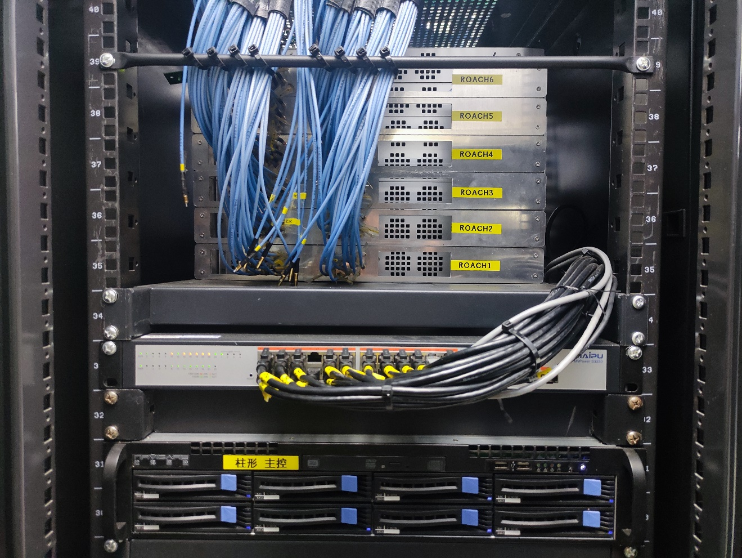
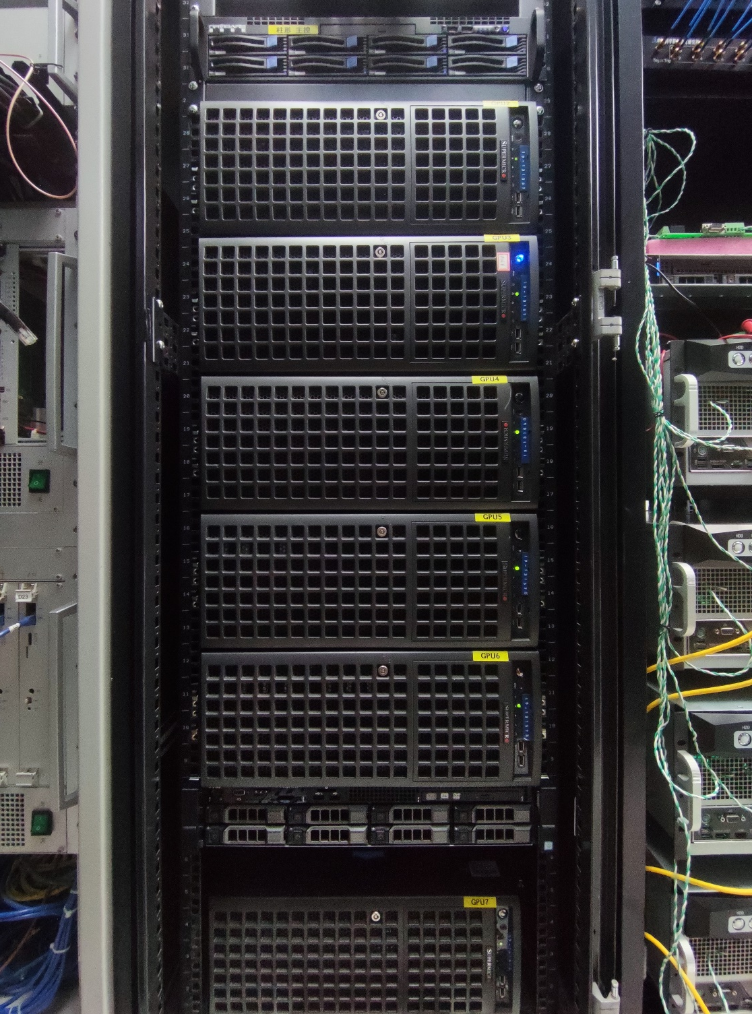
Ungrade Plan---Correlator@core array
ROACH2
boards
FRB
backend
Analog
receiver
Power splitter
correlator
GPU
servers
Correlator
192 signal channel 192+16*4*2=320

Slide 9
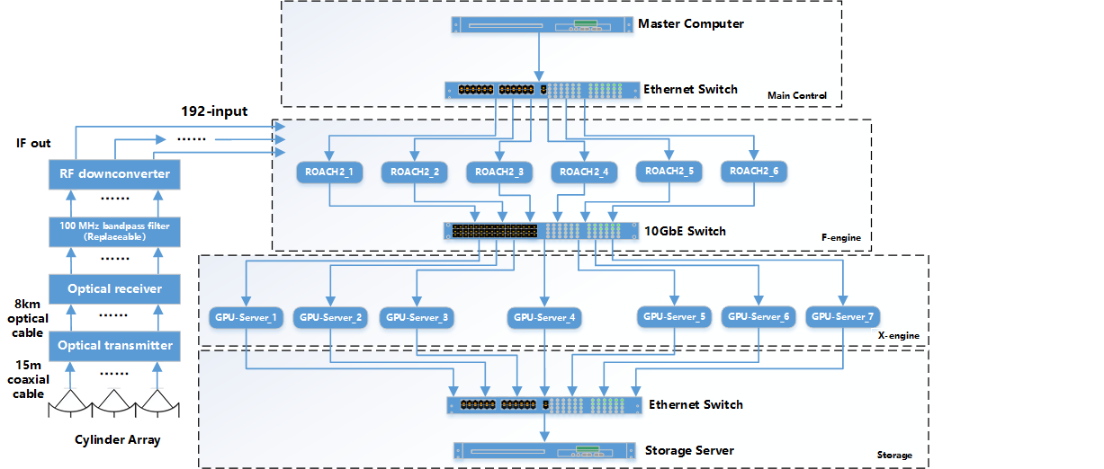
Ungrade Plan---Correlator@core array 192 -> 192+16*4*2=320
32 input
Add 4 RAOCH2 boards
Expand switch ports
Add more GPU servers

