Slide 1
Tianlai HI Stacking Analysis
Shifan Zuo
2026/3/31

Slide 2
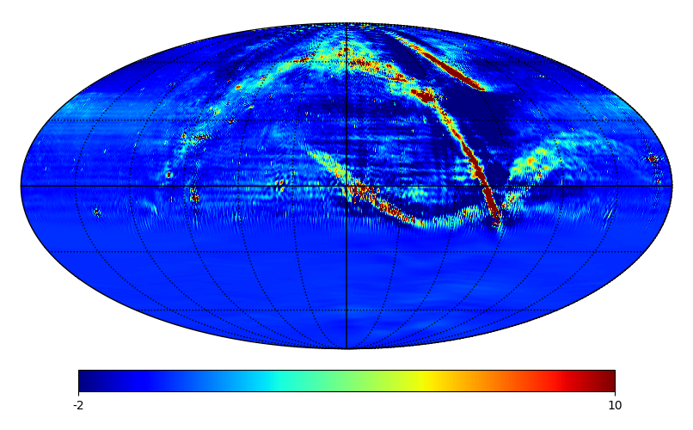
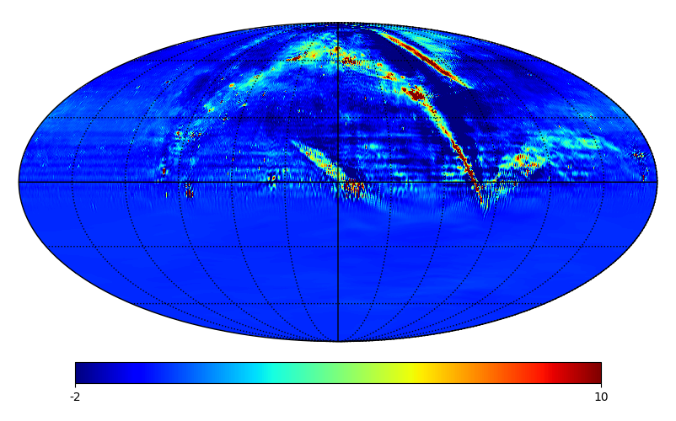
Maps
14 days data start from 2018.1.21
XX YY

Slide 3
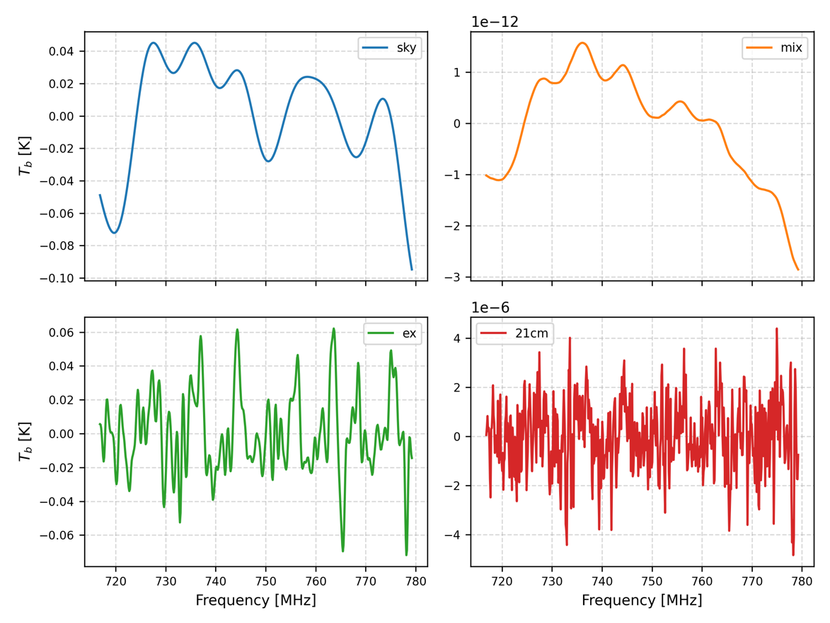
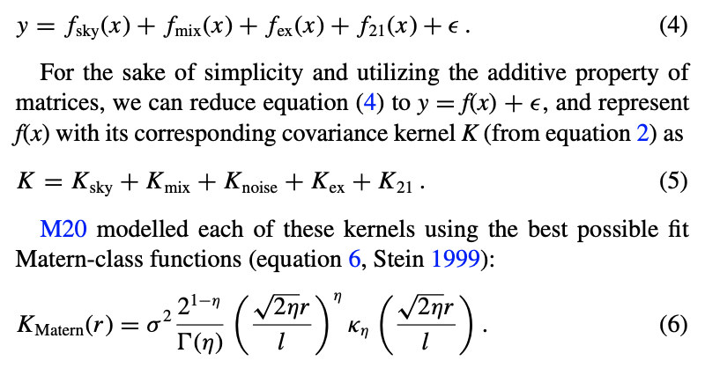
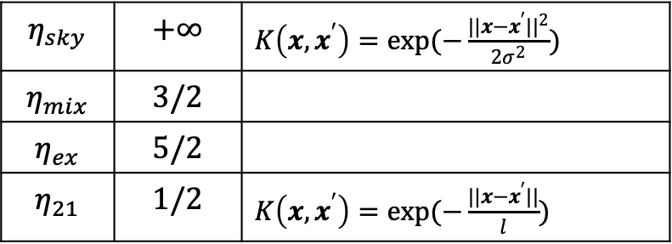
Foreground Subtraction with GPR
$$η_{sky}$$ | $$+∞$$ | $K\left(x, x^{′}\right)=exp(−\frac{||x−x^{′}||^{2}}{2σ^{2}})$
$$η_{mix}$$ | $$3/2$$
$$η_{ex}$$ | $$5/2$$
$$η_{21}$$ | $$1/2$$ | $K\left(x, x^{′}\right)=exp(−\frac{||x−x^{′}||}{l})$

Slide 4
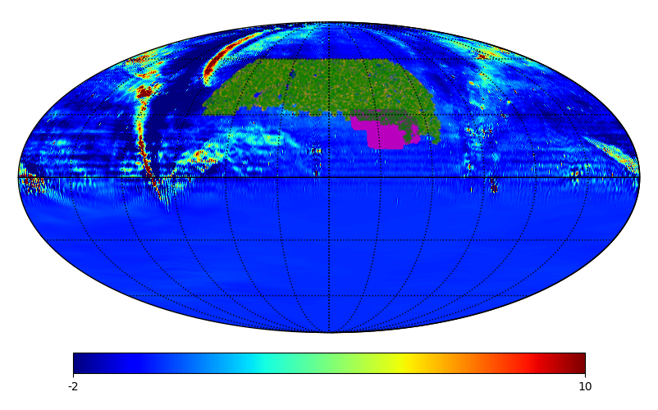
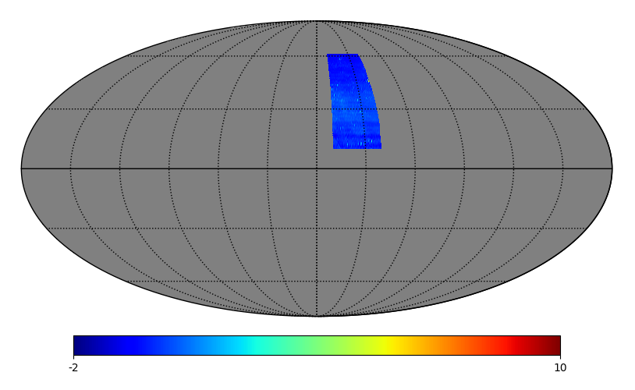
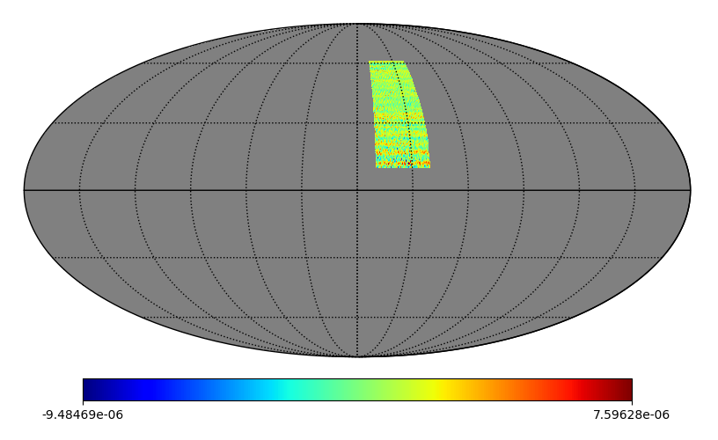
Foreground Subtraction with GPR
Before GPR After GPR

Slide 5
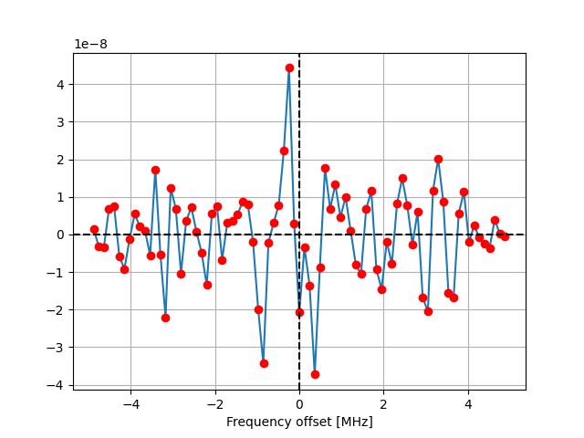
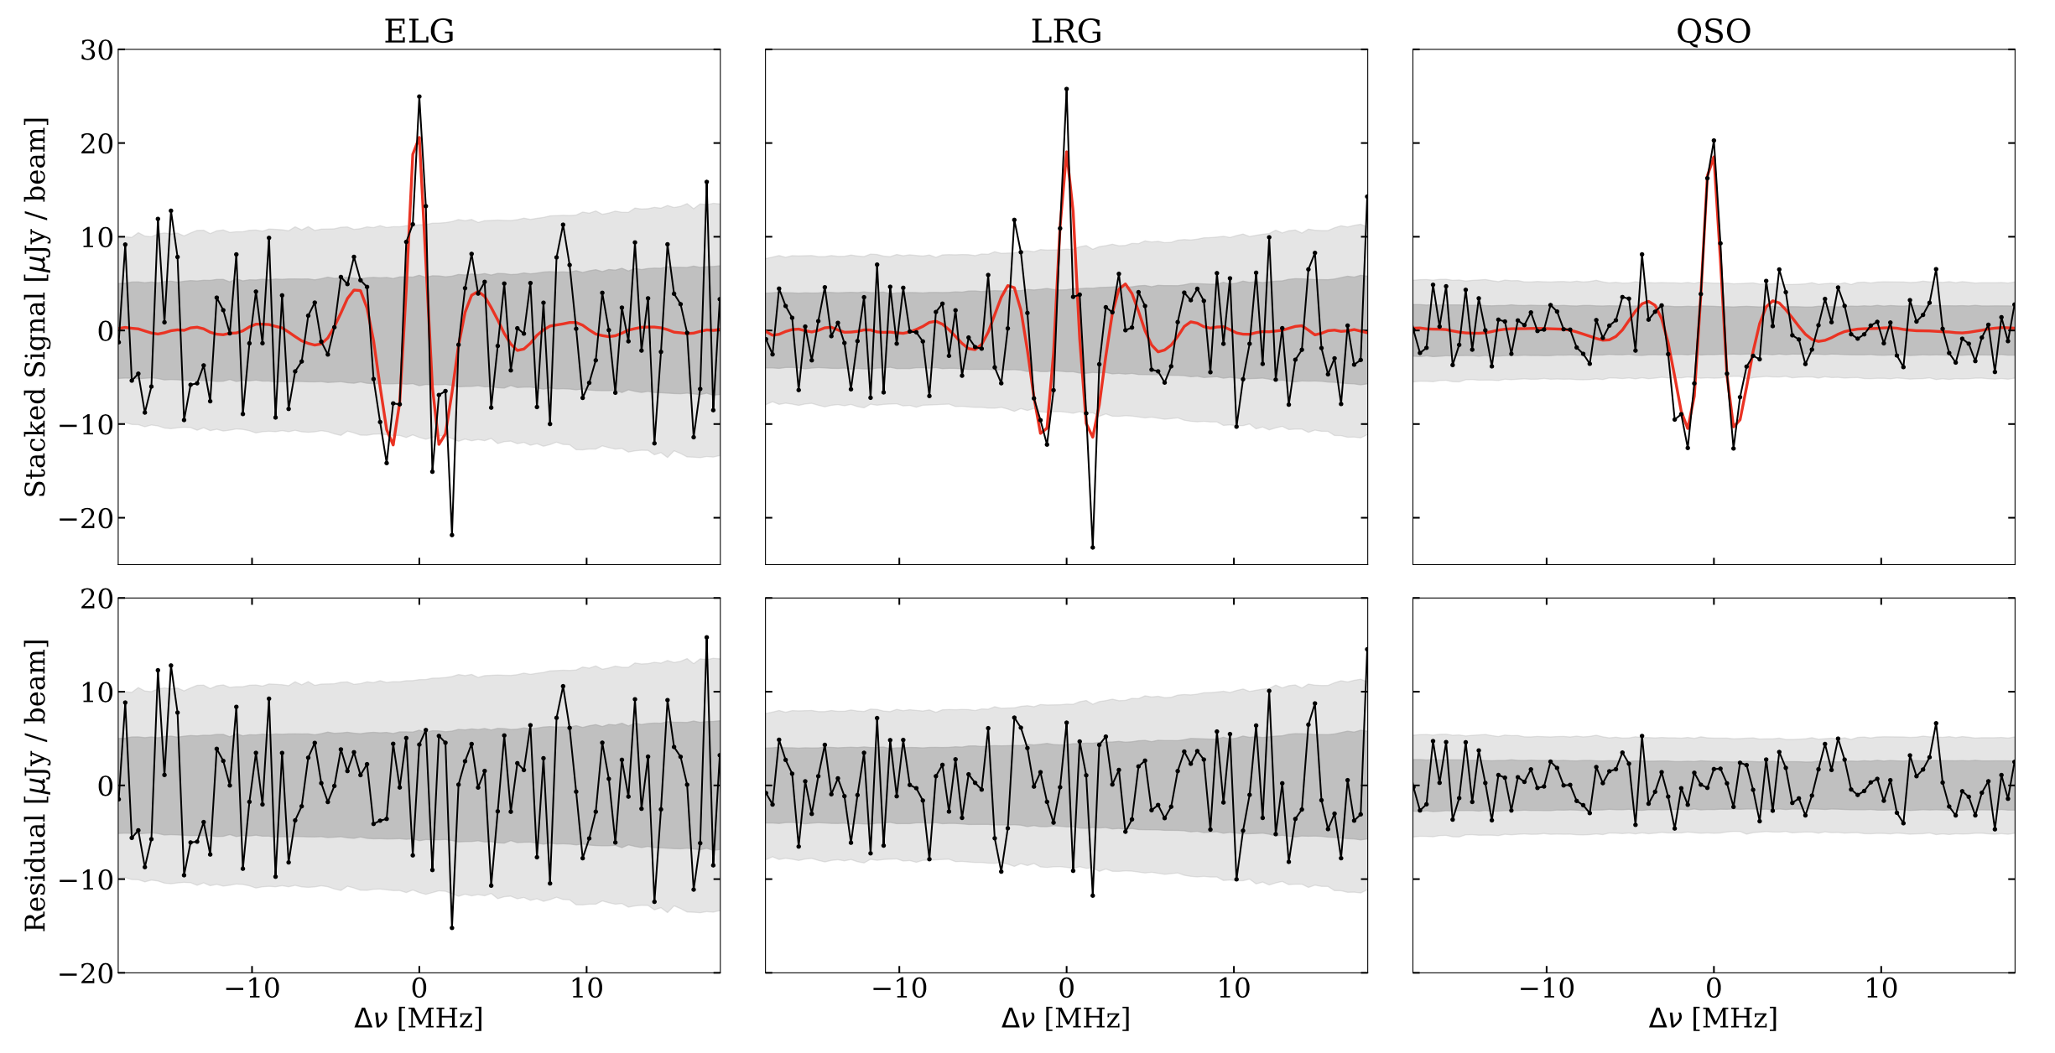
Stacked Signal
Tianlai ELG stacking result (YY only) CHIME result

Slide 6
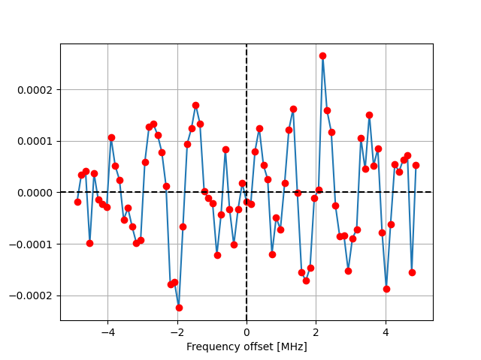
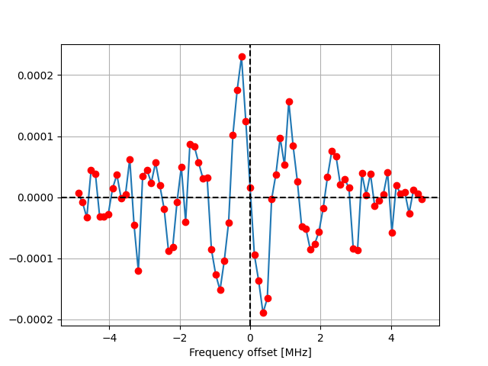
PCA 1-mode
XX YY

Slide 7
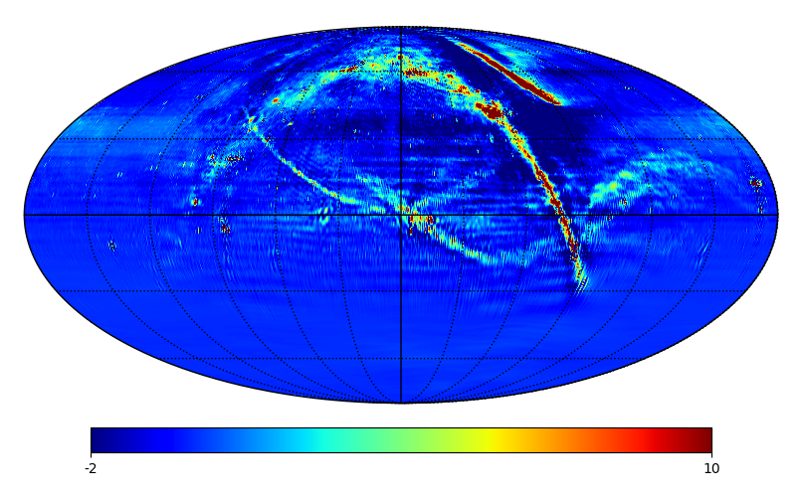
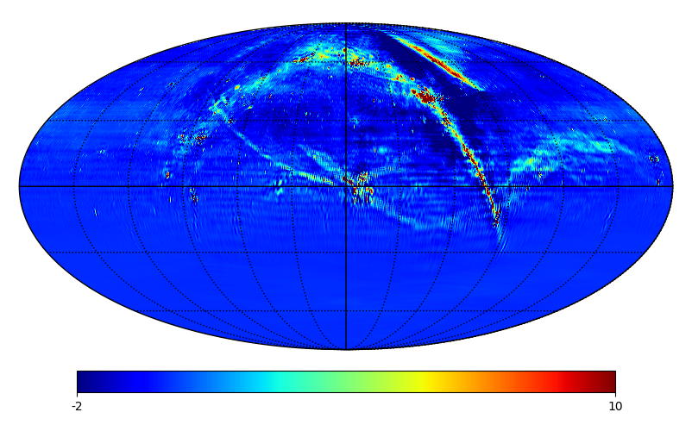
Maps
14 days data start from 2018.1.21 + 6 days data start from 2018.3.22
XX YY

Slide 8
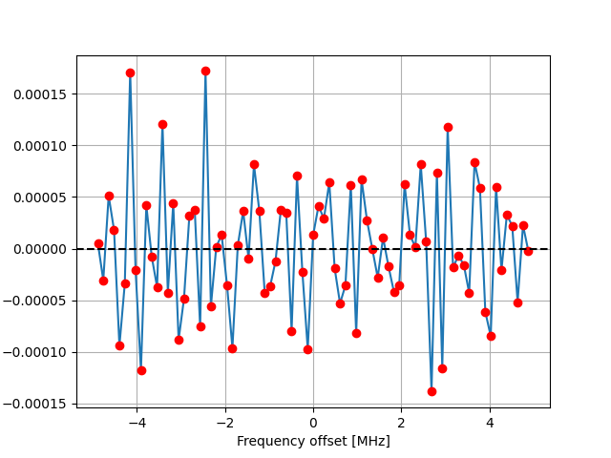
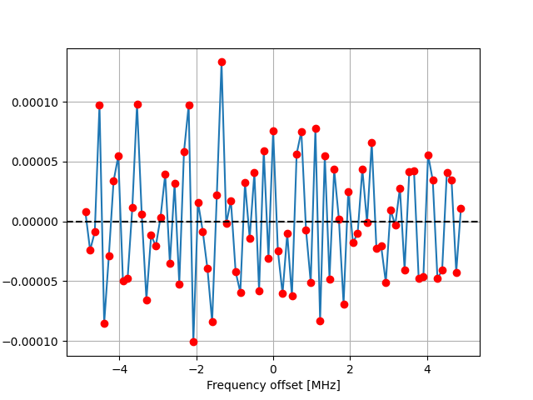
Stacking Result
XX YY

