Slide 1
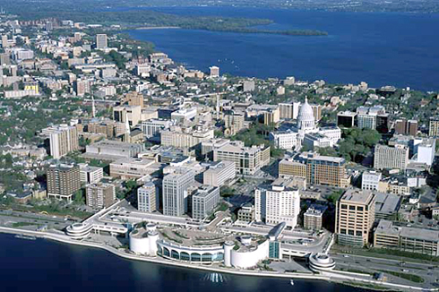
Overview of current and proposed searches for double-beta decay*
Reyco Henning
U. of North Carolina
and
Triangle Universities National Laboratory

Slide 2
Overview
Theoretical Motivation
US/Canadian-based efforts:
Majorana
EXO
SNO+
CUORE/NEMO

Slide 3
Flavor Mixing
Mass eigenstates different than flavor eigenstates.
⇒ Propagating neutrinos undergo flavor oscillations.
Mass to flavor relationship described by neutrino mixing matrix with 5 parameters.
CP Phase
c_{ij} = cos θ_{ij} s_{ij} = sin θ_{ij}
Majorana Phases

Slide 4
Neutrino Masses
Absolute masses weakly constrained, < 1eV.
Relative mass-squared differences known.
Three possible scenarios: Quasi-degenerate, also:
?
“Normal”
“Inverted”
3
2
Δm₁₂²
1
ν_{e}
ν_{μ}
ν_{τ}
Δm₂₃²~2x10⁻³ eV²
Δm₂₃²
2
Δm₁₂²= 7.1x10⁻⁵ eV²
?
1
3
?
Needs to be resolved
?

Slide 5
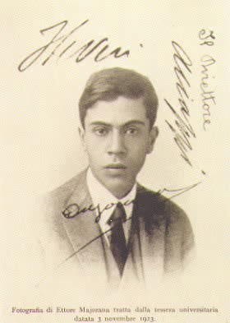
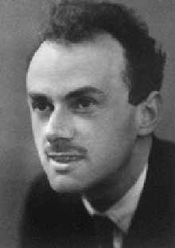
Majorana vs. Dirac
Majorana particles are their own anti-particles.
Dirac particles are not.
No fermions are known to be Majorana.
Experimental evidence consistent with both Majorana or Dirac neutrinos.
Verification difficult due to small neutrino masses and handedness of weak interaction.
Ettore
Majorana
Paul Dirac
Neutrinoless double-beta decay is the only practical process that can resolve this mystery.

Slide 6
What is neutrinoless double-beta decay (0νββ)?
Energetically allowed in many nuclei.
Prefer nuclei stable against β-decay (about 30)
Allowed β-decay
Forbidden β-decay
2υββ: Observed 2nd order weak process.
0,2νββ

Slide 7
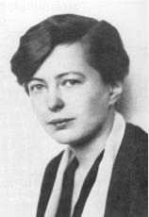
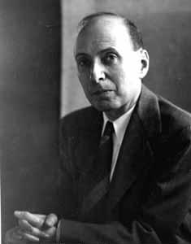
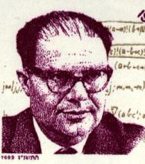
History
1935: Double beta decay postulated by Maria Goeppert-Mayer (assist by Wigner) Phys. Rev. 48 (1935) 512
1937: Ettore Majorana formulates theory with no distinction between ν and anti-ν. Nuovo Cimento 14 (1937) 171
1937: Giulio Racah suggests zero-neutrino double-beta decay as test for Majorana’s theory. Nuovo Cimento 14 (1937) 322

Slide 8
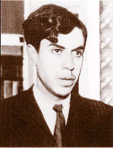
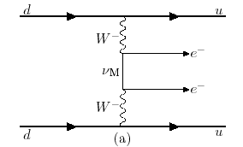
Motivation for 0υββ Search
Implications of discovery:
Neutrino is Majorana* (own antiparticle)
Total lepton number is not conserved
Neutrino has mass* (known)
Absolute neutrino mass.
0υββ nuclear decay may occur via several processes (SUSY, RH currents,…)
Canonical example: Exchange of virtual neutrino
Majorana
* Schechter et al, Phys. Rev. D25, 2951 (1982)

Slide 9
0νββ Rate and Neutrino Mass
: Half-life
: Phase Space (Known)
: Nuclear Matrix Element (large uncertainty)
Effective Majorana electron neutrino mass*
0υββ decay can probe absolute neutrino mass scale and mixing.
Current neutrino experiments measure mass squared differences: Δm².
* Assumes ν_{m} exchange

Slide 10
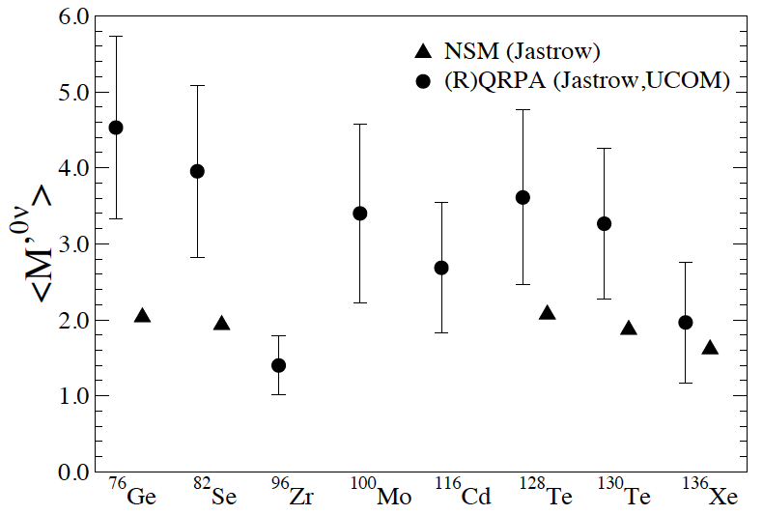
Nuclear Matrix Elements
Nuclear Physics B (Proc. Suppl.) 188 (2009) 20–24
Nuclear Physics and Background Uncertainties Require Multiple Isotope Program

Slide 11
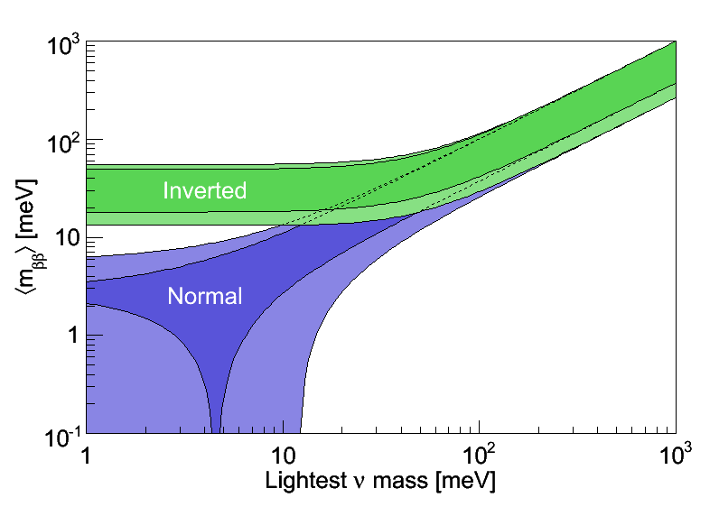
Combined Mass Limits
Estimated KATRIN Sensitivity
DBD
~ 100kg isotope
Cosmology
(best limit)
~ 1 ton
JCAP 0610:014,2006
~ 100 ton

Slide 12
Two Comments
Direct search for neutrinos mass via Tritium-decay experiments (KATRIN) are complementary to neutrinoless double-beta decay searches.
Neutrinos and Cosmology:
Majorana neutrinos
Matter dominated universe?
Required by
See-Saw mass-generating
mechanism
Required by
Leptogenesis

Slide 13
Experimental Considerations
Measure extremely rare decay rates :
T_{1/2} ~ 10²⁶ -10²⁷ years
Large, highly efficient source mass.
Extremely low (near-zero) backgrounds in the 0νββ peak region-of-interest (ROI): 1 count/t-y after analysis cuts.
High Q value
Best possible energy resolution
Minimize 0νββ peak ROI to maximize S/B
Separate 2νββ/0νββ

Slide 14
The Majorana experiment The Majorana Demonstrator, R. Johnson The GERDA experiment, a search for neutrinoless double beta decay, D. Lenz

Slide 15
The MAJORANA Collaboration (Feb. 2009)
Note: Red text indicates students
Black Hills State University, Spearfish, SD
Kara Keeter
Duke University, Durham, North Carolina , and TUNL
James Esterline, Mary Kidd, Werner Tornow
Institute for Theoretical and Experimental Physics, Moscow, Russia
Alexander Barabash, Sergey Konovalov, Igor Vanushin, Vladimir Yumatov
Joint Institute for Nuclear Research, Dubna, Russia
Viktor Brudanin, Slava Egorov, K. Gusey, Oleg Kochetov, M. Shirchenko, V. Timkin, E. Yakushev
Lawrence Berkeley National Laboratory, Berkeley, California and the University of California - Berkeley
Mark Amman, Marc Bergevin, Yuen-Dat Chan,
Jason Detwiler, Brian Fujikawa, Kevin Lesko, James Loach,
Paul Luke, Alan Poon, Craig Tull, Kai Vetter,
Harold Yaver, Sergio Zimmerman
Los Alamos National Laboratory, Los Alamos, New Mexico
Steven Elliott, Victor M. Gehman, Vincente Guiseppe,
Andrew Hime, Kieth Rielage, Larry Rodriguez, Jan Wouters
North Carolina State University, Raleigh, North Carolina and TUNL
Henning Back, Lance Leviner, Albert Young
Oak Ridge National Laboratory, Oak Ridge, Tennessee
Jim Beene, Fred Bertrand, Thomas V. Cianciolo, Ren Cooper,
David Radford, Krzysztof Rykaczewski, Robert Varner, Chang-Hong Yu
Osaka University, Osaka, Japan
Hiroyasu Ejiri, Ryuta Hazama, Masaharu Nomachi, Shima Tatsuji
Pacific Northwest National Laboratory, Richland, Washington
Craig Aalseth, James Ely, Tom Farmer, Jim Fast, Eric Hoppe, Brian Hyronimus, Marty Keillor, Jeremy Kephart, Richard T. Kouzes, Harry Miley, John Orrell,
Jim Reeves, Bob Thompson, Ray Warner
Queen's University, Kingston, Ontario
Art McDonald
University of Alberta, Edmonton, Alberta
Aksel Hallin
University of Chicago, Chicago, Illinois
Phil Barbeau, Juan Collar, Nicole Fields, Charles Greenberg,
University of North Carolina, Chapel Hill, North Carolina and TUNL
Melissa Boswell, Padraic Finnerty, Graham Giovanetti, Reyco Henning, Mark Howe,
Michael Akashi-Ronquest, Sean MacMullin, Jacquie Strain, John F. Wilkerson
University of South Carolina, Columbia, South Carolina
Frank Avignone, Richard Creswick, Horatio A. Farach, Todd Hossbach
University of South Dakolta, Vermillion, South Dakota
Tina Keller, Dongming Mei, Chao Zhang
University of Tennessee, Knoxville, Tennessee
William Bugg, Yuri Efremenko
University of Washington, Seattle, Washington
John Amsbaugh, Tom Burritt, Peter J. Doe
Robert Johnson, Michael Marino, Mike Miller, Allan Myers, R. G. Hamish Robertson,
Alexis Schubert, Tim Van Wechel

Slide 16
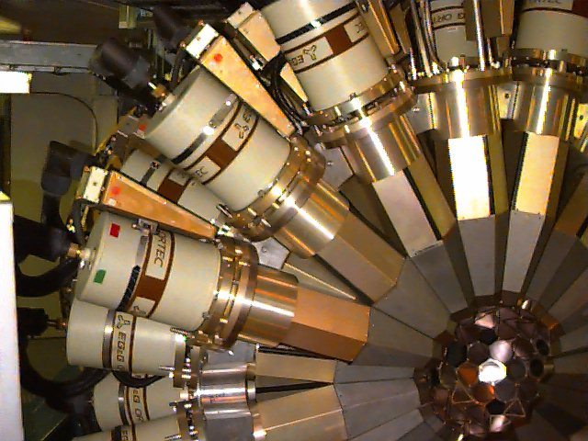
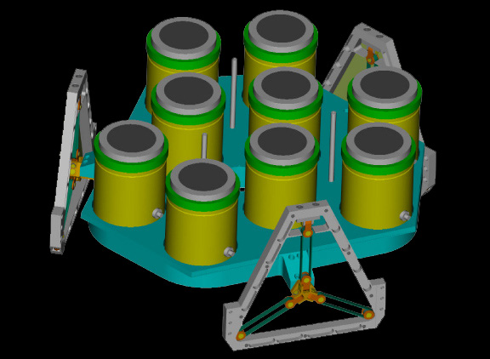
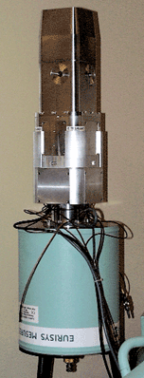
Ge Detection Principle
Fiorini et al, Il Nuovo Cimento 13 (1974) 747
enrGe is semiconductor -- Diode.
Ionizing radiation creates electron-hole pairs.
Signal generated by collecting
electrons and holes.
Gamma-ray spectroscopy
Mature Technology
n
electrons
p
holes
Ionizing radiation
interaction site
Gammasphere
Commercial
RHESSI

Slide 17
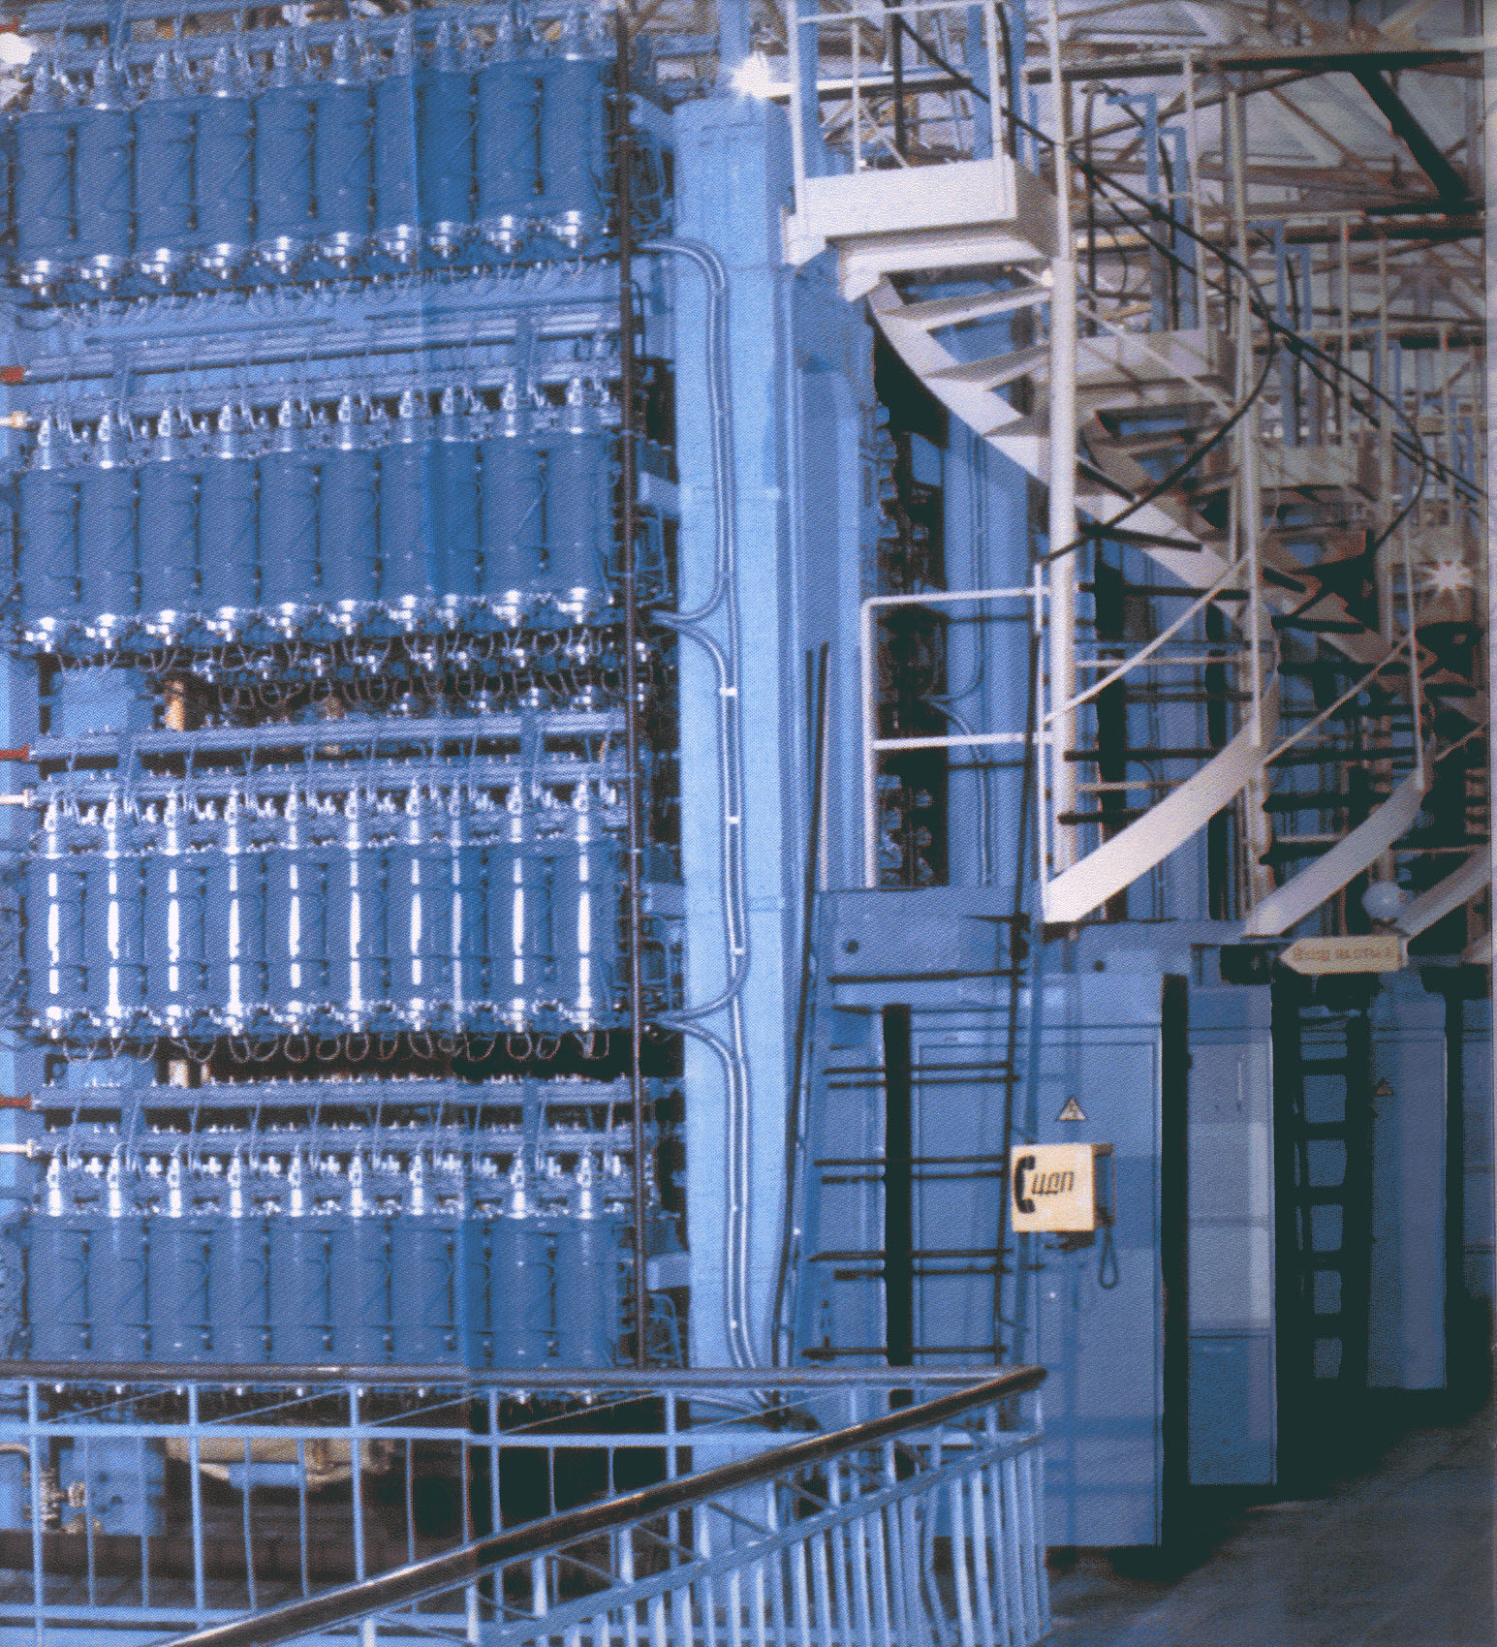
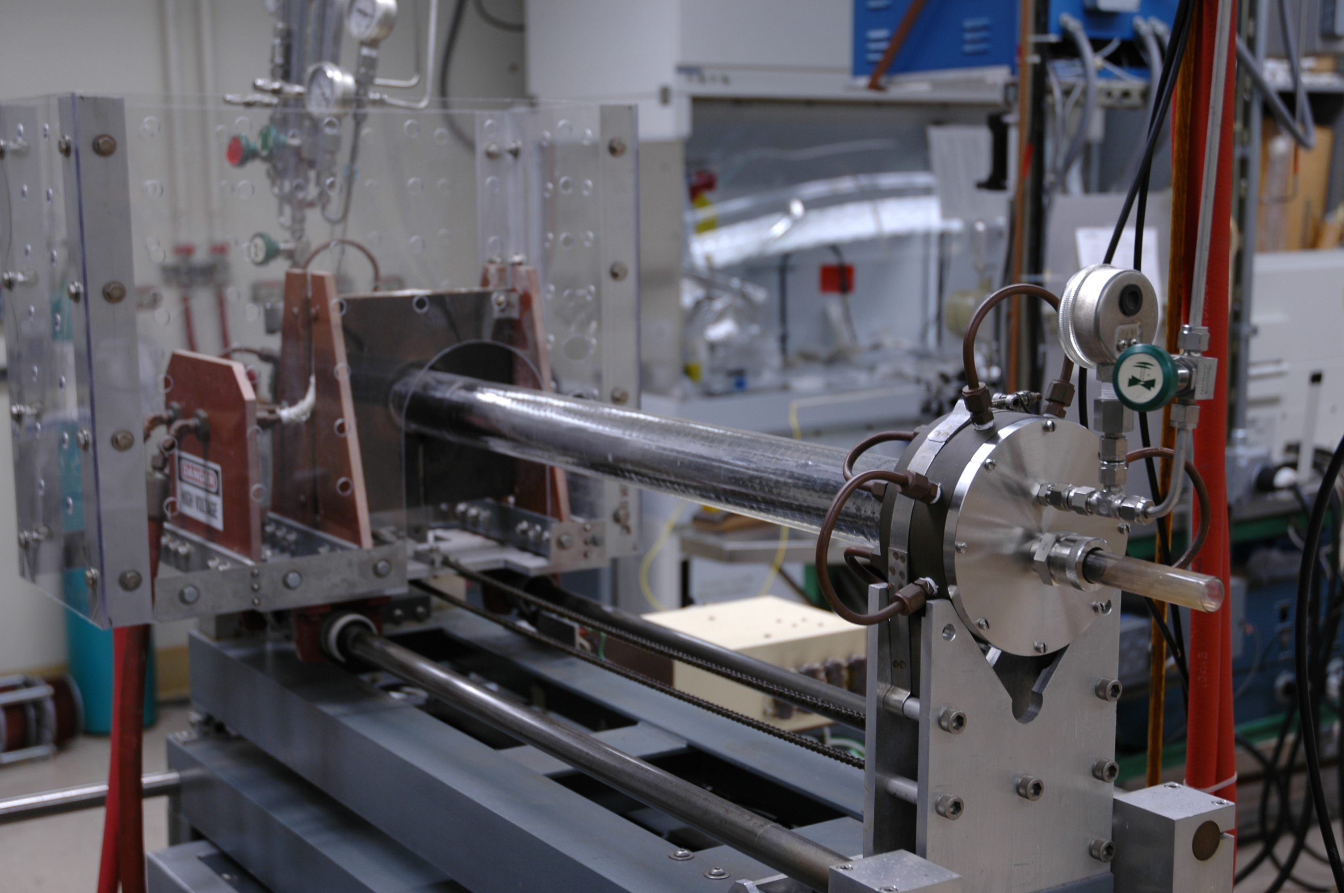
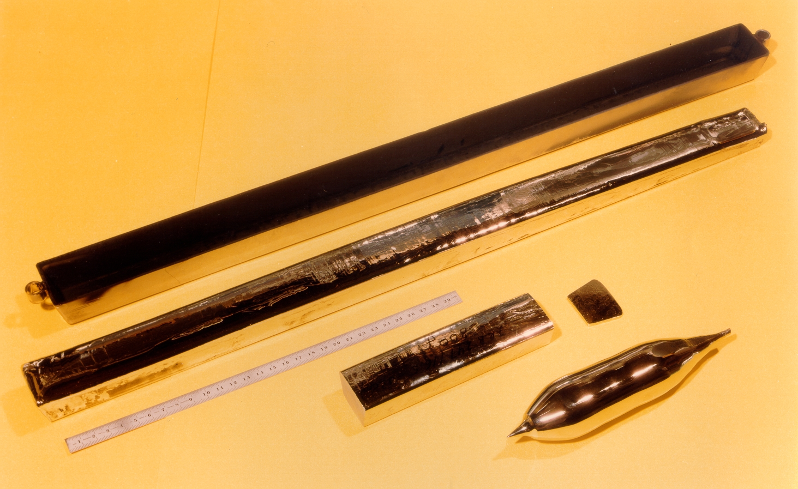
Crystal Production
Enrichment (86% ⁷⁶Ge)
E.E Haller
Crystal growth
Zone refinement
Polycrystalline bars

Slide 18
MAJORANA Collaboration Goals
Actively pursuing the development of R&D aimed at a ~1 tonne scale ⁷⁶Ge 0νββ-decay experiment.
Technical goal: Demonstrate background low enough to justify building a tonne scale Ge experiment.
Science goal: build a prototype module to test the recent claim of an observation of 0νββ. This goal is a litmus test of any proposed technology.
Work cooperatively with GERDA Collaboration to prepare for a single international tonne-scale Ge experiment that combines the best technical features of MAJORANA and GERDA.
Pursue longer term R&D to minimize costs and optimize the schedule for a 1-tonne experiment.

Slide 19
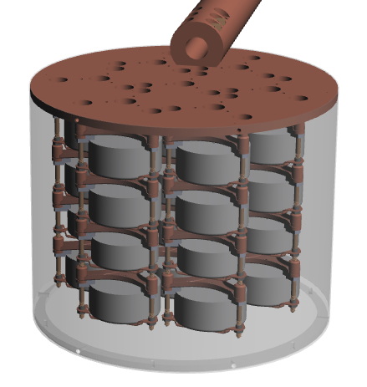
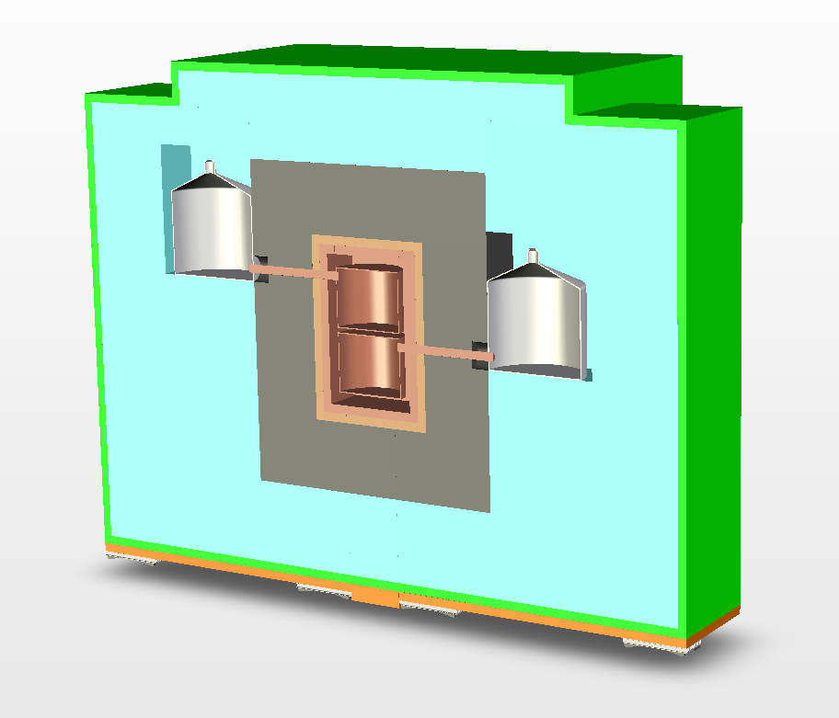
Intermediate Step: The MAJORANA Demonstrator Module
⁷⁶Ge offers an excellent combination of capabilities & sensitivities.
(Excellent energy resolution, intrinsically clean detectors, commercial technologies, best 0νββ sensitivity to date)
60-kg of Ge detectors
30-kg of 86% enriched ⁷⁶Ge crystals required for science goal; 30-kg ^{nat}Ge for background sensitivity
Examine detector technology options p- and n-type, segmentation, point-contact.
Low-background Cryostats & Shield
ultra-clean, electroformed Cu
naturally scalable
Compact low-background passive Cu and Pb shield with active muon veto
‘CD-1 like’ review in 10/2009.
Background Goal in the 0νββ peak region of interest (4 keV at 2039 keV) ~ 1 count/ROI/t-y (after analysis cuts)

Slide 20
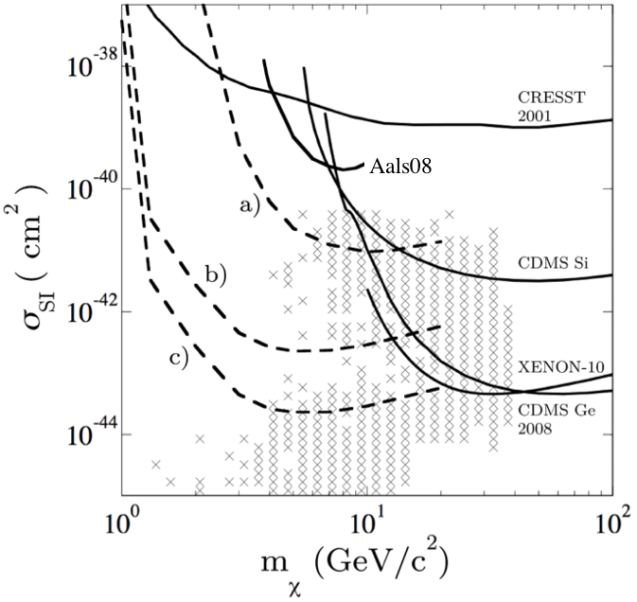
Direct Search for Light WIMPs
CoGeNT Collaboration Demonstrated Very low Threshold HPGe Detectors
Sensitivity to light WIMPS
Majorana can probe this region further
Phys.Rev.Lett.101: 251301, 2008

Slide 21
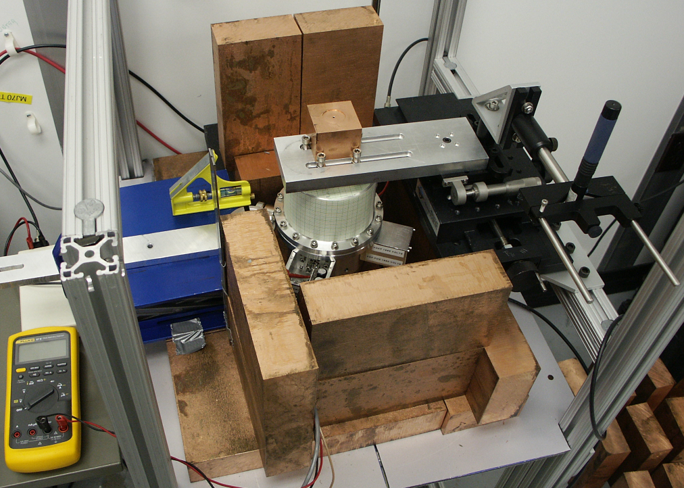
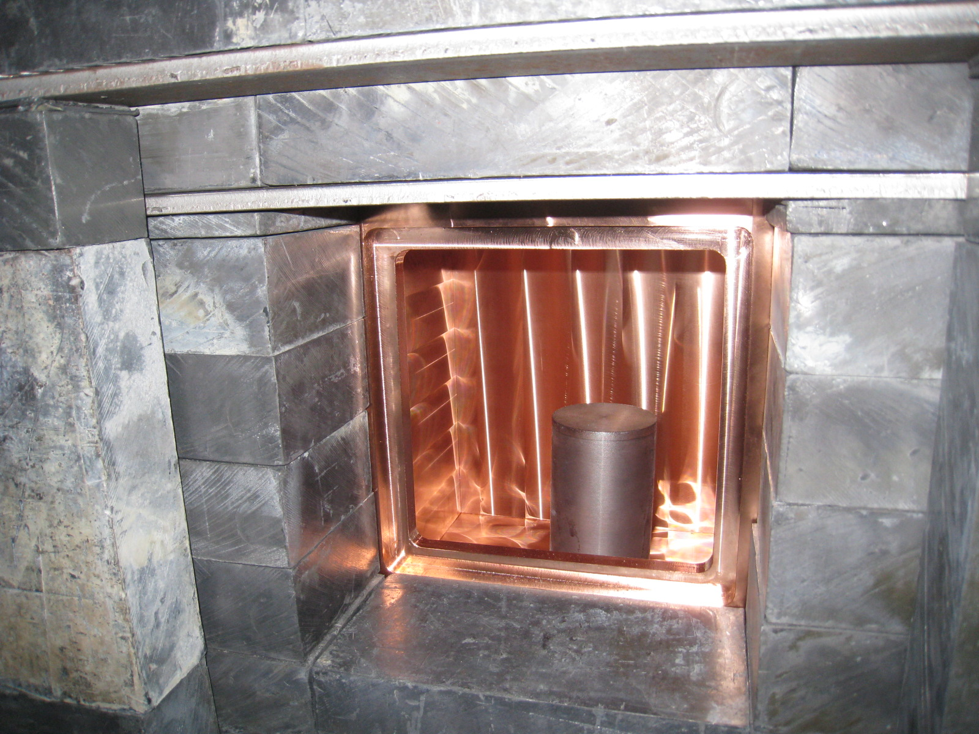
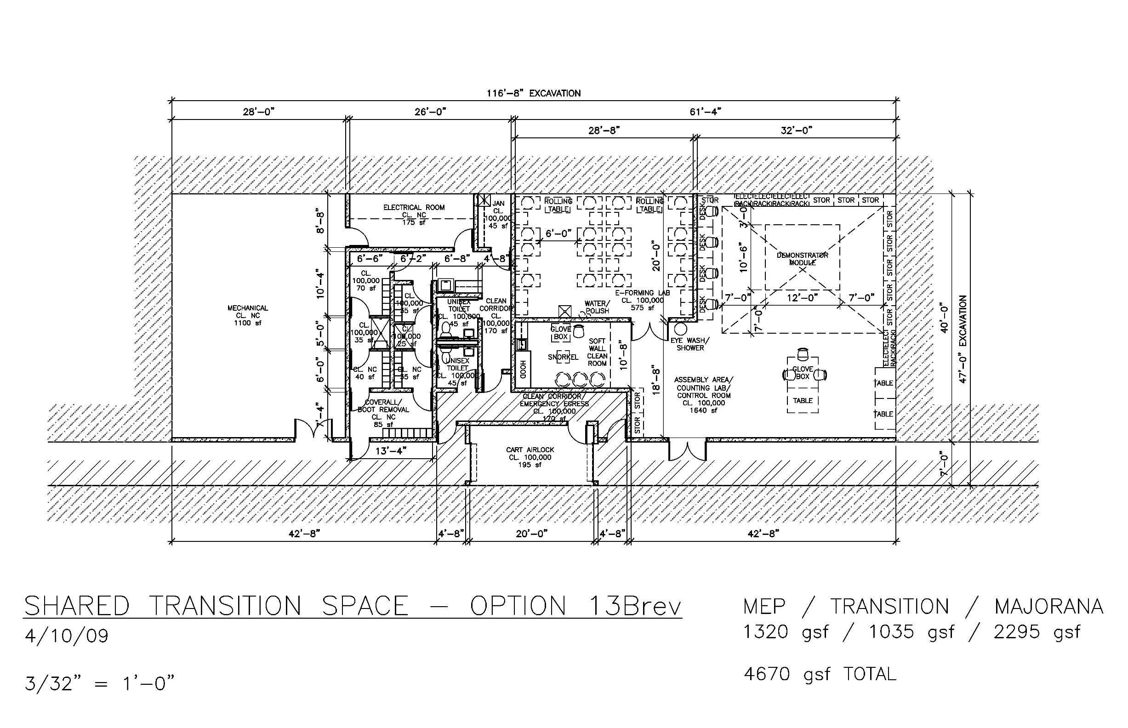
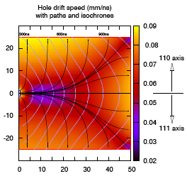
Majorana R&D for 1-t ββ
Materials and Assay
Prototypes
Infrastructure
Simulation and Analysis
Enrichment

Slide 22
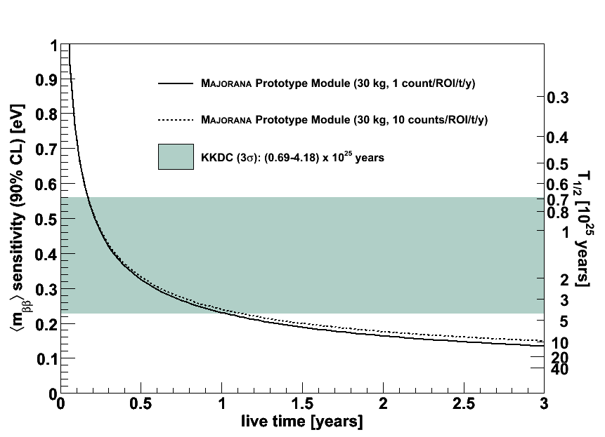
MAJORANA Demonstrator Module Sensitivity
Expected Sensitivity to 0νββ (30 kg enriched material, running 3 years, or 0.09 t-y of ⁷⁶Ge exposure)
T_{1/2} ≥ 10²⁶ y (90% CL).Sensitivity to <m_{ν}> < 140 meV (90% CL) [Rod05,err.]

Slide 23
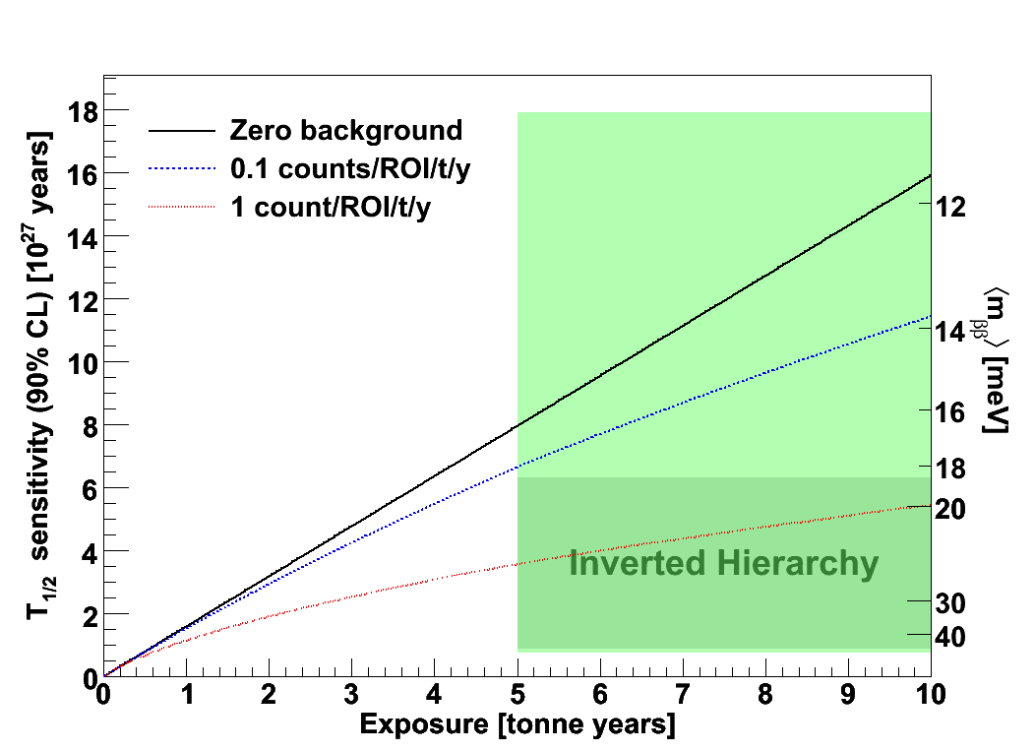
1-tonne Ge - Projected Sensitivity vs. Background
Goal is to achieve ultra-low backgrounds <1 count per ton of material per year in the Region of Interest (ROI)

Slide 24
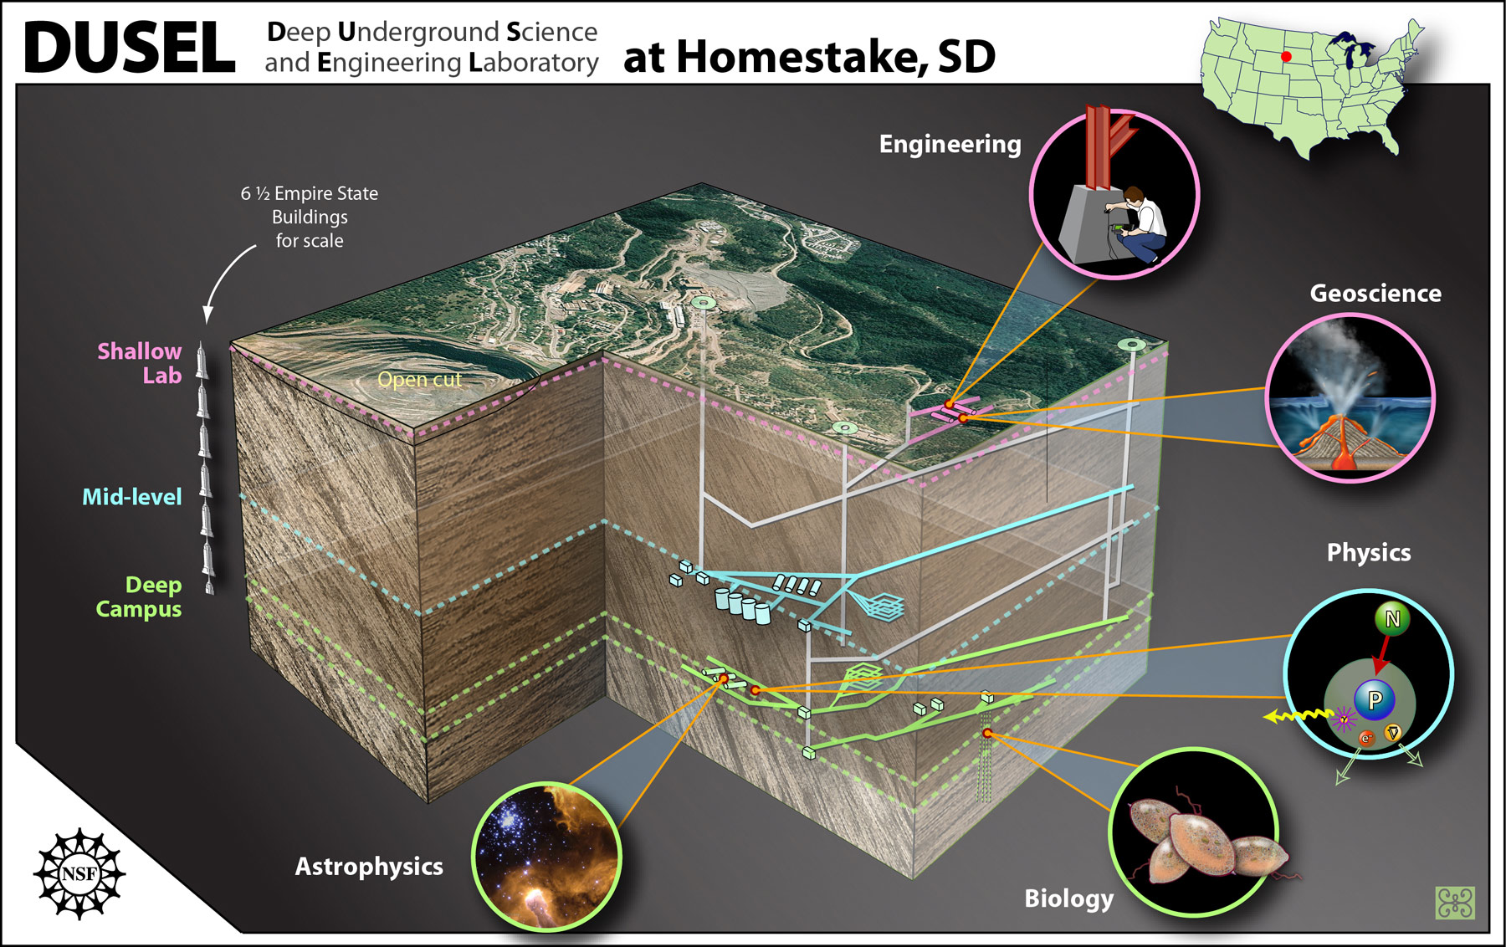
Sanford Lab Intermediate phase of DUSEL

Slide 25
EXO: Enriched xenon observatory

Slide 26
EXO Collaboration
K.Barry, E.Niner, A.Piepke
Physics Dept., U. of Alabama, Tuscaloosa AL, USA
P.Vogel
Physics Dept., Caltech, Pasadena CA, USA
A.Bellerive, M.Bowcock, M.Dixit, K.Graham, C.Hargrove,
E.Rollin, D.Sinclair, V.Strickland
Carleton University, Ottawa, Canada
C.Benitez-Medina, S.Cook, W.Fairbank Jr., K.Hall, B.Mong
Colorado State U., Fort Collins CO, USA
M.Moe
Physics Dept., UC Irvine, Irvine CA, USA
D.Akimov, I.Alexandrov, A.Burenkov, M.Danilov, A.Dolgolenko, A.Karelin, A.Kovalenko, A.Kuchenkov, V.Stekhanov, O.Zeldovich
ITEP Moscow, Russia
B.Aharmin, K.Donato, J.Farine, D.Hallman, U.Wichoski
Laurentian U., Canada
H.Breuer, C.Hall, L.Kaufman, D.Leonard, S.Slutsky, YR.Yen
U. of Maryland, College Park MD, USA
K.Kumar, A.Pocar
U. of Massachusetts, Amherst, Amherst MA, USA
M.Auger, G.Giroux, R.Gornea, F.Juget, G.Lutter, JL. Vuilleumier
Laboratory for High Energy Physics, Bern, Switzerland
N.Ackerman, M.Breidenbach, R.Conley, W.Craddock,
S.Herrin, J.Hodgson, D.Mackay, A.Odian, C.Prescott,
P.Rowson, K.Skarpaas, J.Wodin, L.Yang, S.Zalog
SLAC, Menlo Park CA, USA
L.Bartoszek, R.Cooper, R.DeVoe, M.Dolinski, B.Flatt,
G.Gratta, M.Green, F.LePort, M.Montero-
Diez, R.Neilson, A.Reimer-Muller, A.Rivas,
K.O'Sullivan, K.Twelker
Physics Dept., Stanford University, Stanford CA USA

Slide 27
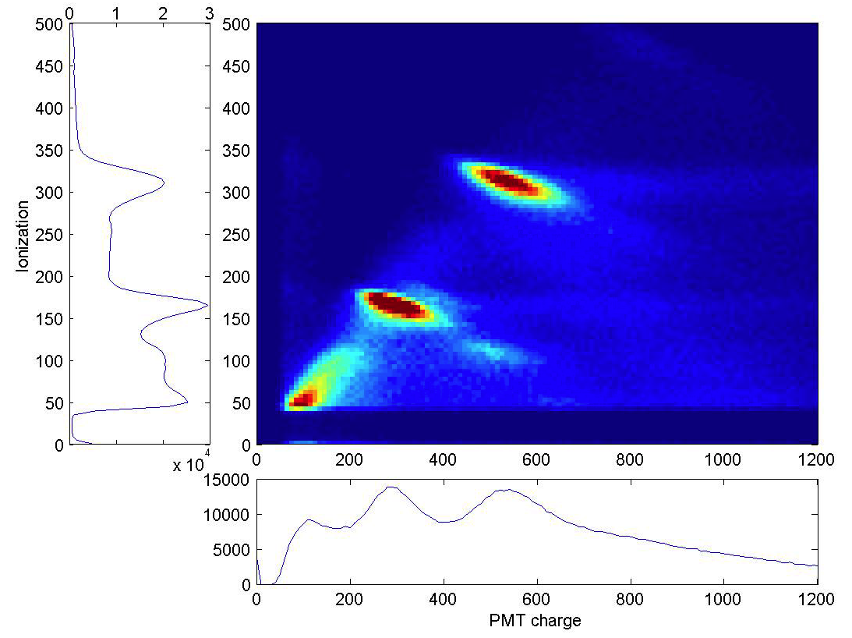
EXO Overview
Detect ionization and scintillation from liquid Xe
Have 200kg Xe enriched to 80% ¹³⁶Xe
Building 200kg prototype
Install at WIPP
Start with natural Xe in 2010
Achieve 6x10²⁵ yr.
Scale to ~10 ton

Slide 28
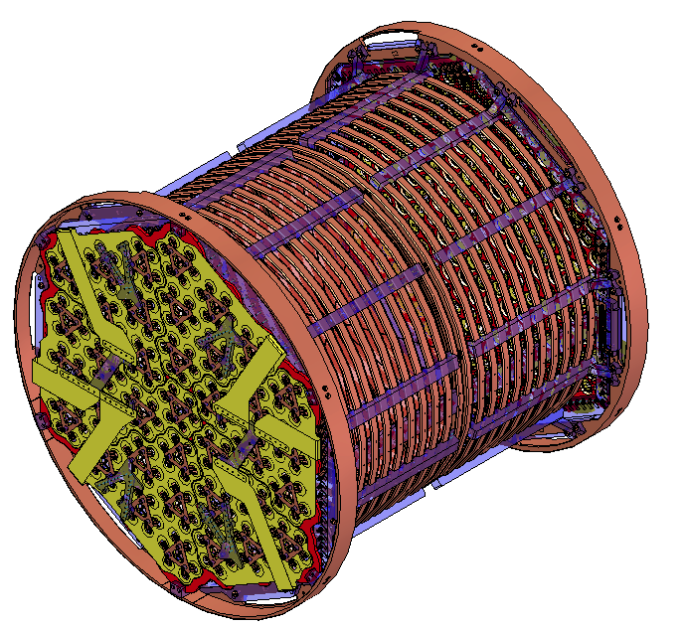
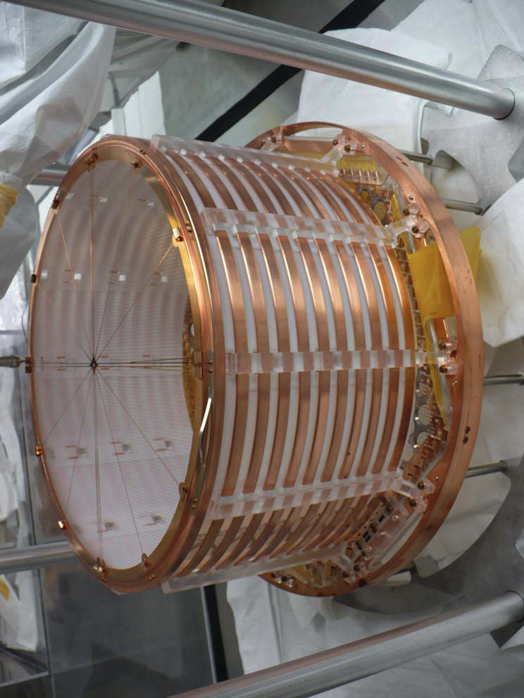
EXO-200 LXe TPC
HV Drift Cage
40cm
APD Plane and Grid

Slide 29
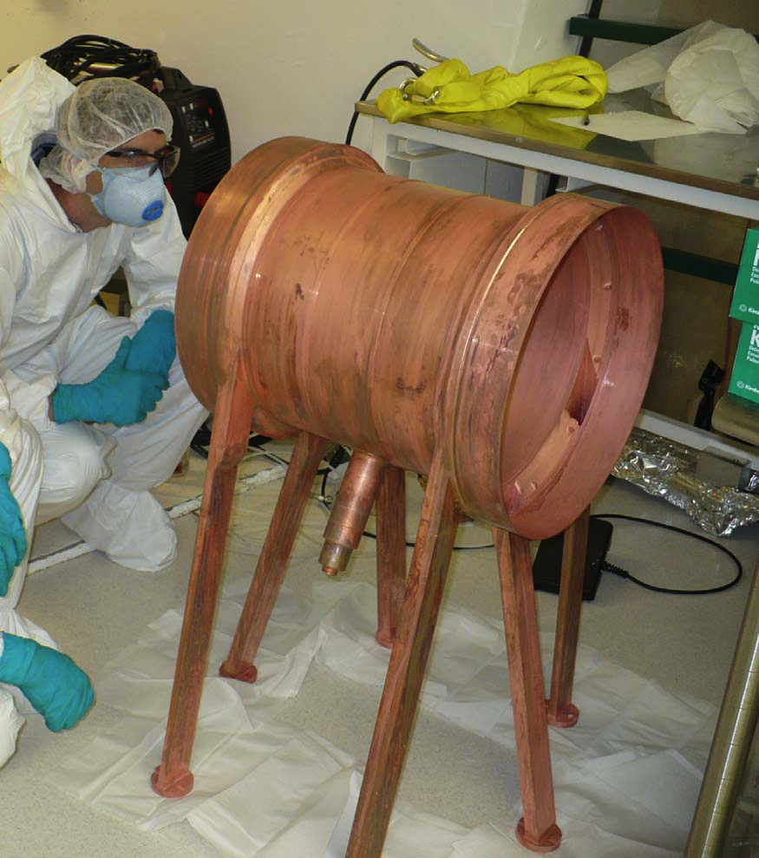
Ultra-low activity Cu vessel

Slide 30
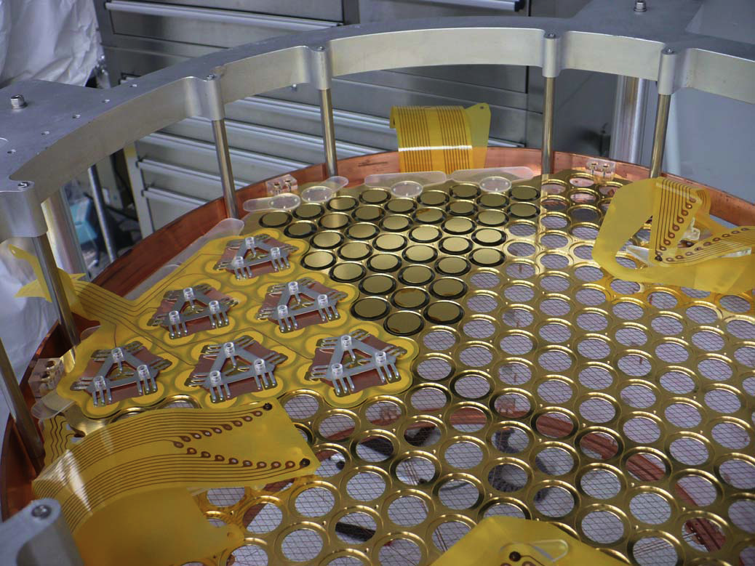
EXO APD Plane
Extensive R&D to reduce component backgrounds
APD clean & lightweight
Sensitive to VUV

Slide 31
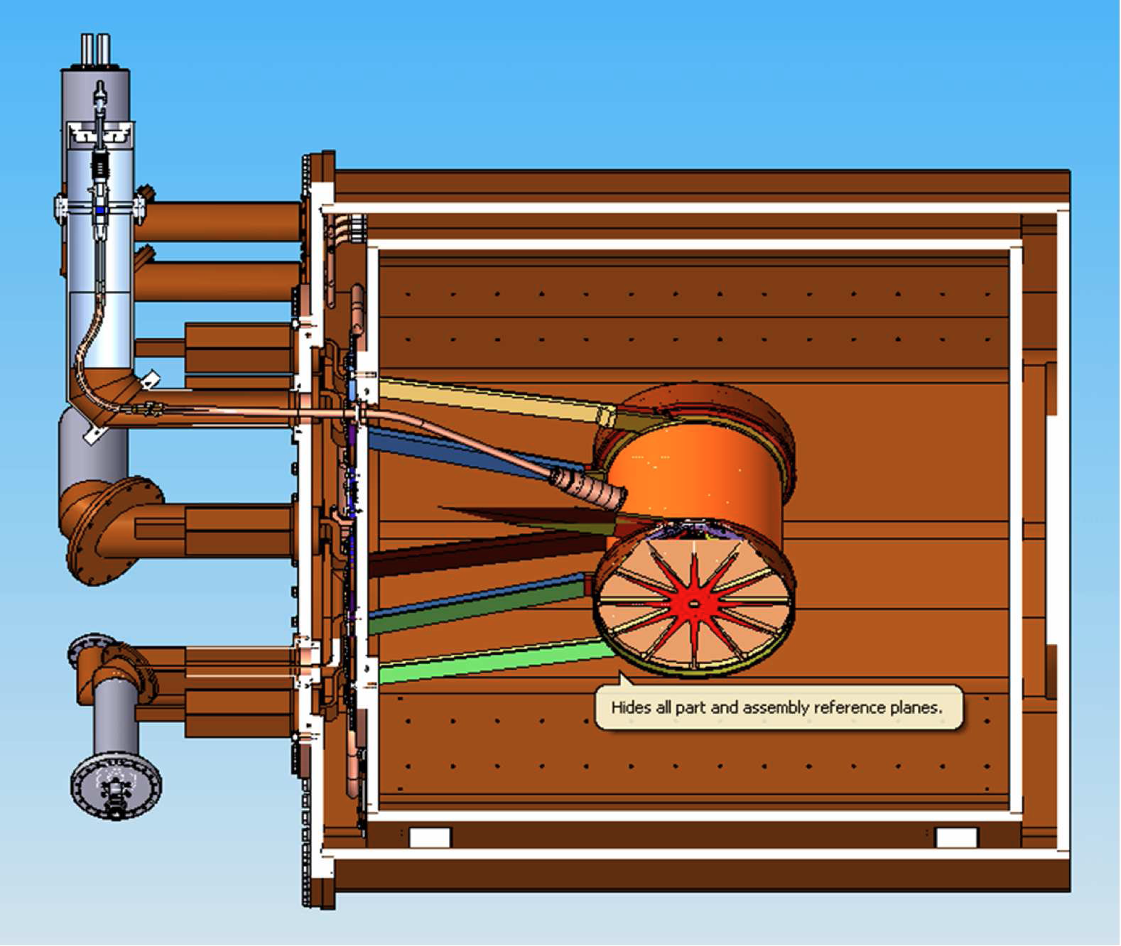
EXO 200 Detector
1.5 m

Slide 32
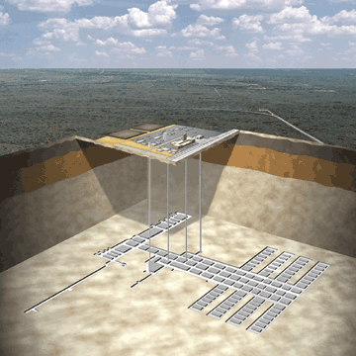
Waste Isolation Pilot Plant
Carlsbad, NM
1500 mwe
Salt, low radio-activity
EXO-200

Slide 33
Ba tagging R&D
M. Moe PRC44 (1991) 931
¹³⁶Ba⁺ final state can be identified using optical spectroscopy.
Provides almost background free confirmation.
²P_{1/2}
650nm
493nm
⁴D_{3/2}
metastable 80s
¹³⁶Ba+
²S_{1/2}

Slide 34
SNO+

Slide 35
SNO+ Collaboration
University of Alberta: A. Bialek, P. Gorel, A. Hallin, M. Hedayatipoor, C. Krauss
Brookhaven National Laboratory: R. Hahn, Y. Williamson, M. Yeh
Dresden University of Technology: K. Zuber
Idaho State University: J. Heise, K. Keeter, J. Popp, E. Tatar, C. Taylor
Laurentian University: O. Chkvorets, E.D. Hallman, S. Korte, M. Schumaker, C. Virtue
University of Leeds: S. Bradbury, J. Rose
LIP Lisbon: S. Andringa, N. Barros, J. Maneira
University of North Carolina: M. Howe, J. Wikerson
University of Oxford: S. Biller, N. Jelley, P. Jones, A. Reichold, J. Wilson-Hawke
University of Pennsylvania: E. Beier, R. Bonaventure, W.J. Heintzelman, J. Klein, G. Orebi Gann, J. Secrest, T. Shokair
Queen's University: M. Boulay, M. Chen, X. Dai, E. Guillian, P.J. Harvey, C. Kraus, X. Liu, A. McDonald, H.O’Keeffe, E. O’Sullivan, P. Skensved, A. Wright
SNOLAB: B. Cleveland, F. Duncan, R. Ford, C.J. Jillings, I. Lawson, E. Vazquez Jauregui
University of Sussex: A. Baxter, E. Falk-Harris, S. Fernandes, J. Hartnell, S. Peeters
University of Washington: J. Kaspar, J. Nance, N. Tolich, H. Wan Chan Tseung

Slide 36
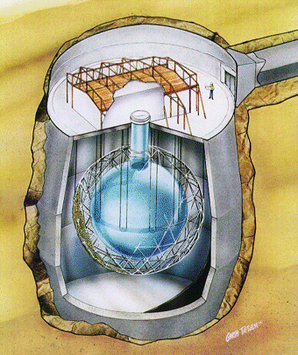
SNO+
Use existing SNO PMTs and Acrylic Vessel
6000 mwe
Physics Goals
Neutrinoless Double Beta Decay
Solar Neutrinos
Reactor Anti-neutrinos
Geo Neutrinos
Supernova Neutrinos

Slide 37
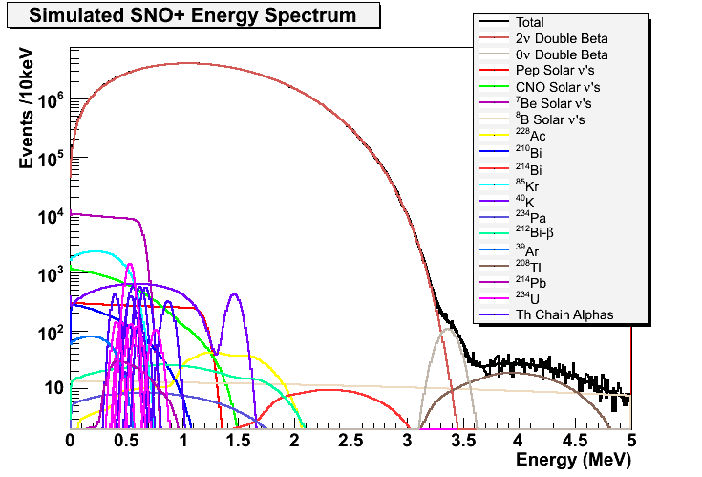
¹⁵⁰Nd SNO+ Summary
Stable Nd-loaded liquid scintillator
Developed acceptable purification techniques to remove Th and Ra from Nd
Physics sensitivity
below 100 meV (using natural Nd)
below to 30 meV (using enriched Nd)
SNO+ plans to deploy 0.1% natural Nd-loaded liquid scintillator for the first phase

Slide 38
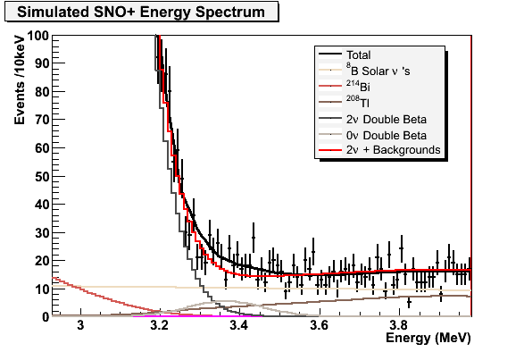
56 kg of ¹⁵⁰Nd and <m_{v}> = 100 meV
6.4% FWHM at Q-value
3 years livetime
5σ sensitivity
Dominant background is ⁸B solar neutrinos!

Slide 39
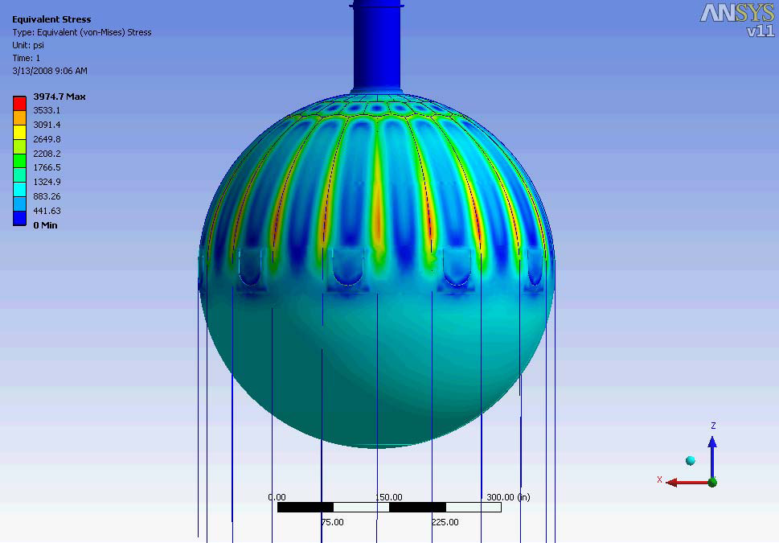
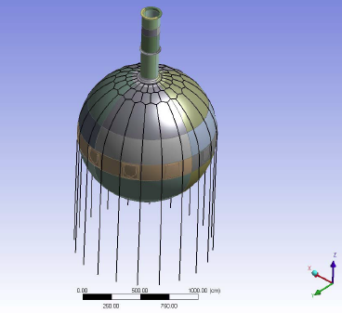
SNO+ Rope Hold Down Net
SNO+ rope will be Tensylon: low U, Th, K ultra-high molecular weight polyethylene
AV Hold Down
Ropes

Slide 40
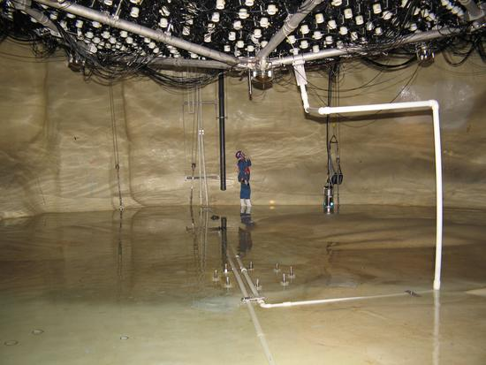
Inspecting the SNO Cavity

Slide 41
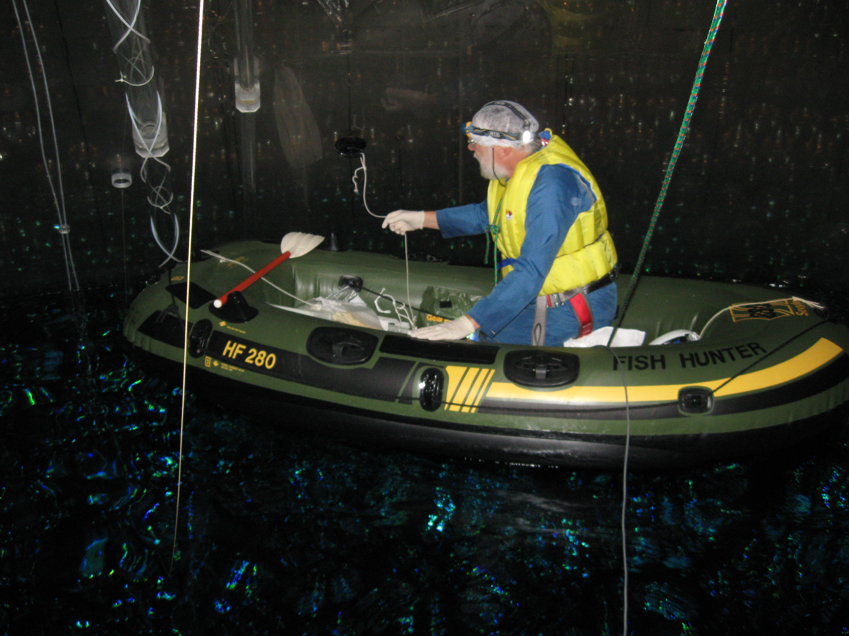
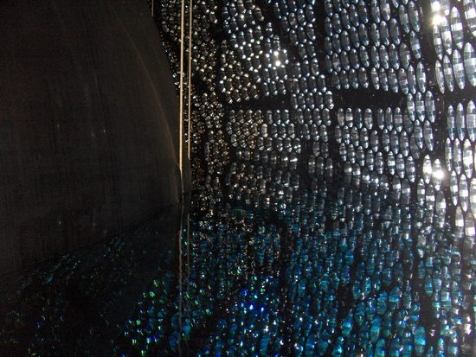
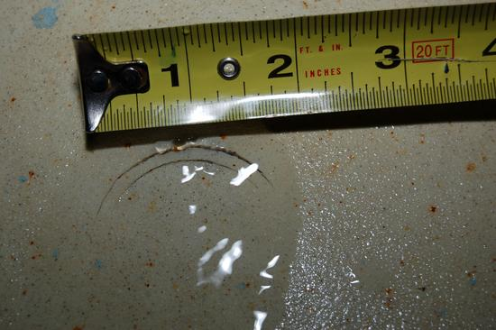
SNO to SNO+ Transition Activities
>$10M proposal submitted to CFI LEF/NIF competition: October 2008
Approved in June 2009.
Commissioning and data taking in 2011
Inspections inside the acrylic vessel

Slide 42
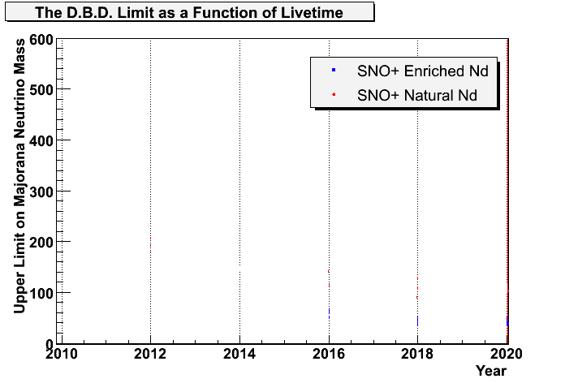
SNO+ ββ Sensitivity
KKDC suggested range
[meV]
90% CL
SNO+ Operating Plan:
Natural Nd in 2011
Enriched Nd in 2014
50% fiducial volume
75% livetime

Slide 43
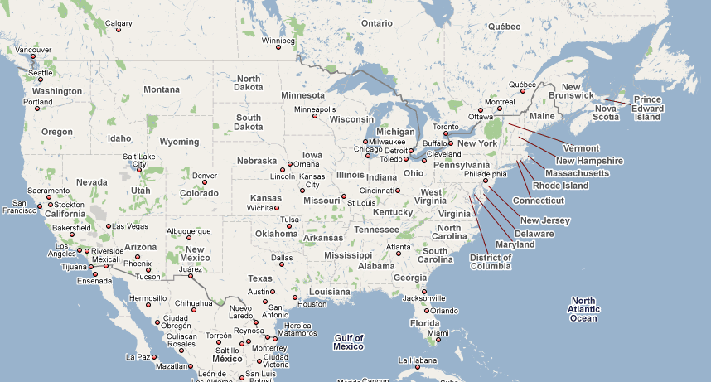
Conclusion
North America has three competitive DBD experiments utilizing a rich variety of experimental approaches.
Majorana
Sanford Lab
SNO+
SNOLAB
EXO-200
(WIPP)

Slide 44
Extras

Slide 45
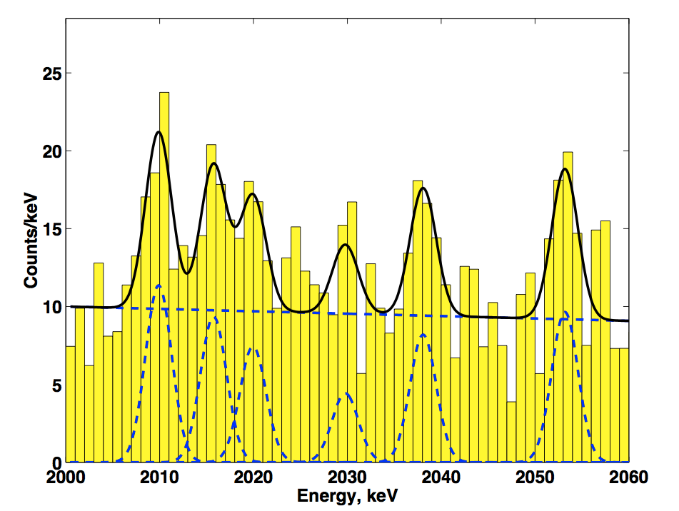
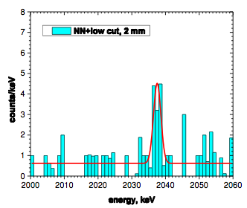
A Recent Claim
Klapdor-Kleingrothaus H V, Krivosheina I V, Dietz A and Chkvorets O, Phys. Lett. B 586 198 (2004).
KKDC used five ⁷⁶Ge crystals, with a total of 10.96 kg of mass, and 71 kg-years of data.
Τ_{1/2} = 1.2 x 10²⁵ y
0.24 < m_{v} < 0.58 eV (3 sigma)
Background level depends on intensity fit to other peaks.
A More Recent Claim 6.8 sigma
Modern Physics Letters A
21 (2006) 1547
Neural Net Analysis

Slide 46
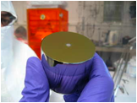
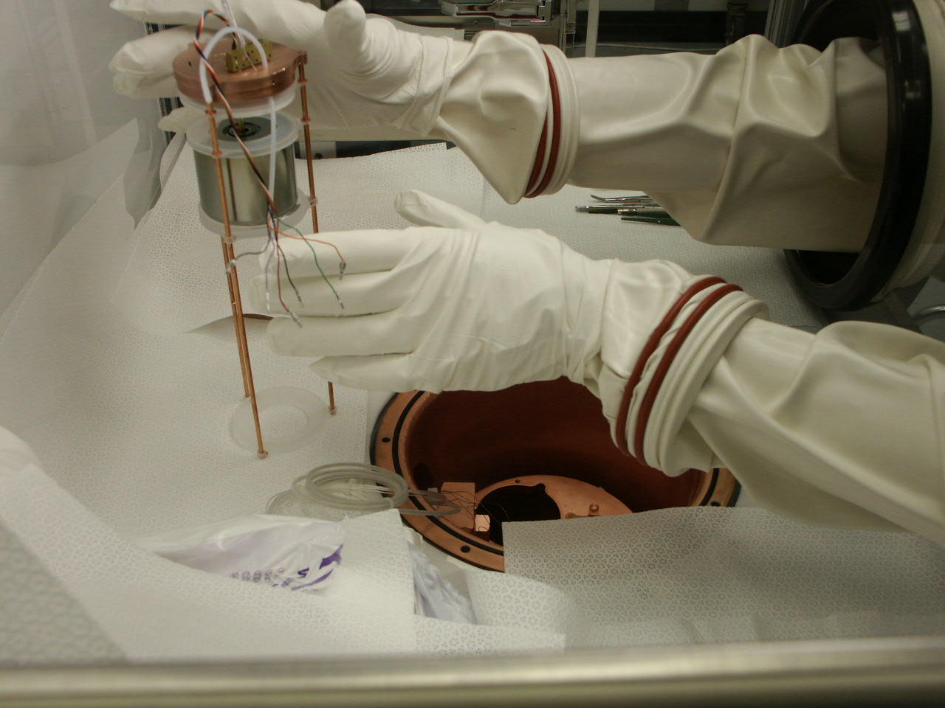
Refinements to the MAJORANA Demonstrator
Concentrate on P-PC Detectors.
Advantages of cost and simplicity, with no loss of physics reach.
Will continue N-SC R&D.
Additional physics opportunities with low-energy P-PC detectors.
Exploits low-energy thresholds (~100 eV threshold) of P-PC detectors
Several Prototypes in hand. 18 Additional ^{nat}Ge detectors ordered (LANL).
First module of Demonstrator

