Slide 1
The Status and Prospects for the Detection of Dark Matter
David B. Cline
Astrophysics Division
UCLA

Slide 12
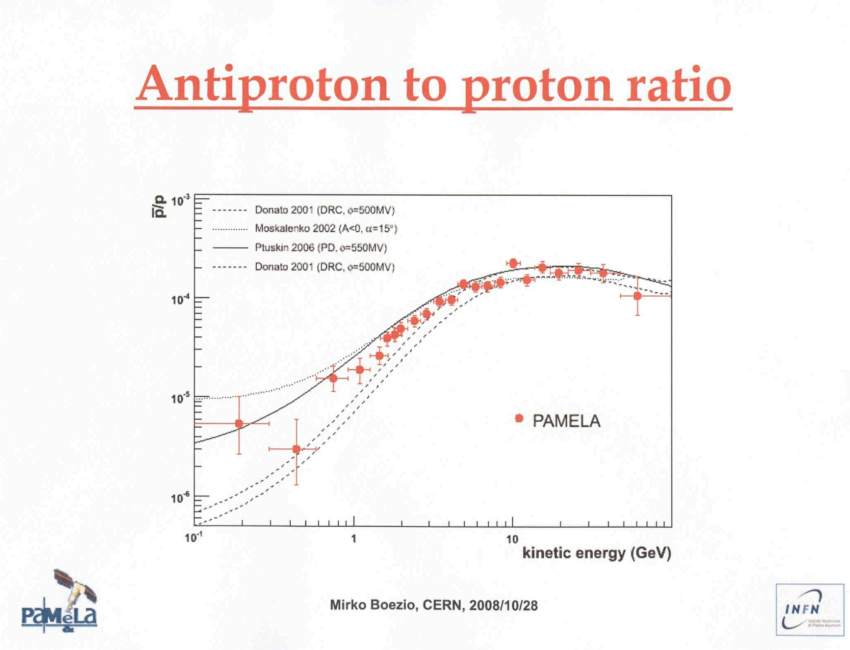

Slide 13
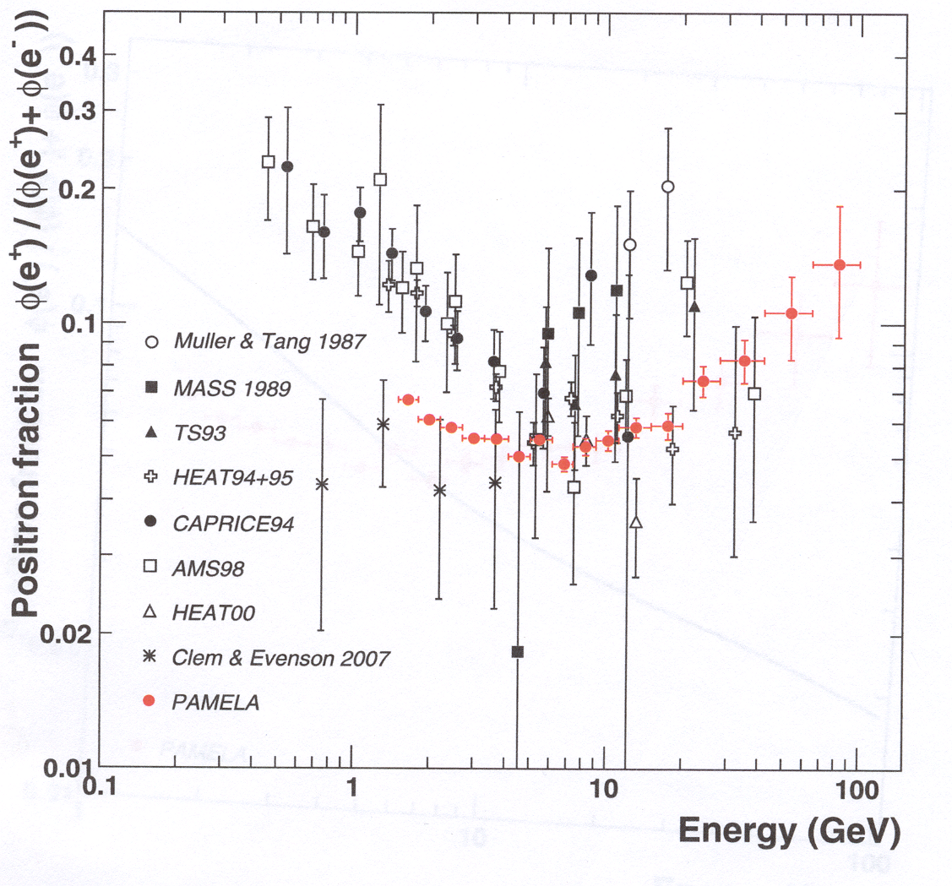

Slide 14
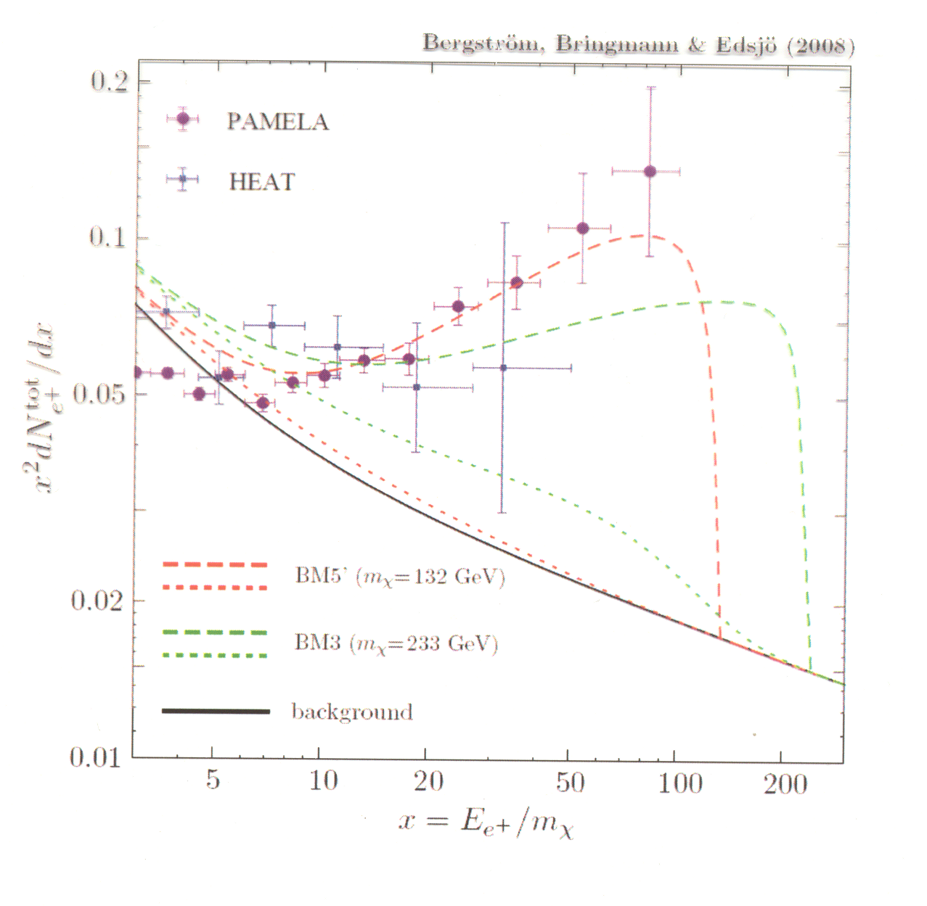

Slide 15
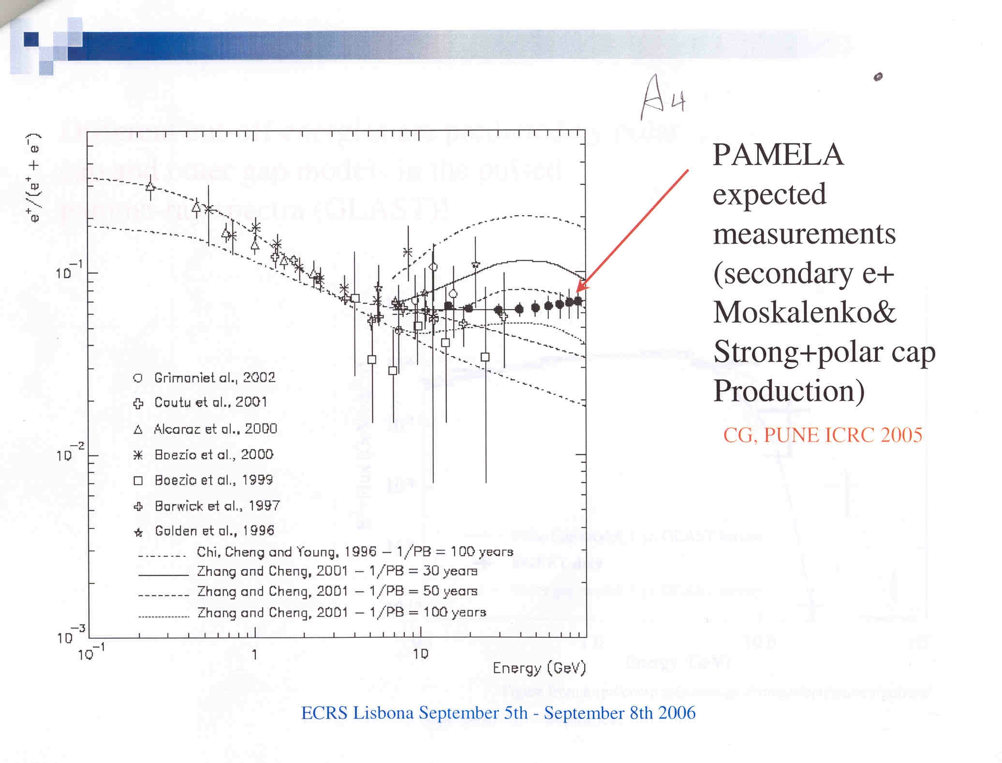

Slide 17
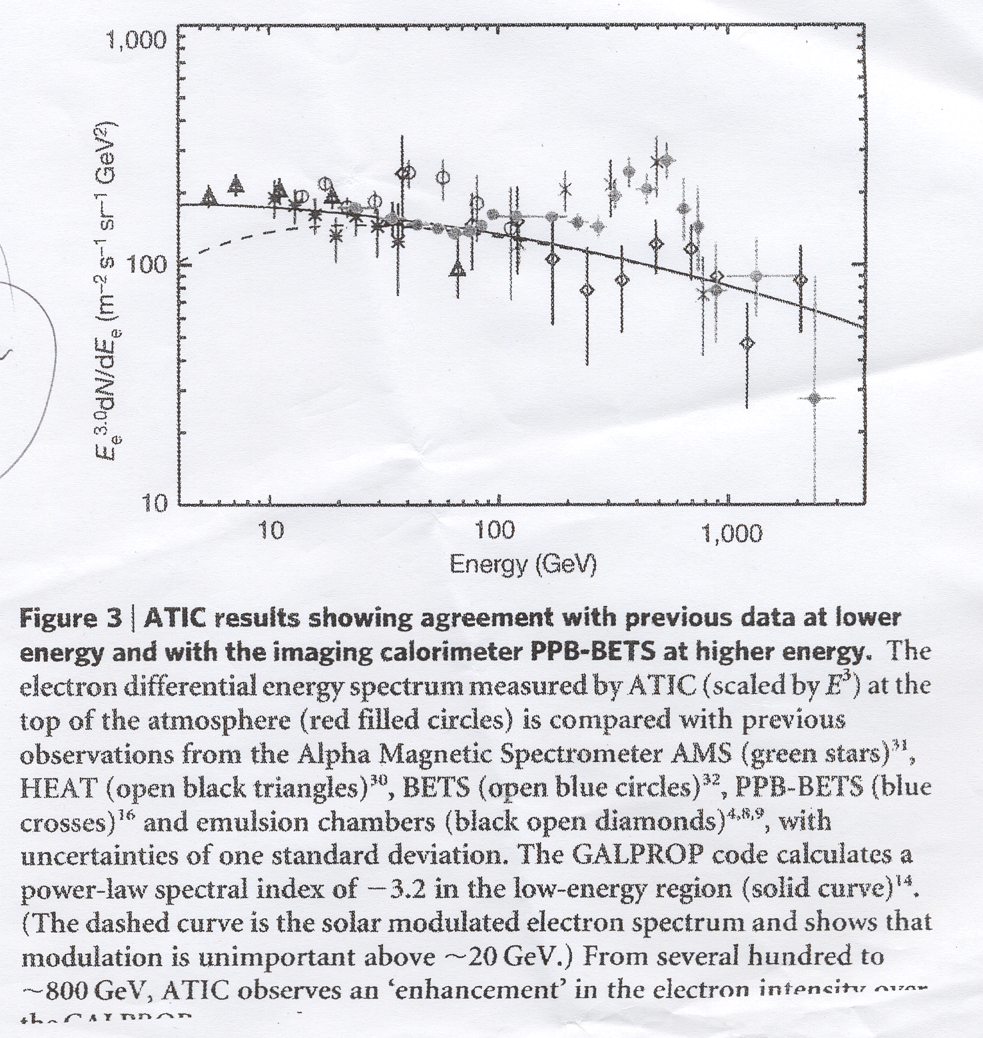

Slide 18
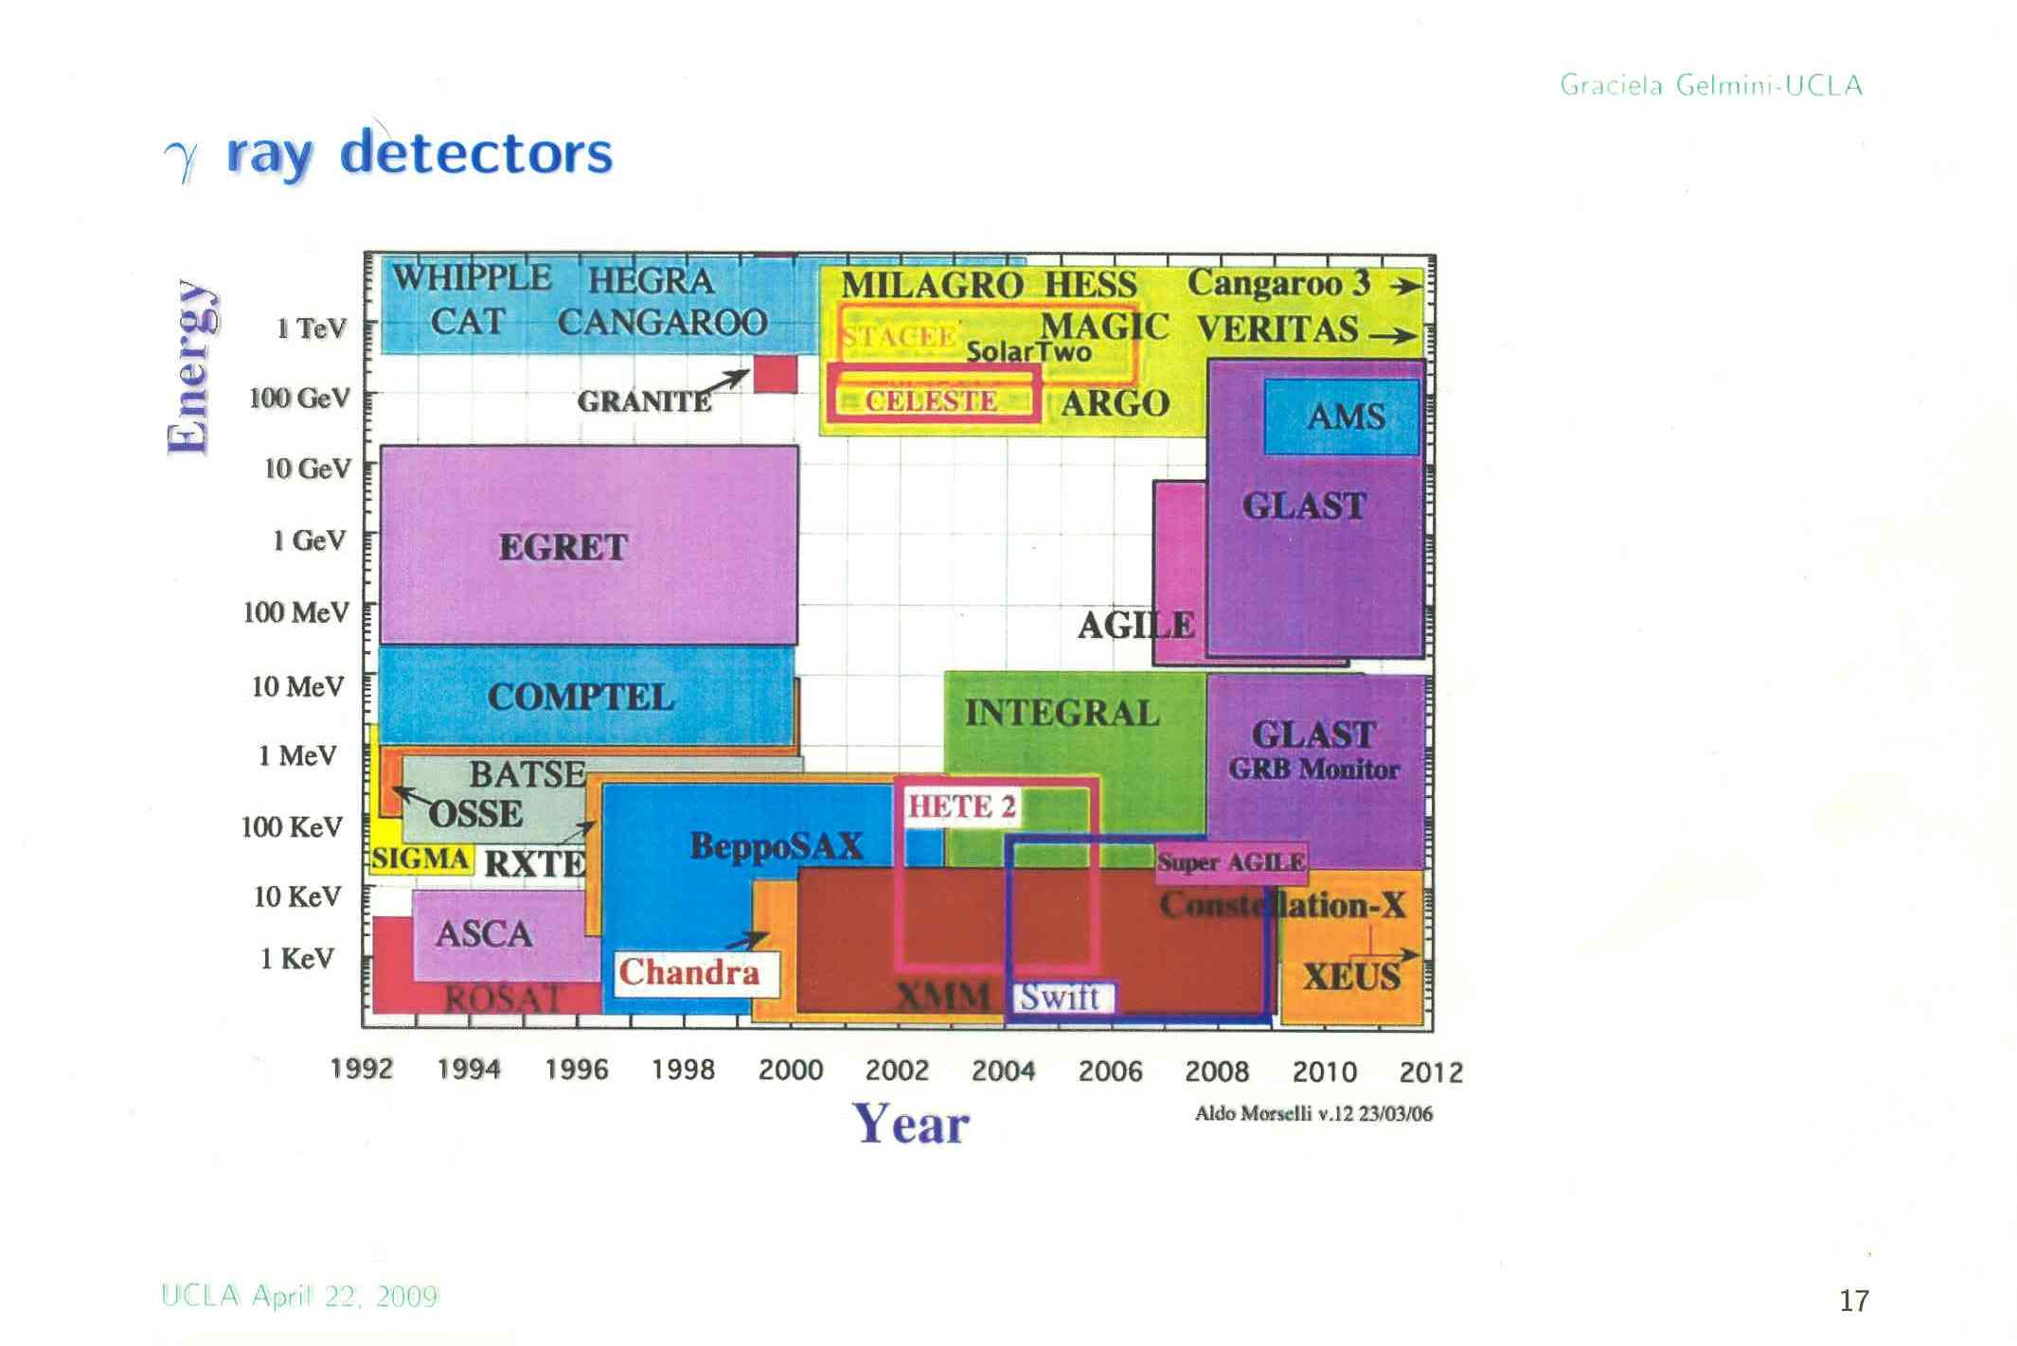

Slide 19
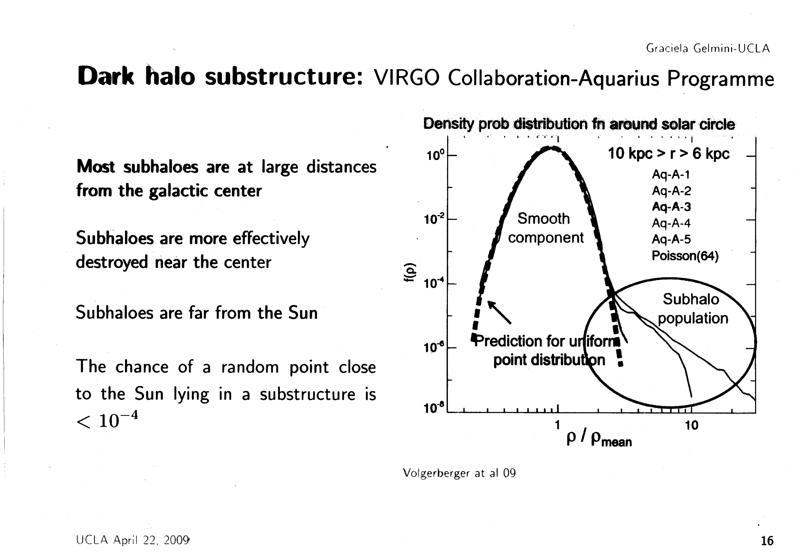

Slide 20
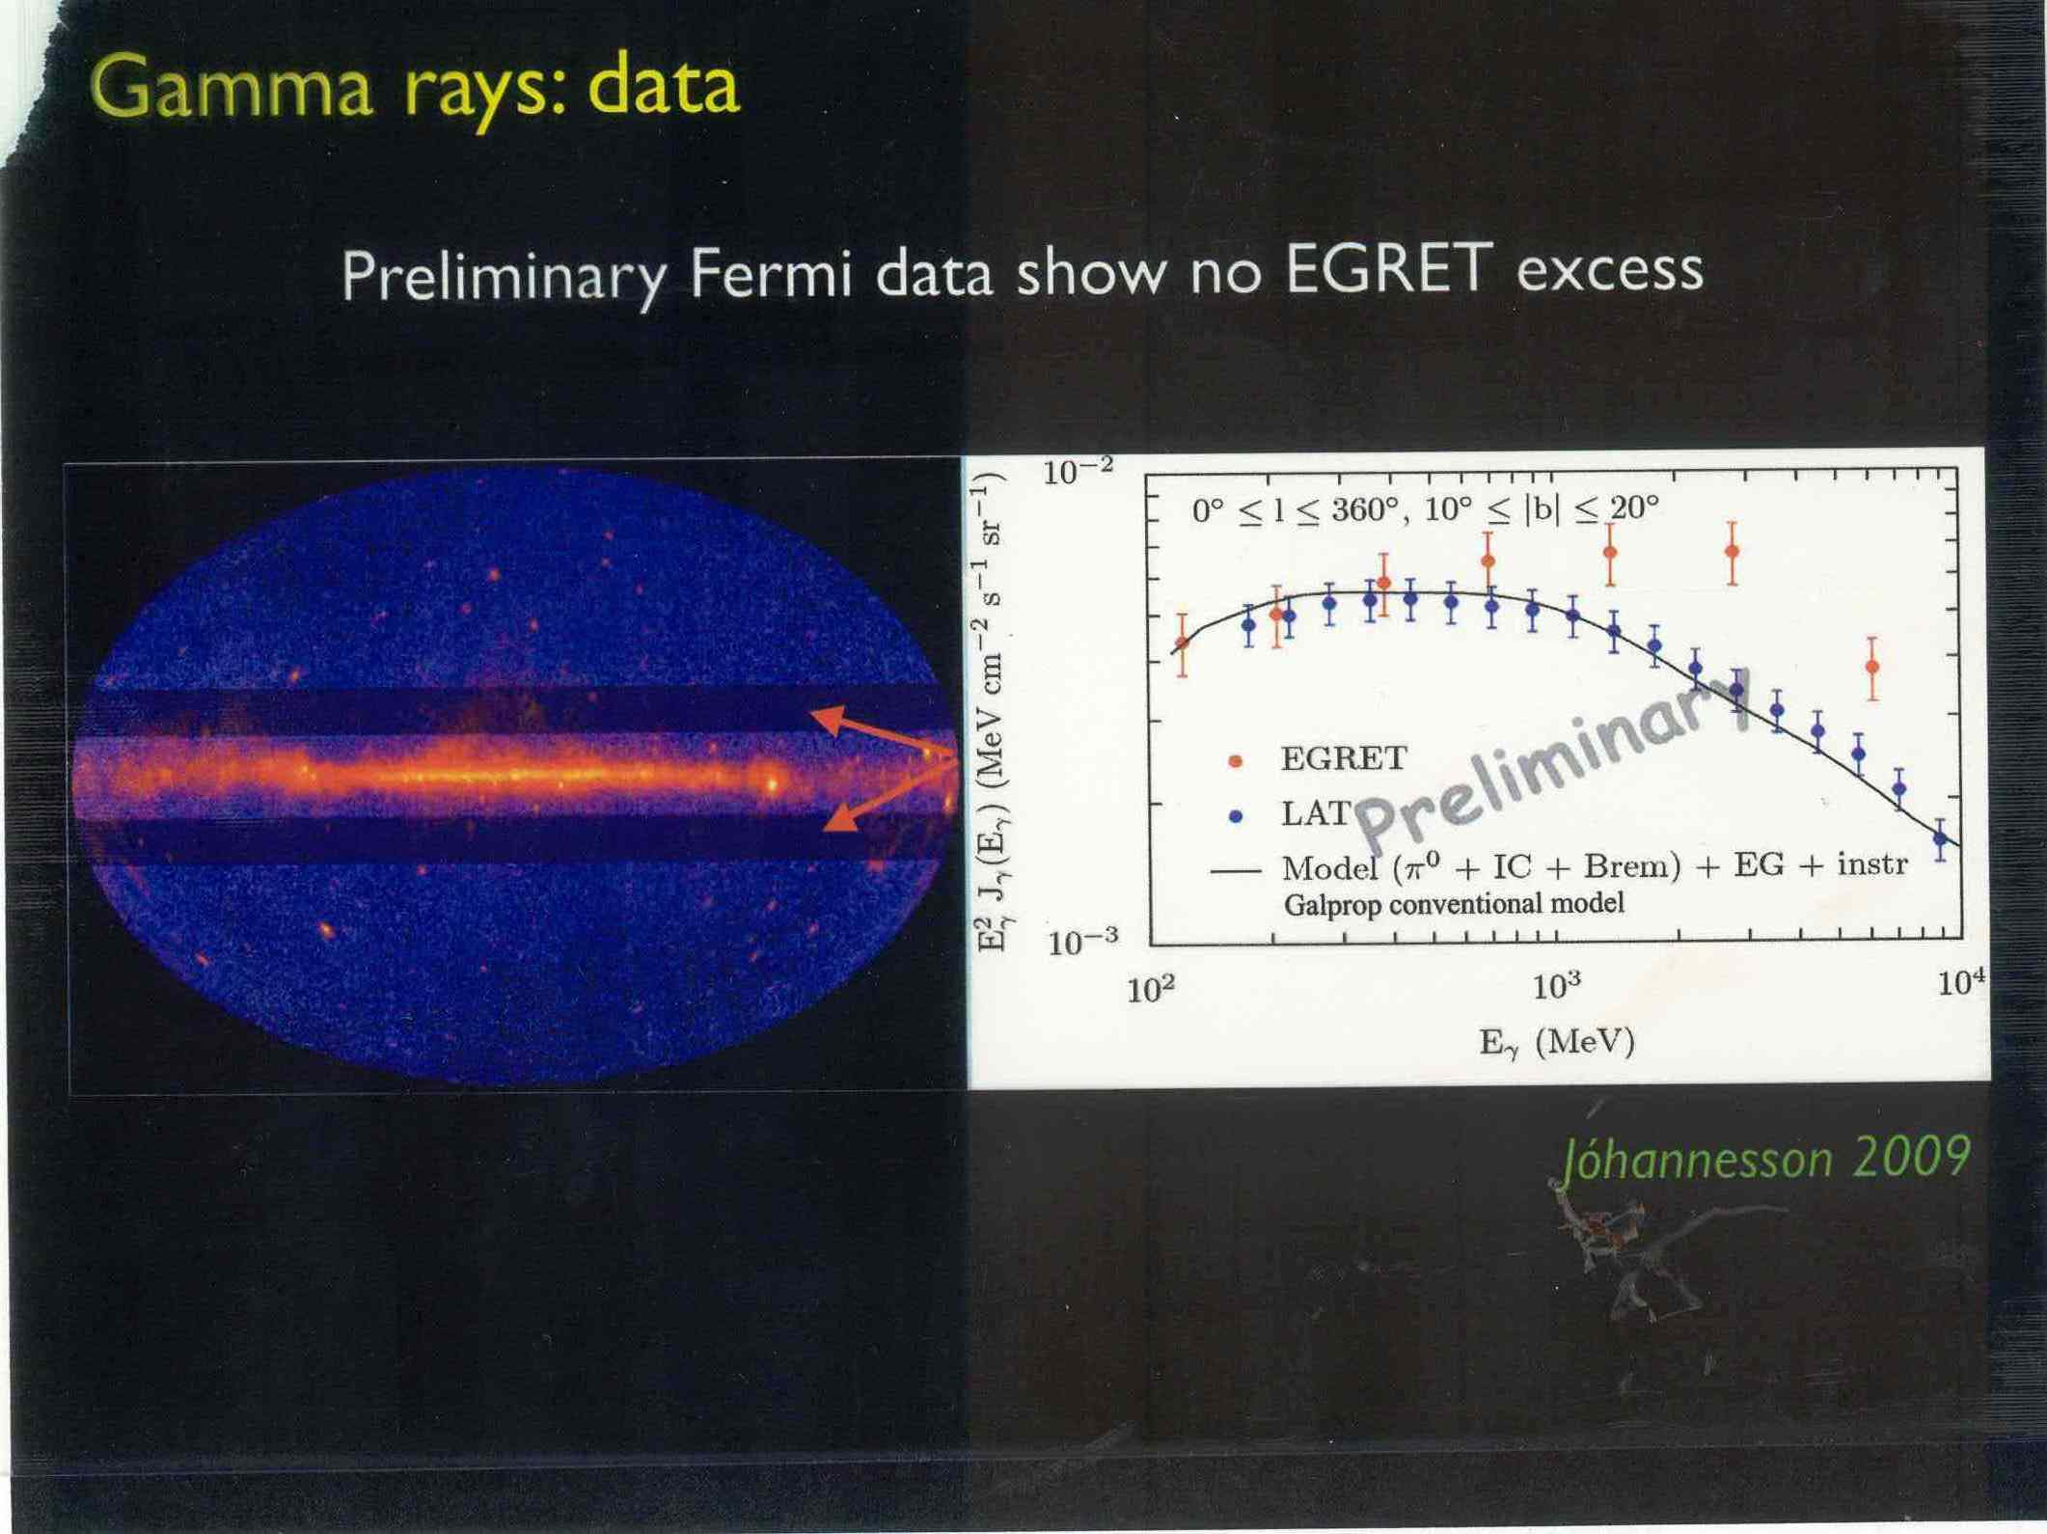

Slide 21
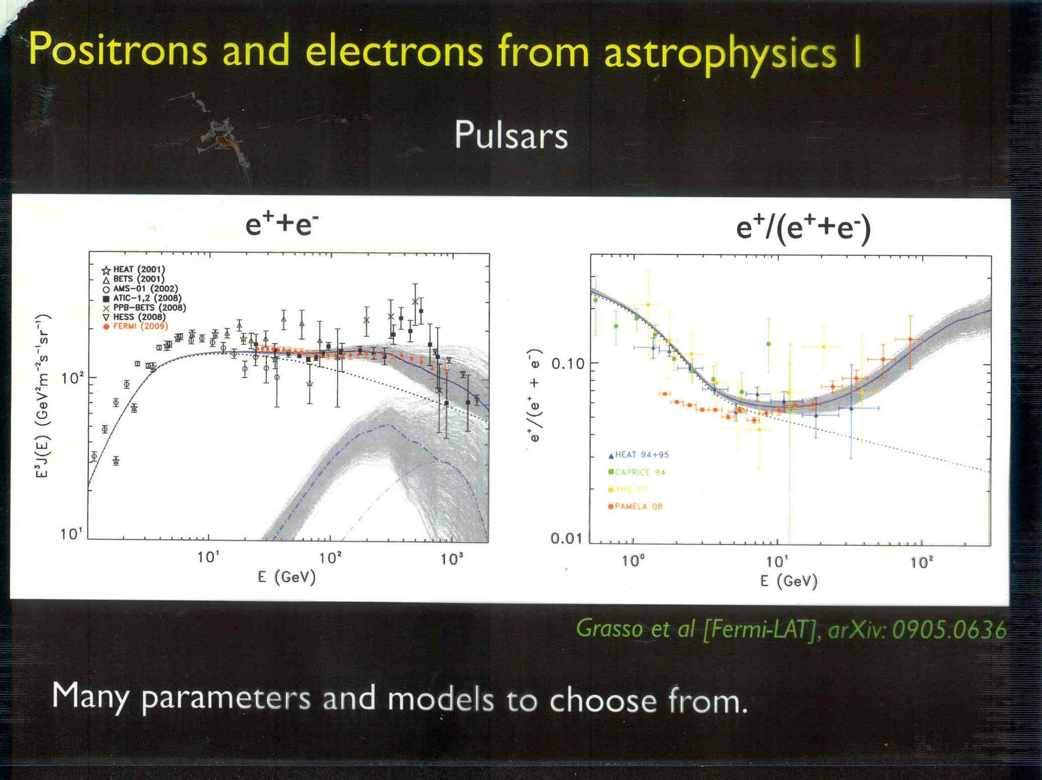
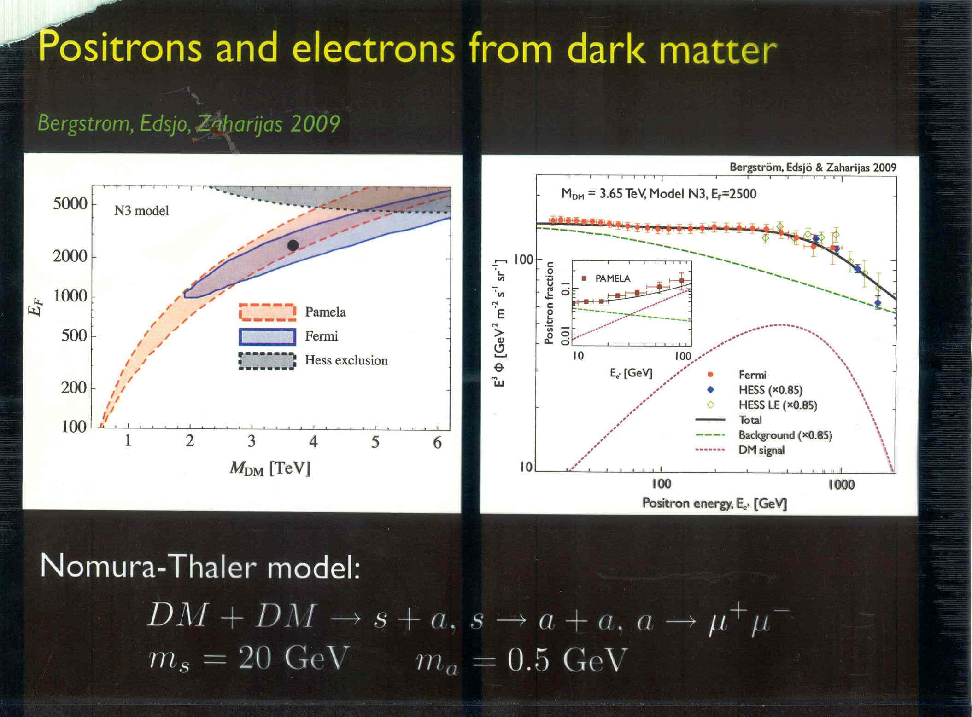

Slide 25
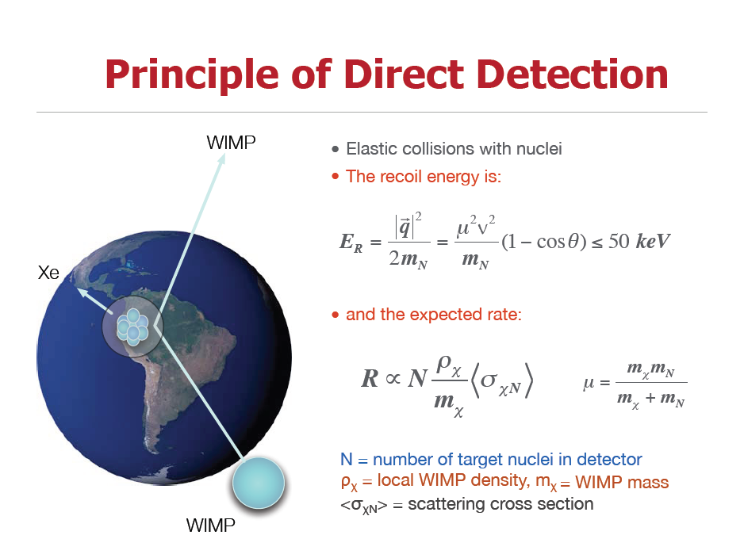

Slide 26
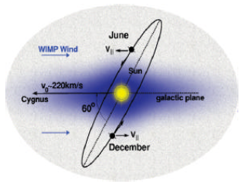
Recoil Spectra of different Targets
σ ~ 10⁻⁴⁴ cm²
x10⁻⁴
x10⁻⁴

Slide 27
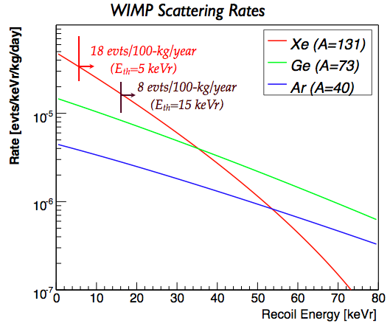
Liquid Xenon for Dark Matter Search
• Large atomic number A~131 best
for SI interactions (σ~A²) if low threshold
• ~50% odd isotopes:
very good for SD interactions
• No long-lived isotopes.
Kr-85 reduction to ppt proven.
• High Z (54) and density:
– compact & self-shielding
• Scalability to large mass for
σ~10⁻⁴⁷ cm2 ~ 1evt/1ton/yr
– cost
– “Simple” cryogenics (-100°C)
• Efficient scintillator
• Background discrimination
– Ionization/Scintillation
– 3D imaging of TPC

Slide 28
Challenges of Direct Detection Experiments
• Low event rates ⇒ ton-scale detectors
• Small deposited energies
⇒ low (~ few keV) energy thresholds
• Low backgrounds
  • shield against cosmic rays
  (deep underground laboratories → μ-spallation reactions)
  • low intrinsic radio-activity
  (ultra-pure materials → (α,n)-reactions)
  • shield radioactivity from surroundings (Pb, PE, H2O, etc)
• Good background rejection
  • Particle identification
  • nuclear vs. electron recoils
  • Identification of surface events
  • Position sensitivity/fiducialisation
  • Self-shielding

Slide 29
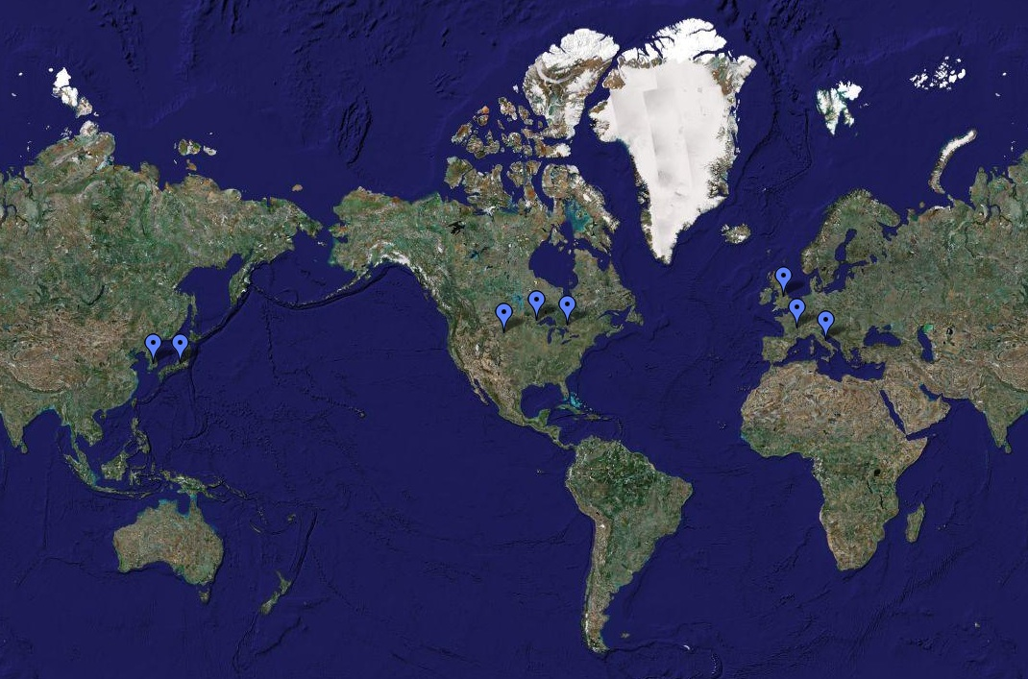

Slide 30
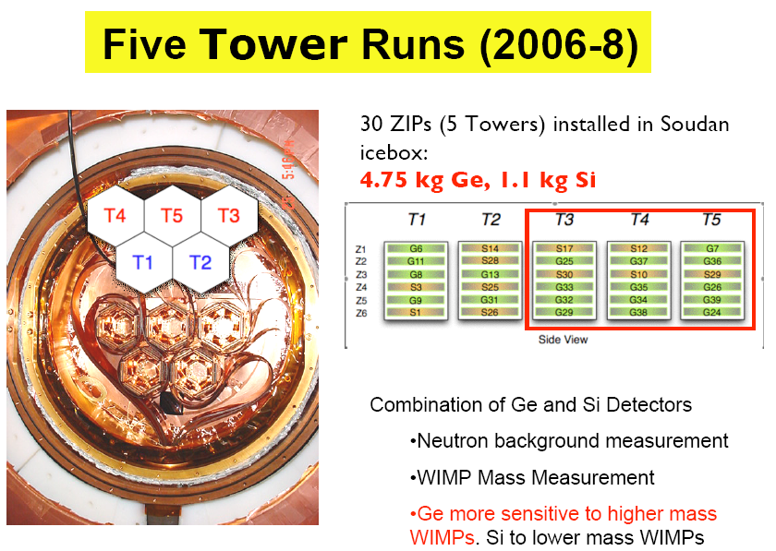

Slide 31
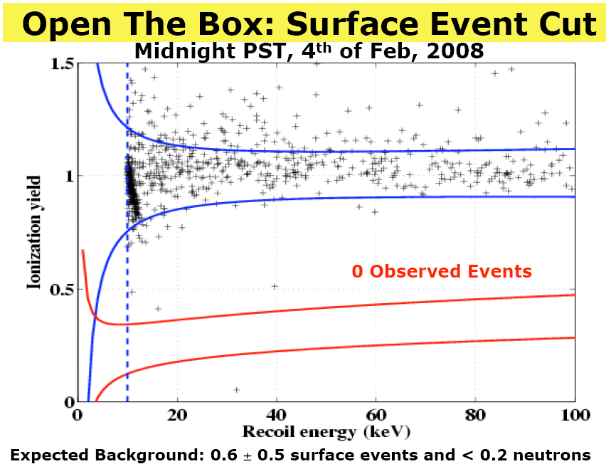

Slide 32
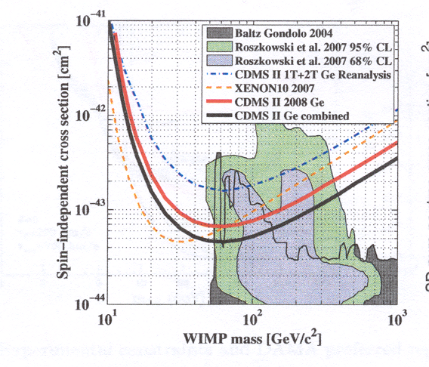
INDEPENDENT EXCLUSION LIMIT

Slide 33
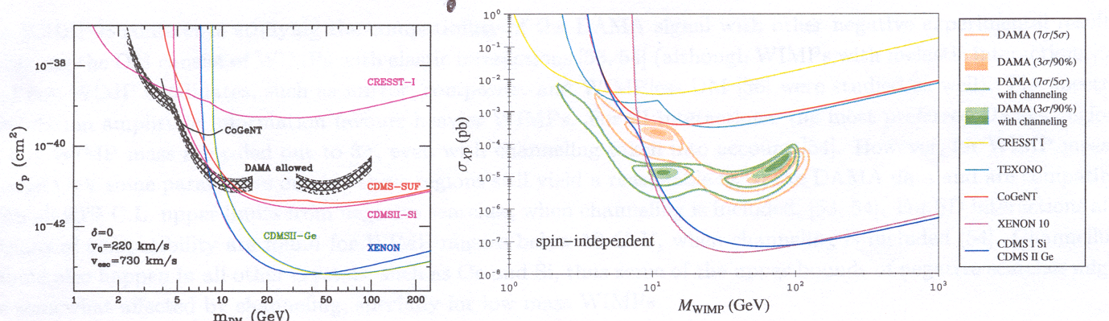

Slide 34
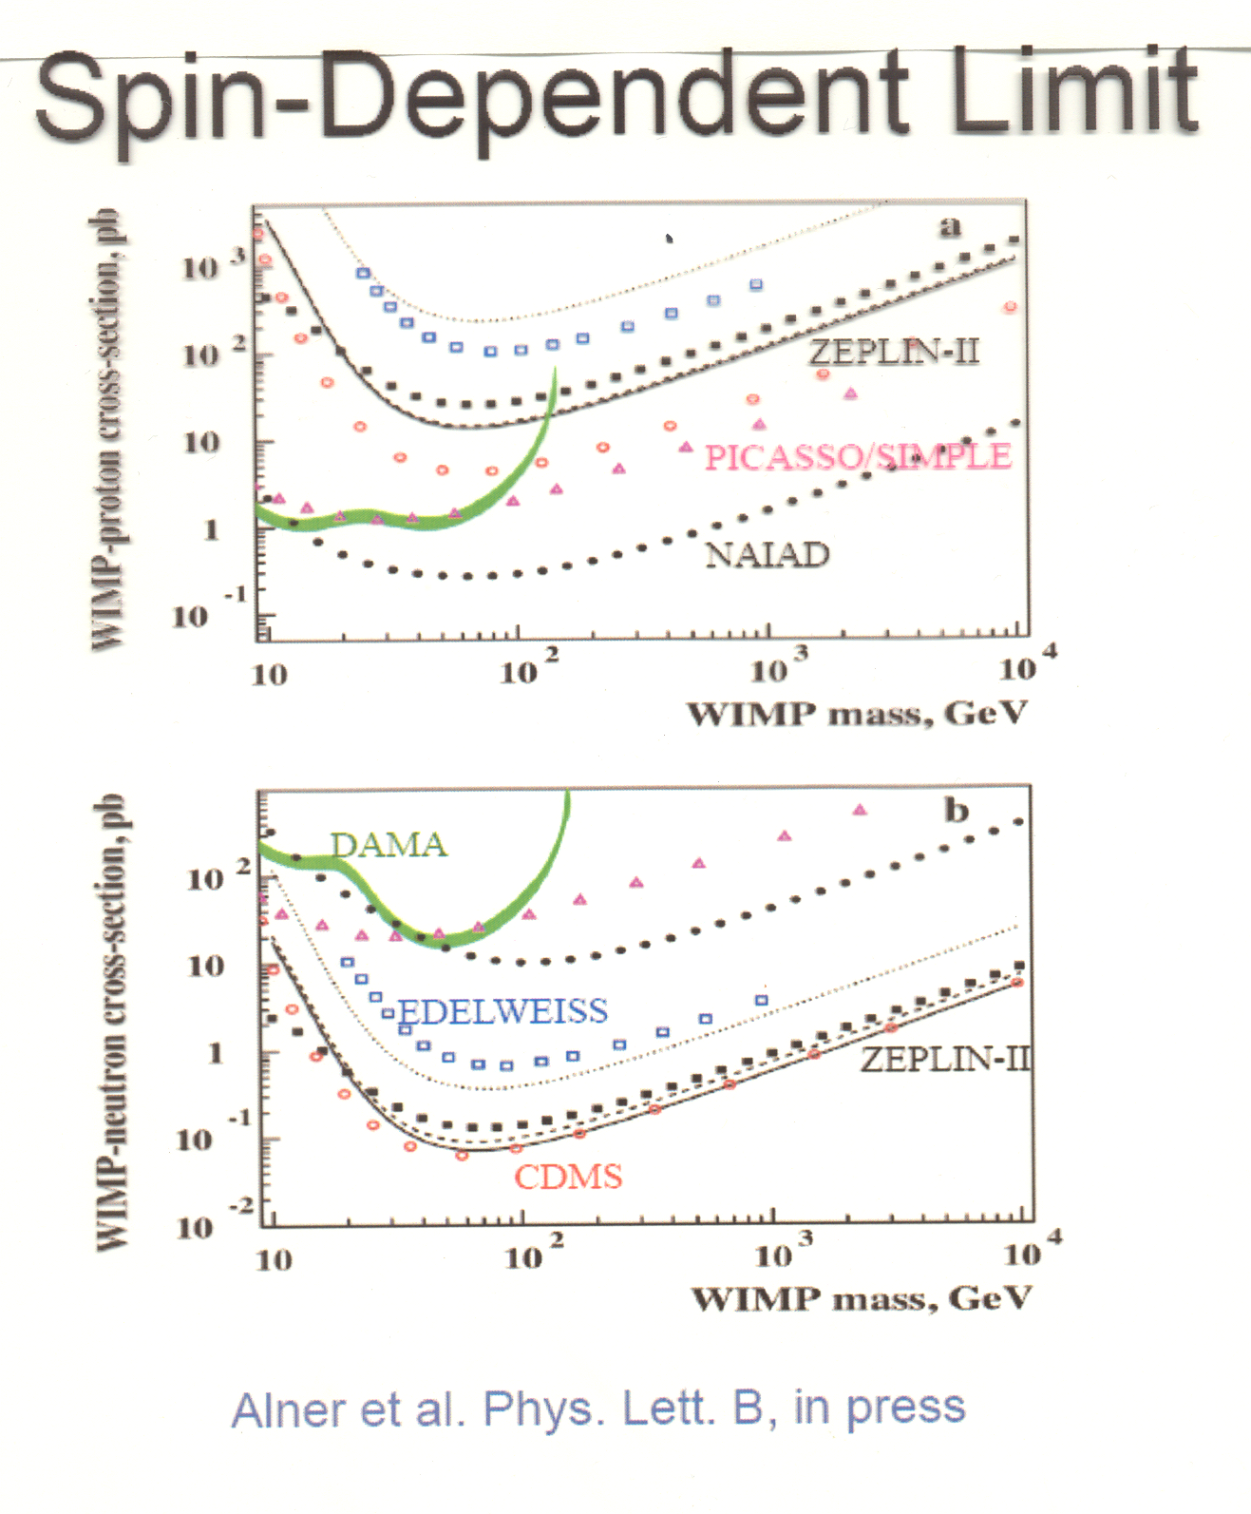

Slide 35
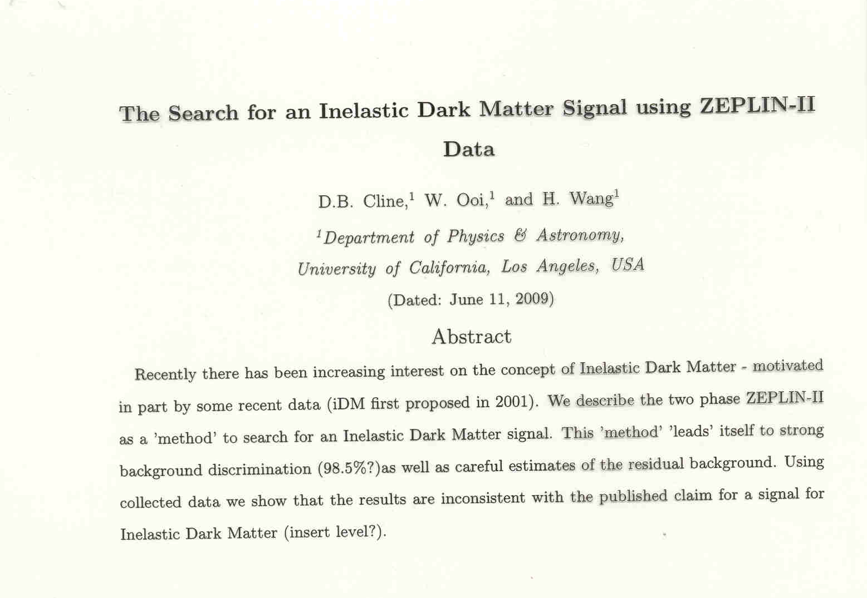

Slide 36
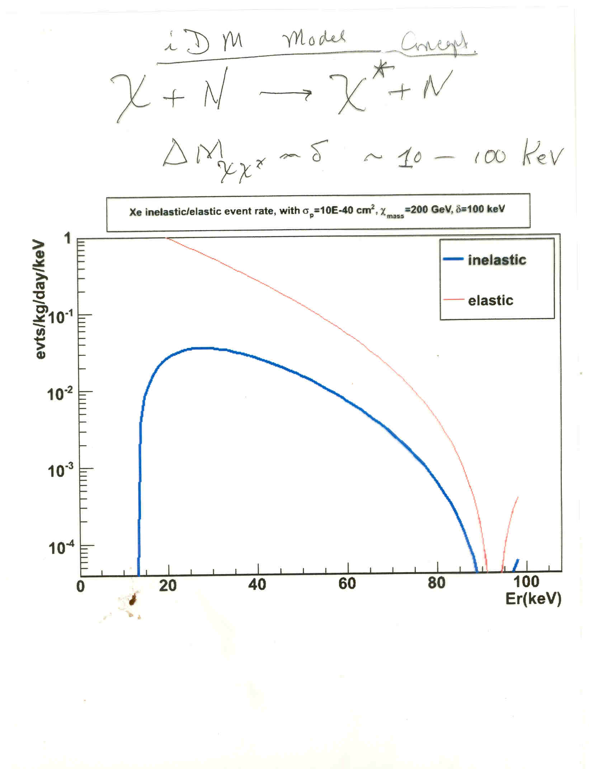

Slide 37
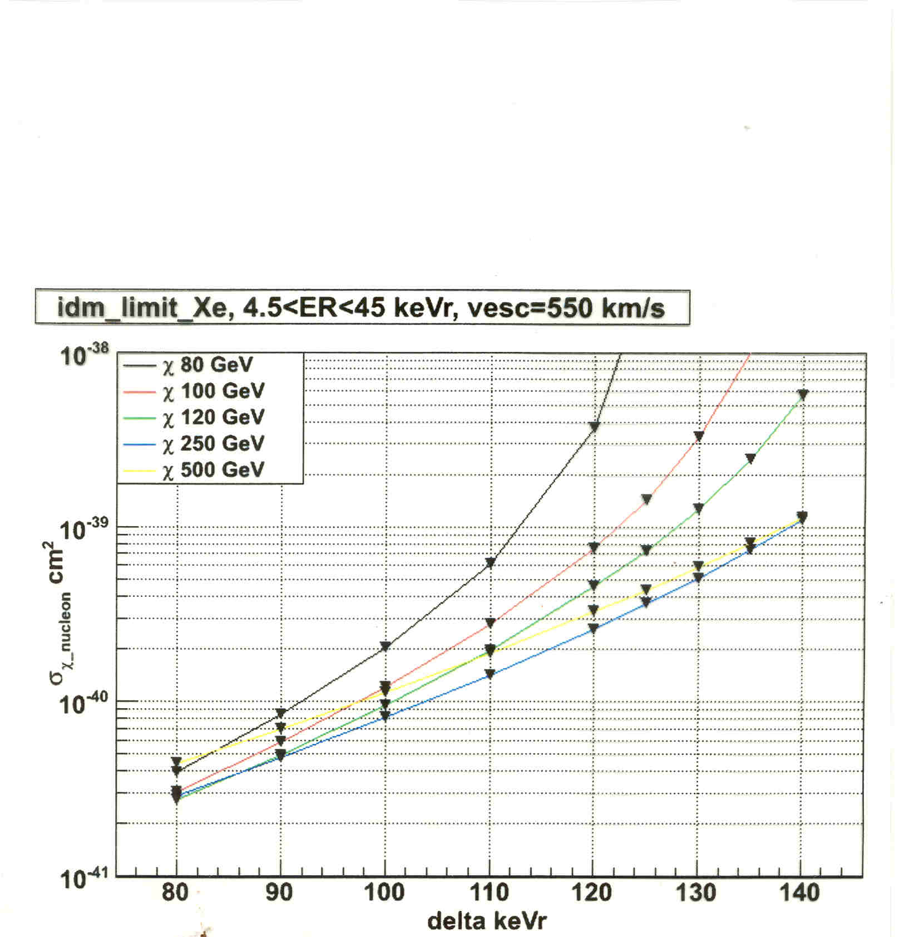

Slide 38
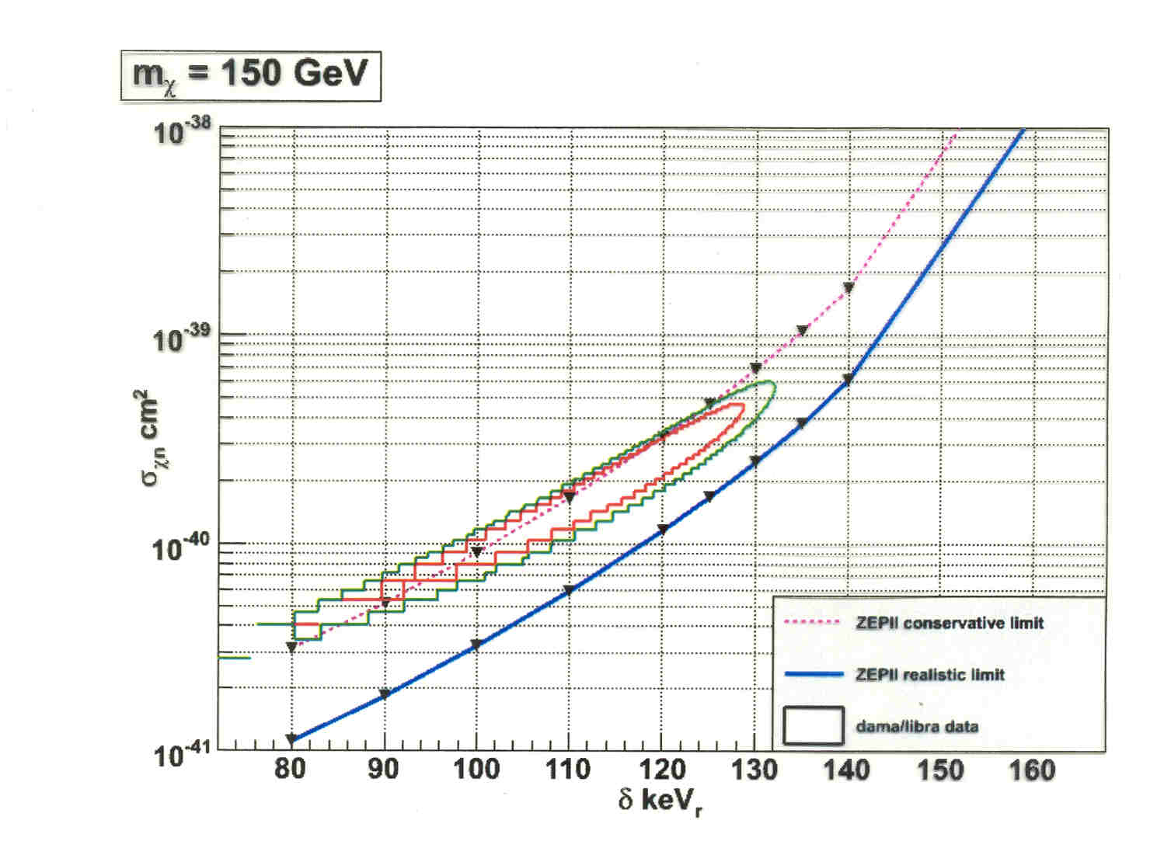

Slide 39
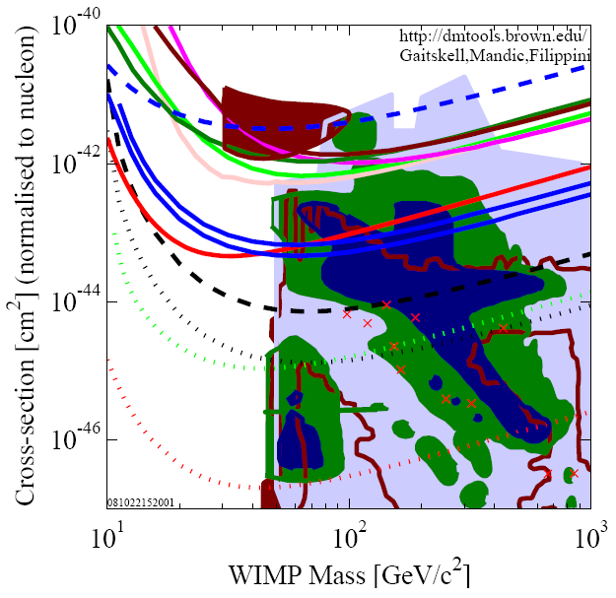
ZEPLIN II
XENON10
8/20/2009
Hanguo Wang, UCLA
39

Slide 42
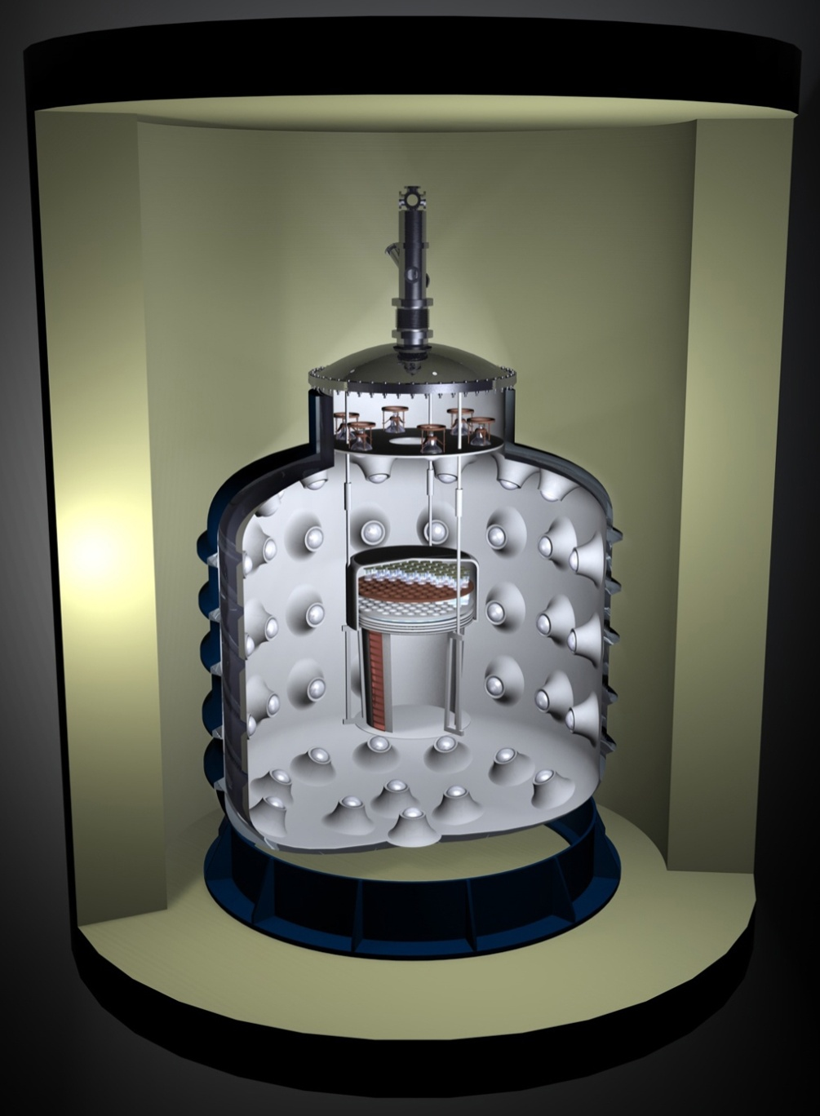
WARP 140-kg Detector
The WARP 140-kg detector, currently under commissioning at LNGS
140 kg active target, to reach into 5x10⁻⁴⁵ cm² and cover critical part of SUSY parameter space
Complete neutron shield!
4π active neutron veto (9 tons Liquid Argon, 300 PMTs)
Active control on nuclide-recoil background, owing to unique feature (LAr active veto)
3D Event localization and definition of fiducial volume for surface background rejection
Detector designed for positive confirmation of a possible WIMP discovery
Cryostat designed to allocate a possible 1400 kg detector
100 liters Chamber
Active Veto
Passive neutron and gamma shield

Slide 43
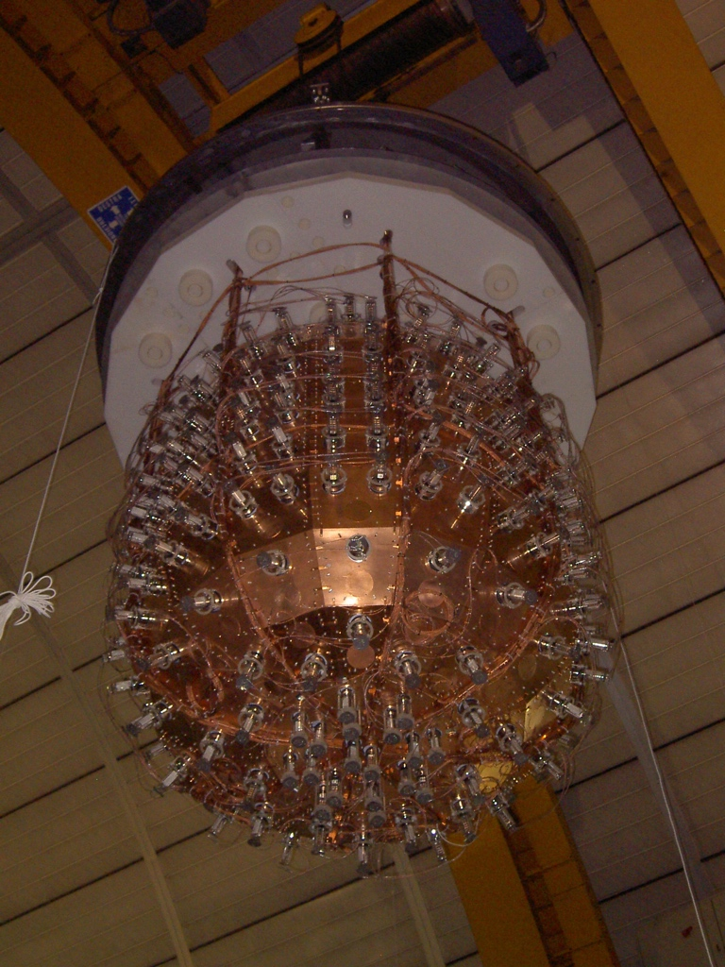
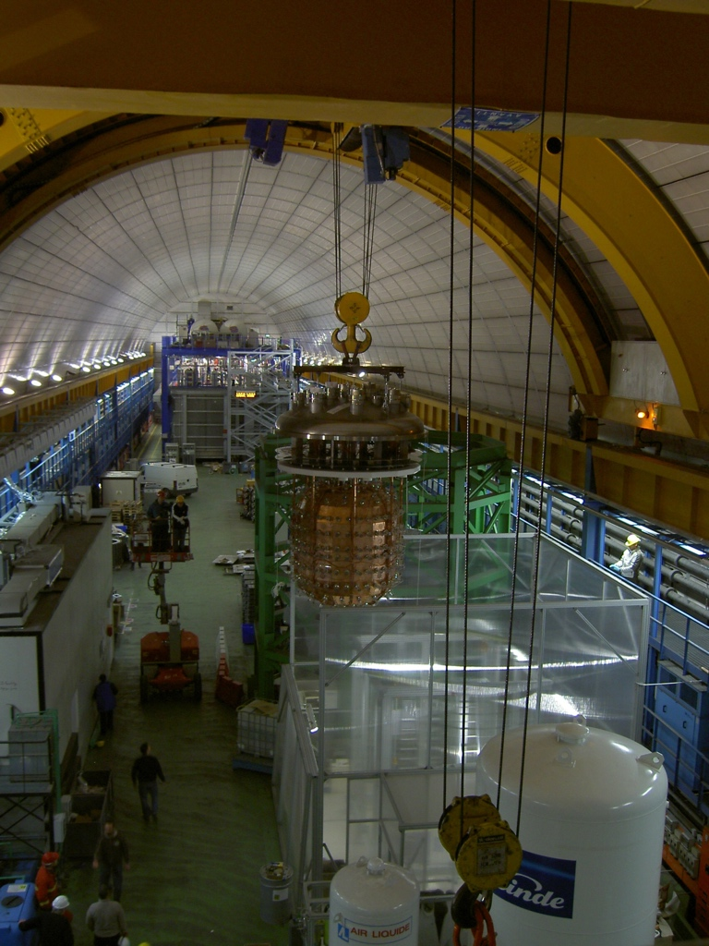

Slide 44
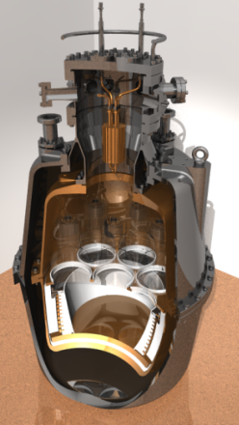
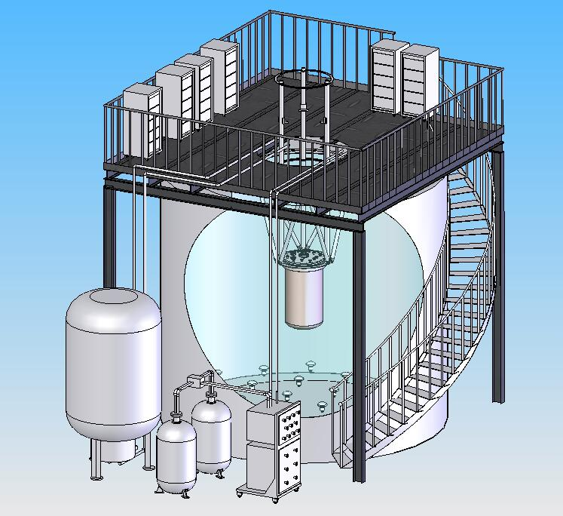
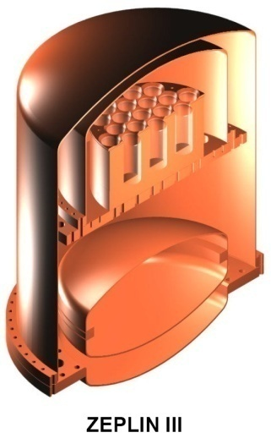
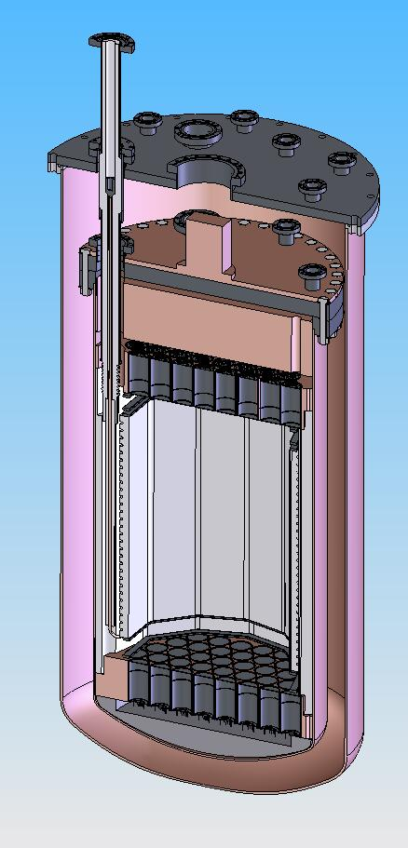
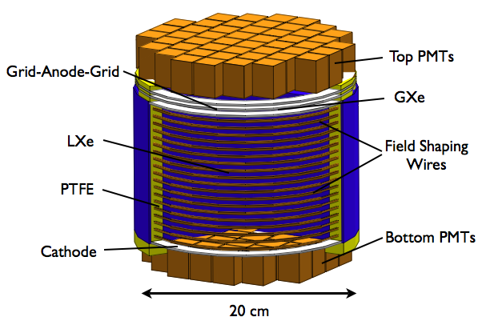
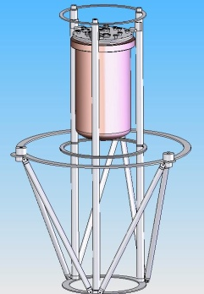
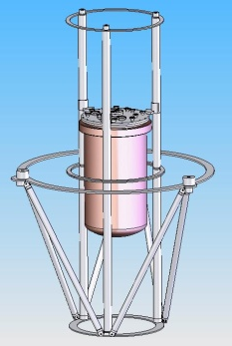
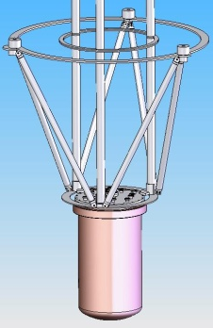
The LUX Detector
30kg
2.5m Water Shield
With Veto.
UCD & LBNL
+ =
ZEPLIN II
8kg
Cathode HV Feed-Through
Full Set up
ZEPLIN III
Dual phase Xe
300kg total
100kg FV
2x60 PMTs
3-D TPC
2kV/cm drift field
5kV/cm extraction
10kV/cm gas gain
10kg
XENON10
8/20/2009
Hanguo Wang, UCLA
Detector installation and operation structure
44
Notes:
44

Slide 45
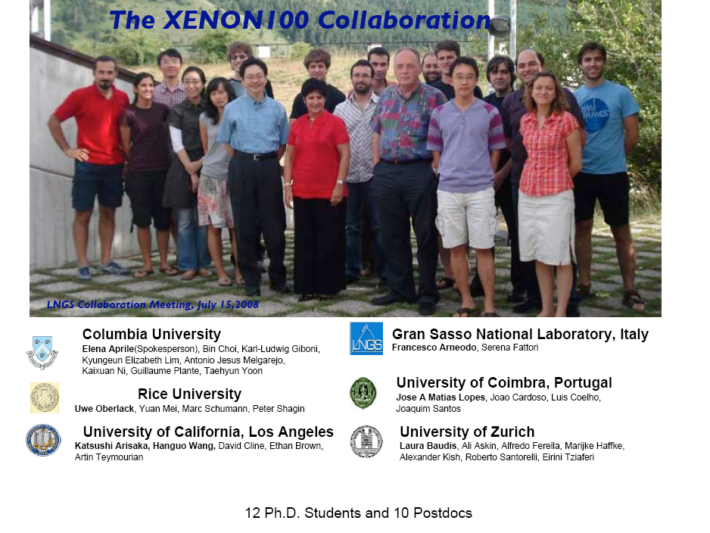
University of Muenster (Germany) Prof. Weinheimer University of Nantes and Subatech Laboratory (France), Dr. Thers, and the Waseda University (Japan), Prof. Hasebe
8/20/2009
Hanguo Wang, UCLA
45

Slide 46
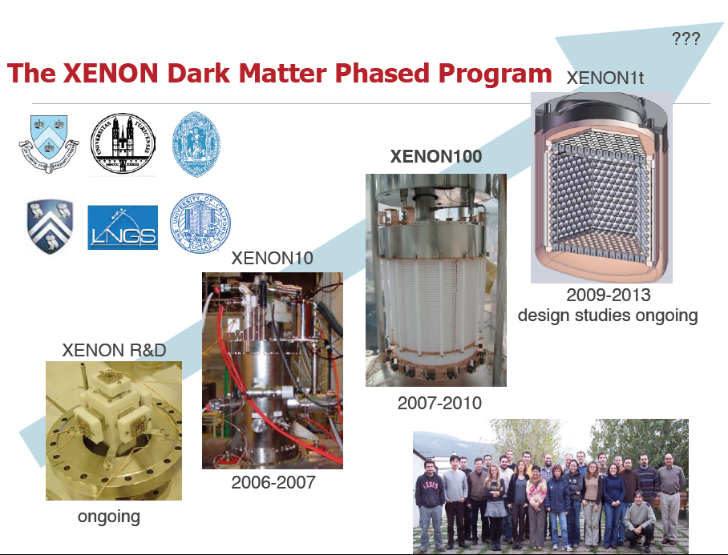
8/20/2009
Hanguo Wang, UCLA
46

Slide 47
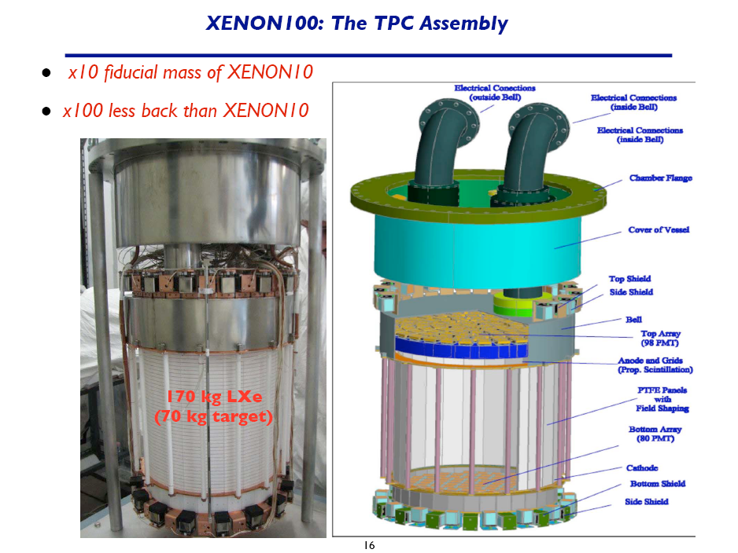

Slide 48
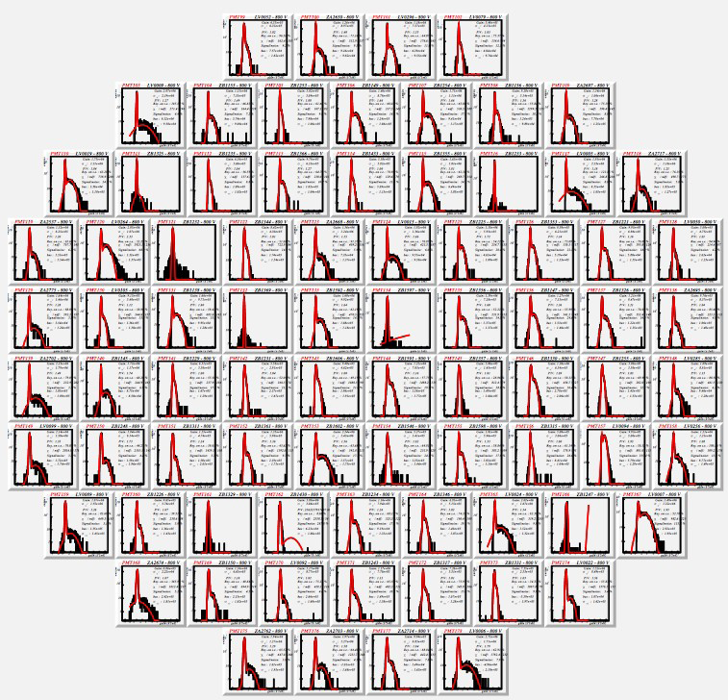
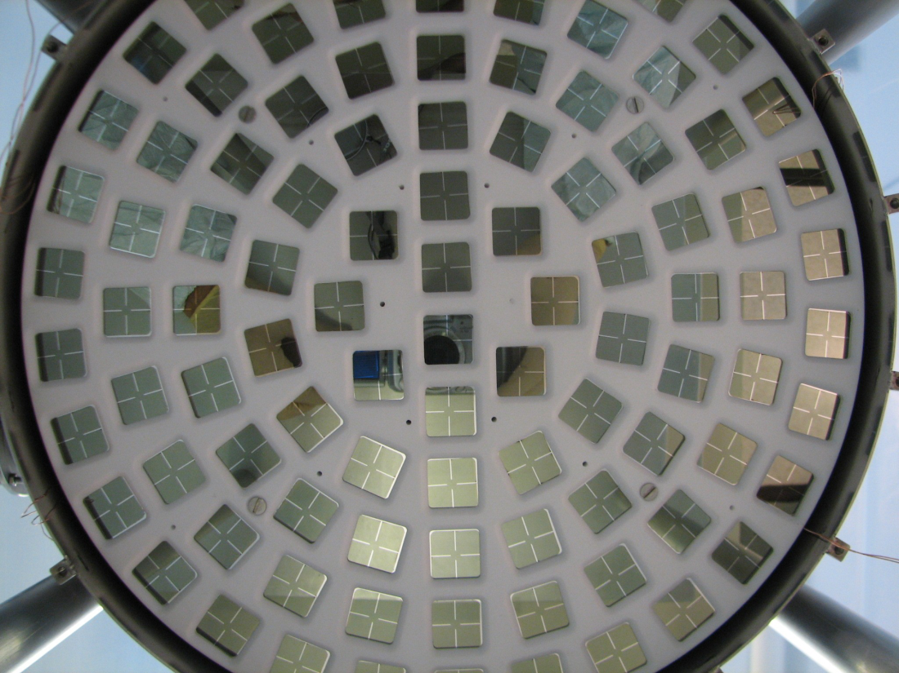
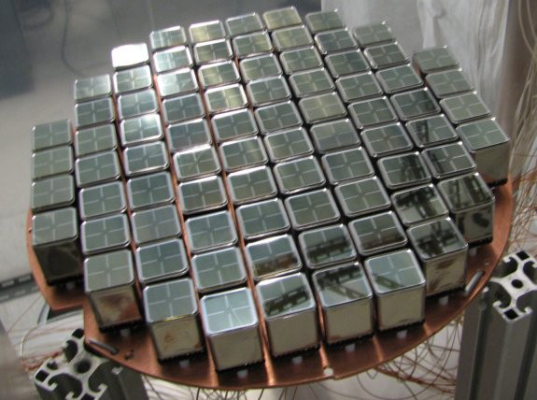
XENON100 PMTs
• Photomultipliers: 1” square Hamamatsu R8520
• 98 on top - 80 on bottom - 64 in active LXe shield
• QE~23% for top array; QE~33% for bottom array
• Use XENON10 PMTs for LXe shield
• Calibrated with external LED's & quartz fibers
• S1 source calibrations with gamma sources

Slide 49
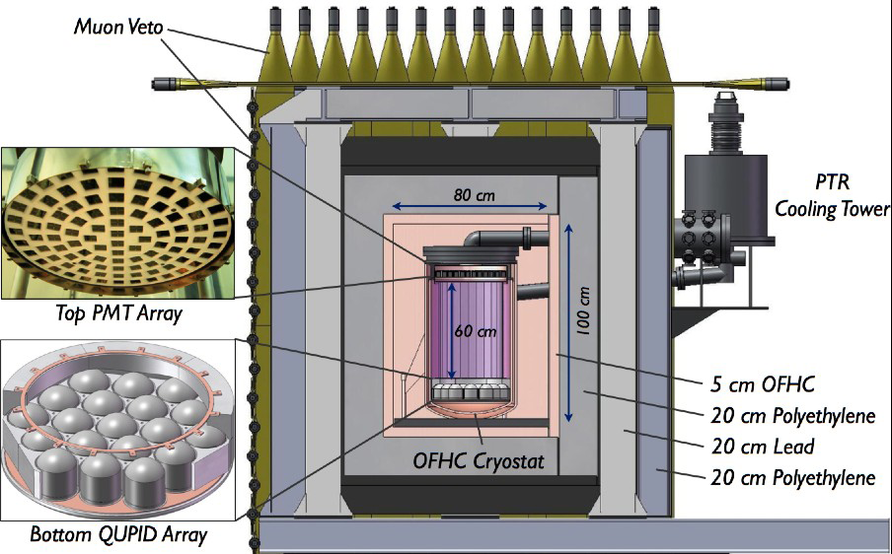
Approved Upgrade for XENON100 (2010-2012)
Test technologies for the ton-scale:
• Low-activity photosensor QUPID
• Double drift length (60 cm)
• Double target mass
• Tenfold lower background in FV
• New shield
• Muon veto
• Sensitivity goal
σ ~ 2 × 10-46 cm2

Slide 50
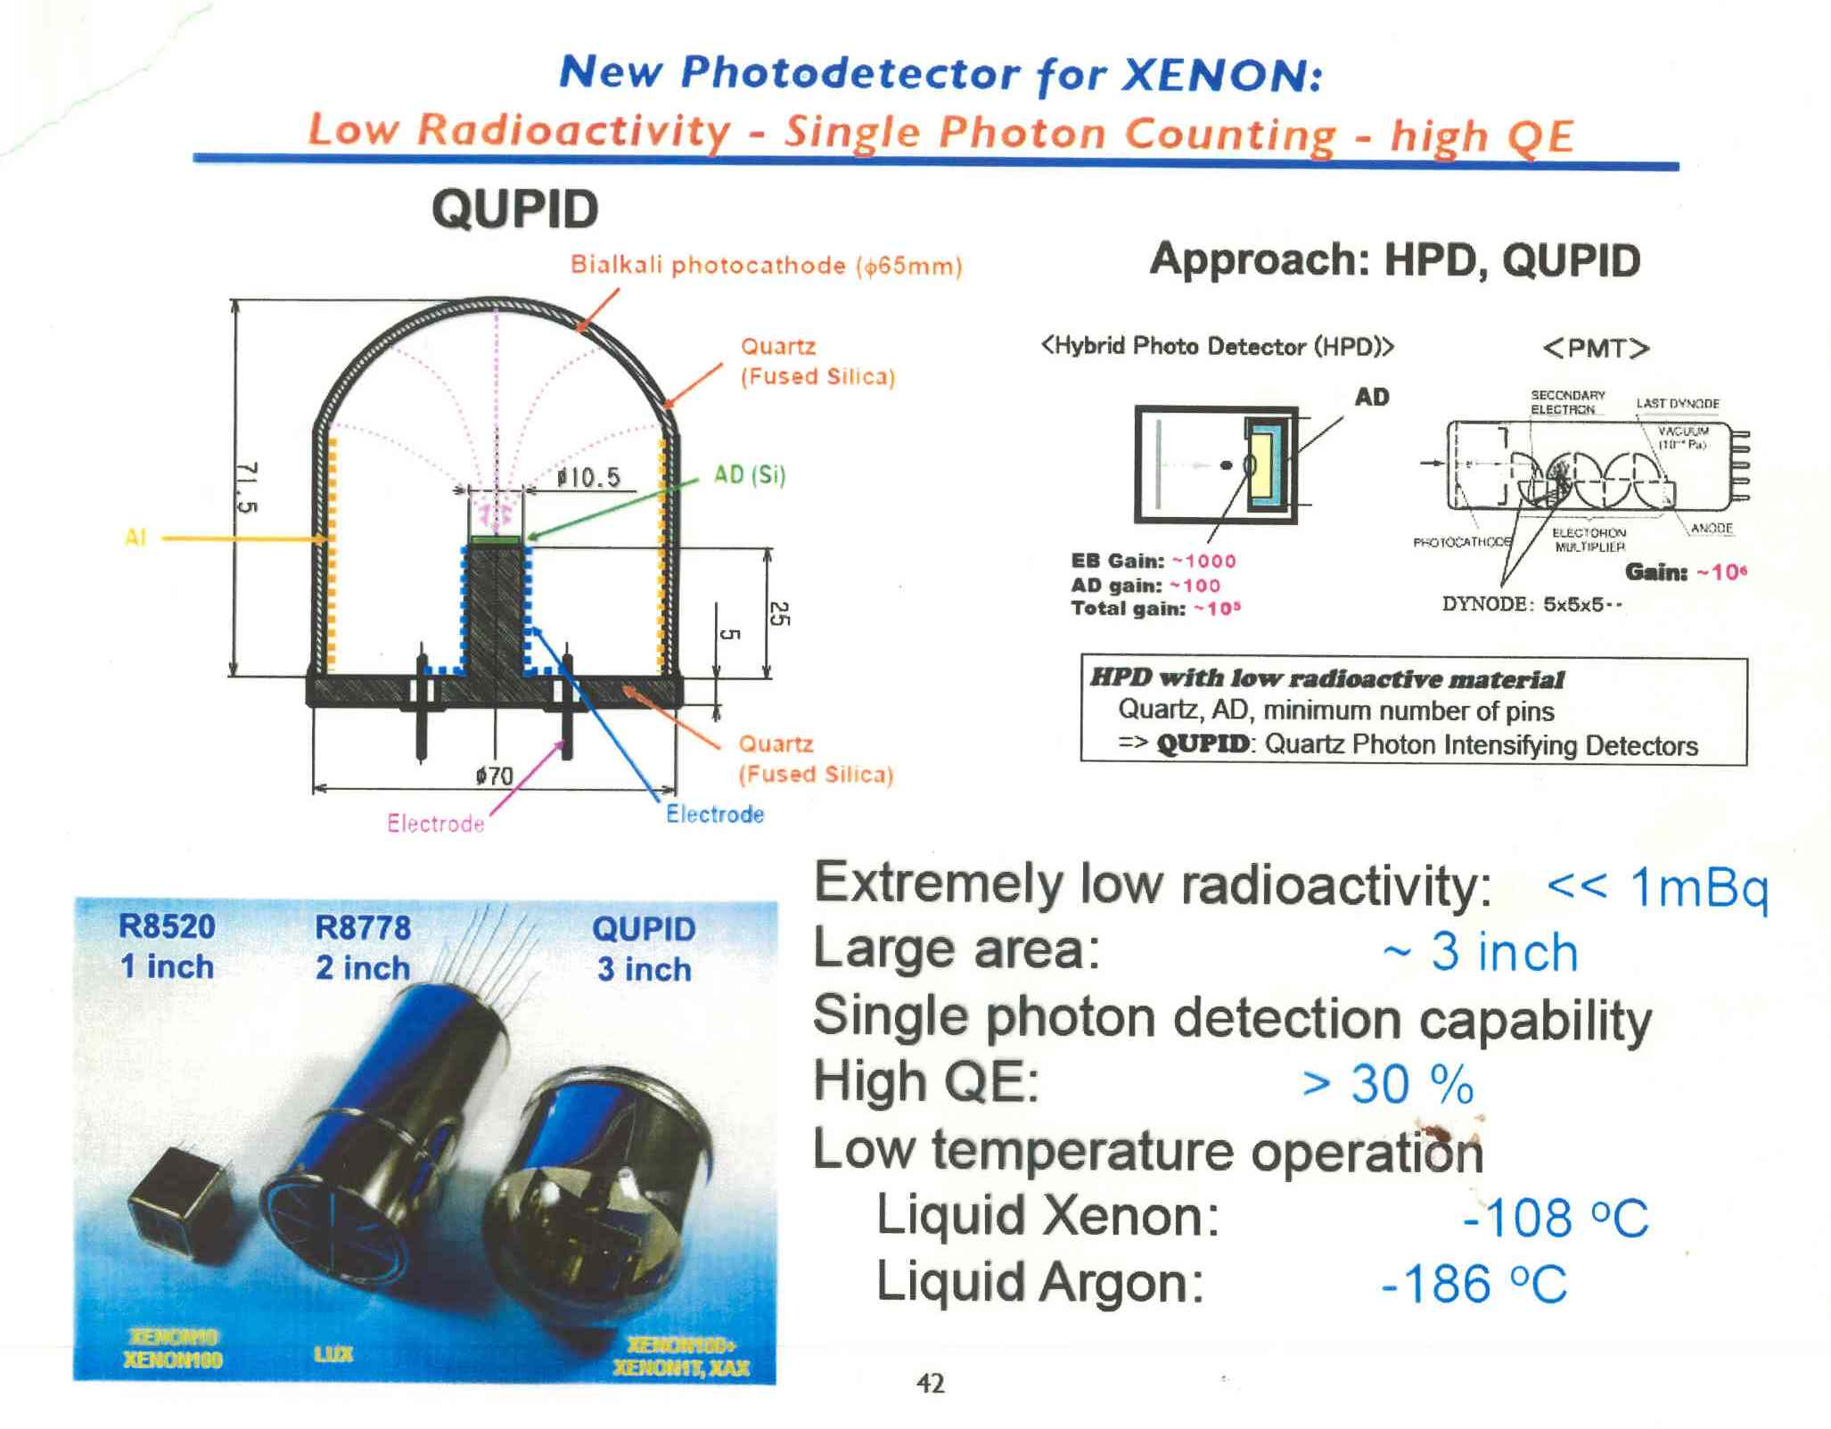

Slide 51
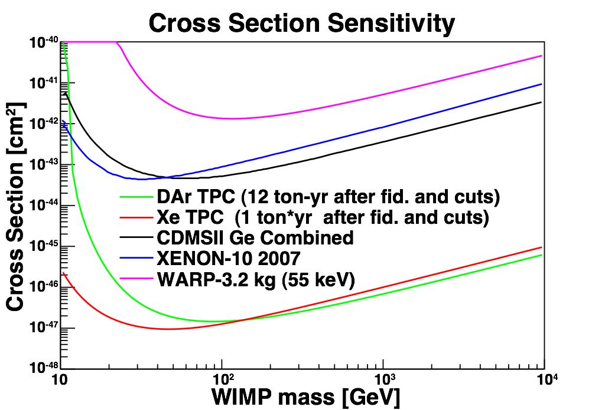

Slide 52
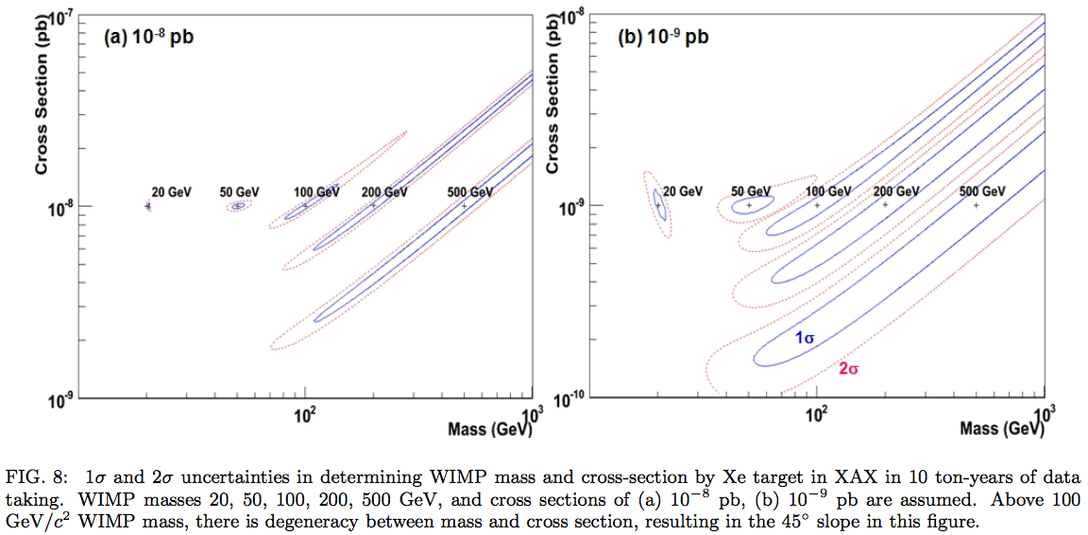
Mass Measurement

Slide 53
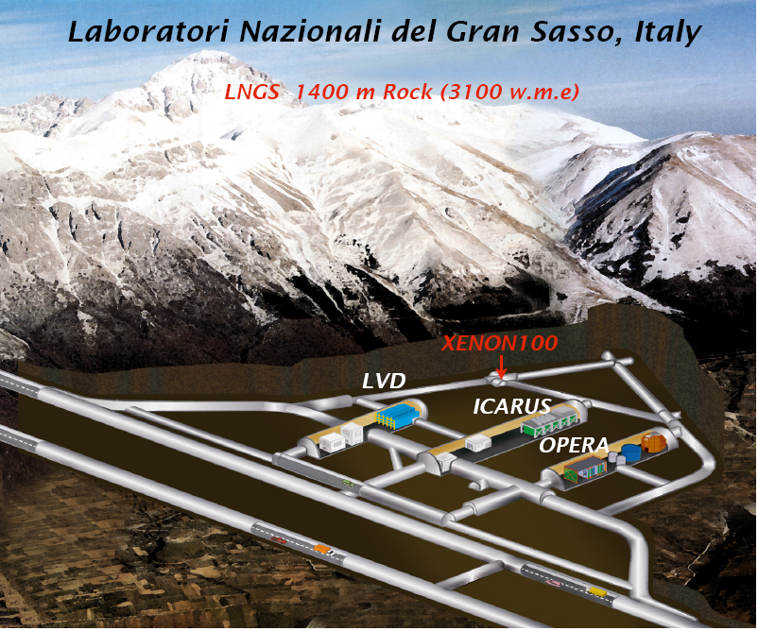
8/20/2009
Hanguo Wang, UCLA
53

Slide 54
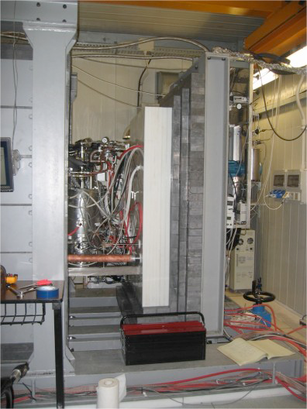
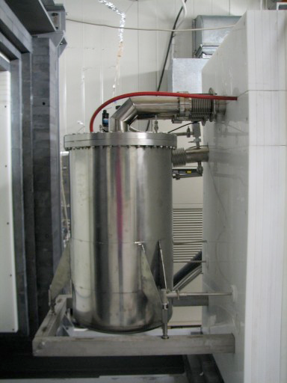
XENON100 Installed underground @ LNGS
Shield modification/improvement completed Jan 08; Detector moved underground Feb 08
• about 25-kg of LXe has been filled; science data expected summer 08
• Sensitivity reach 10⁻⁴⁵ cm2; ~10 signal events if cross section at 10⁻⁴⁴ cm2 in two months
XENON10 (2006-2007)
XENON100 (Feb.2008)
8/20/2009
Hanguo Wang, UCLA
54

Slide 55
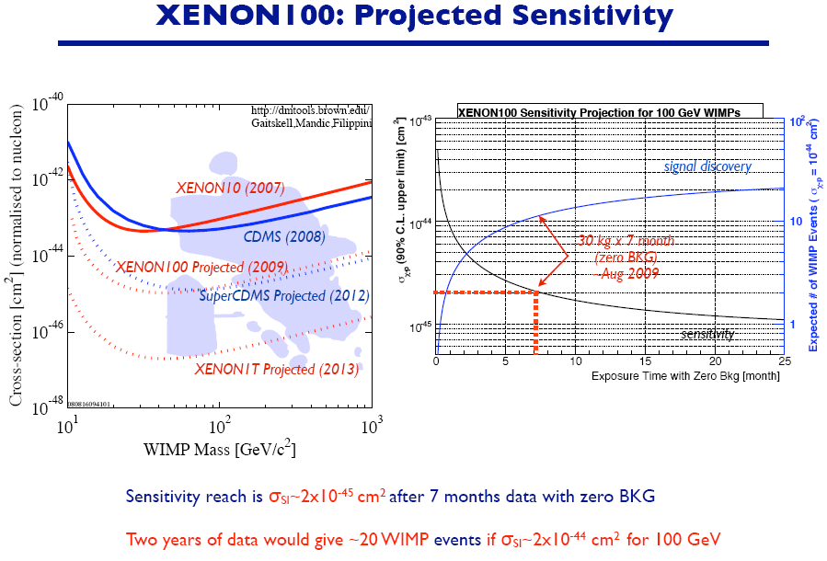
8/20/2009
Hanguo Wang, UCLA
55

Slide 56
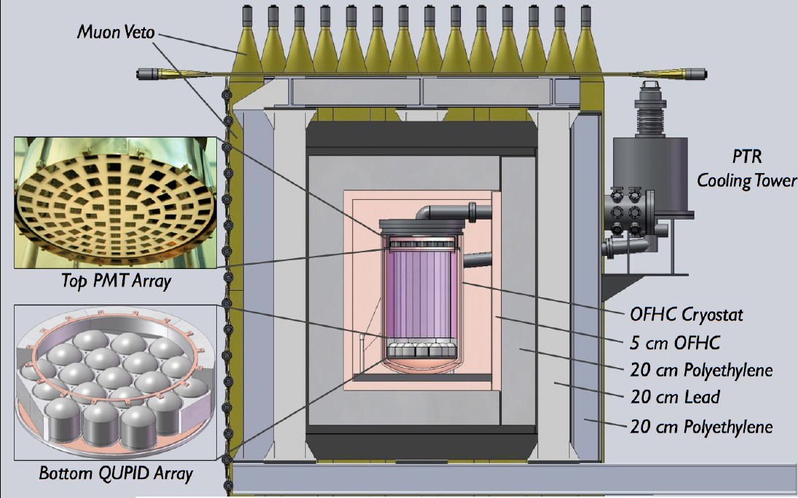
Proposed XENON100 Upgrade
8/20/2009
Hanguo Wang, UCLA
56

Slide 57



XENON1T - the ultimate (?) dark matter detector
Possible new design with full coverage of a new photodetector (QUPID)
New shielding at LNGS, Italy
Will test QUPID in XENON100+
Propose tone scale after XENON100+ test
Explore the full region in CMSSM space (or accumulate WIMP stats)
1 m
First Sample QUPID Patent Pending
8/20/2009
Hanguo Wang, UCLA
57

Slide 58




















MAX - Multi-ton Argon & Xenon (NSF S-4)
MIT,
University of Münster,
University of Notre Dame,
Princeton University,
Rice University,
Temple University,
UCLA,
Univesity of Virginia,
Waseda University,
University of Zürich
UMass Amherst,
Arizona State University,
Augustana College,
Black Hills State University,
Coimbra University,
Columbia University,
Fermilab,
University of Houston,
INAF,
LNGS,

Slide 59
The Physics of MAX
Discovery potential
Confirmation of A2 dependence of cross section
Measurement of the mass of the WIMP by comparison of recoil spectra in different targets
Indication on spin-dependent or spin-independent nature of interactions

Slide 60
Super-XENON
Detector Concepts

Slide 61


Slide 62
Concept of Super-XENON
0 V
Gas Xe
-10 kV
Anode Wire
-17.5 kV
Electron
Trajectories
Double-Layer
Field Shaping Wires
(XENON100 - like)
2 m
-10 kV
5 cm
Radiation-free
Photon Detectors
(QUPID)
+Pt Coating
175 nm
20 cm
Liquid Xe (19 ton)
Fiducial Volume (10 ton)
-200 kV
-10 kV
Cathode Wires
2 m
8/20/2009
Katsushi Arisaka, UCLA
62

Slide 63

90% CL Sensitivity to the Cross Section
(one year, background free)
5-30 keVr
40-130 keVr
XENON10
Ar(1 ton)
Xe(100 kg)
Xe(1 ton)
Ar(10 ton)
Xe(10 ton)
Ar(100 ton)
8/20/2009
Katsushi Arisaka, UCLA
Notes:
63

Slide 64

Prospects for the near future detection of Dark Matter

Slide 65


Slide 66


