Slide 1
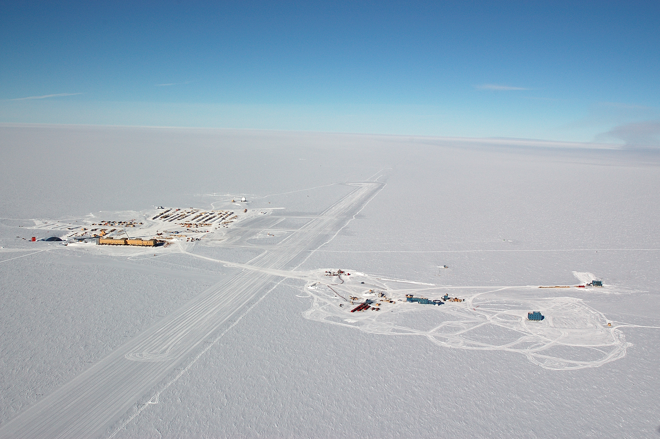
High-energy neutrino astronomy with IceCube
Ignacio Taboada Georgia Institute of Technology for the IceCube collaboration Madison, NDM 2009

Slide 2
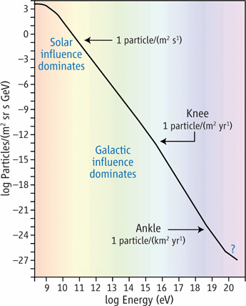
The origin of cosmic rays
Candidate CR sources:
Accelerators
SN remnants
Active Galactic Nuclei
Gamma Ray Bursts
Other
Dark Matter
Exotics
Cosmic ray spectrum

Slide 3
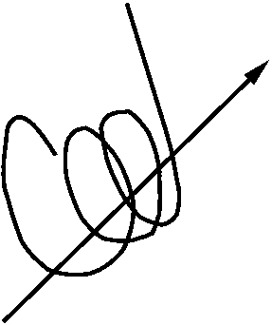
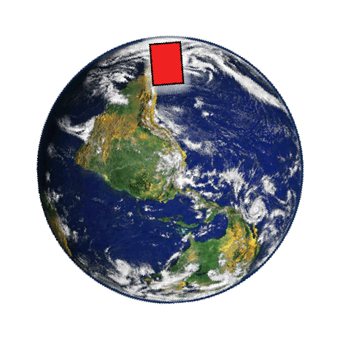
Neutrinos as astronomical messengers
Cosmic accelerator
C.R.
Photon
10²¹
CMB star-light
Neutrinos
10¹⁸
B
10¹⁵
Neutrino
Energy (eV)
Photons
Cosmic ray
10¹²
10⁹

Slide 4
High-energy neutrino detection
Cosmic
Ray
Astrophysical neutrino
Earth
Atmospheric Neutrino
Atmospheric
muon
Cosmic
Ray
Build a BIG detector (~1 km³ of water)
Build underground
Look for up-going events

Slide 5
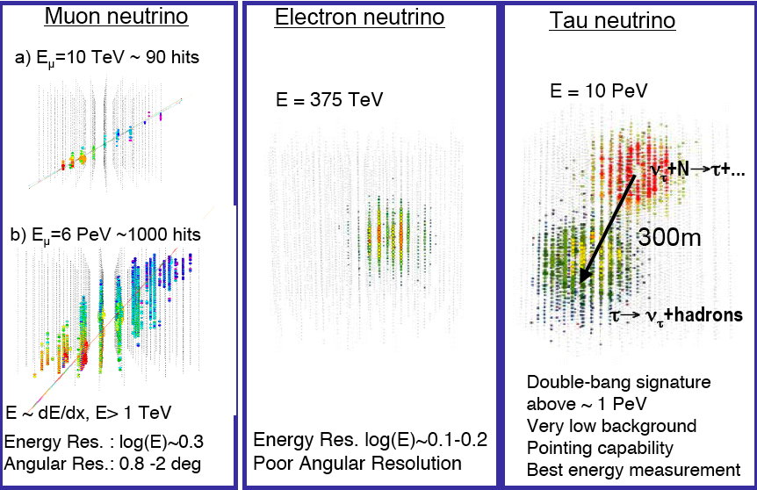
Event Topologies Topologies

Slide 6
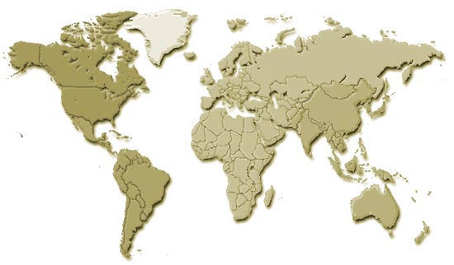
The IceCube collaboration
Germany:
DESY-Zeuthen
Universität Bonn
Universität Mainz
Universität Dortmund
Universität Wuppertal
Humboldt Universität
MPI Heidelberg
RWTH Aachen
Ruhr-Universität Bochum
Sweden:
Uppsala Universitet
Stockholm Universitet
USA:
Bartol Research Institute, Delaware
University of California, Berkeley
University of California, Irvine
Pennsylvania State University
Clark-Atlanta University
Ohio State University
Georgia Institute of Technology
University of Maryland
University of Alabama, Tuscaloosa
University of Wisconsin-Madison
University of Wisconsin-River Falls
Lawrence Berkeley National Lab.
University of Kansas
Southern University and A&M
College, Baton Rouge
University of Alaska, Anchorage
UK:
Oxford University
Netherlands:
Utrecht University
Switzerland:
EPFL
Belgium:
Université Libre de Bruxelles
Vrije Universiteit Brussel
Universiteit Gent
Université de Mons-Hainaut
Japan:
Chiba University
New Zealand:
University of Canterbury
34 institutions, approx. 250 members
http://icecube.wisc.edu
Notes:
PAS CITER TOUS LES PAYS MAUS JUSTE UW HALZEN

Slide 7
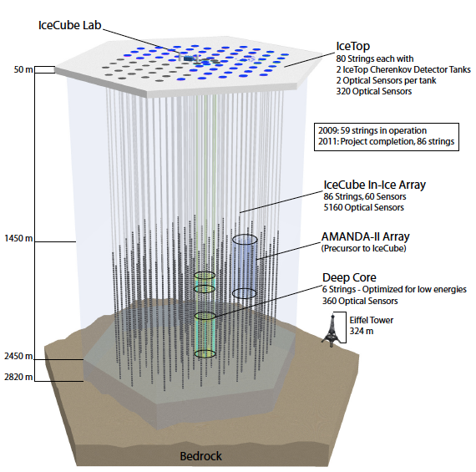
IceCube Status
IceTop 118 / 160 Tanks 2 DOMs per tank
Completion: January 2011
Detector takes data during construction
IceCube “In-Ice” 59 / 86 Strings 60 DOMs per string
AMANDA
Deep Core
Eiffel Tower 324 m

Slide 8
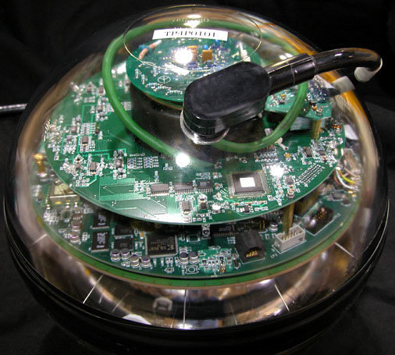
IceCube performance
Low noise rates: ~300Hz (SPE/sec)
Rate with correlated pulses ~500Hz
Supernova detection
High duty cycle: >96%
Event rates (59 strings)
Muons: ~1.5 kHz
Neutrinos: ~160/day
Strings | Year | Livetime | μ rate | ν rate
IC9 | 2006 | 137 days | 80 Hz | 1.7 / day
IC22 | 2007 | 275 days | 550 Hz | 28 / day
IC40 | 2008 | ~365 days | 1000 Hz | 110 / day
IC59 | 2009 | ~365 days | 1500 Hz | 160 / day
IC86* | 2011 | ~365 days | 1650 Hz | 220 / day

Slide 9
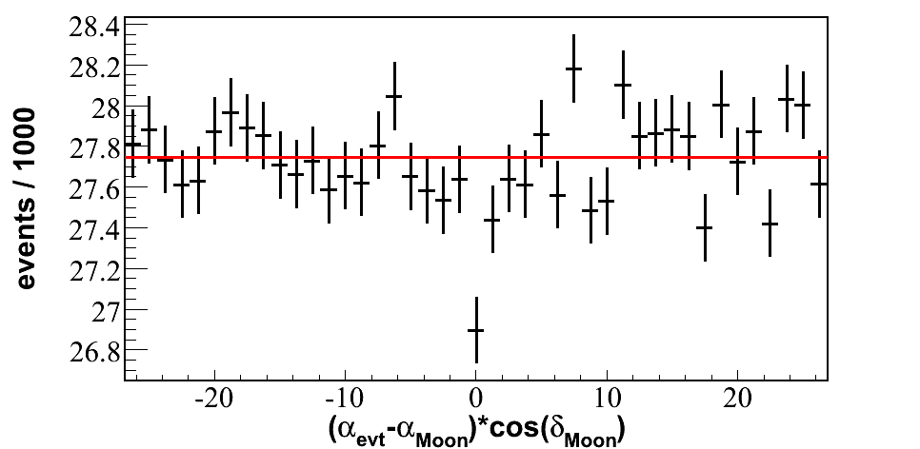
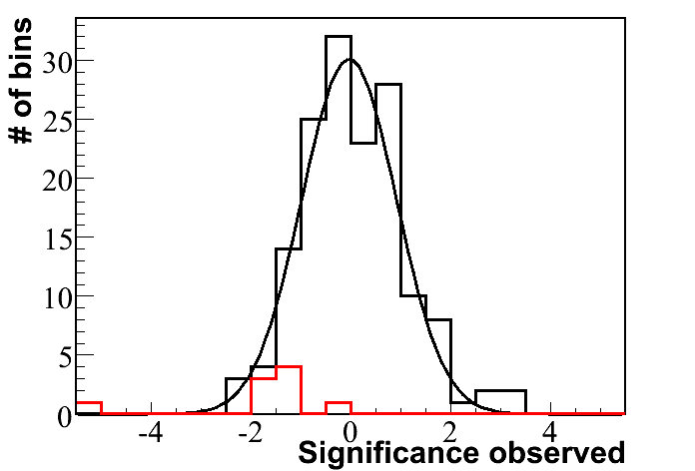
Observation of the Moon shadow (with 5 months of IC40)
Moon max. altitude at the South Pole (2008): 28°
Median primary cosmic ray energy: 30TeV
Deficit: 5 σ (~900 events of ~28000) - consistent with expectation.
Verification of angular resolution and absolute pointing.
More statistics will allow study of angular response function
Preliminary

Slide 10
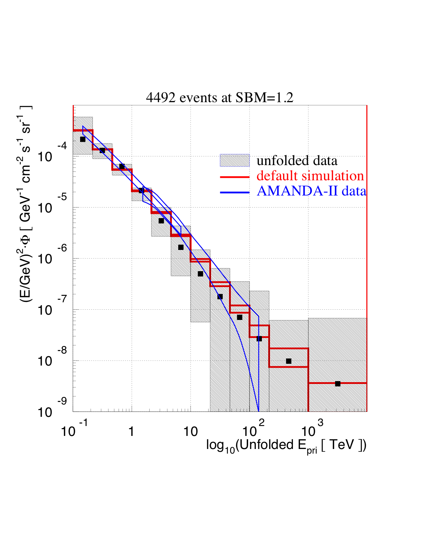
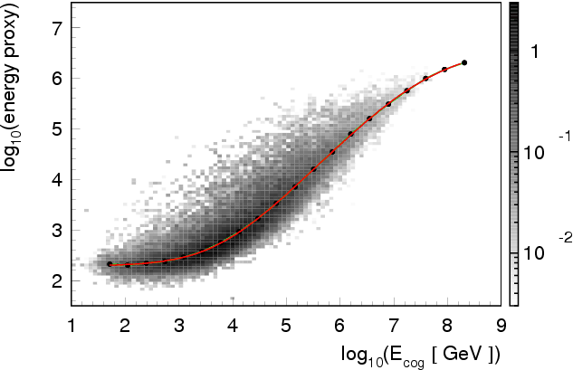
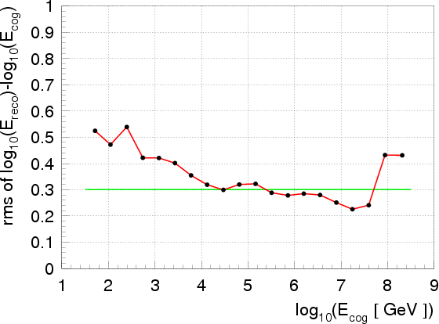
Atmospheric muon neutrinos
Muon energy resolution: ~0.3 in log(E)
Still working to reduce systematic uncertainties of energy/depth dependence
IC-22 string analysis
4492 neutrino events at high purity (>95%)
Preliminary

Slide 11
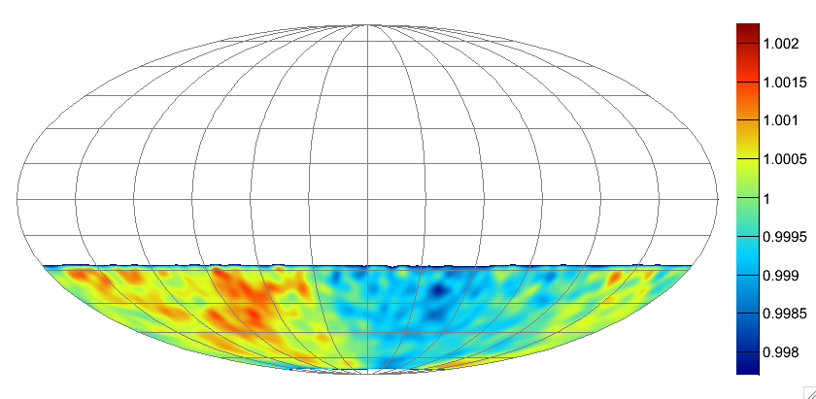
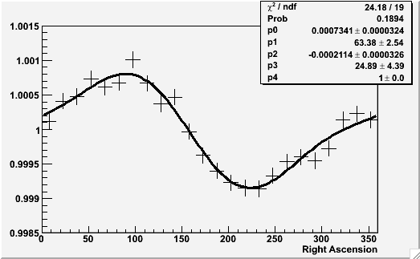
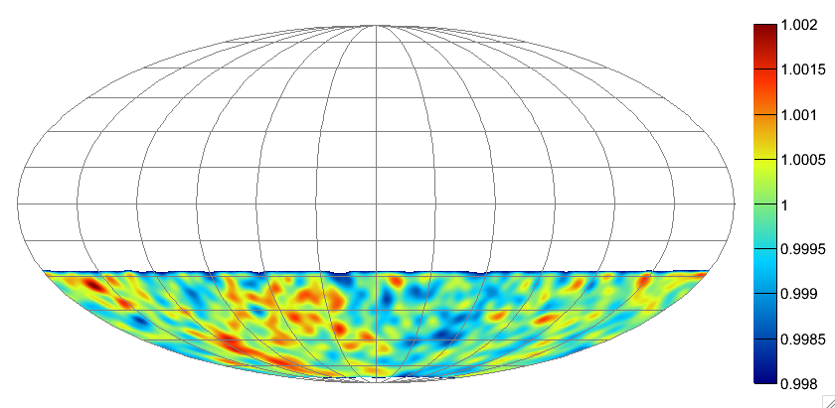
Cosmic ray large scale anisotropy
90
12 TeV
0
24h
Preliminary
Data: IC22 4.3*10⁹ events
Median angular resolution: 3º
Median primary cosmic ray energy: 12 TeV.
-90
90
126 TeV
0
24h
Preliminary
-90

Slide 12
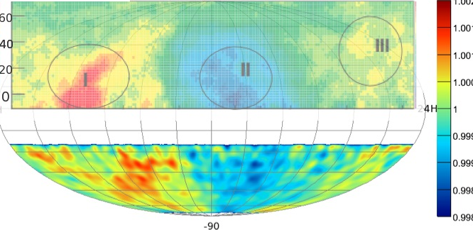
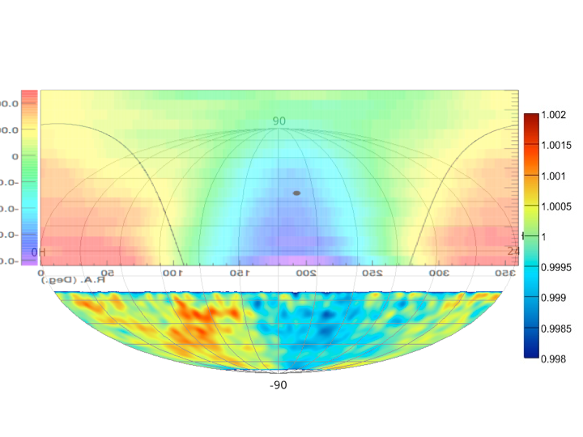
Comparison with Tibet and Milagro
M. Amenomori et. al Science, vol. 314, pp. 439–443, Oct. 2006
IceCube &Tibet Array
A. Abdoet. al. ArXiv:astro-ph/0806.2293, 2008.
IceCube & Milagro
IceCube skymap is consistent with northern hemisphere observations

Slide 13
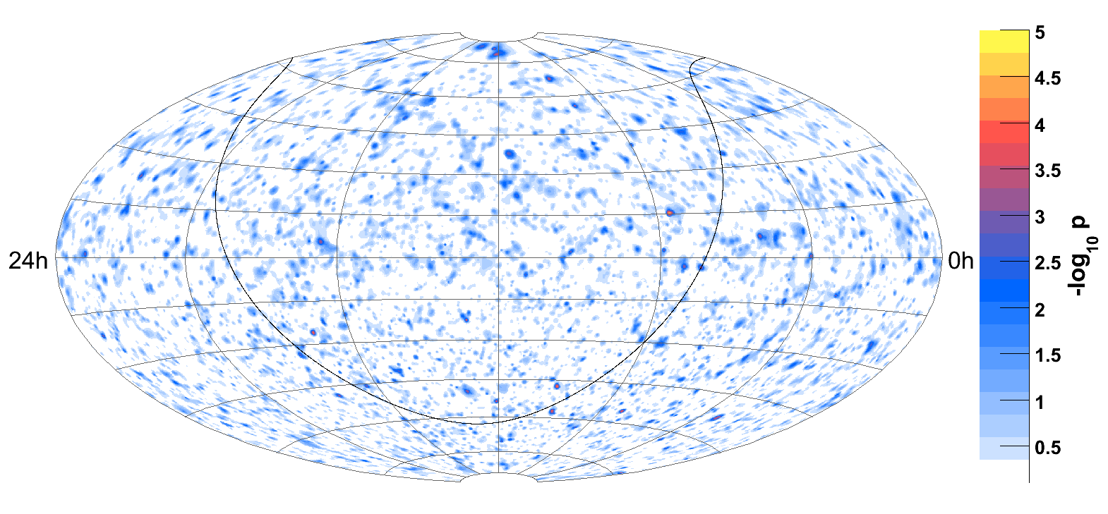
Search for point sources - 40-string(6month) all-sky results
Preliminary
175.5 days livetime,
17777 events:
6796 up-going,
10981 down-going

Slide 14
Search for point sources - 40-string(6month) all-sky results
Preliminary
Northern hemisphere
Background: atmospheric neutrinos
6796 upgoing events
Southern hemisphere
Background: atmospheric muons
Reduced by 10⁻⁵ using energy cut
10981 downgoing (high energy) muon events
175.5 days livetime,
17777 events:
6796 up-going,
10981 down-going

Slide 15
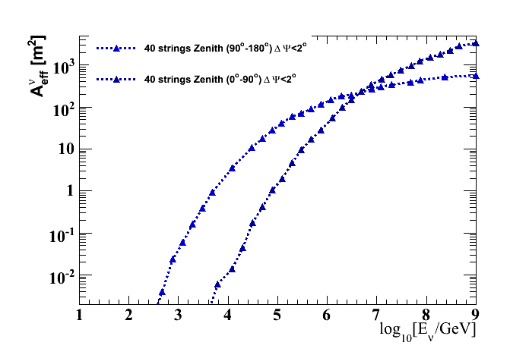
Search for point sources - 40-string(6month) all-sky results
Preliminary
Northern hemisphere
Background: atmospheric neutrinos
6796 upgoing events
Southern hemisphere
Background: atmospheric muons
Reduced by 10⁻⁵ using energy cut
10981 downgoing muon events
175.5 days livetime,
17777 events:
6796 up-going,
10981 down-going
up
down

Slide 16
Search for point sources - 40-string(6month) all-sky results
Preliminary
Hottest location in the all-sky search is:
r.a.=114.95°, dec.=15.35°
Pre-trial -log₁₀(p-value) = 4.43
Best-fit # of source events = 7.1
Best-fit spectral index = 2.1
No excess found!
all-sky p-value is 61%, not significant

Slide 17
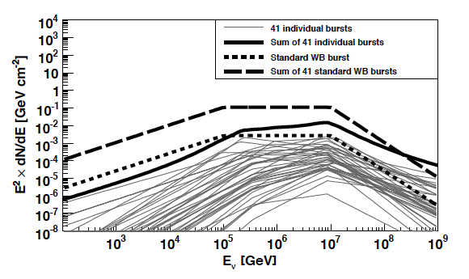
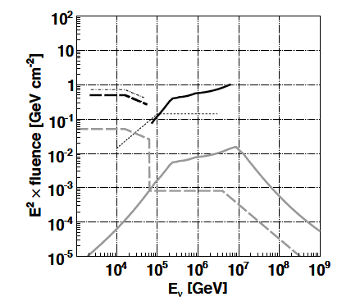
IceCube 22-string: ν_{μ} from GRBs
Individual flux calculation for 41 GRBs in the northern hemisphere (Mostly Swift)
IceCube in coincidence with Fermi/GBM has a 95% of detection potential of Waxman-Bahcall model at 5 σ in one year. Within 5 years, IceCube will extensively sample the allowed parameter space of the Waxman-Bahcall model.
Limits on prompt and precursor neutrino fluence from GRBs
ApJ, in press

Slide 18
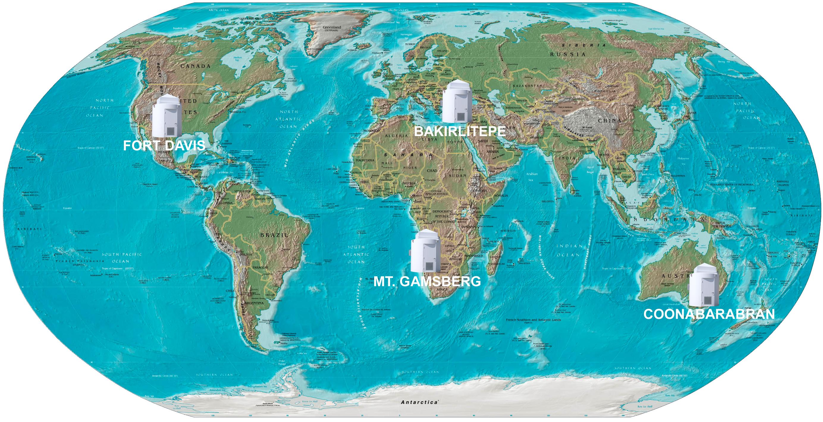
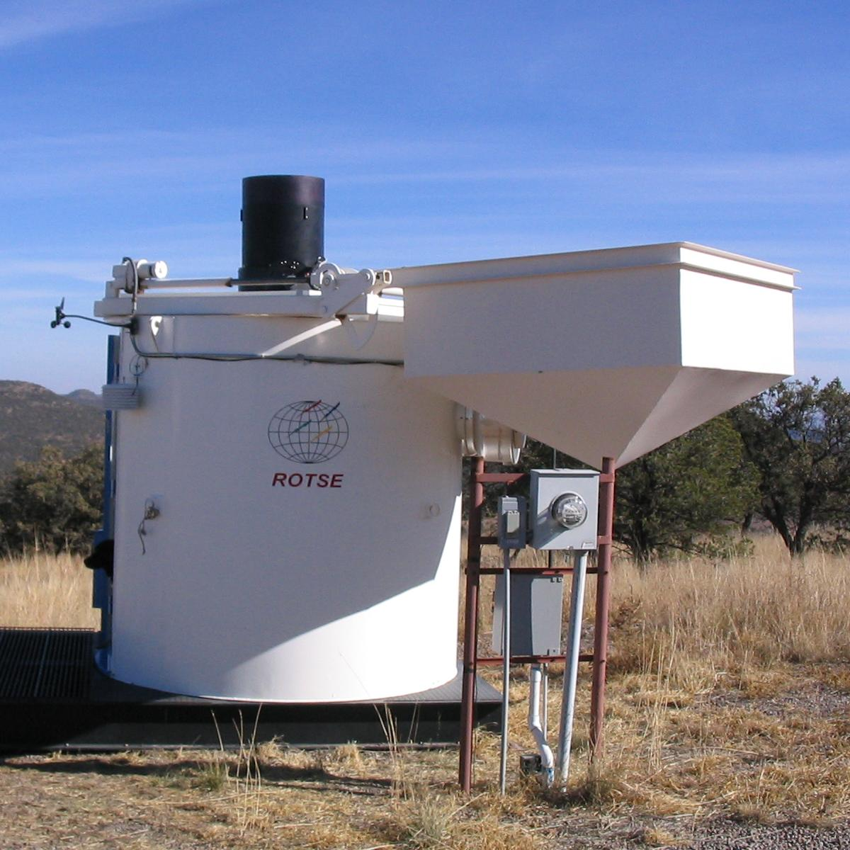
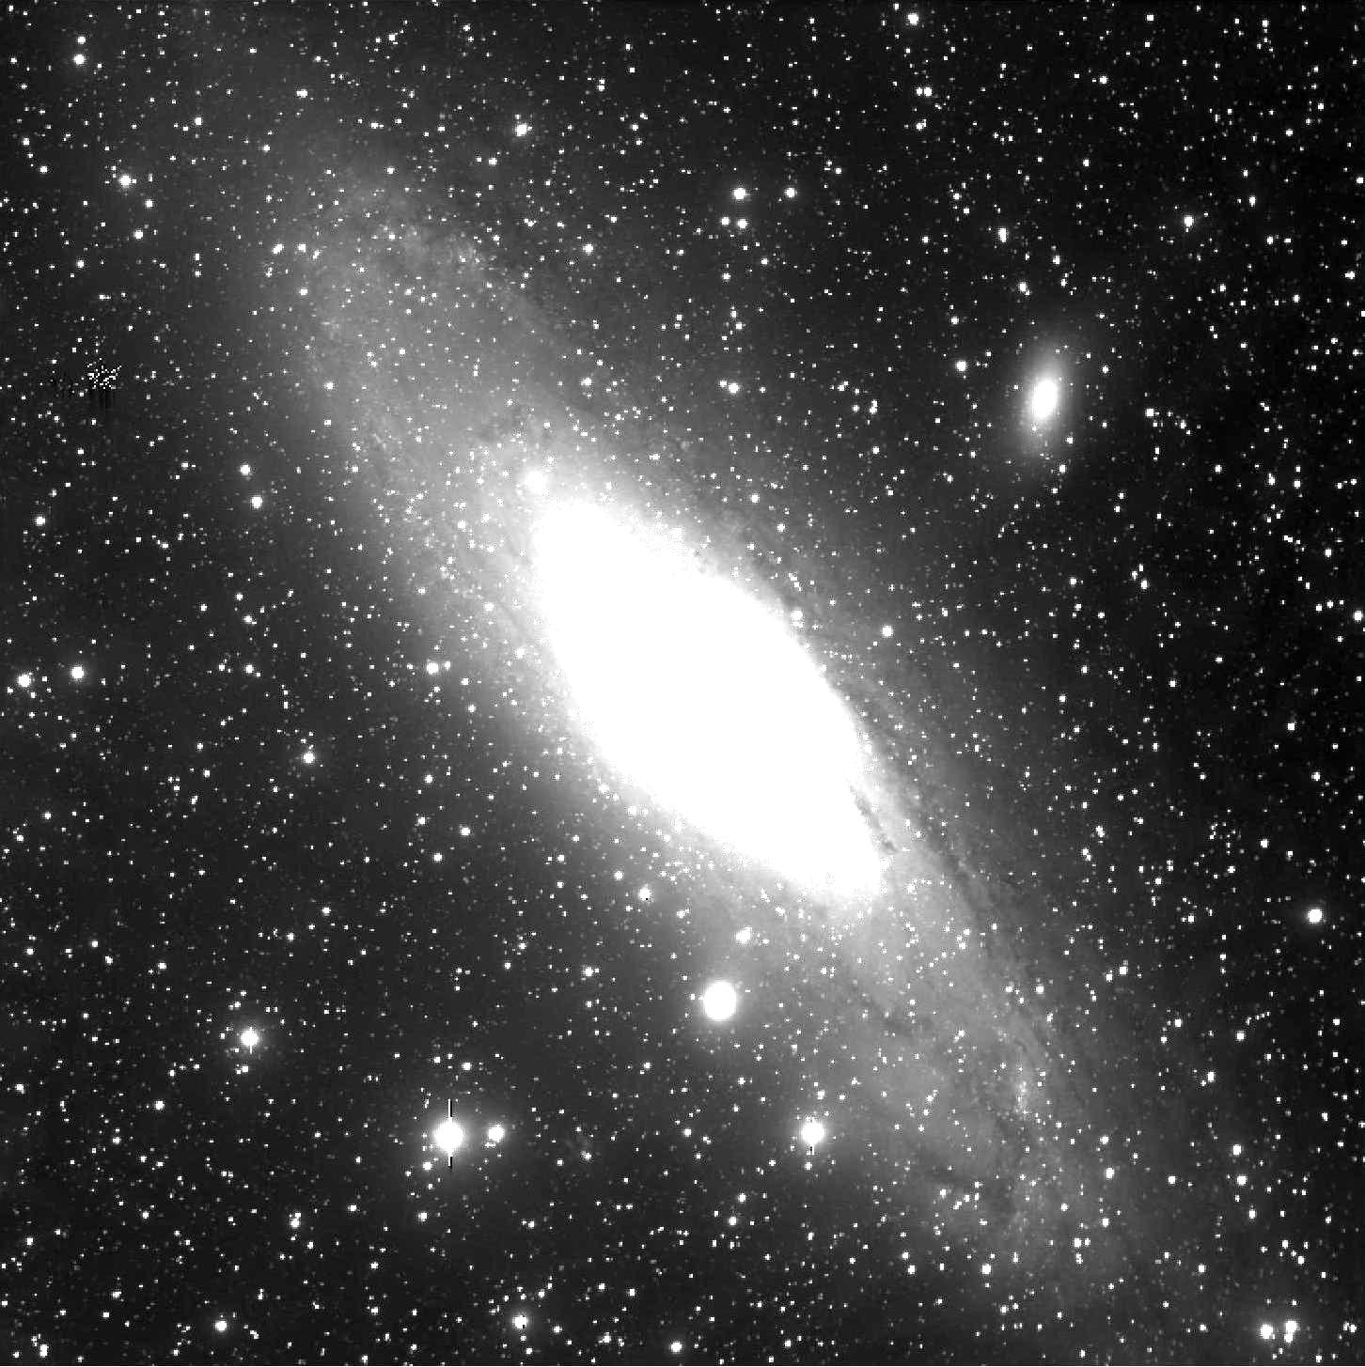
Optical Follow-Up with ROTSE
Iridium satellites
Fast reaction to GRB alerts
SN/GRB
IceCube
Northern hemisphere IceCube CPU
ROTSE III

Slide 19
Conclusions and outlook
IceCube construction is on schedule:
59 of 86 strings in operation
Completion in February 2011
AMANDA has been decommissioned
IceCube meeting or exceeding its design requirements
IceCube already producing scientific results.
Point sources, diffuse, GRBs
Atmospheric neutrinos, cosmic rays
Target of opportunity programs

Slide 20
Overflow

Slide 21
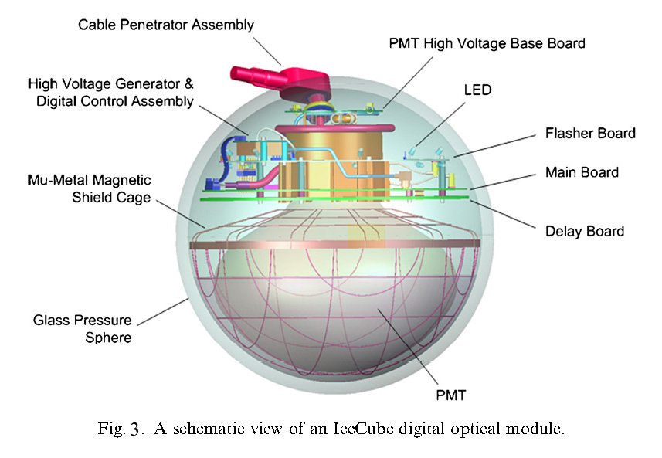
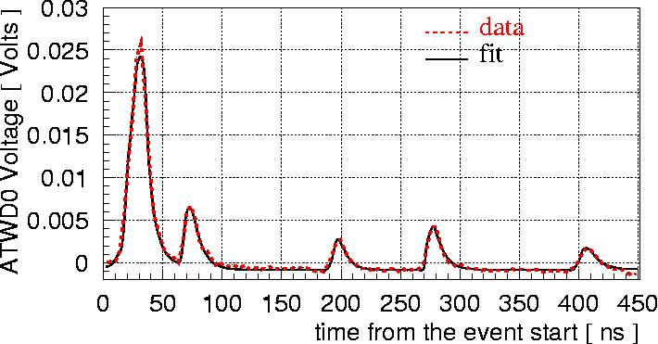
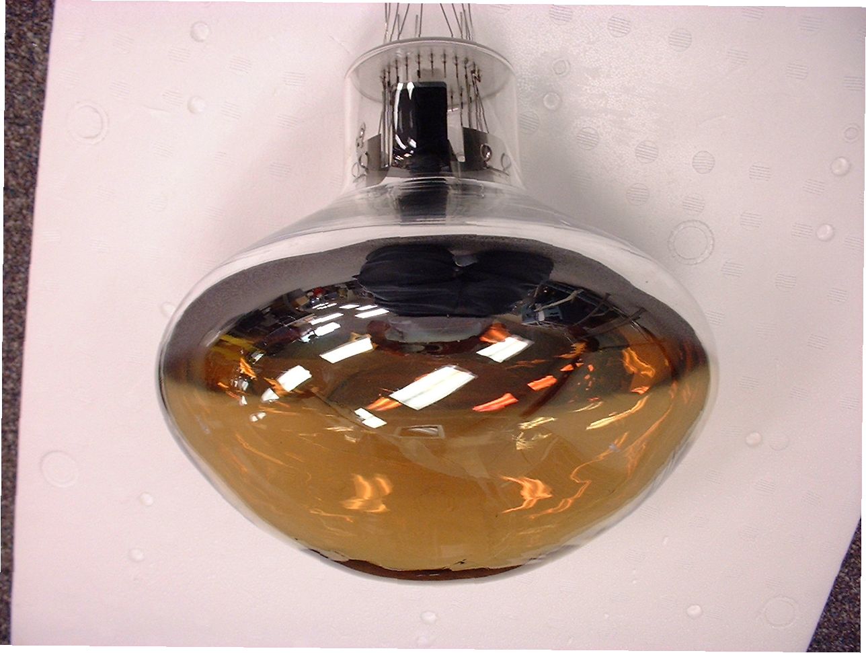
The Digital Optical Module (DOM)
Hamamatsu 10”
Single photo-electrons

