Slide 1
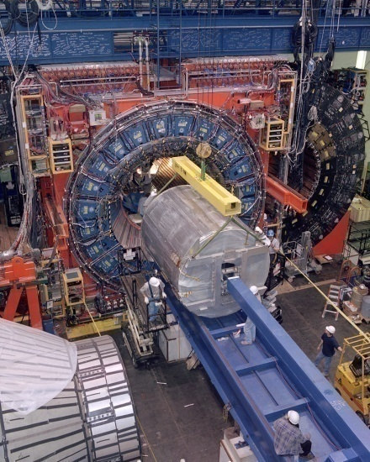
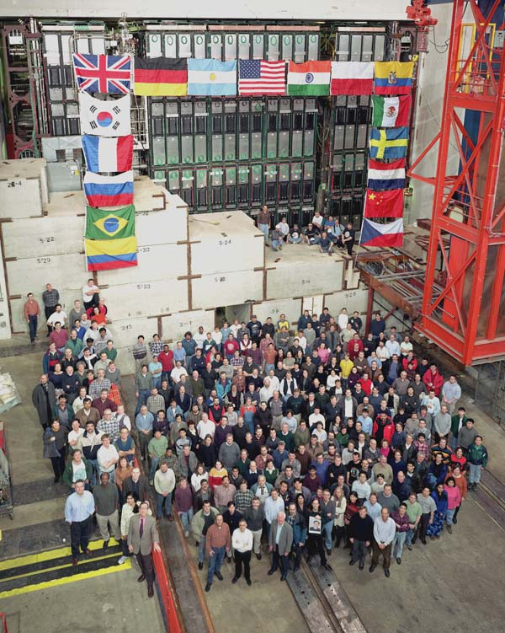
Tevatron Standard Model Physics
QCD
B Physics
Top Physics
ElectroWeak
G. Watts
University of Washington (Seattle)

Slide 2
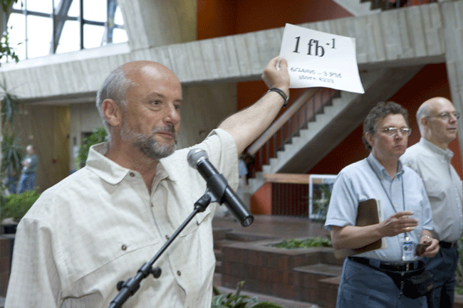
History…
Apr 27, 2001 (6 Years Ago): The lab had a party to celebrate the beginning of Run II
Same day: first 36x36 store in the Tevatron (#449)
Luminosity of ~1x10³⁰
From a stack in the Accumulator of 74x10¹⁰ antiprotons.
May 2005 (1 Years Ago): The lab had a party to celebrate 1 fb⁻¹ delivered to each experiment.
Store #4666
Luminosity of ~1.6x10³²
From a stash in the Recycler of 243x10¹⁰ antiprotons.
Oct 2006 (6 Months Ago): 2 fb⁻¹ delivered. No party??
Now : 2.85 fb⁻¹ delivered. Next party at 10 fb⁻¹?
Store #5376
Luminosity of ~2.7x10³²

Slide 3
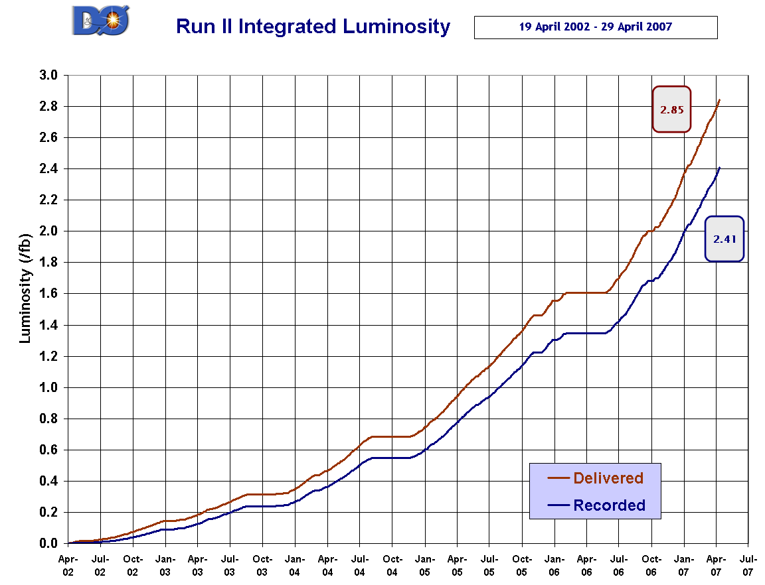
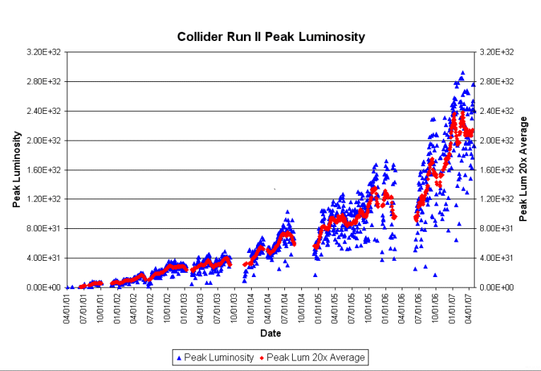
Both Experiments are close to 2.5 fb⁻¹ collected!!
Probably no party at 3 fb⁻¹ delivered either…
Thanks to the Fermi Accelerator Division!
Peak Luminosity

Slide 4
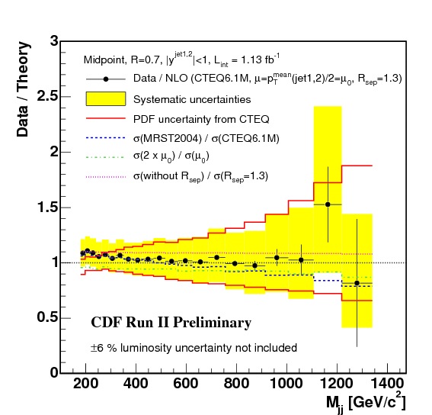
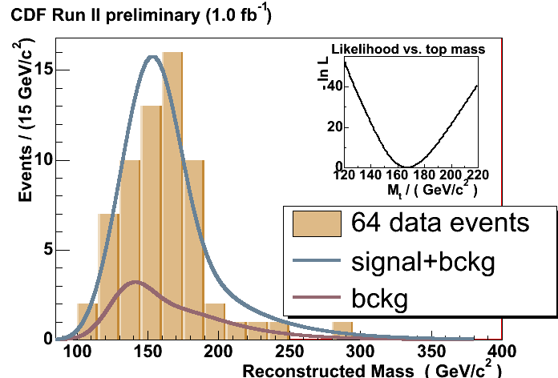
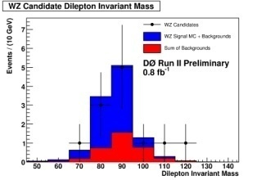
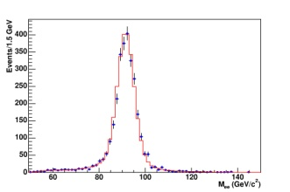
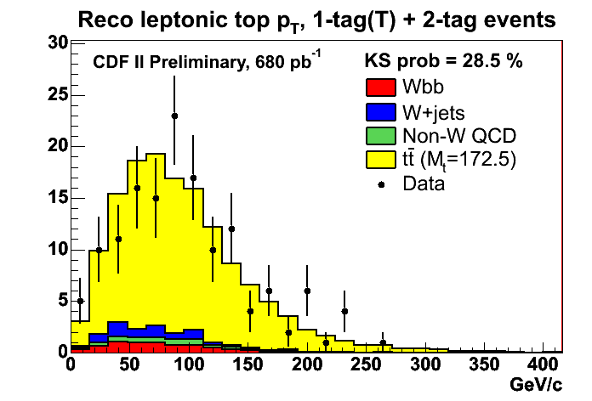
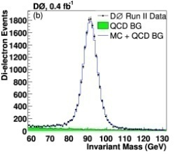
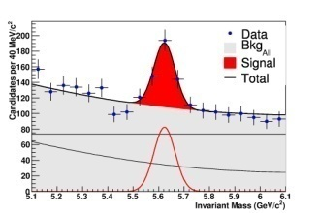
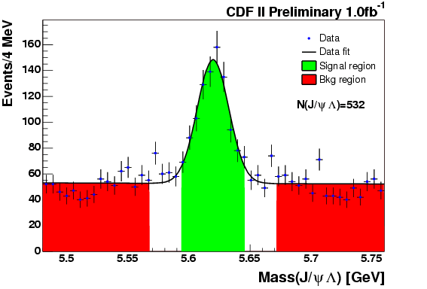
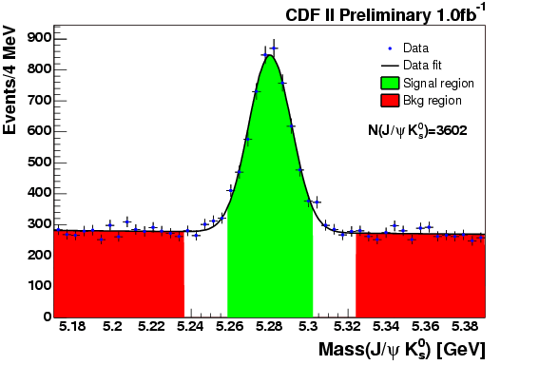
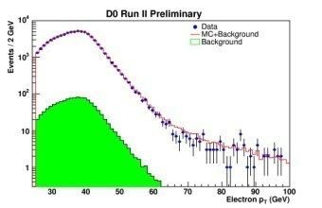
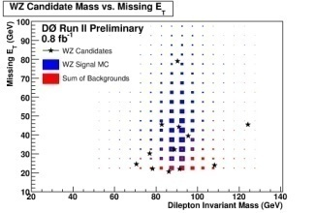
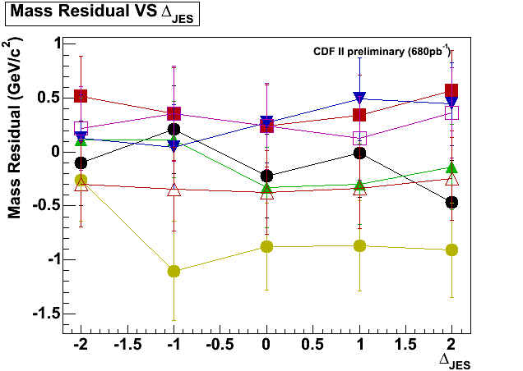
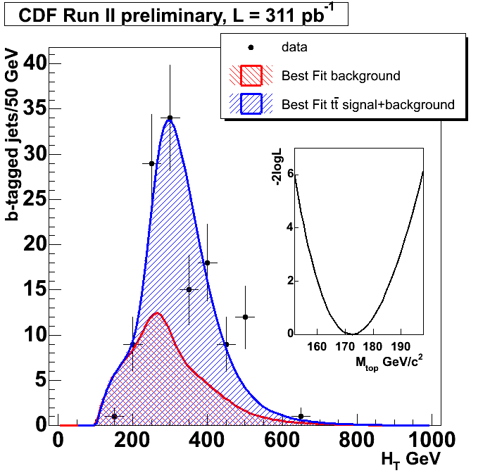
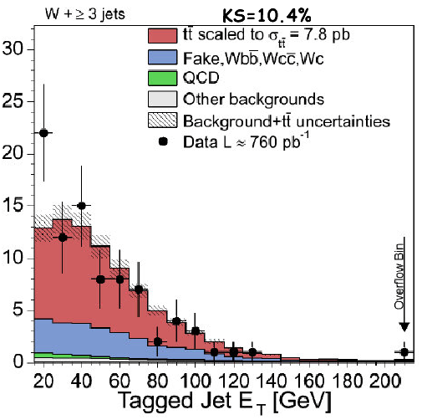
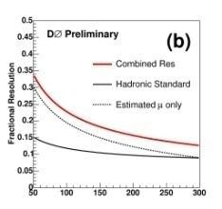
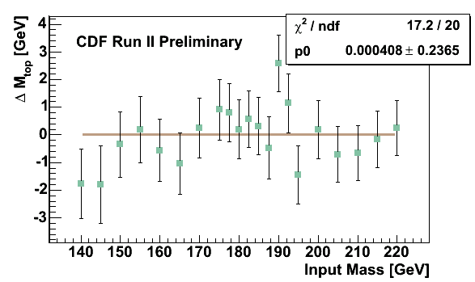
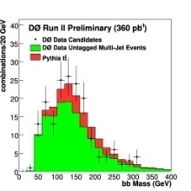
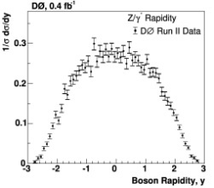
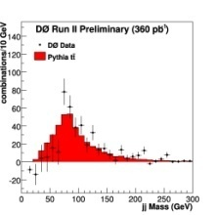
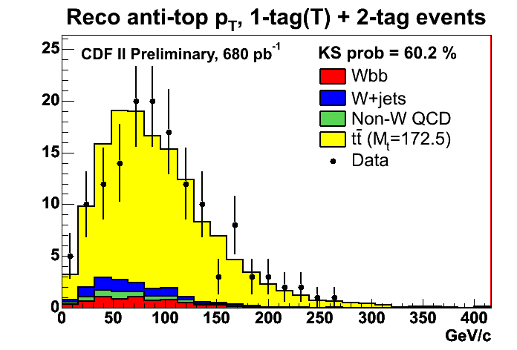
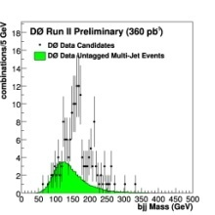
What Can You Do With That Data?

Slide 5
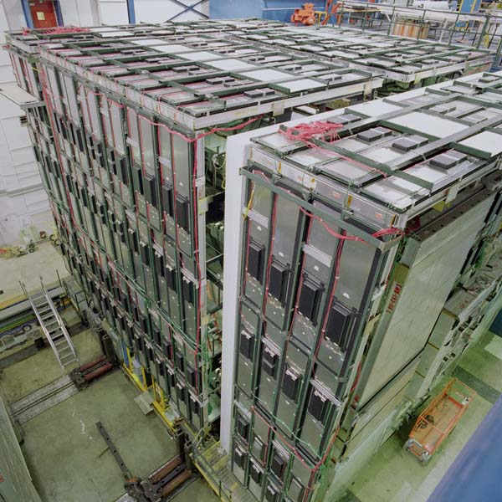
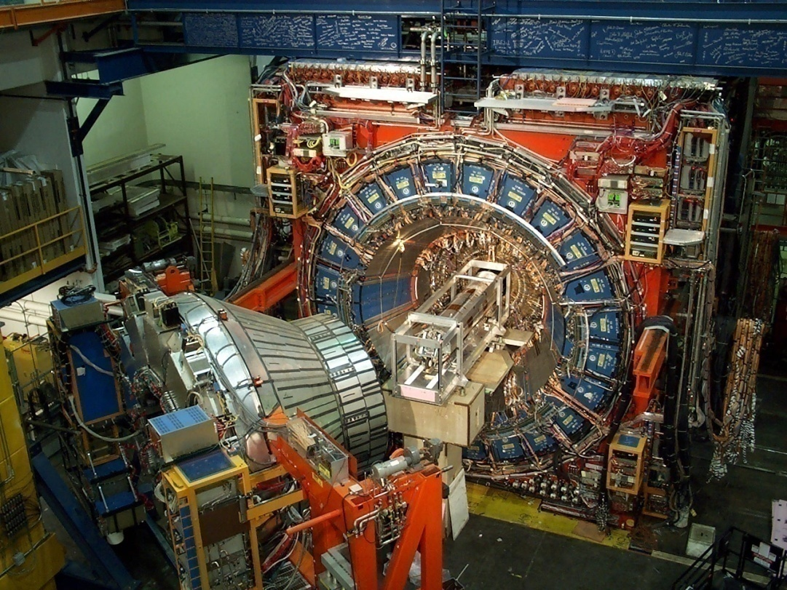
But Only If You Have CDF & DØ…
Silicon detectors for precision tracking
Solenoid for p_{T} measurement
High bandwidth multi-level trigger systems.
Calorimitry
Muon System
Excellent Muon ID Capability
Large Tracking Acceptance (|η|<2-3)
Excellent Tracking Resolution
High Rate L1 Accept Rate (B Physics)

Slide 6
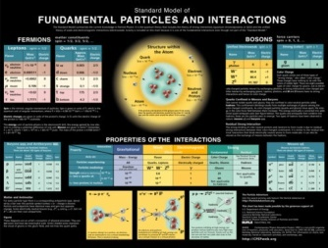
Tevatron Collider Physics
Standard Model Precision Measurements
Gauge Sector
Flavor Sector
M_{W}, M_{top}, …
Cross Sections σ_{W}, σ_{Z}, σ_{tt}, σ_{t}, …
Heavy Flavor Production & Decays
Electro-weak Symmetry Breaking
The Standard Program
✓
Complete the Standard Model
Precision Measurements (BSM hunt)
The Hunt for New Phenomena
✓
Standard Model & Beyond Searches
✓
Higgs
Supersymmetry, Large Extra Dimensions
New Guage Bosons
New Fermions
…
Recent Developments
✓
Dark Matter
Dark Energy
Neutrino Mass/Oscillation
?
?

Slide 7
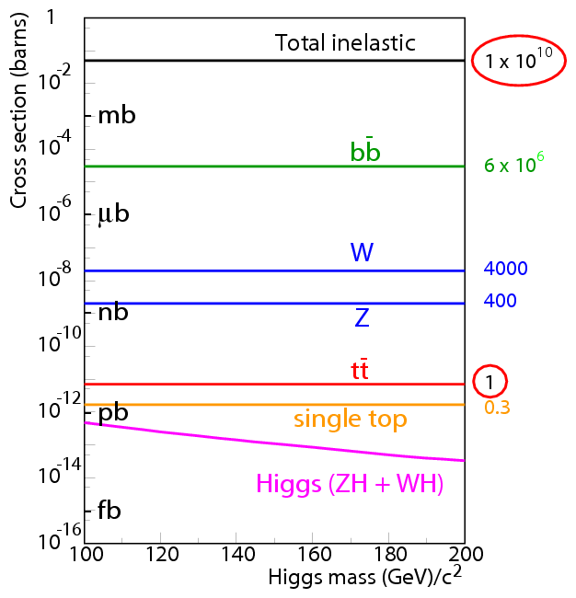
Down The Ladder…
It is getting harder!
Top quark observation in 1995
Single Top Quark Evidence 2007
WW, WZ, ZZ…
Higgs…
1995
2007

Slide 8
The Top Quark

Slide 9
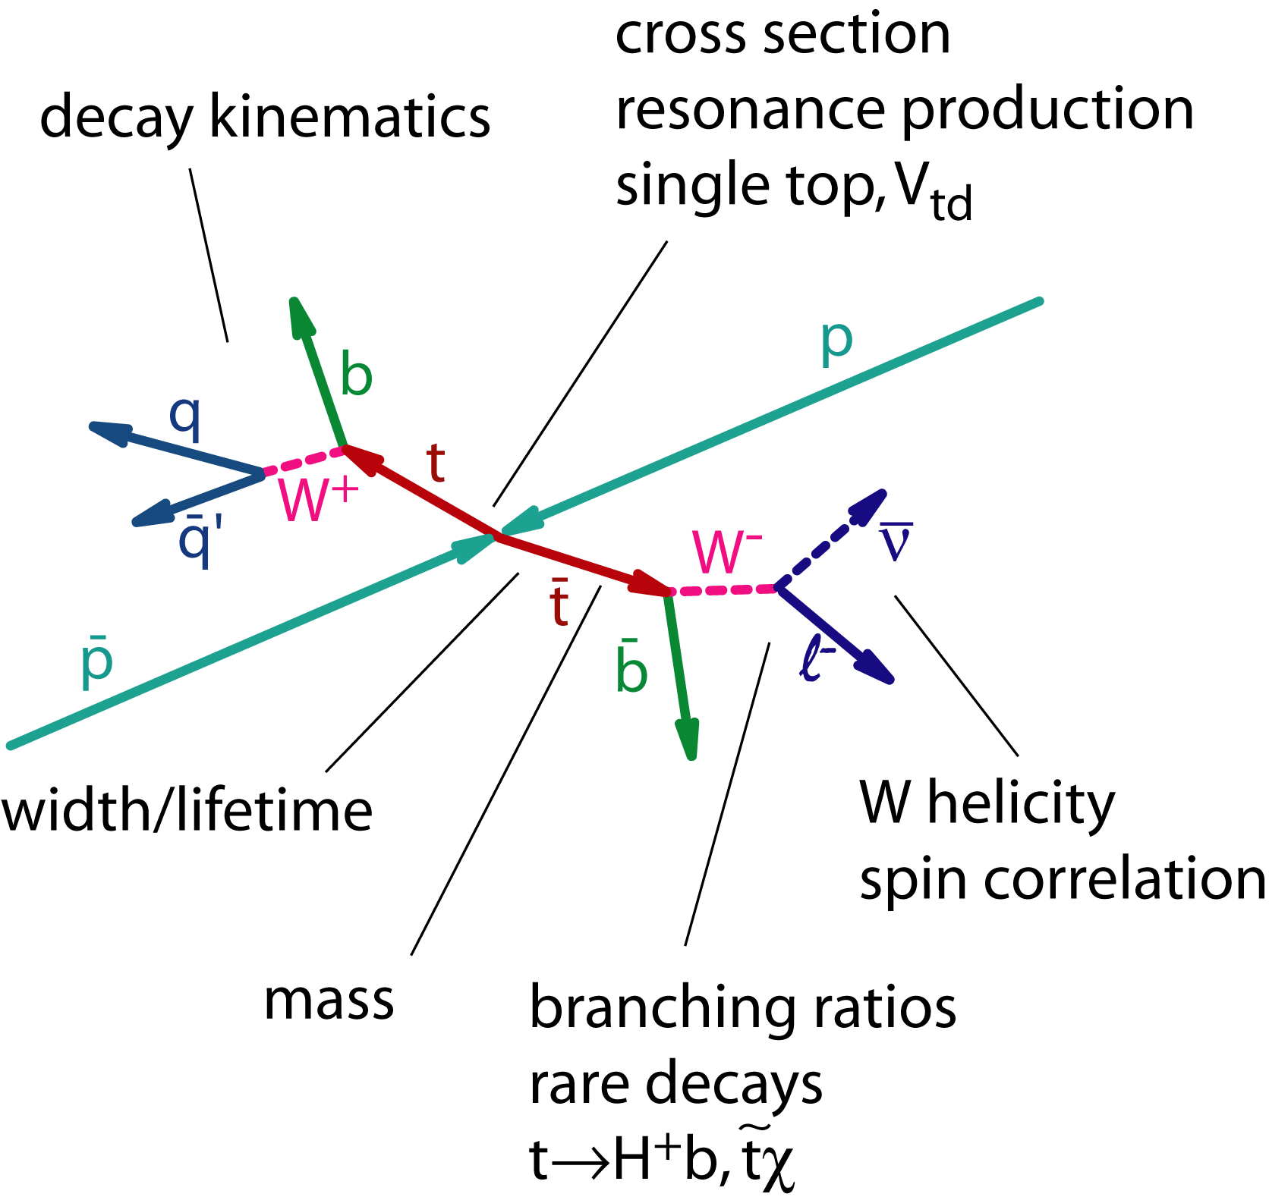
The Tevatron Lab: Top Quark
Wealth of information to be extracted from the top quark system!
Discovered in 1995
Only place for direct measurement is the Tevatron
Much heavier than expected
Implications?
V_{tb}
Single Top Production
Top Cross Section
Top Mass Measurement

Slide 10
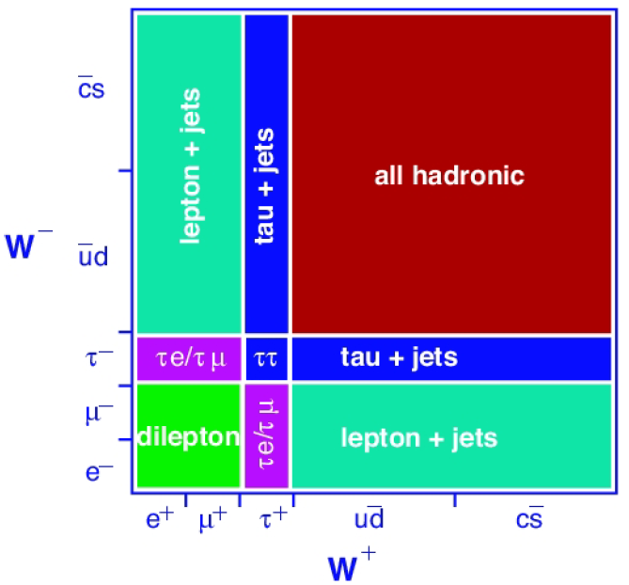
Top Cross Section
Re-Re discovery of the top quark…
Classify our channels by the W decay mode
WW → llν_{l}ν_{l} - dilepton
WW → lν_{l}qq – letpon + jets
WW → qqqq – all hadronic
CDF dilepton
Increase acceptance: allow second lepton to be just a track
Close to a x2 increase in acceptance
For a counting experiment the S/B is 5% better.
σ(tt→dilepton+X) = 8.3 ± 1.5(stat) ± 1.0(syst) ± 0.5(lumi) pb

Slide 11
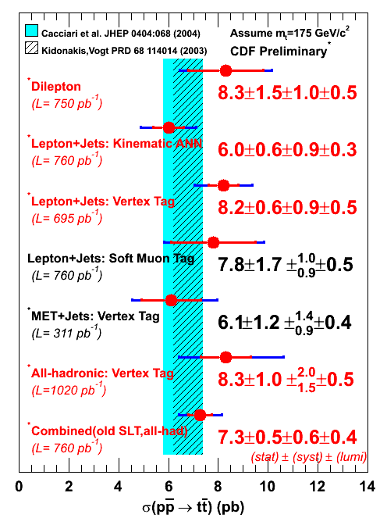
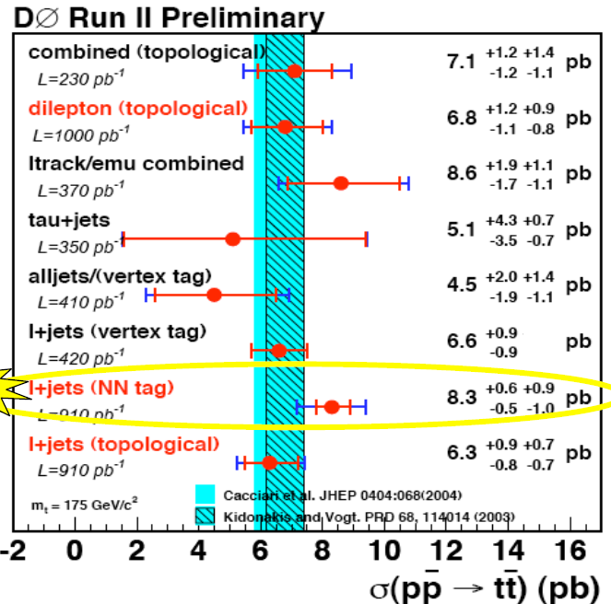
Top Cross Section Summary
Precision is about that of theory!
Combination is in progress…

Slide 12
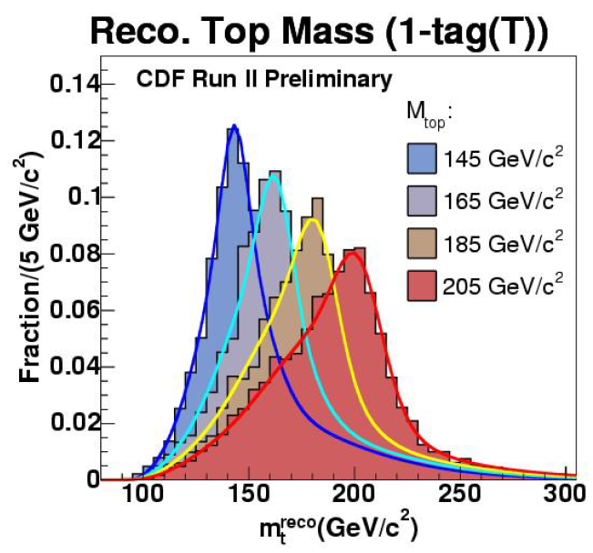
The Top Mass
M_{t} is a fundamental parameter of the SM
Correlated with M_{H} via loop corrections
Measurement Techniques
Template Methods compare data M_{t} distributions to similar ones generated with a variety of MC at different M_{t}s.
Event-by-Event. Weight events in final M_{t} distribution according to their similarity to signal or background.
Currently Giving Smallest Errors

Slide 13
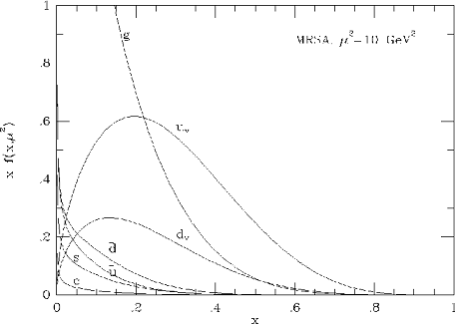
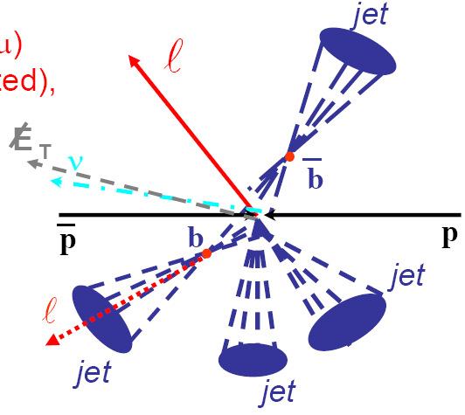
The Top Mass
The Matrix Element Method
Inverted Monte Carlo: what is the differential cross section that a particular event final state could have come from a signal matrix element or a background matrix element.
l
Parton Distribution Functions
ν_{l}
t
b
t
q
l
What is likelihood of a particular parton configuration?
b
What is the chance that the final state partons (y) could produce the measured objects (x).

Slide 14
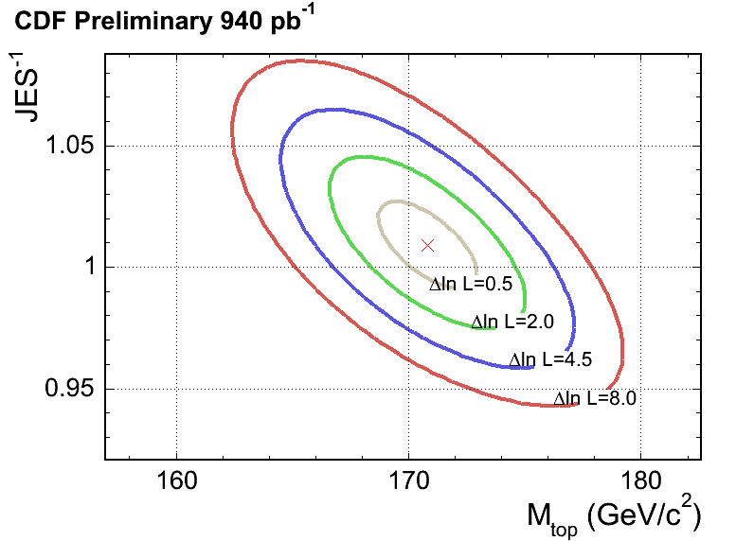
Top Mass
Lepton + Jets
New trick in tool box: In-stiu Jet Energy Scale (JES) calibration
This works because we know the W mass better than we know the JES at these jet energies!
JES is normally determined on photon+jet events.
Let JES float: another parameter similar to M_{t}.
Constrain JES to best of knowledge, if possible (D0).
CDF (fit of M_{top}, f_{top}, and JES):
M_{top} = 170.9 ± 2.2 (stat+JES) ± 1.4 (syst) GeV/c²
DØ (fit of M_{top} and JES):
(0+1+2 tags)
M_{top} = 170.5 ± 2.5 (stat+JES) ± 1.4 (syst) GeV/c²
(1+2 tags)
M_{top} = 170.5 ± 2.4 (stat+JES) ± 1.2 (syst) GeV/c²

Slide 15
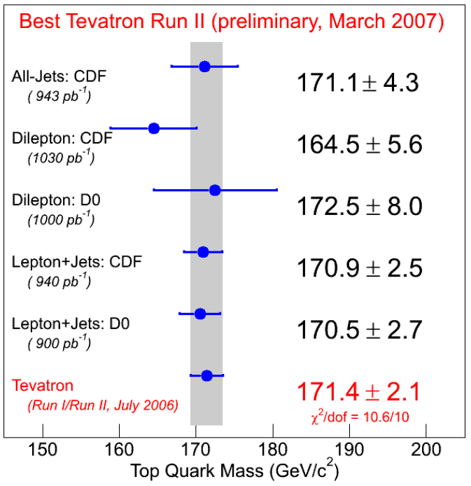
Top Mass Combination
dilepton
Very few backgrounds in SM, but relatively small statistics and two neutrinos add ambiguity.
All hadronic
Largest fraction of production, but multijet backgrounds are very large
lepton + jets
A perhaps happy compromise. Currently yields best measurements (but all are competitive).
Run 2 expectation: ±1 GeV

Slide 16
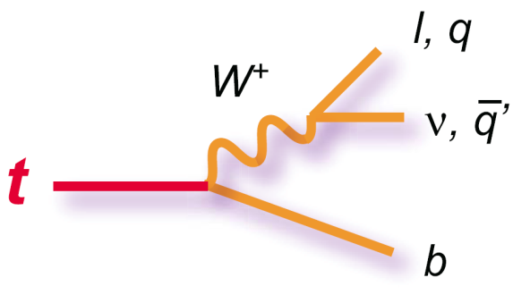
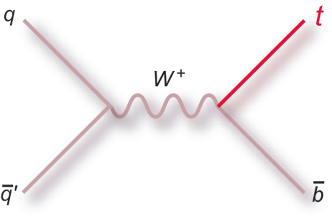
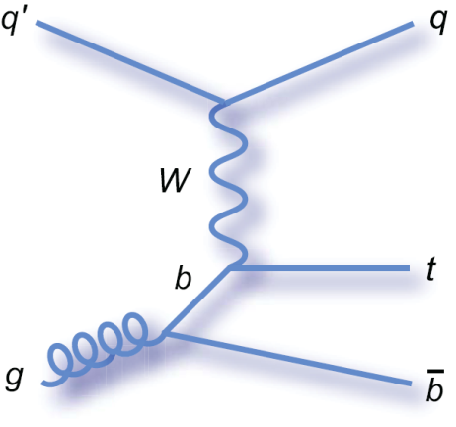
Single Top Production
Direct Access to the W-t-b coupling (σ_{st})
Backgrounds to Higgs!
Measure V_{tb} of the CKM directly
CKM Unitarity
Sensitive to new resonances: W’, top pions, SUSY, FCNC, anomalous couplings...
0.88 ± 0.11 pb
“s-channel”
Single Top Final State
Typical for Top: Lepton, missing E_{T}, and jets
Backgrounds
1.98 ± 0.25 pb
“t-channel”
W+Jets – σ = 1000 pb
tt – σ = 7 pb
QCD multi-jet background/jet mistaken ID

Slide 17
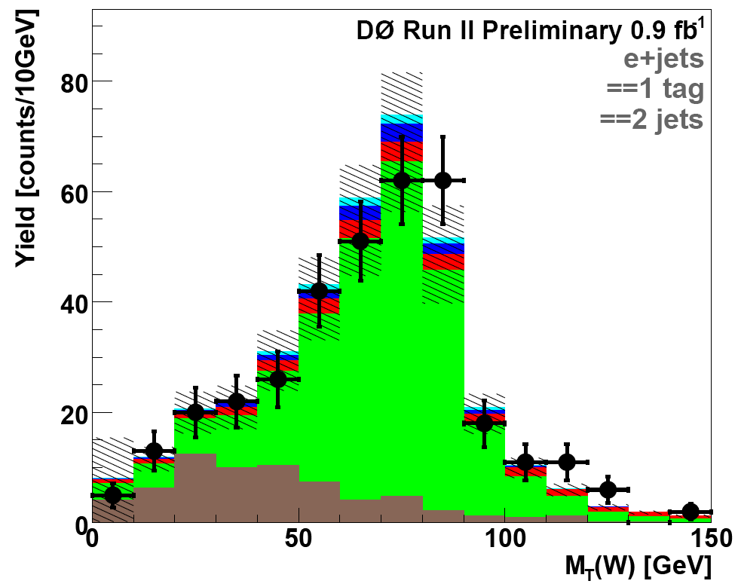
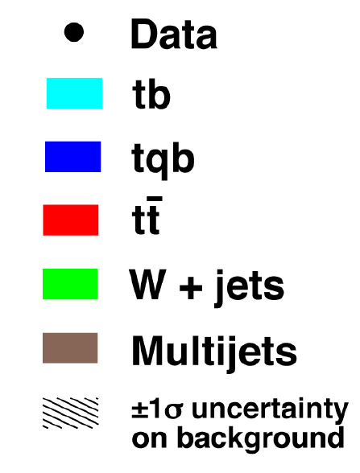
Sophisticated Separation Techniques
The estimated systematic error is larger than the expected signal!
A simple counting experiment isn’t going to work!
e+jets, 1 tag, 2 jets
Neural Network
Likelihood
Matrix Element
Decision Tree
Matrix Element
Bayesian Neural Network

Slide 18
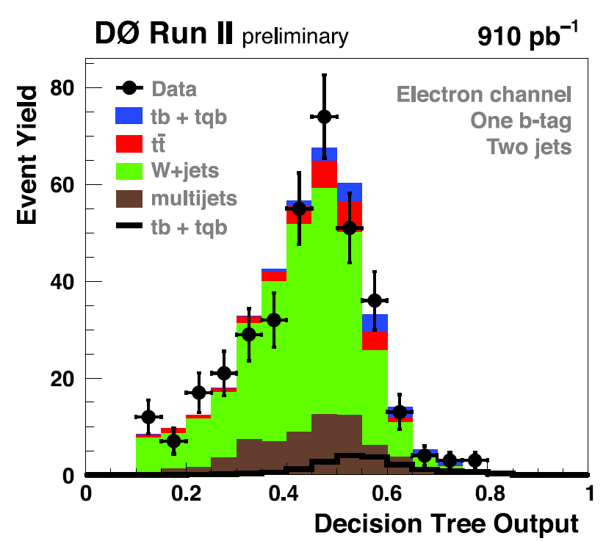
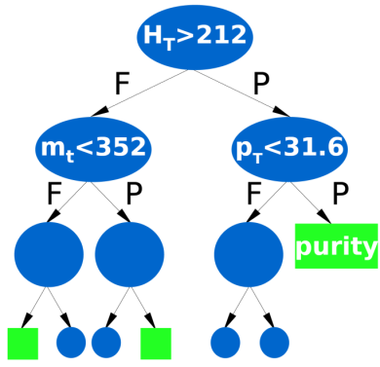
Monte Carlo Trained Techniques
Train on MC signal and background to separate signal and background
Decision Tree(DT): Branch at each node depending on a selection cut. Each leaf contains a purity determined on MC: the result of the DT discriminate. Boosting re-trains to improve incorrect assignments.
Neural Network (NN): functional combination with weights determined by training.
Likelihood: Combined likelihood of multiple variables, all with some minimal separation.
DT(e,2j,1T)
Analyzer must carefully pick variables to increase separation.
Training and over training
Very Fast to redo the analysis.

Slide 19
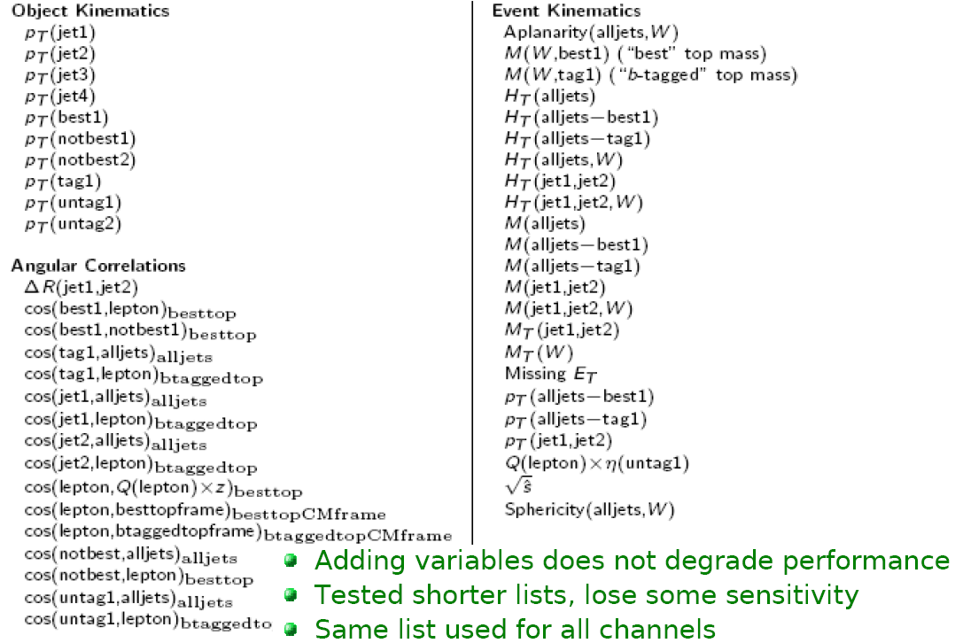
Input Variables

Slide 20
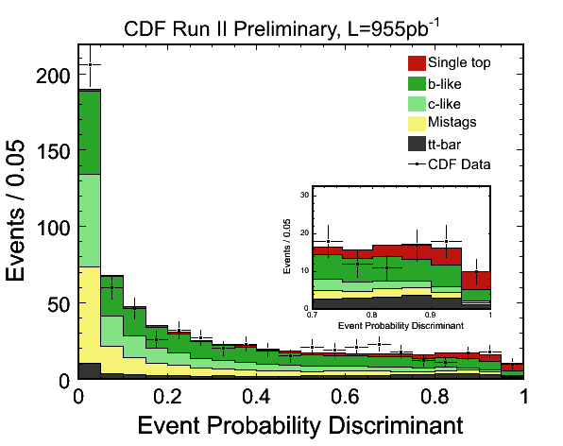
Matrix Element Technique
Use MC LO Matrix Element to predict probability an event is signal or background.
The probability a measured detector topology (x) is a particular process (M):
CTEQ6 Parton Distribution Functions
Leading Order ME from MadGraph and phase space & parton level cuts
Transfer Function: Map Detector to Partons
Matrix Element should extract maximal separation information from event. But is only LO.
Very slow: must integrate over all unknowns (minutes/event)

Slide 21
Results
 | DØ |  | CDF
Technique | Expected Sensitivity | Result & Sensitivity | Expected Sensitivity | Result & Sensitivity
Neural Network | 1.3σ (Bayesian ) | σ_{s+t} = 5.0 ^{+1.9} _{-1.9} pb 2.2σ | σ_{s+t} < 5.7 pb | σ_{s+t} < 2.6 pb @ 95% CL
Likelihood |  |  | σ_{s+t} < 2.9 pb | σ_{s+t} < 2.7 pb @ 95% CL
Matrix Element | 1.8σ | σ_{s+t} = 4.6 ^{+1.8} _{-1.5} pb 2.9σ | 2.5σ | σ_{s+t} = 2.7 ^{+1.5} _{-1.3} pb 2.3σ
Decision Tree | 2.1σ | σ_{s+t} = 4.9 ^{+1.4} _{-1.4} pb 3.4σ
CDF has determined their results are compatible at the 6.5% level.

Slide 22
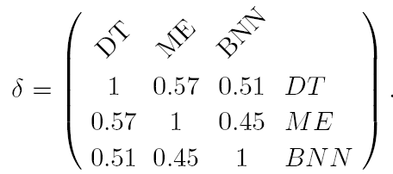
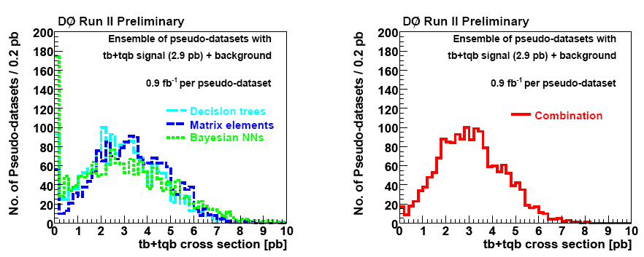
DØ Single Top Result Combination
The analyses are not fully correlated
BLUE MetZhod
f = w_{DT}•DT+w_{ME}•ME+w_{BNN}•BNN
Use the SM Ensemble
Determine the weights such that the mean square error on f is minimal.
σ(s+t) = 4.8 ± 1.3 pb

Slide 23
Single Top Results
Expected Significance: 2.2σ
Observed Significance: 3.5σ

Slide 25
W+Jets
To better top and Higgs searches we have to understand W+Jets and b-quarks at a new level
W+Jets Data comparison ALPJEN
Normalize each jet multiplicity cross section
Inspect behavior vs E_{T}, jet-jet ΔR, jet-jet invariant mass.
Z+Jets Too
b-jet Energy Scale (in Z→bb events)
5674 ± 727 Z→bb events in fit.
Determine response relative to light quark JES
Will help with Higgs and with Top

Slide 26
Electro Weak

Slide 27
The W and Z Boson
The W Mass And Width
First Run 2 Results!
Di Boson Production
1 fb⁻¹ data sets have given the Tevatron to see WW, WZ, and evidence for ZZ.
SM Constraints to hunt for new physics
Wγ Production
SM Constraints to hunt for new physics

Slide 28
W Mass
Endurance sport!
The best way to make progress on M_{H} constraints is better M_{W}!
Muon p_{T}
You really have to know everything about the event!
Recoil
(< 15 GeV)
Missing E_{T}

Slide 29
W Mass
RESBOS+WGRAF(NLO)
Fast Simulation
Backgrounds
Templates
M_{T}, E_{T}, Missing E_{T}
Binned likelihood fit
Data
Detector Calibration
Muons

Slide 30
W Mass
Combined Uncertainty:
± 48 MeV
CDF expects < 25 MeV with data already collected

Slide 31
W Mass
M_{W} = 80.413 ± 0.048 GeV/c²
P(χ²) = 44%
Effects:
World Average: 80.392 → 80398
World Uncertainty: 0.029 → 0.025
Higgs: 85⁺³⁹₋₂₈ → 80⁺³⁶₋₂₆
From 200 pb⁻¹!
Best Single Measurement in World!
A lot of work ahead!

Slide 32
EWWG Standard Model Fit
Was 154 last summer!
March 2007 Plots

Slide 33
W Width
Use same infrastructure as for M_{W}.
Use fast simulation with different widths
Normalize below fit region
Muons
Fit region
World Average Uncertainty: 60 → 47 MeV/c₂
Γ_{W} = 2032 ± 71 MeV/c²

Slide 34
Di Boson Production
Triple Gauge Couplings: Non-Abelian structure of the SM
Tight Limits from Tevatron
A few fb⁻¹ before we are competitive
Complimentary: Higher center of mass, some non LEP couplings available.
Anomalous Couplings – New Physics
Backgrounds to SUSY, H→WW, etc..
WW
Observed
WZ
Observed
ZZ
Evidence…

Slide 35
Di Boson Production
WW
CDF: Observe 95 events
expected background of 37 ± 2
825 pb⁻¹
σ(WW)=13.6 ± 2.3(stat) ± 1.6 (sys) ± 1.2 (lumi)
DØ: Observe 25 events
on expected background of 8 ± 0.5
224-252 pb⁻¹
σ(WW)=14.6^{+5.8}_{-5.1}(stat)^{+1.8}_{-3.0} (sys) ± 0.9 (lumi)
Good Agreement with NLO: 12.4 ± 0.8 pb
WZ
CDF: Observe 95 events
expected background of 2.7 ± 0.44
1.1 fb⁻¹
σ(WZ)=5.0^{+1.8}_{-1.6} pb
DØ: Observe 12 events
on expected background of 3.6 ± 0.20
760-860 pb⁻¹
σ(WZ)=3.9^{+1.9}_{-1.5} pb
6 σ
3.3 σ
Good Agreement with MCFM: 3.68 ± 0.25 pb

Slide 36
Di Boson Production
CDF: Search in both 4 lepton and 2 lepton+2 jet
σ(ZZ) < 2.1 pb @ 95% CL
σ(ZZ) = 0.8^{+0.7}_{-0.5} pb
DØ: Observe 1 events (4-lepton only)
on expected background of 0.17 ± 0.04
224-252 pb⁻¹
σ(ZZ) < 4.3 pb @ 95% CL
ZZ
3.0 σ
Good Agreement with SM: 1.4 ± 0.1 pb

Slide 37
Di Boson Summary
ZZ

Slide 38
Wγ Production
Photon acceptance
CDF: E_{T} > 7 GeV, |η|< 1.1
DØ: E_{T} > 7 GeV, |η|<1.1 or 1.5<|η|<2.5
Photon E_{T} and M_{Wγ} shapes are in good agreement with predictions!
Sensitive to the WWγ coupling

Slide 39
Wγ Production
The Cross Sections are also in good agreement

Slide 40
Radiation Amplitude Zero
Three SM Tree Level Wγ diagrams interfere
Zero production when center of mass angle (θ*) satisfies:
Final state is electron or muon, missing E_{T}, and a photon
Don’t reconstruct the neutrino 4-vector
Usually get two solutions for W’s rapidity: can’t calculate θ*!
But you do expect a dip in the delta η!

Slide 41
Radiation Amplitude Zero
χ² = 16 (12 dof)
Data is consistent with SM
Is the dip real?
Split distribution into 3 bins
Calculate probability that unimodal distribution could fluctuate to actual data.
Dip exists at 90% CL.

Slide 42
Zγ Production
SM: ISR or FSR production
Any other diagrams (anomalous couplings – ZZγ, Zγγ, etc.) are new physics
Photon E_{T} is particular sensitive to these models
Analysis Strategy is similar to Wγ.

Slide 43
Zγ Production
Kinematic Distributions are in Good Agreement
The Cross Sections are in good agreement

Slide 44
QCD

Slide 45
Inclusive Photon and Jet Production
Triple Differential Cross Section
Inclusive Jet Production Cross Section
1.1 fb⁻¹
Photon + Jet
Note Shown: Dijet Cross section from CDF

Slide 46
b-Jet Properties
b-jets are backgrounds in top, Higgs, etc.
We tend to study exclusive B decays, not QCD production, however!
What fraction of jets have 2 b’s vs 1 b
Is the distribution of energy and calorimeter response the same?
Ψ(r) = p_{T}^{R}/p_{T}
Profile of energy in the cone

Slide 47
b-Jet Properties
Data/MC Comparison
Correction account for contamination from non-b-jet jets
The fraction of 1-b quark jets vs. 2-b quark jets is different in LO and NLO generation
By adjusting the 1-b jet fraction by 0.2 (vs. what Pythia gave)
Best Fit
CDF has also measured a photon+b-jet production cross section

Slide 48
B Physics

Slide 49
Bottom Introduction
The Tevatron is a b-factory
Both Experiments have an overwhelming number of results!
Lifetimes as well as mass measurements!

Slide 50
B_{s} Mixing
We have measured all the B_{s} mixing parameters at the Tevatron now!
Δm_{s} is consistent with the SM
Precision measurement of V_{td}/V_{ts}
ΔΓs also consistent with the SM
Charge Parity Violating phase φ_{S}
Δm_{s} = 17.77 ± 0.10 (stat) ± 0.07 (sys) ps⁻¹
Good agreement with SM
|V_{td}|/|V_{ts}| = 0.208^{+0.008}_{-0.007} (sys + stat)
φ_{s} = -0.70^{+0.47}_{-0.39}
Still Some Room for New Physics

Slide 51
Σ_{b} Search
b-Baryons
Λ_{b} seen
LEP evidence for Ξ_{b}⁰ and Ξ_{b}±
Σ_{b}^{(*)±} → Λ_{b}π±
Λ_{b}→ Λ_{c}⁺π⁻
Λ_{c}⁺→ pK⁻π⁺
Fully Hadronic Decay chain!
Displaced Track Trigger
m(Σ_{b}⁺)=5808^{+2.0}_{-2.3} ± 1.7 MeV | m(Σ_{b}⁻)=5816 ± 1 ± 1.7 MeV
m(Σ_{b}^{*+})=5829^{+1.6}_{-1.8} ± 1.7 MeV | m(Σ_{b}^{*-})=5827^{+2.1}_{-1.9} ± 1.7 MeV
Good Agreement with Theory

Slide 52
The B System
Look for Excited B decays:
DØ & CDF: J/ψK⁺
CDF: D₀π⁺
DØ: Δm(B₁-B₂*) = 25 MeV
CDF: Δm(B₁-B₂*) = 4 MeV
Theory: Δm(B₁-B₂*) =14 MeV

Slide 53
Conclusion
B_{S}, M_{W}, and Single Top were big results this year!
Experiments almost done updating 1 fb⁻¹ results
Internally concentrating on 2 fb⁻¹ results.
Both experiments have new hardware (triggers, Layer 0, etc.) that will increase sensitivity.
Increased Luminosity is causing difficulty and making analyses more complex
Please watch talks in parallel sessions!
I apologize for all the results I didn’t cover

