Slide 1
Direct Measurements Working Group
C. Weinheimer
H. Robertson
A. Nucciotti
D. Bagliani
C. Orme
K. Heeger
J. Kopp
M. Jerkins
D. McCammon
W. Wang
B. Monreal
J. Formaggio
F. Gatti
L. Bodine
S. George
S. Sangiorgio
Hamish Robertson – INT Workshop 2/10, Seattle

Slide 2
Tritium
What are the uncertainties coming from final states of molecular tritium? Radiative corrections for the molecule.
What are the prospects for atomic tritium?
Can KATRIN be scaled? Can it be upgraded?
Bolometer focal plane array with <0.5 eV FWHM resolution.
What are the limits of scaling KATRIN, Project 8, reconstruction, and ion beam?
What are the prospects for full kinematic reconstruction?
Can bolometry be done with tritium? What about systematics like leakage, delays in thermalization, spectrum shape + final state, etc.?

Slide 3
KATRIN`s sensitivity limits scaling laws of KATRIN-like experiments
70 m
KATRIN Design Report Scientific Report FZKA 7090)‏
10 m
1) Statistics: source is already opaque: count rate is 90% of an infinitely thick source further increase only by increasing the area A_{source}
but: requires very more efficient (and longer) tritium elimination line & requires larger spectrometer: A_{spectrometer} / A_{source} = E / ΔE
2) Background: KATRIN simulations: sensitivity on m(ν_{e}) as function of background b m(ν_{e}) ~ ⁵b
but: KATRIN design: 90% of background rate originates from main spectrometer maybe reduce b by avoiding traps & very demanding bolometer
ΔE < 10eV
3) Systematics: KATRIN could become better in statistics, if larger energy intervals could be measured or if the parameter correlation could be decreased
but: Inelastic scattering and final states would have to be controlled much better; Endpoint would have to known and energy scale stabilized to a few
meV level.

Slide 4
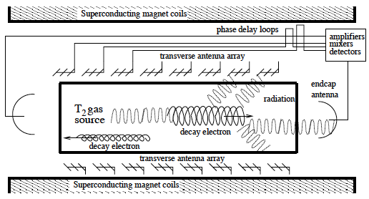
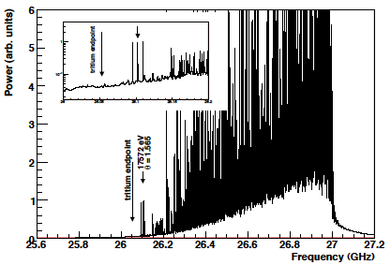
Cyclotron radiation from T₂
(B. Monreal and J. Formaggio, PRD 80:051301, 2009)

Slide 5
¹⁸⁷Re
What are the limits of bolometer resolution? What about systematics like leakage, delays in thermalization, spectrum shape + final state, etc.?
We also discussed MARE source activity:
To obtain sensitivity to 0.2eV, MARE needs 60c/10y (0.016 c/d) in the last 200 meV of the beta spectrum (which corresponds to 400g of Re-187).
KATRIN’s source density and efficiency corresponds to 1.0 c/d in the last 200 meV of the spectrum.

Slide 6
Other Isotopes, General Questions
Are there isotopes with low Q values, large matrix elements and a gamma decay to act as a trigger?
Is the spectral shape for ¹⁶³Ho and other EC cases well enough understood to extract a mass?
What about cost effectiveness?

