Slide 1
Neutrino mass and weak lensing
The Good
The Bad
The Ugly
A Proposal

Slide 2
Gravitational Potentials Decay if Neutrinos have Mass
Massive neutrinos contribute to the energy density
This fraction of the matter does not clump on small scales
Destroys a delicate balance between expansion and gravitational instability
Produces relatively large changes in the power spectrum of matter

Slide 3
Growth of Structure: Gravitational Instability
Define overdensity:
Fundamental equation governing overdensity in a matter-dominated universe when scales are within horizon:

Slide 4
Growth of Structure: Gravitational Instability
Example 1: No expansion (H=0,energy density constant)
Two modes: growing and decaying
Growing mode is exponential (the more matter there is, the stronger is the gravitational force)

Slide 5
Gravitational Instability in an Expanding Universe
Example 2: Matter density equal to the critical density in an expanding universe.
The coefficient of the 3rd term is then 3H²/2, and H=2/(3t)

Slide 6
Gravitational Instability in an Expanding Universe
Insert solution of the form: δ~t^{p}
Growing mode: δ~a. Dilution due to expansion counters attraction due to overdensity. Result: power law growth instead of exponential growth

Slide 7
Gravitational Potential
Poisson Equation:
In Fourier space, this becomes:
So the gravitational potential remains constant! Delicate balance between attraction due to gravitational instability and dilution due to expansion.
Only holds if all the energy is in non-relativistic matter.
Dark energy and massive neutrinos lead to potential decay.

Slide 8
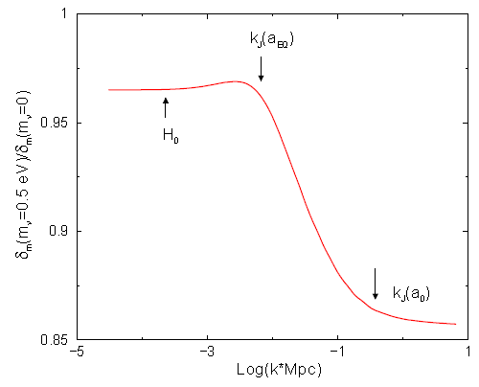

Massive Neutrino Suppress Growth on Small Scales
A fraction f_{ν} of the total density does not participate
in collapse on scales smaller than the free-streaming scale
Kaplinghat 2003

Slide 9
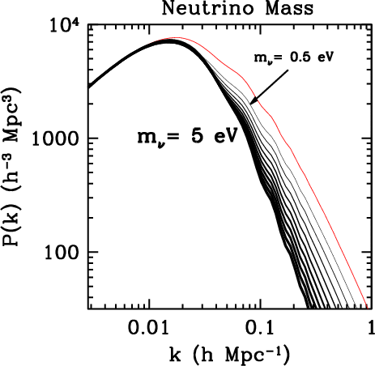
The Power Spectrum Quantifies this Suppression
Even for a small neutrino mass, get large impact on structure: power spectrum is excellent probe of neutrino mass

Slide 10
Overview of Cosmological Probes of Neutrino Mass
Technique | Underlying Physics | Linear? | Un-biased? | 3D?
Lensing of Galaxies | Decaying Φ | No | Yes | No+
Lensing of CMB | Decaying Φ | No | Yes | No
Galaxy Clustering | Decaying Φ | No | No | Yes
Lyman alpha forest | Decaying Φ | No | No | No
CMB | Acoustic Oscillations | Yes | Yes | No
Red/No is Bad

Slide 11
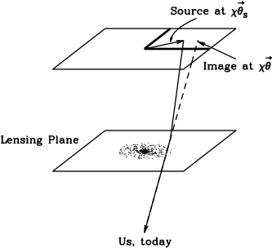


Gravitational Lensing
The geodesic equation
in a perturbed Friedman-Robertson-Walker metric reduces to
Distance from us
Angular position

Slide 12


Integrate to find the deflection
with kernel
Define the distortion tensor

Slide 13

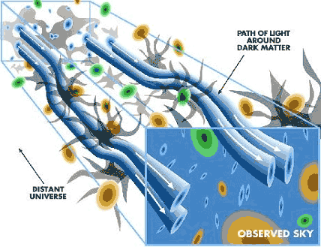
Distortion Tensor is Measurable!
is the projected density, a measure of the convergence of light rays.
γ_{I} are the two components of shear.

Slide 14
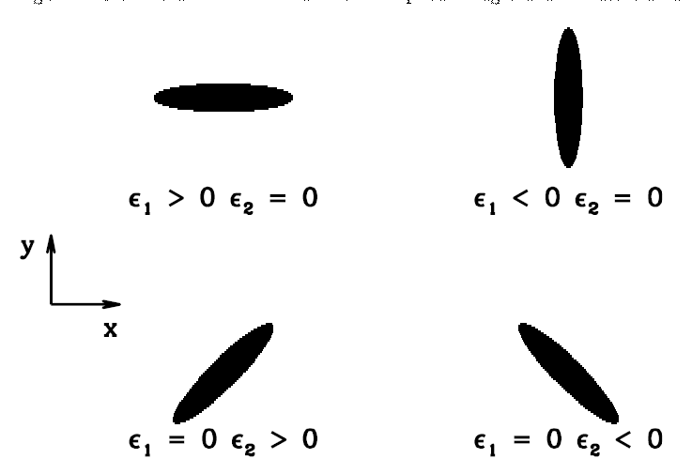
Galaxy ellipticities are probes of cosmic shear
Mean shear is zero
RMS shear is 0.01
Galaxy has intrinsic ellipticity (randomly oriented on the sky) ~0.3
To get S/N~1, need ~1000 galaxies

Slide 15
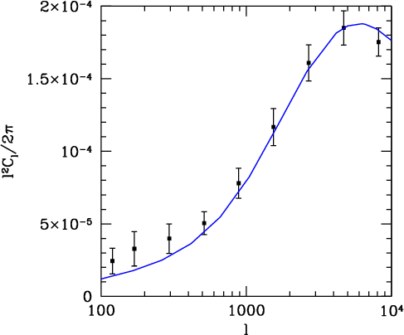
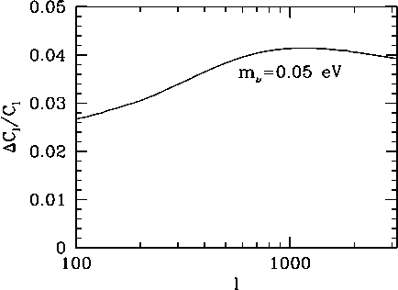

We can compute the 2-point functions of cosmic shear
CDM-CHDM
Dodelson, Shapiro, & White 2005
Curves
Points
N Body Simulations

Slide 16
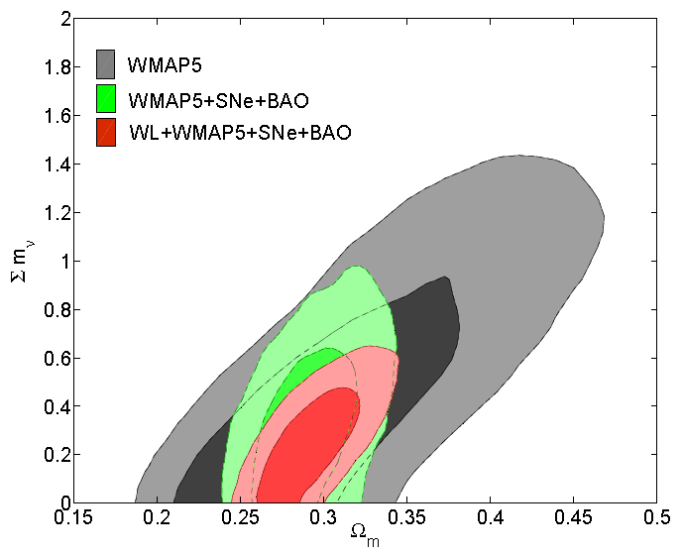
Lensing Improves Current Constraints
Canada-France-Hawaii Telescope Legacy Survey
Ichiki, Takada, & Takahashi 2009

Slide 17
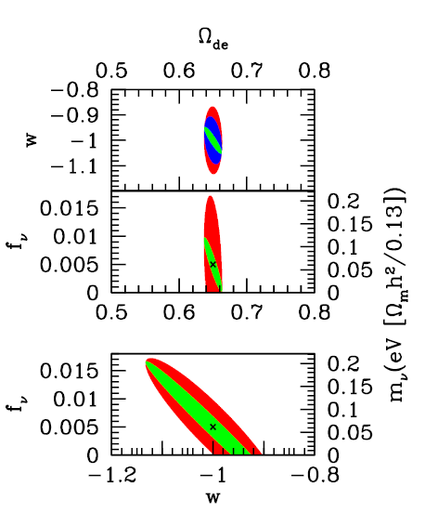
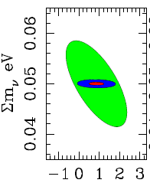
Projections for Future Constraints
De Bernardis et al. 2009
Abazajian & Dodelson 2003
α

Slide 18
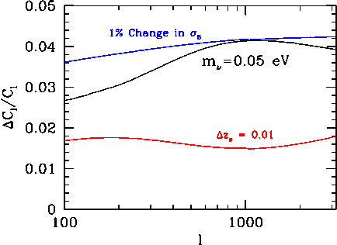
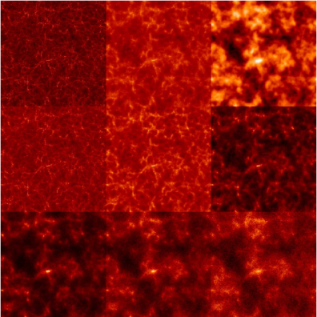
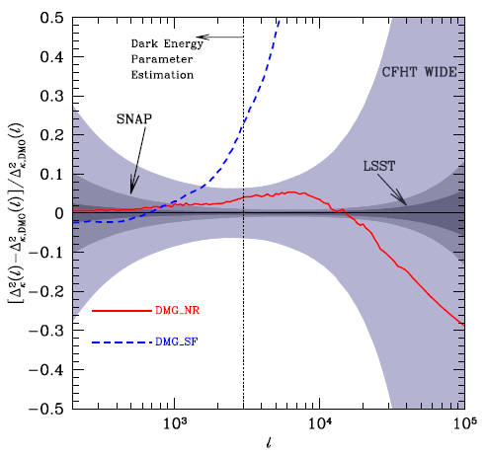
The Bad
Degeneracies
Nonlinearities
Baryons

Slide 19
Degeneracies

Slide 20
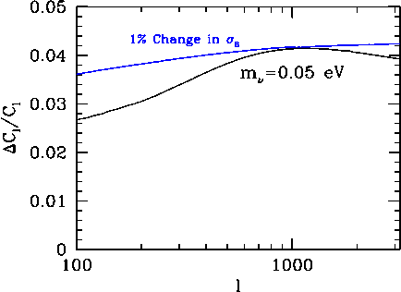
Degeneracies

Slide 21
Degeneracies

Slide 22
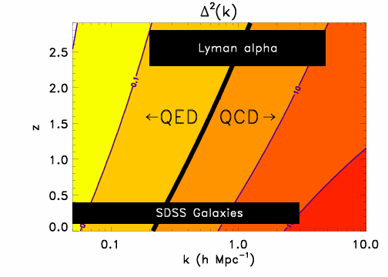
Nonlinearities
Dimensionless measure of nonlinearity

Slide 23
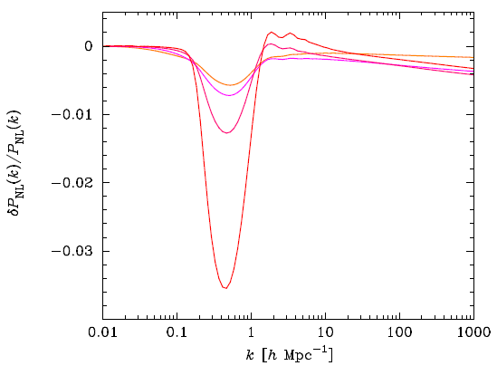
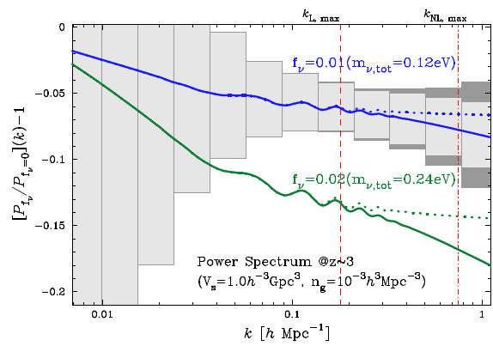

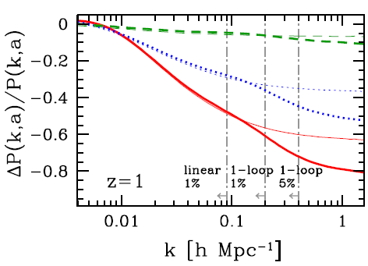
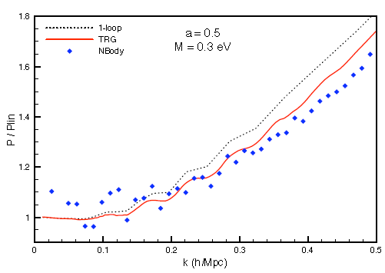
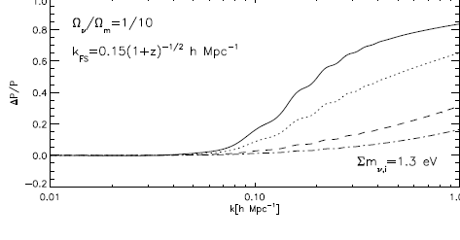
Nonlinearities
Abazajian et al. 2005
Saito, Takada, & Taruya 2008
Brandbyge & Hannestad 2009
Lesgourgues et al. 2009
Shoji & Komatsu 2009
Wong 2008

Slide 24
Baryons affect the gravitational potential on small scales
Rudd, Zentner & Kravtsov 2007

Slide 25
The Ugly
Use shapes of stars (point-like) to correct for PSF
Before Correcting for PSF
After Correcting for PSF
Stripe 82 Gang: Soares-Santos, Simet, Dodelson, Lin, Kubo, Annis et al.

Slide 26
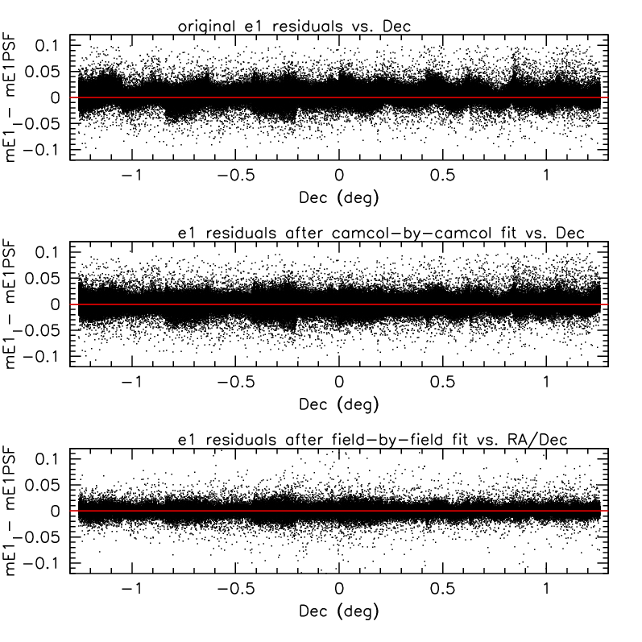
The Ugly
Use stars to model PSF across the field. These plots show difference between actual stellar ellipticities and model ellipticities
Stripe 82 Gang: Soares-Santos, Simet, Dodelson, Lin, Kubo, Annis et al.

Slide 27
Proposal: Cosmological Neutrino Challenge
Mock Sky using Input Cosmology
  3D Density (Linear, Non-Linear, Baryons, Bias, …)
  Shear Maps (Ray Tracing)
  Lyman alpha maps (HPM, Hydro, …)
  Lensed CMB Maps (including tSZ, kSZ, Reionization, …)
Blind Analysis
  Apply Planck Priors
  Extract Neutrino Mass
We will not be believed (nor will we believe) until we do this

Slide 28
Back Up Slides

Slide 29
Learn more form lensing if redshifts of background galaxies are known

Slide 30
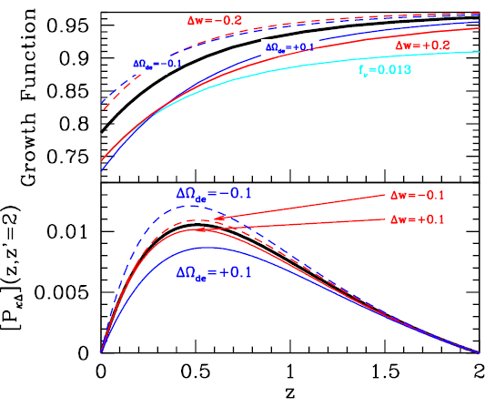

Slide 31
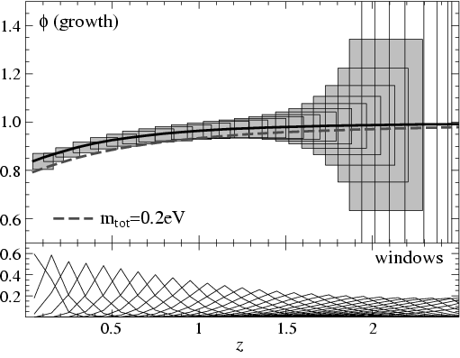
Tomography
Hu 2002

Slide 32
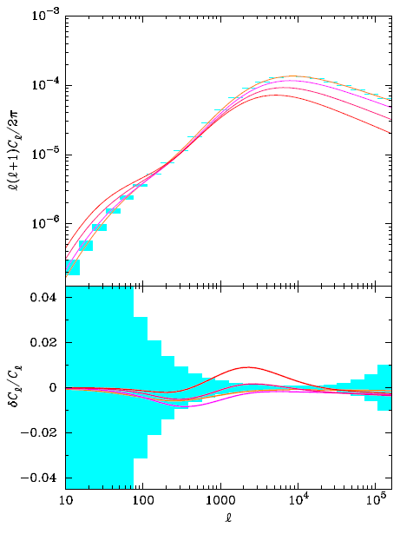
0.1,0.3,0.6,0.9 eV
Abazajian et al. 2005

Slide 33


Order of Magnitude Estimate
Gravitational
Potential
Shear
Comoving distance
First guess:
Only Fourier modes contribute which do not
vary along line of sight

Slide 34
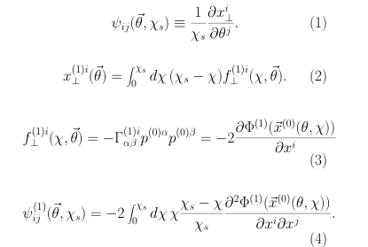
Review of First Order Calculation
ψ is shear; χ comoving distance; x⊥ perpendicular deflection; p is direction vector
Solve 1st order geodesic eqn for f in terms of first order gravitational potential φ
To be consistent, evaluate φ at undeflected x

Slide 35
