Slide 1
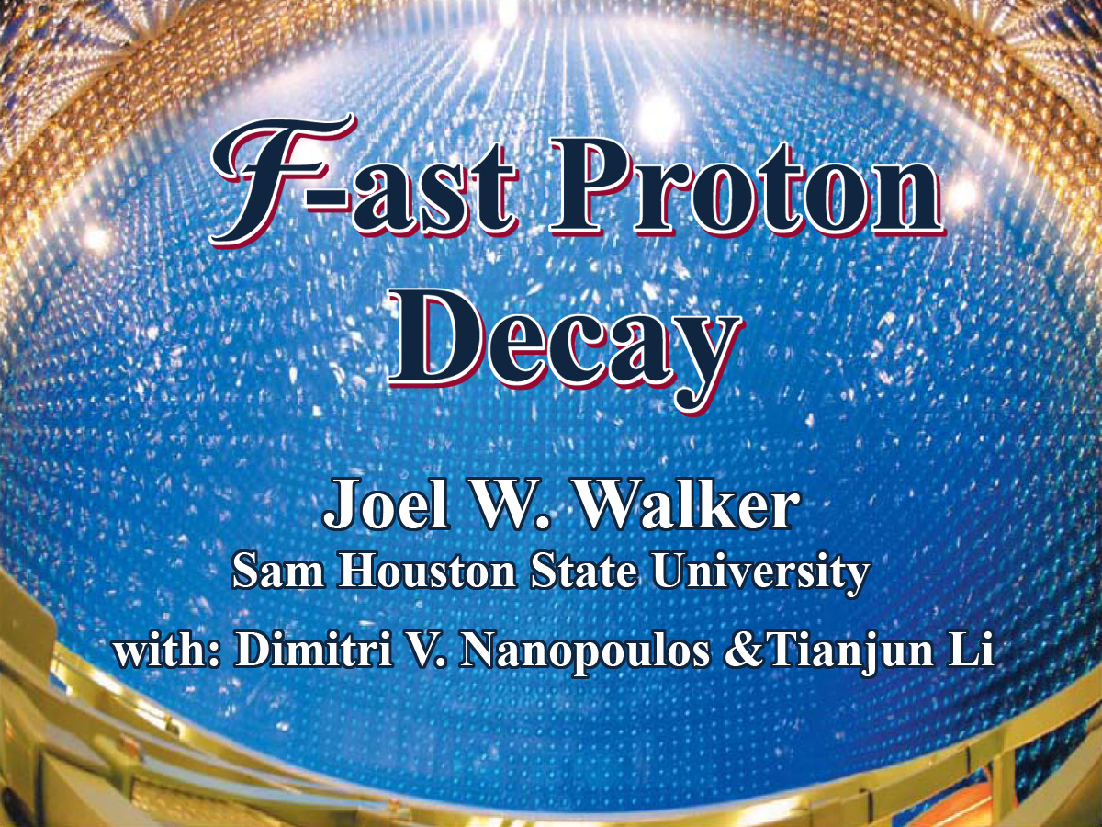

Slide 2
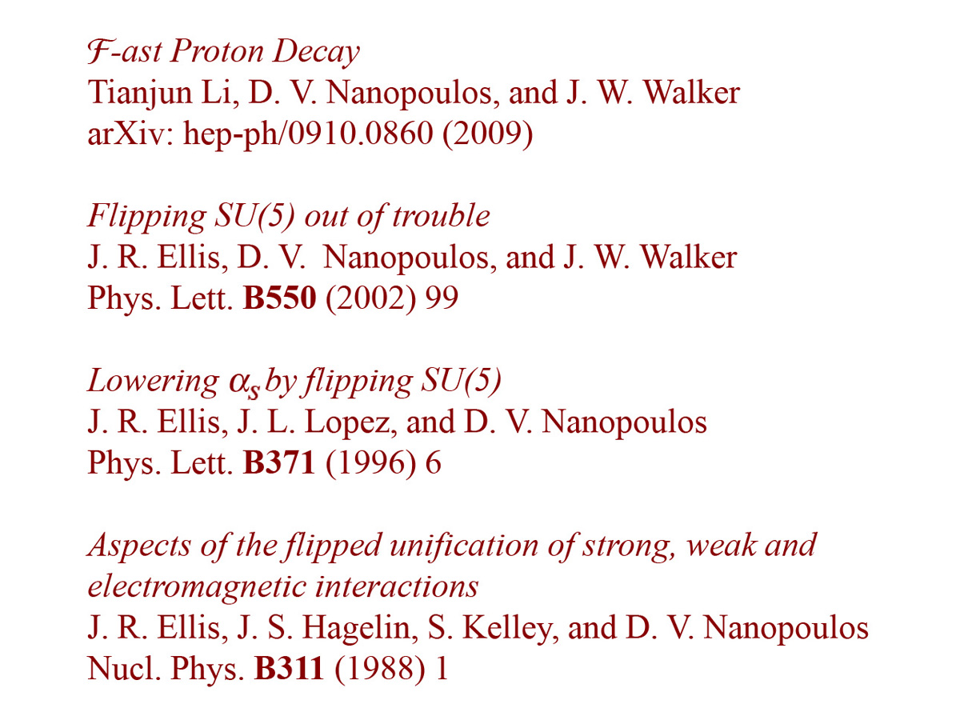
Bibliography

Slide 3
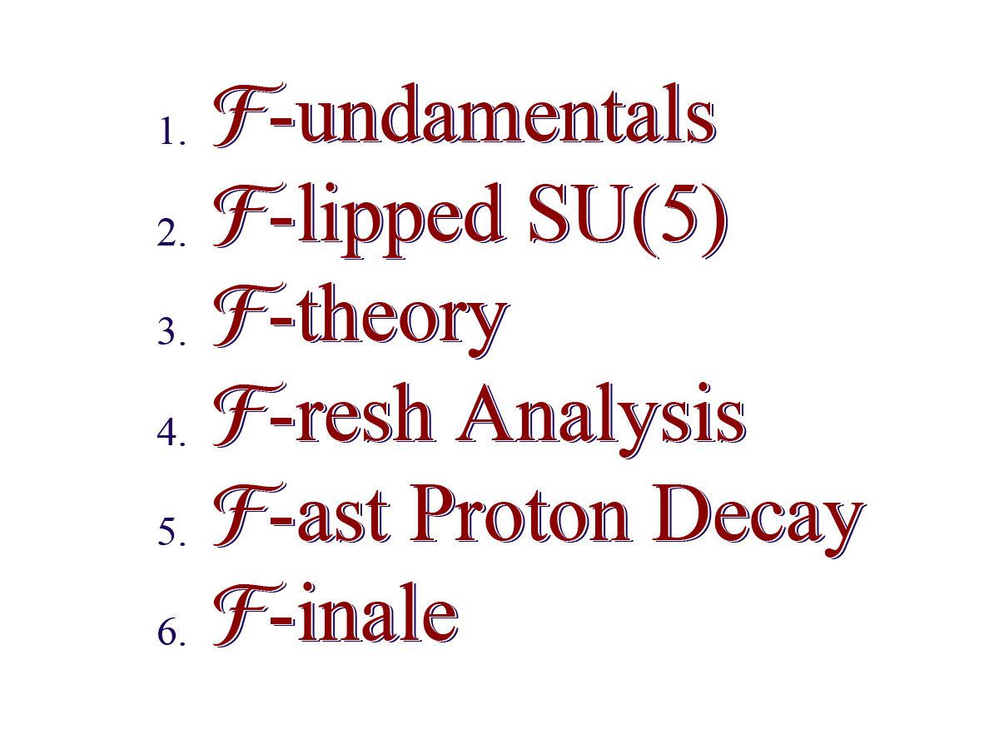
Presentation Outline

Slide 5
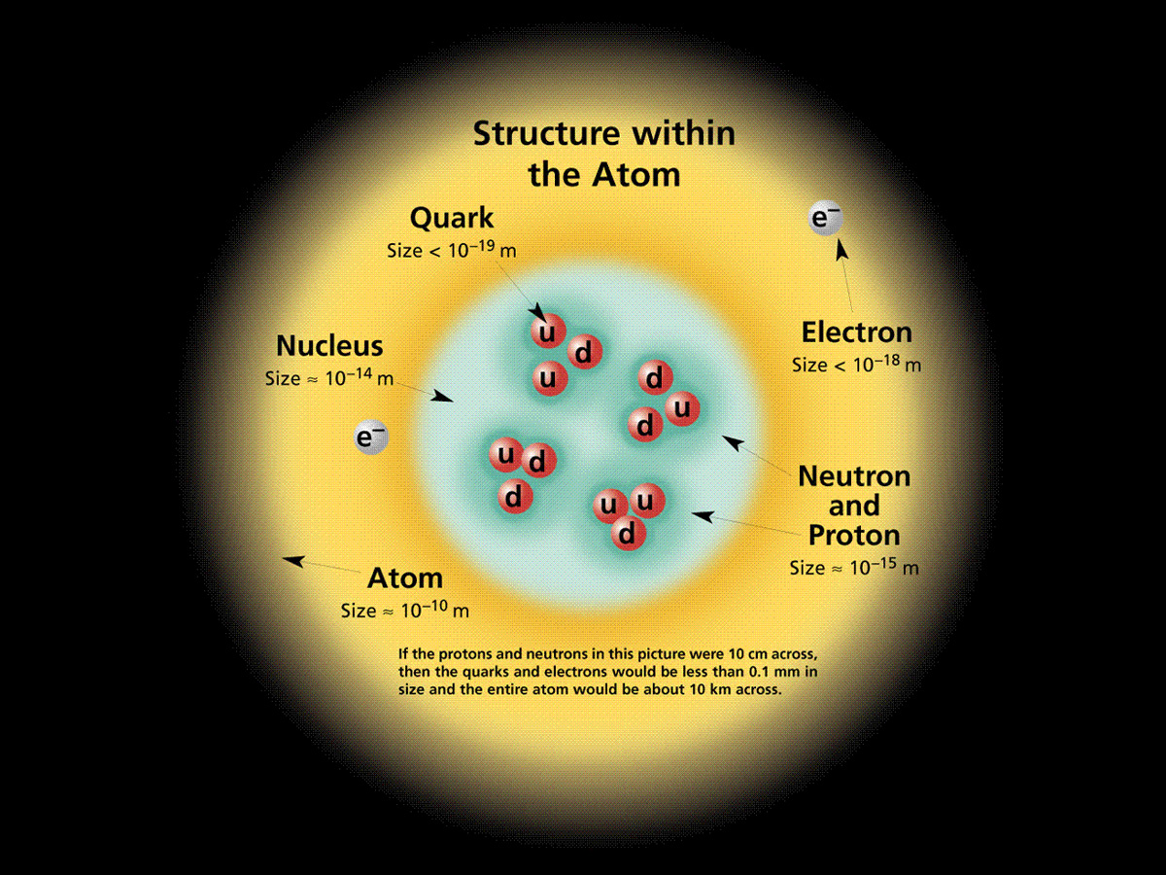
The Atom
http://CPEPweb.org

Slide 6
The Four Fundamental Forces
http://CPEPweb.org

Slide 7
Elementary Matter Particles of the Standard Model
http://CPEPweb.org

Slide 8
Light Hadrons (Particles Made of Quarks)
http://CPEPweb.org

Slide 9
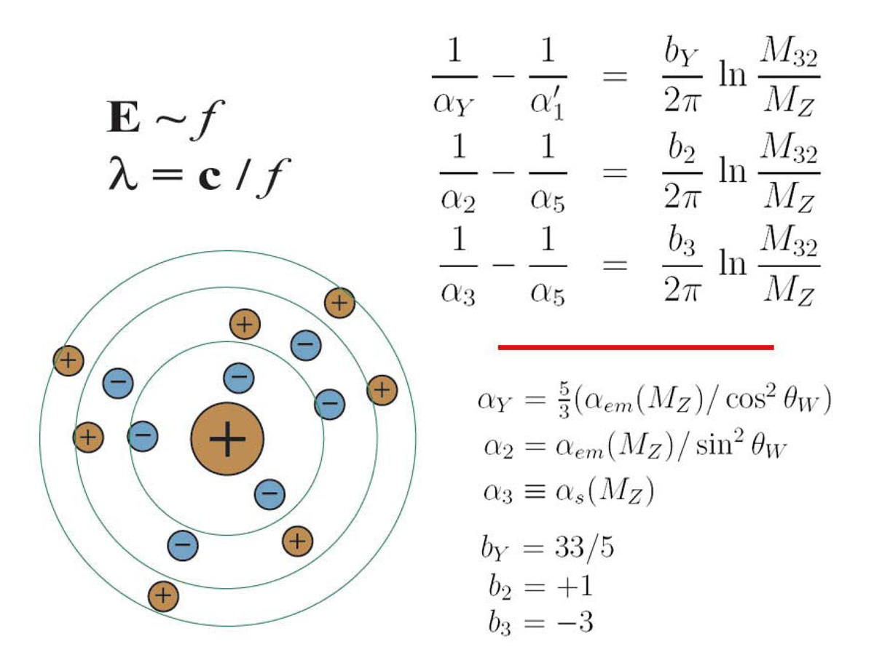
Radiative Shielding & Charge Renormalization
Quantum Mechanics says that Short Distances correspond to High Energies. Also, truly empty space violates the Heisenberg Uncertainty Principle. The quantum vacuum polarizes, and all measurements of charge vary with the interaction energy.

Slide 10
Grand Unification and Proton Decay
Slide Courtesy of Ed Kearns

Slide 11
Motivations for Supersymmetry
Detection of Supersymmetric Particles is a key motivating goal of the Large Hadron Collider.

Slide 12
Grand Unification Predicts Proton Decay
Coupling Unification, Neutrino Masses, Supersymmetry, and the third Quark Generation are all either directly confirmed, or have at least solid indirect experimental support. It is time for Proton Decay!

Slide 13
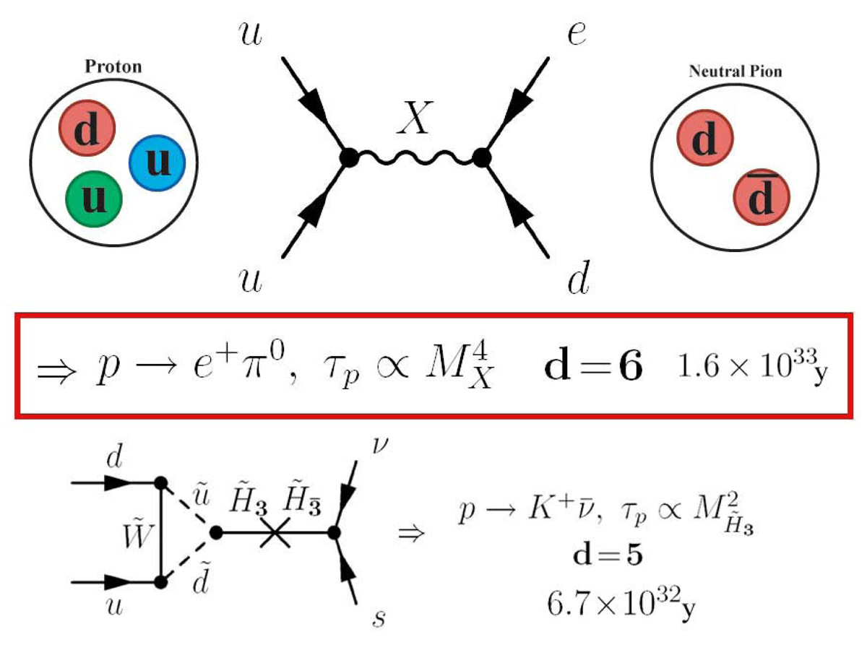
Proton Decay Channels
Dimension 5 decay can be dangerously fast. Dimension 6 decay can be so slow that you won’t see it!

Slide 14
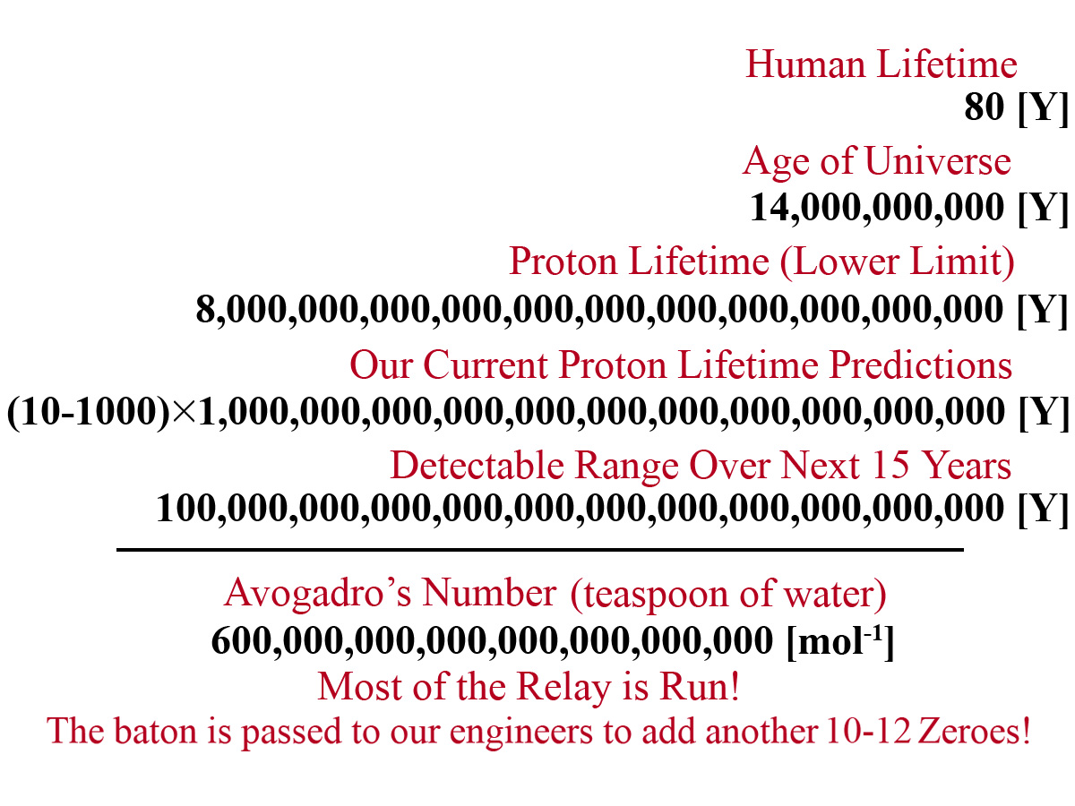
Comparison of Relevant Time Scales
Having survived the overly rapid ‘ignoble’ dimension 5 decay channel, the question becomes whether dimension 6 decay is too slow to be tested. It is grand comedy that our resources could expire ‘one zero short’, having come already so very far.

Slide 15
The Super-Kamiokande Experiment

Slide 17
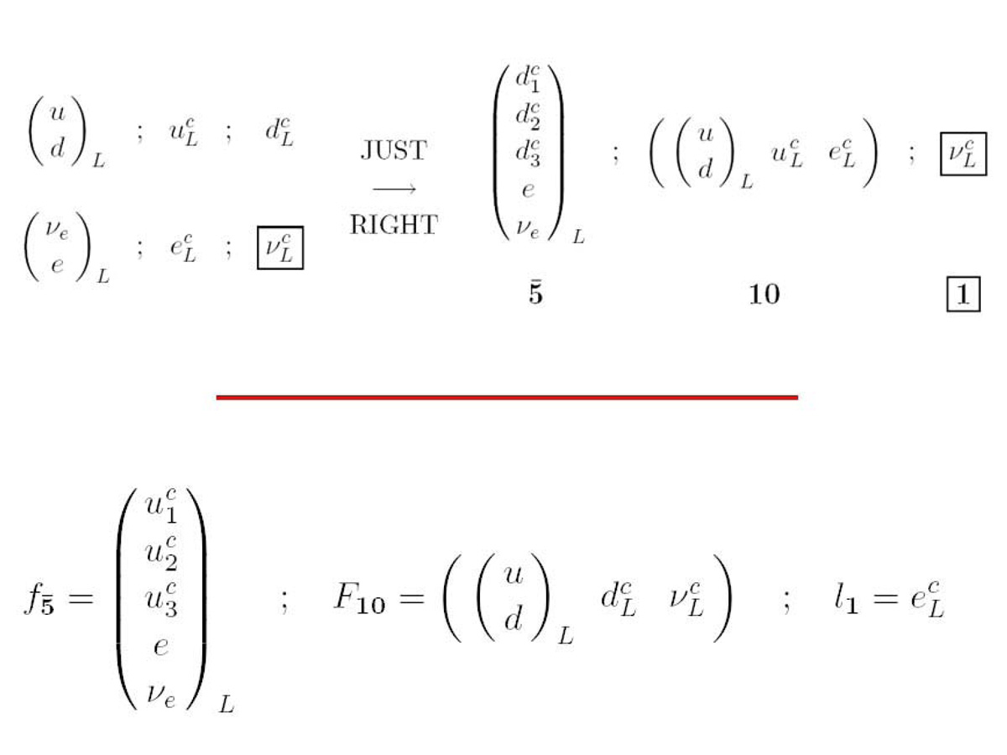
The Standard and Flipped SU(5) Particle Representations
Upper: Each generation of the Standard Model fits perfectly into a fundamental 5-bar and an antisymmetric 10 of SU(5). The RH neutrino is “out”. Lower: The RH up/down quarks, and the electron/neutrino can “flip” places relative to standard SU(5).

Slide 18
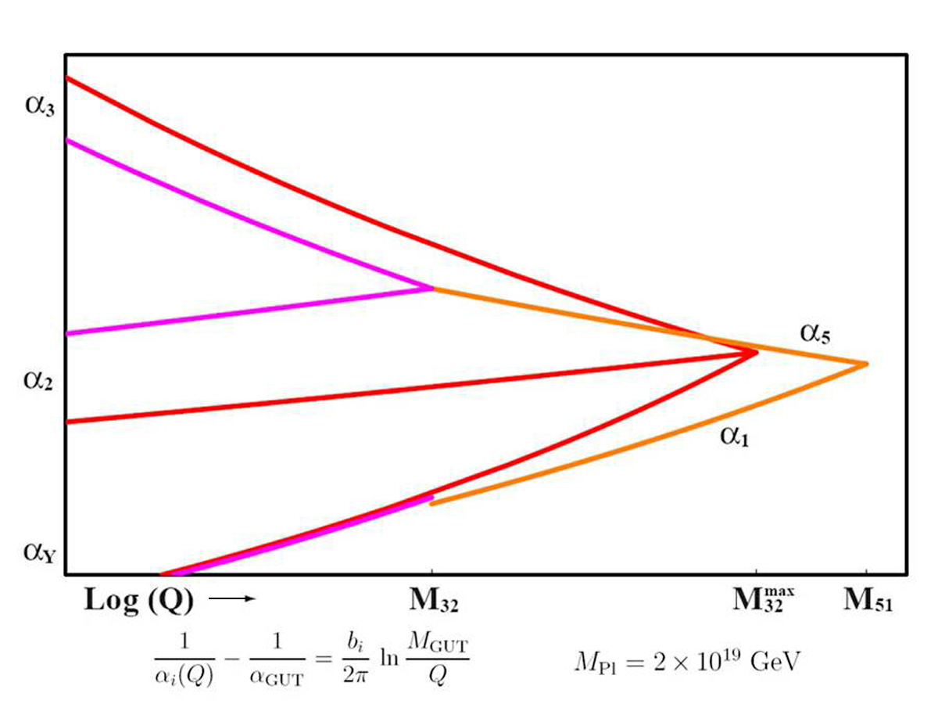
Flipped Unification
A heuristic graphical representation of Flipped SU(5) in purple Vs. Standard SU(5) in red. Note that Flipped SU(5) is not fully unified at M32. It “waits” for Super Unification at M51, which may be closer to MPlanck .

Slide 19
Motivations for Flipped SU(5)

Slide 20
Consistency with Low Energy Phenomenology
Standard SU(5) unification predicts a value for the strong coupling at the Z-Boson mass which is much too large. Attempts to fix this with heavy thresholds only speed dimension 5 proton decay. We can lower αs by Flipping SU(5).

Slide 21
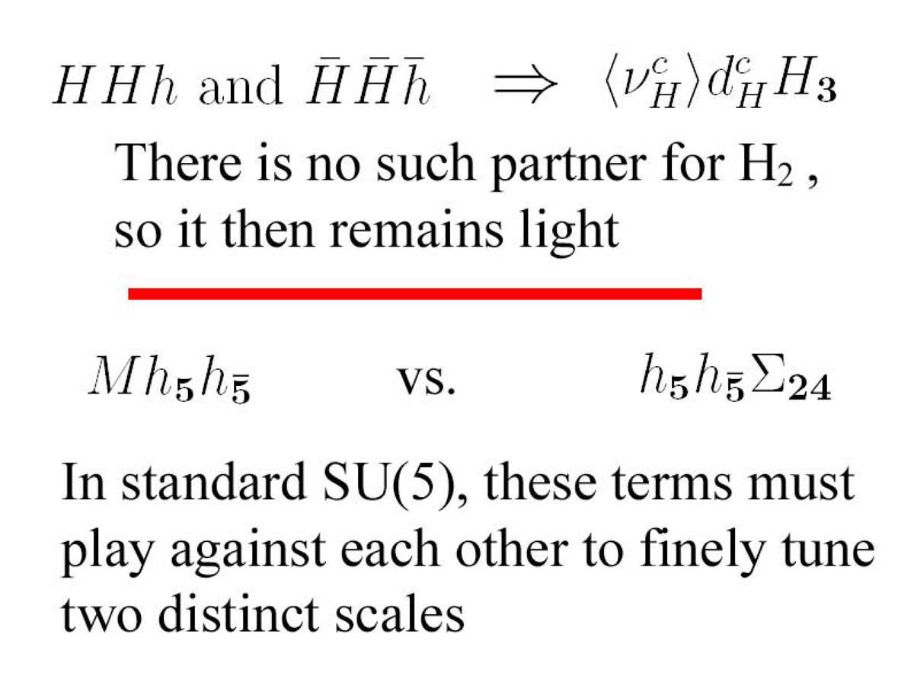
The Missing Partner Mechanism
We achieve a Natural splitting between the double and triplet Higgs. We avoid fine tuning and the overly rapid dimension 5 proton decay!

Slide 22
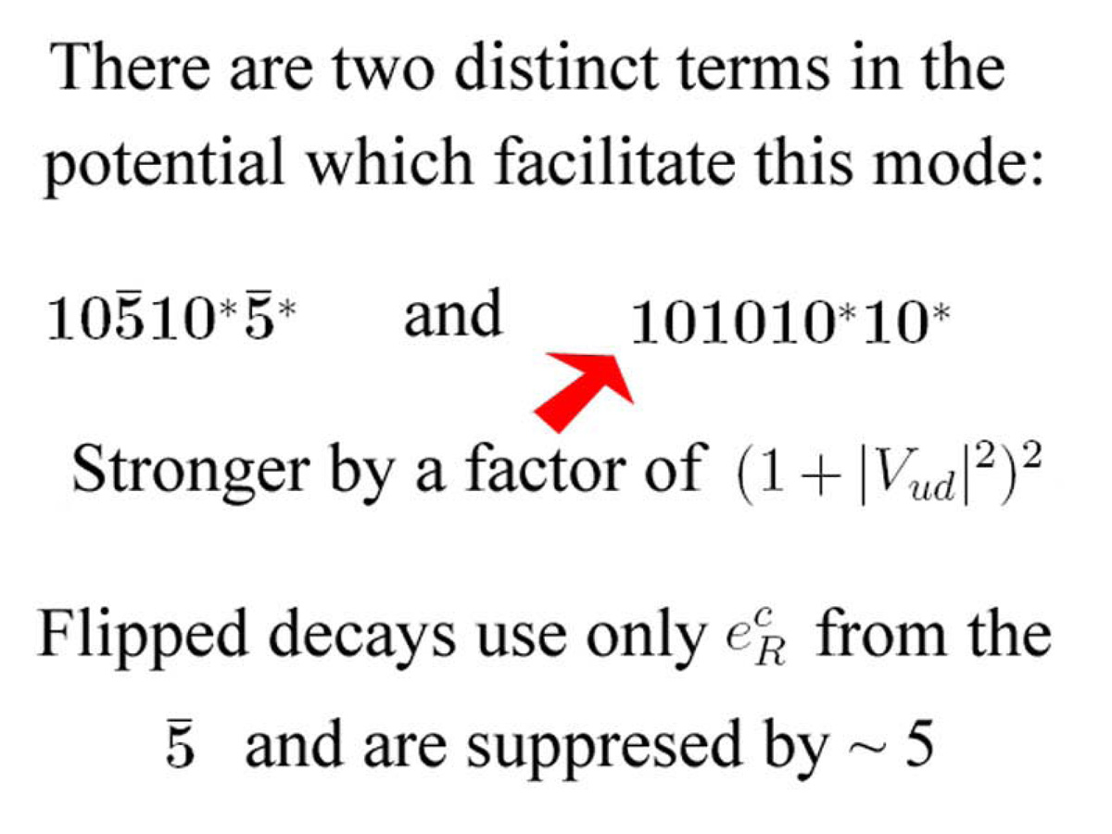
Suppression of Flipped Decay
This suppression seems at first sight detrimental, in that the dimension 6 decay has generally not been predicted as problematically fast. However, the lowering of the M32 scale will more than compensate for this lifetime increase.

Slide 23
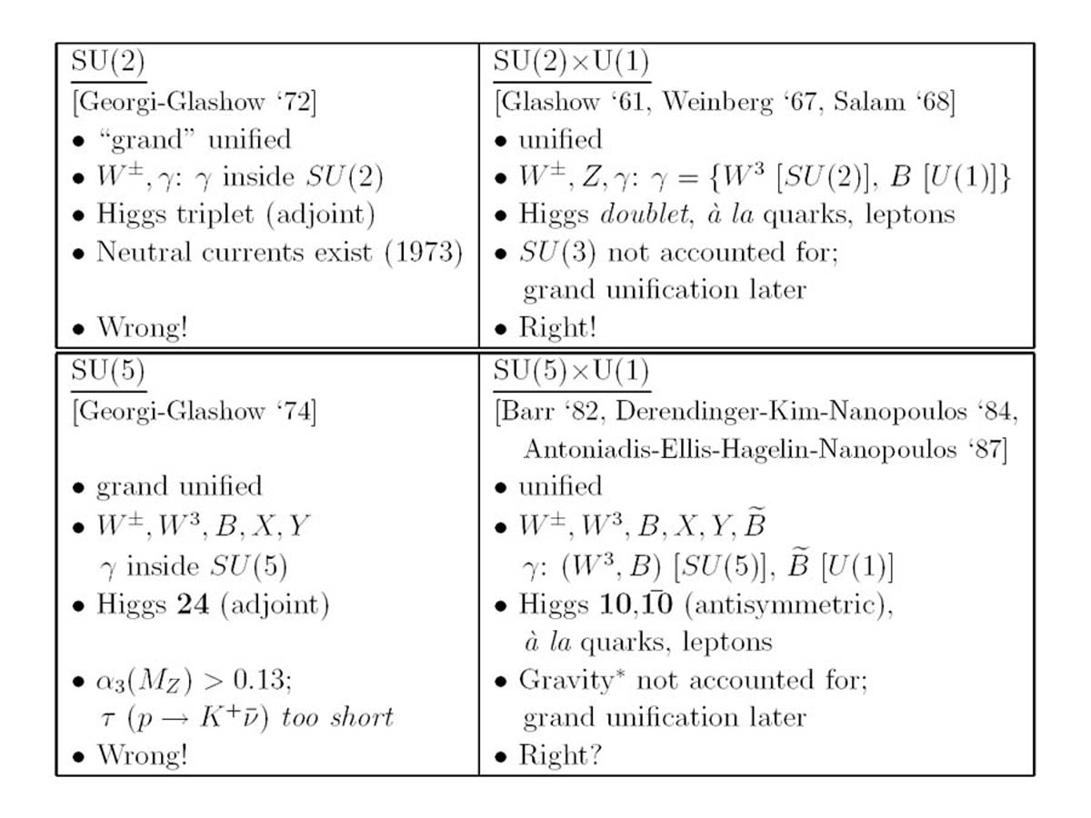
A Lesson from History
Nature repeats her favorite themes, in delicate reprise.

Slide 24
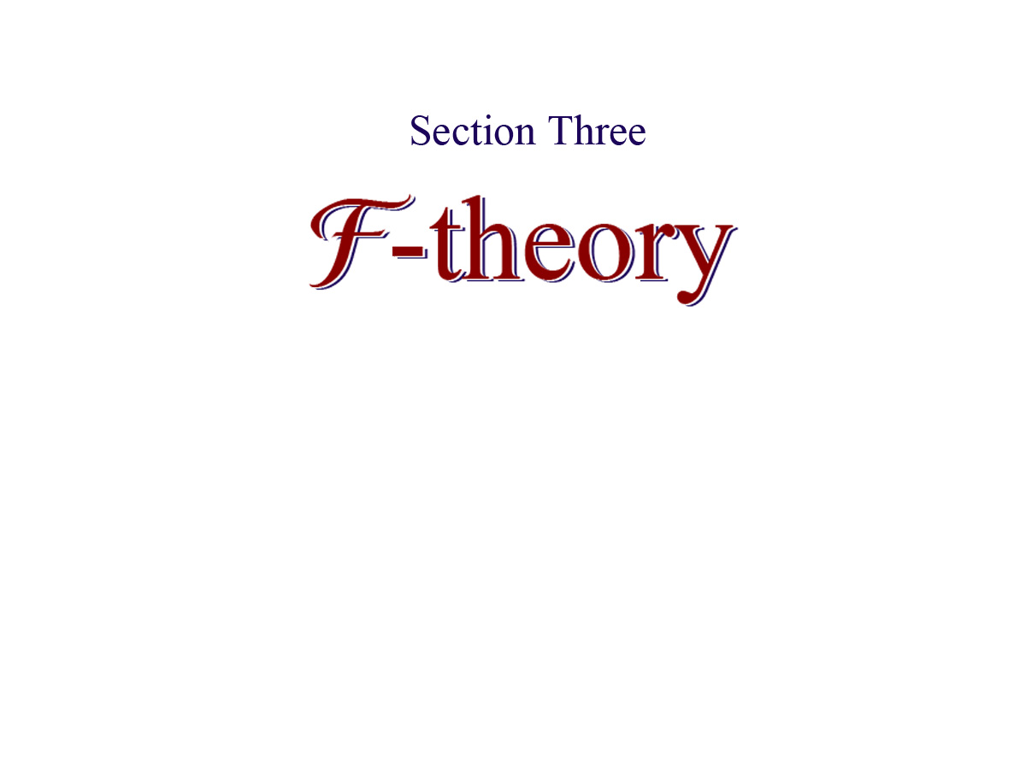

Slide 25
Grand Unification and String Phenomenology
These distinct points of view are natural symbiotic partners.

Slide 31
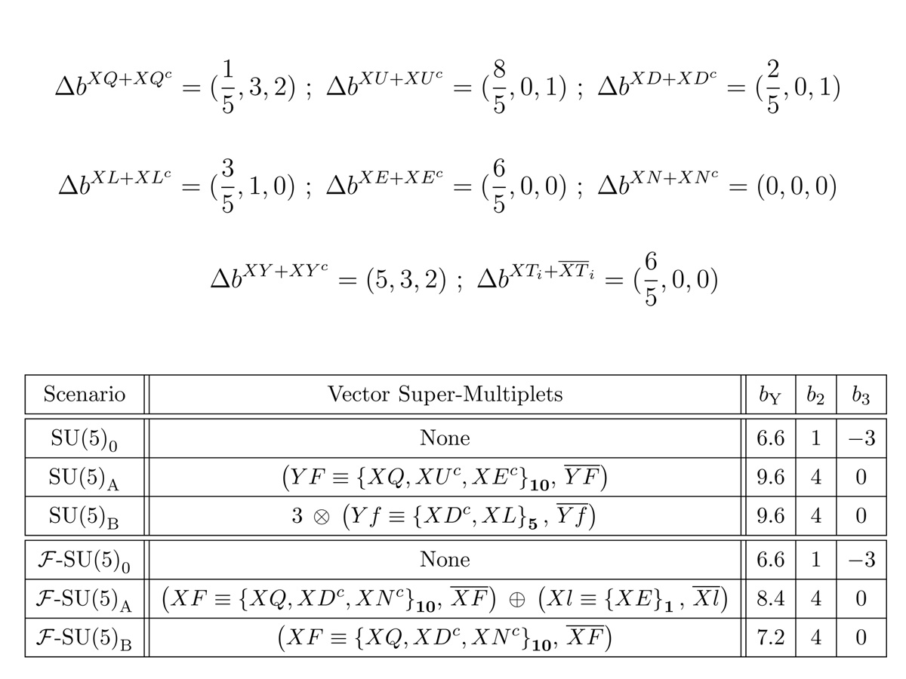
TeV Scale Vector Multiplets
Inclusion of TeV scale Vector Multiplets, as motivated by F-theory, creates a dramatic early adjustment to the running of the gauge couplings.

Slide 32
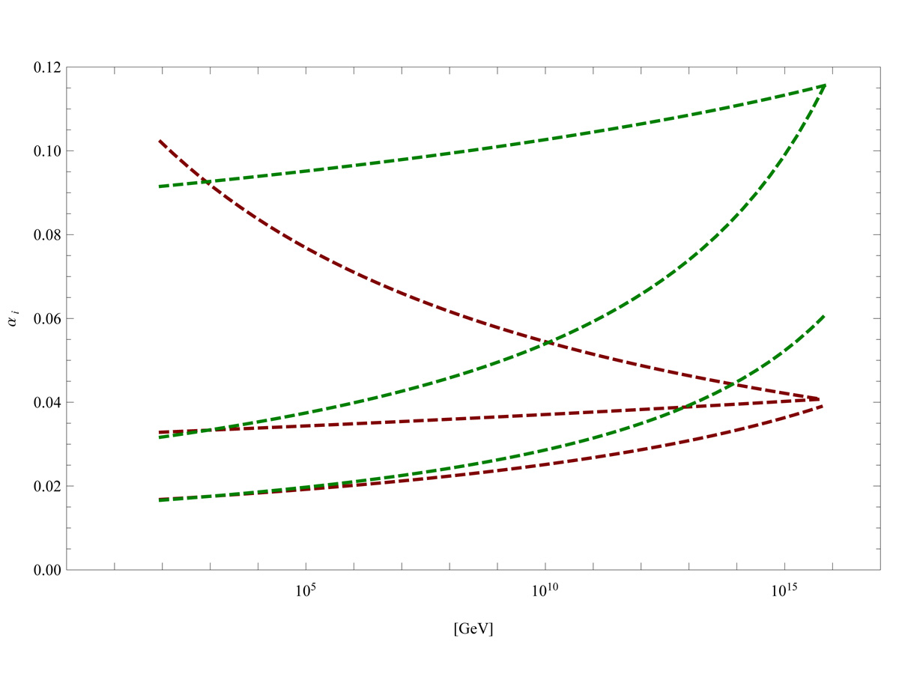
Flipped Unification with & without Vector Multiplets
Inclusion of TeV scale Vector Multiplets levels out the renormalization of the strong coupling, driving up the SU(5) coupling, and speeding proton decay. The gap between the M32 scale couplings becomes extreme.

Slide 34
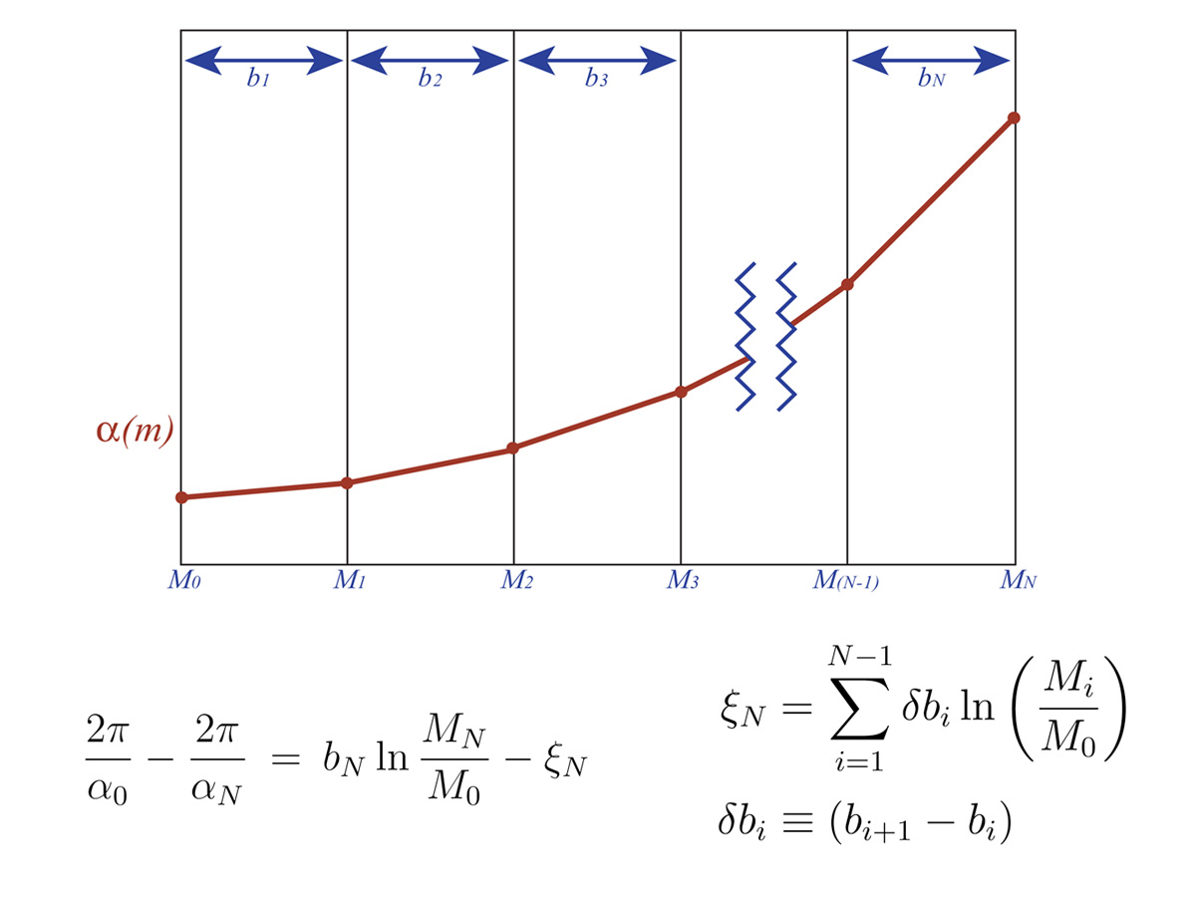
Light Thresholds
As the renormalization scale passes the mass threshold of each Supersymmetric partner, they begin to participate in quantum loops. This alters the slope of the coupling renormalization from that point onward.

Slide 35
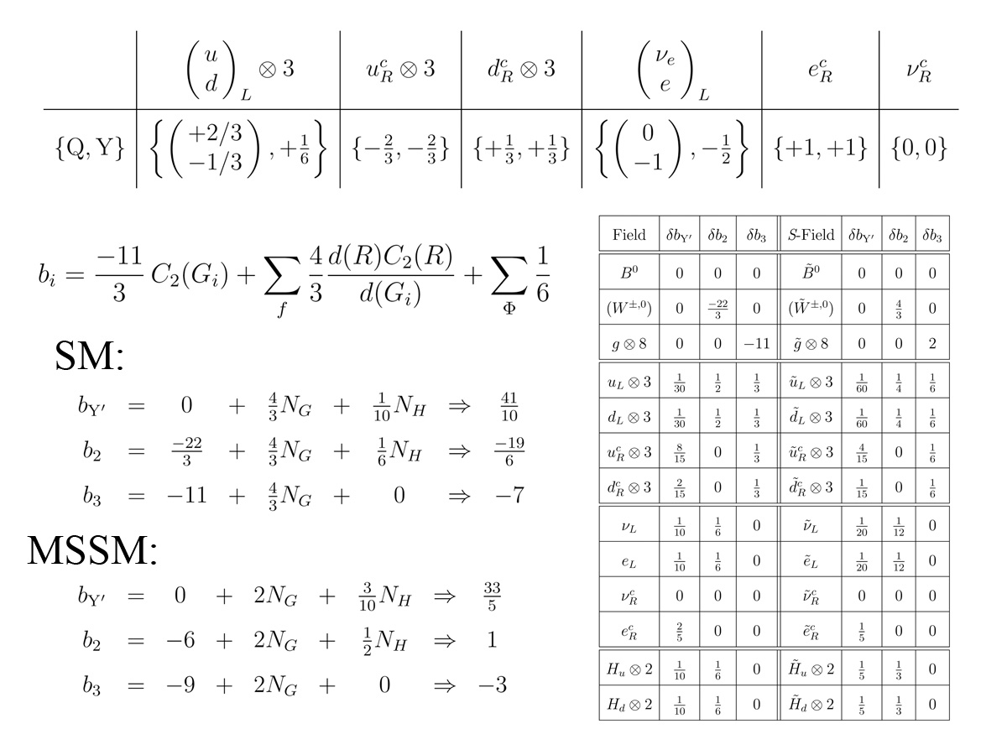
Beta Function Coefficients of the CMSSM
To correctly isolate the effects of the light thresholds, it is essential to know the individual contributions to the CMSSM beta function coefficients from each superpartner.

Slide 36
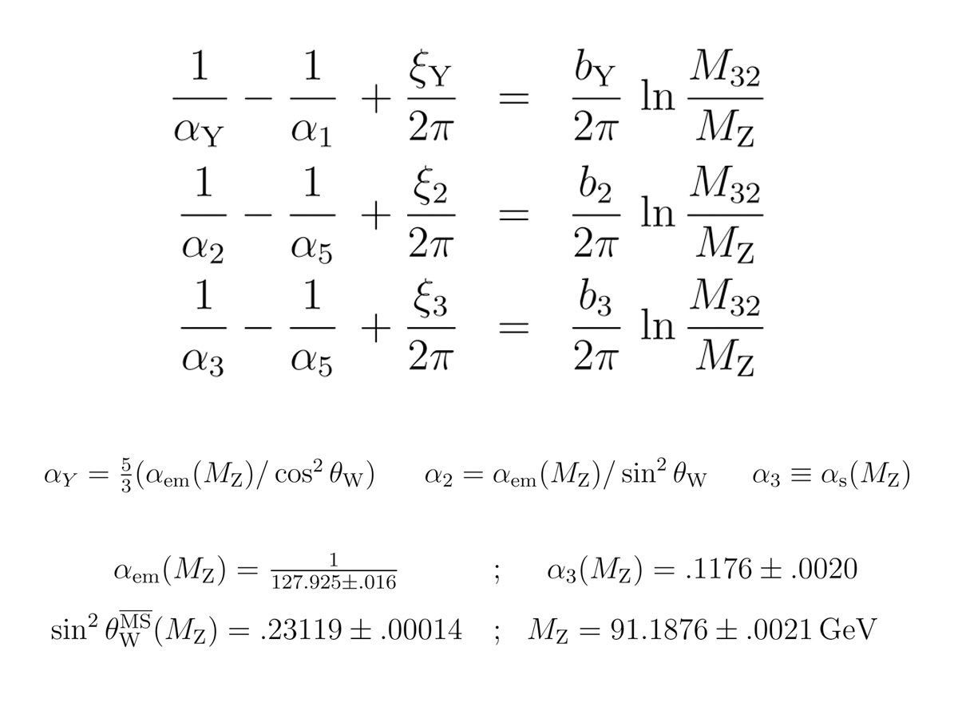
Absorption of Light Thresholds into the RGE’s
The cumulative effect of a threshold presence may be absorbed into one constant for each coupling.

Slide 37
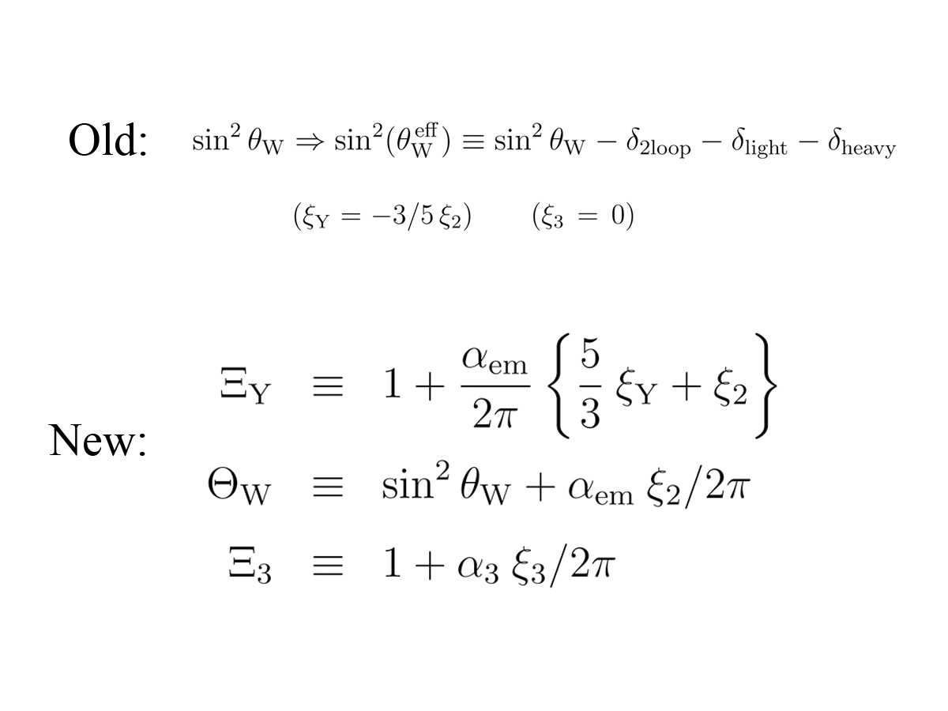
Improvement in Detail of the Threshold Analysis
In prior studies, the thresholds were applied to an effective shift in only the second coupling. Presently, we account the shift individually to each of the three couplings.

Slide 38
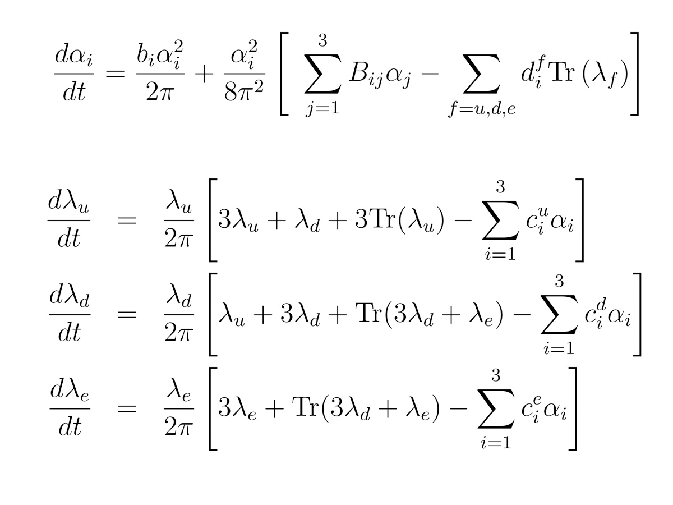
The Second Loop
A fresh numerical evaluation of the Second Loop has been performed for each scenario under consideration, including each distinct selection of Tan(β) and the MSSM mass spectrum.

Slide 39
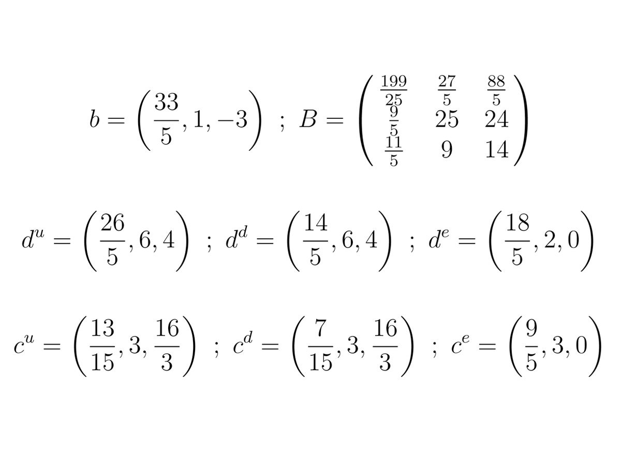
Coefficients of the Second Loop

Slide 40
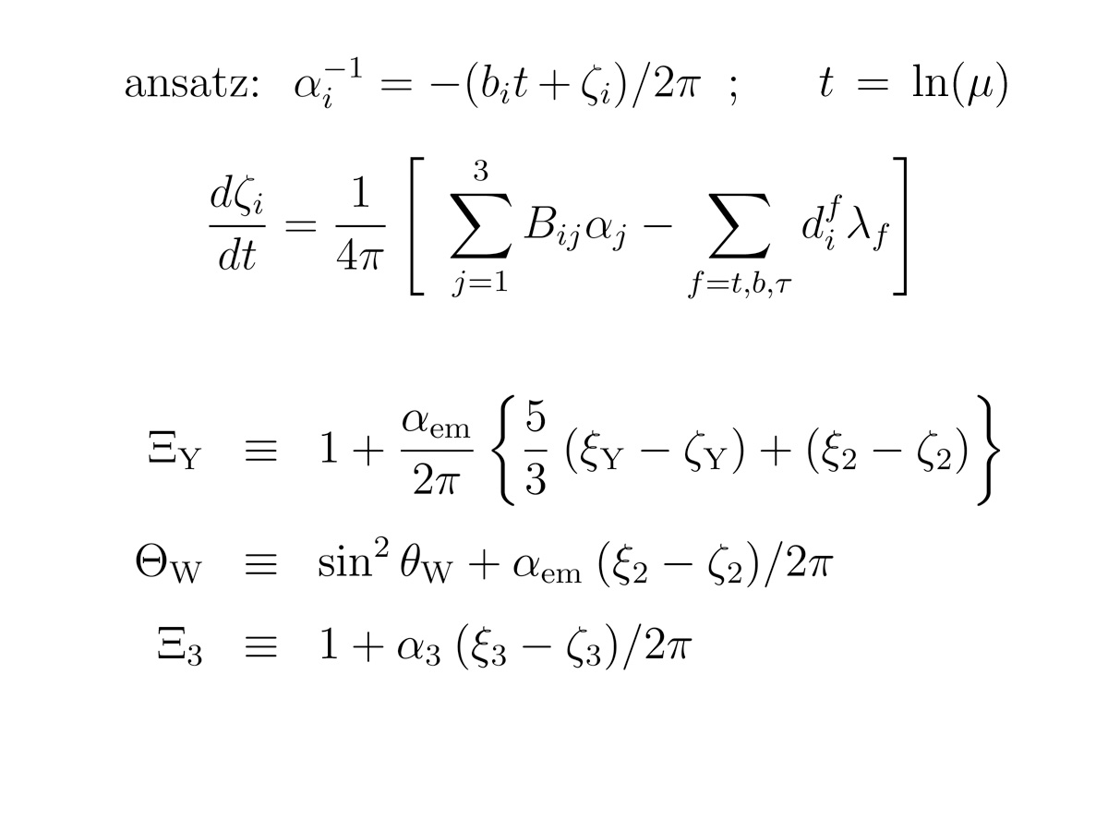
Improvement in Detail of the Two-Loop Analysis
As with the light thresholds, we expand the two-loop analysis to individually account for contributions to the running of each of the three couplings, expanding the prior definition of our three effective parameters.

Slide 41
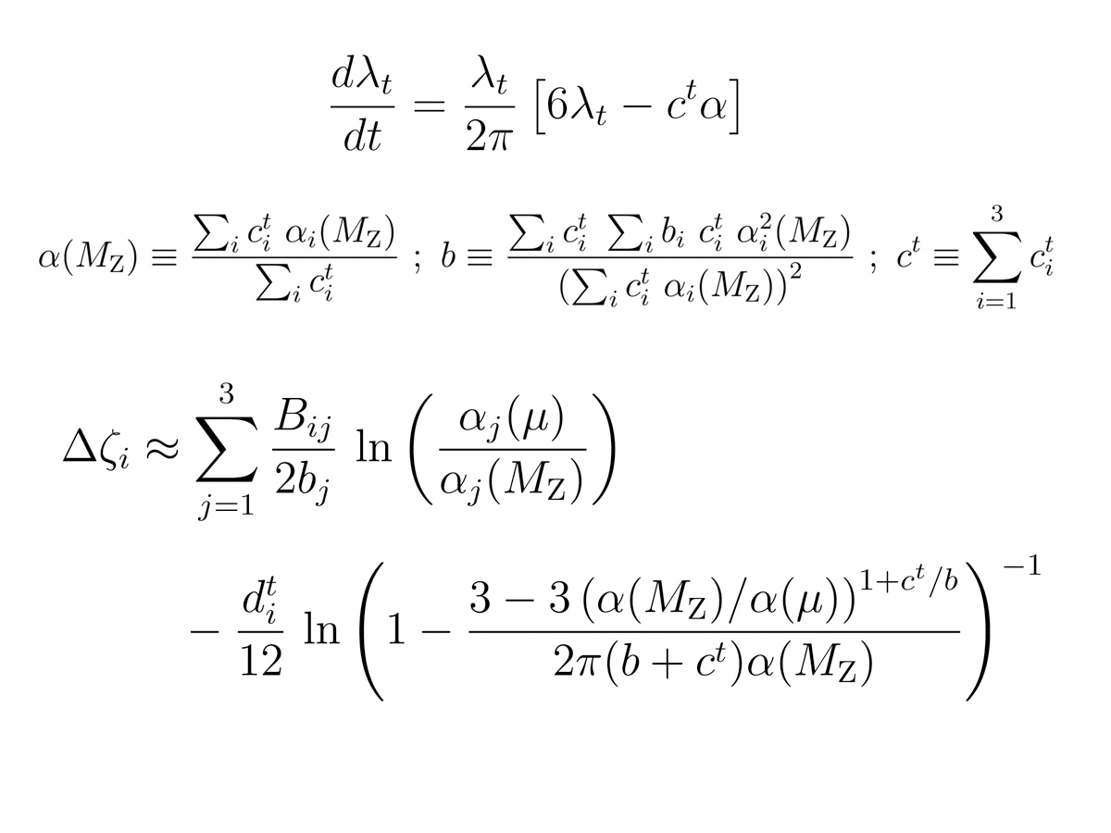
Closed Form Approximate Two-Loop Solution
We have developed a closed form approximation to the 2nd loop contribution which generally agrees with numerical evaluation to about 20%.

Slide 42
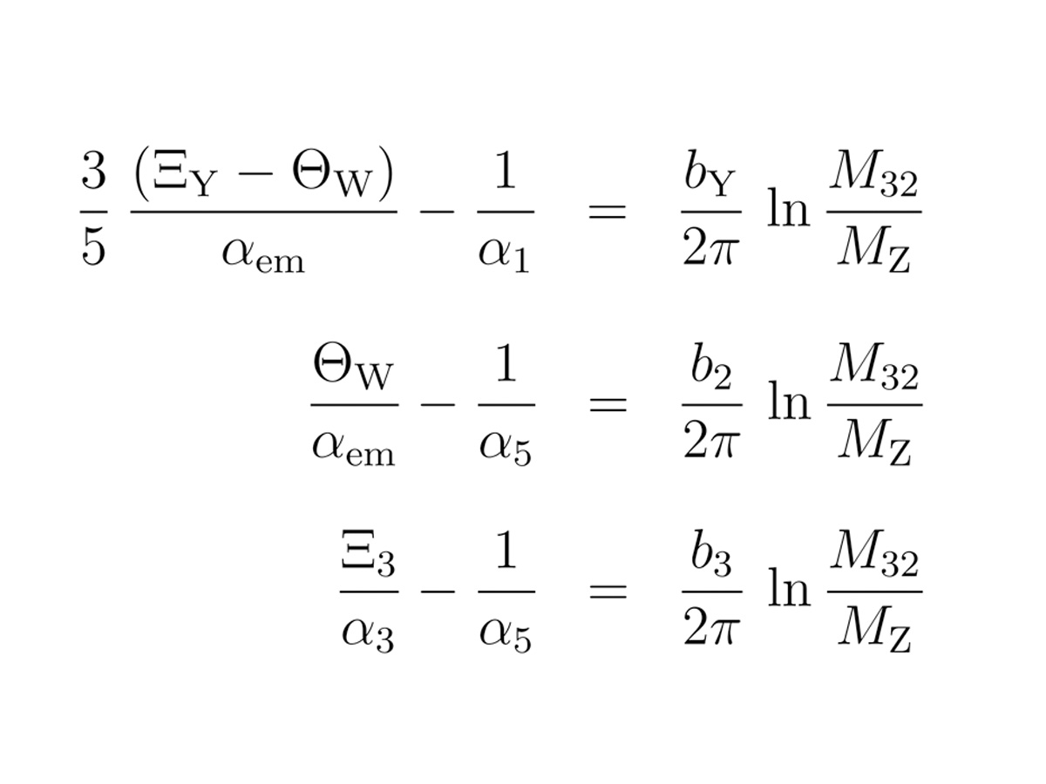
Renormalization Group Equations With 2nd Order Effects
Both Threshold and Second Loop Corrections are absorbed into an Effective Sine-Squared Weinberg angle Plus a corresponding shift term for the Hypercharge and Strong Coupling.

Slide 43
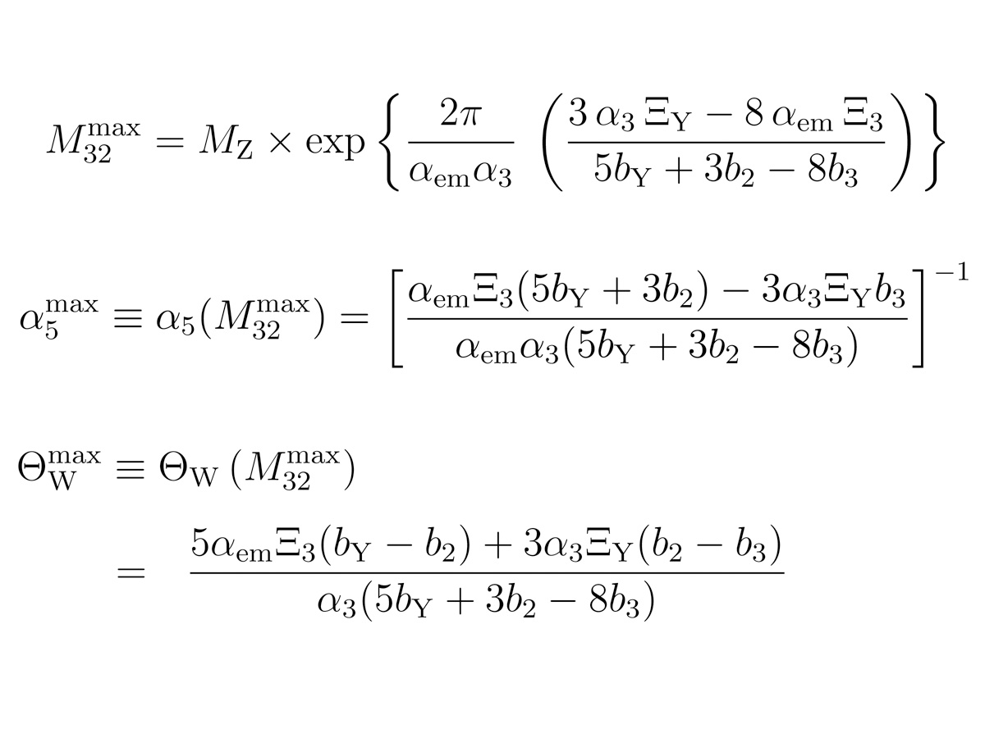
The Standard SU(5) Limit
The “max” limit corresponds to a strict triple unification of the SM couplings. It is essential to recognize that the “max” effective Weinberg angle is a dependent variable. Failure to match the expected value signals a failure of unification itself.

Slide 44
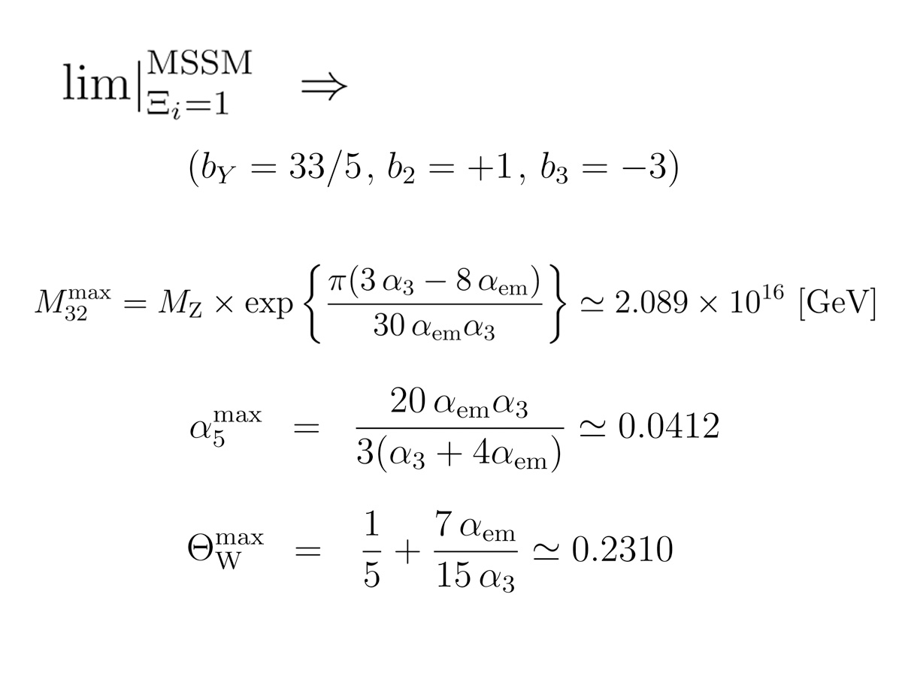
The Standard SU(5) Limit with MSSM Field Content
Note that the “predicted” value for the effective sine-squared Weinberg angle is a good match for the experimental number. This implies that the actual 2nd order effects must finely cancel if the Standard SU(5) unification is to be consistent.

Slide 45
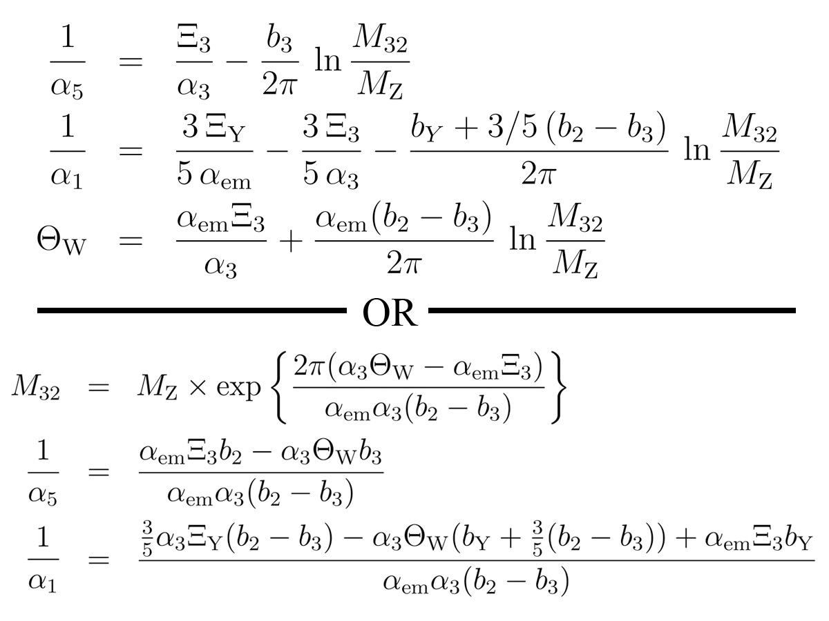
Flipped SU(5) Solutions
It is critically important to select a properly orthogonalized set of dependent functions. For Flipped SU(5) it is convenient to choose the SU(5) and U(1)X couplings, and either the unification scale M32 OR the effective Weinberg angle.

Slide 48
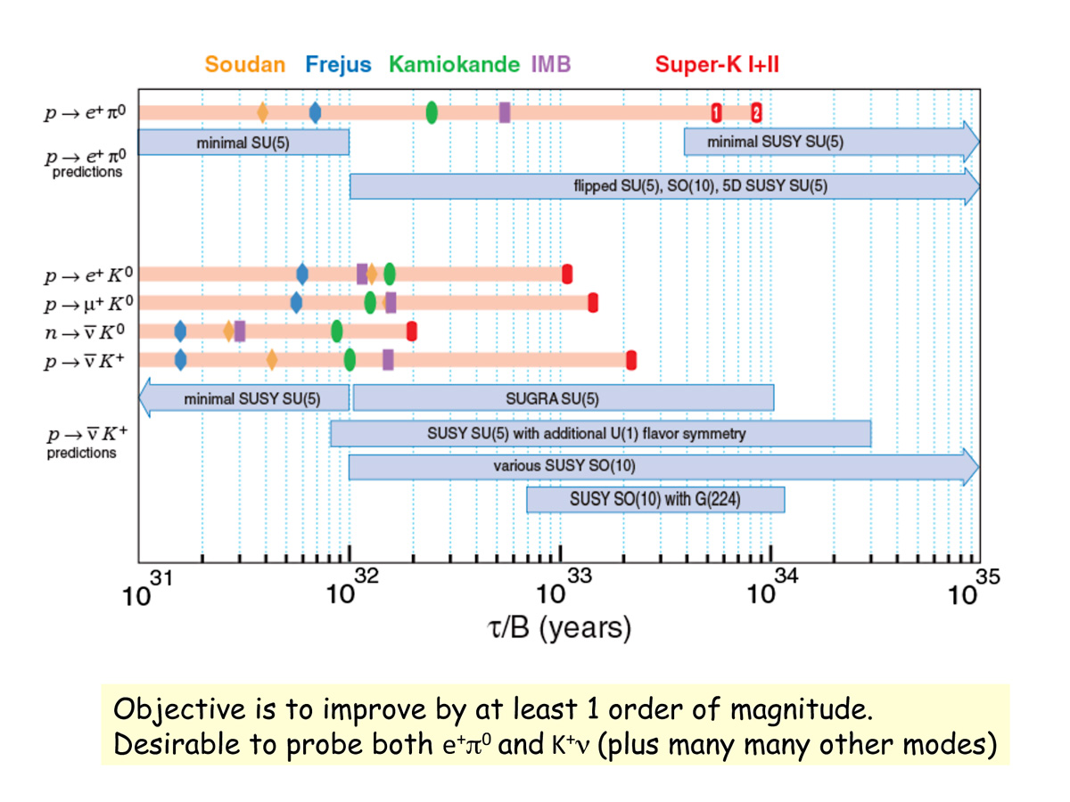
Proton Decay Experiment Vs. Theory
Slide Courtesy of Ed Kearns

Slide 49
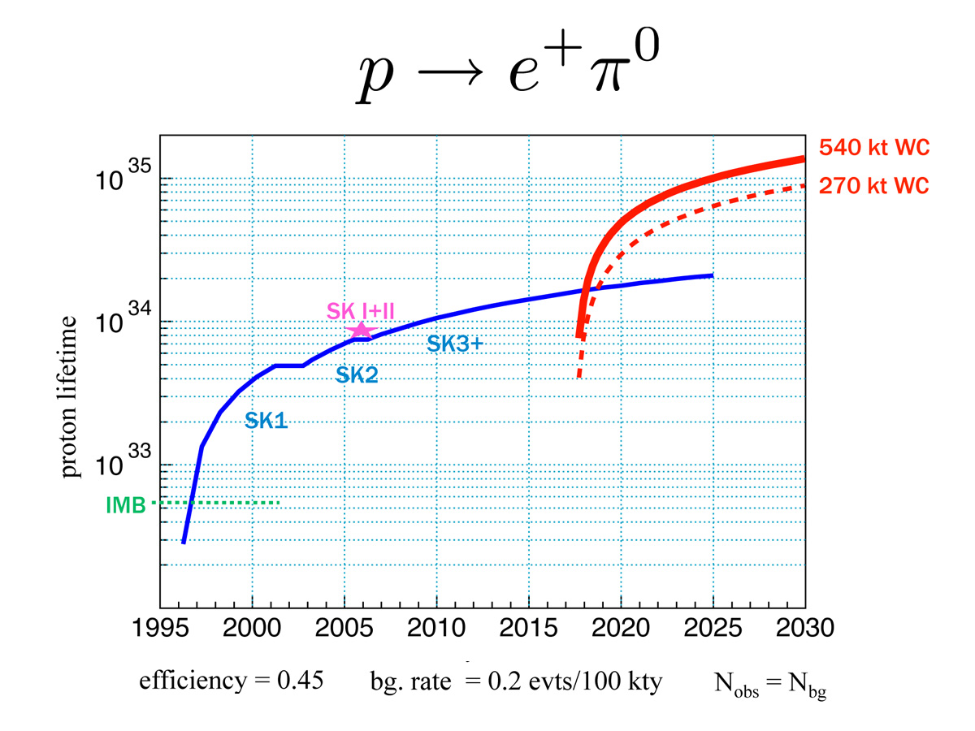
Detection Prospects for the e⁺π⁰ Mode
Slide Courtesy of Ed Kearns

Slide 50
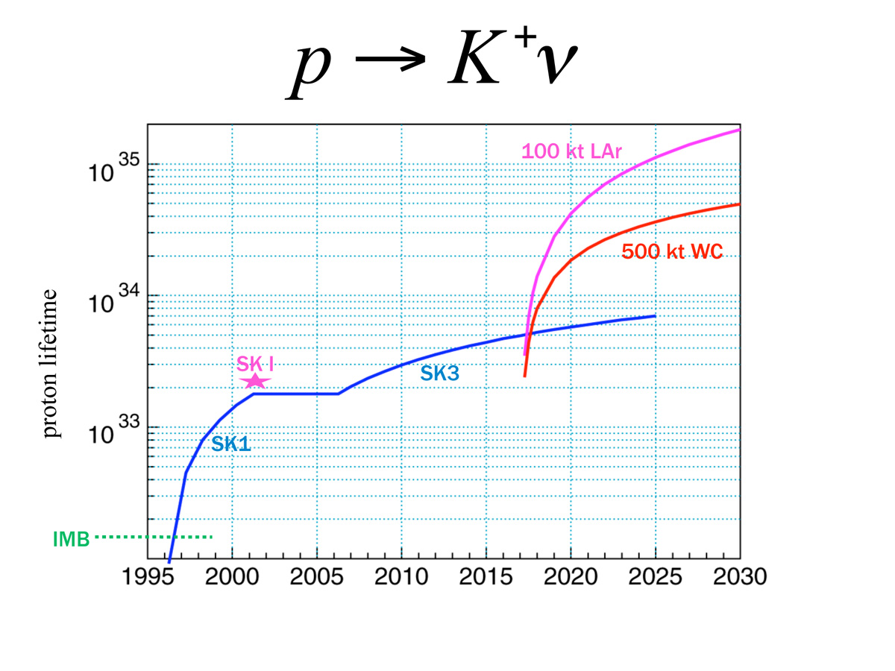
Detection Prospects for the K⁺ν Mode
Slide Courtesy of Ed Kearns

Slide 53
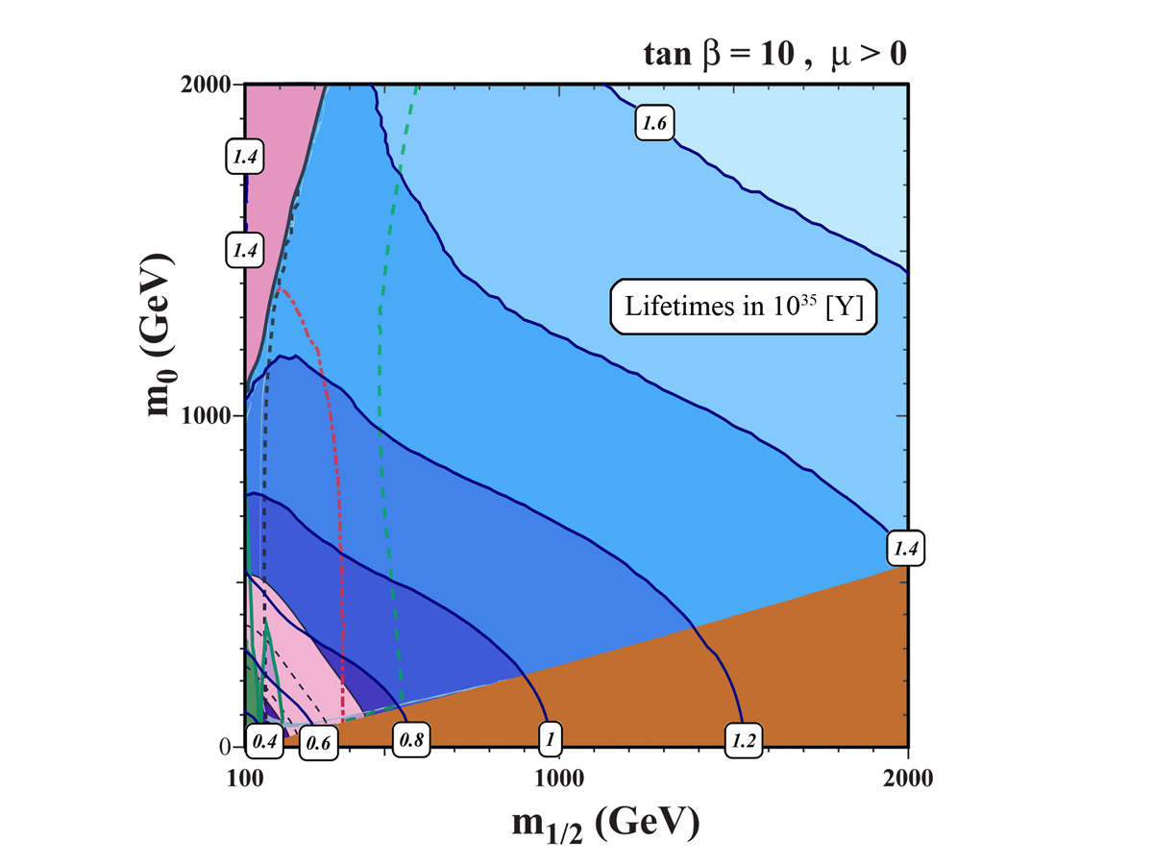
Proton Lifetime Within the M1/2 - M0 Plane
Proton Lifetime in the Flipped SU(5) e⁺π⁰ channel is depicted against the background of phenomenological constraints on the MSSM. Background figure courtesy of Keith Olive.

Slide 54
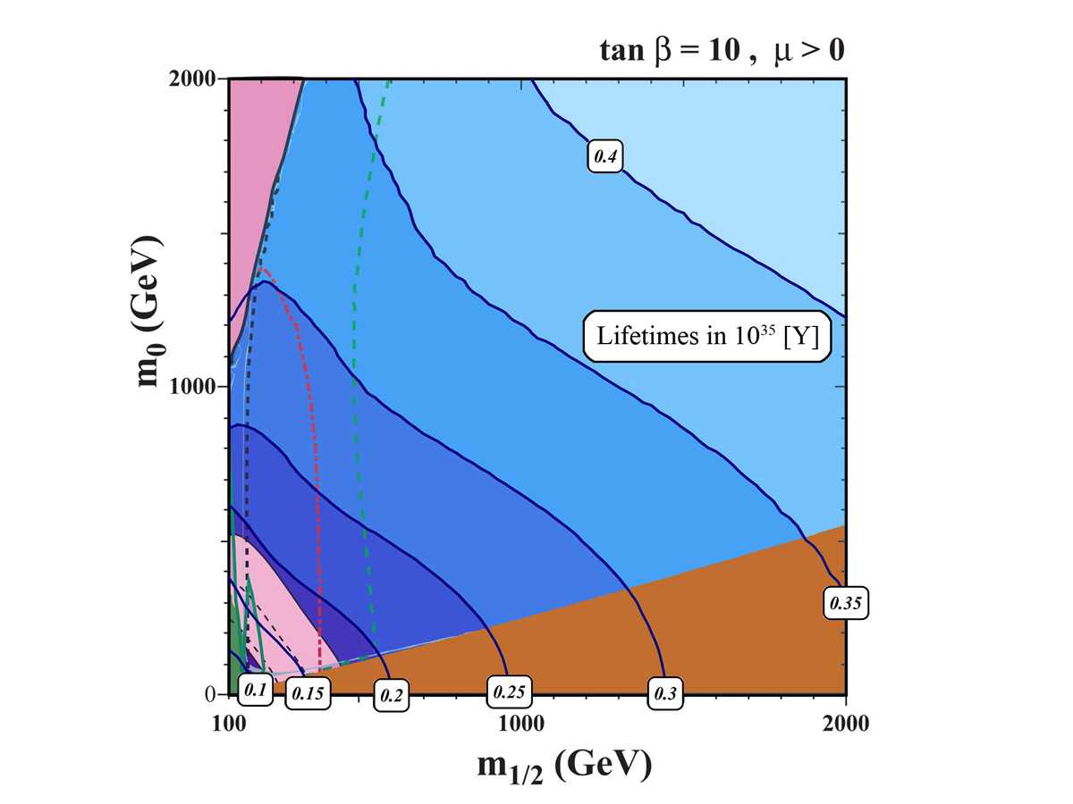
The M1/2 - M0 Plane with Vector Multiplets
Proton Lifetime in the Flipped SU(5) e⁺π⁰ channel, including TeV vector multiplets, is depicted against phenomenological constraints on the MSSM. Background figure courtesy of Keith Olive.

Slide 55
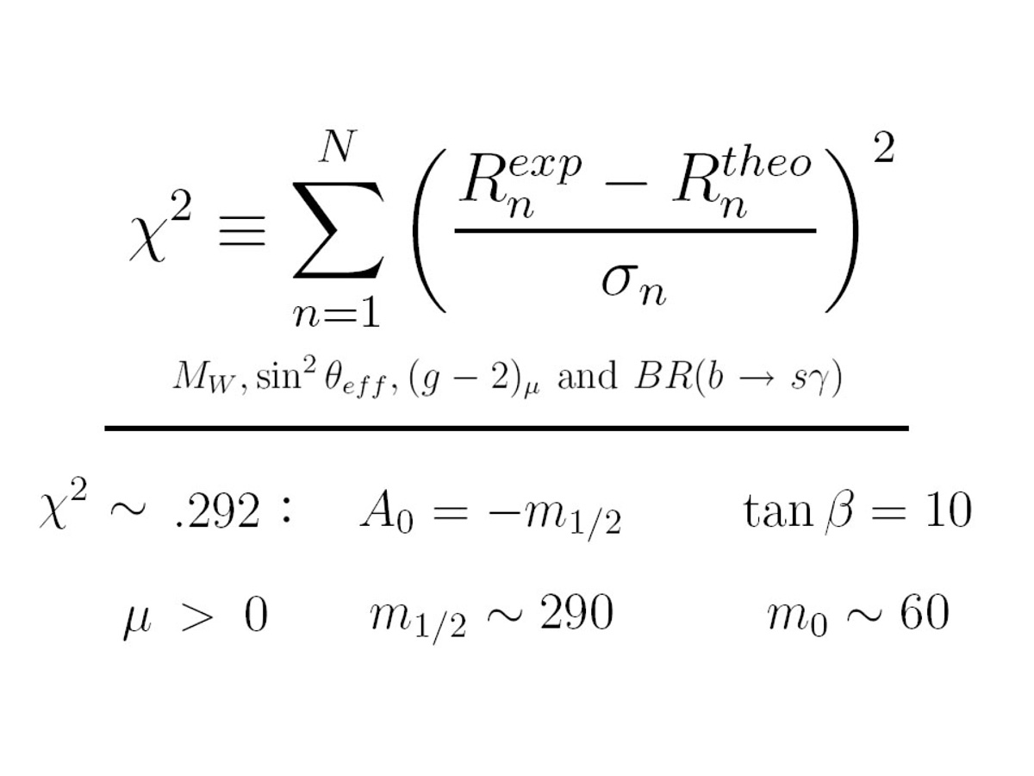
Minimizing the Error Quadrature of the CMSSM
With Thanks to Sven Heinemeyer

Slide 56
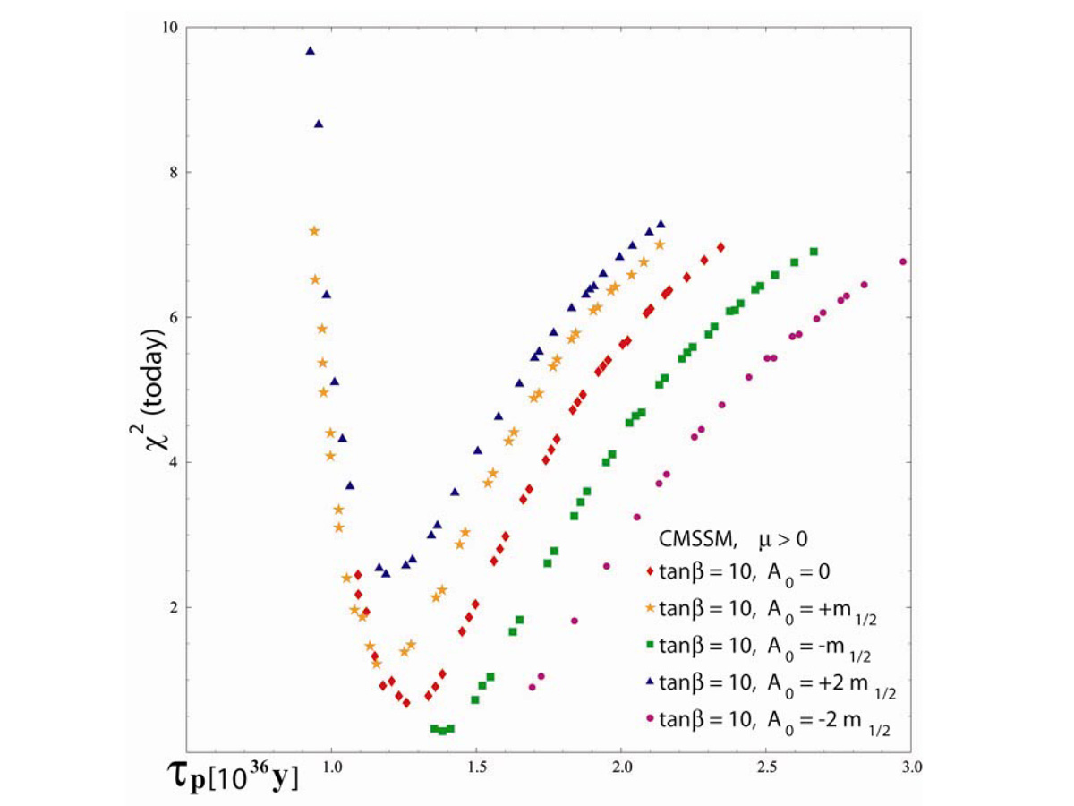
The Favored CMSSM Parameterization
With Thanks to Sven Heinemeyer

Slide 57
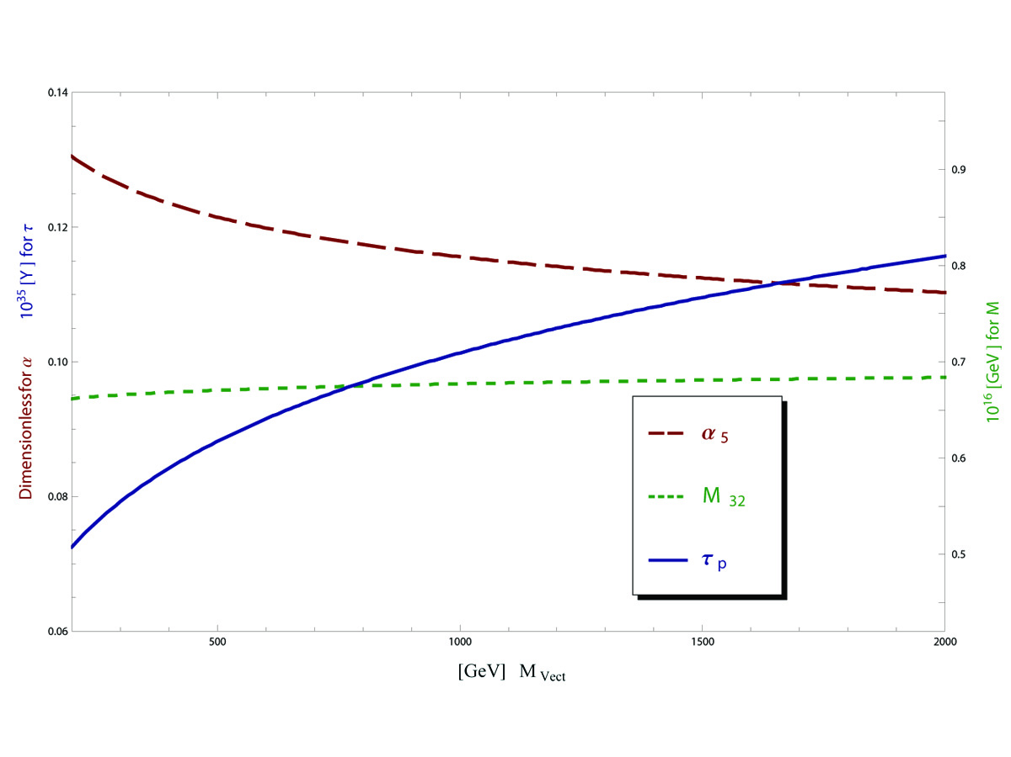
Variation of Vector Multiplet Scale
Proton lifetime (solid blue) is measured in 10³⁵ [Y] on the left numeric scale. The dimensionless SU(5) coupling (dash red) is also measured on the left-hand scale. The unification mass (dot green) is measured in 10¹⁶ [GeV] on the right-hand scale.

Slide 58
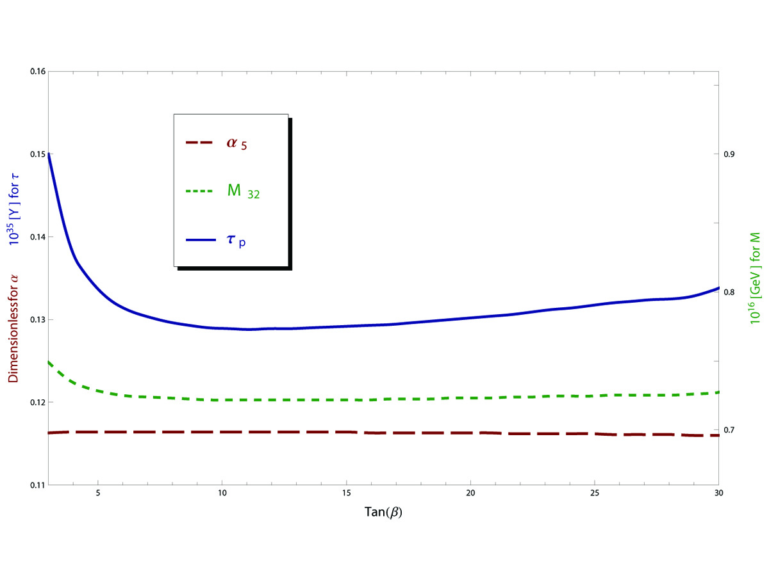
Variation of Tan(β)
Proton lifetime (solid blue) is measured in 10³⁵ [Y] on the left numeric scale. The dimensionless SU(5) coupling (dash red) is also measured on the left-hand scale. The unification mass (dot green) is measured in 10¹⁶ [GeV] on the right-hand scale.

Slide 60
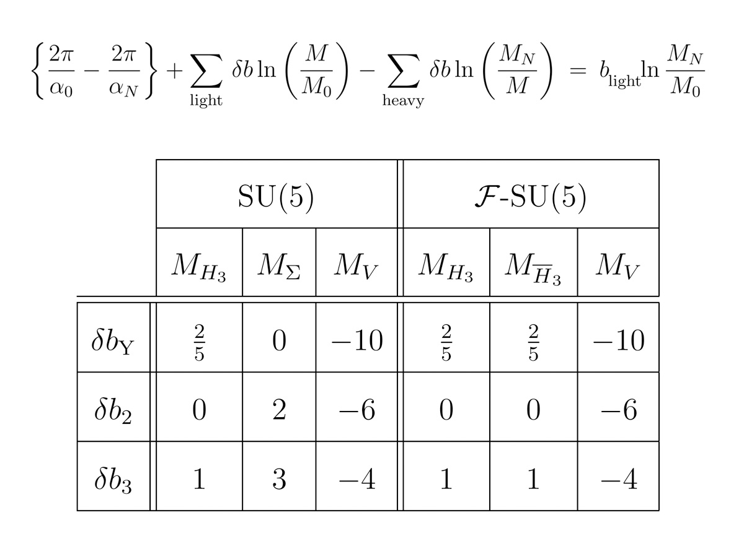
Heavy Thresholds
Light thresholds are treated additively, heavy thresholds subtractively. The heavy thresholds are compared to the upper mass scale rather than the lower. Heavy fields are not included in the main β-function coefficients.

Slide 61
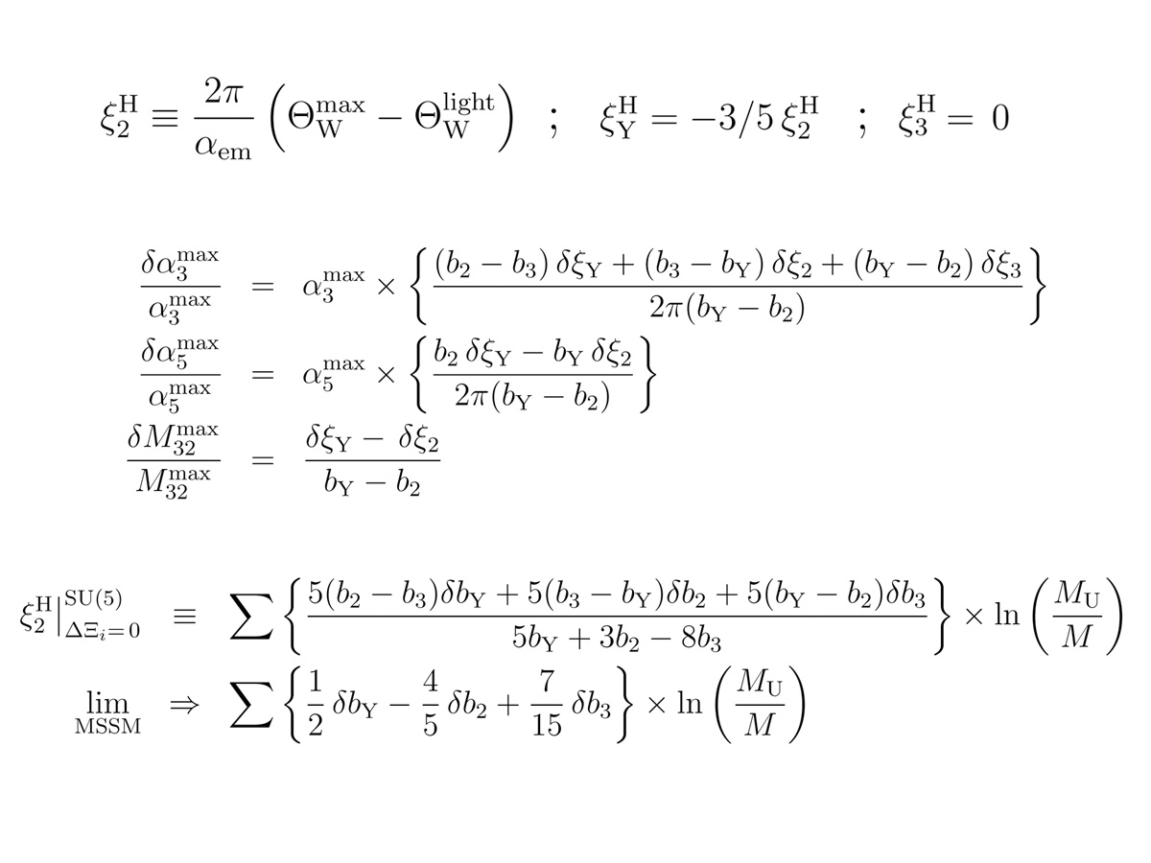
Heavy Thresholds in Standard SU(5)
Standard SU(5) generally requires heavy thresholds in order to match low energy phenomenology. We choose a single effective shift parameter for the second coupling which will not disrupt agreement with the measured strong coupling at Mz.

Slide 62
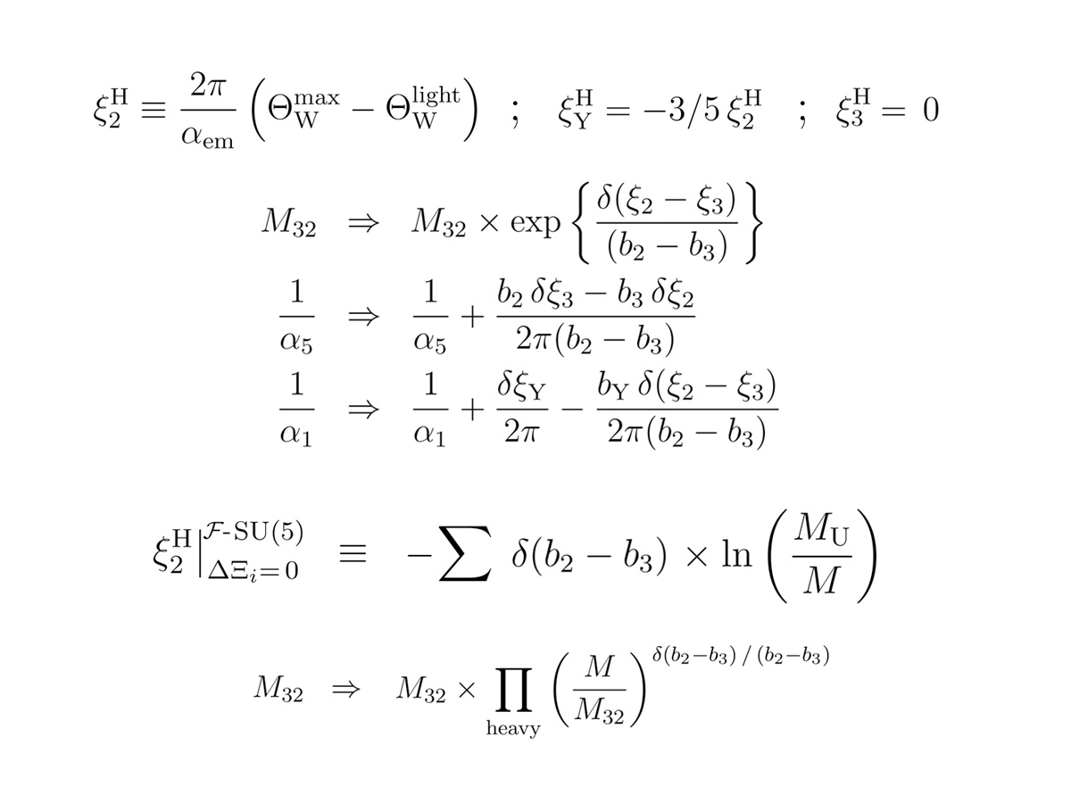
Heavy Thresholds in Flipped SU(5)
Heavy thresholds are generally not required in Flipped SU(5), as variation in the M32 scale is sufficient alone to match low energy constraints. Neither can the prospect of an appreciable contribution be ruled out by low energy physics alone.

Slide 63
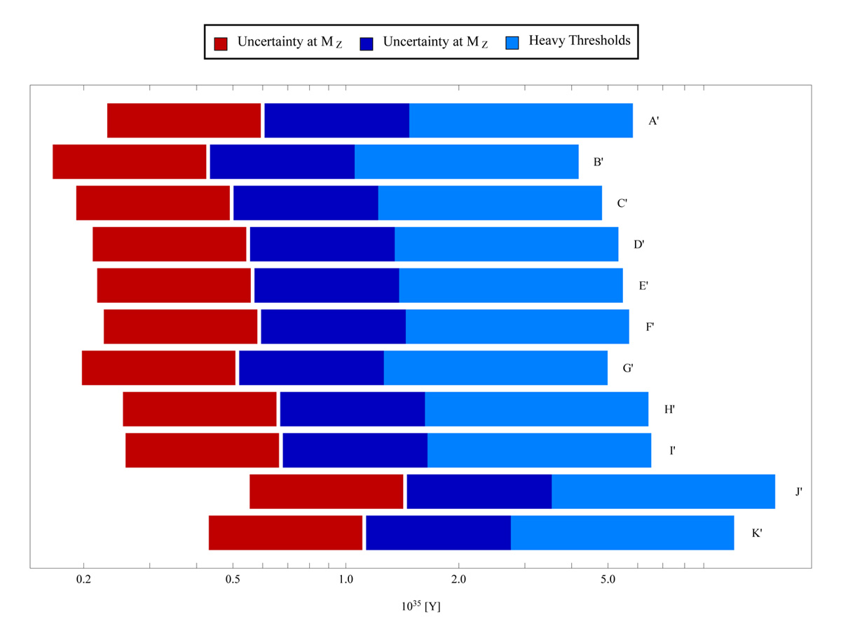
Uncertainty & Heavy Thresholds in Flipped SU(5)
Central values for proton lifetime at the MSSM Benchmarks lie on the white boundary. The dark red / blue bands show uncertainty of low energy measurements. The large light blue error bars depict plausible variation of the heavy thresholds.

Slide 64
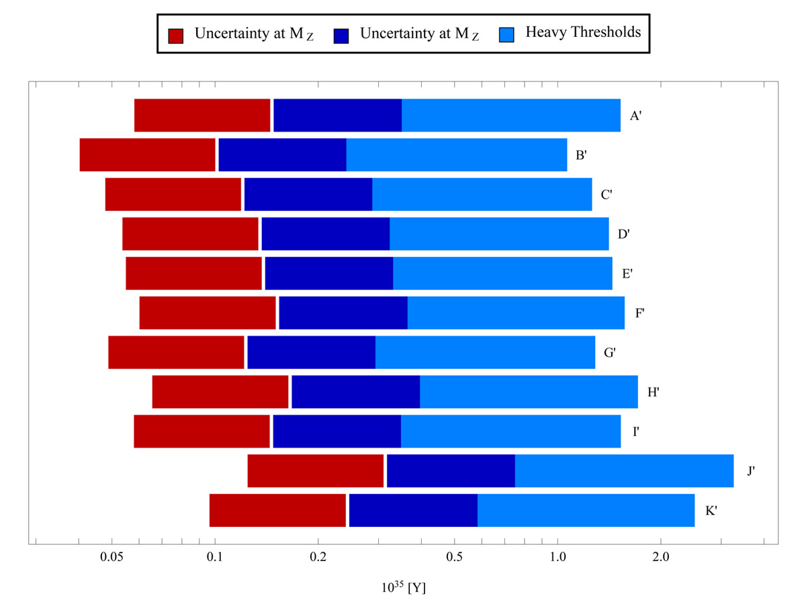
Heavy Thresholds with Vector Multiplets
Central values for proton lifetime at the MSSM Benchmark Points lie on the white boundary. The dark red / blue bands show uncertainty of low energy measurements. The large light blue bars depict plausible variation of the heavy thresholds.

Slide 65
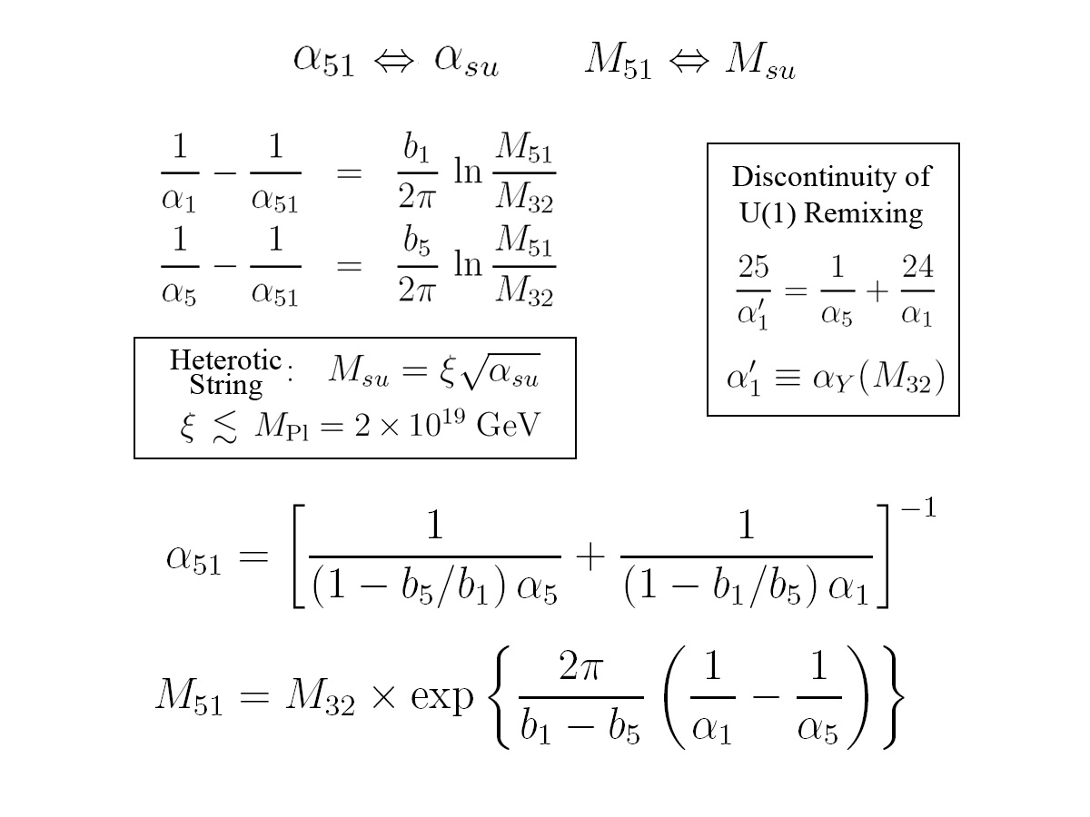
Super Unification
The prospect exists of confining Grand Unification from both the Electroweak and Planck Scales. The restriction that M51, and thus likewise M32, not creep too far forward may limit the potential “damage” from heavy threshold effects.

Slide 66
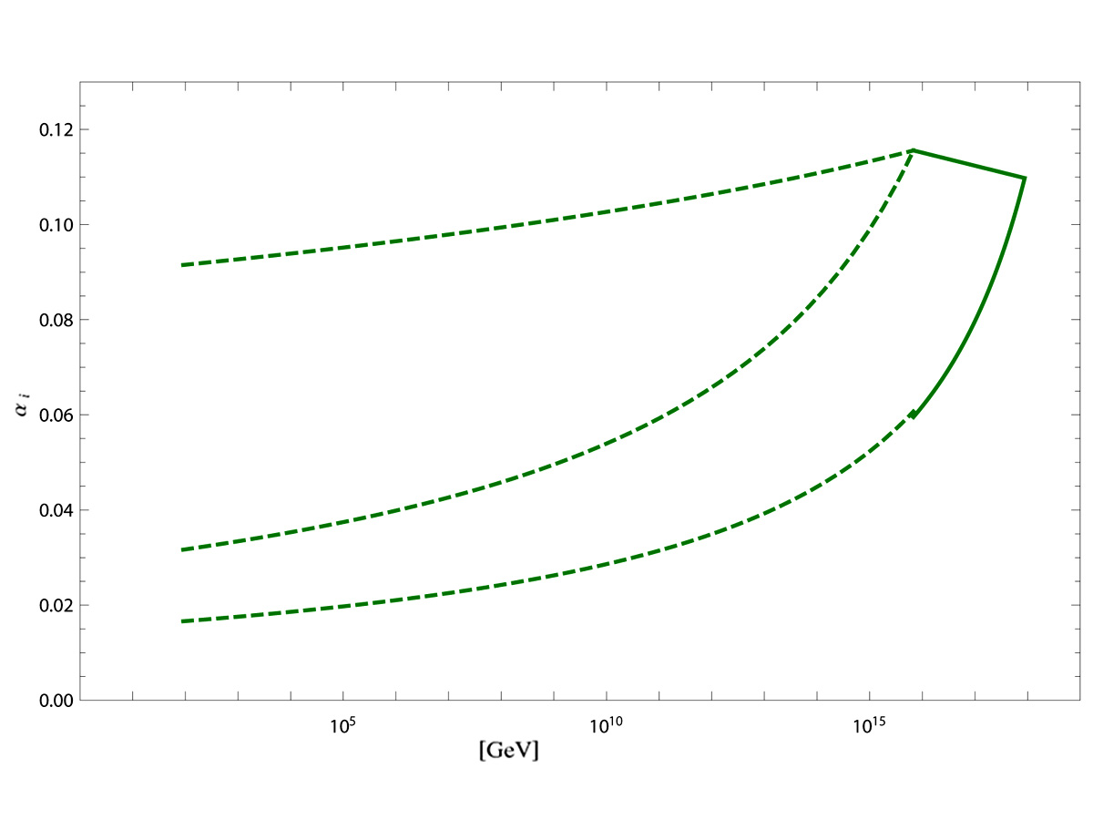
Super Unification with Vector Multiplets
Continuing the two-loop renormalization beyond the 3,2 partial unification can result in a super unification near the reduced Planck scale. The wide coupling separation at M32 which was produced by the F-theory fields allows sufficient room to run.

Slide 67
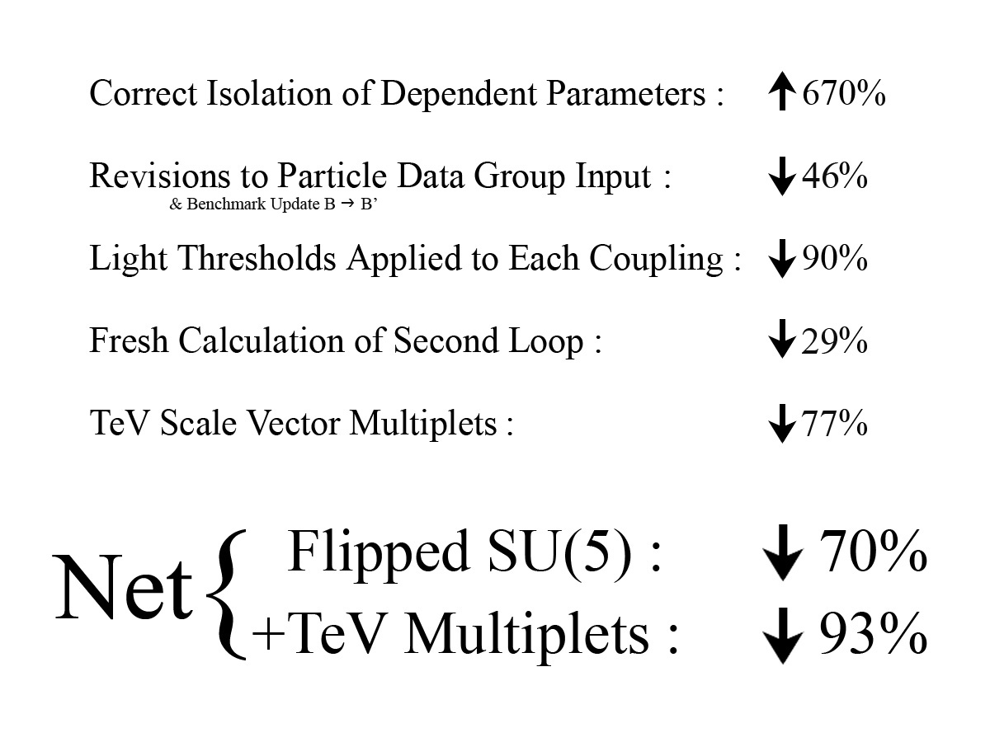
Reasons for the Decline in Proton Life Expectancy
Comparisons are relative to the 2002 report on Flipped SU(5) by Ellis, Nanopoulos, and Walker. The increases and decreases are combined multiplicatively in sequence to develop the net change.

Slide 68
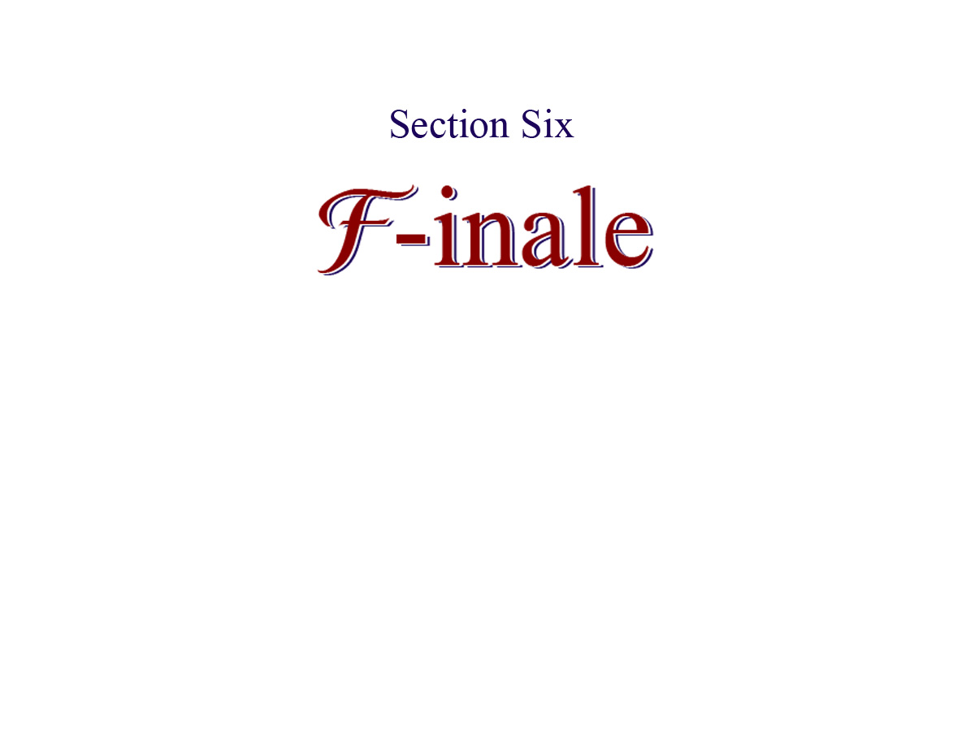

Slide 71
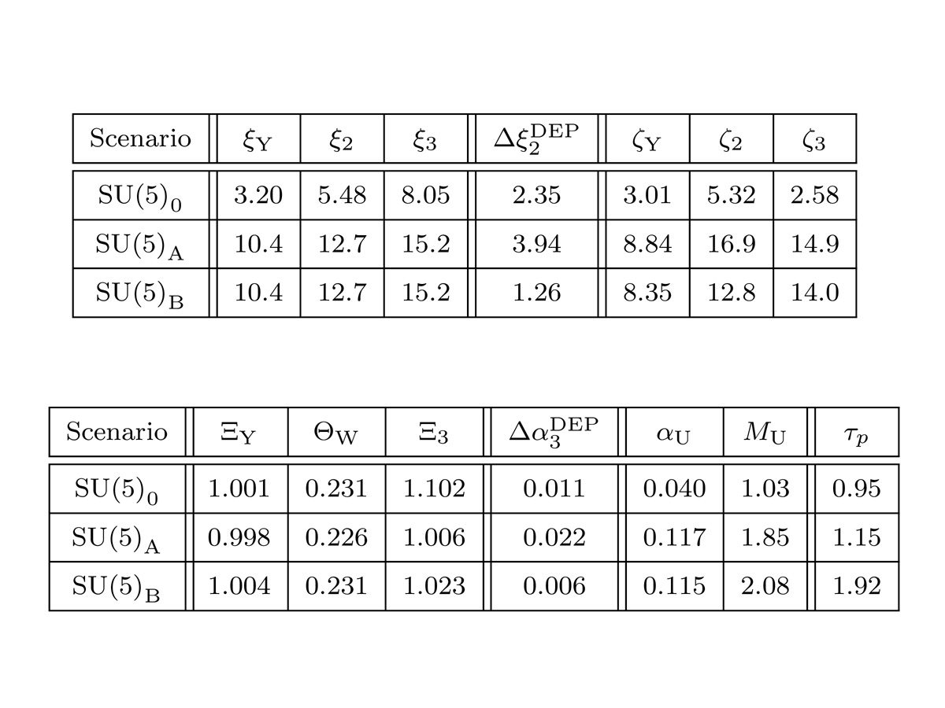
Numerical Results for Standard SU(5)
The e⁺π⁰ channel is predicted to decay at 1-2 x 10³⁵ [Y] for Standard SU(5). However, dimension five decay dominates this model. The excess Δα3 in the “predicted” strong coupling shows that unification requires impossibly large heavy thresholds.

Slide 72
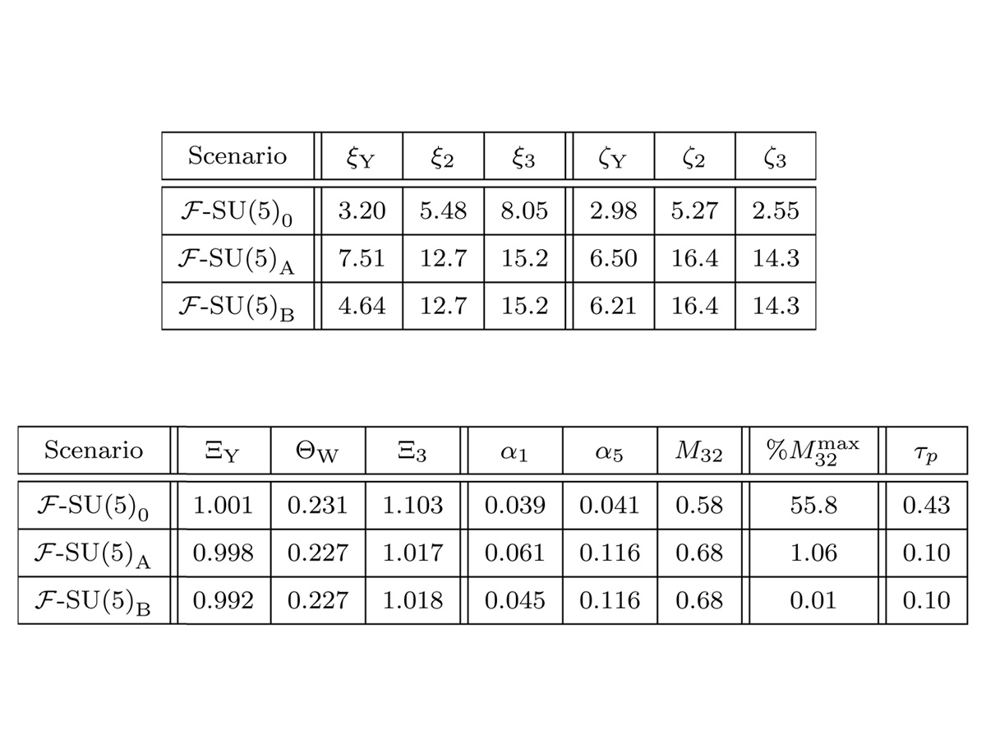
Numerical Results for Flipped SU(5)
The e⁺π⁰ channel is predicted to decay at 0.4 x 10³⁵ [Y] for Flipped SU(5). The (A,B) type TeV Vector Multiplet scenarios predict a lifetime four times shorter still. Partial unification occurs at around 0.6 x 10¹⁶ [GeV].

Slide 73
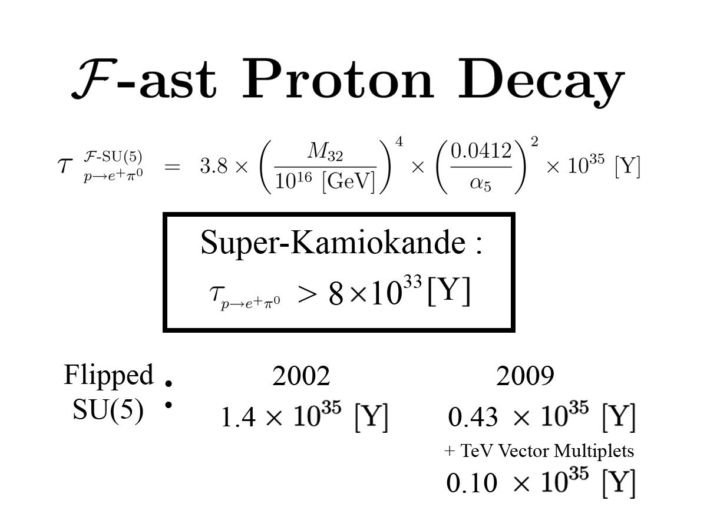
Comparison of Central Value Predictions
The 2009 central predictions for proton decay narrowly evades current detection bounds from Super-Kamiokande. Even with the possibility of substantial heavy thresholds, the majority of the predicted range is testable in the next generation.

Slide 75
A Convergence of Large Experiments
Proton decay, hastened by the inclusion of TeV scale Vector Multiplets, represents an imminently testable convergence of the most exciting particle physics experiments of the next decade.

