Slide 1
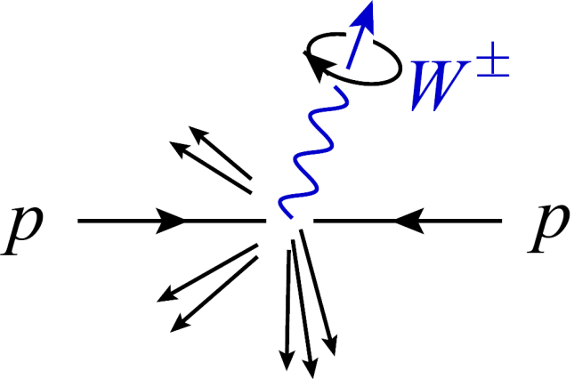
Theoretical Strategies for LHC Physics
Lance Dixon (SLAC)
and representing the BlackHat collaboration
C.F.Berger, Z. Bern, LD, D. Forde, F. Febres Cordero,
T. Gleisberg, H. Ita, D. Kosower, D. Maître
Pheno 2010 Symposium
Madison, Wisconsin, May 10, 2010

Slide 2
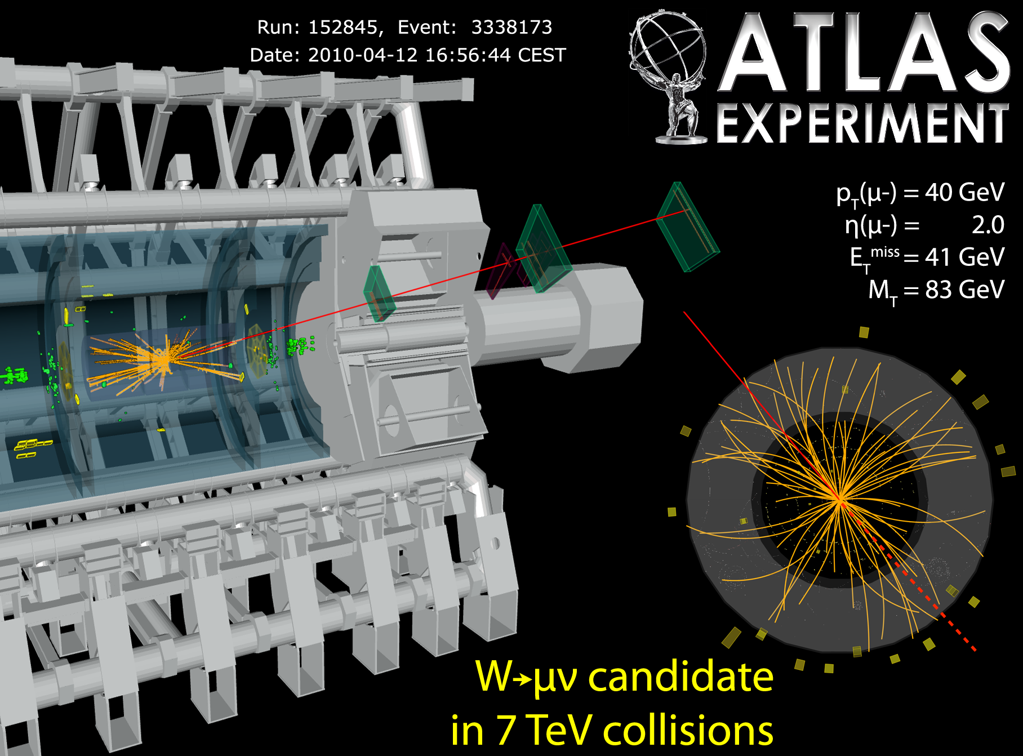
Electroweak physics is underway!

Slide 3
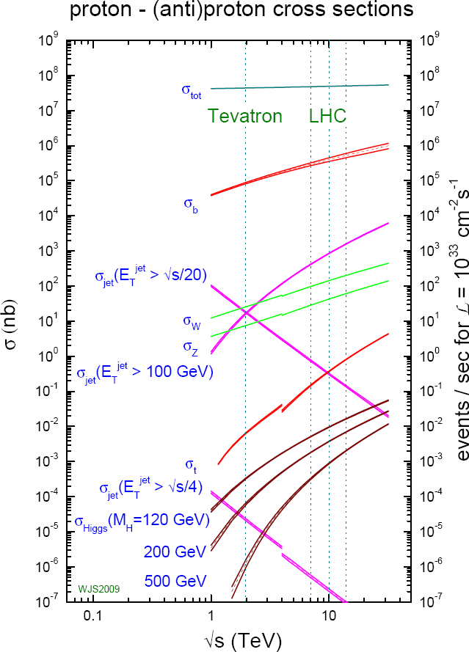
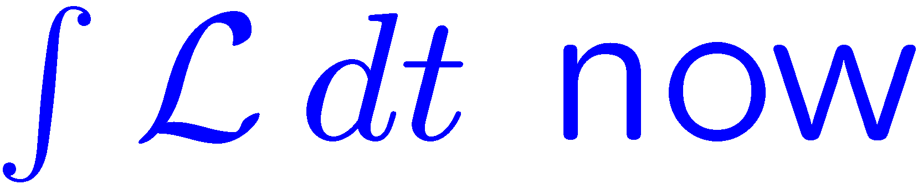
LHC is a jetty environment
Every process shown
also occurs with one more jet
at ~ 1/5 – 1/10 the rate
Very important to understand not only Standard Model production of X but also of
X + n jets
where
X = W, Z, tt, WW, H, …
n = 1,2,3,…
LHC @ 7 TeV
_
New physics
Higgs physics
For more on signals, see talks
by Joe Lykken, Marcela Carena,
…

Slide 4
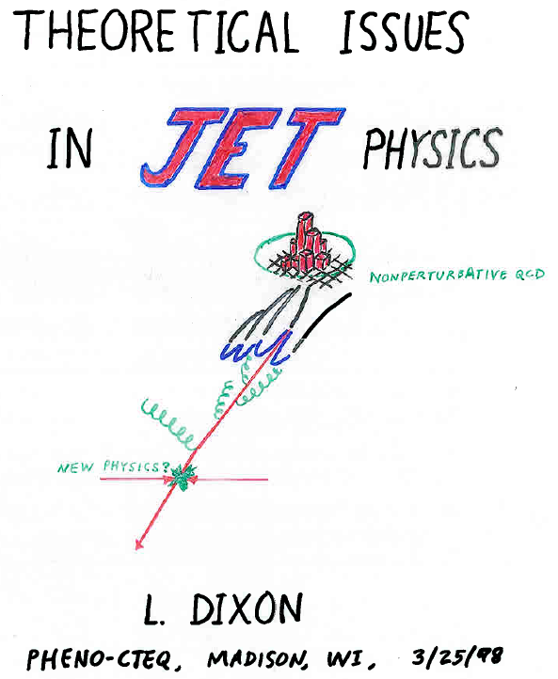
Jets never go out of fashion…

Slide 5
Multi-particle backgrounds
ν
New particles – whether from
  supersymmetry
  extra dimensions
  new forces
  Higgs boson(s)
typically decay into old particles:
quarks, gluons, charged leptons, neutrinos, photons,
Ws & Zs (which in turn decay to leptons, …)
Kinematic signatures not always clean (e.g. mass bumps)
if dark matter, neutrinos, or other escaping particles present
gluino
cascade
ν
χ
χ
Need precise Standard Model backgrounds for a
variety of multi-particle – and especially multi-jet – processes, to maximize potential for new physics discoveries

Slide 6
How best to control
SM backgrounds?
Get the best theoretical prediction you can, whether
  Basic Monte Carlo [PYTHIA, HERWIG, Sherpa, …]
  LO QCD parton level
  LO QCD matched to parton showers [MadGraph/MadEvent, ALPGEN/PYTHIA, Sherpa, …]
  NLO QCD at parton level
  NLO matched to parton showers [MC@NLO, POWHEG,…]
  NNLO inclusive at parton level
  NNLO with flexible cuts at parton level
Increasing availability →
Increasing accuracy →
Take ratios whenever possible
- QCD effects cancel when event kinematics are similar
- Closely related to “data driven” strategies
In this talk, focus mainly on vector boson + jets

Slide 7
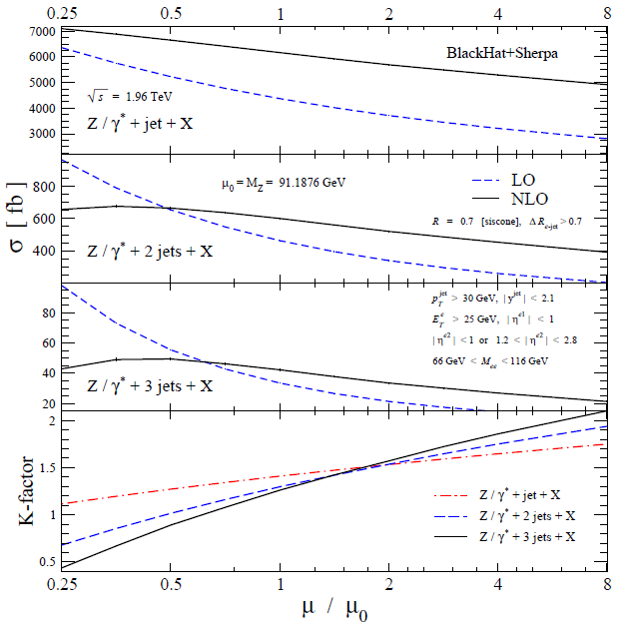
LO uncertainty increases with n_{jets}
Example of
Z + 1,2,3 jets
at Tevatron
(CDF cuts)
arXiv:1004.1659
Uncertainty
brought under
much better control
by NLO corrections:
~ 50% → ~ 15-20%
NLO really required
for quantitative
control of multi-jet
final states

Slide 8
Background to Search for Supersymmetry
Cascade from gluino to neutralino
(dark matter, escapes detector)
Signal: missing energy + 4 jets
SM background from Z + 4 jets,
Z → neutrinos
Current state of art for Z + 4 jets: ALPGEN, based on LO tree amplitudes → normalization still quite uncertain
ν
ν
χ
χ
Motivates goal of
◊ ν ν
Now only 1 jet beyond state-of-art

Slide 9
Good news
There has been a dramatic increase recently in the rate at which NLO predictions for new processes are being made!

Slide 10
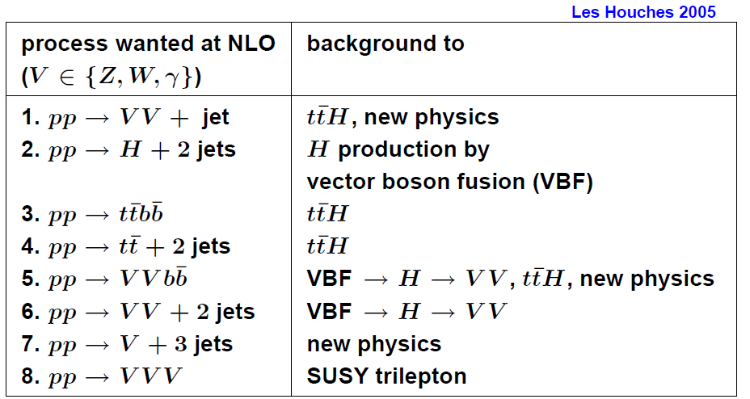
The Les Houches Wish List (2005)

Slide 11
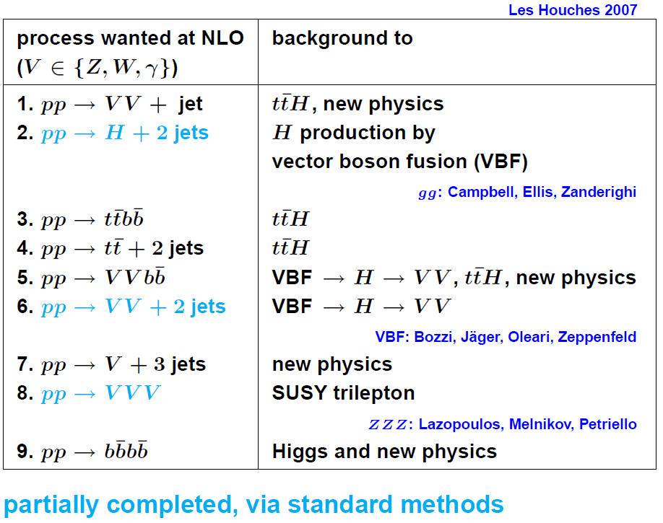
The Les Houches Wish List (2007)

Slide 12
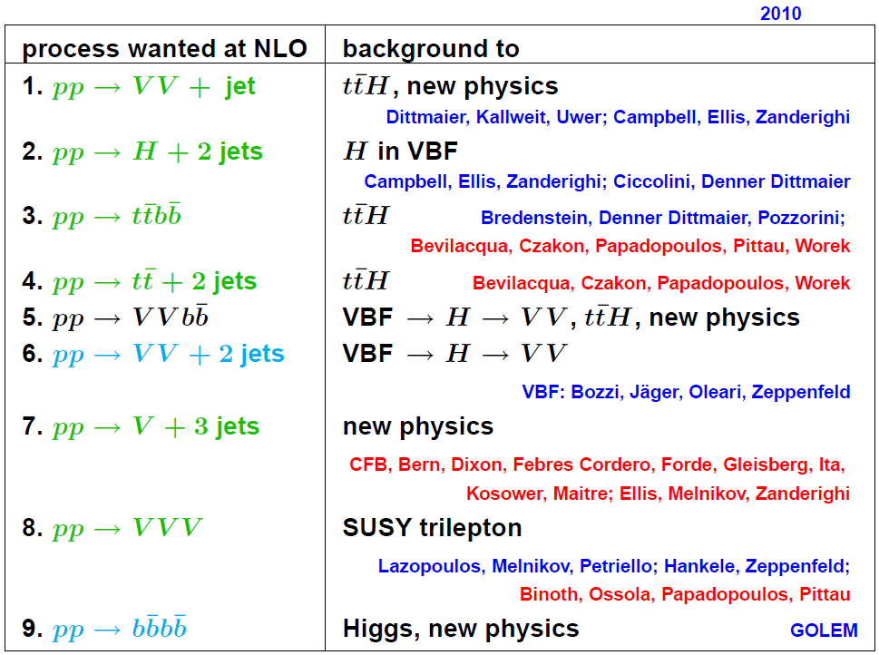
The Les Houches Wish List (2010)
Feynman
diagram
methods
now joined
by
unitarity
based
methods

Slide 13
NLO Computations for Multi-Jet Final-States are Difficult
Feynman diagrams can be used – in principle
# of jets
# 1-loop Feynman diagrams (gluons only)
3
4
5
On-shell methods,
exploiting analyticity,
can be more efficient,
especially for multi-gluon
+ quark processes
6

Slide 14

The Analytic S-Matrix
Bootstrap program for strong interactions in 1960s:
Reconstruct scattering amplitudes directly from analytic properties
Poles
Chew, Mandelstam;
Eden, Landshoff,
Olive, Polkinghorne;
Veneziano;
Virasoro, Shapiro; …
Branch cuts
Analyticity fell out of favor in 1970s with the rise of QCD & Feynman rules
Now resurrected for computing amplitudes for perturbative QCD
– as on-shell or unitarity-based methods
– efficient alternative to Feynman diagrams

Slide 15

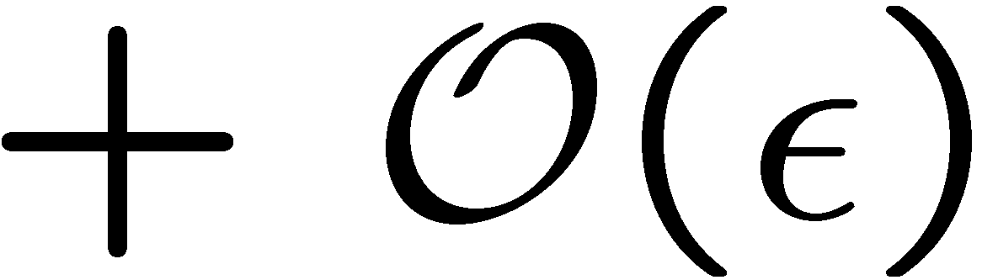
One-Loop Amplitudes Reduced To Trees
When all external momenta are in D = 4, loop momenta in D = 4-2ε
(dimensional regularization), one can write:
Bern, LD, Dunbar, Kosower (1994)
coefficients are all rational functions – determine algebraically
from products of trees using (generalized) unitarity
known scalar one-loop integrals,
same for all amplitudes
rational part

Slide 16
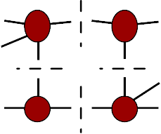
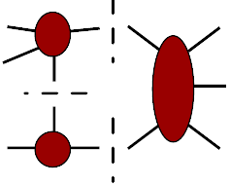
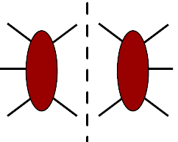
Unitarity method implementation
Each box coefficient uniquely isolated by a “quadruple cut” given simply by a product of 4 tree amplitudes
Britto, Cachazo, Feng,
hep-th/0412103
triangle coefficients come from triple cuts, product of 3 tree amplitudes, but these are also “contaminated” by boxes
bubble coefficients come from ordinary double cuts, after removing contributions of boxes and triangles

Slide 17
Several Recent Implementations of On-Shell Methods for 1-Loop Amplitudes
Method for
Rational part:
CutTools: Ossola, Papadopolous, Pittau, 0711.3596
NLO WWW, WWZ, ... Binoth+OPP, 0804.0350
NLO ttbb, tt + 2 jets Bevilacqua, Czakon,
Papadopoulos, Pittau, Worek, 0907.4723; 1002.4009
specialized
Feynman
rules
_ _ _
D-dim’l
unitarity
Rocket: Giele, Zanderighi, 0805.2152
Ellis, Giele, Kunszt, Melnikov, Zanderighi, 0810.2762
NLO W + 3 jets in large N_{c} approx./extrapolation
Ellis, Melnikov, Zanderighi, 0901.4101, 0906.1445
Melnikov, Zanderighi, 0910.3671
D-dim’l
unitarity
+ on-shell
recursion
Blackhat: Berger, Bern, LD, Febres Cordero, Forde, H. Ita,
D. Kosower, D. Maître; T. Gleisberg,
0803.4180, 0808.0941, 0907.1984, 0912.4927, 1004.1659
+ Sherpa → NLO production of W,Z + 3 (4) jets

Slide 18
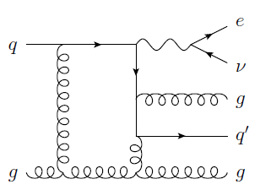
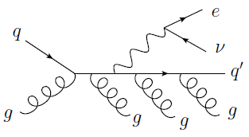
Besides virtual corrections,
also need real emission
Infrared
singularities
cancel
General subtraction methods for integrating real-emission contributions developed in mid-1990s
Frixione, Kunszt, Signer, hep-ph/9512328;
Catani, Seymour, hep-ph/9602277, hep-ph/9605323
Recently automated by several groups
Gleisberg, Krauss, 0709.2881;
Seymour, Tevlin, 0803.2231;
Hasegawa, Moch, Uwer, 0807.3701;
Frederix, Gehrmann, Greiner, 0808.2128;
Czakon, Papadopoulos, Worek, 0905.0883;
Frederix, Frixione, Maltoni, Stelzer, 0908.4272

Slide 19
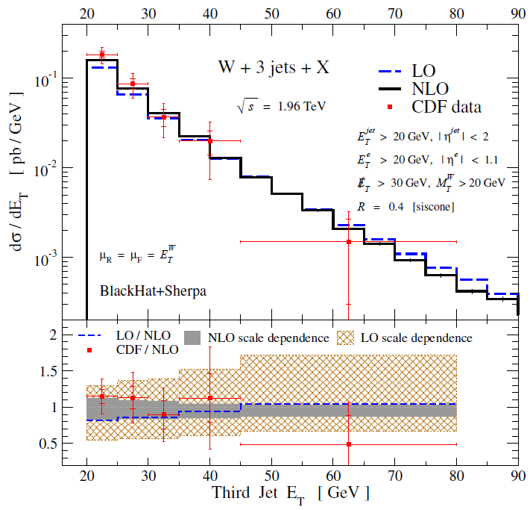
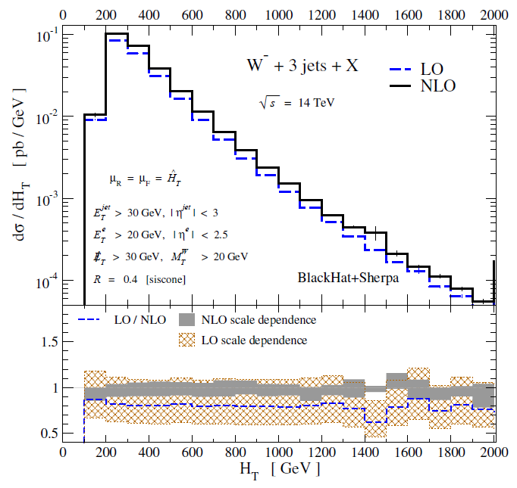
Example of W + 3 jets at NLO
C. Berger et al., 0907.1984
Results “validated” at Tevatron, give precise predictions for LHC

Slide 20

NLO Parton-Level vs. Shower MCs
Recent advances on the Les Houches NLO Wish List have all been at parton level: no parton shower, no hadronization, no underlying event.
Methods for matching NLO parton-level results to parton showers, maintaining the NLO accuracy
  MC@NLO Frixione, Webber (2002), ...
  POWHEG Nason (2004); Frixione, Nason, Oleari (2007); ...
  GenEvA Bauer, Tackmann, Thaler (2008)
However, none has yet been implemented for complex final states with multiple light-quark & gluon jets
NLO parton-level predictions generally give best normalizations for total cross sections (unless NNLO available!), and distributions away from shower-dominated regions.
The right kinds of ratios will be considerably less sensitive to shower + nonperturbative effects

Slide 21
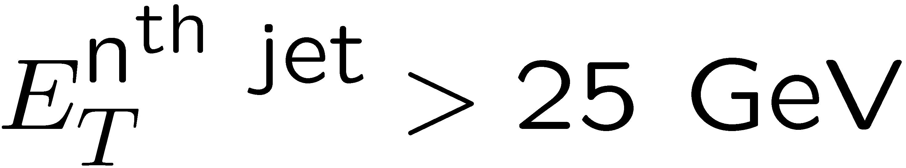
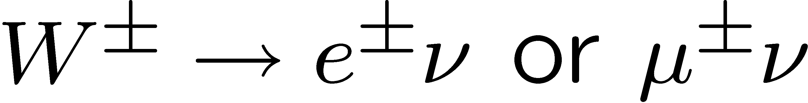
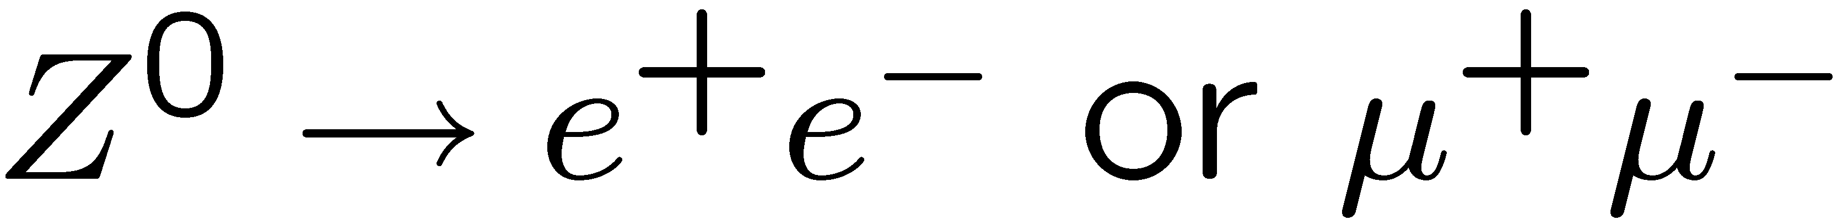
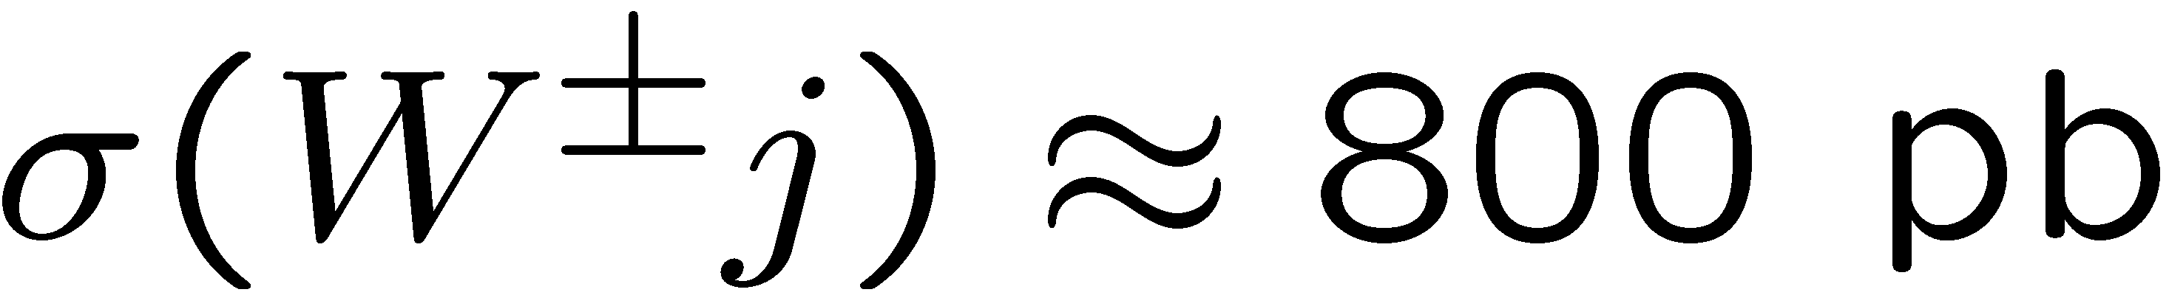
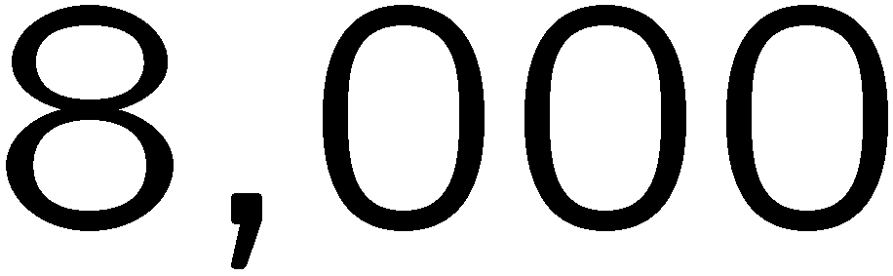
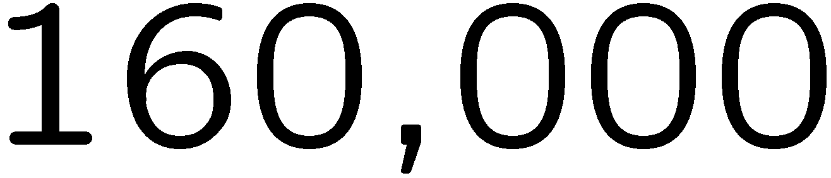
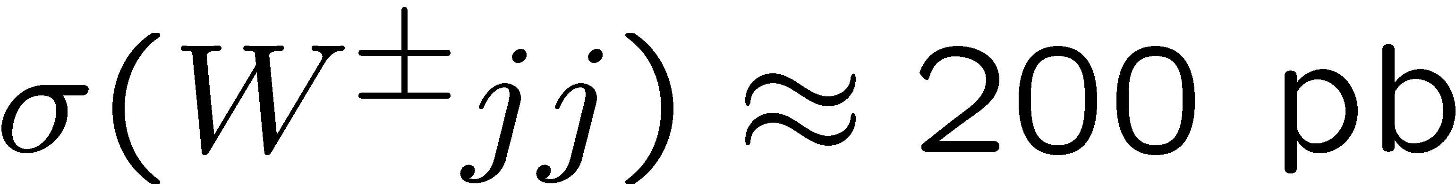
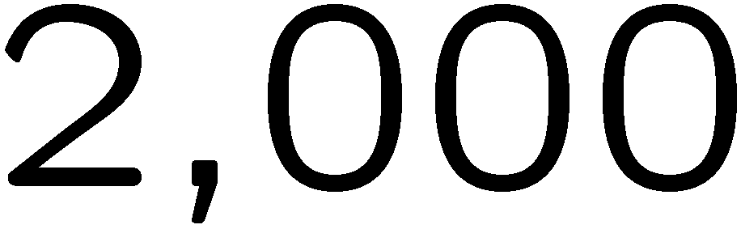
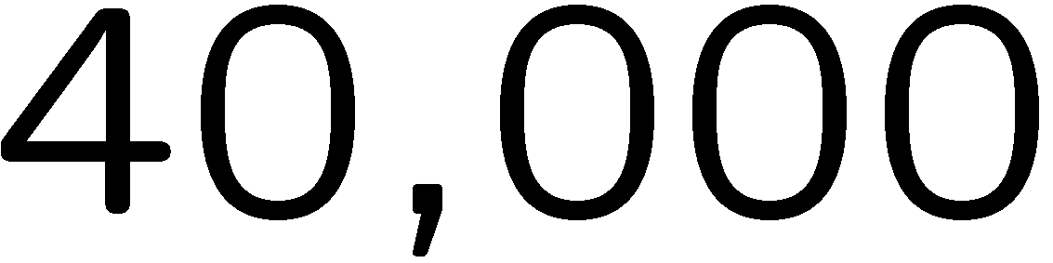
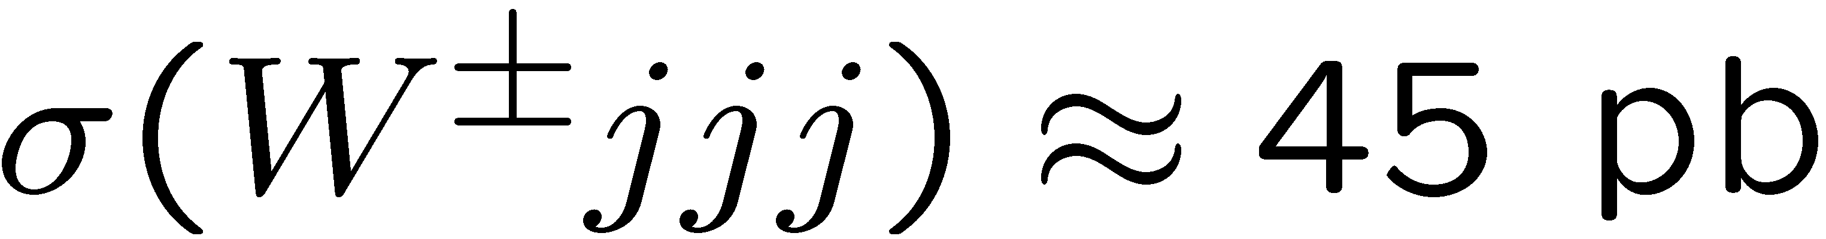
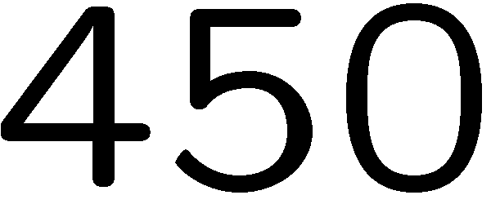
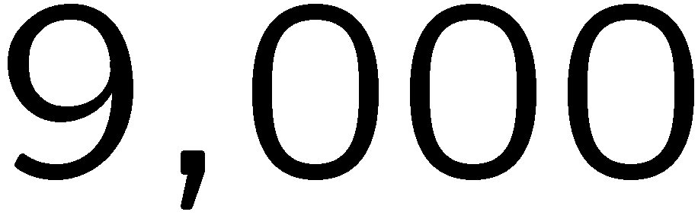
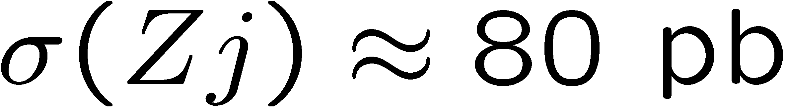
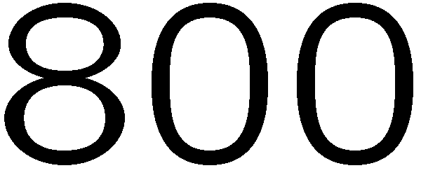
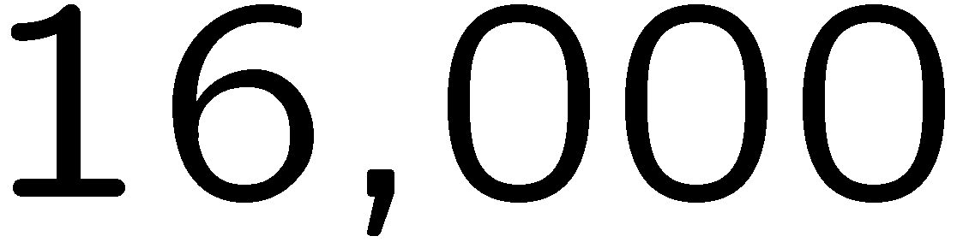
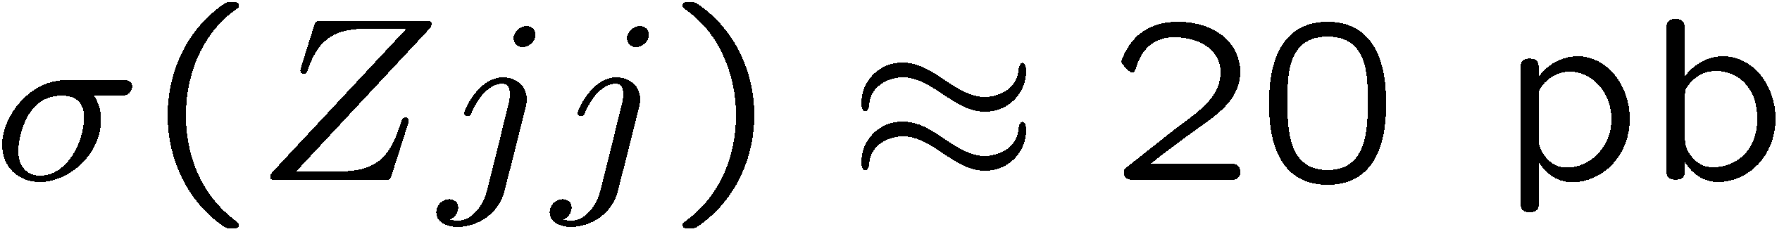
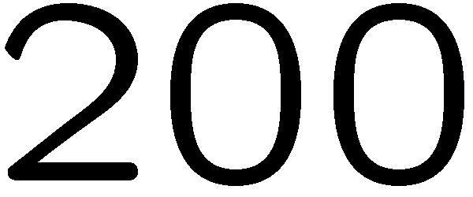
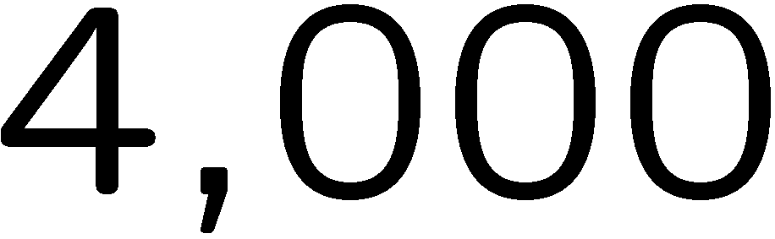
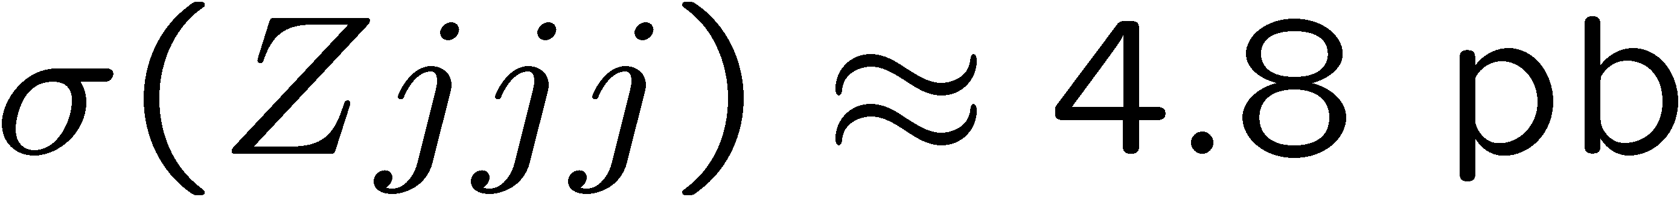
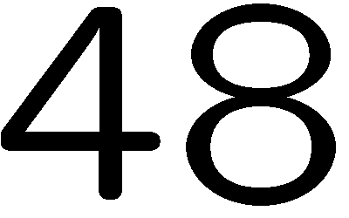
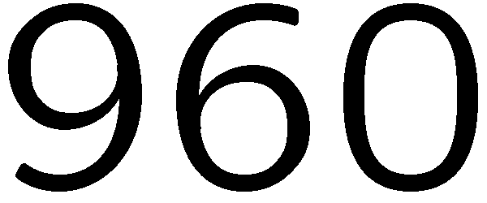
Numbers of V + jets events at 7 TeV
Includes leptonic branching ratio, and
standard cuts on jet (anti-k_{T}, R=0.4)
rapidity, lepton, missing E_{T}
At these small E_{T}’s, Z + 3 jets @ 10 pb⁻¹ ~ Tevatron @ few fb⁻¹
21

Slide 22
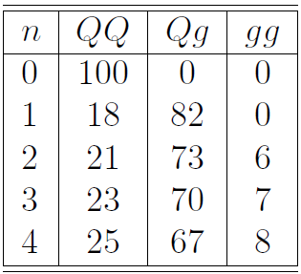
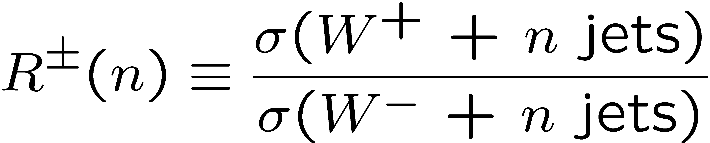
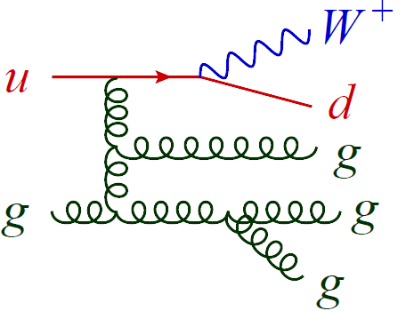
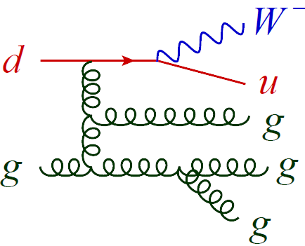
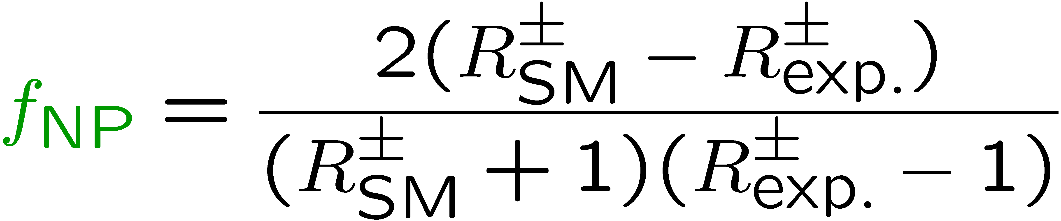
Simple yet robust ratio: W⁺ to W⁻
Kom, Stirling, 1004.3404.
Very small experimental systematics
(N)NLO QCD corrections quite small, 2% or less
→ Intrinsic theoretical uncertainty very small.
PDF uncertainty also ~1-2%. Driven by PDF ratio
u(x)/d(x)
in well-measured valence region of moderate x.
Sensitive to new physics (or Higgs, or top quark pairs)
that produces W± symmetrically
Fraction of new physics in sample is:

Slide 23
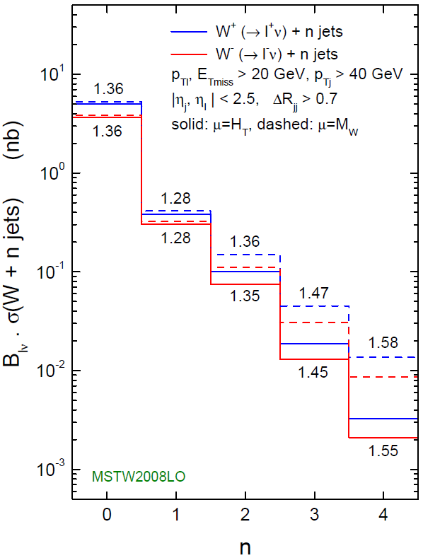
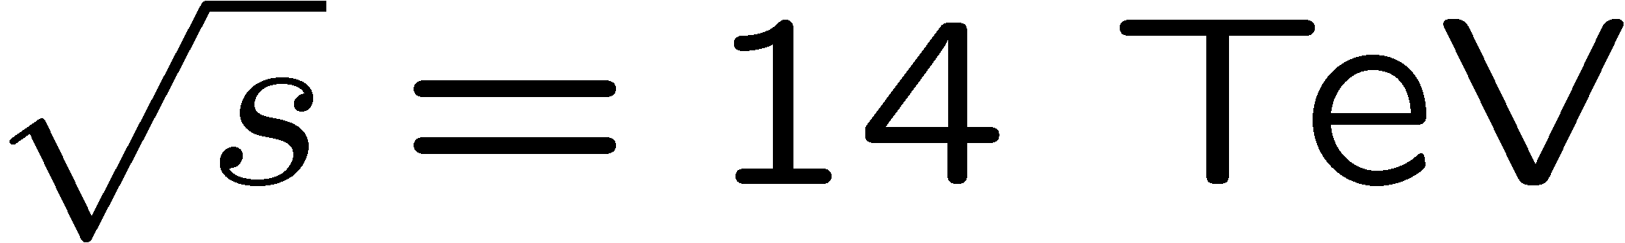
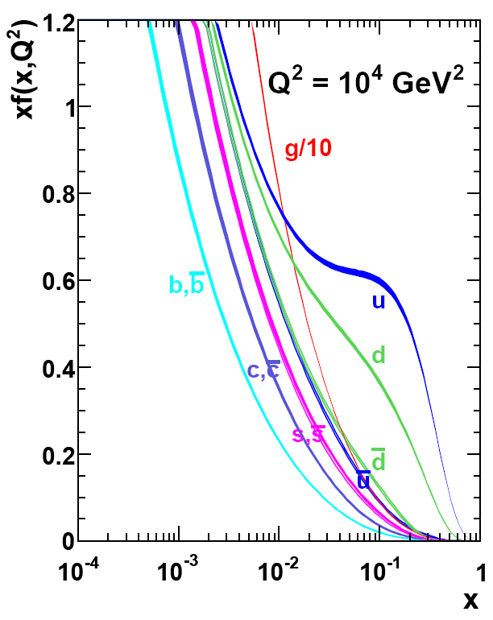
W⁺ to W⁻ ratio
Kom, Stirling, 1004.3404.
Huge scale dependence at LO
cancels in ratio
Increases with n due to increasing x
MSTW2008

Slide 24
Another ratio – W polarization fraction
BlackHat+Sherpa
0912.4927
Strong left-handed polarization
Increases with W boson p_{T} due to increasing x
Very stable against QCD corrections

Slide 25

Same left-handed polarization for W ⁻ case
BlackHat+Sherpa
0912.4927

Slide 26

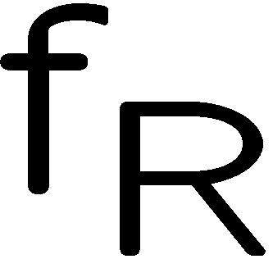

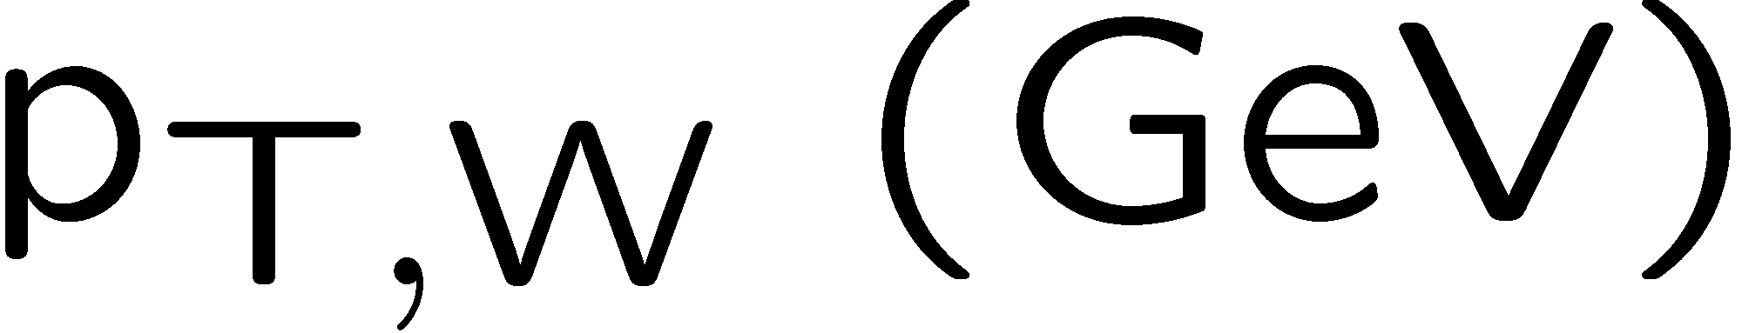
Polarization at moderate p_{T,W} very stable vs. jet p_{T} cut
LO
14 TeV
C. Berger et al.
to appear

Slide 27
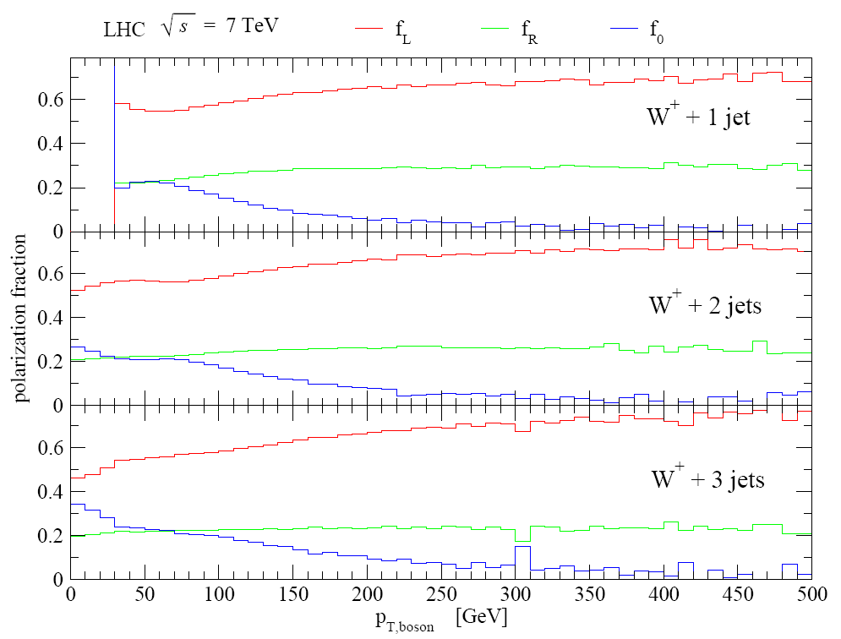
Polarization very similar for 1, 2 or 3 jets
LO
C. Berger et al.
to appear

Slide 28
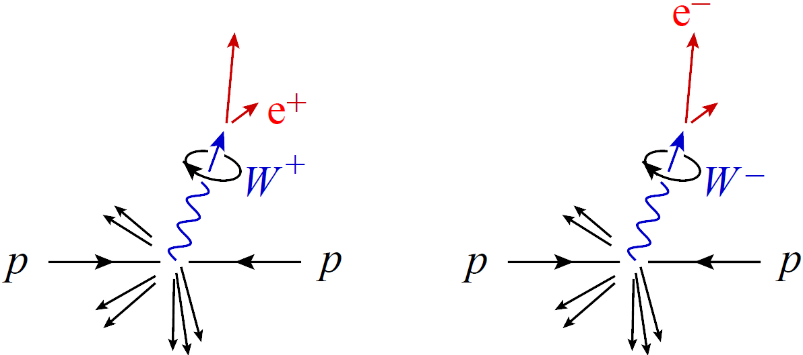
W polarization analyzed by leptonic decay
ν_{L}
_{L}
_
ν_{R}
_{R}
_{L}
_{L}
Left-handed polarization translates into:
- larger p_{T} for ν_{L} (missing E_{T}) in W⁺ events
- larger p_{T} for e_{L} in W⁻ events
SU(2)_{L} pure V-A → 100% analyzing power

Slide 29


W^{+/-} + n jets: e⁺/e⁻ p_{T} ratio
NLO LO
1 jet
2 jets
3 jets

Slide 30


W^{+/-} + n jets: Missing E_{T} ratio
NLO LO
1 jet
2 jets
3 jets

Slide 31
What’s the reason?

Slide 32









Origin of W polarization at LHC:
Simplest case – LO W + 1 jet
SU(2)_{L} + valence quark dominance
_
d
W + 2,3 jets is more complex still
dominate due to PDFs

Slide 33




Top quark pairs very different
Main production channels are C invariant:
Semi-leptonic decay involves (partially) left-handed W⁺
But charge conjugate decay involves (same degree) right-handed W⁻
→ electron and positron have almost identical p_{T} distributions
→ Nice handle on separating W + jets from semileptonic top pairs
What about signals like supersymmetry? Depends on whether
initial quarks are correlated with final leptons:
NO (at Ο(α_{s}²))
YES

Slide 34




W polarization in WW scattering
Han, Krohn, Wang, Zhu, 0911.3656
parton
level
Polarization fractions again more stable against perturbative and nonperturbative QCD effects, than are total event rates
Here interest is in longitudinal fraction f₀ rather than f_{L} vs. f_{R}
Sensitive to new physics, e.g. operator
Good study for 14 TeV and high luminosity
hadron
level

Slide 35

W /Z ratios
Like W⁺/W⁻ ratio, stable against perturbative nonperturbative QCD effects, since M_{W} ≈ M_{Z}
Like W⁺/W⁻ ratio, in inclusive case (n = 0) it’s a precision observable, computable at NNLO, also including experimental cuts
Perhaps not quite as clean experimentally as W⁺/W⁻, because W and Z selections are not identical
MSTW

Slide 36


W /Z ratios (cont.)
Like W⁺/W⁻ ratio, now computable at NLO for up to 3 associated jets [BlackHat+Sherpa]
Use ratio, plus measurement of W (→lν) + n jets to calibrate Z(→νν) + n jets bkgd to MET+jets searches [CMS analysis note]
Much better statistics than Z(→l⁺l⁻) + n jets
NLO
W + 3 jets Z + 3 jets
vs. Tevatron data

Slide 37



NLO Z + 3 jets
Very similar to W + 3 jets
Additional closed fermion loop graphs, not present in W case
But analogous contributions in W/Z + 2 jets case
known to be very small. So we drop them.
Also more identical-fermion channels, and γ* sitting under the Z → a bit more computationally intensive than W case.
Initial results [1004.1659] for Tevatron, CDF and D0 cuts.
Now computing NLO W/Z + 1,2,3 jets for 7 TeV LHC, allowing detailed study of W/Z ratio as function of kinematics

Slide 38



NLO W/Z + 4 jets now in sight
C. Berger et al.
Evaluation of virtual corrections
by BlackHat now fast and stable
enough – for one subprocess
Real corrections also nontrivial,
but again Sherpa fast and stable
enough for one subprocess

Slide 39
Conclusions
Large backgrounds to many types of new physics at the LHC demand quantitative control over backgrounds, particularly for complex multi-jet final states.
NLO QCD results needed, but Feynman diagrams can be too slow.
New efficient computational approaches to one-loop QCD amplitudes, exploiting analyticity, are now producing results for important LHC backgrounds
  implemented numerically in C++ program BlackHat, as well as in CutTools and Rocket
Because these NLO results are still at parton level, not embedded in a full Monte Carlo, the best ways to use these results may sometimes be via ratios – as aids to data-driven analysis of backgrounds.
W⁺/W⁻ ratio nontrivial, well-determined, sensitive to new physics
Left-handed W polarization is surprisingly large and very stable, leading to further charge-asymmetric effects in W + n jets
W/Z + 1,2,3 jets known at NLO; W/Z + 4 jets also now feasible
Eagerly awaiting the first 1 fb⁻¹ !!

