Slide 1
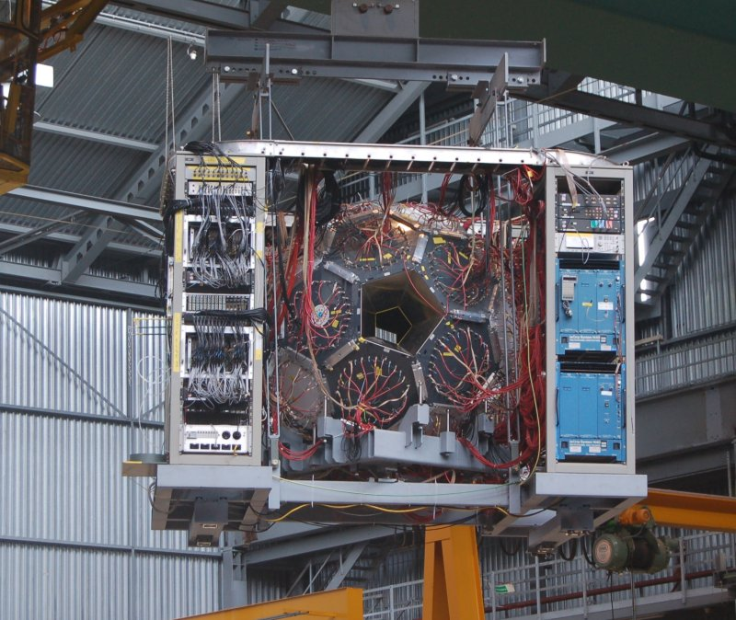
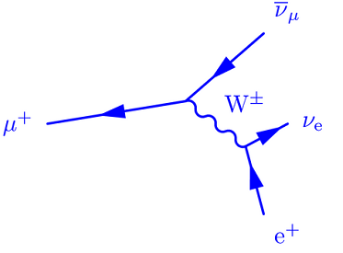
A new determination of the positive muon lifetime to part per million precision
David M. Webber
University of Illinois at Urbana-Champaign
For the MuLan Collaboration

Slide 2
Motivation
gives the Fermi Constant to very high precision (actually G_{μ})
needed for “reference” lifetime for precision muon capture experiments
  MuCap: μ⁻ + p
  MuSun: μ⁻ + d
Capture rate from lifetime difference μ⁻ and μ⁺

Slide 3
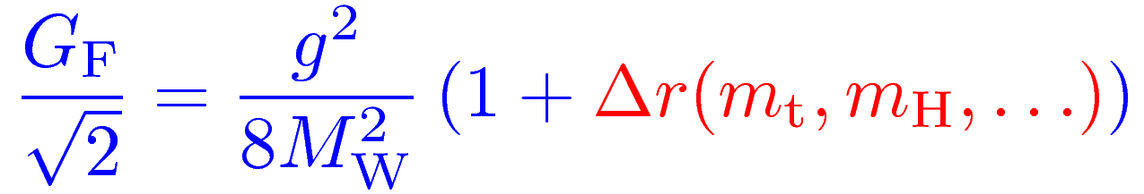
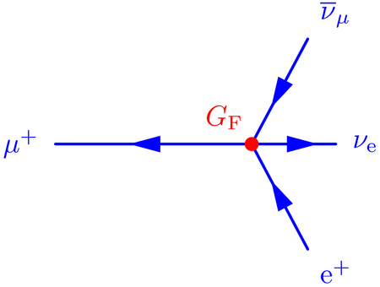
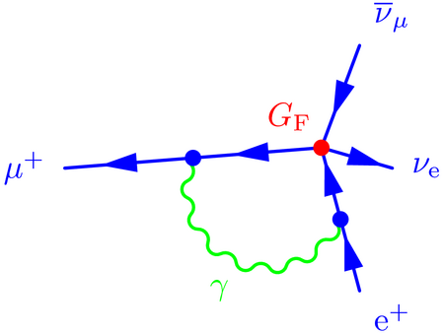
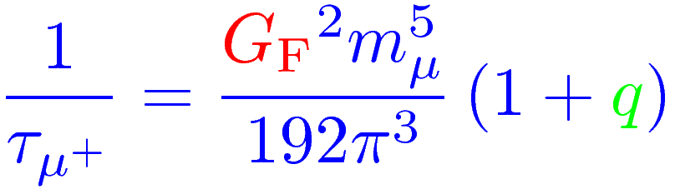
The Fermi constant is related to the electroweak gauge coupling g by
Contains all weak interaction loop corrections
In the Fermi theory, muon decay is a contact interaction where Δq includes phase space, QED, hadronic and radiative corrections
Δq
In 1999, van Ritbergen and Stuart completed full 2-loop QED corrections reducing the uncertainty in G_{F} from theory to < 0.3 ppm (it was the dominant error before)

Slide 4
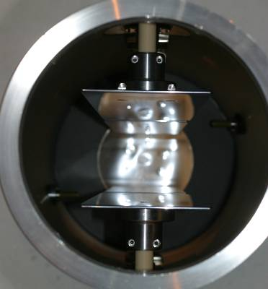
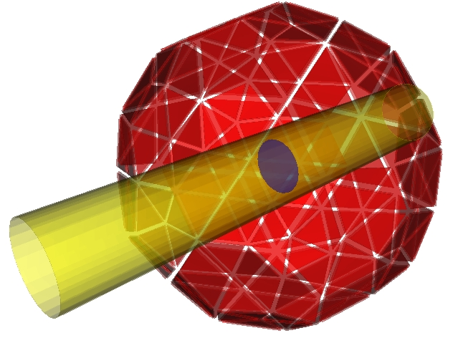
The experimental concept in one animation …
Real data
Fast-switching electric kicker on
Measurement Period
Number (log scale)
time
Fill Period
100% polarized muons at ~4 MeV
-12.5 kV
B
12.5 kV
Kicker Systematic Uncertainty < 0.2 ppm
Rapidly precess

Slide 5
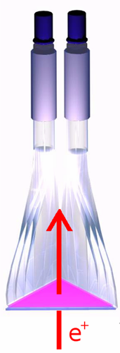
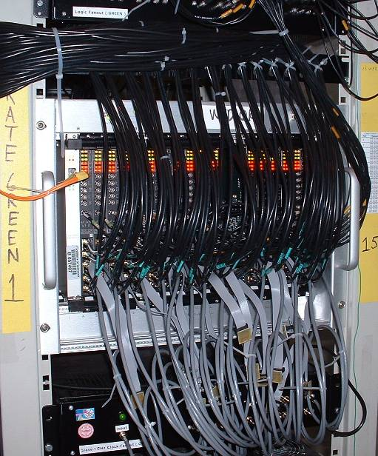

170 scintillator tile pairs readout using 450 MHz waveform digitizers.
2 Analog Pulses
x2
Waveform
Digitizers
1 clock tick = 2.2 ns
1/6 of system
Uncertainty from electronics stability: 0.26 ppm

Slide 6
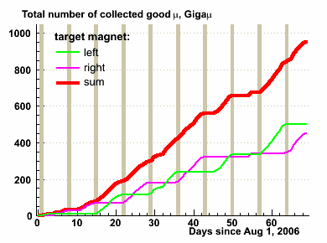
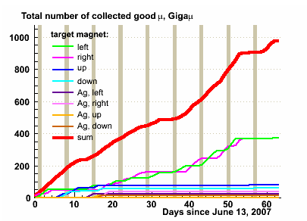
MuLan collected two datasets, each containing 10¹² muon decays.
Ferromagnetic Target, 2006
Quartz Target, 2007
Two (very different) data sets
  2006:
    Ferromagnetic target dephases muon ensemble
    1.18 ppm statistical uncertainty
  2007:
    Quartz target forms 90% muonium, 10% free (precessing) muons
    1.7 ppm statistical uncertainty

Slide 7
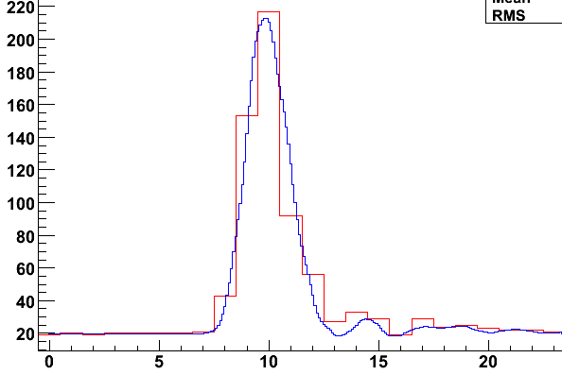
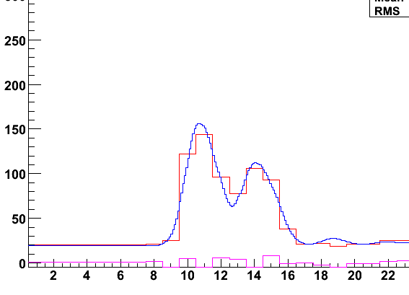
Fits of raw waveforms using Templates
>2 x 10¹² / data set
>135 TBytes raw data
Normal Pulse
Two pulses close together
A difficult fit

Slide 8
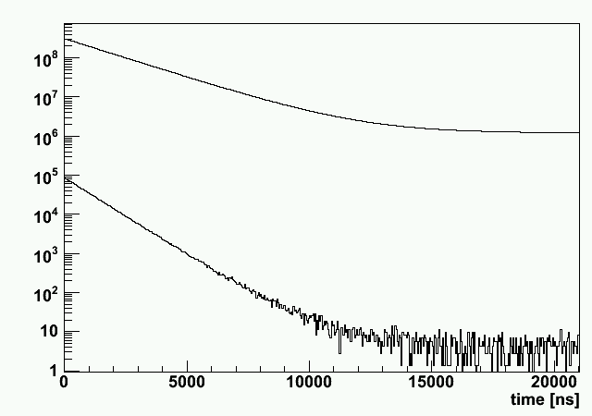
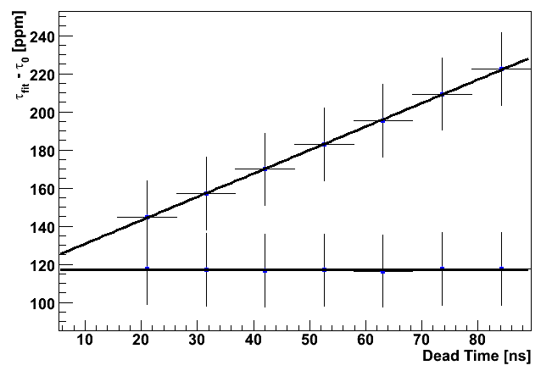
Leading order pileup
Same probability
Statistically reconstruct
pileup time distribution
Fit corrected distribution
Measured τ vs. Deadtime
Normal Time
Distribution
Raw Spectrum
Pileup
Corrected
Pileup Time
Distribution

Slide 9
Pileup to sub-ppm requires higher-order terms
12 ns deadtime, pileup has a 5 x 10⁻⁴ probability at our rates
Proof of procedure validated with detailed Monte Carlo simulation
  Over 10¹² MC events generated
uncorrected
Pileup terms at different orders …
R (ppm)
1 ppm
150 ns deadtime range
Artificial Deadtime (ct)

Slide 10
Lifetime vs artificially imposed deadtime window is an important diagnostic
A slight slope exists, which we continue to investigate
R (ppm)
1 ppm
150 ns deadtime range
Artificial Deadtime (ct)
Extrapolation to 0 deadtime should be correct answer and our indications are that this extrapolation is right
Pileup Correction Uncertainty: 0.2 ppm

Slide 11
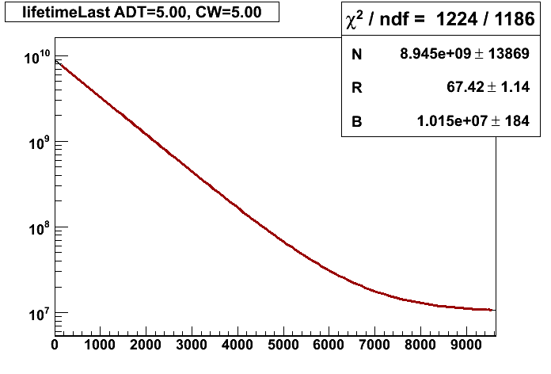
2006: Fit of 30,000 AK-3 pileup-corrected runs
ppm τ_{μ} + Δ_{secret}
22 μs
Clock Ticks (1 clock tick ~ 2.2 ns)
R vs fit start time
Red band is the set-subset allowed variance

Slide 12
2007: Quartz data fits well as a simple sum, exploiting the symmetry of the detector. The μSR remnants vanish.

Slide 13
MuLan Systematic Uncertainties (preliminary)
Source | 2006 (ppm) | 2007 (ppm)
Kicker stability | 0.22 | 0.07
Clock calibration | 0.03 | (same as 2006)
Errant muon stops | 0.10 | (same as 2006)
Gain stability vs time | 0.70 | (same as 2006)
Gain stability vs dt | 0.27 | (same as 2006)
Timing stability vs time | 0.09 | (same as 2006)
Timing stability vs dt | 0.08 | (same as 2006)
Electronic readout stability | 0.26 | (same as 2006)
Pileup correction | 0.20 | (same as 2006)
Residual polarization | n/a | 0.20
Total Systematic (0.51 common) | 0.86 | 0.86
Statistical Uncertainty | 1.18 | 1.7
τ_{μ} in common blinded space (compared Feb 8, 2010) | 4901.55 | 4901.83
Δ=0.3 ppm!
Total Uncertainty: 1.3 ppm
For the rest of the talk I will use 1.3 ppm, but it should decrease as studies finalize.

Slide 14
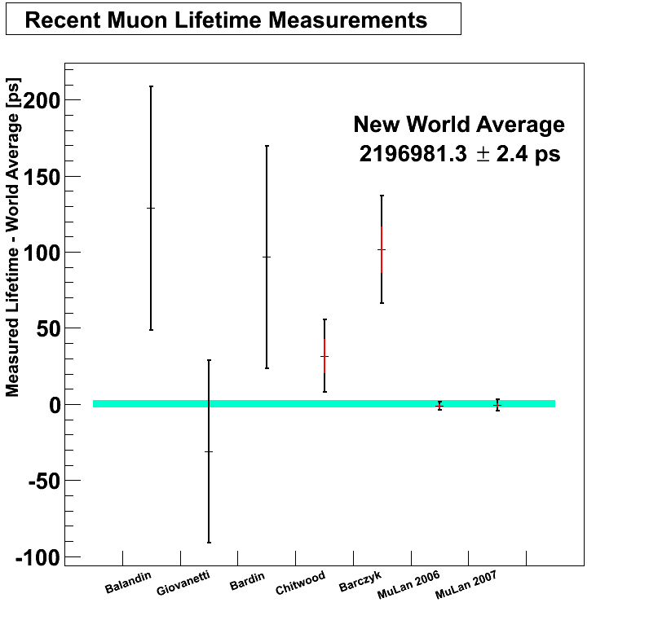
New MuLan Result
Lifetime value final, preliminary error will decrease
MuLan 2006: τ_{μ} = 2196980.1 ± 2.6(stat) ± 1.9(sys) ps
MuLan 2007: τ_{μ} = 2196980.7 ± 3.7(stat) ± 1.9(sys) ps
2006 & 2007 avg: τ_{μ} = 2196980.3 ± 2.8 ps (1.3 ppm)
G_{F} = 1.166 381 8 (8) x 10⁻⁵ GeV⁻² (0.7 ppm)*
*includes 0.43 ppm shift on Δq from linear m_{e} term (Pak & Czarnecki, 2008)

Slide 15
FAST
MuLan 2004

Slide 16
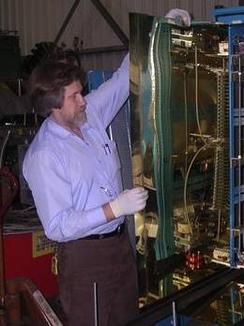

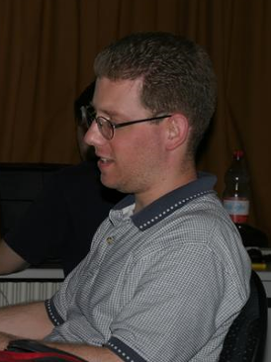

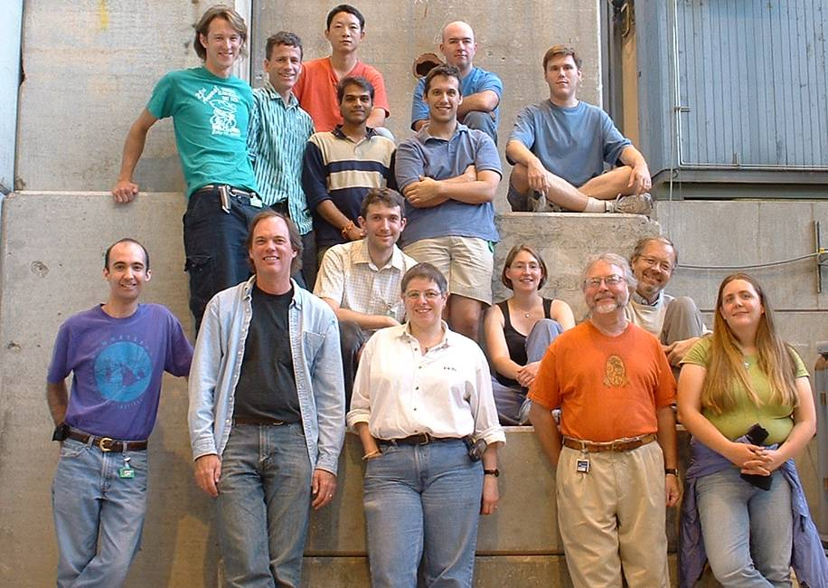
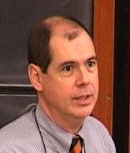
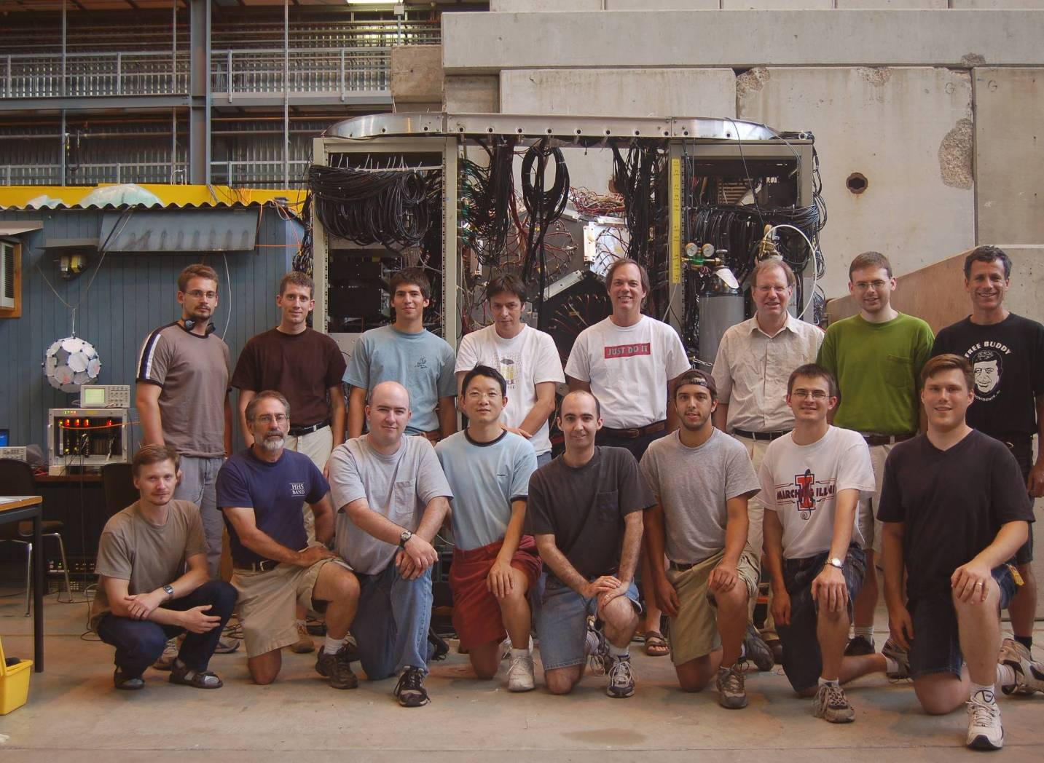


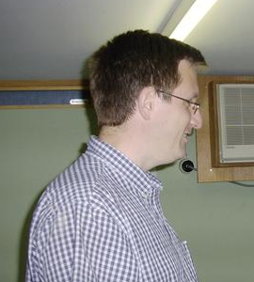
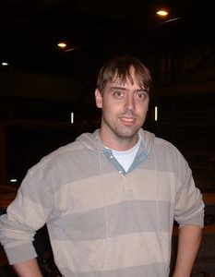
MuLan Collaborators
Institutions:
University of Illinois at Urbana-Champaign
University of California, Berkeley
TRIUMF
University of Kentucky
Boston University
James Madison University
Groningen University
Kentucky Wesleyan College
2004
2006
2007

Slide 17
MuLan measured the muon lifetime to ppm-level precision.
MuLan measurement is most precise (and accurate)
MuLan τ_{μ} = 2196980.3 ± 2.8 ps
Lifetime value final, preliminary error will decrease
  Combined uncertainty 1.3 ppm
G_{F} = 1.166 381 8(8) x 10⁻⁵ GeV⁻²

