Slide 1
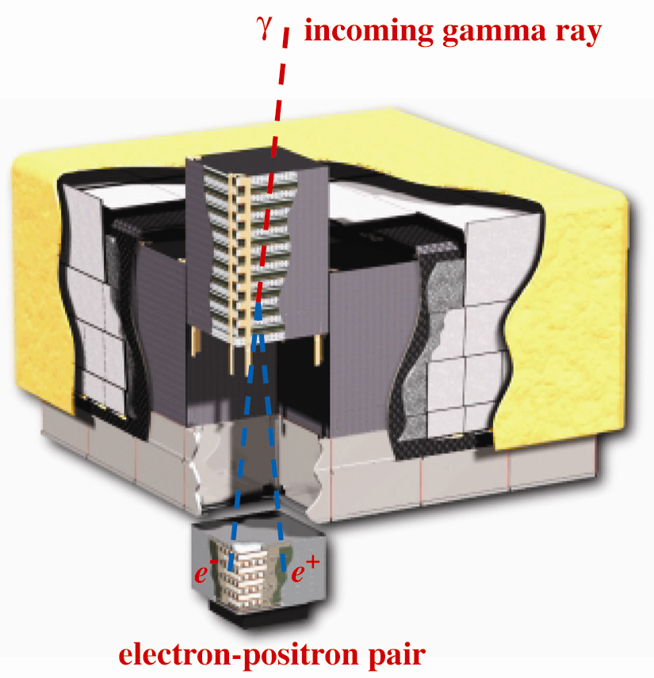
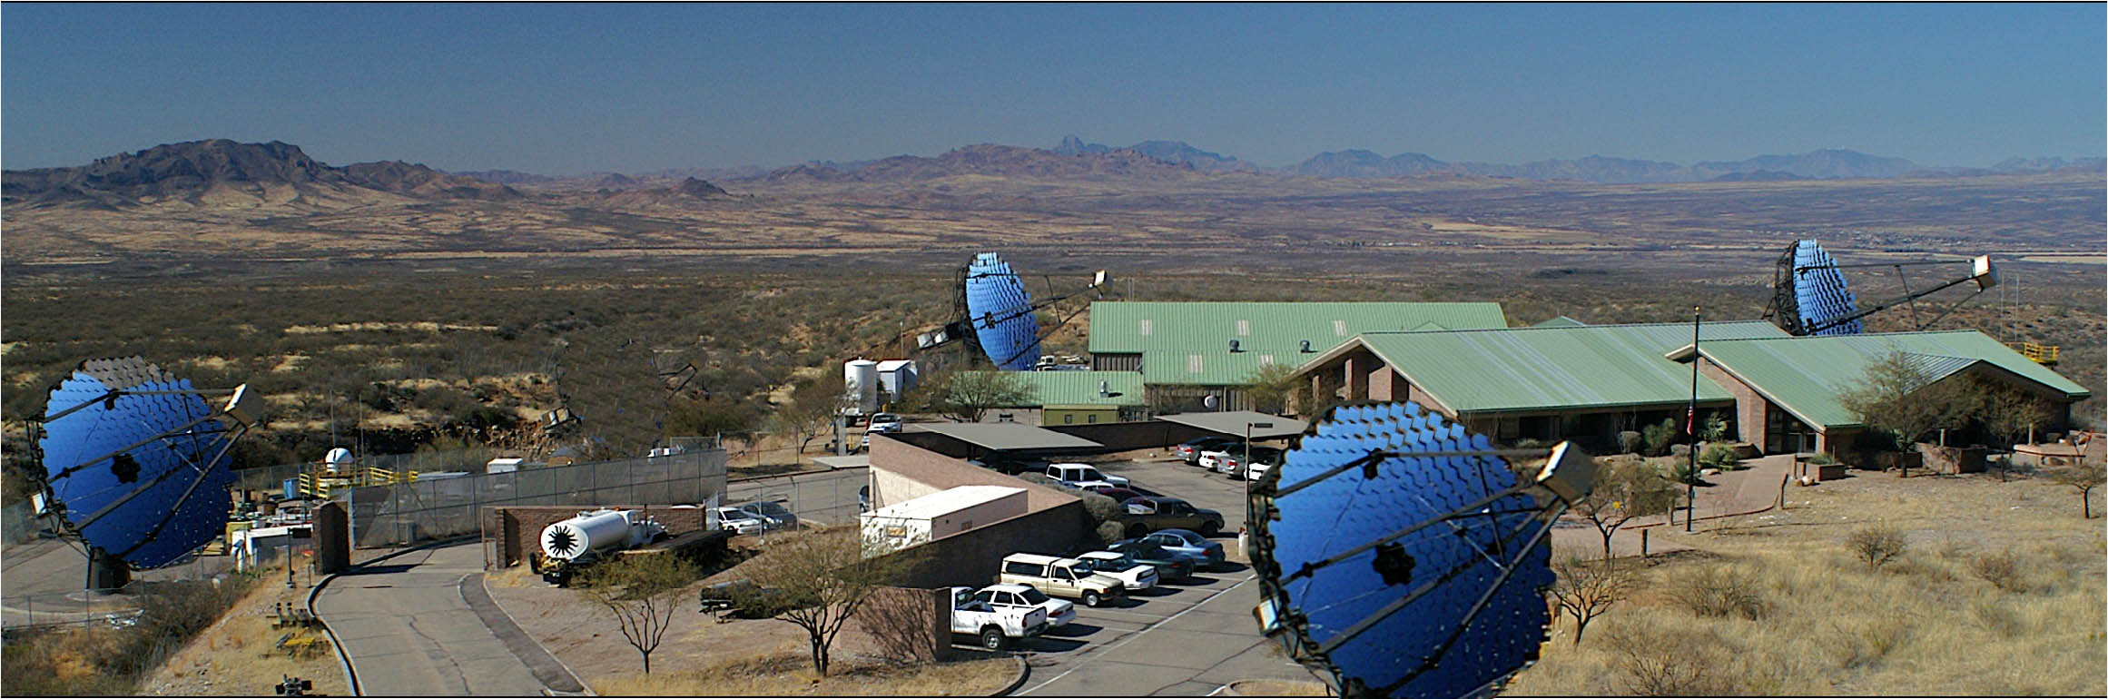
Astroparticle Physics with Cosmic Messengers
Astroparticle Physics
with Cosmic Messengers

Slide 2
Outline
Cosmic particle astronomy/physics overview
New generation γ-ray observatories.
Acceleration of cosmic particles.
Propagation on cosmological distance scales.
Tests of Lorentz invariance violation.
Indirect dark matter searches.
Next steps: AGIS & CTA.

Slide 3
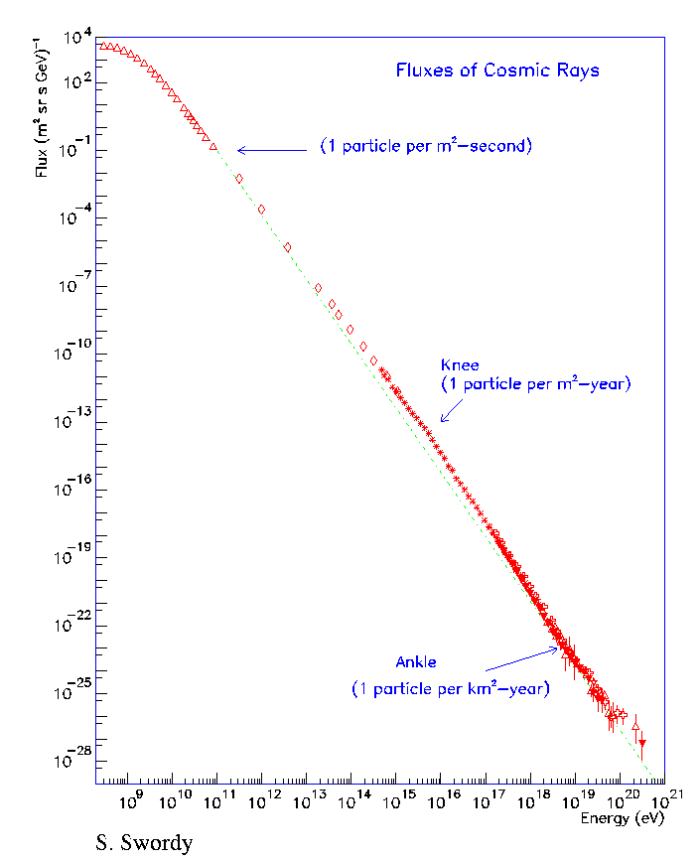
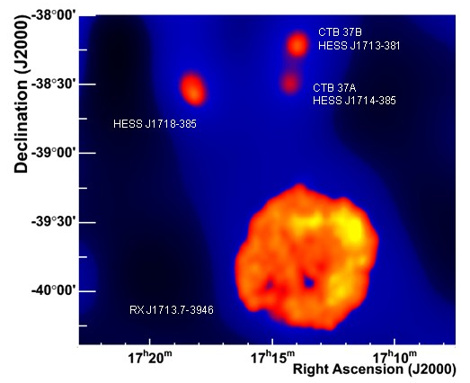
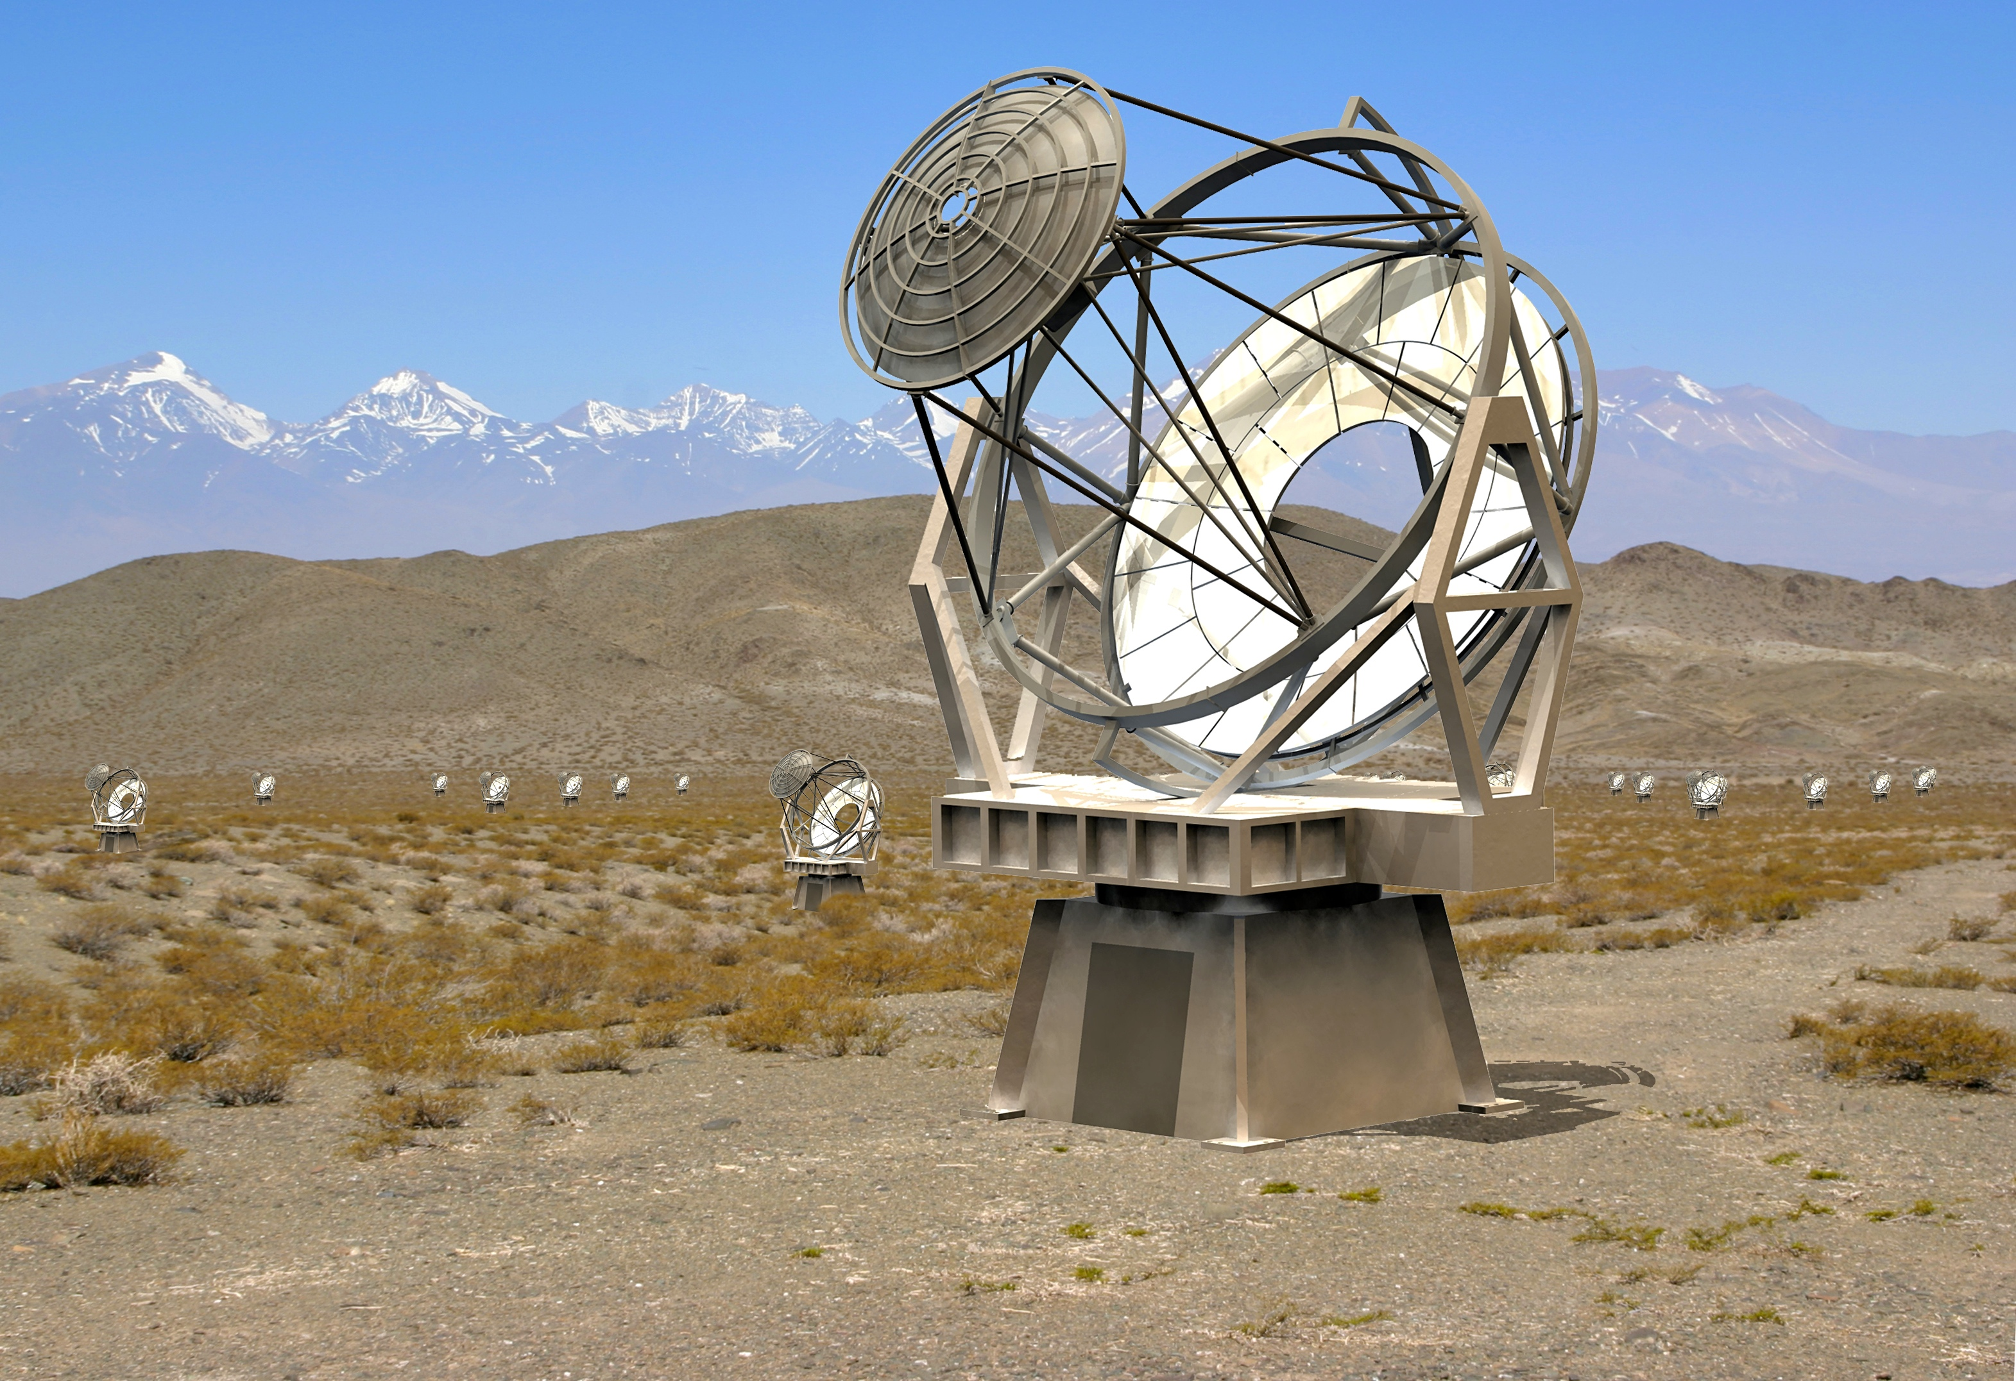
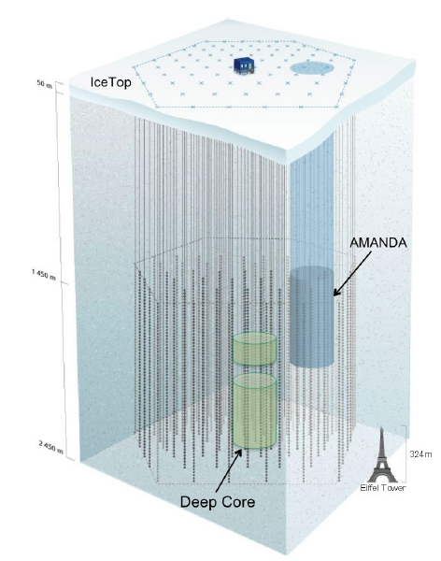
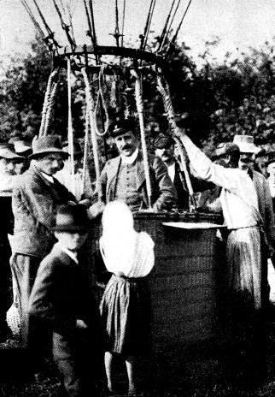
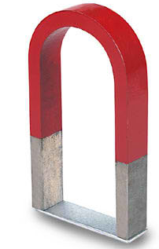
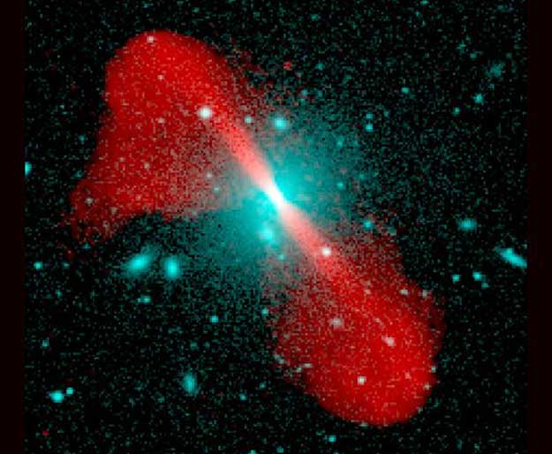
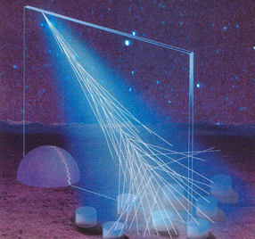
Cosmic Particles
γ
ν
century old mystery
p

Slide 4
Cosmic Particles
γ
ν
century old mystery
p,e

Slide 5
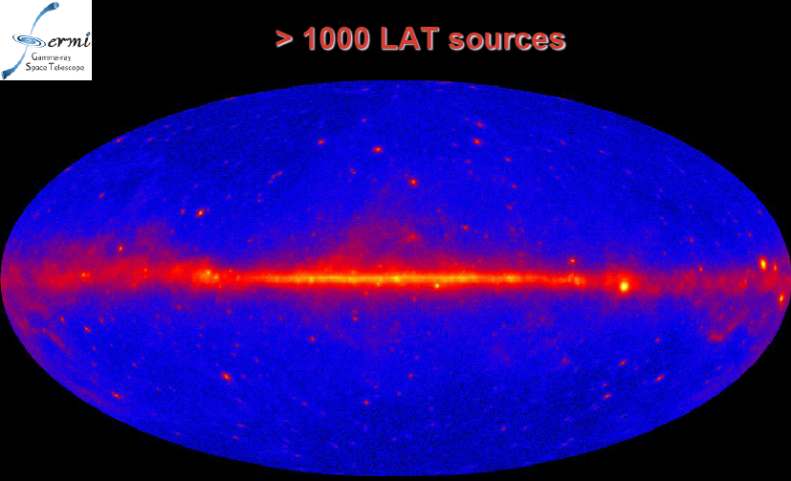
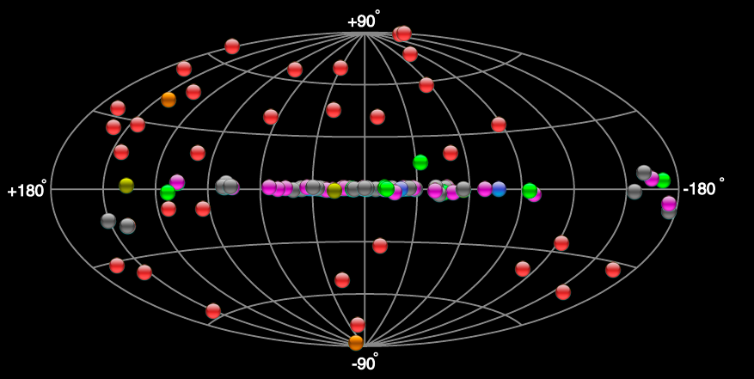
Cosmic particle physics/astronomy
Supernova remnants
Starburst galaxies
Dark accelerators
‘Milagro’ sources
Molecular Clouds
Pulsars
Galactic DM clumps
Galatic center
DM profile in dwarf galaxies
(E > 0.1 GeV)
Cosmic
Particle
Origin
Dark Matter
> 100 sources (E > 200 GeV)
Relic Particles
Ext. Gal. Backg. Light
Axion-Like Particle
Lorentz Inv. Violation
GRBs
AGNs

Slide 6
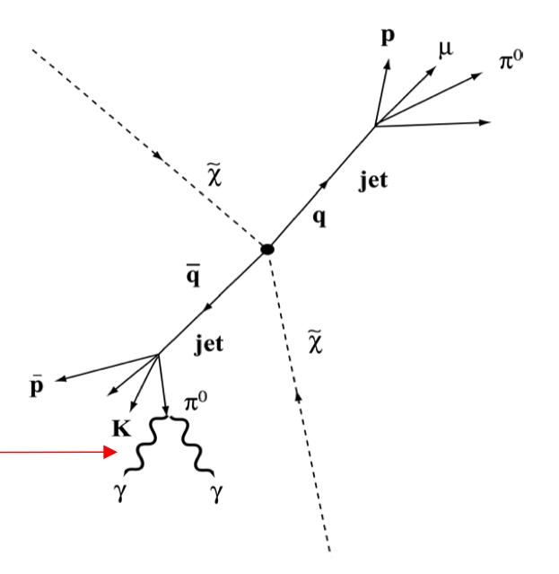
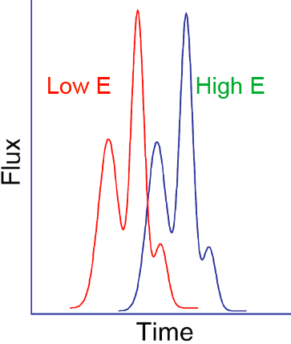
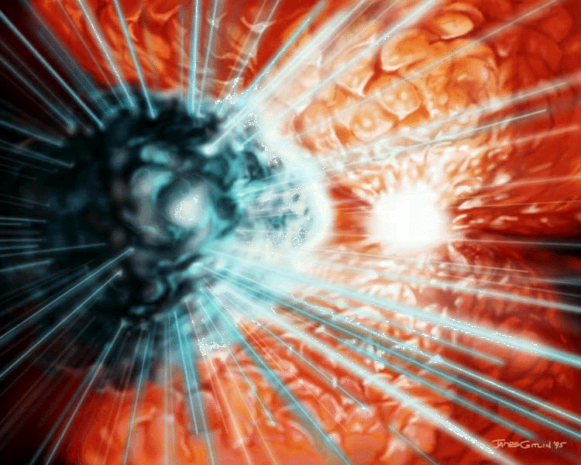
Cosmic particle physics processes
p-target: gas π production
e⁻-target: optical, IR, CMB
for IC scattering
Supernova remnants
Starburst galaxies
Dark accelerators
‘Milagro’ sources
Molecular Clouds
Pulsars
Galactic DM clumps
Galatic center
DM profile in dwarf galaxies
Cosmic
Particle
Origin
source
γ, ν
Dark Matter
“Time of flight tests”
Lorentz invariance
at the Planck scale.
Relic Particles
Ext. Gal. Backg. Light
Axion-Like Particle
Lorentz Inv. Violation
GRBs
AGNs

Slide 7
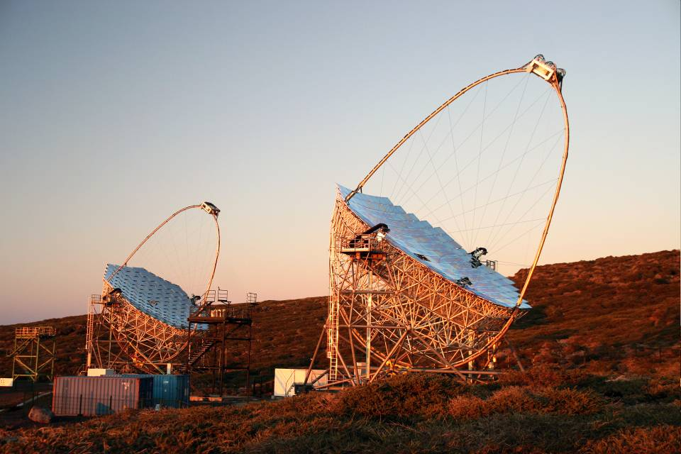
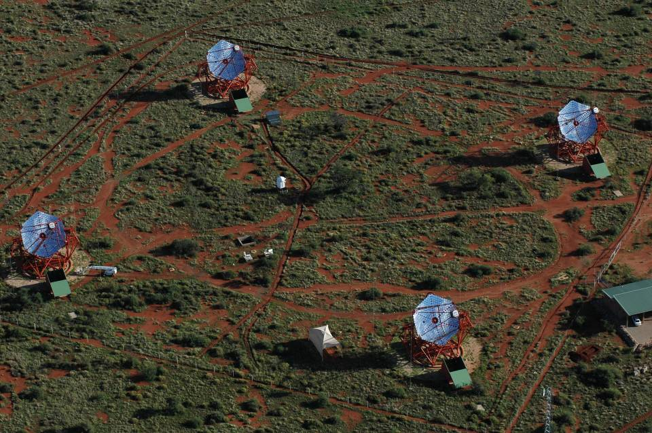
Current Generation Instruments
HESS, VERITAS:
Sensitivity ~ 1% Crab in 20 – 30 h
E_{range} ~ 100 GeV – 100 TeV
A_{eff} ~ 100,000 m²
Angular resolution ~ 0.1º
MAGIC-II:
E_{thres} ~ 25 GeV

Slide 8
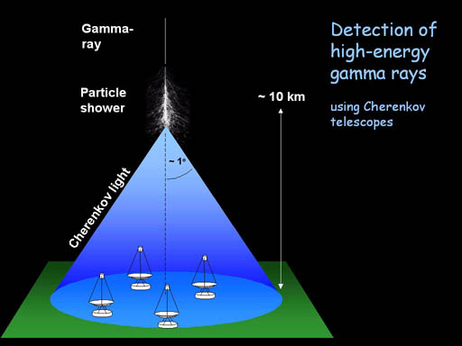
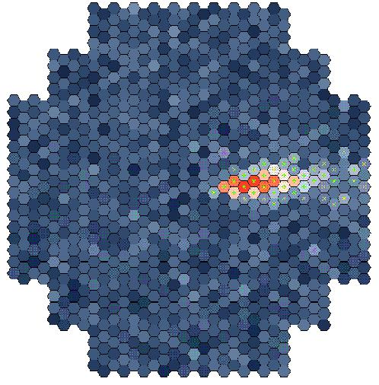
IACT Technique
1968
Whipple: Weekes et al. 1989, ApJ, 342, 379

Slide 9
IACT Technique
1968
Stereoscopic views
Whipple: Weekes et al. 1989, ApJ, 342, 379

Slide 10
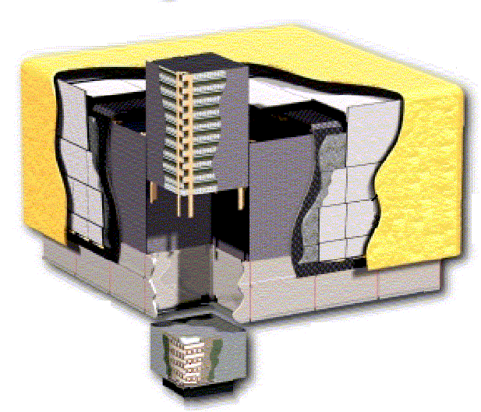
Fermi Gamma-ray Space Telescope
Si Tracker
pitch = 228 μm
8.8 10⁵ channels
18 planes
γ
E ~ 0.1 – 300 GeV
A_{eff} ~ 1 m²
Ω ~ 2 sr
ACD
segmented
scintillator tiles
CsI Calorimeter
hodoscopic array (8 layers)
6.1 103 channels
e⁺
e⁻

Slide 11
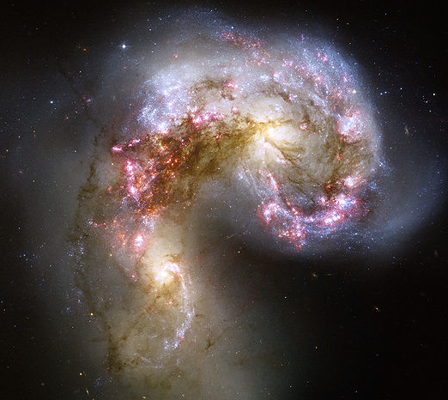
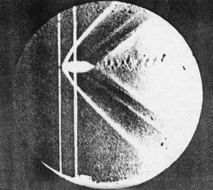
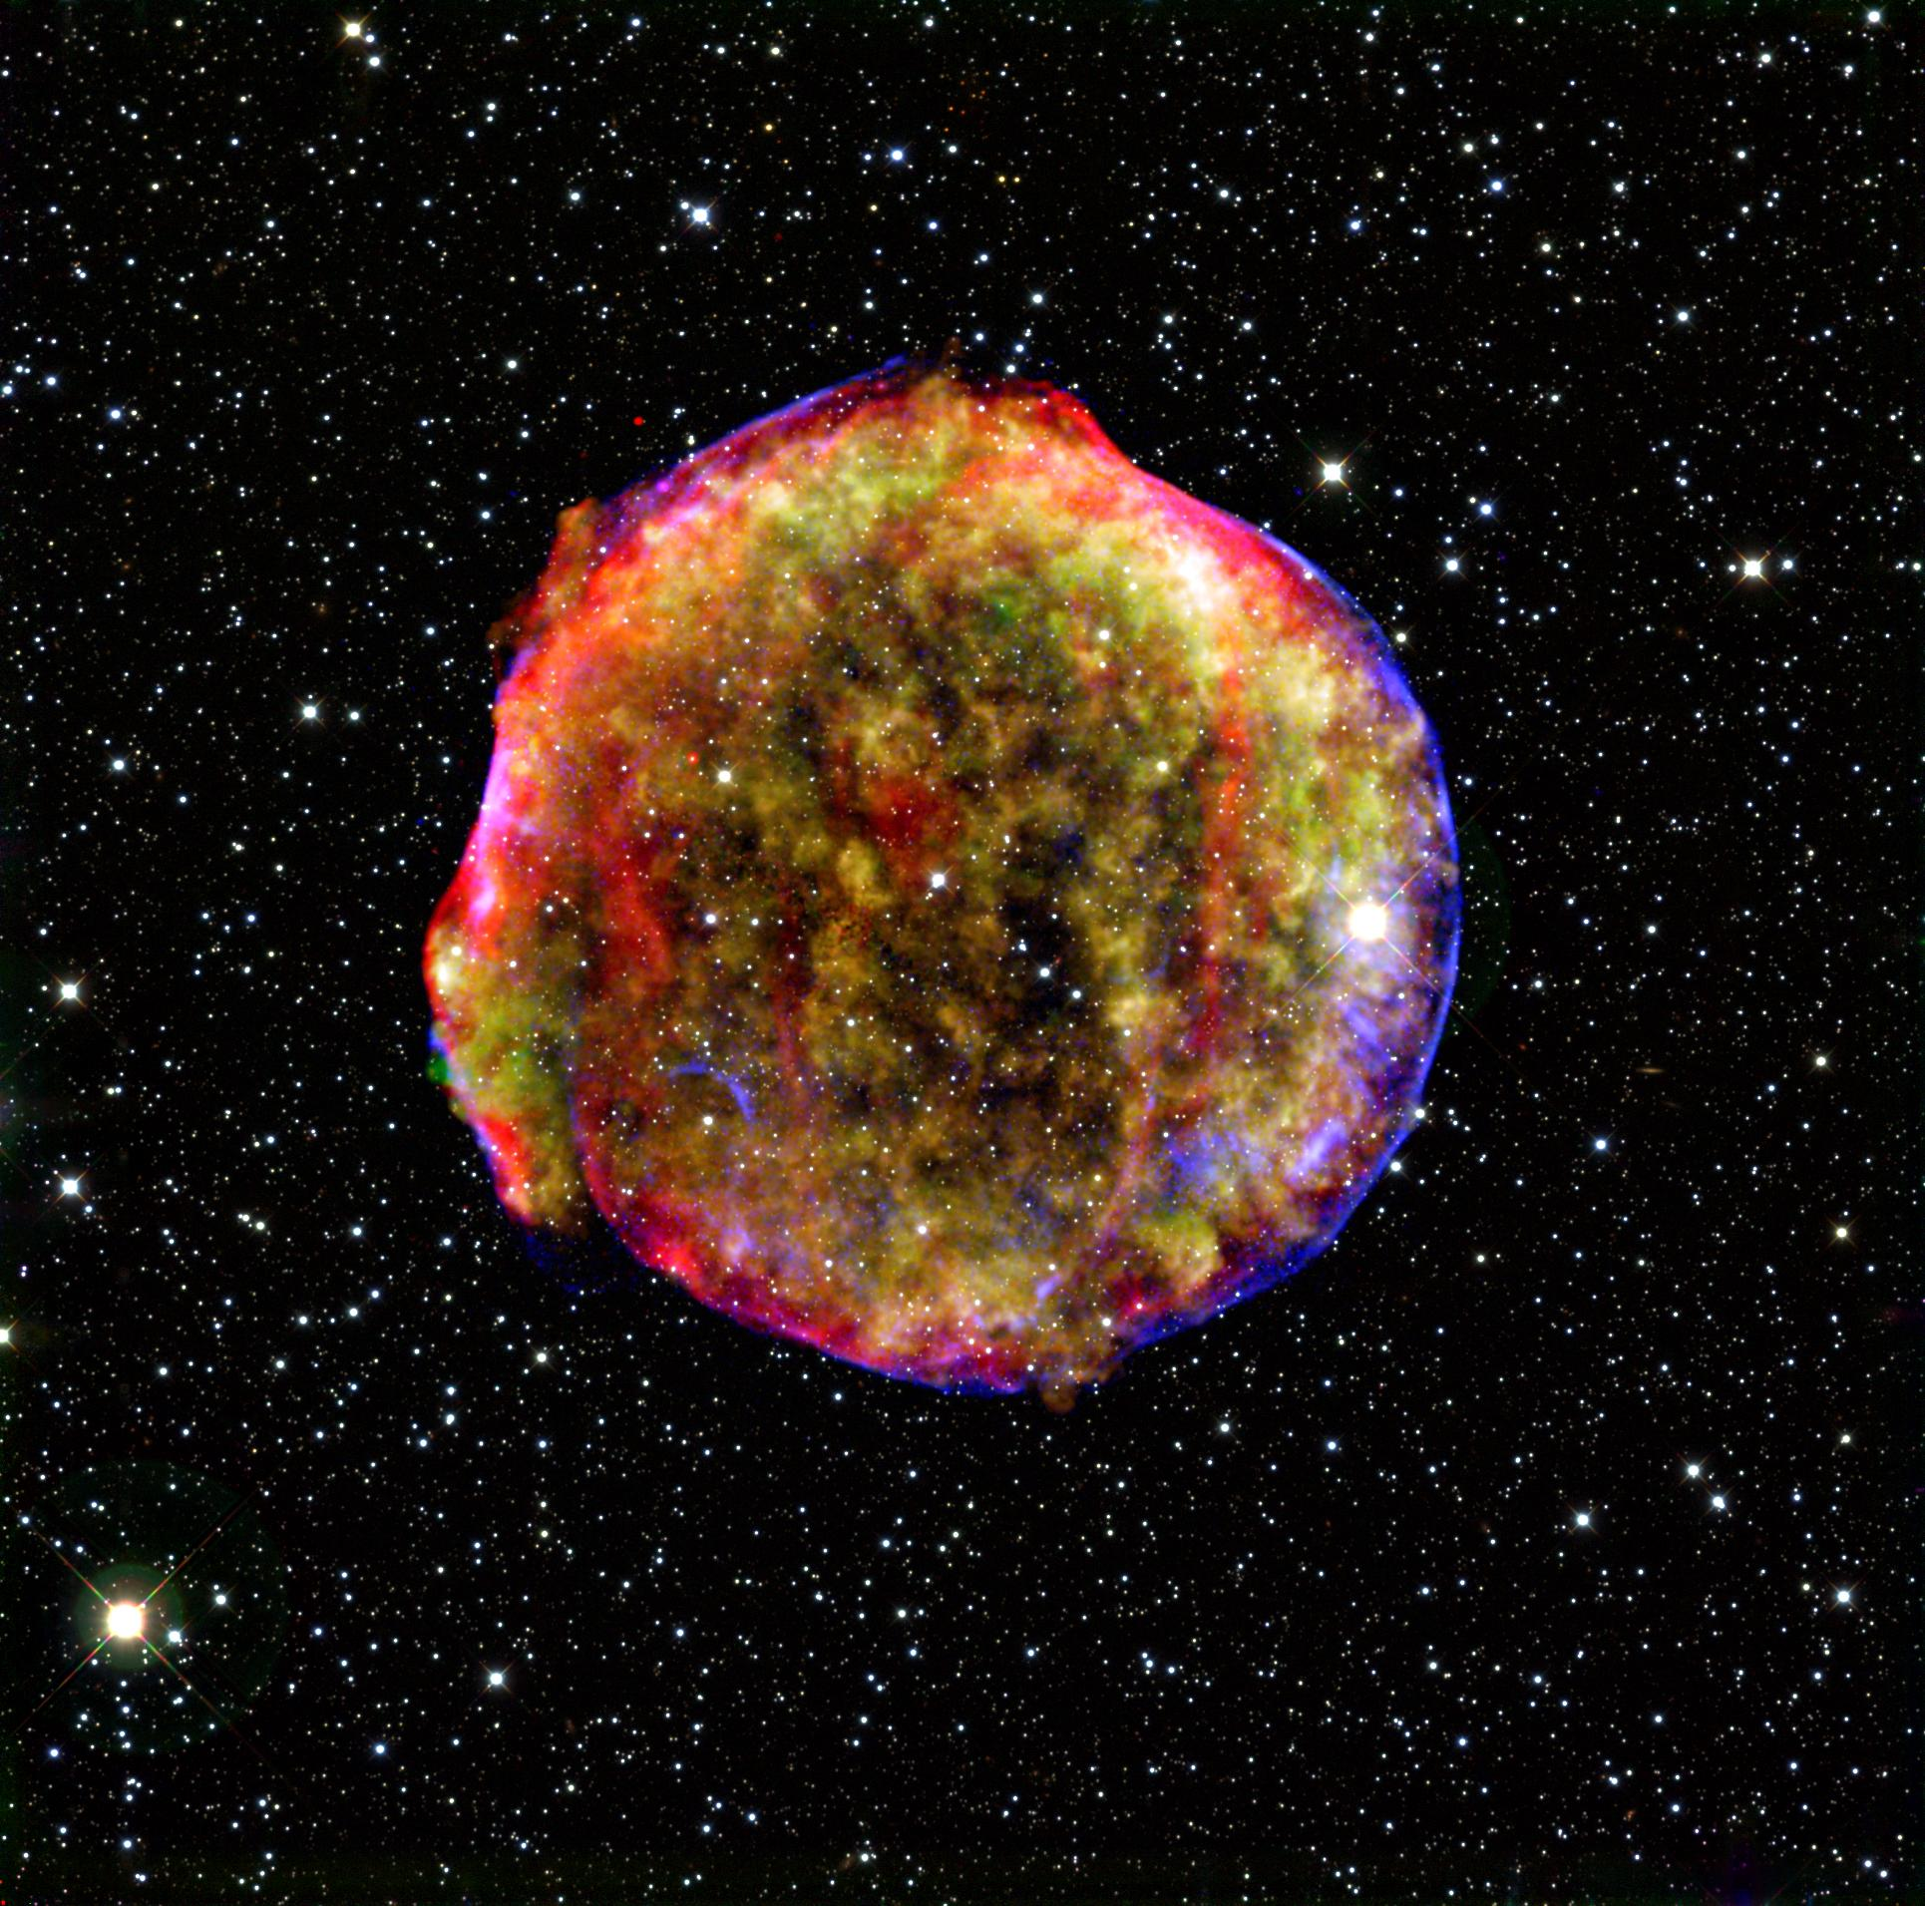
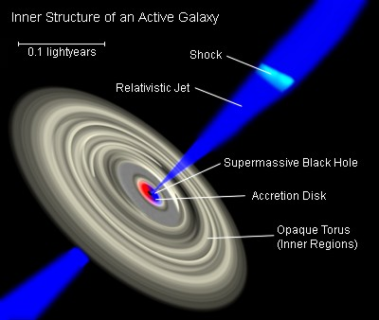
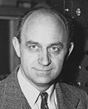
Particle Acceleration
π^{ο}
γγ
Supersonic
Many Supernova remnants
Supernova remnant
E_{max} ~ u_{s} B_{IS} R_{s}
B-field amplification ~ B_{is} x 100

Slide 12
Cosmic Ray Origin: Supernova Remnants?
Do SNRs emit GeV – TeV γ-rays?
Electron/proton ratio?
Power law spectrum E^{-2.2} ?
Do they accelerate to the knee – are
SNRs Pevatrons?
How efficient is diffusive shock acceleration?
Evidence for B-field amplification?
Notes:
If SNRs are indeed the sources of CRs, they should emit GeV – TeV gammma rays
from radio & X-ray observations we know that SNRs accelerate electrons in shocks
X-ray emission from shells of several SNRs (SN 1006), -> 100 TeV electrons, cannot travel far
→ therefore accelerated in shells – shocks
- Correlation studies of TeV emission with X-rays might provide important clues about
CR acceleration (prototons) – at angular scale of 0.01 degrees (factor of 10 off current instruments)
Study of e/p ratio
- diffusive shock acceleration predicts a spectrum of ddN/dE ~ E-2.2
-> importance of Fermi spectrum (GeV) + TeV spectrum!
- if SNRs are the sources of CRs up to 10**15 eV, they should emit
gamma rays of 100 TeV and beyond! (200 TeV)!
- Need to study SNRs in bulk, to determine how efficient diffusive shocks are to accelerate CRs → need to study either many SNRs or their collective effects (starburst galaxies)!

Slide 13
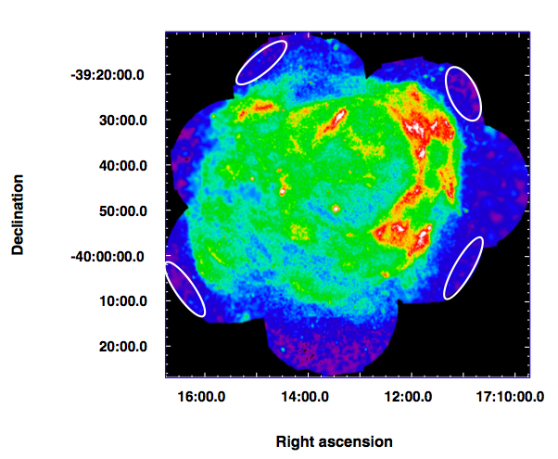
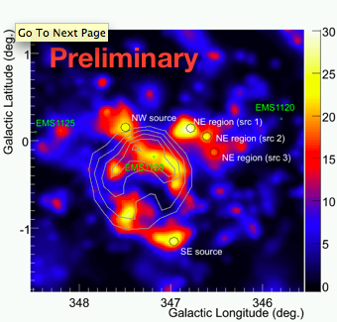
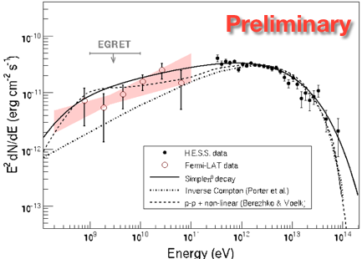
Young Supernova remnants:
RX J1713.7-3946
30 TeV!
S. Funk et al., Fermi Symposium 2009
Aharonian et al., … 2007
Notes:
Efficient CR accelerators might be found in young SNRs with high shock velocities (therefore significant magnetic field amplification)
RX J1713.7-3946 parameters: age ~ 1600 yrs, d ~ 1 kpc,
Rshock ~ 8.7 pc, core collapse SN, Bampl
Shock speeds of > 1000 km/sfor protons, require that electrons are heated to 0.3 keV – 1 keV via Coulomb collisions! The lack of X-ray line emission question such high shock speeds and hadronics origin.
So the situation is quite complicated!
So while the GeV – TeV spectrum is quite flat (E-2) it is not unambiguous proof for CR acceleration!

Slide 14
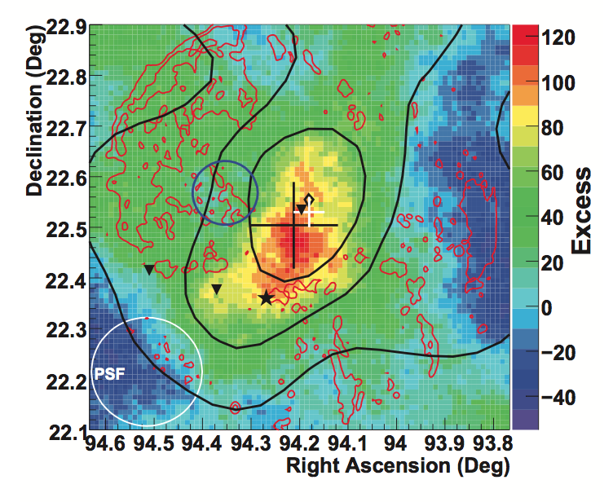
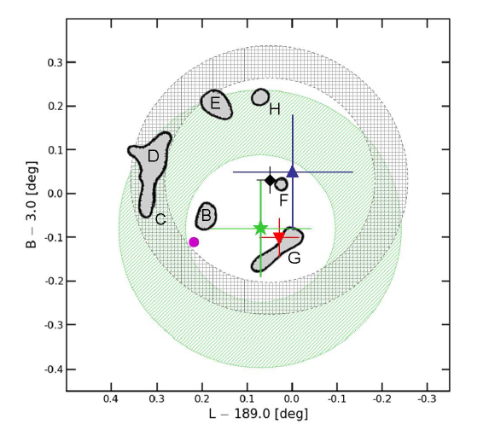
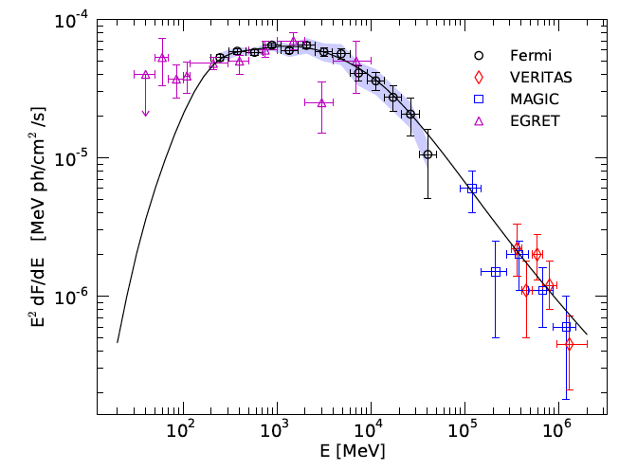
Mid-aged SNR: IC443
VERITAS extended
Fermi extended
Notes:
Well studied SNR with strong molecular line emission (radio) → SNR interacting with molecular clouds!
is one of the best candidates for revealing the connection between a SNR’s molecular cloud (target for CRs)
and gamma-ray emission.
Age is ~ 30,000 yrs, maximum energy reached is age dependent,
maximum energy also depepends on source (shock) geometry, B-field amplification and
GeV emission (1 – 50 GeV) is extended 0.26 deg., similar to the extension found by VERITAS at TeV energies!
Molecular clouds wrap around the southern rim
- need to look at many more SNRs to provide …

Slide 15
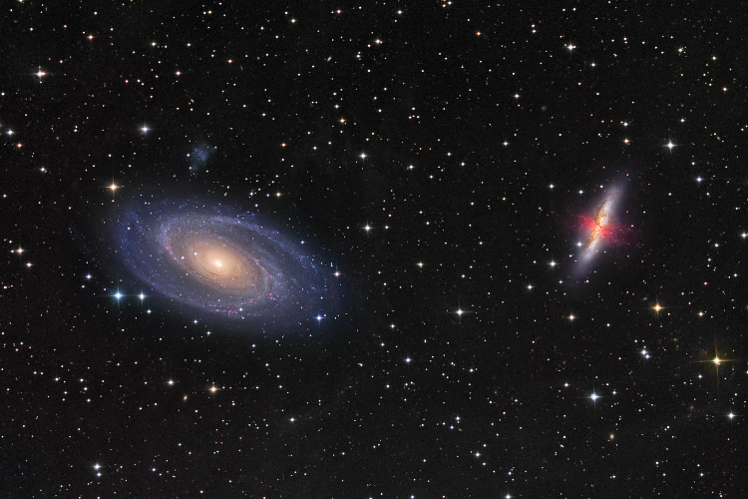
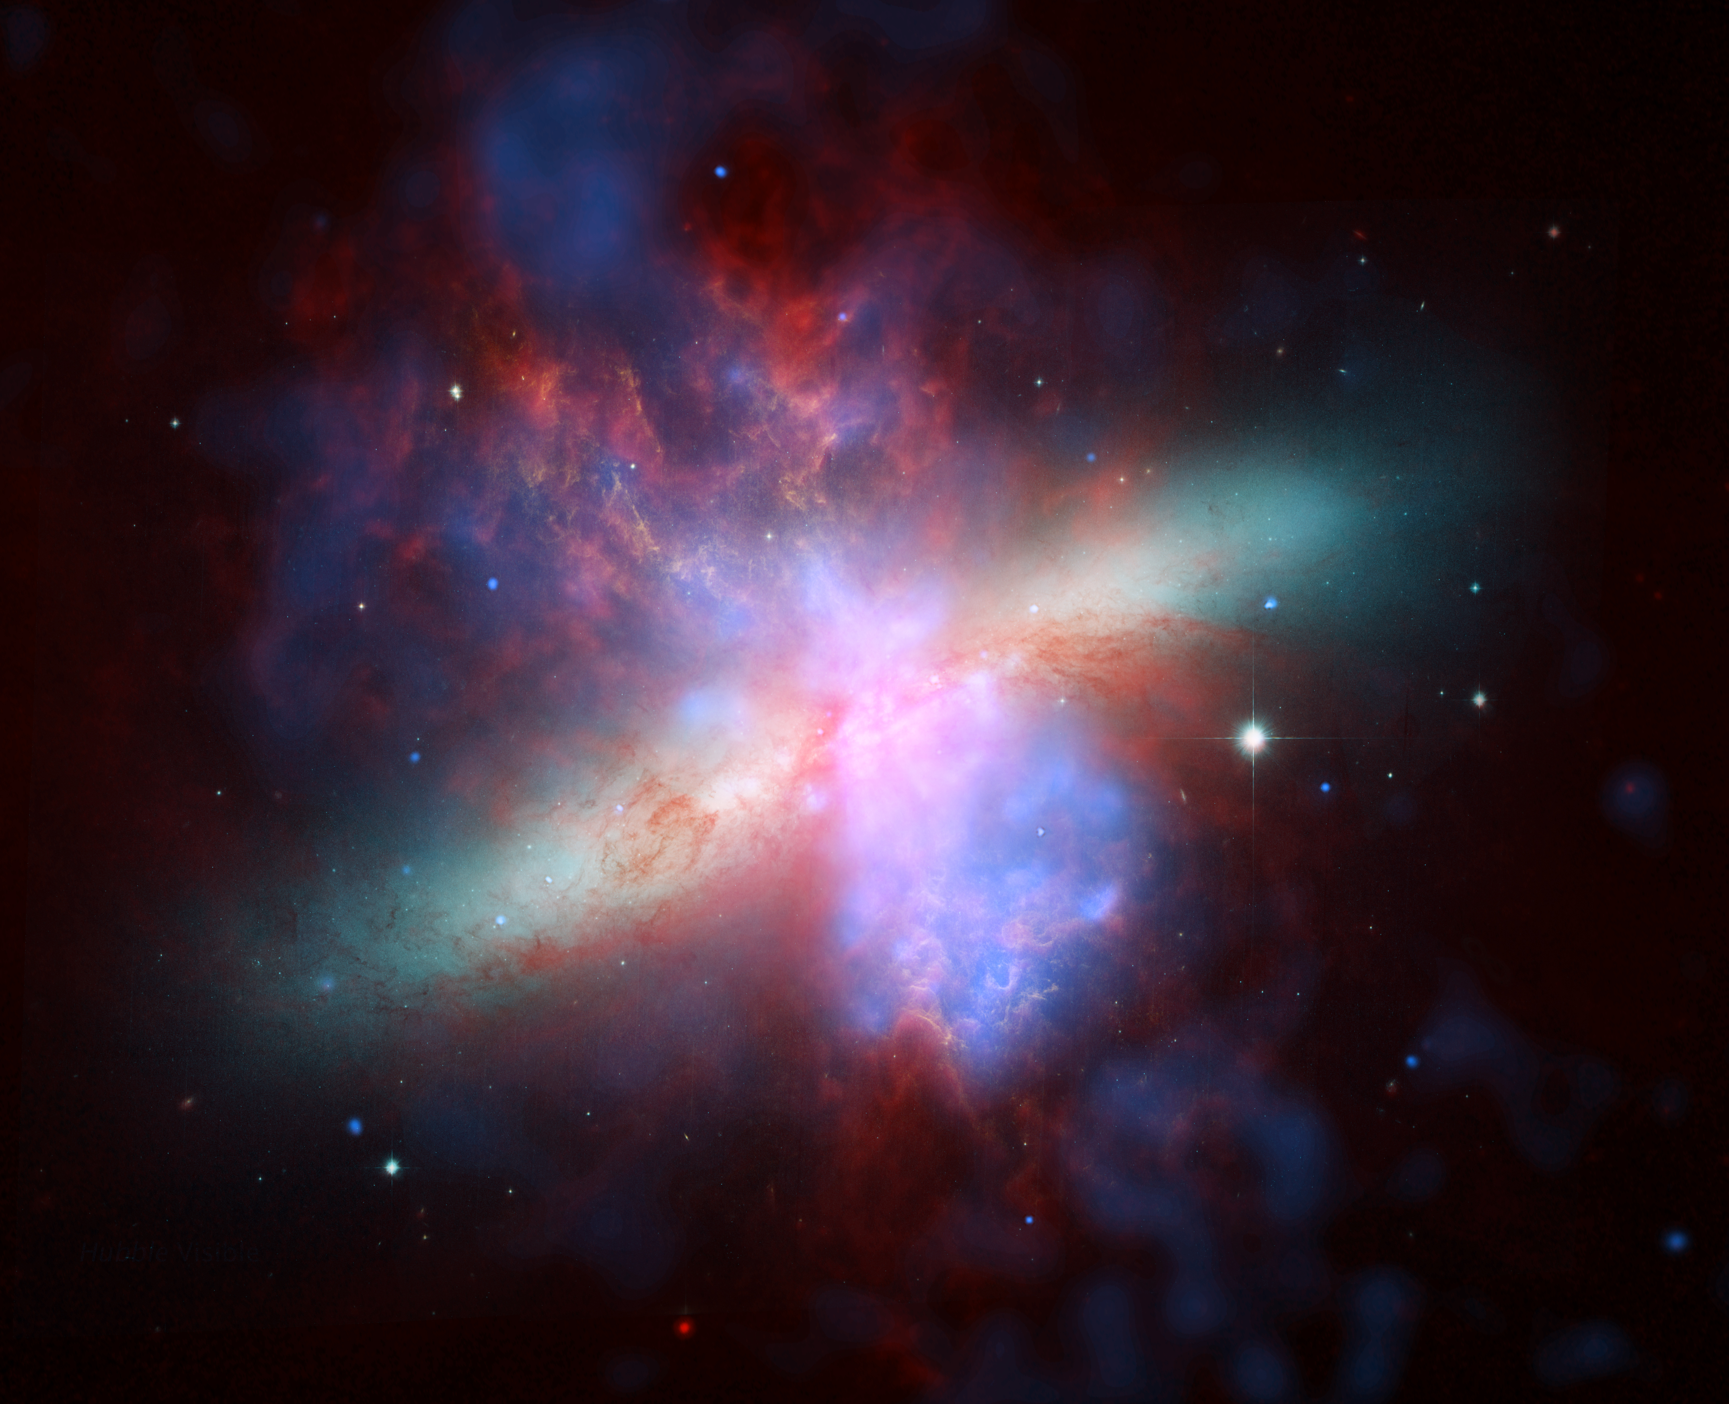
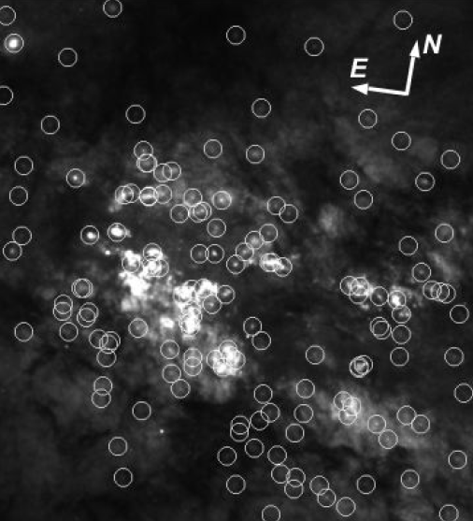
Starburst galaxies (M82)
M82
0.01º
Johannes Schedler
(Panther Observatory)
M82 is the prototype starburst galaxy
Distance ~ 3.9 Mpc
Tidal interaction with M81
150 massive star clusters
High supernova rate ~ 0.1-0.3 /year
High gas density: 150 atoms/cm³
NASA, ESA, The Hubble Heritage Team, (STScI / AURA)

Slide 16
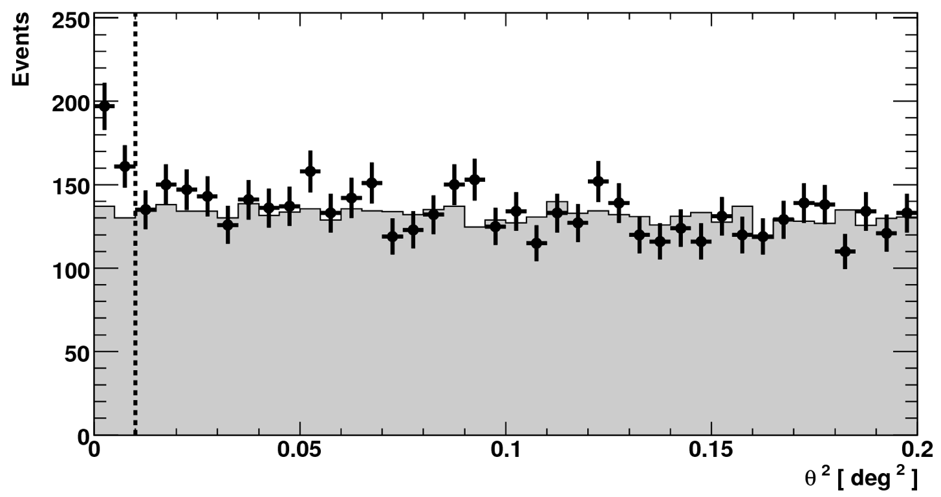
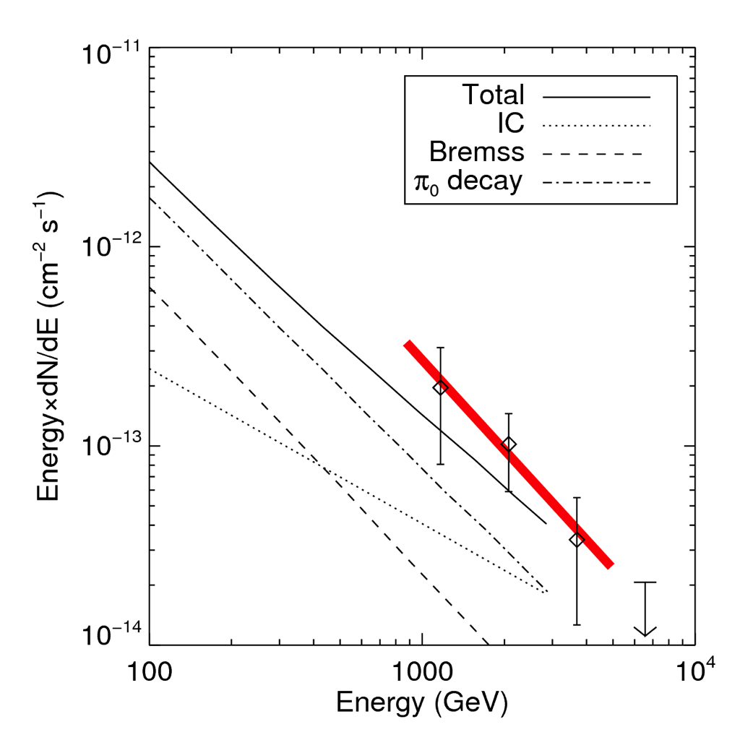
M82: VERITAS discovery
VERITAS data ~ 137 h lifetime
Gamma-ray rate: 0.7 γ/hour
Steady signal: signififcance 5 σ
dN/dE ~ (E / TeV)^{-Γ}: Γ = 2.5 ± 0.6
Origin: hadronic or leptonic?
Acciari et al. (VERITAS Collab.),
Nature, 462, 770 (2009)
radio
20 GeV
cutoff
with Γ=2.3, TeV flux OK.

Slide 17

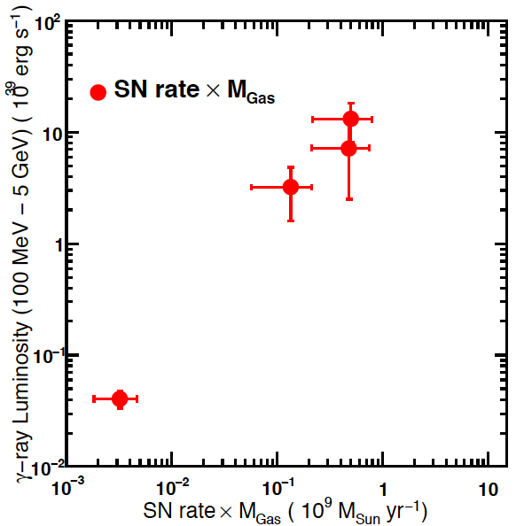
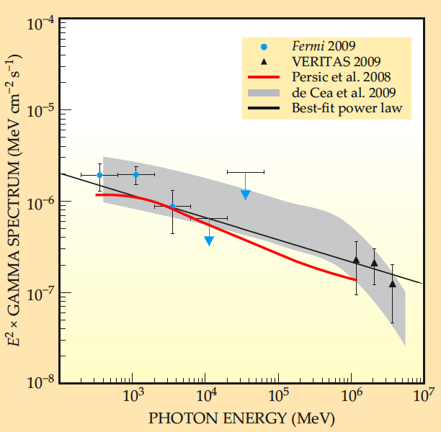
Origin of Cosmic Particles
NGC253
M82
Milky
Way
LMC
C.R.-SNR connection: γ-ray flux should scale with product of
supernova rate and gas density!
Acciari et al. (VERITAS Collab.), Nature, 462, 770 (2009)
Abdo et al. (Fermi Collab.), arXiv:0911.5327
B. Schwarzschild, Physics Today, vol. 63, p 13 (2010)

Slide 18
Cosmic Ray Origin: Supernova Remnant?
Do SNRs emit GeV – TeV γ-rays?
Electron/proton ratio?
Power law spectrum E^{-2.2} ?
Do they accelerate to the knee – are
SNRs Pevatrons?
How efficient is diffusive shock acceleration?
Evidence for B-field amplification?

Slide 19
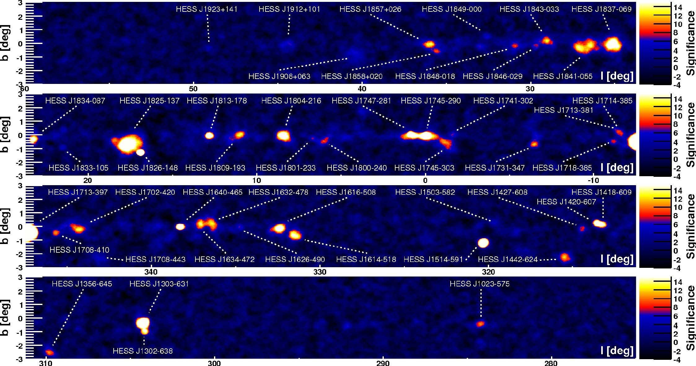
Other Accelerators?
dark accelerators, pulsar wind nebulae: extended

Slide 20
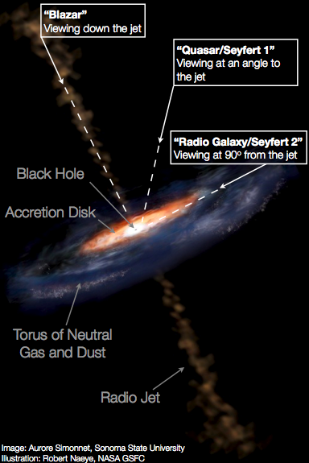
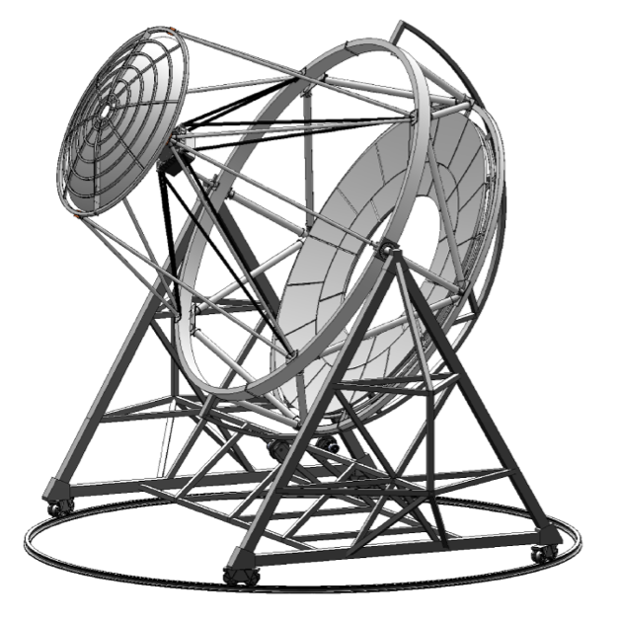
Cosmological (Distant) Sources
> 100 sources (E > 200 GeV)
> 30 AGNs (TeV)
> 700 AGNs (GeV)
Relativistic jets & supermassive black holes
Extremely bright distant sources
Photon interactions with cosmological radiation Fields
Probing Lorentz Invariance Violation at E ~ 10¹⁹ GeV

Slide 21
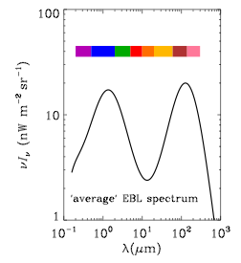
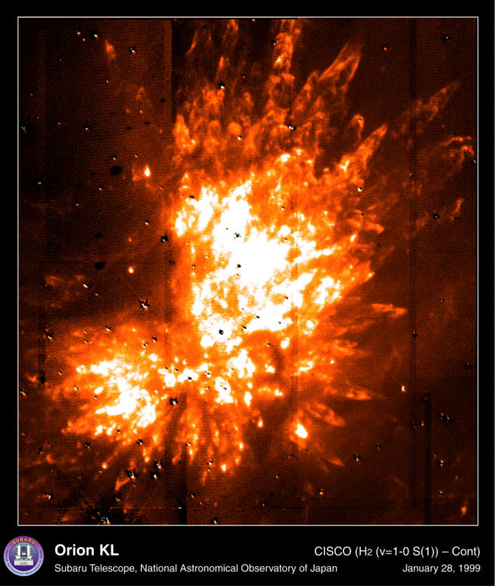
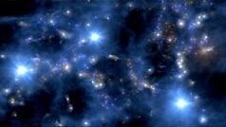
Cosmological (Distant) Sources
probe diffuse Cosmic IR-Background
EBL poorly understood: near - mid IR
TeV beam: γ + γ -> e⁺ + e⁻ interaction
measure CIRB: absorption(z)
10 GeV - 10 TeV
nuclear
accretion
First stars
Star/galaxy
Formation
z<5
AGNs
z<5
Pop III
z ~ 7 - 30
Truly diffuse
Component?
Relics?

Slide 22
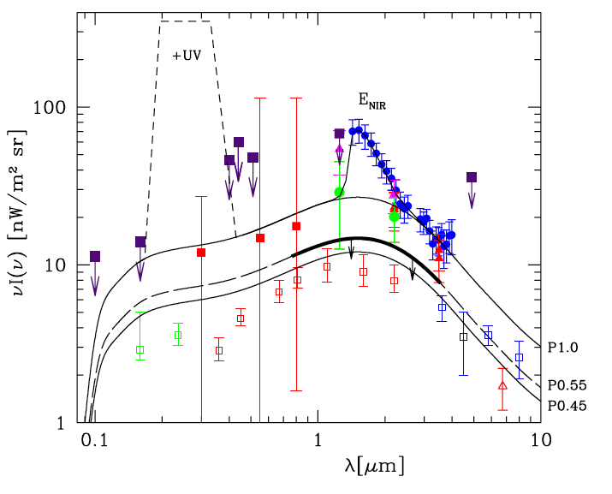
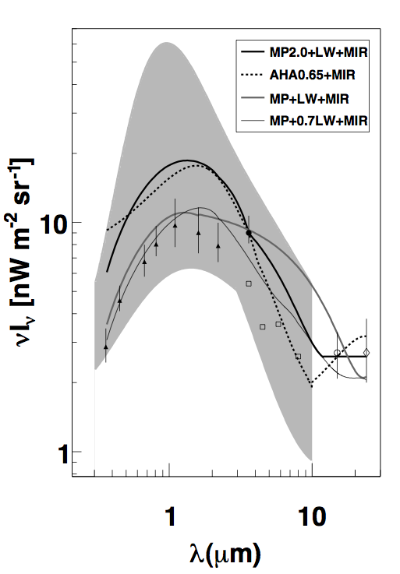
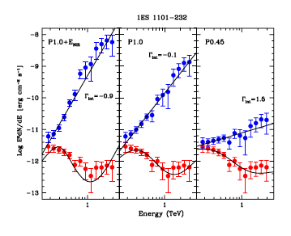
Cosmological (Distant) Sources
K, Dwek, & Imran, 2008, ApJ, L89, L93
1ES0347-121
1ES1101-232
1ES1218+30.4
H2356-309
1ES0229+200
1ES0229+200
RGB J0710+591
Γ > 1.28+-0.20
Γ_{obs} ~ 2.5 - 3.1
Hard spectra blazars
exhibit unusually hard spectra for given z (0.12 - 0.22)
intrinsic spectra by considering EBL lower limits
Γ~1.5 already reached by combining lower limits
Γ=1.5 not a speed limit, or new physics?
Γ > 1.5
Aharonian et al. 2006, Nature, 440, 1018
For review of theoretical papers see: Boettcher et al. 2008, ApJ, 679, L9

Slide 23
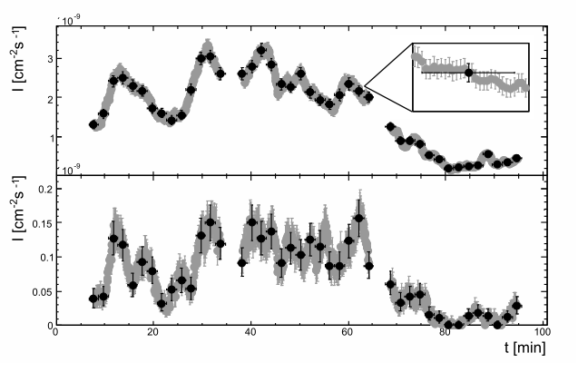
Testing Lorenz Invariance
Amelino-Camelia, G., Ellis, J. et al. 1998 , Nature, 395, 525
300 s
E ~ 200 GeV
Abdo et al. 2009, Science, 323, 1688
Fermi Collab.
HESS
10¹²
10¹⁶
10¹⁹
10²²
E [GeV]
E ~ 800 GeV
Biller et al. 1999,
PRL, 83, 2108
Whipple Collab.
HESS: Aharonian et al. 2008,
PRL, 101.170402
HESS
PKS2155-304
Albert et al. 2008, Phys. Lett. B, 668, 253
MAGIC Collab.

Slide 24
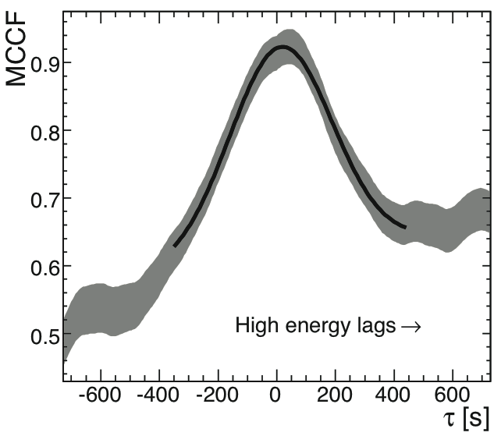
Testing Lorenz Invariance
Amelino-Camelia, G., Ellis, J. et al. 1998 , Nature, 395, 525
HESS
E ~ 200 GeV
Abdo et al. 2009, Science, 323, 1688
Fermi Collab.
10¹²
10¹⁶
10¹⁹
10²²
E [GeV]
E ~ 800 GeV
Biller et al. 1999,
PRL, 83, 2108
Whipple Collab.
HESS: Aharonian et al. 2008,
PRL, 101.170402
HESS
PKS2155-304 no dispersion!
Albert et al. 2008, Phys. Lett. B, 668, 253
MAGIC Collab.

Slide 25
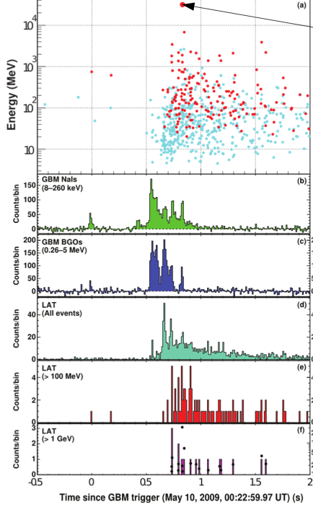
Max Δt
At the Planck Mass!
GRB090510
31 GeV
photon
redshift z = 0.9
duration < 2 s
highest E photon trails by 0.829 s
V. Vasileiou et al. (Fermi Collab.), arXiv:0908.1832

Slide 26



Physics: Dark Matter
Fermilab Tevatron
Large Hadron Collier
CDMS @ Soudan
Produce neutralino
in lab
Three complementary approaches
Directly detect DM WIMP in specialty detectors in (underground) labs
Indirect detection of astrophysical γ-rays from DM self-annihilation
Only direct link between a neutralino and dark matter halo profiles
Diemand et al. 2008, arXiv:0805.1244
Notes:
What is dark matter made from? If dark matter consists dominantly of WIMPS, one need three types of experiments:
→ generate WIMPs (neutralinos) in the laboratory
→ detect WIMPs locally (dolar neighborhood) in underground labs
→ indirect detection technique: the ONLY technique to establish the link between super-symmetric particles and the DM in
astrophysical environments
Many body simulations of structure formation due to the presence of cold DM in a typical galaxy (Milky Way)
- the simulation follows the growth of a Milky Way size galaxy and its halo using a LAMDA CDM scenario
structure grows by merging of smaller units!
- but merging is incomplete and results in the formation of “subhalos”
this leads to a sub structure even in the inner galaxy and in the near proximity of the galactic disk
the observation of dwarf galaxies that are within a few galactic radii make a very compelling target
lleads to ~ 40,000 sub halos within 40 kpc from the galactic center!!!
to search for dark matter annihilation
Those objects have a very large mass-to-light ration and are therefore dominated by dark matter!
In fact the mass and phase space densities of darwf galaxies matches those from simulations!
sub halos boost the potential gamma-ray flux substantially due to the fact that the annihilation rate ~ density2
sub halos provide typical boost factors of 5 – 20!!!!!!!!!!
-

Slide 27

Physics: Dark Matter
Effective
Area
AGIS:
probe the annihilation cross-section
measure the WIMP mass
usher the era of “dark matter astronomy”
Flux
sensitivity
Large area
detector ~ 1km²
Credit: Jim Buckley

Slide 28
Targets for Searches for Dark Matter
Galactic center?
Intermediate mass black holes?
Globular clusters?
Diffuse emission from Milky Way?
Nearby radio galaxies
Dwarf spheroidal galaxies?
Others …
X
X
X
X

Slide 29


Recent Indirect Searches for DM at 0.2 – 10 TeV
VERITAS
HESS
Dwarf galaxies:
High M/L ratio.
Little contamination from CR production (low gas, dust content).
distances: 6 are within 100 kpc (Draco, Willman I, Ursa minor, Bootes I, Seque I, …).
Number of Dwarf galaxies doubled ~ last few years due to Sloan Digital SS.
→ limits of 10⁻²³ cm³/s at 200 – 10 TeV.
Notes:
The general lack of active or recent star formation in most dwarf spheroidals implies little background from conventional astrophysics processes.
spectroscopic (velovity distribution) data of stars constrains the DM distributions profile!!!!
→ Willman 1 is maybe the best candidate: d = 38 kpc, “scale radius rs = 0.18 kpc,” “half light radius r h = 25 pc”

Slide 30
Next Steps: AGIS & CTA

Slide 31

Large Array Concept
Event containment:
- angular resolution Θ x 3
background rejection x 2
collection area x 10
solid angle Ω x 4
100 m

Slide 32


AGIS +CTA Instrument Concept
Major Steps to advance the
100 GeV - 10 TeV regime:
36 element array
Wide FOV
high resolution camera
-> angular resolution
-> better background rejection
-> better sensitivity
CTA
AGIS
Approaching the limit of the IACT technique in mid Energy regime, where it works best!

Slide 33






New Physics
Increased FOV
Fly’s Eye mode
X-rays
VERITAS
AGIS
Angular resolution:
emission components
from particle acceleration
& annihilation!
VERITAS

Slide 34
New Physics
Increased FOV
Fly’s Eye mode
X-rays
VERITAS
AGIS
Angular resolution:
emission components
from particle acceleration
& annihilation!
VERITAS

Slide 35
New Physics
Increased FOV
Fly’s Eye mode
X-rays
VERITAS
AGIS
Angular resolution:
emission components
from particle acceleration
& annihilation!
VERITAS

Slide 36
New Physics
Increased FOV
Fly’s Eye mode
X-rays
VERITAS
AGIS
Angular resolution:
emission components
from particle acceleration
& annihilation!
VERITAS

Slide 37
What New Physics?
Cosmic
Particle
origin
In order to
separate
emission
components!
particle acceleration
of hadrons
vs.
leptons
vs.
DM
annihilation
products
SNRs
Dark accelerators
Molecular Clouds
Morphology
Dark Matter
Resolve
Diffuse emission
Extended ‘Milagro’ sources
galactic DM clumps
Source confusion (Fermi)
Axion-Like Particle
Resolve
Spatial Profile
Burst region in SBGs
DM profile in dwarf galaxies
Pair halos around AGNs
EBL & Cosmic
Relic particles

Slide 38

SAO
Stanford/SLAC
UNAM
UCLA
UCSC
U. Chicago
U. Iowa
U. Utah
Yale U.
Washington U.
Institutions:
Adler
ANL
Barnard
Delaware
IAFE
INAF (Brera)
Iowa State
McGill
MSFC
Penn State
Pittsb. State
Purdue
Executive Committee:
J. Buckley
S. Funk
H. Krawzcynski
F. Krennrich (SP)
V. Vassiliev
15 US University groups
3 National Labs
4 International groups

Slide 39
AGIS Instrument Concept

Slide 40
AGIS-Specifications
Specification of the AGIS-36 Array | Target
Telescope Spacing | 120 - 150 m
Effective Mirror Area per Tel. | 100 m²
Field of View (FOV) | 8 deg.
Pixelation | 0.05 - 0.10 deg.
Effective Collection Area | 1 km²
Energy Threshold | 100 GeV
Angular Resolution | 0.02 - 0.05 deg.
Key attributes of AGIS

Slide 41

AGIS Telescope Concept
Pixelation
AGIS Element:
Schwarzschild-Couder optics
0.28º
0.20º
0.07º
FOV
3.5 deg.
8 deg.
Relative
Size
8º (FoV)
DC optics
SC optics

Slide 42


AGIS Telescope Concept
Pixelation
AGIS Element:
Schwarzschild-Couder optics
0.28º
0.20º
0.07º
FOV
3.5 deg.
8 deg.
Actual
Size
Secondary optics, but telescope with short F/D & compact high resolution, wide FOV cameras!
DC optics
SC optics

Slide 43


Array Layout
Grid spacing: 120 - 150m
Interconnected: power, trigger
Flat area: 1 km²
Elevation: 2 - 3 km
Power requirement: 150 kW
Location: equatorial - southern
Atmospheric conditions: clear skies

Slide 44
Summary:
VHE astronomy: new view of Universe new probes for particle physics.
Techniques for HE & VHE γ-ray much advanced ~ 1000 (100) sources.
Origin of cosmic particles well on its way to be resolved.
Search for dark matter annihilation is in full swing.
LIV tests are already done at the Planck Energy.
Universe is more transparent to γ-rays than expected or blazar spectra of
distant source are unusual.
Deep probes for Dark Matter origin, with arcminute imaging capabilities and
km² effective area with next generation telescope array.
AGIS + CTA combined ~ 500 physicists/astronomers.

Slide 45
Blank

Slide 46

Recent Indirect Searches for DM at 10 – 1,000 GeV
Dwarf galaxies
no significant detection of any dwarf
limits of 10⁻²⁵ cm³/s at 100 GeV
Fermi

