Slide 1
Search for High Mass Higgs at CDF
Mark Neubauer
(University of Illinois at Urbana-Champaign)
On behalf of the CDF Collaboration

Slide 2
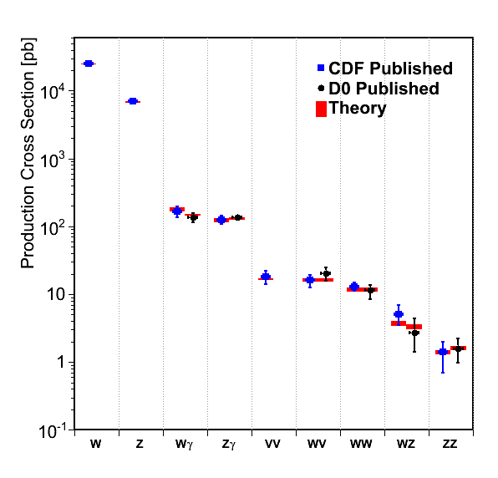
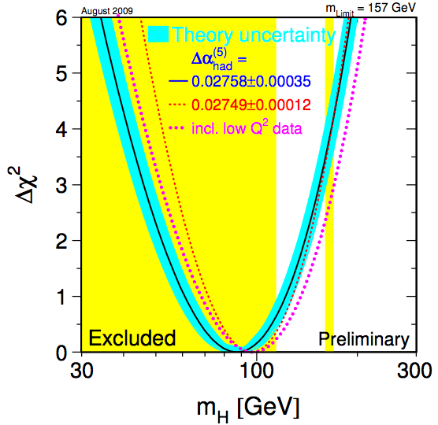
Run II
Tevatron experiments probe production processes covering many orders of magnitude in cross section
Many discoveries
WZ, ZZ, single top
Now reached sub-picobarn cross section sensitivity
1st Observation in
Hadron Collisions
WW
1st Observation
SM Higgs:
Direct search at LEP:
m_{H}>114 GeV @ 95%CL
Including indirect electroweak constraints
m_{H}<186 GeV @ 95%CL

Slide 3
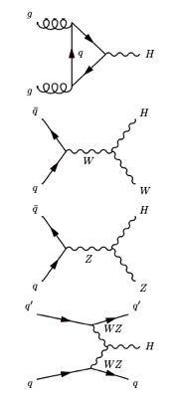
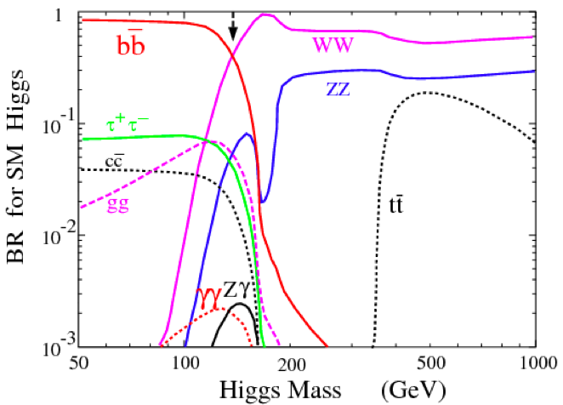
SM Higgs at the Tevatron
@M_{h}=160 GeV
Low Mass
High Mass
ggH (78 %)
WH (9 %)
ZH (6 %)
WBF (7 %)
WW dominates at M_{H} > 135 GeV
Contributes to Higgs searches down to 120 GeV/c²

Slide 4
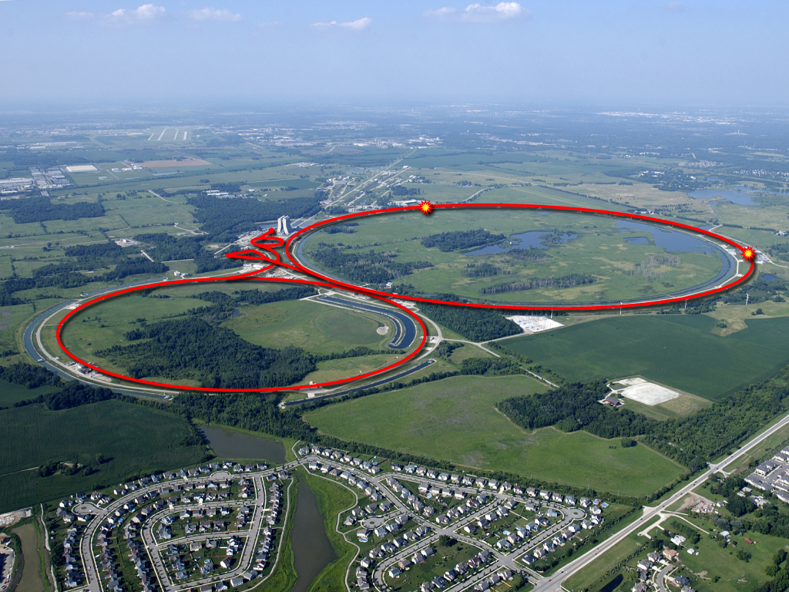
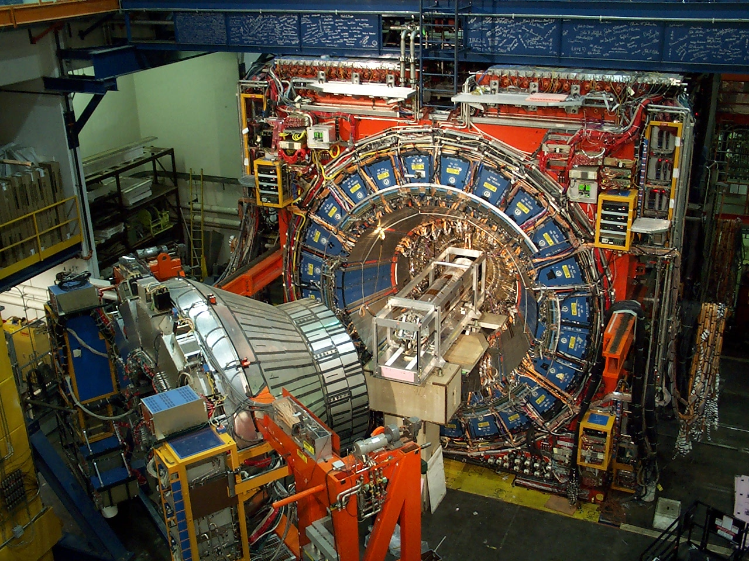
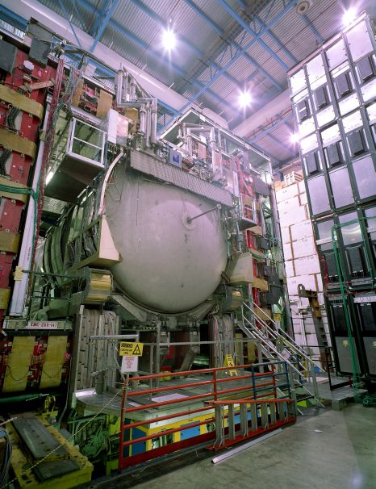
Tevatron, CDF, D0
CDF
D0
`
~8.6 fb⁻¹ of data delivered
More than 7 fb⁻¹ acquired per experiment
Results presented today use up to 5.4 fb-1

Slide 5
Candidate Selection
Focus on
Separate channels by
Triggered on high p_{T} electron or muon
Events with ≥ 2 opposite charge high p_{T} leptons and W-like missing E_{T}
Backgrounds
After selection, the main backgrounds are due to:
Diboson production – WW, WZ, ZZ
W+jets where a jet fakes a lepton
W+γ where the photon fakes a lepton
ttbar and single top
5

Slide 6
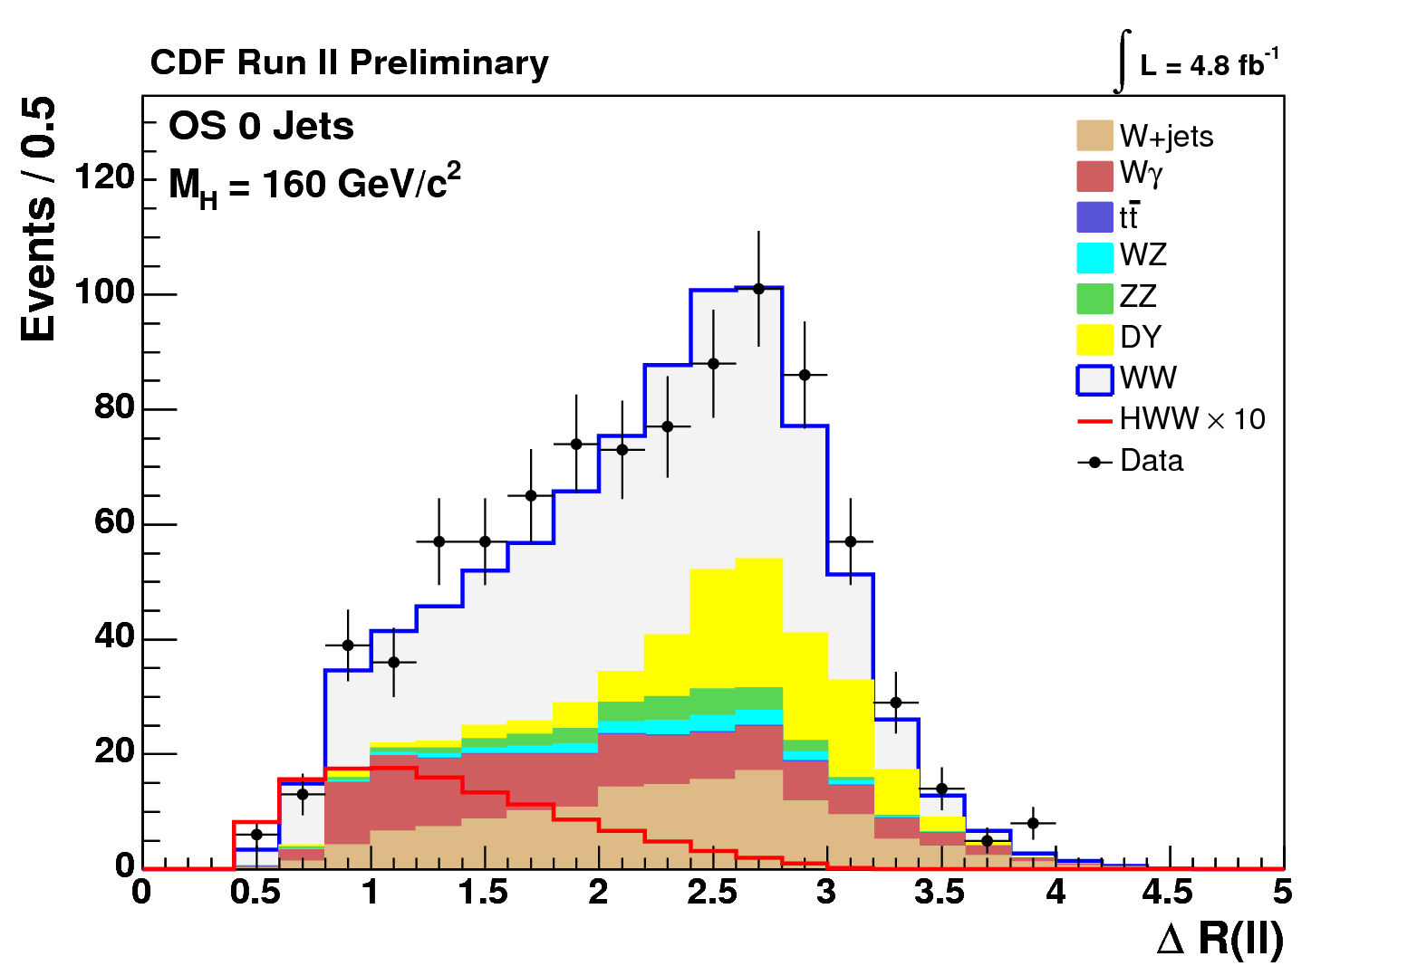
Higgs Signature
Main challenge: to distinguish signal from direct WW pair production:
Spin-0 Higgs leads to spin correlation:
Leptons go in the same direction
Backgrounds
Signal x 10
H
W⁺
W⁺
μ⁺
W⁻
ν
W⁻
e⁻
ν
Dilepton opening angle is the strongest background discriminant
6

Slide 7
Strategy
Simple event counting is not good enough (S/√B too low): Use multivariate analysis (MVA) techniques to discriminate between signal and background:
Matrix Elements (ME), Neural Networks (NN), Boosted Decision Trees (BDT)
Each channel and M_{H} hypothesis has its own MVA template
Many control regions to verify background modeling
Cross section measurements of some SM processes (e.g. WW, WZ, ZZ)
Separate analysis into channels by S/B ratio in lepton purity and jet multiplicity: 0, 1 and 2+ jets
Consider how ggF, WH, ZH, and WBF can feed these channels
No Channel Left Behind!

Slide 8
ggF & WBF
opposite sign leptons
+ MET
+ jets (usually 0)
ggH
opposite sign leptons
+ MET
+ jets (usually 2)
WBF

Slide 9
WH (OS dileptons)
opposite sign leptons
+ MET
+ jets (usually 2)
WH

Slide 10
ZH (OS dileptons)
opposite sign leptons
+ MET
+ jets (usually 2)
ZH

Slide 11
WH (SS dileptons)
Same-sign leptons
+ MET
+ jets (usually 2)
WH

Slide 12
WH (trileptons)
Trileptons
+ MET
+ jets (usually 0)
WH

Slide 13
ZH (trileptons)
Trileptons
+ MET
+ jets (usually 2)
ZH

Slide 14
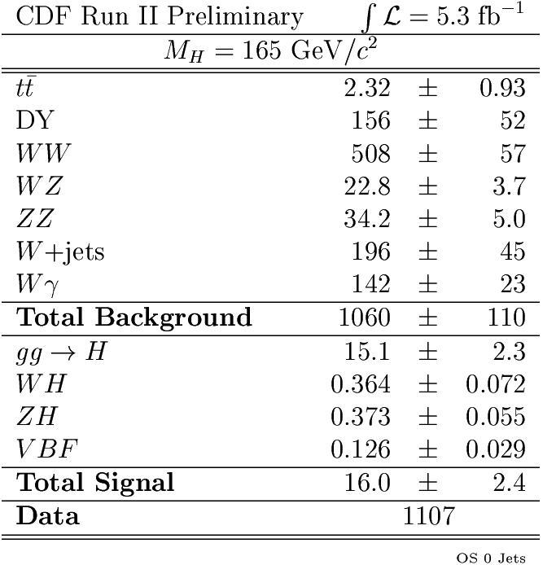
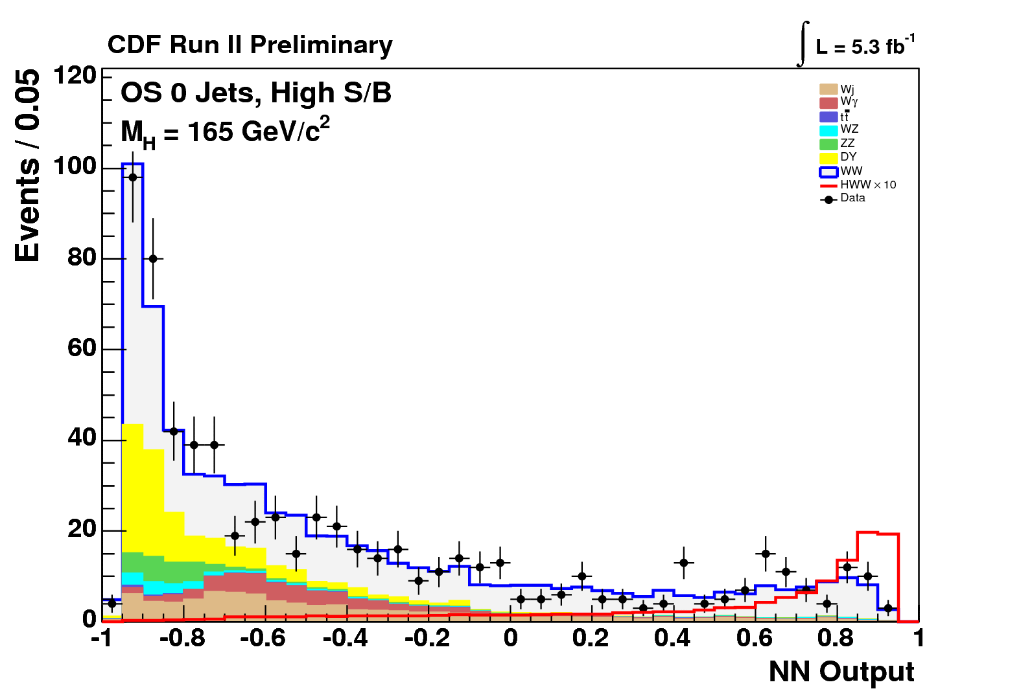
OS dilepton + 0 jets:
Make good use of ME calculations (LO)
Majority of signal from gluon fusion
OS dilepton + 1 jet:
Extra tt backgrounds
Extra signal (VH & WBF): ~20%
OS dilepton + ≥ 2 jets:
tt is main background (anti b-tagging!)
Extra signal (VH & WBF) ~60%
OS dilepton (M_{ll}<16 GeV) + 0,1 jet:
W+γ (fake e) dominant background
Lepton p_{T} a powerful discriminating variable
SS dilepton + ≥ 1 jet:
Charge mis-ID and W+jets (fake e,μ) Bkgs
Extra signal (WH) ~10% @ high M_{H}
WW Background
Trileptons:
tt is main background (anti b-tagging!)
Extra signal (WH & ZH)
Signal x 10
Hadronic taus…

Slide 15
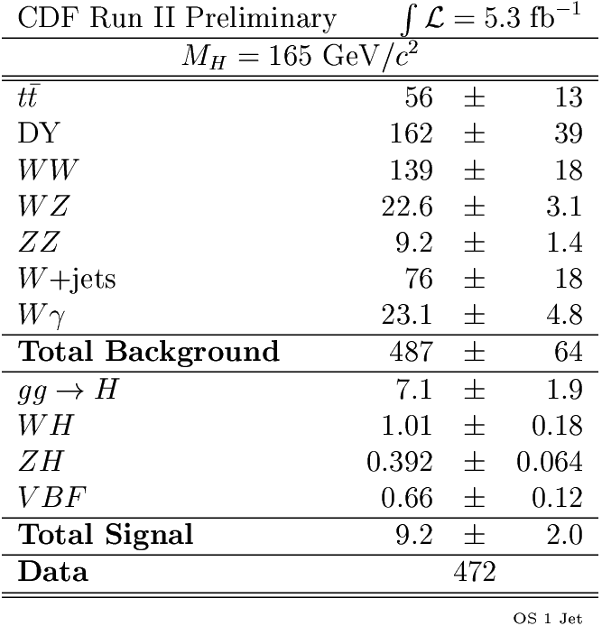
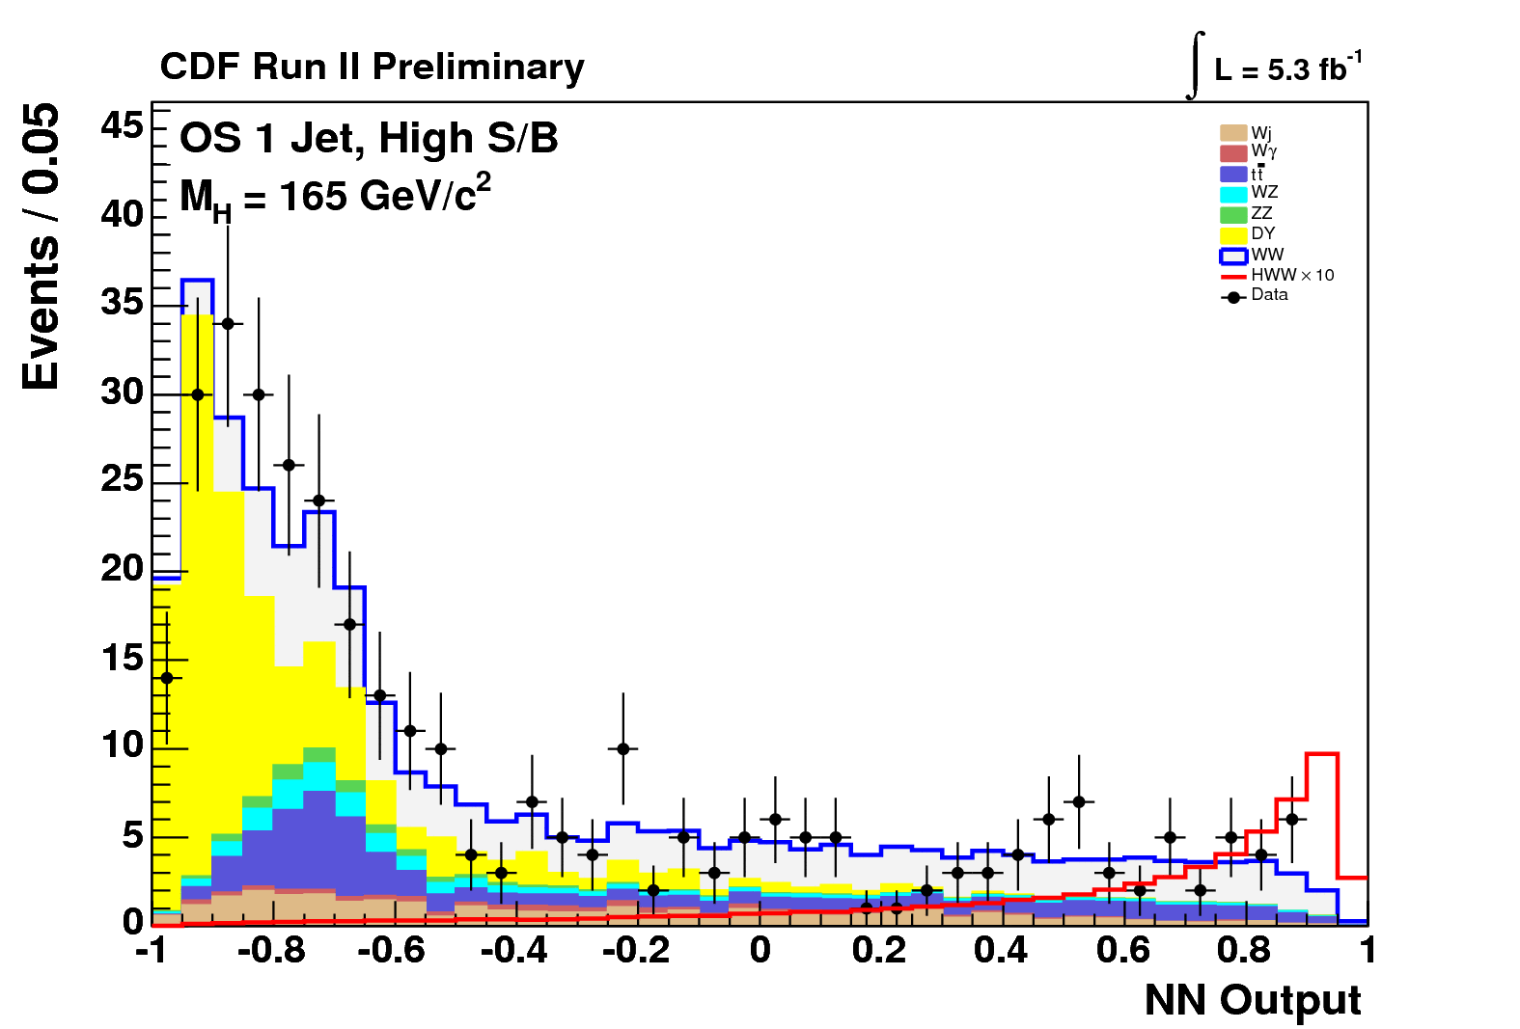
OS dilepton + 0 jets:
Make good use of ME calculations (LO)
Majority of signal from gluon fusion
OS dilepton + 1 jet:
Extra tt backgrounds
Extra signal (VH & WBF): ~20%
OS dilepton + ≥ 2 jets:
tt is main background (anti b-tagging!)
Extra signal (VH & WBF) ~60%
OS dilepton (M_{ll}<16 GeV) + 0,1 jet:
W+γ (fake e) dominant background
Lepton p_{T} a powerful discriminating variable
SS dilepton + ≥ 1 jet:
Charge mis-ID and W+jets (fake e,μ) Bkgs
Extra signal (WH) ~10% @ high M_{H}
WW Background
Trileptons:
tt is main background (anti b-tagging!)
Extra signal (WH & ZH)
Signal x 10
Hadronic taus…

Slide 16
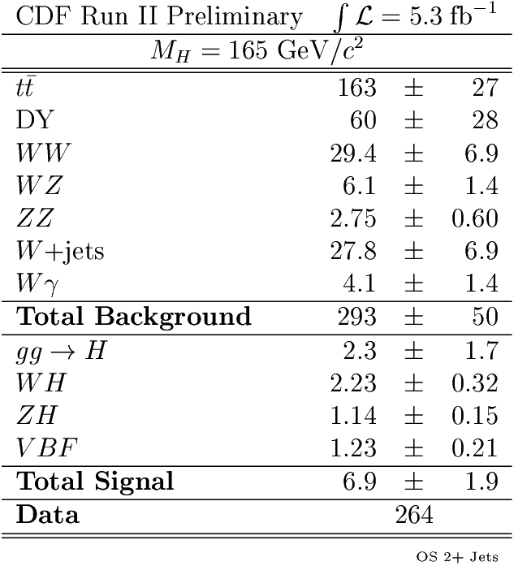
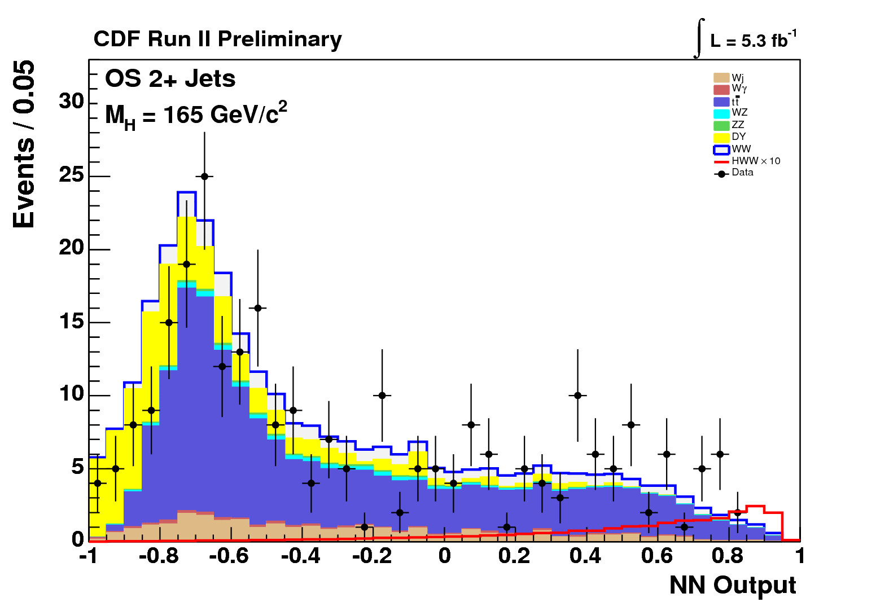
OS dilepton + 0 jets:
Make good use of ME calculations (LO)
Majority of signal from gluon fusion
OS dilepton + 1 jet:
Extra tt backgrounds
Extra signal (VH & WBF): ~20%
OS dilepton + ≥ 2 jets:
tt is main background (anti b-tagging!)
Extra signal (VH & WBF) ~60%
OS dilepton (M_{ll}<16 GeV) + 0,1 jet:
W+γ (fake e) dominant background
Lepton p_{T} a powerful discriminating variable
SS dilepton + ≥ 1 jet:
Charge mis-ID and W+jets (fake e,μ) Bkgs
Extra signal (WH) ~10% @ high M_{H}
ttbar Background
Trileptons:
tt is main background (anti b-tagging!)
Extra signal (WH & ZH)
Signal x 10
Hadronic taus…

Slide 17
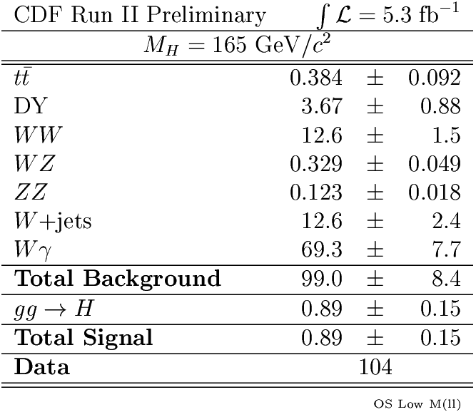
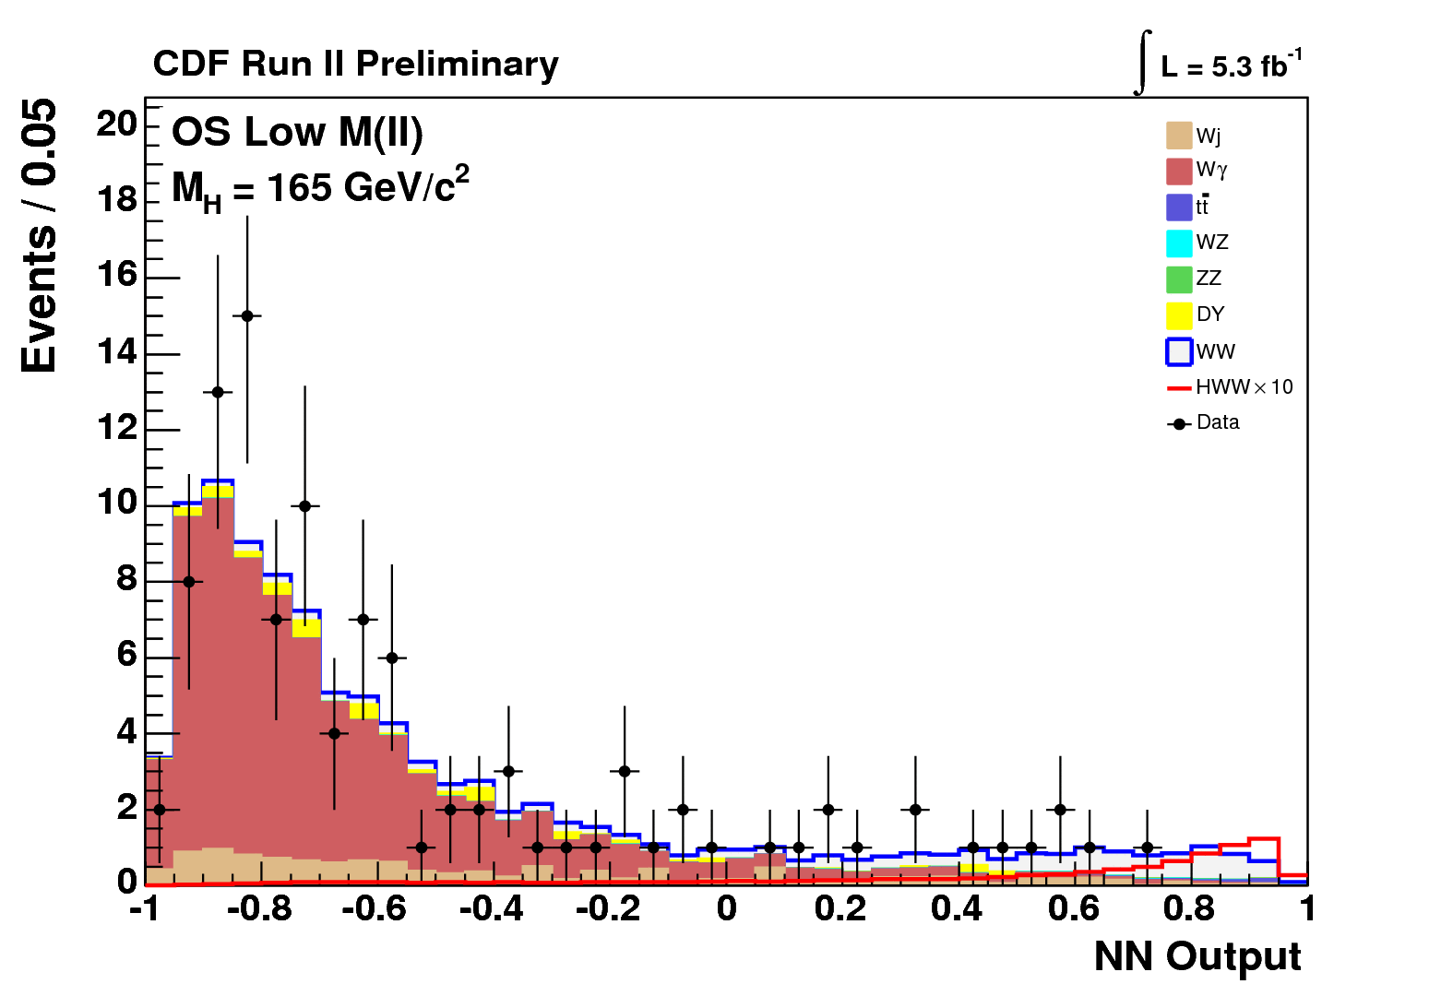
OS dilepton + 0 jets:
Make good use of ME calculations (LO)
Majority of signal from gluon fusion
OS dilepton + 1 jet:
Extra tt backgrounds
Extra signal (VH & WBF): ~20%
OS dilepton + ≥ 2 jets:
tt is main background (anti b-tagging!)
Extra signal (VH & WBF) ~60%
OS dilepton (M_{ll}<16 GeV) + 0,1 jet:
W+γ (fake e) dominant background
Lepton p_{T} a powerful discriminating variable
SS dilepton + ≥ 1 jet:
Charge mis-ID and W+jets (fake e,μ) Bkgs
Extra signal (WH) ~10% @ high M_{H}
Wγ Background
Trileptons:
tt is main background (anti b-tagging!)
Extra signal (WH & ZH)
WW Background
Signal x 10
Hadronic taus…

Slide 18
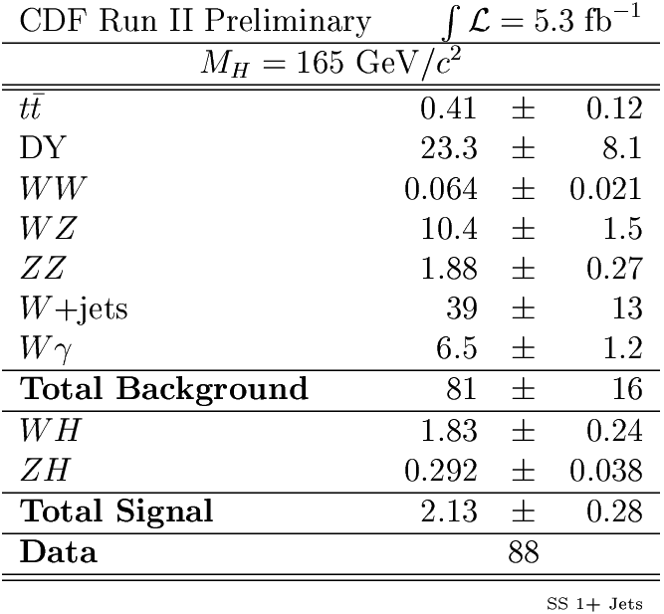
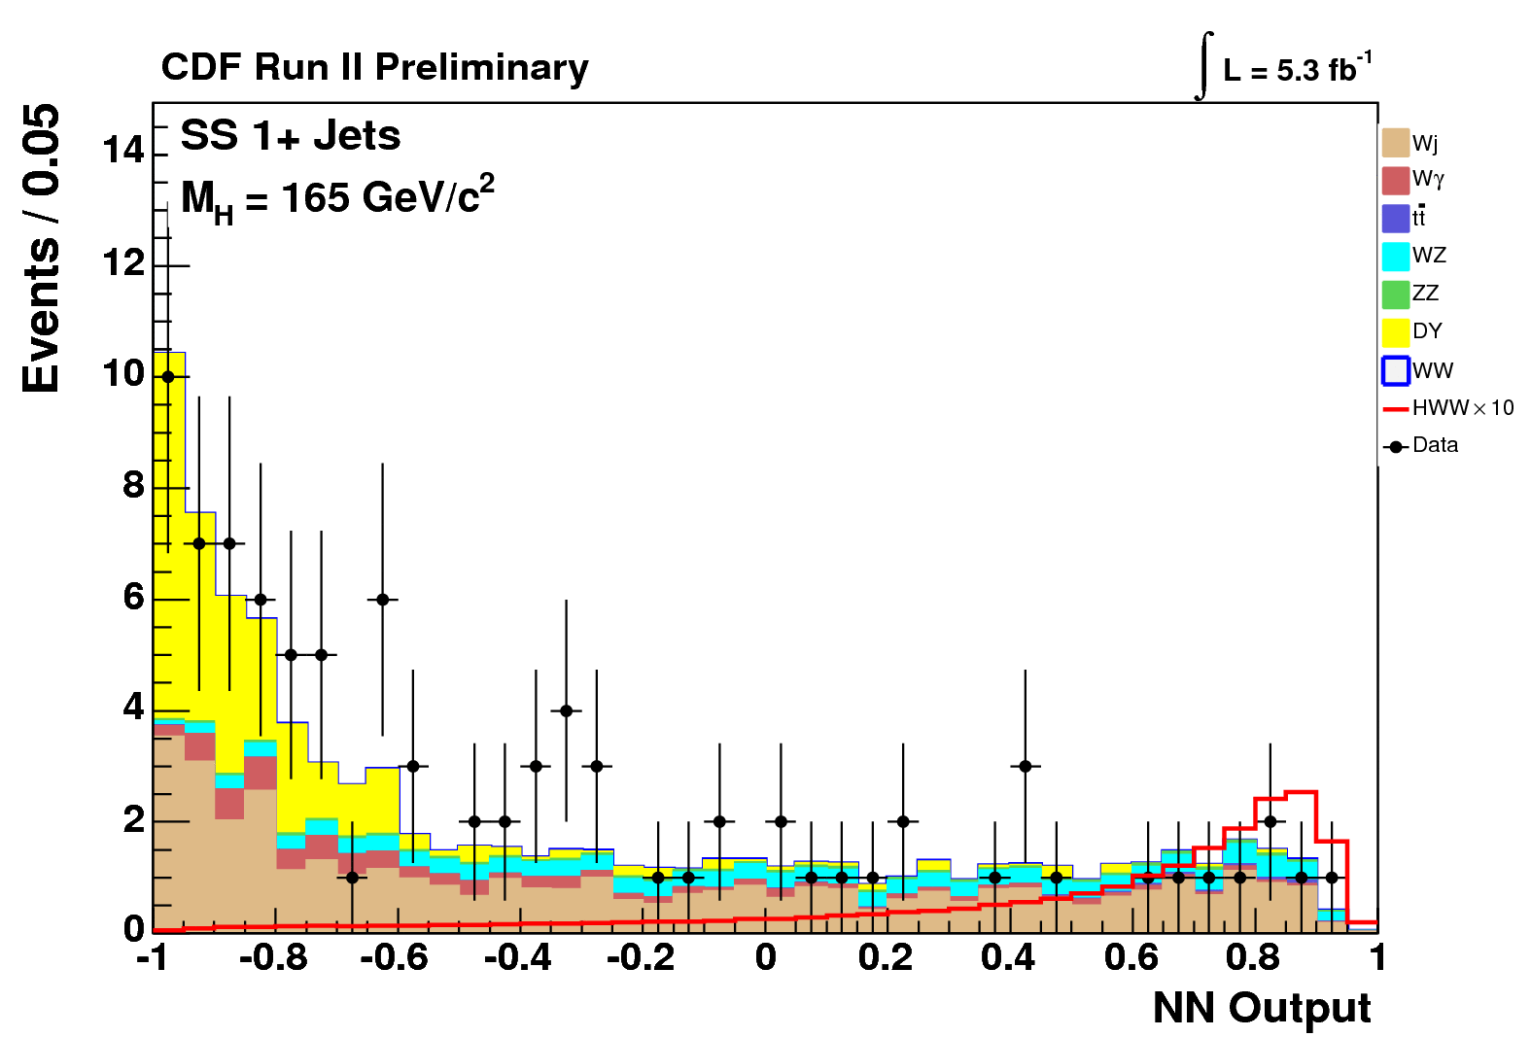
OS dilepton + 0 jets:
Make good use of ME calculations (LO)
Majority of signal from gluon fusion
OS dilepton + 1 jet:
Extra tt backgrounds
Extra signal (VH & WBF): ~20%
OS dilepton + ≥ 2 jets:
tt is main background (anti b-tagging!)
Extra signal (VH & WBF) ~60%
OS dilepton (M_{ll}<16 GeV) + 0,1 jet:
W+γ (fake e) dominant background
Lepton p_{T} a powerful discriminating variable
SS dilepton + ≥ 1 jet:
Charge mis-ID and W+jets (fake e,μ) Bkgs
Extra signal (WH) ~10% @ high M_{H}
Wj Background
Trileptons:
tt is main background (anti b-tagging!)
Extra signal (WH & ZH)
Signal x 10
Hadronic taus…

Slide 19
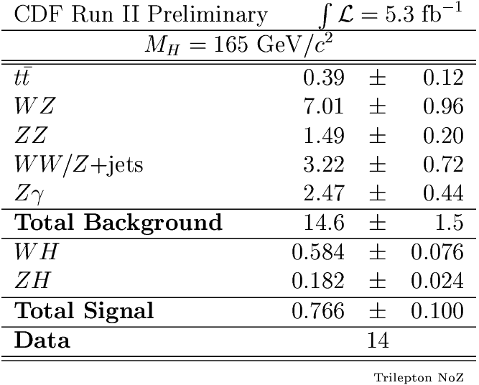
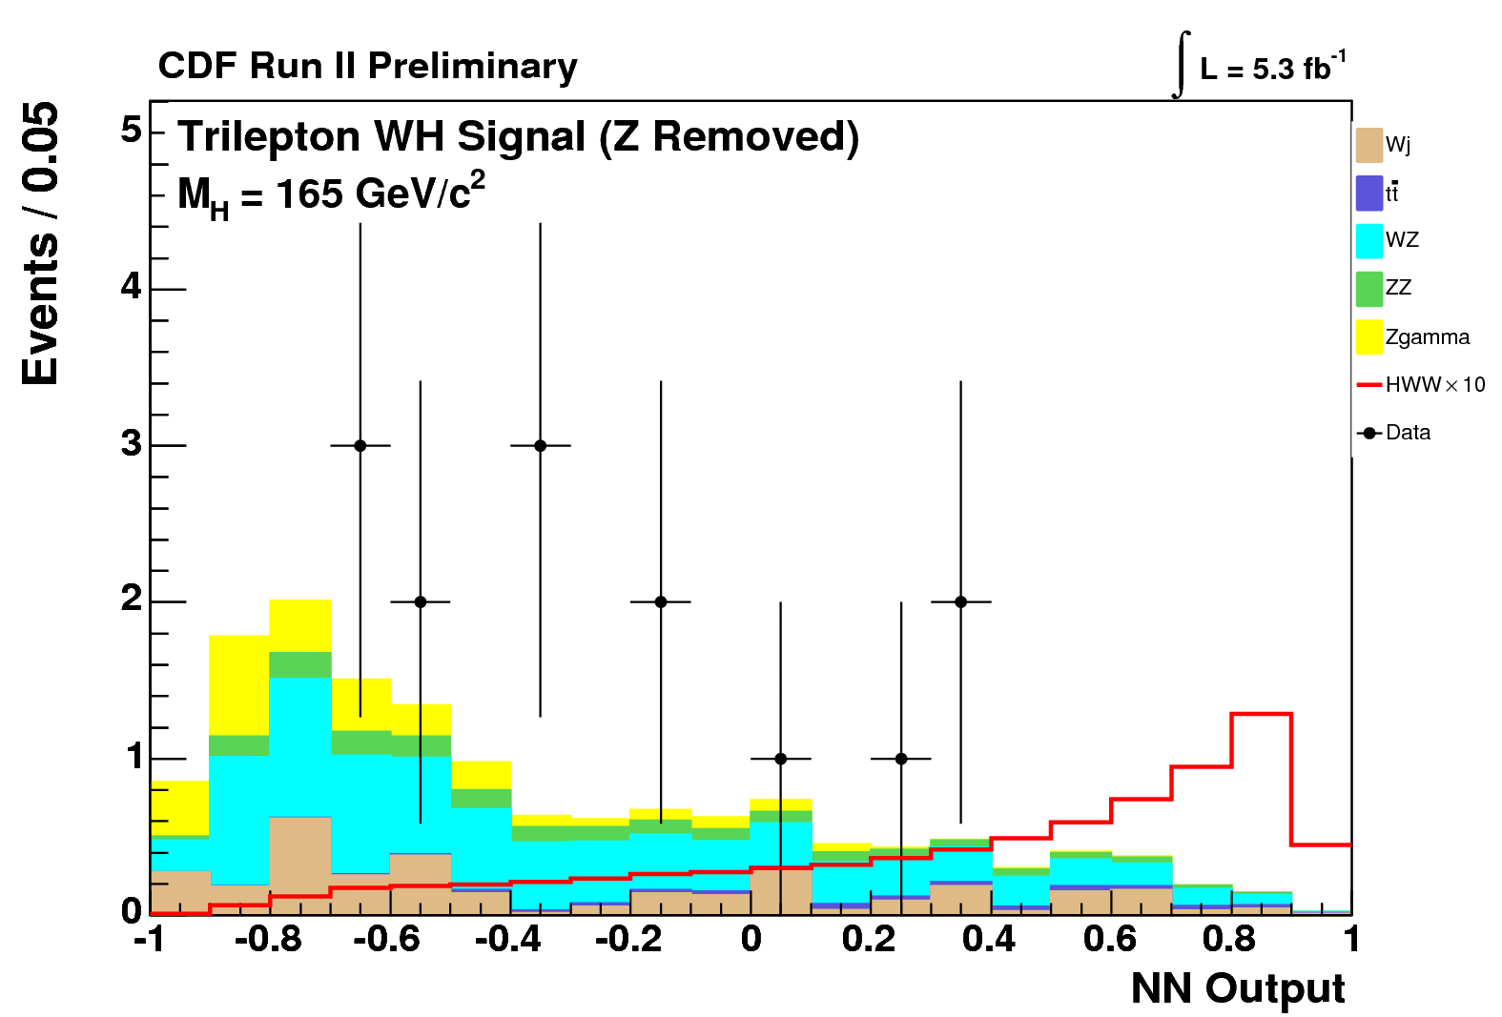
OS dilepton + 0 jets:
Make good use of ME calculations (LO)
Majority of signal from gluon fusion
OS dilepton + 1 jet:
Extra tt backgrounds
Extra signal (VH & WBF): ~20%
OS dilepton + ≥ 2 jets:
tt is main background (anti b-tagging!)
Extra signal (VH & WBF) ~60%
OS dilepton (M_{ll}<16 GeV) + 0,1 jet:
W+γ (fake e) dominant background
Lepton p_{T} a powerful discriminating variable
SS dilepton + ≥ 1 jet:
Charge mis-ID and W+jets (fake e,μ) Bkgs
Extra signal (WH) ~10% @ high M_{H}
WZ Background
Trileptons:
WZ is main background
Extra signal (WH & ZH)
Signal x 10
Hadronic taus…

Slide 20
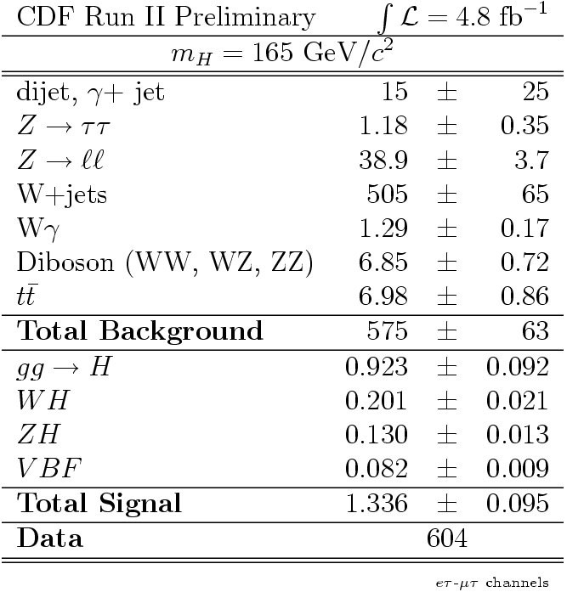
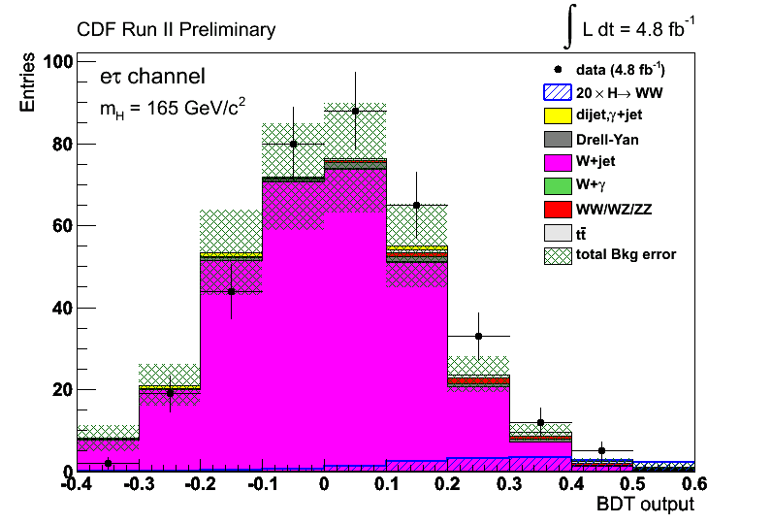
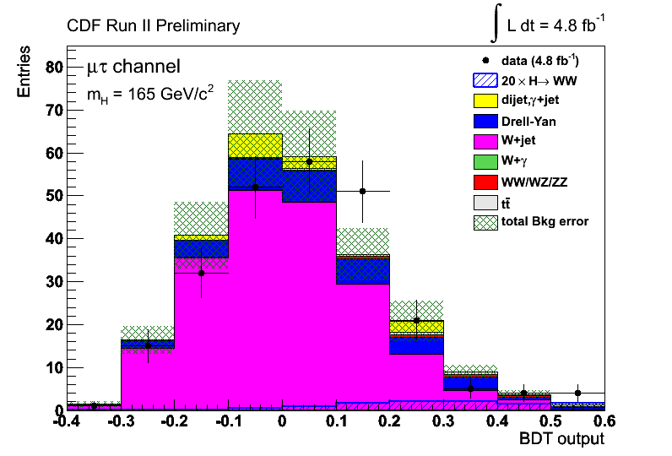
OS dilepton + 0 jets:
Make good use of ME calculations (LO)
Majority of signal from gluon fusion
OS dilepton + 1 jet:
Extra tt backgrounds
Extra signal (VH & WBF): ~20%
OS dilepton + ≥ 2 jets:
tt is main background (anti b-tagging!)
Extra signal (VH & WBF) ~60%
OS dilepton (M_{ll}<16 GeV) + 0,1 jet:
W+γ (fake e) dominant background
Lepton p_{T} a powerful discriminating variable
SS dilepton + ≥ 1 jet:
Charge mis-ID and W+jets (fake e,μ) Bkgs
Extra signal (WH) ~10% @ high M_{H}
Trileptons:
tt is main background (anti b-tagging!)
Extra signal (WH & ZH)
Signal x 20
Wj Background
Hadronic τ’s!

Slide 21
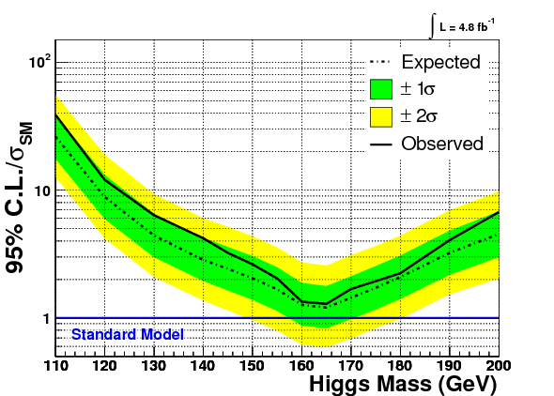
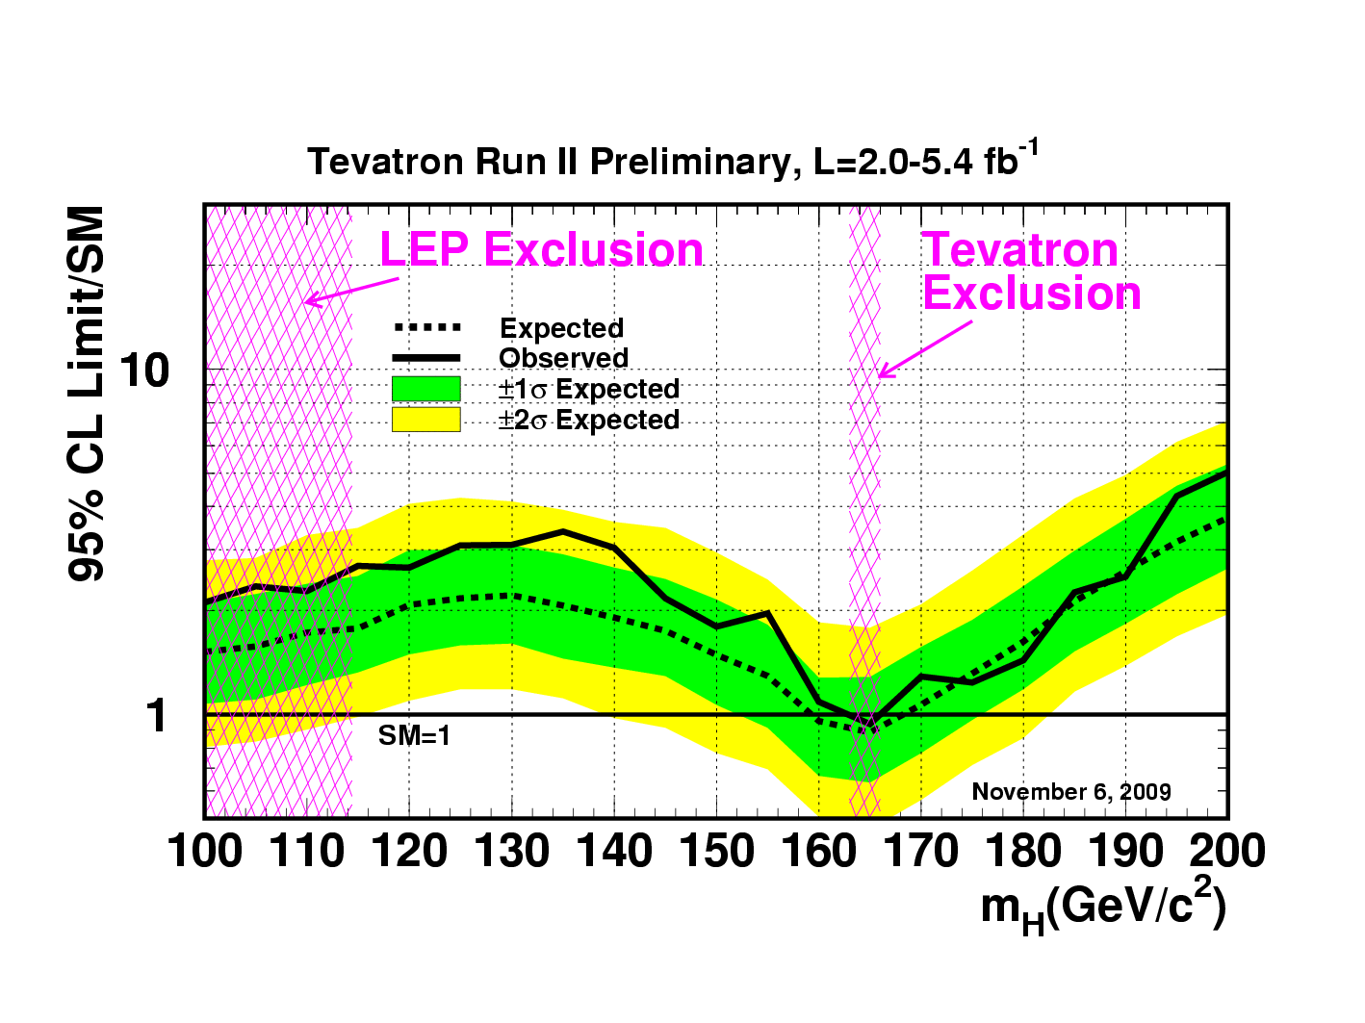
Previously published limits on SM Higgs Production
T. Aaltonen et al. (CDF Collaboration), Phys. Rev. Lett. 104, 061803 (2010).
+
SM Sensitivity:
159-169 GeV/c²!
SM Exclusion:
162-166 GeV/c²!
T. Aaltonen et al., (CDF and DØ Collaborations), Phys. Rev. Lett. 104, 061802 (2010).

Slide 22
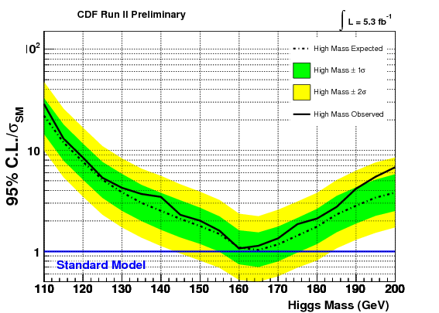
Improvements over published results
4.8→5.3 fb⁻¹: 5% better
Optimized e⁻ selection
Add Trileptons, Low M_{ll} , VH, WBS for 0 Jet
All together: 15% better!
Improvements continue (τ modes add few %)
For M_{H}=165 GeV/c² | Expected | Observed
CDF New | 1.03 | 1.13
CDF Pub | 1.20 | 1.29

Slide 23
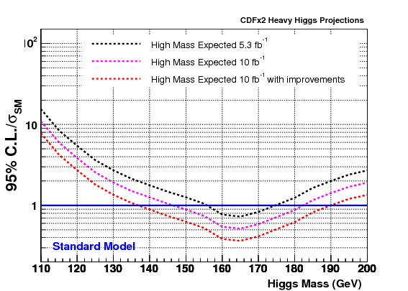
146-183
136-190

Slide 24
Summary
“No channel left behind” strategy successful: different, backgrounds, systematics, S/B and many channels.
Combined Tevatron results exclude the Standard Model Higgs at 95% CL for 162 ≤ M_{H} ≤ 166 GeV/c².
Updated CDF results: sensitivity close to 95% CL exclusion for M_{H}=160-165 GeV/c².
The High mass sensitivity will be expanded: 2 x CDF gives 146-183 GeV/c² if no improvements, 136-190 GeV/c² with improvements.
Both experiments have almost 9 fb⁻¹ delivered! May have 12 fb⁻¹ by the end of Run II!

