Slide 1
Low-scale Gaugino Mediation in Warped Spacetime
Toshifumi Yamada
Sokendai, KEK
in collaboration with Nobuchika Okada (Univ. of Alabama) arXiv:
May 11, 2010 @ Pheno 2010

Slide 2
SUSY Breaking Mediation
What is the mechanism for SUSY breaking mediation in MSSM?
We must have almost flavor blind and CP-preserving soft masses. We also have to derive term and term with the same order around O(100) GeV .

Slide 3
Gaugino Mediation Framework
Gauge and Higgs superfields couple to SUSY breaking at Tree Level.
Matter sparticles get soft mass radiatively below KK scale.

Slide 4
Features of Gaugino Mediation
SUSY breaking sector and Matter are separated.
No contact terms No large FCNC
and arise from Giudice-Masiero mechanism.
We have .

Slide 5
The Model

Slide 6
Setup
We studied gaugino mediation in warped spacetime.

Slide 7
How does Warped Spacetime work?
Thanks to warped geometry,
Cutoff can be low without inconsistency.
“SUSY fine-tuning problem” is solved.
Gravitino is the LSP.
“Stau LSP problem” is solved.

Slide 8
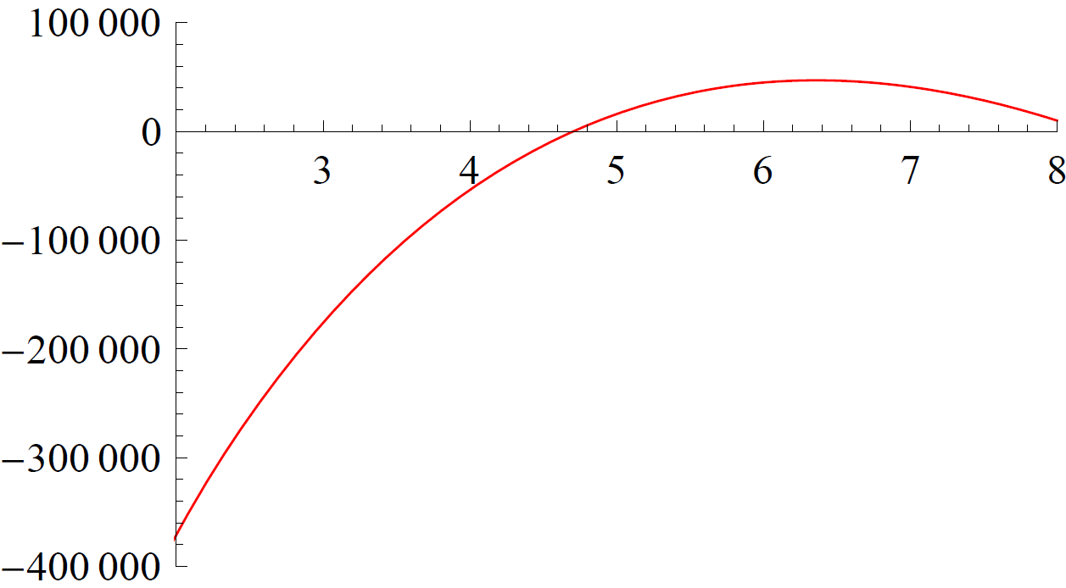
SUSY Fine-tuning Problem
“SUSY fine-tuning problem”
EWSB imposes
@ SUSY breaking scale .
On the other hand, gets large RG contribution while running from MSSM cutoff scale to SUSY breaking scale .
To avoid fine-tuning, cutoff scale must be Low.
Actually, is required to avoid fine-tuning.

Slide 9
Cutoff of Gaugino Mediation
Cutoff of MSSM with Gaugino mediation = KK scale.
KK scale cannot be low in 5D Flat Gaugino mediation.
Proof : Consider flat 5th dimension on .
Consistency of theory on branes :
To derive 4D Planck scale :
Zero cosmological const. :
To derive TeV scale gaugino mass :
KK scale cannot be low
Strongly warped spacetime ( KK scale = ) has no such problem.

Slide 10
From the previous two slides, …
Low MSSM cutoff is favorable from the point of view of “SUSY fine-tuning problem”.
Cutoff of 5D flat gaugino mediation models cannot be low enough, .
On the other hand, cutoff of gaugino mediation in warped spacetime, , can be anywhere.
Warped geometry is necessary to solve “SUSY fine-tuning problem”.

Slide 11
Stau LSP Problem
“Stau LSP problem”
Normally, stau is the LSP in 5D flat gaugino mediation models (without GUT).
However, charged LSP is cosmologically disfavored.
In warped spacetime, gravitino mass is suppressed by the warp factor. So gravitino is always the LSP and “Stau LSP problem” does not exist.

Slide 12
Numerical Analysis

Slide 13
Mass Spectrum
Mass spectrum is calculated by solving RGE from cutoff = KK scale to SUSY breaking scale with matter soft mass at cutoff being all zero.
We checked how the “level of tuning” of each spectrum changes for various values of cutoff .

Slide 14
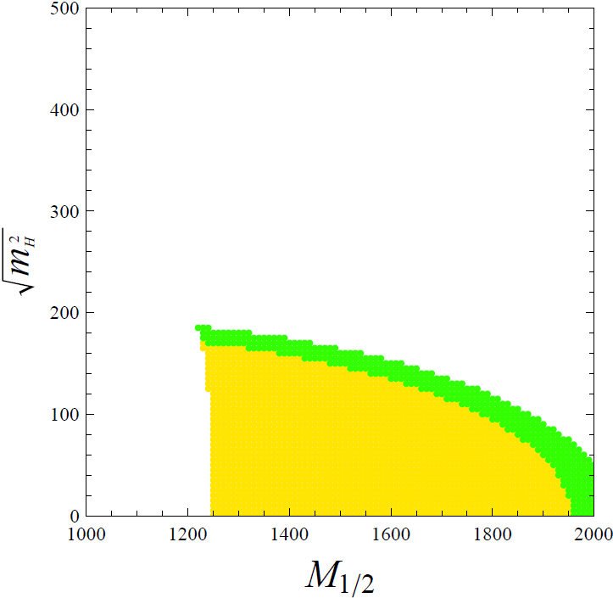
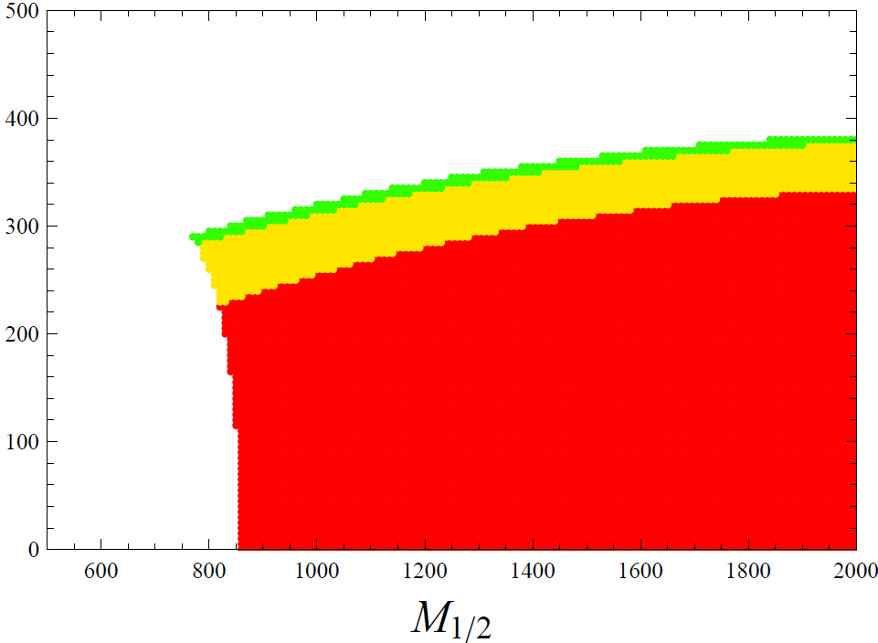
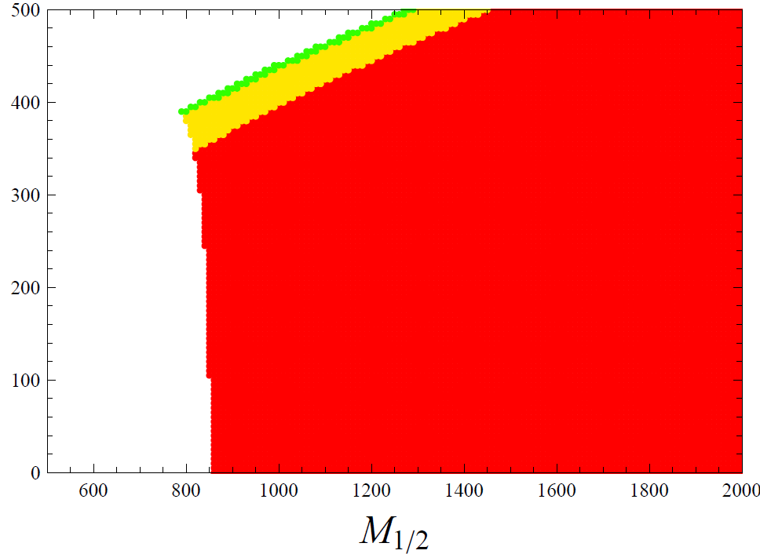
Results
For simplicity, we assumed universal gaugino mass , Higgs soft mass and A-term at cutoff.
We plotted the “level of tuning” of each spectrum in c space for fixed and .
For example, with and :
Blank : unrealistic spectrum,
Red : tuning < 0.1 (bad), Yellow : 0.1 < tuning < 0.3 (good), Green : 0.3 < tuning (good)

Slide 15
Discussion
When , fine-tuning is absent in large parameter regions.
If we consider the “SUSY fine-tuning problem”,
lower than is preferred.
Warped spacetime works here.

Slide 16
Gravitino Phenomenology

Slide 17
Gravitino DM
Since gravitino is the LSP, we want gravitino to be the DM.
However, the mass of gravitino is
,
i.e. it is hot DM and disfavored.
There is a way to raise the gravitino mass.
Adding small SUSY breaking on UV brane

Slide 18
SUSY breaking on UV brane
Additional SUSY breaking on UV brane is allowed.
Dominant contribution to gravitino mass :
Gravity superfield is localized towards UV brane.
Flavor non-diagonal soft mass :
Gravity mediation contribution.
Gravitino mass and FCNC rates are related.

Slide 19
SUSY breaking on UV brane
Additional SUSY breaking on UV brane is allowed.
Dominant contribution to gravitino mass :
Gravity superfield is localized towards UV brane.
Flavor non-diagonal soft mass :
Gravity mediation contribution.
Gravitino mass and FCNC rates are related.

Slide 20
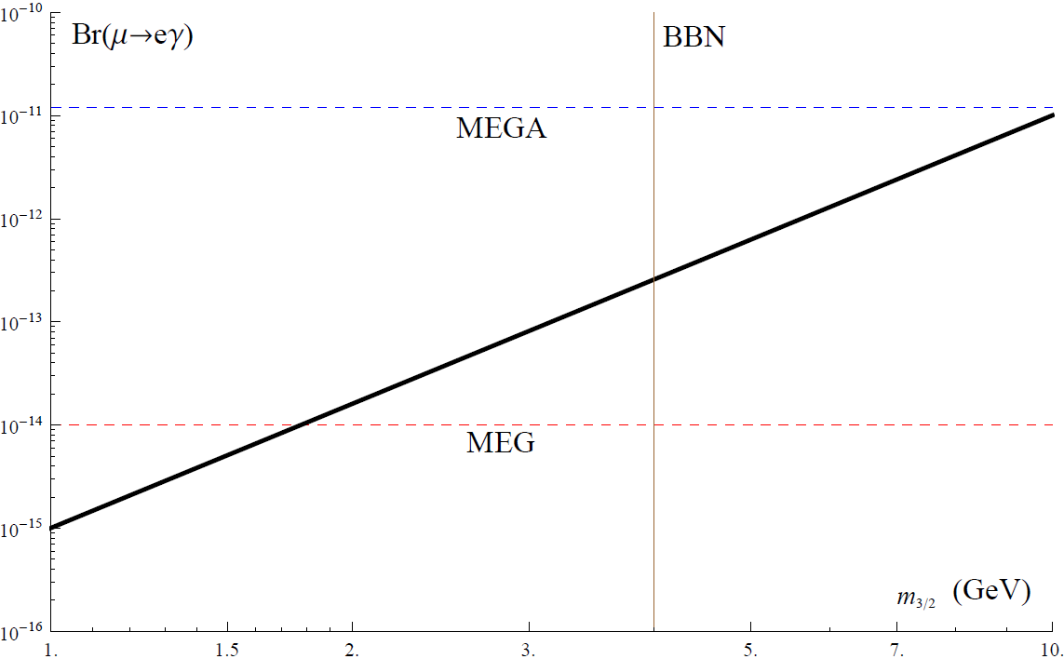
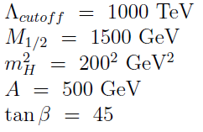
Gravitino Mass vs. Flavor Violation
We calculated the correlation between gravitino mass and branching ratio for a specific spectrum. ( assumed )
stau NLSP
MEGA : Current experimental bound on
MEG : Future accessible limit on
BBN : Big Bang nucleosynthesis bound on

Slide 21
Conclusions

Slide 22
We have studied “Gaugino mediation in warped spacetime”, where Gauge and Higgs superfields live in the bulk, Matter on UV brane and Main SUSY breaking on IR brane.
Gaugino mediation in warped spacetime solves “SUSY fine-tuning problem” and “stau LSP problem”, as well as flavor problem and -problem.
In particular, warped geometry is necessary to solve “SUSY fine-tuning problem” in gaugino mediation models.
Additional SUSY breaking on UV brane gives correlation between and FCNC processes.

