Slide 1



DOE REVIEW
Wisconsin at ATLAS
Sau Lan Wu
For the Task H and Task H-1 (Wu)
August 26, 2010
1

Slide 2
OUTLINE
At the request of Associate Professor Pan and Assistant Professor Mellado, Task H is split into two independent tasks:
Task H – 1 (Wu)
Task H – 2 (Pan and Mellado)
Separation in research since March/April 2010
2

Slide 3
OUTLINE
PART 1
LHC Physics with data since April 2010 Task H-1 (Wu)
Manpower and University Contribution Task H-1 (Wu)
Near term physics goals (FY11-13) Task H-1 (Wu)
Our contribution in detector and Task H-1 (Wu) services – present and future (presented by Assistant Scientist Luis Flores)
3

Slide 4
OUTLINE
PART 2
ATLAS notes with Data Task H-2 (Mellado, Pan)
Progress report of the past 3 years Task H ( All ) (2007 to March 2010) ( Mellado, Pan, Wu)
Contribution and future plans for hardware will be covered by B.Mellado
Future plans for physics analysis will be covered by Y.Pan
4

Slide 5
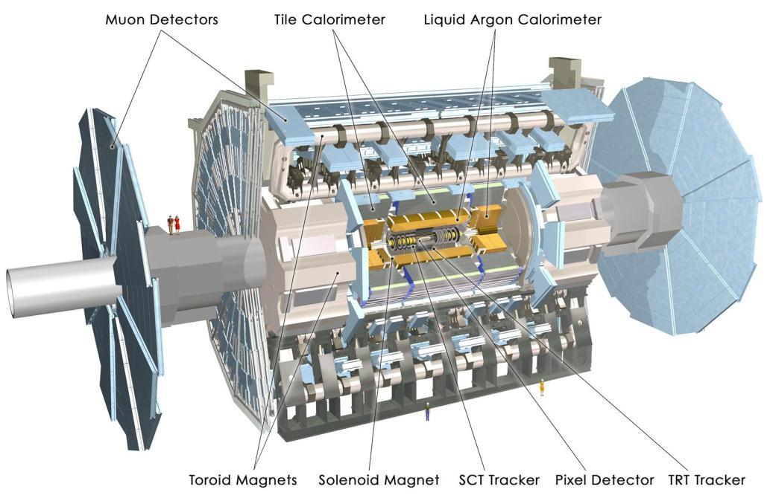
Muon Spectrometer (|η|<2.7) : air-core toroids with gas-based muon chambers
Muon trigger and measurement with momentum resolution < 10% up to E_{μ} ~ 1 TeV
Length : ~ 46 m
Radius : ~ 12 m
Weight : ~ 7000 tons
~10⁸ electronic channels
3000 km of cables
3-level trigger
reducing the rate
from 40 MHz to
~200 Hz
Inner Detector (|η|<2.5, B=2T):
Si Pixels, Si strips, Transition Radiation detector (straws)
Precise tracking and vertexing,
e/π separation
Momentum resolution:
σ/p_{T} ~ 3.8x10⁻⁴ p_{T} (GeV) ⊕ 0.015
EM calorimeter: Pb-LAr Accordion
e/γ trigger, identification and measurement
E-resolution: σ/E ~ 10%/√E
HAD calorimetry (|η|<5): segmentation, hermeticity
Steel/scintillator Tiles (central), Cu/W-LAr (fwd)
Trigger and measurement of jets and missing E_{T}
E-resolution: σ/E ~ 50%/√E ⊕ 0.03
Notes:
5

Slide 6
LHC Physics with data since April 2010 TASK H-1 (Wu)
Contribution to physics results for summer conferences

Slide 7
FOR THE FIRST TIME WITH ATLAS DATA
I started in ATLAS in 1993; for 16 years I have stood at exactly this place telling the DOE reviewers about
our Silicon Readout Driver effort,
our High Level Trigger effort,
our software development effort,
our physics preparation with MonteCarlo data.
This is an emotional day for me: after 16 years of preparation, I can show you for the first time results from data. Our hard work begins to bear fruit.
7

Slide 8
Update since written proposal, April 2010
LHC physics results on data
I am reporting here first only on the work of TASK H-1 (Wu).
Since the completion of the DOE write-up in April for this review, our group has made important contributions to 20 results on data (conference notes) and 5 public notes on Monte Carlo studies for the summer conferences
(Results shown here which intend for conferences in September are work in progress. Please treat them confidential)
Physics at the LHC 2010 (PLHC) DESY, Hamburg, June 7-12
ICHEP 2010. Paris, July 22-28
Hadron Collider Physics 2010 (HCP) Toronto, August 23-27
SUSY 10. Bonn, August 23-28
Physics in Collision 2010 (PIC) Karlsruhe, Sep1-4
ISMD 2010* Antwerp, Belgium Sep 21-25
8
* 40th International Symposium On Multiparticle Dynamics

Slide 9
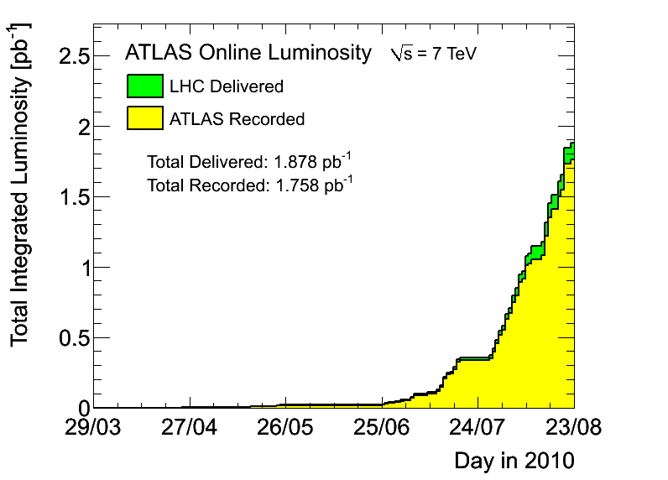
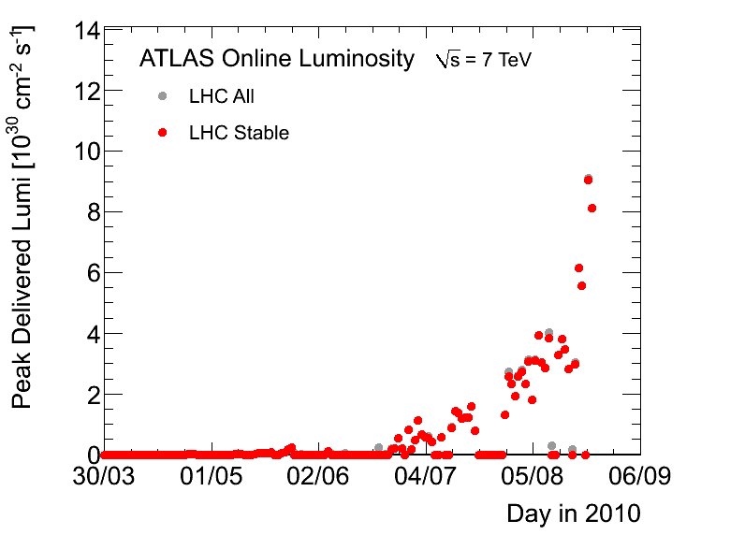
Update since written proposal, April 2010
LHC physics results on data
Peak luminosity
9×10³⁰ cm⁻²s⁻¹
1.758 pb⁻¹
Aug. 23
First collisions at 7 TeV on March 30, 2010
3 orders of magnitude luminosity improvement in 5 months
For ICHEP, at ~330nb⁻¹ (Expected : end of 2011: 1 fb⁻¹)
9

Slide 10
Contribution to physics results for summer conferences
LHC physics results on data
TASK H-1 (Wu)
Our group TASK H-1 has contributed significantly to the following 25 results (20 results from data) for summer conferences. In each physics result, we fully collaborate with other ATLAS institutions.
Detector Performance (5 conference notes)
Physics with Jets (5 conference notes)
W, Z, Z+jets and W’ (5 conference notes)
Physics with Photons (2 conference notes)
SUSY (1 conference notes)
Higgs (2 conference notes)
Public notes contribution to conferences with MC results (5 notes : 2 in SUSY, 1 in W’/Z’, 2 in Higgs)
10

Slide 11
Physics results from first data since April 2010 TASK H-1 (Wu)
Detector performance
S. L. Wu, Postdocs Fang, Ma, Quayle, Sarangi,
Grad. Student Wang
Performance of the ATLAS electromagnetic calorimeter for π⁰ to γγ and η to γγ events
Performance of the missing transverse energy reconstruction in minimum bias events at √s of 900 GeV and 2.36 TeV
Performance of the missing transverse energy reconstruction in minimum bias collisions at center-of-mass energy of √s =7 TeV with the ATLAS detector
Performance of the Missing Transverse Energy Reconstruction and Calibration in pp Collisions at √s = 7 TeV
Performance of the ATLAS Jet Trigger in the Early √s = 7 TeV Data.

Slide 12
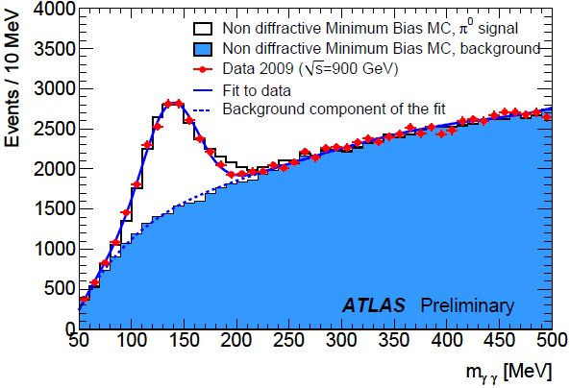
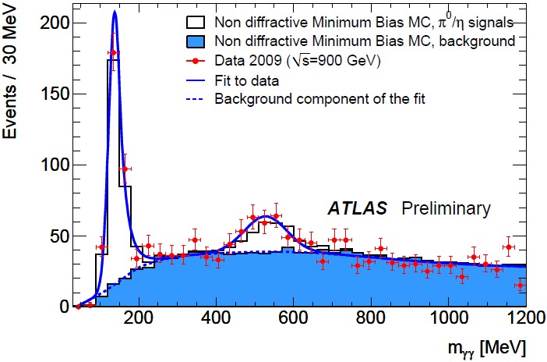
π⁰ and η to γγ
Conf note 1
Task H-1 (Wu)
Conf note 1 : Performance of the ATLAS electromagnetic calorimeter for π⁰ to γγ and η to γγ events (PLHC 2010, DESY)
First collision data, at √s =900 GeV
π⁰ and η are reconstructed from diphotons
With this sample, the response uniformity along the pseudo-rapidity was shown to be better than ±2%
Our contribution: event selection, photon calibration

Slide 13
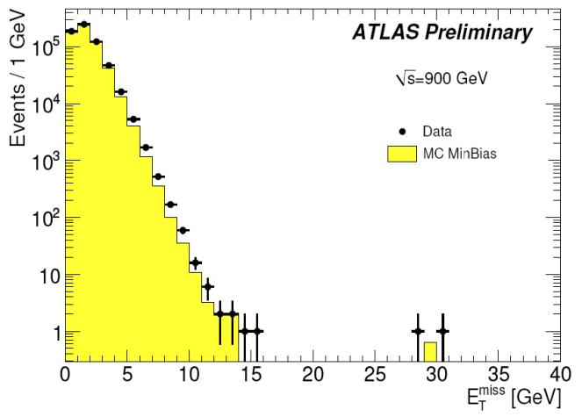
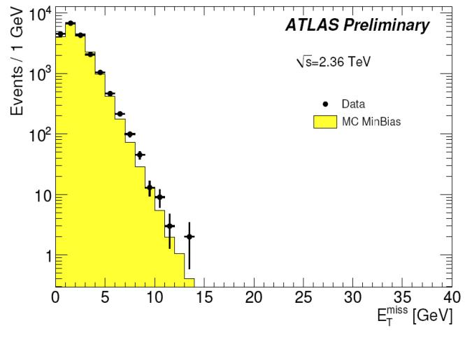
Missing Transverse Energy
Conf note 2
Task H-1 (Wu)
Conf note 2 : Performance of the missing transverse energy reconstruction in minimum bias events at √s of 900 GeV and 2.36 TeV (PLHC 2010, DESY)
First collision data at √s of 900 GeV and 2.36 TeV
Our contributions: algorithm development and study of the performance of the missing transverse energy and investigate events with high E_{T}^{miss}

Slide 14
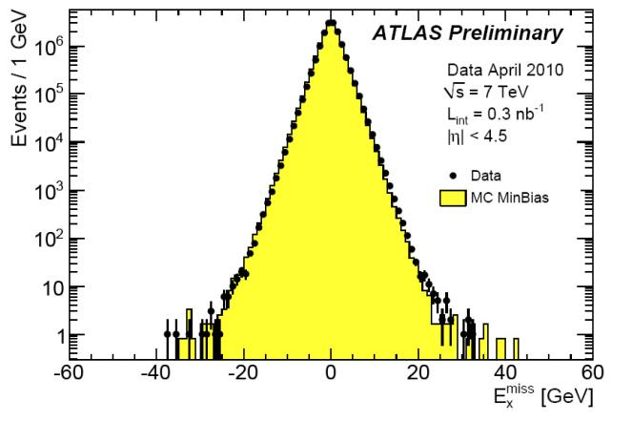
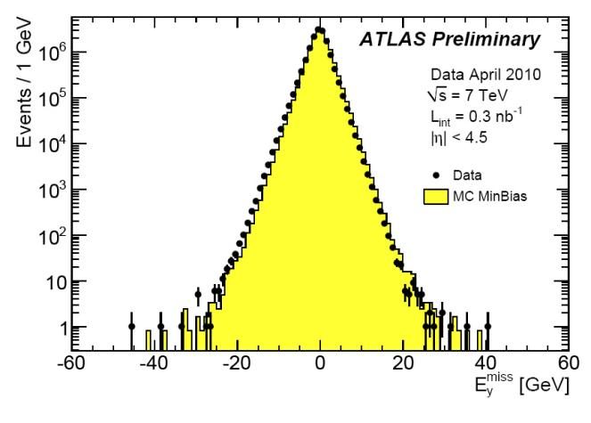
Missing Transverse Energy
Conf note 3
Task H-1 (Wu)
Conf note 3 : Performance of the missing transverse energy reconstruction in minimum bias collisions at center-of-mass energy of √s =7 TeV with the ATLAS detector (PLHC 2010, DESY)
First collision data at √s of 7 TeV
Our contributions : studying the performance of the missing transverse energy and checking all the components used for the E_{T}^{miss} calculation. Conclude that the E_{T}^{miss} tail mainly comes from the muon term.

Slide 15
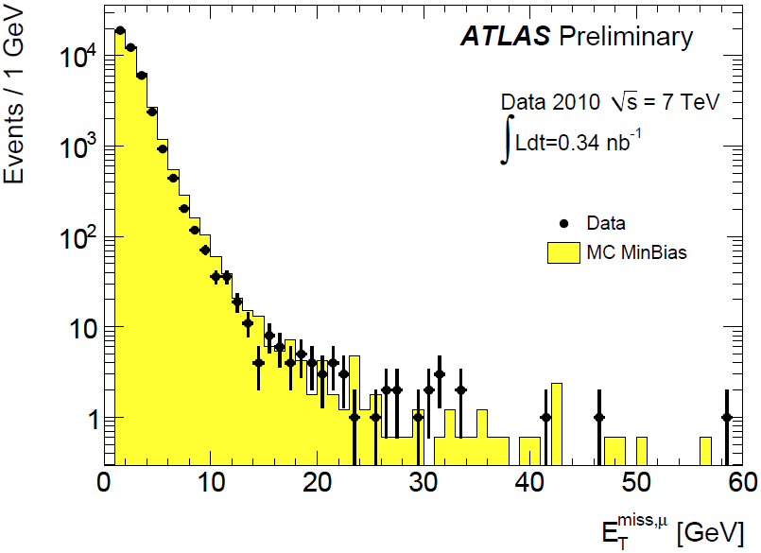
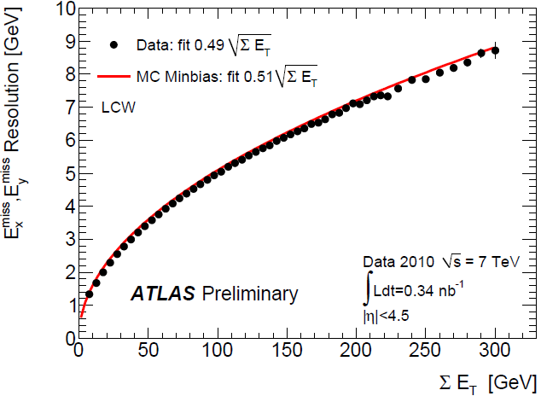
Missing Transverse Energy
Conf note 4
Task H-1 (Wu)
Conf note 4: Performance of the Missing Transverse Energy Reconstruction and Calibration in pp Collisions at √s=7 TeV (ICHEP 2010, Paris)
Our contributions:
Propose a set of cleaning cuts on muons used in the reconstruction of Missing Transverse Energy.
Study the resolution of Missing Transverse Energy with different calibration schemes.

Slide 16
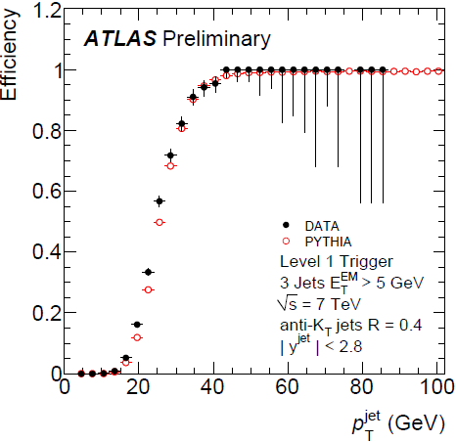
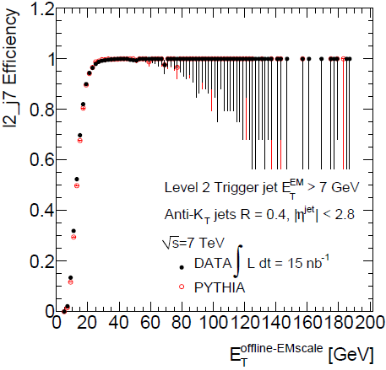
ATLAS jet trigger
Conf note 5
Task H-1 (Wu)
Conf note 5 : Performance of the ATLAS Jet Trigger in the Early
√s =7 TeV Data (ICHEP 2010, Paris)
Jet trigger studies with early data at 7TeV
Good data/MC agreement at both L1 and L2 (in pass-through mode)
Our contribution: development and validation of the trigger monitoring framework

Slide 17
Physics results from first data since April 2010 TASK H-1 (Wu)
Physics with jets
S. L. Wu, Postdocs Peng, Poveda, Sarangi,
Grad. Students A. Castaneda, Ji, Li
Measurement of jet production in 7 TeV pp collisions with the ATLAS detector
Measurements of multijet production cross sections in pp collisions at 7 TeV
Search for new particles decaying into dijets in pp collisions at √s=7 TeV
High-pT dijet angular distributions in pp interactions at √s=7 TeV
Search for new physics in multi-body final states at high invariant masses

Slide 18
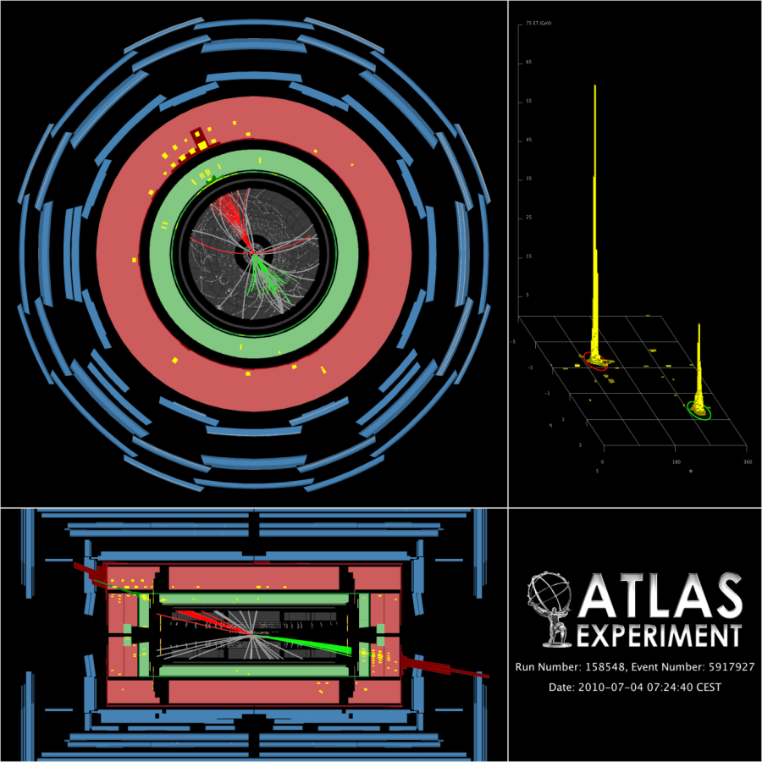
PHYSICS WITH JETS
Highest m_{jj} dijet event observed for ICHEP
m_{jj}=2.55TeV. p_{T}^{j1}=420GeV, p_{T}^{j2}=320GeV

Slide 19
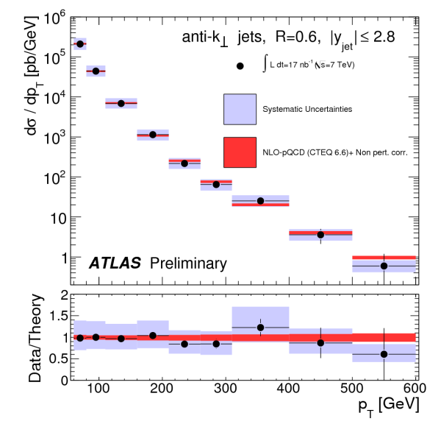
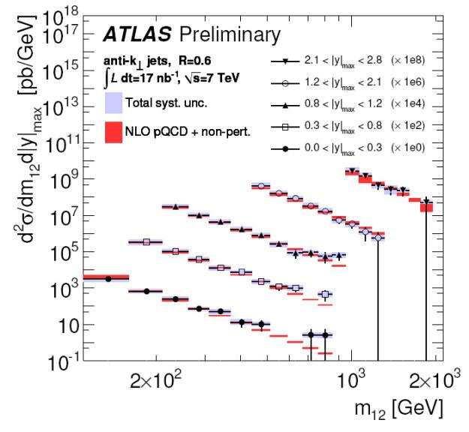
Inclusive jet cross sections
Conf note 6
Task H-1 (Wu)
Conf note 6 : Measurement of jet production in 7 TeV proton-proton collisions with the ATLAS Detector (ICHEP 2010, Paris)
×10⁴
×10⁶
×10⁸
×10²
Leading jet p_{T} > 60 GeV
Subleading jet p_{T} > 30 GeV.
Jet p_{T} > 60 GeV
First inclusive jet and dijet cross sections measurement in ATLAS
The cross sections extend up to jet pT of 500 GeV and Mjj of 2 TeV
Good agreement with NLO QCD expectation over 5 orders of magnitude

Slide 20
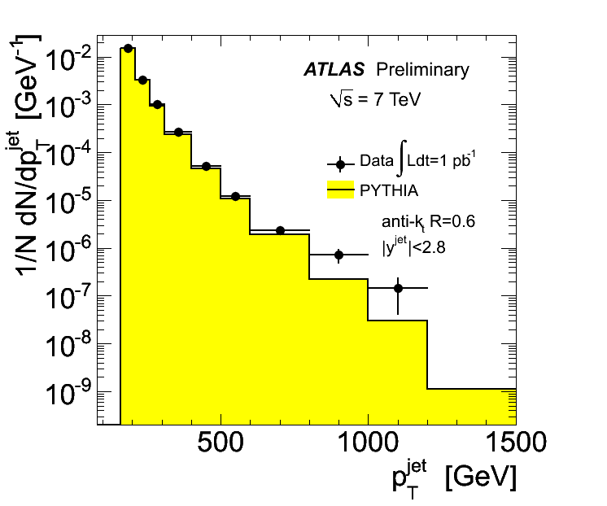
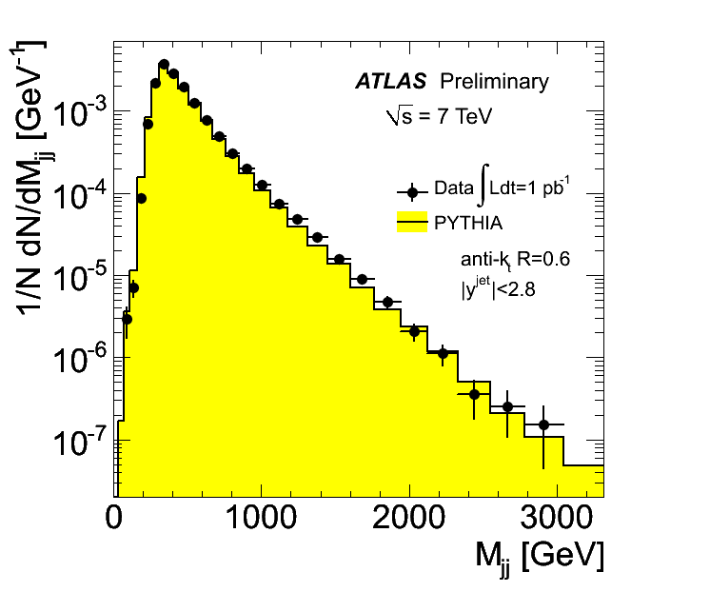
Inclusive jet cross sections
Task H-1 (Wu)
updated to 1 pb⁻¹
33
10
4
2
3
2
Jet pT > 160 GeV
Leading jet pT > 160 GeV
Subleading jet pT > 40 GeV.
69568
51253

Slide 21
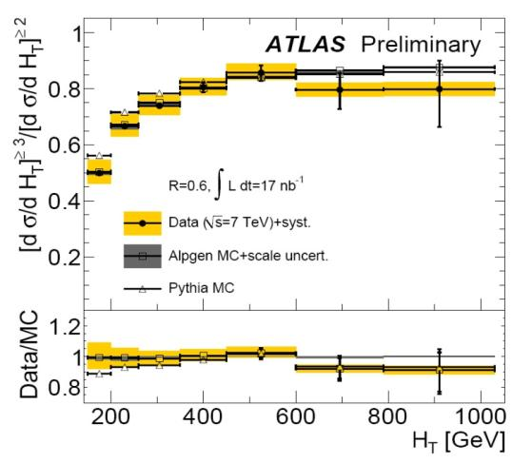
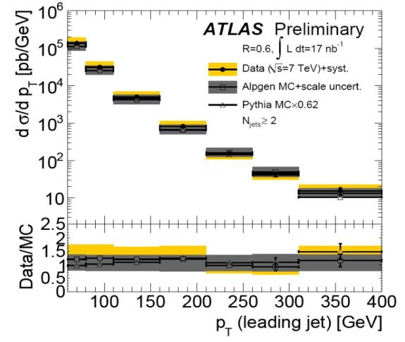
Multijet cross section
Conf note 7
Task H-1 (Wu)
Conf note 7 : Measurements of multijet production cross sections in proton-proton collisions at 7 TeV center-of-mass energy with the ATLAS Detector (HCP 2010, Toronto)
Differential cross sections of 1st, 2nd, 3rd and 4th leading jets
Ratio of differential cross sections as a function of H_{T} for events ≥ 3 jets and events ≥ 2 jets
Good agreement with LO QCD expectation

Slide 22
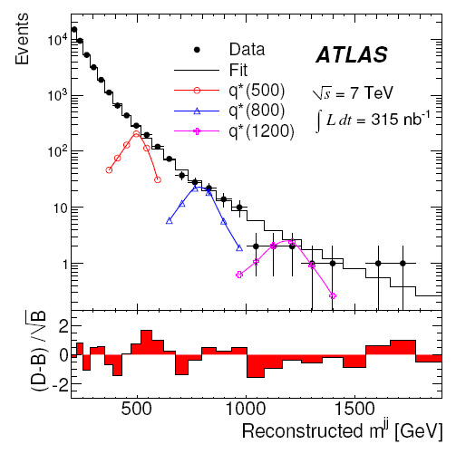
Dijet resonance search
Conf note 8
Task H-1 (Wu)
Conf note 8 : Search for new particles decaying into dijets in pp collisions at √s=7TeV (ICHEP 2010)
Signature of excited quark:
Signal acceptance :
Range from
~36% for m_{q*} = 400 GeV
(σ_{mjj}/m_{jj} ~ 11%)
to
~49% for m_{q*} = 1.5 TeV
(σ_{mjj}/m_{jj} ~ 7%)
New state: Excited quark q*
U. Baur, I. Hinchliffe, and D. Zeppenfeld, Int. J. Mod. Phys., A2, 1285 (1987)
U. Baur, M. Spira, and P. M. Zerwas, Phys. Rev., D42, 815 (1990)

Slide 23
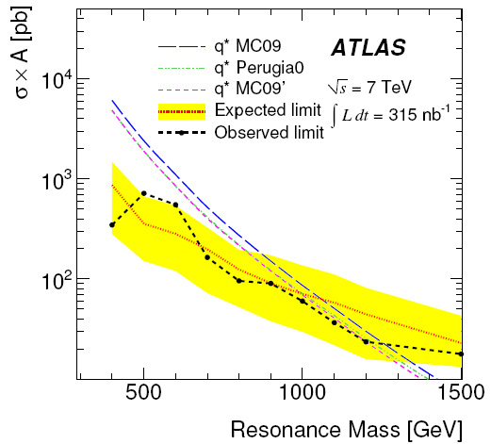
Dijet resonance search
Conf note 8
Task H-1 (Wu)
Conf note 8 : Search for new particles decaying into dijets in pp collisions at √s=7TeV (ICHEP 2010, Paris)
Limit on q* production
Excluded at 95% CL:
With MRST PDF: (Martin, Roberts, Stirling, Thorne)
400<m_{q*}<1260 GeV
with 315 nb⁻¹
Latest published limit:
260<m_{q*}<870 GeV
with 1.1fb-1
CDF Collaboration,
Phys.Rev.D 79(2009)112002
First search result on new physics from ATLAS
We are now moving into unexplored territory
Submitted for publication (PRL) on Aug. 13, 2010 arXiv:1008.2461v1[hep-ex]

Slide 24
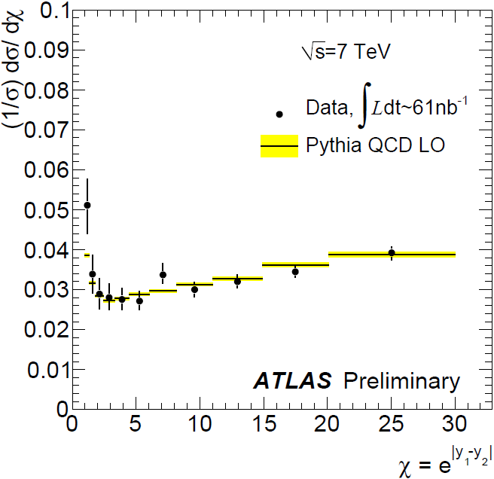
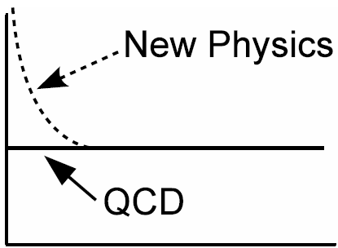
Dijet angular distribution
Conf note 9
Task H-1 (Wu)
Conf note 9 : High-pT dijet angular distributions in pp interactions at √s = 7 TeV measured with the ATLAS detector at the LHC (ICHEP 2010, Paris)
Search for deviations from QCD via angular distributions
High-pT dijets: QCD: mainly t-channel; new physics: s-channel.
ICHEP
χ control region: 320<m_{jj}<520 GeV
Observable (at high m_{jj})
The choice of χ is motivated by the fact that the lowest-order QCD cross section is independent of χ (distorted by radiative correction)

Slide 25
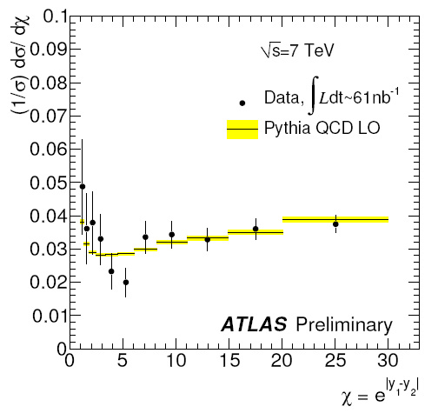
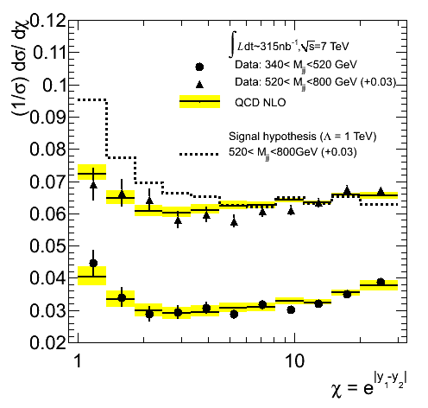
Dijet angular distribution
Conf note 9
Task H-1 (Wu)
ICHEP
χ signal region: 520<m_{jj}<680 GeV
Updated to 315 nb⁻¹
Moved up by +0.03
Limit on quark contact interaction :
Λ> 875 GeV (61 nb-1) for ICHEP 2010
This corresponds to : 2.3×10⁻⁴ fm
Latest published limit (DØ Collaboration) :
Λ>2.8 TeV (0.7 fb⁻¹)
Phys.Rev.Lett.103:191803,2009
Effective Lagrangian for four-quark
contact interaction model
(η=+1)
Larger Λ corresponds to weaker four-quark contact interaction

Slide 26
Multi-body final states
Conf note 10
Task H-1 (Wu)
Conf note 10 : Search for new physics in multi-body final states at high invariant masses (HCP 2010, Toronto)
Motivation : Look for signature of large multiplicity, high transverse energy and large invariant mass.
Inspired by : Black Hole and String Ball signatures.
Search for deviations from the SM with final state topologies of large multiplicity, high total transverse energy of decay products and large invariant mass( Black Hole signature ) .
These multi-body topologies may be evidence of scenarios of low scale gravity from gravitationally mediated interactions.
The electroweak scale and the Planck scale (~10¹⁸GeV), at which gravitational interactions become strong, differ by ~16 orders of magnitude
This can be addressed by gravity expanding into extra dimensions, while the SM particles are confined to our familiar 4D space
For large extra dimensions, the fundamental scale of gravity can be as low as the electroweak scale and black holes can be produced at the LHC

Slide 27
Multi-body final states
Conf note 10
Task H-1 (Wu)
Conf note 10 : Search for new physics in multi-body final states at high invariant masses (HCP 2010, Toronto)
Black holes vs String balls
The Black Hole mass is expected to be greater 5 TeV; at √s=7TeV, the production cross section is small
In string theory, black holes have a minimum mass below which they transition into highly excited long and jagged strings – “string balls”
Because they are lighter, they may be more accessible to the LHC. String balls have the same signature as Black Hole.
Our multi-body analysis strategy can be used for the search for string balls; Its cross section can be large enough for discovery even with O(10 pb⁻¹)

Slide 28
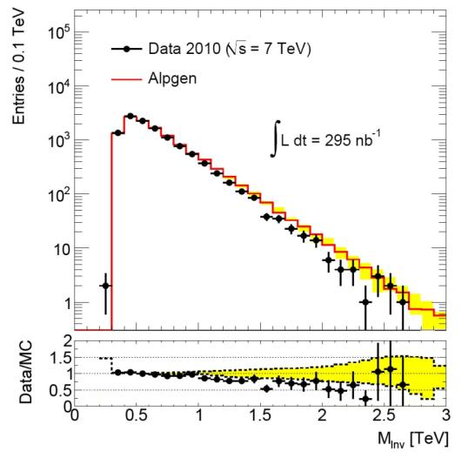
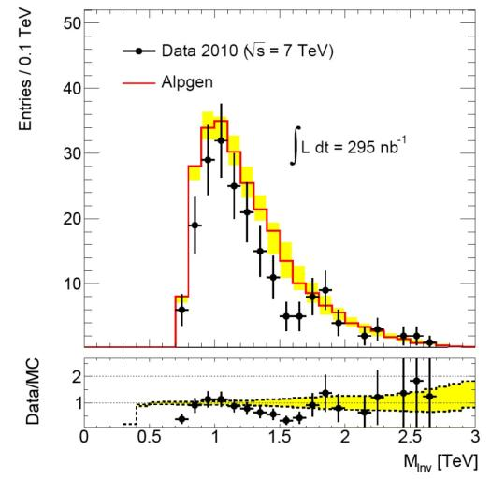
Multi-body final states
Conf note 10
Task H-1 (Wu)
Conf note 10 : Search for new physics in multi-body final states at high invariant masses (HCP 2010, Toronto)
Control region: Σ|p_{T}|>300GeV
Signal region: Σ|p_{T}|>700GeV
Observed
= 193 events
Expected
= 253 ±18 ±84
95%CL upper limit of 0.34 nb for cross section × acceptance for final states with at least three particles and an invariant mass above 800GeV and Σ|p_{T}|>700GeV
95%CL upper limit of 0.6 nb for cross section ( acceptance ~55% for the model used )
The result is of interest for models of low-scale gravity and weakly-coupled string theory (cross section can be as high as O(100 nb ) (Black Max) )
This is the first search of this type

Slide 29
Physics results from first data since April 2010 TASK H-1 (Wu)
W, Z and W’
S. L. Wu, Assistant scientist Flores, Postdocs Ma, Sarangi,
Grad. Students Carrillo, A. Castaneda, E. Castaneda, Pedraza
Observation of W->lν and Z->ll production in proton-proton collisions at √s=7 TeV with the ATLAS detector
Measurement of W→lν production cross section and observation of Z →ll production in proton-proton collisions at √s=7 TeV with the ATLAS Detector
Measurement of the Z→ll production cross section in proton-proton collisions at √s=7 TeV with ATLAS detector
Measurement of Z + Jets Cross Section at 1 pb⁻¹
Search for high-mass states with lepton plus missing transverse energy using the ATLAS Detector at √s=7 TeV

Slide 30

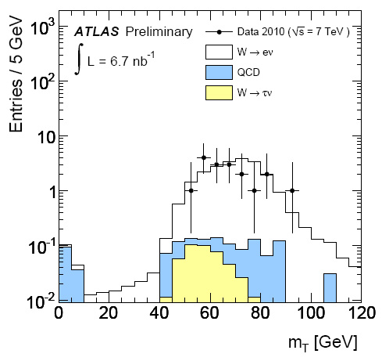
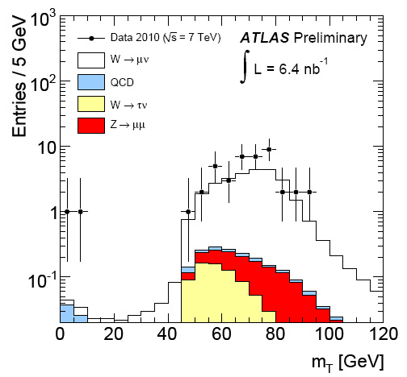
W, Z Observation
Conf note 11
Task H-1 (Wu)
Conf note 11 : Observation of W->lν and Z->ll production in proton-proton collisions at √s=7 TeV with the ATLAS detector (PLHC 2010, DESY)
First observation of W and Z in ATLAS (6.7 nb⁻¹)
W → lν : 57 events
Z → ll : 3 events

Slide 31
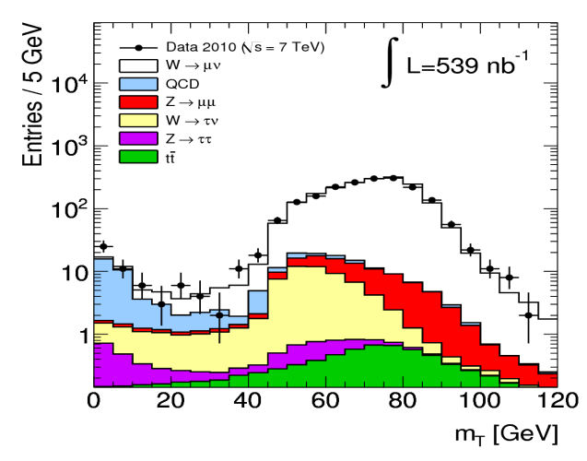
W cross section
Conf note 12
Task H-1 (Wu)
Conf note 12 : Measurement of W→lν production cross section and observation of Z→ll production in proton-proton collisions at √s=7 TeV (ICHEP 2010, Paris)
Asymmetry (ICHEP results 17 nb⁻¹)
A(W→ eν) = 0.21 ± 0.18 ± 0.01(syst)
A(W→ μν) = 0.33 ± 0.12 ± 0.01(syst)
(NNLO prediction: A=0.2)
E_{T}^{miss}>25 GeV
ICHEP results (17 nb⁻¹)
119 events:
47 W→ eν
72 W→ μν
σ(W→lν) = 9.3 ± 0.9(stat) ± 0.6(syst) ± 1.0(lumi) nb
σ(W→eν) = 8.5 ± 1.3(stat) ± 0.7(syst) ± 0.9(lumi) nb σ(W→μν) = 10.3 ± 1.3(stat) ± 0.8(syst) ± 1.1(lumi) nb
NNLO: 10.46 nb

Slide 32
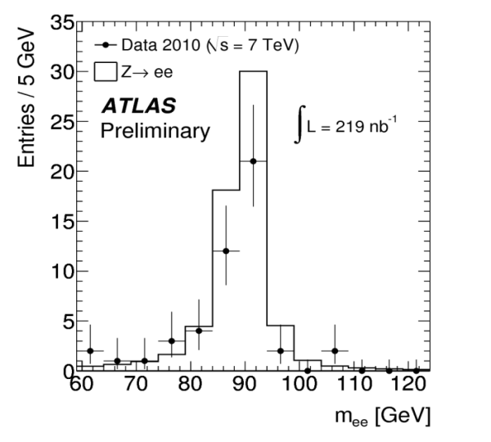
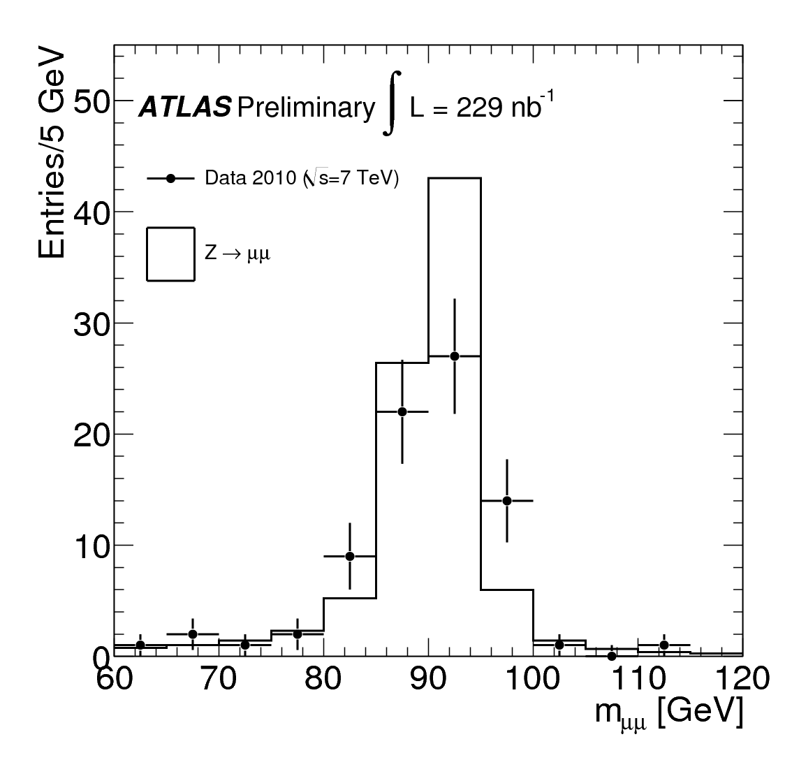
Z cross section
Conf note 13
Task H-1 (Wu)
Conf note 13 : Measurement of the Z→ll production cross section in proton-proton collisions at √s =7 TeV (ICHEP 2010, Paris)
ICHEP results 225 nb⁻¹
σ(Z→ll) = 0.83 ± 0.07(stat) ± 0.06(syst) ± 0.09(lumi) nb
NNLO: 0.99 nb per family for m_{ll}>60GeV
125 events:
46 Z→ ee
79 Z→ μμ
σ(Z→ee) = 0.72 ± 0.11(stat) ± 0.10(syst) ± 0.08(lumi) nb σ(Z→μμ) = 0.89 ± 0.10(stat) ± 0.07(syst) ± 0.10(lumi) nb

Slide 33
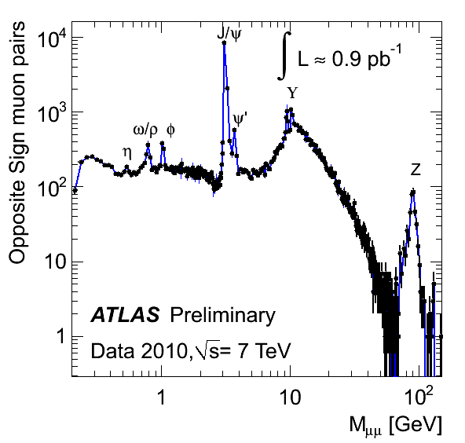
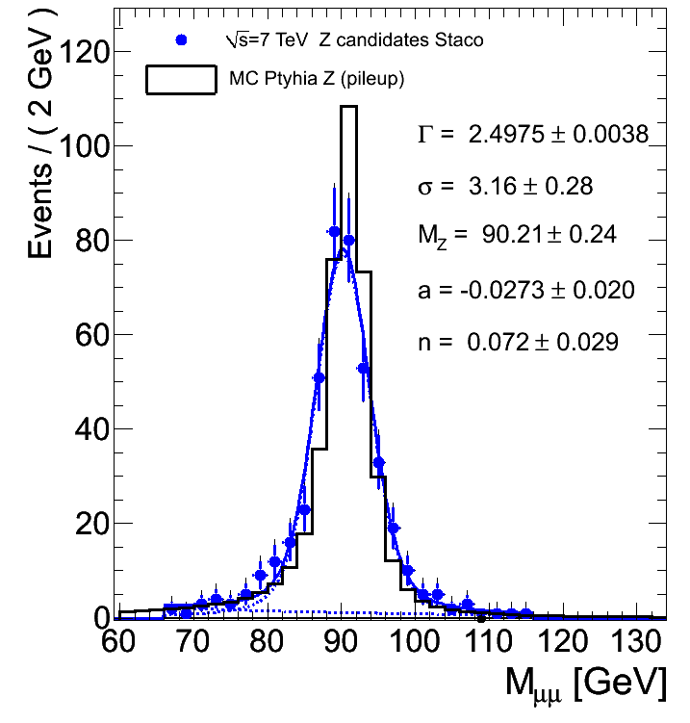

Z cross section
Task H-1 (Wu)
Z mass is updated to 1.22 pb⁻¹
424 Z→μμ candidates (Staco)
STACO
Fitting function for Z mass : Breit-Wigner (Z) convoluted with a Gaussian (Resolution) + Exponential (Low Drell-Yan)
= 3.16±0.28 GeV (data)

Slide 34
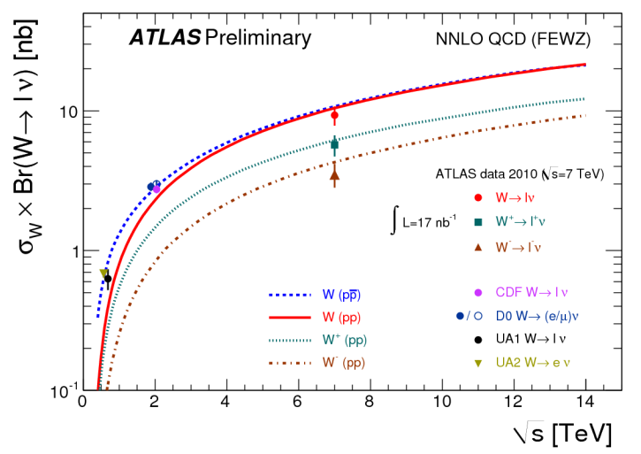
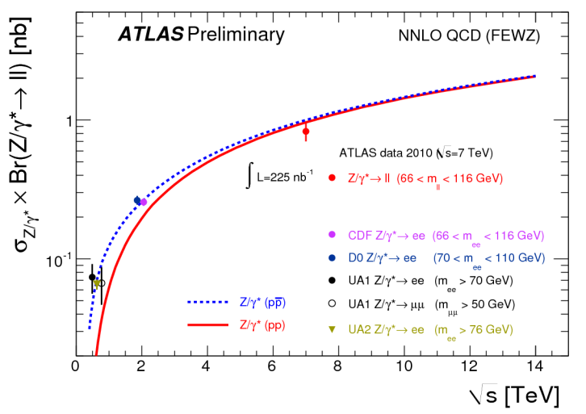
W and Z cross sections
Conf notes 12,13
Task H-1 (Wu)
Good agreement with theoretical expectations, both on cross sections and asymmetry.
Submission for publication is expected in September/October for 300 nb⁻¹ data.

Slide 35
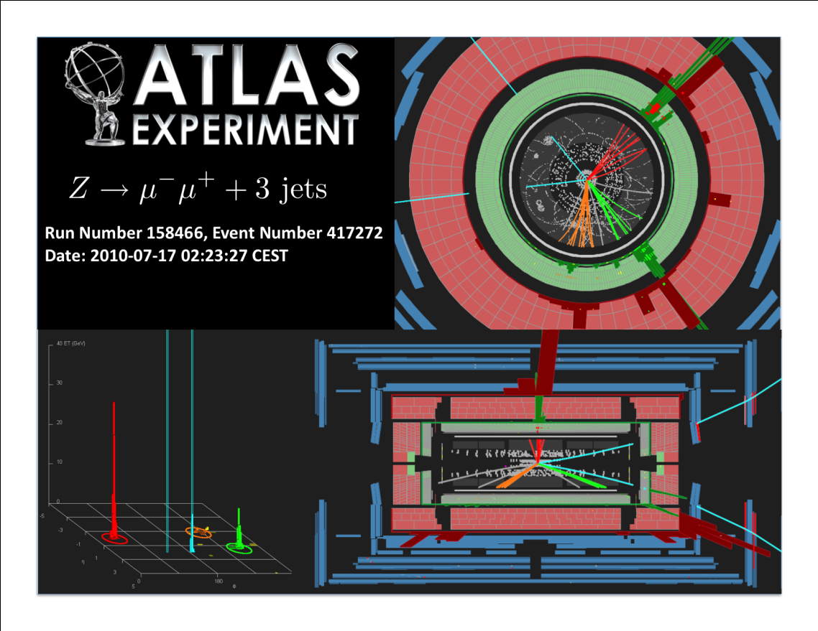
Z + Jets Cross Section
Conf notes 14
Task H-1 (Wu)
Conf note 14 : Measurement of Z + Jets Cross Section at 1 pb⁻¹
(International Symposium On Multiparticle Dynamics (ISMD 2010). Sep 2010, Antwerp, Belgium; Figures shown in HCP 2010, Toronto)

Slide 36
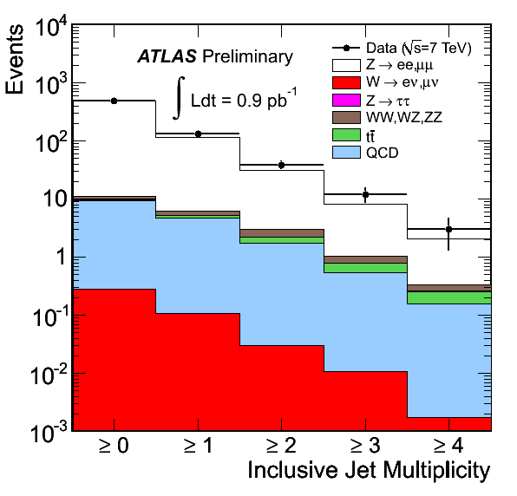
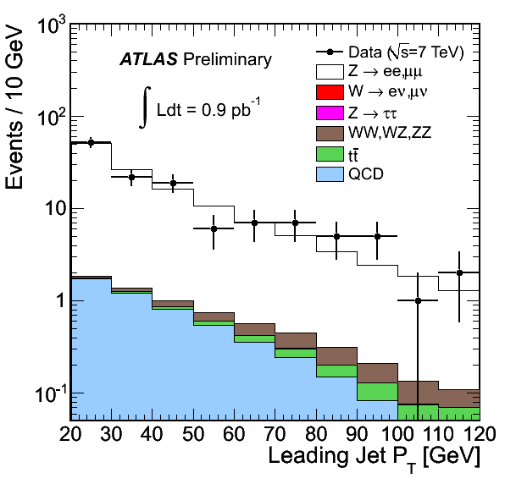
Z + Jets Cross Section
Conf notes 14
Task H-1 (Wu)
Conf note 14 : Measurement of Z + Jets Cross Section at 1 pb⁻¹
(ISMD 2010, Antwerp, Belgium; Figures shown in HCP 2010, Toronto)
Measure the cross section ratio Z(→l⁺l⁻) + N jets / Z(→ l⁺l⁻) and compare with theoretical predictions from fixed-order NLO
Z →ee,μμ combined
0.9 pb⁻¹

Slide 37
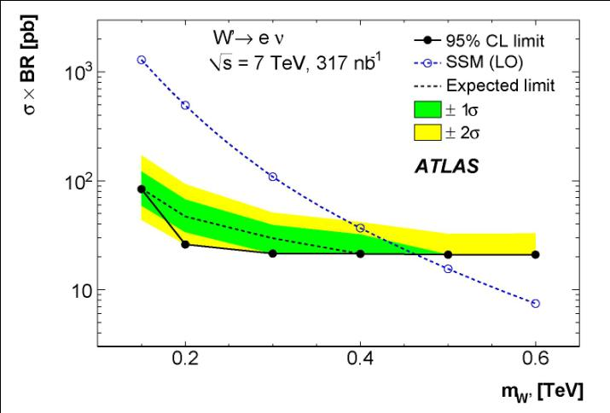
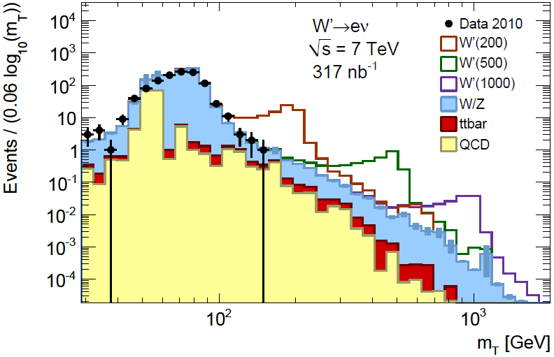
W’ search
Conf note 15
Task H-1 (Wu)
Conf note 15 : Search for high-mass states with lepton plus missing transverse energy using the ATLAS Detector at √s=7 TeV (HCP 2010, Toronto)
Preliminary
For Sequential Standard Model, we obtain limits on cross section×BR as a function of m_{W’}
95% C.L. exclusion: m_{W’} > 460 GeV
Tevatron limit: m_{W’} > 1 TeV
ATLAS limit will be competitive with Tevatron with ~ 5 pb⁻¹

Slide 38
Physics results from first data since April 2010 TASK H-1 (Wu)
Physics with photons
S. L. Wu, Postdocs Fang, Ma, Grad. Students Wang
Evidence for prompt photon production in pp collisions at √s=7 TeV
Search for a two photon + ETmiss final state in √s=7 TeV pp collisions at the LHC using the ATLAS detector in the context of the One Universal Extra Dimension model with gravity mediated decays

Slide 39
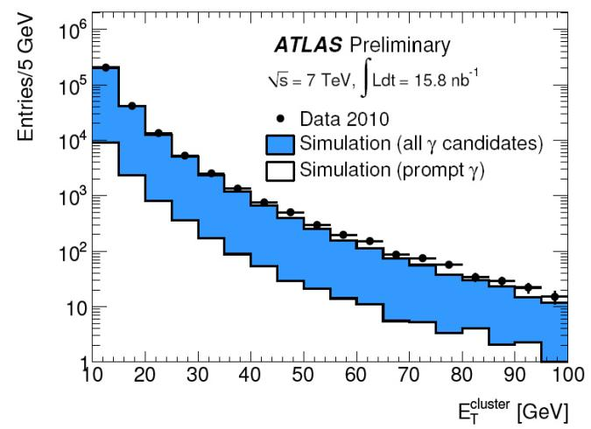
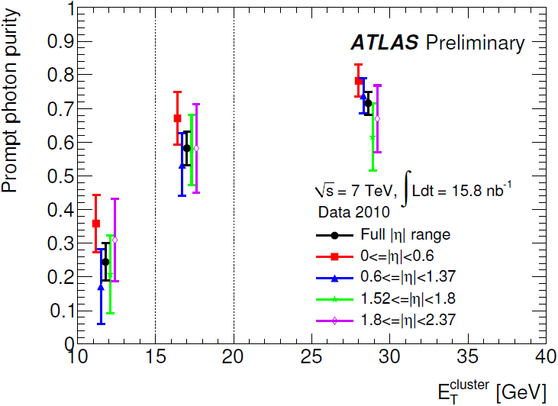
Prompt photon production
Conf note 16
Task H-1 (Wu)
Conf note 16 : Evidence for prompt photon production in pp collisions at √s=7 TeV (ICHEP 2010, Paris)
Measurement of inclusive prompt-photon production would give a test of perturbative QCD with the potential to constrain PDF
Statistically significant signal of prompt photons from 16 nb⁻¹
Yield: N = ( 618 ± 72 )
Purity : P = ( 72 ± 7 ) %
(Use shower shapes and isolation variables)

Slide 40
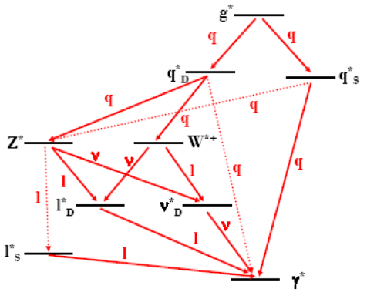
Universal Extra Dimension
Conf note 17
Task H-1 (Wu)
Conf note 17 : Search for a two photon + ETmiss final state in √s=7 TeV in the context of the One Universal Extra Dimension model with gravity mediated decays (Fourth ATLAS Physics Workshop of the Americas. August , 2010, University of Texas, Arlington, TX) (ISMD 2010. Sep 2010, Antwerp, Belgium)
Cheng, Matchev, and Schmaltz [Phys. Rev. D66, 056006 (2002)]
Motivation : Look for signature of two photons
and missing energy
Inspired by : Theory of UED
In one-dimensional UED, each SM particle
has n = 1, 2, 3, ... Kaluza-Klein (KK)
excitations of squared mass
with the n = 0 state corresponding to the SM particle. Due to momentum conservation in the extra dimension, KK particles are not produced singly.
If the (4+1)-dimensional UED space is embedded into a larger space of (4+N) dimensions into which only gravity propagates, KK particles may decay directly to photon by emitting a graviton.
Signature : Two photons and two gravitons → two photons + missing energy
Cascade decay of
KK particles

Slide 41
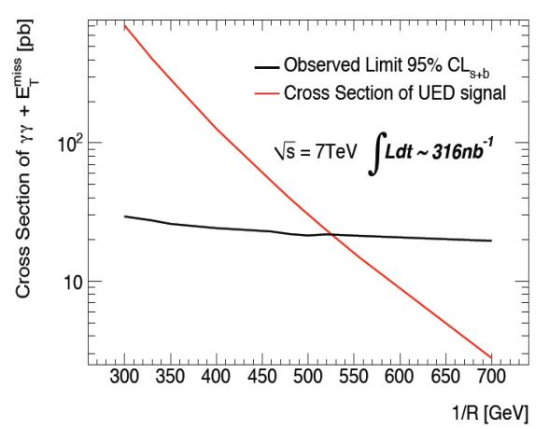
Universal Extra Dimension
Conf note 17
Task H-1 (Wu)
ATLAS workshop in Arlington, TX
In progress not official
Plan to submit for publication in Sept./Oct.
We use cross section and branch ratio given by “New signal for universal extra dimensions” C. Macesanu, C.D. McMullen, S. Nandi, Phys. Lett. B 546 (2002), 253
The gravity mediated UED model with N=6 and ΛR =20 is excluded for a curvature 1/R= 520 GeV at 95% C.L. with 316nb⁻¹ (In progress, not official)
Excluded by D0 for a curvature 1/R≤477 GeV at 95% C.L (6.3 fb⁻¹) (arXiv : 1008.2113v1 [hep-ex] 12 Aug 2010)
R is the radius of the Universal Extra Dimension

Slide 42
Physics results from first data since April 2010 TASK H-1 (Wu)
SUSY
S. L. Wu, Postdocs Chen, Poveda, Sarangi,
Grad. Student A.Castaneda
Early supersymmetry searches with jets, missing transverse momentum and one or more leptons with the ATLAS Detector

Slide 43
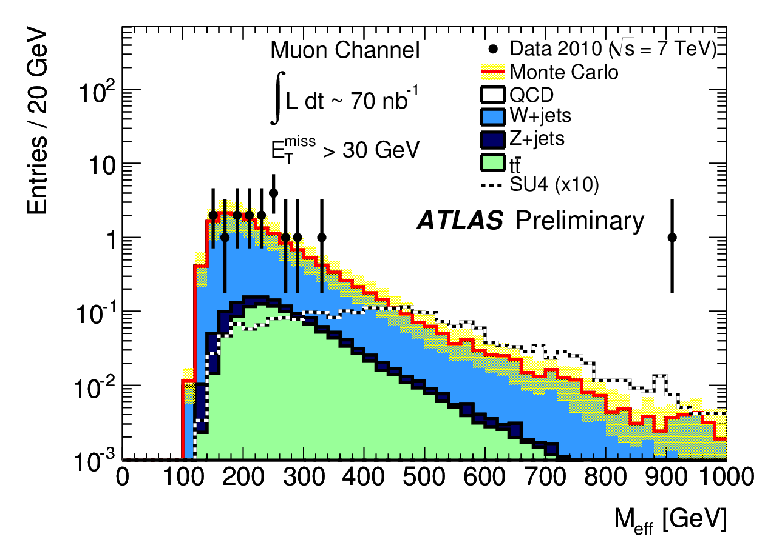
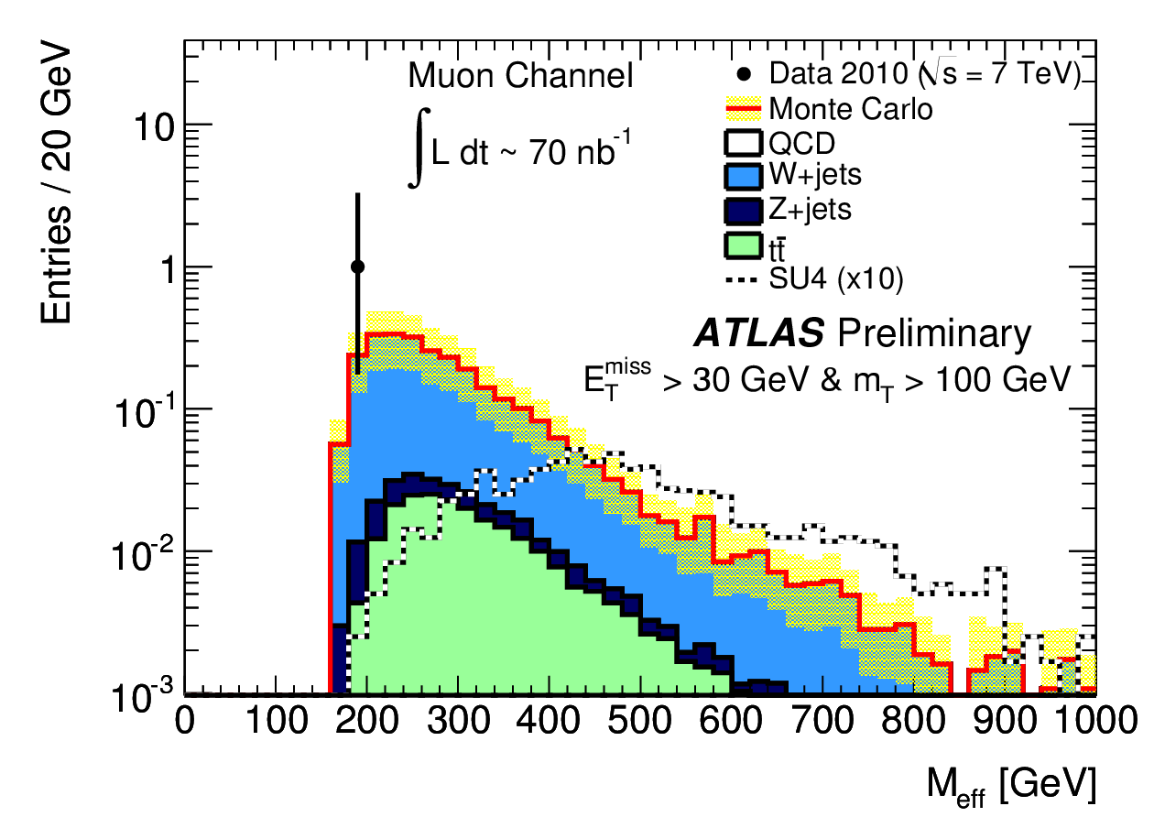
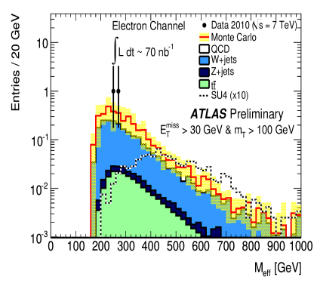
SUSY (1-lepton channel)
Conf note 18
Task H-1 (Wu)
Conf note 18 : Early supersymmetry searches with jets, missing transverse momentum and one or more leptons with the ATLAS Detector (ICHEP 2010 )
M_{eff}=p_{T}(lepton)+ Σp_{T}(jets)+E_{T}^{miss}
Muon
Muon
SU4(×10)
SU4(×10)
ICHEP results
Electron
SU4(×10)
Analysis with very loose cuts: 1 isolated lepton, 2 jets with 30 GeV, E_{T}^{miss}>30 GeV and M_{T}>100 GeV
With 70 nb⁻¹, some events passing the cuts are observed with good agreement with Monte Carlo
Typical low-mass SUSY point included in the plots as a reference (“SU4”: point with squark and gluino masses around 410 GeV)

Slide 44
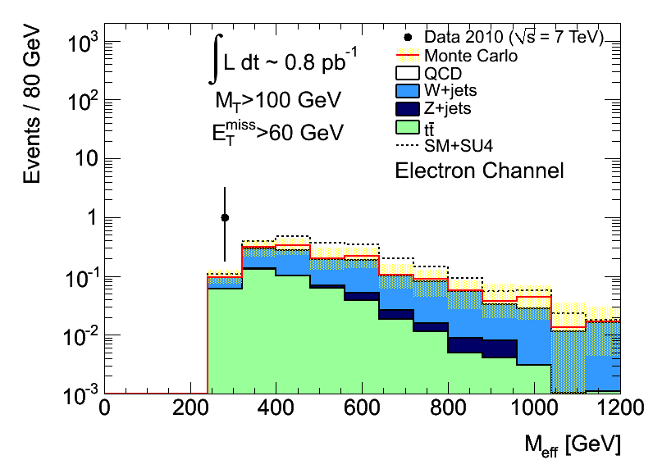

SUSY (1-lepton channel)
Task H-1 (Wu)
Updated to 0.8 pb⁻¹ (In progress)
Electron
Muon
SU4(×1)
SU4(×1)
Cuts
- 3 jets (pT leading jet more than 60 GeV, pT other jets more than 30 GeV) - E_{T}^{miss}>60 GeV and M_{T}>100 GeV The number of events: - Electron channel: data = 1 ; (Background MC = 1.5 +/- 0.5; SU4 : 0.78) - Muon channel: data = 2; (Background MC: 1.6 +/- 0.6; SU4: 0.72)

Slide 45
Physics results from first data since April 2010 TASK H-1 (Wu)
Higgs
S. L. Wu, Assistant scientists Flores, Postdocs Fang, Quayle,
Grad. Students Asfandiyarov, Carrillo, Sabbatini, Wang
Measurement of Background from W+jets to the H→WW* →lνlν Search at √s=7 TeV
Test of data driven ZZ and Z+jets background estimation methods for the Higgs boson search in the 4-lepton final state

Slide 46

Higgs to WW
Conf note 19
Task H-1 (Wu)
Conf note 19 : Measurement of the Background from W+jets to the H→WW*→lνlν Search at √s=7 TeV (HCP 2010, Toronto)
H → WW →lνlν
Background : W + jets (jet gives fake lepton) Need to measure the fake rate of e or μ from jets in data
From 311 nb⁻¹ data, events with one good lepton and one fake lepton together with large Missing ET. 9 events are observed (W+jets candidates).
In this note, methods are proposed to estimate from data the lepton fake rates.

Slide 47



Higgs to WW
Conf note 19
Task H-1 (Wu)
Conf note 19 : Measurement of the Background from W+jets to the H→WW*→lνlν Search at √s=7 TeV (HCP 2010, Toronto)
Example : Use γ + jet control sample,
Back
to back
Jet→e
effect of pileup on jet veto
Work of Postdoc Fang
Work of Student Ruslan Asfandiyarov
Fake rate from loose to medium is 0.11 ± 0.05.

Slide 48

Higgs to ZZ
Conf note 20
Task H-1 (Wu)
Conf note 20 : Test of data driven ZZ and Z+jets background estimation methods for the Higgs boson search in the 4-lepton final state (International Symposium On Multiparticle Dynamics (ISMD 2010). Sep 2010, Antwerp, Belgium)
bjet
Work of Postdoc Fang
b→μ
In H→ZZ
Irreducible background : ZZ
Reducible background : Z + jets which is dominated by Zbb (b→μ)
Use data driven method to estimate Zbb
From 331 nb-1 data
Obtain events with 1 good quality b-tagging jet and 1 non-isolated lepton (A).
Also obtain events with 1 good quality b-tagging jet and 1 isolated lepton (B). The b jet and lepton should be back to back in the transverse plane.
The ratio of B over A will be used to estimate the Zbb background.

Slide 49
Public Notes Contributed to
Conferences(Monte Carlo) Task H-1 (Wu)
SUSY
1. Searching for Supersymmetry with two same-sign leptons, multi-jets plus missing transverse energy in ATLAS at √s=10 TeV, ATL-PHYS-PUB-2009-085, Aug 2009
2. Prospects for Supersymmetry discovery based on inclusive searches at a 7 TeV centre-of-mass energy with the ATLAS detector ATL-PHYS-PUB-2010-010, Jul 2010
W’, Z’
3. ATLAS sensitivity prospects to W′ and Z′ in the decay channels W′->lν and Z′->l+l- at √s=7 TeV ATL-PHYS-PUB-2010-007, Jul 2010

Slide 50
Public Notes Contributed to
Conferences(Monte Carlo) Task H-1 (Wu)
Higgs
4. Prospects for Higgs Boson Searches using the H->WW*->lνlν Decay Mode with the ATLAS Detector for 10 TeV ATL-PHYS-PUB-2010-005, Jun 2010
5. ATLAS Sensitivity Prospects for Higgs Boson Production at the LHC Running at 7 TeV ATL-PHYS-PUB-2010-009, Jul 2010
Publication (Detector performance)
6. Combined performance studies of the ATLAS detector using cosmic-ray muons, To be submitted to: Eur. Phys. J. C

Slide 51
Publication plan for physics results
involved by Task H-1 (Wu)
Confidential
Topics Expected dates of submission
Dijet resonance (q*) Aug. 13, 2010
W, Z cross sections and W⁺/W⁻ asymmetry September, 2010
Inclusive jet cross section September, 2010
Multijet cross section October, 2010
Z + jets cross section October, 2010
UED – diphotons + E_{T}^{miss} October, 2010
W’ limit October, 2010
New physics from dijet angular distribution November, 2010
SUSY – E_{T}^{miss} signature November, 2010
New physics in multi-body final states at high invariant mass November, 2010

Slide 52
Manpower and University Contribution
for Task H-1 (Wu)

Slide 53
MANPOWER
Task H-1 (Wu)
A conscious effort We have no one beyond 7 years of PhD both in our DOE-based supported program and our University funded program (except Sau Lan Wu)
Since the split with Profs. Pan and Mellado in March, 2010 Sau Lan Wu has worked closely with our present team of graduate students and research associates (Postdoc Xin Chen will move from Task H-1 to Task H-2).
DOE BASED PROGRAM SUPPORTED PERSONNEL (FY11 REQUEST)
One Assistant Scientist – Luis Flores
One Research Associate – William Quayle
Six Graduate Students – Yang Heng, Haoshuang Ji, Luca Sabbatini, Haichen Wang, Suli Yang, Fangzhou Zhang.
One third FTE Computing Software Engineer – Neng Xu
Summer salary – Sau Lan Wu
53

Slide 54
UNIVERSITY SUPPORT FOR SAU LAN WU
The University of Wisconsin has a long tradition in strong investment in my research, starting from former Chancellor Donna Shalala. It is due to our dedication to graduate education (48 PhD’s granted so far) and our strong research record. Chancellor Donna Shalala was motivated also by the fact that I am one of the few female leaders in the male-dominated field of Experimental High Energy Physics.
Sau Lan Wu – Supported by various University Fellowships
Romes Fellowship
Enrico Fermi Distinguished Professorship
Hilldale Professorship
Vilas Professor, which is the highest rank professorship in Wisconsin-Madison, with only twelve in the entire University.
Our program has also been strongly supported by the Vilas Foundation.
54

Slide 55
UNIVERSITY SUPPORTED PERSONNEL
Task H-1 (Wu)
LHC is a high-profile research project; the University would like to assure Sau Lan Wu’s success in this endeavor by supporting her research. This continuing commitment of support is made with the understanding of a similar continuing commitment of support for Wu’s team from DOE.
Research Associates Yaquan Fang, Ximo Poveda, Tapas Sarangi, Lianliang Ma and Haiping Peng.
Graduate Students Ruslan Asfandiyarov, German Carrillo and Haifeng Li.
Graduate Students with a joint program with Mexican Universities Alfredo Castaneda (Universidad de San Luis Potosí), Elizabeth Castaneda (CINVESTAV, Mexico’s Instituto Politécnico Nacional) Isabel Pedraza (Benemérita Universidad Autónoma de Puebla).
Two thirds FTE Computing Software Engineer – Neng Xu
Sau Lan Wu’s academic salary (9 months) each year is supported by her Vilas Professorship award. This allows her to be full-time on research at CERN.
The University support is equivalent to a one-to-one matching to the DOE grant.
55

Slide 56
Near Term Goals for Task H-1 (Wu) – FY11-13

Slide 57
Near Term Goals for Task H-1 (Wu)
Silicon Read Out Driver
Continue the maintenance of its full functionality
High Level Trigger (HLT)
Continue to maintain the full functionality of this critically important element for data taking
Postdocs and students continue to contribute to trigger tasks
Contribute to the High Level Trigger upgrade
Atlas Tier-3 Development
Continue to contribute to system structure design in collaboration with BNL, to improve data analysis capabilities in a distributed storage system
Detector performance
Continue to contribute in e/gamma, jets and missing transverse energy
Shift and operation tasks.
ATLAS requires 30% FTE per physicist

Slide 58

Near Term Physics Goals for Task H-1 (Wu)
(1) JET PHYSICS (Sau Lan Wu, Postdocs Poveda, Peng, Grad Students Ji and Li)
Continue the study of high pT jets
Look for shoulders and deviations from QCD
Contribute to the calibration of high pT jets using the multijet balance method
Continue the search for di-jet resonances –extend to multi-TeV dijet mass
With 315nb⁻¹, we have excluded 400<m_{q*}<1260 GeV
Submitted for publication (PRL) on Aug. 13, 2010 arXiv:1008.2461v1[hep-ex]

Slide 59
Near Term Physics Goals for Task H-1 (Wu)
(2) BLACK HOLES AND STRING BALLS SEARCHES (Sau Lan Wu, Postdocs Peng and Sarangi, Grad Students Ji and A. Castaneda)
Our analysis strategy in search for new physics in multi-body final states at high invariant masses will be applied to String Balls and Black Holes with additional requirements of high pT leptons to suppress QCD background.
With ~50pb⁻¹, we will be able to have a 3 sigma observation of String Balls up to a mass of 3TeV
At the end of 2011, with 1fb⁻¹, it may be possible to observe microscopic black holes
Publications are expected in both 2010 and 2011

Slide 60

Near Term Physics Goals for Task H-1 (Wu)
(3) High mass diphoton resonances (Sau Lan Wu, Postdoc Fang, Grad Students Wang and Zhang)
Model-independent search for a diphoton resonance
New limits beyond Tevatron possible with O(10) pb⁻¹
Example: Randall-Sundrum graviton (large signal cross section)
Our group’s expertise in the search for Higgs into diphotons will allow us to maintain a strong involvement in this search
Randall-Sundrum model
Gravitons are the only particles that propagate in the fifth dimension, and appear as a Kaluza-Klein series of massive excitations
KK gravitons would appear as narrow resonances in the ee and γγ invariant mass spectra

Slide 61
Near Term Physics Goals for Task H-1 (Wu)
(4) W’, Z’ (Sau Lan Wu, Assistant Scientist Flores, Postdoc Ma, Grad Students E. Castaneda, Pedraza and Yang)
W’→μν and eν, Z’ →μμ and ee
New heavy gauge bosons may provide the first evidence of physics beyond the Standard Model at the LHC
We will continue our leading role in these searches
W’ (SSM)
Tevatron exclusion: ~1TeV
10 pb⁻¹ exclusion ~1.0 TeV
20 pb⁻¹ discovery ~1.0 TeV
50 pb⁻¹ exclusion ~1.5 TeV
100 pb⁻¹ discovery ~1.5 TeV
1 fb⁻¹ discovery ~2.0 TeV
Z’ (SSM)
Tevatron exclusion: ~1TeV
50 pb⁻¹ exclusion ~1.0 TeV
100 pb⁻¹ discovery ~1.0 TeV
300 pb⁻¹ exclusion ~1.5 TeV
1 fb⁻¹ discovery ~1.5 TeV
(all exclusions quoted are 95% CL limits)
SSM: Sequential Standard Model

Slide 62


Near Term Physics Goals for Task H-1 (Wu)
(4) W’, Z’ (Sau Lan Wu, Assistant Scientist Flores, Postdoc Ma, Grad Students E. Castaneda, Pedraza and Yang)
1fb⁻¹: exclude up to ~2 TeV
1fb⁻¹: discovery up to ~1.5 TeV

Slide 63
Near Term Physics Goals for Task H-1 (Wu)
(5) SUSY (Sau Lan Wu, Postdocs Poveda and Sarangi, Grad Students A.Castaneda and Heng)
For a range of sparticle masses, discovery could be possible even with as few as hundreds of pb⁻¹.
We will continue to pursue vigorously the analysis techniques that we have developed for these searches
Inclusive studies: 1, 2 or 3 leptons plus missing energy Discovery or new limits with as low as few tens of pb⁻¹
Fit-based analysis for one-lepton plus missing energy Higher discovery and exclusion potential than cut-and-count
SUSY parameter scans.
Expect to publish the physics results in both 2010 and 2011

Slide 64

Near Term Physics Goals for Task H-1 (Wu)
(5) SUSY (Sau Lan Wu, Postdocs Poveda and Sarangi, Grad Students A.Castaneda and Heng)
SUSY PARAMETER SCANS
The minimal SUperGRAvity (mSUGRA) model reduces the number of SUSY free parameters to only five,
These five determine masses and decays of all sparticles
Discovery reach (5σ) evaluated in the mSUGRA parameter space (masses of squarks and gluinos)
tanβ=10, A₀=0 GeV, μ>0
SUSY [for ]
Tevatron: for m_{q}~m_{g}: 400GeV (95%CL)
200 pb⁻¹ discovery up to ~480GeV
1 fb⁻¹ discovery up to ~700GeV

Slide 65




Near Term Physics Goals for Task H-1 (Wu)
(5) SUSY (Sau Lan Wu, Postdocs Chen, Poveda and Sarangi, Grad Students A.Castaneda and Heng)
Current efforts on fit-based analysis in the SUSY 1-lepton mode
Simultaneous fit to a Control Sample and a Signal Region
First exclusion results already obtained with 0.8 pb⁻¹. Promising prospects for higher luminosities
We will perform both cut-based and fit-based analysis
In progress
not official

Slide 66
Near Term Physics Goals for Task H-1 (Wu)
(6) HIGGS. We will continue to focus on Higgs searches
( Sau Lan Wu, Assistant Scientist Flores, Postdoc Fang, Quayle, Grad Students Asfandiyarov, Carrillo, Sabbatini, Wang )
H→WW
The most sensitive Higgs channel for m_{H}~160GeV
We will continue our study of all three topologies (0,1,2 jets)
With 1fb⁻¹, H→WW→lνlν alone could exclude 137<m_{H}<185 GeV
Current exclusion (Tevatron, all channels): 158<m_{H}<175 GeV
H→ZZ →4 leptons
Working towards exclusion and discovery in a mass range inaccessible so far
Develop new data-driven background estimation methods
With 1fb⁻¹, can exclude ~2 SM cross section at 200GeV
H→γγ
Most sensitive channel for low mass Higgs (115-140GeV)
We will continue to work on the techniques needed for the proper statistical combination of all channels

Slide 67

Near Term Physics Goals for Task H-1 (Wu)
(6) HIGGS
SM HIGGS exclusion (95%CL)
Tevatron: 158<m_{H}<175 GeV
1 fb⁻¹ (7 TeV): 136 < m_{H} < 190 GeV
[ ATLAS result. Prepared by our postdoc W. Quayle ]

Slide 68
Near Term Physics Goals for Task H-1 (Wu)
(7) Topological searches
(Sau Lan Wu, Assistant Scientist Flores, Postdocs Poveda and Sarangi and
Grad. Student Ji).
Automatic, model-independent, search for deviations from Standard Model expectations
For a large number of the event topologies that can be reconstructed by ATLAS
“Topology“: specific combination of reconstructed physics objects; for example, three leptons of the same charge and flavor.
We will pursue this line of work to identify topologies for which the Standard Model predicts very low backgrounds with the 7 TeV data.
It will provide us an early indication of potential new physics signals.

Slide 69



Near Term Physics Goals for Task H-1 (Wu)
(8) PILE UP (Grad Student Ruslan Asfandiyarov)
With recent luminosity > 10³⁰cm⁻²s⁻¹ pile-up is a real effect in data and presents complication for many physics analyses.
In recent data more than 40% of events contain extra collisions. On average there are ~2 primary vertices in every event.
The energy of signal jets can be altered by up to 3-4%.
It is possible to effectively reject jets from pile-up collisions using association of tracks to vertices (Jet-Vertex-Fraction)

Slide 70


Near Term Physics Goals for Task H-1 (Wu)
(8) PILE UP(Grad Student Ruslan Asfandiyarov)
effect of pileup on jet veto
If we veto events with two or more high pT jets, we can partially recover events rejected because of pileup.
Jet Vertex Fraction (JVF)

Slide 71
Near Term Physics Goals for Task H-1 (Wu)
(9) THESES expected to be completed during the period 2010-2013/14 using ATLAS data (thesis advisor Sau Lan Wu)
H. Wang, “Search for Higgs bosons and Gravitons decaying into diphotons with 7TeV data”
H. Ji, “Search for TeV-Scale Gravity effects (String Balls, Microscopic Black Holes) with 7TeV data”
E. Castaneda, “Search for a dilepton resonance with 7TeV data”
A. Castaneda, “Search for Supersymmetric particles with 7TeV data”
R. Asfandiyarov, “Search for Higgs bosons in H→WW to dileptons with 7TeV data”
G. Carrillo, “Search for Higgs bosons in H→ZZ→4 leptons with 7TeV data”
L. Sabbatini, “Search for Higgs bosons in H→WW to lepton and hadrons with 7TeV data”
S. Yang, “Search for W' and Z' resonances with 7TeV data”
Education is one of our primary missions.

Slide 72
Near Term Physics Goals for Task H-1 (Wu)
CERN is considering a new plan of running at 8 TeV in FY11. This will be discussed in the LHCC meeting in September.
In FY12 : Publications on physics results with 7 TeV data and preparation for the 14 TeV run
FY13 and after
- Search for SUSY and Higgs with 14 TeV data.
- Other discovery physics.
We cannot predict what data will bring
Running conditions may change rapidly.
New physics topics may pop up in front of us.
Both findings and running conditions may strongly influence our planning. We are prepared to adjust our direction accordingly.

Slide 73
Our contribution to detector and services – Present and future
TASK H-1 (Wu)
High Level Trigger

Slide 74

The ATLAS Trigger System
Wisconsin’s Contribution in the High Level Trigger
2.5 μs
Level-1
Hardware trigger
<75 (100) kHz
High Level Triggers (HLT)
Level-2 + Event Filter
Software trigger
runs on commodity hardware
~ 40 ms
2 GHz / 4 core
CPU
~ 3 kHz
~ 4 s
2 GHz / 4 core
CPU
~ 200 Hz
Rate
Data Recording
Event Size ~1.6 MB
Target processing time

Slide 75
The ATLAS Trigger System
Wisconsin’s Contribution in the High Level Trigger
Wisconsin contribution:
Read Out Drivers for the Silicon Detector
High Level Trigger run control and event selection framework
2.5 μs
Level-1
Hardware trigger
<75 (100) kHz
High Level Triggers (HLT)
Level-2 + Event Filter
Software trigger
runs on commodity hardware
~ 40 ms
2 GHz / 4 core
CPU
~ 3 kHz
~ 4 s
2 GHz / 4 core
CPU
~ 200 Hz
Rate
Data Recording
Event Size ~1.6 MB
Target processing time

Slide 76
Wisconsin’s Contribution in the High Level Trigger
Effort since 1994
Design, Development & Maintenance of the ATLAS Event Format Library
All subsystems use the library to en/decode their raw data
Design, Development & Maintenance of the HLT Application Control Framework
Run control interface for HLT applications
Design, Development & Maintenance of the HLT Event Selection Framework
Basic HLT selection code environment. Provides common algorithm interfaces for online and offline
Development of HLT Algorithm Integration Strategy
Provide:
Algorithm integration, debugging and reprocessing tools.
Partition generation tools
Automatic testing and analysis tools for multi-node trigger setups
Trigger Monitoring and Validation
Software for automatic release tests
Automatic trigger validation tools
Trigger performance monitoring
Responsibility for L2 farm operation
L2 segment generation & maintenance

Slide 77
Wisconsin’s Contribution in the High Level Trigger
Effort since 1994
Design, Development & Maintenance of the ATLAS Event Format Library
All subsystems use the library to en/decode their raw data
Design, Development & Maintenance of the HLT Application Control Framework
Run control interface for HLT applications
Design, Development & Maintenance of the HLT Event Selection Framework
Basic HLT selection code environment. Provides common algorithm interfaces for online and offline
Development of HLT Algorithm Integration Strategy
Provide:
Algorithm integration, debugging and reprocessing tools.
Partition generation tools
Automatic testing and analysis tools for multi-node trigger setups
RAW DATA FORMAT
HLT APPLICATION RUN CONTROL
HLT SELECTION FRAMEWORK
Trigger Monitoring and Validation
Software for automatic release tests
Automatic trigger validation tools
Trigger performance monitoring
Key components
Responsibility for L2 farm operation
L2 segment generation & maintenance

Slide 78
Wisconsin’s Contribution in the High Level Trigger
Effort since 1994
Design, Development & Maintenance of the ATLAS Event Format Library
All subsystems use the library to en/decode their raw data
Design, Development & Maintenance of the HLT Application Control Framework
Run control interface for HLT applications
Design, Development & Maintenance of the HLT Event Selection Framework
Basic HLT selection code environment. Provides common algorithm interfaces for online and offline
Development of HLT Algorithm Integration Strategy
Provide:
Algorithm integration, debugging and reprocessing tools.
Partition generation tools
Automatic testing and analysis tools for multi-node trigger setups
Support for daily operations
Trigger Monitoring and Validation
Software for automatic release tests
Automatic trigger validation tools
Trigger performance monitoring
Responsibility for L2 farm operation
L2 segment generation & maintenance

Slide 79

Trigger operations
Wisconsin’s Contribution in the High Level Trigger
All Wisconsin-provided components have been successfully used in all ATLAS data-taking campaigns
From early commissioning w/cosmics to routine data-taking w/LHC
High data-taking efficiency (avg. 96.5% March to August 2010)
Especially appreciated: pre-scales and conditions data can be changed without stopping the run
7 TeV data
1 TByte/hour typically recorded
Cosmic
data

Slide 80


HLT Processor Evaluation and Commissioning
Wisconsin’s Contribution in the High Level Trigger
Wisconsin is responsible for:
Benchmarking new processor models with HLT code and performance suites
Commissioning all HLT processors
2008: ~ 720 machines
2010: ~ 320 machines
Important contribution from Wisconsin students for commissioning shifts

Slide 81
Contributions to Trigger Tasks
Wisconsin’s Contribution in the High Level Trigger
Development and maintenance of software for trigger monitoring in nightly release tests (grad. Student A. Castaneda)
Development of trigger validation tools (postdoc W. Quayle)
Development and maintenance of software for validating the LAr cell energy in online and offline (postdoc T. Sarangi)
Monitoring of trigger performance for
e/γ selection (grad. Student H. Wang)
b-physics (postdoc Ma and grad. Student H. Ji)
J/ψ selection (grad. Student H. Ji)

Slide 82


Data Flow Evolution Prototype
Wisconsin’s Contribution in the High Level Trigger
For ATLAS upgrades, development of new system architectures
A first prototype, created under our leadership, is already in use to measure critical dataflow parameters
Combine L2 and EF in one HLT processing unit
Scalability tests on ATLAS dataflow test cluster show expected scaling with number of selection applications

Slide 83
Our contribution to detector and services – Present and future
TASK H-1 (Wu)
Silicon ROD’s

Slide 84

The Silicon Read-Out Driver (ROD)
Interfaces the Silicon detectors in ATLAS with the Trigger and Data Acquisition systems.
Wisconsin has been responsible for 100% of the ROD’s. Including design, production and maintenance of the hardware, firmware and software.
Silicon detectors:
Closest to the interaction point.
Pixel Detector inside the Semiconductor Tracker (SCT).
Critical for charged-particle tracking, B hadron tagging and τ-lepton tagging.

Slide 85


The Silicon Read-Out Driver (ROD)
Wisconsin has built 270 ROD’s
Each ROD supports a large number of detector channels:
Up to 48 SCT modules [total: 4088 modules, 6.2 million channels]
Up to 32 Pixel modules [total: 1744 modules, 80 million channels]
Purpose: - Module configuration, trigger propagation, data formatting. - Calibrations, monitoring

Slide 86
Recent activity
The Silicon Read-Out Driver (ROD)
Wisconsin has provided hardware, firmware and software support for the RODs
The pixel and SCT RODs are 100% operational
Contributions
SCT ROD Digital Signal Processors’ code
ROD boards repair
Firmware development for SCT and Pixels
Full detector calibration procedures, ensuring low dead time and safe operation
SCT detector operation: more than 500 hours shifts

Slide 87


The Silicon Read-Out Driver (ROD)
7 TeV Collision
The performance of the RODs has been crucial for data taking
In the past 3 years
Over 500M cosmics in 2008-9
Over 450k 900 GeV collisions
Over 30k 2.36 TeV collisions
Over 400M 7TeV collisions
The first published paper by the ATLAS Collaboration Phys.Lett.B.
More than 20 public notes
Pixels
SCT

Slide 88
Our contribution to detector and services – Present and future
Computing

Slide 89
Our ATLAS Tier-3 computing facility
We collaborate with groups in BNL, SLAC, CERN and the Wisconsin Computing Science Department to
strengthen our Tier-3 facility and to
contribute to ATLAS Tier-3 working groups.
GRID-attached Tier3; a dedicated file transfer channel to BNL provides high data transfer speed (~300MB/s).
Based on the Condor system and integrated in the Wisconsin computing farm (GLOW).
Mainly used for ATLAS Monte Carlo production and optimized for massive data analysis activities.
Fruitful collaboration with the PROOF team at CERN
Virtual dynamic Tier-3 structure. Designed to optimize analysis over a large data pool in an existing batch system

Slide 90
OUTLINE
PART 2
ATLAS notes with Data Task H-2 (Mellado, Pan)
Progress report of the past 3 years Task H ( All ) (2007 to March 2010) ( Mellado, Pan, Wu)
Contribution and future plans for hardware will be covered by B.Mellado
Future plans for physics analysis will be covered by Y.Pan
90

Slide 91
ATLAS notes with data
For Task H-2 (Pan & Mellado)

Slide 92
ATLAS notes with Data (Profs. Pan & Mellado, Postdoc Zhu)
Task H-2 (Pan & Mellado)
Notes with ☑ and ☑ are in common with Task H-1 (Wu)
Detector performance (4 notes)
Performance of the missing transverse energy reconstruction in minimum bias events at √s of 900 GeV and 2.36 TeV with the ATLAS detector, ATLAS-CONF-2010-008
Data-Quality Requirements and Event Cleaning for Jets and Missing Transverse Energy Reconstruction with the ATLAS Detector Proton-Proton Collisions at a Center-of-Mass Energy of √s =7 TeV, ATLAS-CONF-2010-038
Performance of the missing transverse energy reconstruction in minimum bias collisions at center-of-mass energy of √s =7 TeV with the ATLAS detector, ATLAS-CONF-2010-039
Performance of the Missing Transverse Energy Reconstruction and Calibration in Proton-Proton Collisions at a Center-of-Mass Energy of √s =7 TeV with the ATLAS Detector, ATLAS-CONF-2010-057
Physics results (4 notes)
Observation of W→ℓυ and Z→ℓℓ production in proton-proton collisions, ATLAS-CONF-2010-044
Measurement of the W→ℓυ production cross-section and observation of Z→ℓℓ production in proton-proton collisions at √s =7 TeV with the ATLAS detector, ATLAS-CONF-2010-051
Milestones

Slide 93
ATLAS notes with Data
Task H-2 (Pan & Mellado)
Notes with ☑ and ☑ are in common with Task H-1 (Wu)
Measurement of the Background from W+jets to the H→WW→ℓυℓυ Search with the ATLAS detector at 7 TeV, ATLAS-COM-CONF-2010-084
Milestone, first Higgs-like note with data!
Tests of the data driven ZZ and Z+jets background estimation methods for the Higgs boson search in the 4-lepton final state, ATL-COM-PHYS-2010-611 (To appear publicly)
Publications
Combined performance studies of the ATLAS detector using cosmic-ray muons, To be submitted to: Eur. Phys. J. C

Slide 94


Task H-2 (Pan & Mellado)
Before data-taking started our group contributed to the understanding of potential non pp collision sources of fake MET, like calorimeter noise, cosmic muons. Use shower shapes and timing. Developed likelihood-based discriminator against these backgrounds:
https://twiki.cern.ch/twiki/bin/view/Atlas/Approved2009CosmicPlotsJetEtMiss

Slide 95



Task H-2 (Pan & Mellado)
Based on these and 6-year long studies of the MET performance of ATLAS we made strong contribution to first MET performance studies, MET clean up…
Calibrated MET
MET cleaning

Slide 96



Task H-2 (Pan & Mellado)
Our knowledge was applied for the first observation of the W boson at ATLAS and the first cross-section. Made sure that the MET reconstruction was robust, get full confidence in the MET reconstruction at this early stage, define MET reconstruction, evaluate contribution from fake MET, MET systematics for x-sec
First observation of W and first cross-section
Systematic error due to MET 2%

Slide 97


The Roadmap to the Higgs
Task H-2 (Pan & Mellado)
One good lepton + one fake lepton from W+jets
Following the success in the observation of the W the Higgs WG is preparing for the first Higgs results with data: first observation of one good lepton fake lepton
MC agrees well with data.
Gives us a lot of confidence that we will be able to search for a low mass Higgs with the WW decay mode!

Slide 98
Progress report of the past 3 years
For Task H (Wu, Pan, Mellado)
( 2007 until March 2010 )

Slide 99
ATLAS THESES (2005-2009)
K. Cranmer (Goldhaber Fellow at BNL; Presidential Early Career Award for Scientists and Engineers 2007, now Assistant Professor at New York University) Searching for New Physics: Contributions to LEP and the LHC, 2005
K. Loureiro (Postdoc at Ohio State University) Measuring the Photon Energy Scale Through Test Beam Data, 2006
A. Stradling (Postdoc at University of Texas-Arlington) An Examination of Backgrounds to Early-Run Minimum-Bias Events in ATLAS at the LHC, 2008
Y. Fang (Postdoc at University of Wisconsin-Madison) Search for SM Higgs Decaying to Two Photons via ATLAS Detector, 2008
W. Quayle (Postdoc at University of Wisconsin-Madison) Searches in the H→WW Decay Mode Using the ATLAS Detector, 2008
X. Chen (Postdoc at University of Wisconsin-Madison) Reconstruction of the missing transverse energy and search for a SM Higgs boson via VBF in the di-tau decay with ATLAS”, 2009

Slide 100
Education
Training of Graduate Students:
48 Grad. students have obtained Ph.D. degrees from this task:
10 in TASSO, 22 in ALEPH, 10 in Babar and 6 in ATLAS
( 43 from Sau Lan Wu, 2 from Yibin Pan, 3 from Bruce Mellado)
Faculty Positions of Former Postdocs and Grad Students
27 Former Postdocs and Graduate Students are (or have
been) faculty members mainly in major U.S. universities
(12 are in ATLAS, 4 in CMS).
9 are permanent staff members at major High
Energy laboratories.
100
Notes:
100

Slide 101
Education: Training of Graduate Students
10 TASSO
22 ALEPH
10 BaBar
48 Grad. students have obtained Ph.D. degrees from this task:
6 ATLAS
1) J. Freeman 2) T. Barklow 3) E. Wicklund 4) H. Venkataramania 5) D. Strom 6) M. Cherney 7) A. Caldwell 8) S. Ritz 9) D. Muller 10) M. Takashima 11) D. Cowen 12) J. Hilgart 13) J. Boudreau 14) J. Wear 15) Y. Pan 16) D. Cinabro 17) J. Pater 18) F. Weber 19) M. Walsh 20) L. Bellantoni 21) Z. Feng 22) Y. Gao 23) J. Nachtman 24) J. Grahl | 1981 1983 1984 1985 1986 1987 1987 1988 1989 1989 1990 1991 1991 1991 1991 1991 1993 1995 1995 1995 1995 1995 1997 1998 | Fermilab Stanford Caltech Yale Chicago Berkeley Columbia Columbia Stanford CERN Fellow Caltech CERN Fellow CERN Fellow U.C.SantaCruz Wisconsin Wisconsin CERN Fellow CERN Fellow Rutgers FNAL Wilson Fellow John Hopkins Harvard FNAL Wilson Fellow Iowa State | 25) P.Elmer 26) S. Armstrong 27) W. Orejudos 28) X. Wu 29) O. Hayes 30) T. Greening 31) D. Ferguson 32) J. Nielsen 33) E. Charles 34) P. McNamara 35) S. Sekula 36) R. Liu 37) J .Wu 38) Z. Yu 39) B. Cheng 40) A. Mihalyi 41) K. Cranmer 42) M. Datta 43) K .Loureiro 44) P. Kutter 45) A. Stradling 46) W. Quayle 47) Y. Fang 48) X. Chen | 1998 1998 1998 1998 1999 1999 2001 2001 2002 2002 2004 2004 2004 2005 2005 2005 2005 2005 2006 2006 2008 2008 2008 2009 | Princeton CERN Fellow Berkeley SBC Communications Booz Allen Hamilton Consulting CERN Fellow Wisconsin Berkeley Berkeley Rutgers MIT Berkeley Business School Harvard Clear Shape Technologies Avestar-IP Princeton Consulting BNL FNAL Ohio State Citizen’s Insurance Texas Arlington Wisconsin Wisconsin Wisconsin
101
Notes:
101

Slide 102
Education: Faculty Positions of Former Postdocs and Grad Students
27 Former Postdocs and Graduate Students are (or have been) faculty members mainly
in major U.S. universities and 10 are permanent staff members at major High Energy laboratories.
(13 full prof., 8 associate prof. with tenure, 5 assistant prof. and 1 former assistant prof.)
Full Professors
Associate Professors with tenure
1. Robert Johnson | UC Santa Cruz
2. Steven Ritz | UC Santa Cruz
3. Vivek Sharma | UC San Diego
4. Allen Caldwell | Columbia University
5. David Strom | University of Oregon
6. Yuanning Gao | Tsinghua Univ. in Beijing
7. Michael Cherney | Creighton Univ.
8. Joe Izen | Univ. of Texas, Dallas
9. Shan Jin | IHEP, Beijing
10. Hongbo Hu | IHEP, Beijing
11. John Harton | Colorado State Univ.
12. Haibo LI | IHEP, Beijing
13. David Cinabro | Wayne State Univ.
14. Joe Boudreau | Univ. of Pittsburg
15. Doug Cowen | Penn. State Univ.
16. Gerald Rudolph | Universitat Innsbruck
17. Yibin Pan | Univ. of Wisconsin
18. Michael Schmitt | Northwestern Univ.
19. John Conway | UC Davis
20. Stathes Paganis | Lecturer at Sheffield Univ.
21. Jane Nachtman | Univ. of Iowa
Assistant Professors
22. Yongsheng Gao | California State Univ.-Fresno
23. Tom Meyer | Formerly at Texas A&M
24. Bruce Mellado | Univ. of Wisconsin
25. Jason Nielsen | UC Santa Cruz
26. Kyle Cranmer | New York University
27. Stephen Sekula | Southern Methodist
ATLAS: 12
CMS: 4
ALICE: 1
102
Notes:
102

Slide 103
Permanent Staff at Major Research Laboratories
1. Saul Gonzalez | Program Manager for Proton Accelerator Physics, Physics Research division of Office of High Energy Physics, DOE
2. Pierre Lecomte | Staff Physicist, ETH (Switzerland)
3. Tom C.Meyer | Staff Physicist at CERN
4. John Walsh | Researcher, INFN, Italy
5. James Freeman | Scientist II, FNAL
6. Tim Barklow | Staff Physicist at SLAC
7. David Muller | Staff Physicist at SLAC. Now at DOE
8. Eric Wicklund | Staff Physicist at Fermilab
9. Leo Bellantoni | Scientist I, FNAL
Former
Postdocs
Former
Students
103
Notes:
103

Slide 104
TECHNOLOGY TRANSFER
An interesting development is that high energy physicists are entering the workforce of well-known industries. Having been well trained in the high technology environment of large international physics collaborations, members of our group are extremely well suited to provide the functionality of technology transfer, always on the leading edge. For example, former postdocs and students who now hold positions in companies are:
Ian Scott – Director of Client Services at Angoss Software
John Yamartino – Engineering Program Manager at Applied Materials, Inc., Silicon Valley
Makoto Takashima – Executive Director in Equities Division at Morgan Stanley in London
Zhong Feng – Lead System Engineer at Raytheon for NASA/Goddard Space Flight Center
John Hilgart – eCommerce Infrastructure Architect at BASF Corporation
Fred Weber – Senior Research Scientist at ScanSoft, Inc. (Boston) for speech recognition
Jim Wear – Senior Scientist at GE Medical Systems
Michael Walsh – Superior Consulting Company Inc.
Xidong Wu – Software Engineer at SBC Communications (now at AT&T)
Owen Hayes – Senior Associate at Booz Allen Hamilton Consulting Firm
Thomas Greening – Principal Scientist at Honeywell; recipient of Technical Achievement Award (2003) and Outstanding Engineer of the Year Award (2002) ( Now in Apple Inc. )
Zhitang Yu – Research and Development Engineer at ClearShape Technologies
Baosen Chen – Software Engineer at Avestar-IP
Attila Mihalyi – Senior Associate/Consultant at Princeton Consultants
Jinwei Wu – Goldman Sachs

Slide 105
DETECTOR PERFORMANCE AND SOFTWARE DEVELOPMENT
MISSING TRANSVERSE ENERGY RECONSTRUCTION (Profs. S.L.Wu, Pan and Mellado, Assist. Scientist Flores and Grad. Student X. Chen) The object-based algorithm, developed by our group, has been integrated into the ATLAS MET software package.
SUPPRESSION OF FAKE MISSING ENERGY FROM COSMIC RAYS (Profs. S.L. Wu, Pan and Mellado, Postdocs Zhu, Peng) Suppression of Fake Missing Transverse Energy from Cosmic Ray Muons in the ATLAS Calorimeter, Mellado, Peng, S.L.Wu, Zhu (Wisconsin), Assamagan(BNL), Valls(Valencia), ATL-PHYS-INT-2010-028
HIGH PT JET ENERGY CALIBRATION (Postdoc Poveda, Peng and Grad. Student Ji) Data-driven calibration of high-p_{T} jets with the multijet balance method.
CALORIMETER-BASED MUON IDENTIFICATION (Assist. Scientist Flores) Crucial for recovering muons in regions where the muon chambers have a reduced efficiency
105

Slide 106
DETECTOR PERFORMANCE AND SOFTWARE DEVELOPMENT
ELECTRON CALIBRATION (Assist. Scientist Flores)
PHOTON CALIBRATION AND IDENTIFICATION (Postdoc Fang) The calibration constants produced by our group are used in this year’s π⁰ and η⁰ analyses.
PHOTON PURITY (Postdoc Fang)
TAU RECONSTRUCTION AND PERFORMANCE (Assist. Scientist Vickey). In collaboration with other institutions we were the first in ATLAS to develop identification criteria for high p_{T} hadronic taus, as those expected in MSSM Higgs decays.
MONTE CARLO PRODUCTION (Programmer Xu, Postdoc Peng and Grad. Student Li). We have produced tens of millions of Monte Carlo events which were added to the central production pool.
106

Slide 107
CONTRIBUTION TO ATLAS COMPUTING SYSTEM COMMISSIONING
(Physics with √s = 14 TeV)
(CSC) BOOK (CERN-OPEN-2008-20, http://cdsweb.cern.ch/record/1125884 )
In anticipation of data taking, the ATLAS Collaboration has mounted a major effort to prepare over 50 CSC notes for publication (CERN OPEN 2009-20) . Members of our group either led or were heavily engaged in 25 CSC notes in which our names are listed as co-authors ( in the form of “prepared by” ).
1. Calibration and Performance of the Electromagnetic Calorimeter
2. Reconstruction and Identification of Electrons
3. Reconstruction and Identification of Photons
4. Reconstruction of Photon Conversions
5. Reconstruction of Low-Mass Electron Pairs
6. Muons in the Calorimeters: Energy Loss Corrections and Muon Tagging
7. Reconstruction and Identification of Hadronic Tau Decays
8. Jet Energy Scale: In-situ Calibration Strategies
9. Measurement of Missing Transverse Energy in ATLAS
10. A Study of Minimum Bias Events
Detector performance
SM →
107

Slide 108
11. Prospects for the Discovery of the Standard Model Higgs Boson Using the H → gamma gamma Decay
12. Search for the Standard Model H → ZZ* → 4leptons
13. Search for the Higgs boson via Vector Boson Fusion production process in the di-tau channels
14. Higgs Boson Searches in Gluon Fusion and Vector Boson Fusion using the H→WW Decay Mode
15. Discovery Potential of h/A/H → τ⁺τ⁻ → ℓ⁺ℓ⁻ 4ν
16. Charged Higgs Boson Searches
17. Statistical Combination of Several Important Standard Model Higgs Boson Search Channels
18. Data-Driven Determinations of W, Z and Top Backgrounds to Supersymmetry
19. Estimation of QCD Backgrounds to Searches for Supersymmetry
20. Prospects for Supersymmetry Discovery Based on Inclusive Searches
21. Multi-Lepton Supersymmetry Searches
22. Dilepton resonances at high mass
23. Lepton plus Missing Transverse Energy Signals at High Mass
24. Trigger for Early Running
25. Physics performance studies and strategy of the Electron and Photon Trigger Selection
Higgs
SUSY
W’, Z’
Trigger

Slide 109
TALKS GIVEN IN ATLAS WORKING GROUPS (January 2007-July 2010)
Importance is placed in giving many talks in the ATLAS working groups.
ATLAS Working Groups | Number of Talks | ATLAS Working Groups | Number of Talks
Higgs | 275 | Jet Etmiss, Egamma, Tau, TileCal, b-tag | 124
SUSY | 105 | US ATLAS Physics | 12
Exotics | 110 | High Level Trigger | 72
SM | 66 | Computing Operations | 33
Statistics Forum | 30 | SCT, PAT, Physics Validation, Data Quality, Other | 65
TOTAL TALKS IN ATLAS WORKING GROUPS (Jan.2007-July 2010) 892
http://wisconsin.cern.ch/physics/t.html

Slide 110
Talks Given at Conferences and Workshops (74 talks from Jan. 2007 to April 2010) http://wisconsin.cern.ch/a/ATLAS-CONF-TALKS.html
Publications (29 conference proceedings publications from Jan. 2007 to April 2010) http://wisconsin.cern.ch/a/ATLAS-PUB.html
ATLAS Physics Notes by Wisconsin (41 ATLAS Notes from Jan. 2007-April 2010) http://wisconsin.cern.ch/a/ATLAS-NOTES.html

Slide 111
WISCONSIN LEADERSHIP ROLES AND RESPONSIBILITY IN ATLAS
Memberships, Convenorships and Responsibility Roles (2007-April 2010)
Name | Appointment | Period
Andre Dos Anjos | Co-leader of the event format group | 2007-present
R. Asfandiyarov | In charge of the Higgs→WW validation | 2009-present
German Carrillo | In charge of Higgs→ZZ→4leptons validation | 2009-present
German Carrillo | Member of ATLAS Higgs cross section task force | 2010
Yaquan Fang | Referee for ATLAS note ATL-COM-PHYS-2010-107 (H→γγ) | 2010
Yaquan Fang | Coordinator of a conf. note on H→WW backgrounds | 2010
Luis Flores | Coordinator of the first ATLAS W’ publication | 2010
Luis Flores | Co-convener for Exotic subgroup on leptonic channels | 2008-present
Luis Flores | Editor of the W’ CSC note | 2007-2008

Slide 112
Luis Flores | Convener for Monte Carlo production in H→ZZ→4 leptons | 2007-2009
Luis Flores | Referee for ATLAS note ATL-COM-PHYS-2009-449 (J/Psi) | 2009
Bruce Mellado | Convener of the Higgs→WW analysis sub-group | 2008-2010
Bruce Mellado | Member of US ATLAS Resource Allocation Committee | 2005-2009
Bruce Mellado | Co-convener US ATLAS Standard Model and Higgs forum | 2006-2008
Bruce Mellado | Co-convener of Higgs→γγ CSC note | 2006-2008
Bruce Mellado | Co-convener of W/Z+jets CSC note | 2006-2008
Sanjay Padhi | Member of Grid Tools and Services Coordination | 2007-2008
Sanjay Padhi | Member of ATLAS LCG-EGEE Task Force | 2007-2008
Sanjay Padhi | Leader of CRONUS-ATLAS Production System | 2006-2007
Sanjay Padhi | Member of ATLAS Computing Operations | 2006-2007
William Quayle | On editorial board for a series of 5 Etmiss/Jet conference notes | 2010

Slide 113
William Quayle | On editorial board for the ATLAS detector performance journal publication | 2010
William Quayle | Representative of the Higgs Group for ATLAS / CMS statistics forum | 2007-present
William Quayle | Co-convener of the Higgs→WW CSC note | 2006-2008
Tapas Sarangi | Coordinator of background estimation in W/Z plus jets group for the first publication on 7 TeV data | 2010
Tapas Sarangi | Referee for ATLAS note ATL-COM-PHYS-2009-529 | 2009
Haichen Wang | In charge of the Higgs→γγ validation | 2009-present
W. Wiedenmann | Coordinator of DAQ/HLT applications working group | 2007-present
W. Wiedenmann | Member of DAQ/High Level Trigger Coordination Group | 2006-present
Sau Lan Wu | Member of Top Cross-section Review Committee | 2010
Sau Lan Wu | Member of Advisory Board: Western ATLAS Tier 2 | 2006-present
Haimo Zobernig | Member of DAQ/ High Level Trigger Coordination Group | 2006-present
Haimo Zobernig | Co-coordinator of March 2007 TDAQ “Technical Run” | 2007
Haimo Zobernig | Head of ATLAS TDAQ Speakers Committee | 2007-2009
Haimo Zobernig | Co-coordinator of DAQ/HLT Level-2 working group | 2007-present

Slide 114
Leadership at ATLAS Task H-2 (Pan & Mellado)
Y.Pan chaired the session “Detectors and Performance (Calorimetry) at the 4th ATLAS Physics Workshop of the Americas (August 2010)
Y.Pan to join the TileCal publications committee
B.Mellado is the convenor of the H->WW group
Editor of the two ATLAS public notes in 2010
B.Mellado to chair MissingET cleaning session at the ATLAS-wide Hadronic calibration workshop (September 2010)
TileCal contact person
B.Mellado appointed ATLAS contact person for data-driven extraction methods for H->WW,ZZ searches
B.Mellado was a member of the Higgs cross-sections task force
B.Mellado was a member of the US ATLAS Tier3 task force
B.Mellado is a member of the ATLAS cross-section task force
B.Mellado is a member of US ATLAS panel “Collaboration involvement in remote analysis”

Slide 115
HIGGS PHYSICS
From 2007 to April 2010, 255 talks in Higgs working groups. List and content of the talks: http://wisconsin.cern.ch/physics/t.html
Our group has maintained a strong role in the preparation of the main Higgs search channels in ATLAS
H→WW with 0, 1 or 2 high p_{T} jets
H→γγ with 0, 1 or 2 high p_{T} jets
H→4 leptons
H→ττ
Postdoc Quayle was co-editor of the H→WW section in CERN-OPEN-2008-020 (the CSC book).
Prof. Mellado is currently the convener of the ATLAS H→WW subgroup, and was co-editor of the H→γγ section in the CSC Book
Twelve notes by our group have been refereed and approved as ATLAS INT by the collaboration.
and their combination
115

Slide 116
HIGGS PHYSICS. H→WW @ 14 TeV
(Profs. S.L.Wu and Mellado, Postdocs Fang, Quayle, Grad. Students Asfandiyarov, Carrillo)
Three ATLAS refereed INT notes, extensive contributions to the CSC H →WW chapter, one ATLAS PUB (public note).
“Higgs Boson Searches in Gluon Fusion and Vector Boson Fusion using the H→WW Decay Mode,” The ATLAS Collaboration, in ATL-PHYS-PUB-2009-056 ( http://cdsweb.cern.ch/record/1174270 ).
“Multivariate and Fit-based Approaches to H+0j, H→WW→lvlv,” Mellado, Quayle, Vickey, and S.L. Wu, ATL-PHYS-INT-2009-083 .
“Background Determination in the H+2j, H→lvqq Analysis,” Goldschmidt, Mellado, Padhi, Quayle, and S. L. Wu, ATL-PHYS-INT-2009-061.
“Fit-based Search for H+2j, H→WW→eνµν,” Mellado, Quayle, and S.L.Wu, ATL-PHYS-INT-2009‑062 .
116

Slide 117
HIGGS PHYSICS. H→WW @ 10 and 7 TeV
(Profs. S.L.Wu, Postdocs Fang, Ma, Quayle, Grad. Students Asfandiyarov and Carrillo)
Five ATLAS INT notes, one PUB, one COM.
“Prospects for H+0j, H→WW→lνlν in 10 TeV Collisions,” Asfandiyarov, Carrillo, Fang, Ma, Quayle, S.L.Wu, ATL-PHYS-INT-2010-032 [includes 7 TeV results]
“Prospects for H+1j, H→WW→lνlν in 10 TeV Collisions,” Asfandiyarov, Carrillo, Fang, Ma, Quayle, S.L.Wu, ATL-PHYS-INT-2010-045 [includes 7 TeV results]
“Prospects for H+2j, H→WW→lνlν in 10 TeV Collisions,” Asfandiyarov, Carrillo, Fang, Ma, Quayle, S.L.Wu, ATL-PHYS-INT-2010-010 [includes 7 TeV results]
“Estimation of Backgrounds for H→WW with Data-Driven methods,” Asfandiyarov, Carrillo, Fang, Ma, Quayle, S.L.Wu, ATL-COM-PHYS-2009-607
“Combined Sensitivity to H→WW→lνlν in 7 TeV Collisions at ATLAS,” Asfandiyarov, Carrillo, Fang, Ma, Quayle, S.L.Wu, ATL-PHYS-INT-2010-047.
“Prospects for Higgs Boson Searches using the H→WW Decay Mode with the ATLAS Detector for 10 TeV,” The ATLAS Collaboration, ATL-PHYS-PUB-2010-005, ( http://cdsweb.cern.ch/record/1270568 )
117

Slide 118

COMBINATION OF H→WW CHANNELS
Combining H→WW with 0, 1, 2 high-p_{T} jets:
1 fb⁻¹, 7 TeV : m_{H} expected exclusion from 137 to 185 GeV
Tevatron exclusion (all channels): 158 to 175 GeV
Prepared by Postdoc Quayle
118

Slide 119

HIGGS PHYSICS. H→γγ with 0, 1, 2 jets
(Profs. S.L.Wu, Pan and Mellado, Postdoc Fang, Grad. student Wang )
Prof. Mellado was co-editor of the H→γγ section in CERN-OPEN-2008-020 ( http://cdsweb.cern.ch/record/1125884 )
One of the most promising channels for m_{H}<140GeV.
Our group demonstrated a significant increase in sensitivity by using information about associated jets.
Combined (0,1,2 jets), fit based with M_{H} fixed
Inclusive, fit based with M_{H} fixed
√s=14TeV
“Search of the Standard Model Higgs boson with H→γγ,” Fang, Mellado, Pan, and S.L.Wu, ATL-PHYS-INT-2009-081
“Prospects for the exclusion of a SM Higgs decaying to two photons,” Fang, Mellado, S.L.Wu and other ATLAS collaborators, ATL-PHYS-INT-2010-061
119

Slide 120

HIGGS PHYSICS. H→ZZ→4l
(Prof. S.L.Wu, Assist. Scientist Flores, Postdoc Quayle, Grad. student Carrillo)
The “golden channel”
We have studied its statistical properties and its combination with other channels,
We developed a fit-based analysis that accounts properly for the “look-elsewhere” effect.
“Search for H→ZZ→4l using a global fit procedure,” Flores, Quayle, and S.L. Wu, ATL-PHYS-INT-2009-043
“ATLAS sensitivity prospects for the SM Higgs boson in the decay channel H→ZZ⁽*⁾→4l at √s=10 and 7TeV,” Anastopoulos et al., ATL-PHYS-INT-2010-062
“Using the Profile Likelihood to Set Limits on H→ZZ→4l,” Quayle, Wu, ATL-COM-PHYS-2010-459
120

Slide 121

HIGGS PHYSICS. H→ττ, H→μμ
(Profs. S.L.Wu and Mellado, Assist. Scientist Vickey, Postdoc Quayle, Grad. Student Chen)
Our group developed data-driven methods to estimate backgrounds to H→ττ and a fit-based analysis of this channel.
“Searching for New Physics Using High-Pt Tau Pair in ATLAS,” Mellado, Vickey, S.L.Wu, ATL-PHYS-INT-2008-038
“A Data-driven Control Sample for Z→ττ+jets Backgrounds to Higgs Searches,” Vickey, Chen, Mellado, Quayle, and S.L.Wu, ATL-COM-PHYS-2008-144
“Search of a SM Higgs in the VBF H→ττ channel at ATLAS,” Chen, Mellado, Vickey, and S.L.Wu, ATL-PHYS-INT-2009-030
“b-Tag-Independent Search for the Neutral MSSM Higgs Boson in the Dimuon Decay Channel,” Mellado, S.L.Wu and other ATLAS collaborators, ATL-PHYS-INT-2009-086
121

Slide 122
COMBINED HIGGS SENSITIVITY
Our group has played a leading role in the ATLAS Higgs combination results for several years.
“Higgs Boson Production Cross Sections and Decay Branching Ratios,” Carrillo, Mellado and Vickey and other ATLAS collaborators, ATL-PHYS-INT-2010-030
"ATLAS Sensitivity Prospects for Higgs Boson Production at the LHC Running at 7 TeV,” The ATLAS Collaboration [ATL-PHYS-PUB-2010-009]
"Expected Combined Sensitivity to the Standard Model Higgs boson at a 7 TeV Centre-of-Mass Energy Using Monte Carlo Simulation," (contribution to the draft above; WW/ZZ/γγ combination) [ATL-PHYS-INT-2010-064]

Slide 123
SUPERSYMMETRY
(Profs. S.L.Wu and Pan, Postdocs Chen, Poveda, Sarangi, and Grad. Student A. Castaneda)
From 2007 to April 2010, 85 talks in SUSY working groups. List and content of the talks: http://wisconsin.cern.ch/physics/t.html
We have contributed extensively in several areas of SUSY studies in ATLAS:
Inclusive SUSY studies
One lepton + etmiss
Two leptons + etmiss
Three leptons + etmiss
Fit-based analysis for one-lepton + etmiss channel
123

Slide 124


SUPERSYMMETRY
SUSY PARAMETER SCANS
The minimal SUperGRAvity (mSUGRA) model reduces the number of free parameters to only five. We have studied the analysis potential at 10 and 7TeV. For low sparticle masses, discovery could be possible within 100 pb⁻¹ at 7 TeV.
200 pb⁻¹ √s=10TeV
Two lepton + Etmiss
One lepton + Etmiss
124

Slide 125
SUPERSYMMETRY
Two PUB notes, three INT note, one COM
“Data-driven determinations of W, Z and top background to Supersymmetry searches at the LHC,” B. Mellado, T. Sarangi, S. L. Wu and other ATLAS collaborators ATL-PHYS-INT-2008-030
“SUSY searches in the lepton plus inclusive jets plus missing transverse energy final state,” Pan, Fang, Sarangi and S. L. Wu ATL-PHYS-INT-2009-031
“Searching for Supersymmetry with two same-sign leptons, multi-jets plus missing transverse energy in ATLAS at √s =10 TeV,” Sarangi, Chen, A. Castaneda, Pan, Poveda and S.L. Wu, ATL-PHYS-INT-2009-065. Approved by ATLAS to be publicly available as ATLAS-PHYS-PUB-2009-085.
“Initial sensitivity of ATLAS inclusive SUSY search at √s=10 TeV in the one-lepton final state by fitting and number counting,” Chen, A. Castaneda, Pan, Poveda, Sarangi and S.L. Wu, ATL-COM-PHYS-2010-050.
125

Slide 126
SUPERSYMMETRY
“Discovery Potential and Exclusion Limits for R-Parity Conserving SUSY Signals at √s =10 TeV in ATLAS,” Poveda, A. Castaneda, Chen, Pan, Sarangi and S.L. Wu, ATL-PHYS-INT-2009-114.
“Prospects for Supersymmetry discovery based on inclusive searches at a 7 TeV centre-of-mass energy with the ATLAS detector,” A. Castaneda, Chen, Poveda, Sarangi, S.L. Wu et al., ATL-PHYS-INT-2010-051. Approved by ATLAS to be publicly available as ATL-PHYS-PUB-2010-010.
126

Slide 127
EXOTIC PHYSICS
From 2007 to April 2010, 96 talks in Exotic working groups. List and content of the talks: http://wisconsin.cern.ch/physics/t.html
Luis Flores is co-convener of the ATLAS Lepton+X Exotics subgroup, which is in charge of physics searches involving leptons or photons.
Our group has been strongly involved in several exotic physics searches
We provided physics prospects to the Chamonix workshops in 2009 and 2010 for discussions on the initial LHC energy.
ONE LEPTON + MISSING ENERGY (W’→lν) (Prof. S.L.Wu, Assist. Scientist Flores, Grad. Student Pedraza)
DILEPTON SEARCH (Z'→ll) (Prof. S.L.Wu, Assist. Scientist Flores, Grad. Student Castaneda)
TOPOLOGICAL SEARCH (Profs. S.L.Wu and Pan, Postdocs Peng and Sarangi, Grad. Student Wang) We have implemented a model-independent search that relies only on the event topology (for example, e+e+, e-e-, μ+μ+μ+).
127

Slide 128
EXOTIC PHYSICS
One PUB note, two INT notes, two COM
“Z’ to ll prospects as a function of LHC center-of-mass energy with ATLAS,” E. Castaneda, Flores, S.L.Wu, ATL-PHYS-INT-2009-036.
“W' to lepton-neutrino prospects as a function of LHC center-of-mass energy with ATLAS”, Flores, Pedraza, S.L.Wu, ATL-PHYS-INT-2009-038.
“Potential discovery of a W' signal with the ATLAS Detector at √s=10 TeV and √s= 7 TeV”, Flores, Pedraza, S.L.Wu, ATL-COM-PHYS-2010-354.
“ATLAS sensitivity prospects to W′ and Z′ in the decay channels W′→lν and Z′→l+l- at √s=7TeV”, The ATLAS collaboration. ATL-PHYS-PUB-2010-007.
“Searching for Hints of New Physics using a Topological Method in ATLAS at √s= 10TeV”, Pan, Peng, Flores, Sarangi, Wang, S.L.Wu. ATL-COM-PHYS-2009-600
128

Slide 129
STANDARD MODEL PHYSICS
From January 2010 to April 2010, 25 talks in Standard Model working groups. List and content: http://wisconsin.cern.ch/physics/t.html
CONTRIBUTIONS TO STANDARD MODEL JET SUBGROUP (Prof. S.L.Wu, Postdoc Poveda and Grad. Student Li)
“Inclusive Jet Transverse Momentum Unfolding in ATLAS”, Poveda, Li and S.L. Wu. ATL-PHYS-INT-2010-063
W/Z PRODUCTION CROSS-SECTIONS (Profs. S.L Wu, Pan and Mellado, Postdoc Zhu, Grad. Student Carrillo)
ATLAS Standard Model Cross Section recommendations for 7 TeV LHC running (to appear), Mellado and other ATLAS collaborators,
Z+JETS CROSS SECTION
(Profs. S.L.Wu, Pan and Mellado, Postdoc Sarangi)
“Prospects for W/Z+jets early data measurements with the ATLAS detector at the LHC,” Fang, Pan, Sarangi, S.L.Wu and other ATLAS collaborators, ATL-COM-PHYS-2010-150
NORMALIZATION OF WEAK BOSON PAIR PRODUCTION (Profs. S.L. Wu and Mellado, Postdoc Fang, Grad. Student E. Castaneda and two collaborators from other institutions)
"Normalizing Weak Boson Pair Production at the Large Hadron Collider," E. Castaneda-Miranda; Fang; Mellado; Wu, Sau Lan et al. Phys. Rev. D80:054023,2009 ( http://prd.aps.org/abstract/PRD/v80/i5/e054023 )
129

Slide 130
Summary (Task H-1, WU)
After 16 years preparation, for the first time I can show you results from collision data. Our hard work begins to bear fruit.
From April to August, 2010, We (TASK H-1 Wu) are contributing significantly to 25 results for summer conferences (5 detector performance results from data and 15 physics results from data)
University contribution equivalent to a one-to-one matching to the DOE grant.
Strive for new physics and discovery at LHC

