Slide 1
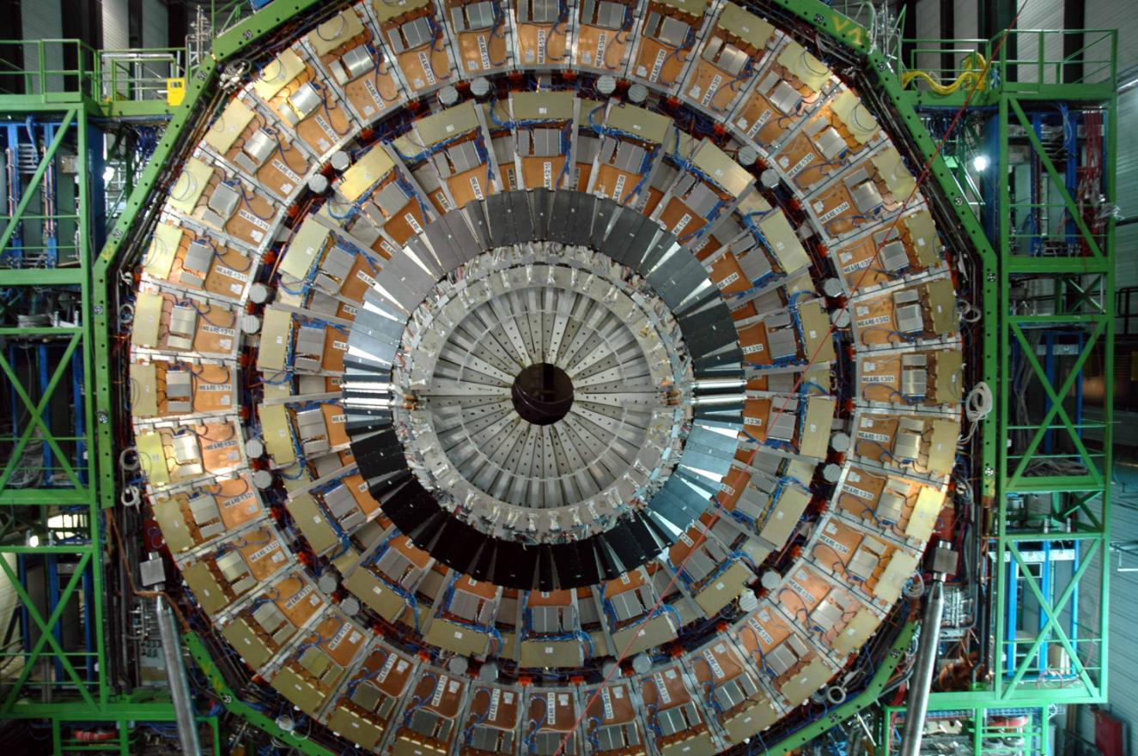
CMS Muon System
Dick Loveless
University of Wisconsin
DOE Review
26 August 2010

Slide 2
Wisconsin EMU Personnel
Dick Loveless -- Distinguished Scientist
EMU Technical Coordinator (former L2 for Construction & Common Projects)
EMU L2 Deputy Manager, US-CMS Election Committee – Co-chair
Editor – CMS Muon Upgrade Proposal (soon Muon Upgrade Manager?)
Armando Lanaro -- Associate Scientist
EMU Field Technical Coordinator – responsibility for all CSC operations
EMU DPG Deputy Coordinator – responsibility for physics data quality
EMU Safety Officer
Proposed ME4/2 Upgrade Factory Manager
Duncan Carlsmith – Associate Professor
Leader of the endcap alignment task force
Jim Bellinger -- Associate Scientist
EMU Alignment Readout & Analysis, moving to EMU simulation
Lindsey Gray -- Graduate Student
EMU CEO (CSC Expert Operator) – serve weekly shifts operating EMU
Data Validation

Slide 3
Endcap Muon System
473 Cathode Strip chambers
Typical sizes -- 1.5m x 1.8 m, 3.3m x 1.3 m
Typical weights – 200 kg to 400 kg
Large number of electronics boards
CFEB (strips) – 2268 boards
AFEB (wires) -- 11448 boards
Trigger mother board -- 473 boards
Data mother board -- 473 boards
Many others – low voltage, high voltage, monitoring etc.
Most boards have FPGAs (need programming via firmware)
Flexibility – make changes without access
New maintenance problem (downloading firmware)

Slide 4
CSC Maintenance
Mechanics & infrastructure
Wisconsin installed the mechanics of CSC system and is responsible their operations
Maintenance on such an extensive system difficult
Armando is Field Technical Coordinator – crucial position
Responsible for all parts of CSC system
Armando keeps the system operating
PSL engineers available for consulting and design
Example – cooling leak
In Oct ‘09 a small bushing cracked and caused a leak
CMS contains over 400 such bushings
CMS decided to do an emergency opening during Xmas ‘09
Dick , Armando, and Dan led a team of 6 Polish techs to replace all 400 bushings in a two-week period

Slide 5
DPG (Detector Performance Group)
A. Lanaro is Deputy DPG Co-ordinator
Supervise maintenance/implementation of software tools
Offline monitoring of CSC system performance
Online monitoring of data quality
L. Gray is working on CSC data validation
Upgrades of reconstruction software
Provide constant feedback to CSC Operations Group
Update lists of faulty chambers, channels, boards, etc.
Organization of weekly joint DPG-Operations meetings
Improve coordination with other muon groups (DT, RPC)
Organize and chair joint meetings to resolve overall problems
Provide feedback to Physics Objects Group (POG) and Physics Analysis Groups (PAG)
Info on general muon reconstruction, identification, efficiency

Slide 6
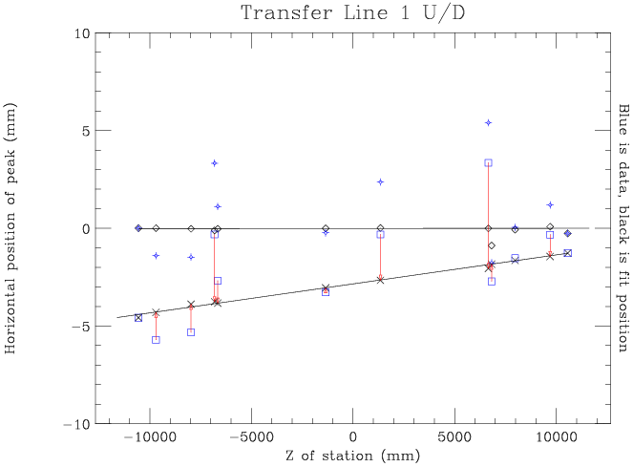
Endcap alignment
Each disk/wheel located
wrt transfer laser line
Jim Bellinger responsible for almost all the endcap alignment analysis
Transfer lines
2 transfer lines – one φ angle
SLM lines
12 transfer laser lines --
6 from one end, 6 from other
YE+1
YE-1
YE+2
YE-2
Residual fit ~ 90 μ

Slide 7
EMU Simulation
Jim Bellinger
Finish major alignment analysis by end of 2010
Move to Simulation Task Leader (CDF experience)
Represent EMU at bi-weekly CMS Simulation meetings
Improve matrix fitting
Tune strip-charge distributions to match data
Basically model the gas gain effects in the CSC chambers
Introduce field-on geometry to simulation models
Disks bend ~15 mm when B field in on

Slide 8
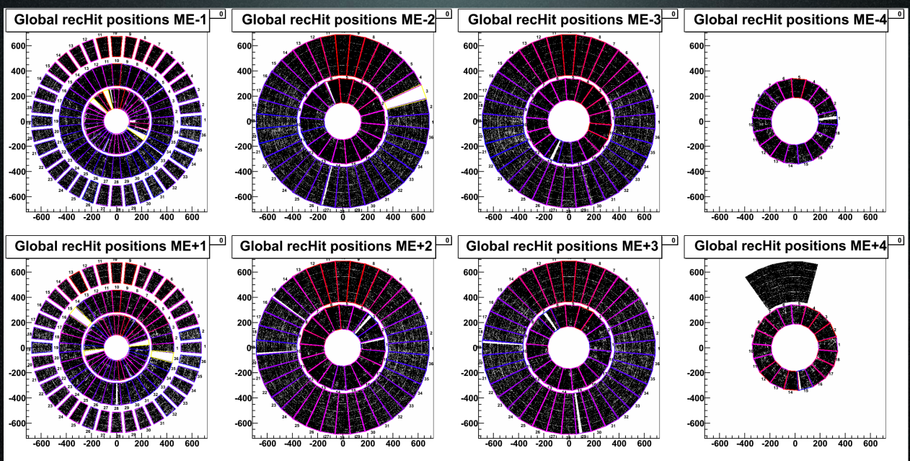
CSC Performance
Each muon shows as a one dot in each disk
Gaps show dead chambers or boards
More than 98% of chambers are working
More than 99% of channels are working
Cosmic Run
24 August 2010

Slide 9
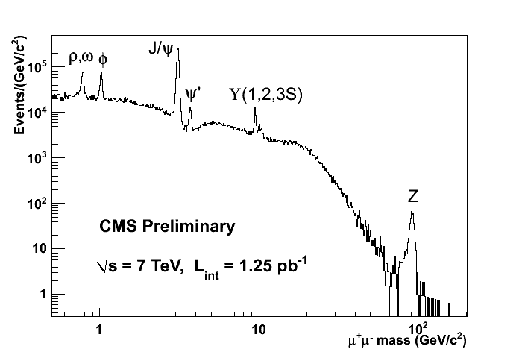
μ⁺μ⁻ Spectrum
New since ICHEP!

Slide 10
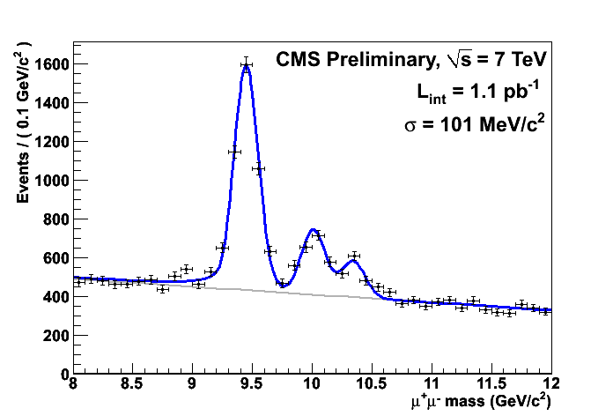
Upsilon Production

Slide 11
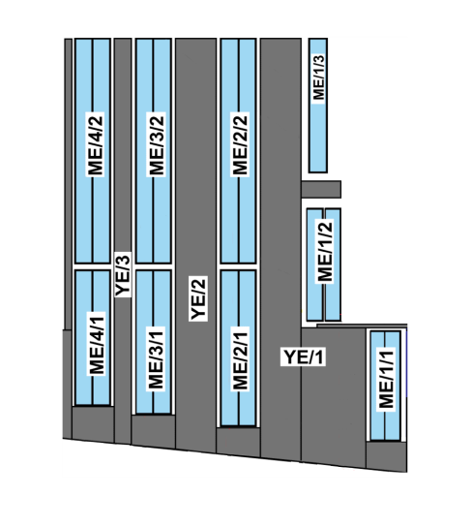
Addition of ME4/2 chambers
Requirements for Forward Muon System
Sufficient redundancy to reduce background
Bremsstrahlung, neutrons, halo muons, etc.
Chamber efficiencies (gaps, dead electronics, etc.)
Good enough resolution to match Tracker tracks
Multiplicity increasing faster than expected
Need 4 stations of chambers as luminosity increases
ME4 chambers were descoped at the beginning of the construction project
ME4/1 chambers recovered using contingency
ME4/2 chambers not yet funded

Slide 12
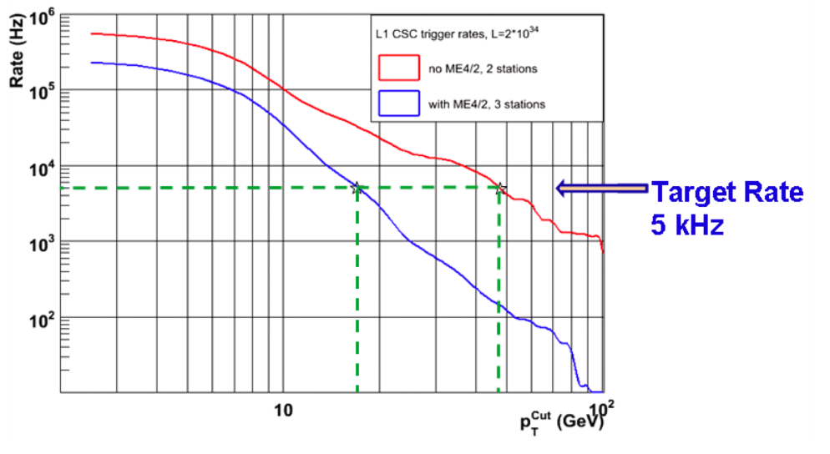
Trigger simulation
At L = 2 x 10³⁴
Triggering becomes very difficult without the ME4/2 station, and the threshold for 5 kHz rate becomes 48 Gev, instead of 20 Gev
By adding the ME4/2 station we can reduce the trigger threshold to less than 20 GeV even for events with a missing station

Slide 13
CMS Endcap Plans I
Geometry
ME4/2 chamber mount close to the iron disk YE3
Must be installed first
RE4 (RPC) chambers mount above the CSC chambers
YE4 shielding wall built on the outside
Protect muon system from collimator spray
Schedule
CMS plans to rebuild the 4th station in 2012 shutdown
2016 shutdown for replacing pixel, HCAL SPIMs
No access planned for muon systems
ME4/2 station is not funded, will not be ready for 2012

Slide 14
CMS Endcap Plans II
CMS has offered help for ME4/2
Building 904 factory
1000 m² space for chamber assembly
Open area, clean, has services (gas,power, air, etc.)
Occupancy in early 2011
Shipping tooling from Fermilab this Fall
Armando Lanaro will be factory manager
1 MCHF funding to get production started
Almost sufficient funding for 30 chambers M&S
With spares, prototypes enough for 1 endcap
Difficult to use with US vendors ( EU bidding reqs)

Slide 15
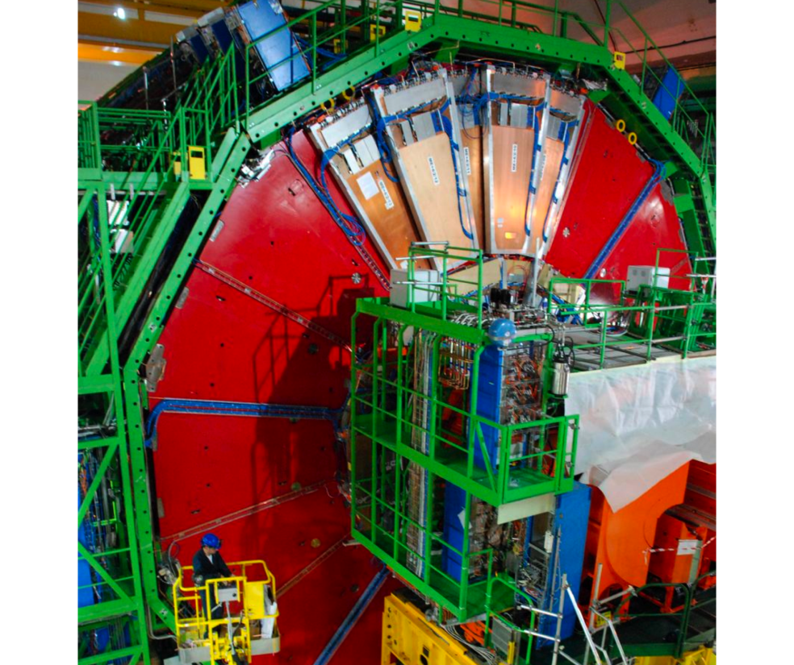
Plans for ME4/2 station
Added 5 spare ME 4/2 chambers to YE+3
Parts for 3 prototypes will be assembled in 2011 in the B904 factory
Will try to complete this endcap during 2012 shutdown
Get remaining ME4/2 station ready for 2016

Slide 16
Beam Pipe Shielding
CMS has asked us to design beam pipe shielding that will permit CMS maintenance after beam pipe (and EE) activation
Safety requirement from CERN/French Nuclear Agency
Wisconsin had a leading role in designing/building beam supports
CMS providing funding
Dick and Dan Wenman are leading the design effort
Looking at mechanical shielding for the next few years
Substantial radiation shielding for high luminosity
Large weight of lead shielding (Pb 2 to 4 cm thick)
Needs to be easy to install with small exposure to personnel
Install around beam pipe in various opening scenarios
Schedule
Review design during Autumn 2010, then begin production
Trials during 2012 shutdown

Slide 17
Summary
EMU Status
CSC chambers operating very well
Delivering good triggers and reconstructed muons
Wisconsin team is an important ingredient
Goals
Provide maintenance, keep EMU operating well
Complete ME4/2 station as soon as possible
Complete design and production of beam pipe shielding

