Slide 1
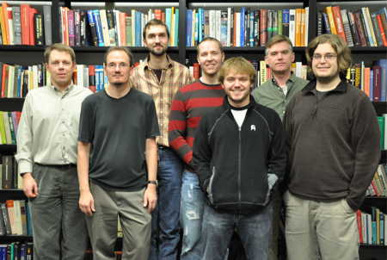
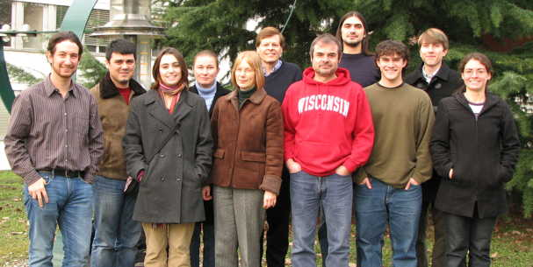
Task T – CMS at LHC
Wesley H. Smith
DOE Site Visit, Madison, WI, August 26, 2010
Subtasks:
Trigger: Regional Calorimeter Trigger, Higher Level Triggers, Trigger Coordination (W.S.)
Computing: CMS Tier-2, US CMS Production Management (Talk by Dasu w/Physics)
Endcap Muon: Project Management, Chambers & Infrastructure, Alignment (Loveless)

Slide 2
Task T Personnel
Professors: Duncan Carlsmith, Sridhara Dasu, Matt Herndon, Wesley Smith
Distinguished Scientist: Richard Loveless
Electronics Engineer: Tom Gorski (CMS project)
Associate Scientists: Pam Klabbers, Armando Lanaro, Sascha Savin Jim Bellinger (50%, 25% CMS Project, 25%Task E - CDF)
Assistant Scientist: Monika Grothe
Postdoc: Jonathan Efron
Software Engineers: Dan Bradley, Ajit Mohapatra, Will Maier (CMS project)
System Manager: Steve Rader, Matt Radtke (50 %, 50% UW) -- Support all HEP Computing
Grad. Students: Mike Anderson (NSF-computing), Michail Bachtis, Lindsey Gray, Kira Grogg, Christos Lazaridis, Jeff Klukas, Jessica Leonard, Will Parker, Ian Ross, Joshua Swanson, Marc Weinberg
Grad. Summer Students: Austin Belknap, Isobel Ojalvo, Bethany Reilly
Technician: Robert Fobes (CMS project)
PSL* Engineers: F. Feyzi, P. Robl, D. Wahl, D. Wenman, A. White (CMS project)
PSL* Draft/Tech: B. Dana, G. Gregerson, D. Grim, J. Johnson, A. Riley, T. Sailor, R. Smith (CMS project)
(*UW Physical Sciences Lab: world-class electronic & mechanical engineering & construction)
ACTIVE GROUP: over 600 Talks in CMS Meetings between Jan. ‘08 – May ‘10

Slide 3
Wisconsin Senior Personnel Official CMS Responsibilities
Prof. Wesley Smith
CMS Trigger Coordinator (07-), CMS Trigger Project Manager (94-07) , CMS Executive Board
CMS Management Board, CMS Electronics Systems Steering Committee
SLHC Upgrade Management Board, SLHC Peer Review Board Chair
US CMS Trigger Level 2 Manager, Project Management Group
US CMS Institutional Advisory Board Member, Technical Advisory Board Member
Prof. Sridhara Dasu
CMS Electroweak Physics Co-Convener (07-09), Upgrade Physics Coordinator (10-)
Online Selection Physics Co-Convener (06-07), Computing Tier-2 Manager (Wisconsin)
SLHC Upgrade Management Board, US LHC Users Organization Secretary
US CMS Calorimeter Trigger Level 3 Manager, Institutional Advisory Board Member
Prof. Duncan Carlsmith
US CMS Endcap Muon Alignment Task Manager, Elections Committee Co-chair (07-09)
Distinguished Scientist Richard Loveless
CMS Endcap Muon Technical Coordinator (09-), CMS EMU Project Manager (07-09),
CMS Muon Upgrade Co-Convener (TBC), US CMS EMU Deputy Operations Project Manager
US CMS Common Projects Manager (98-07), US CMS EMU Project Manager (02-07)
Associate Scientist Pam Klabbers
CMS Calorimeter Trigger Technical Coordinator, Regional Calorimeter Trigger On-site Operations Manager
Associate Scientist Armando Lanaro
CMS Deputy Convener, EMU Detector Performance Group, EMU Upgrade Chamber Construction Mgr. (TBC)
CMS EMU Safety Officer, US CMS Level 3 EMU On-site Operations Manager
Associate Scientist Sascha Savin
CMS Trigger Performance Group Co-convener
Assistant Scientist Monika Grothe
CMS Conference Comm. (10-), CMS Forward Physics Convener (07-08), Electroweak Physics Data Validation

Slide 4
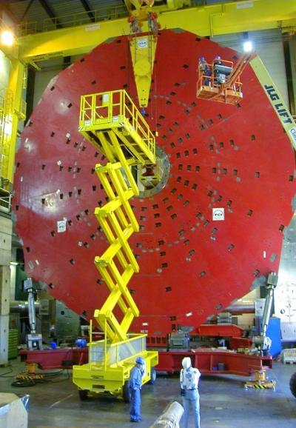
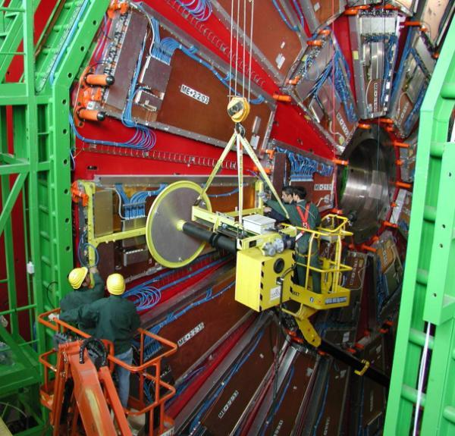
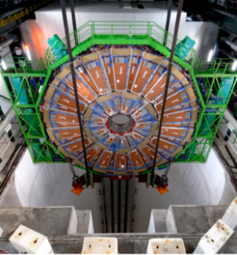
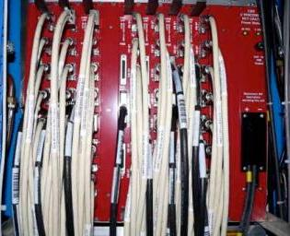
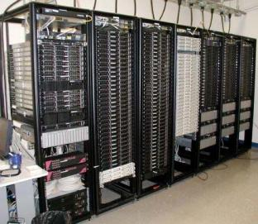
Wisconsin CMS Contributions
Endcap Disks (EMU)
6 disks ~3500 tons
UW Design & Contract
Chamber Installation
400 EMU Chambers & infrastructure
Gas, Power, Cooling & Signal Cables
Calorimeter Trigger
19 Crates, 2000 boards
Custom ASICs
Sorts objects w/coords
Tier-2 Computing Center
Large UW Investment
Leverages GLOW -- Grid Laboratory of Wisconsin
CMS Software
Collaboration with UW Condor group to develop CMS Grid Tools

Slide 5
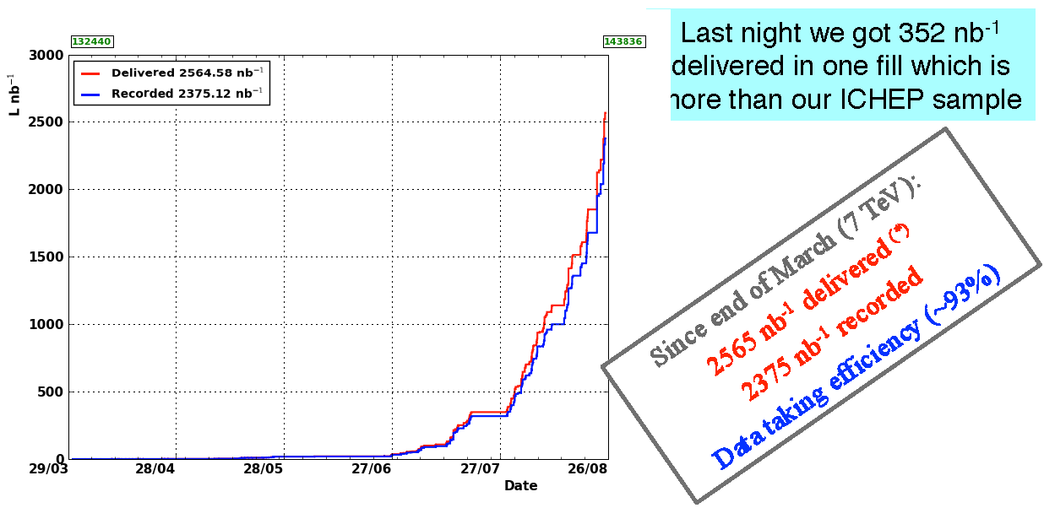
CMS & LHC Performance
Tuesday night (Aug. 24): 352 nb⁻¹ delivered in one fill – more than our ICHEP data sample!
Reached L=10³¹ on Aug. 24. Expect 10³² by end 2010 Run. Expect 1 fb⁻¹ by end of 2011.

Slide 6
Task T: CMS Physics
Leadership and Responsibility for Early Physics with LHC
Supervision of a large group of postdocs & students across CMS (many institutes)
Physics Trigger Studies (CMS Trigger Coordinator: Prof. Smith)
Thresholds at L1T and object ID refinement at HLT determines physics reach
e/γ trigger validation and DQM (Leonard+Lazaridis+Anderson/Grothe+Klabbers)
τ trigger algorithm improvements and DQM (Bachtis+Swanson/Savin+Dasu)
μ trigger: HLT development, validation, and DQM (Klukas/Herndon)
Calorimeter Trigger Calibration (Efron)
Electroweak Physics Analyses (CMS Electroweak Co-convener: Prof. Dasu)
W and Z reconstruction, especially with jet activity, key for new physics search
Drell-Yan e⁺-e– Production on & off Z peak (Leonard/Klabbers+Grothe)
γ+Jets Measurement (Anderson/Dasu)
W(→eν)+Jets Measurement (Grogg/Efron)
Z(→e⁺e–)+Jets Measurement (Lazaridis/Grothe+Klabbers)
Z(→ττ →μ⁺τ_{h}-jet) Measurement (Bachtis/Savin)
Z(→ττ →e⁺τ_{h}-jet) Measurement (Swanson/Savin)
SM Zγ Production and Search for Anomalous Couplings (Gray/Lanaro+Dasu)
SM Top Production and Search for SUSY in dilepton channel (Weinberg/Savin)
SM WZ Production and Search for W’→WZ, Technicolor (Klukas/Herndon)
SM ZZ Production and Upgrade Simulations (Ross/Grothe+Klabbers)
Forward Physics Analyses (CMS Forward Physics Convener: Dr. Grothe)
Completed Exclusive di-lepton (pp →ppl⁺l–)production (luminosity measurement) & Exclusive W production (collaboration with Electroweak)
Notes:
6

Slide 7
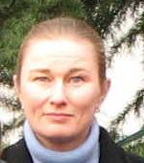
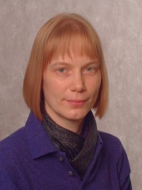
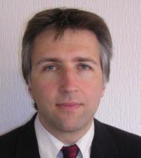
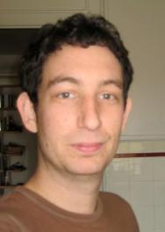
Task T: Trigger I
Leadership & Responsibility for Trigger Operations & Upgrades
CMS Trigger Coordinator & US CMS Trigger L2 Manager (Smith)
CMS L1 Regional Calorimeter Trigger
US CMS L3 Manager for Calorimeter Trigger (Dasu)
Operations, Hardware, On-Site Management (Klabbers)
UW Hardware diagnostics & repair (Gorski, Fobes -- CMS Project)
CERN Maintenance & testing facilities (Klabbers, Grothe, Savin)
Online Diagnostics (Klabbers)
Downloading detailed test patterns (Efron, GS: Grogg, Ross, Ojalvo )
Trigger Emulator (Dasu, GS: Bachtis, Swanson)
Online Configuration & Control (Klabbers & Grothe)
Trigger Supervisor (Grothe, GS: Lazaridis, Ross)
Memory Lookup Tables (Dasu,GS: Bachtis, Swanson)
Configuration & Conditions Data Bases (Efron, GS: Swanson)
Detector Controls System (Grothe)
Monitor temperatures & voltages (Grothe, GS: Grogg, Ross)
Data Quality Management (Savin)
Online Histograms & Alarms (Savin, GS: Weinberg, Parker)
Offline Histograms & Run Certification (Savin, GS: Weinberg, Parker)
Klabbers
Grothe
UW Trigger Scientists/Postdoc
Savin
Efron

Slide 8
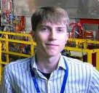
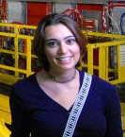
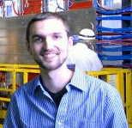
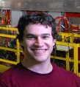
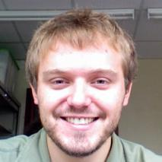
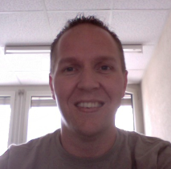
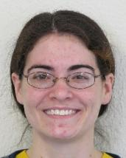
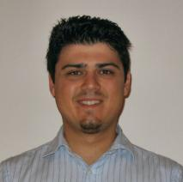
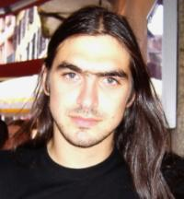
Task T: Trigger II
CMS Higher Level Triggers, Trigger Coordination
CMS Trigger Coordinator (Smith)
CMS Trigger Performance Co-convener (A. Savin)
UW Trigger Developers/DQM:
Muon: Herndon, Klukas,
e/γ: Dasu, Anderson,
τ: Dasu, Bachtis
SLHC Trigger Upgrade
Trigger Upgrade Chapter Editor (W. Smith)
New Algorithm Design & Simulation
Dasu, Grothe, Bachtis, Ross
Hardware design & prototyping
Smith, Klabbers, Gorski, Fobes
UW CMS Trigger Students (RCT unless otherwise):
T-B➔: Anderson (γ HLT), Grogg, Klukas (μ HLT), Weinberg
⬅L-R: Ross, Swanson, Leonard, Lazaridis, Bachtis (RCT & τ HLT)

Slide 9
Task T: Endcap Muon - I
Operations – during running
EMU Technical Coordinator & US CMS Deputy Manager (Loveless)
EMU Detector Performance Group Deputy Coordinator (Lanaro)
EMU Detector Performance (Lanaro, Gray)
EMU Field Technical Coordinator & Safety Officer (Lanaro)
Keep infrastructure (cooling, gas, LV, HV, etc.) running (Lanaro, Loveless)
Fix detector mechanicals (leaks, cables, etc.) (Lanaro, Loveless, PSL team)
EMU Field Technical Coordinator, EMU Safety Manager (Lanaro)
Maintenance -- during shutdowns
Fix detector mechanicals (includes removing chambers for board replacements) (Lanaro, Loveless, PSL team)
CMS Endcap Alignment
Management of EMU alignment task force (Carlsmith)
Analysis of alignment data (Bellinger)

Slide 10
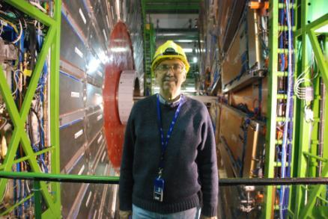
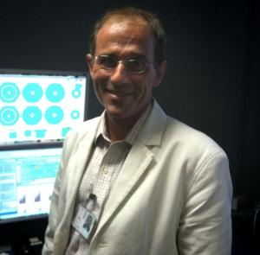
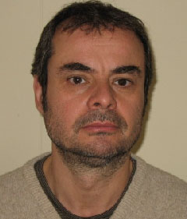
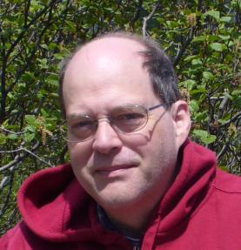
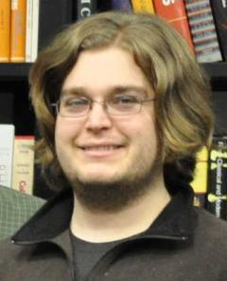
Task T: Endcap Muon - II
EMU Simulation
J. Bellinger
Upgrade -- build 72 ME4/2 chambers
Editor CMS Muon Upgrade Proposal (Loveless)
Proposed Upgrade Chamber Factory Manager (Lanaro)
Preliminary plan for ME4/2 chamber production
Project engineer at PSL (F. Feyzi - PSL)
Parts procurement, QC, shipping (from US) (Feyzi, Loveless)
Management of Assembly at CERN (Lanaro)
UW CMS Muon Team:
Loveless
Carlsmith
Lanaro
Bellinger
Gray

Slide 11
Task T: Computing
Task-T operates general purpose HEP and CMS specific computing
Dasu provides scientific leadership for the team
Rader and Radtke supported at 50% each for HEP computing
Summer Students and RA based in Madison keep Tier-2 validated for physics
HEP Computing (Director of Computing: Rader, Desktop & Login Support: Radtke)
Serve > 250 users (150 remote/guest users)
Mail, AFS storage, desktop, network, backup, printing services
24/7 coverage for core services
CMS Tier-2, Grid Laboratory Of Wisconsin, Open Science Grid (Manager: Dasu)
Most productive Tier-2 center in all CMS (System Manager: Maier, NSF)
3000 MSI2k, 500 TB useable storage, Over 20 M CPU hours served since 2005
Seamless integration with GLOW and OSG
Responsible for all CMS simulation production (Manager: Mohapatra, NSF)
Responsible for world-wide CMS production
More than half the production done on OSG through 2010 (Mohapatra, Anderson)
Innovative software development (Lead: Bradley, Support: Anderson, NSF)
New tools for analysis (Rapid-response Adaptive Computing Environment)
Smooth scaling of Condor farms to very large sizes, helping all grid facilities
Works within Condor team addressing concerns of FNAL (Tier-1) and Tier-2 sites
CMS Analysis Support (Summer Students, Reilly from Fall 2011 -- Task T Activity)
Wisconsin is primary Tier-2 for Electroweak, Forward Physics and Trigger Studies
Notes:
11

Slide 12
CMS Trigger & DAQ Systems
Level-1
Detector Front-ends
Trigger
Readout
Event
Switch Fabric
Controls
Manager
Farms
Computing Services
Level-1 Trigger
LHC beam crossing rate is 40 MHz & at full Luminosity of 10³⁴ cm⁻²s⁻¹ → 10⁹ collisions/s
Reduce to 100 kHz output to High Level Trigger and keep high-P_{T} physics
Pipelined at 40 MHz for dead time free operation
Latency of only 3.2 μsec for collection, decision, propagation

Slide 13
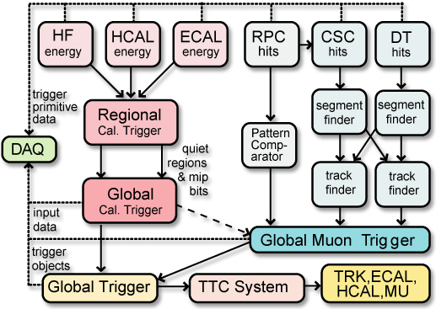
The CMS Level-1 Trigger & Regional Calorimeter Trigger
Only calorimeter and muon systems participate in CMS L1
3<|η|<5 |η|<3 |η|<3 |η|<2.1 0.9<|η|<2.4 |η|<1.2
4K 1.2 Gbaud serial links Cu cables
e/γ, jets,
E_{T}, H_{T},
jet counts
muons
Regional Calorimeter Trigger
Receives Trigger Primitives (TPs) from 8000 ECAL/HCAL/HF towers
Finds 28 e/γ candidates, creates 14 central tower sums, 28 quality bits, and forwards 8 HF towers and 8 HF quality bits
All sent to Global Calorimeter Trigger at 80 MHz on SCSI cables

Slide 14
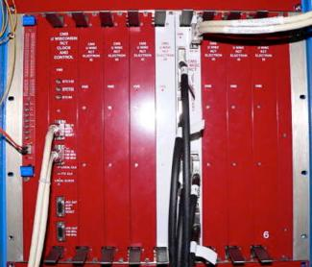
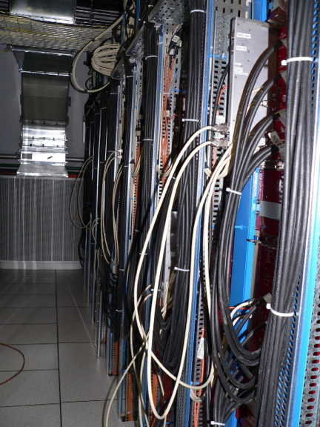
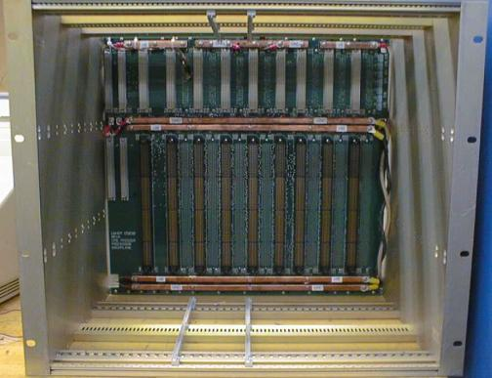
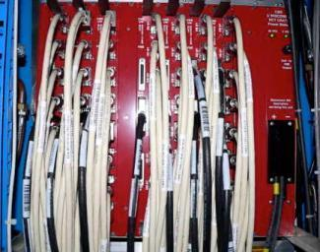
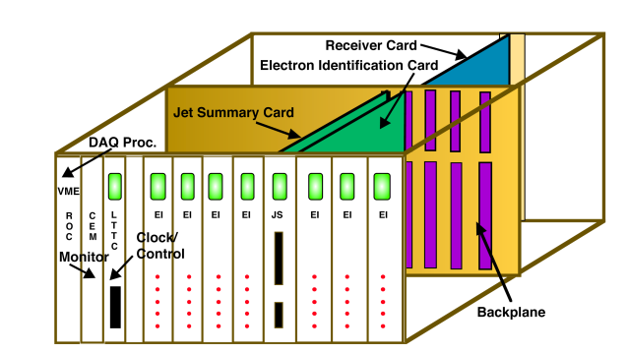
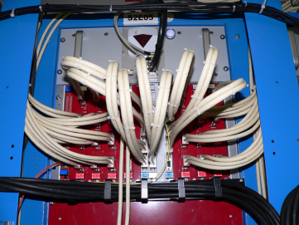
Regional Cal. Trigger Crates UW Scientist Pam Klabbers, CMS Cal Trig Coord.
Main RCT Crate
RCT
Front
⬅VME➔
48V DC Power
160 MHz Diff. ECL ⬅ 0.4 Tbit/s ➔
Point-to-point
Dataflow
RCT
Back
RCT
Racks
In
USC55
18 Operating (26 incl. Spare & Test) crates with custom backplane incorporate algos: e/γ, τ & Jet Triggers
Master Clock Crate (MCC):
One crate with 3 custom cards to create & fan-out 160 & 120 MHz clocks, ReSync, & Bunch Crossing 0

Slide 15
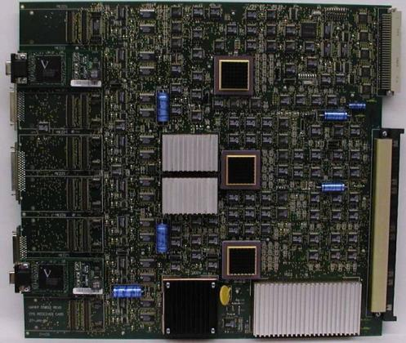
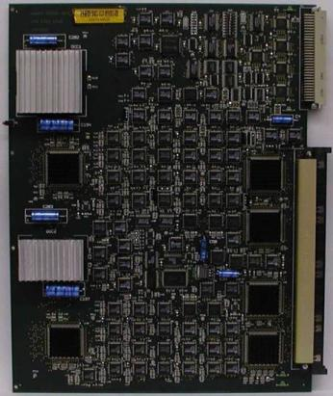
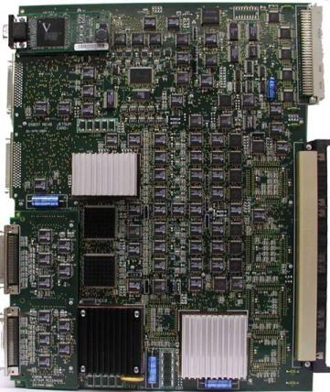
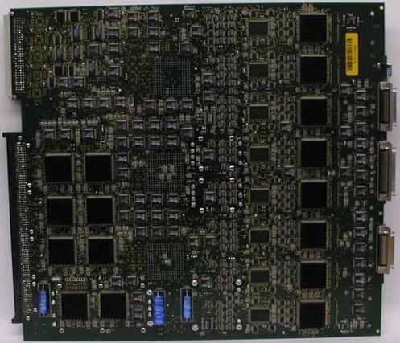
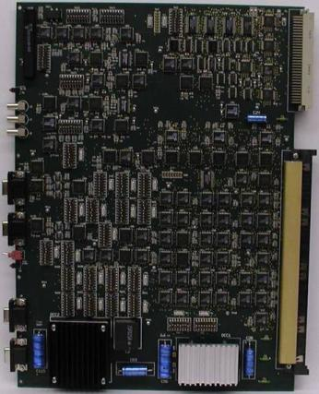
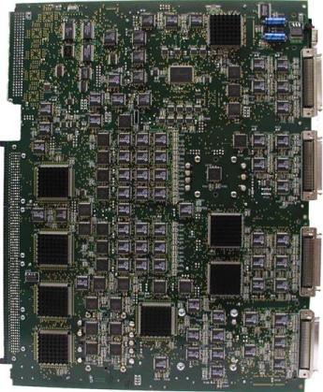
Regional Cal. Trigger Cards 2000 Cards built by U. Wisconsin using 5 UW Custom ASICs
Receiver Card: Electron Isolation & Clock: Jet/Summary:
number
needed +spares
(incl.
test
setups) available
Bar Code
Receiver
Mezz. Card
Front
Adder
EISO
128+26
mezz
link
cards
1026+390
Front
EISO
SORT
ASICs
(w/heat sinks)
BSCAN
ASICs
Input
DC-DC
EISO
128+32
18+7
Back
Oscillator
Phase
ASIC
Bar Code
Clock
PHASE
ASICs
18+7
Back
(18+9
Custom
Backpl)
Clock Input
Clock delay adjust
BSCAN
ASICs
BSCAN
ASICs
Sort
ASICs
MLUs
DC-DC
Converters

Slide 16
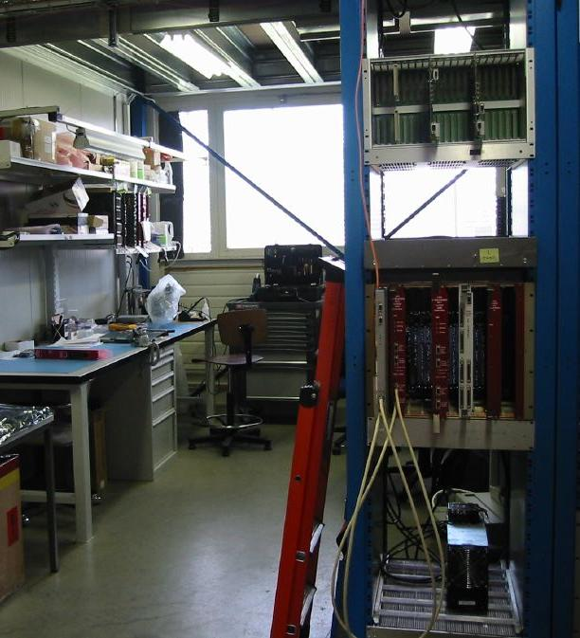
Trigger Lab Setup at CERN
Repair & Test Facility – Prevessin 904
Stores boards, crates, cables.
Power up and run system tests
Operate in water-cooled rack for extended tests
Integration tests
Racks with cooling on a raised floor nearby
Will be used for upgrade tests
Storage and Repair
Spare Crates and cards also available for use in testing and replacement of suspect cards
Soldering station, scope, and tool storage
Spare component storage
Responsible:
P. Klabbers & M. Grothe

Slide 17
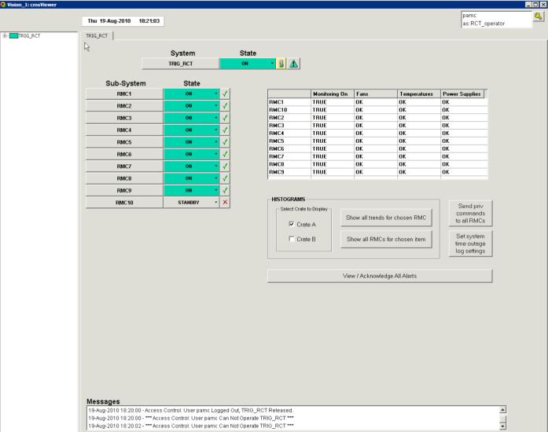
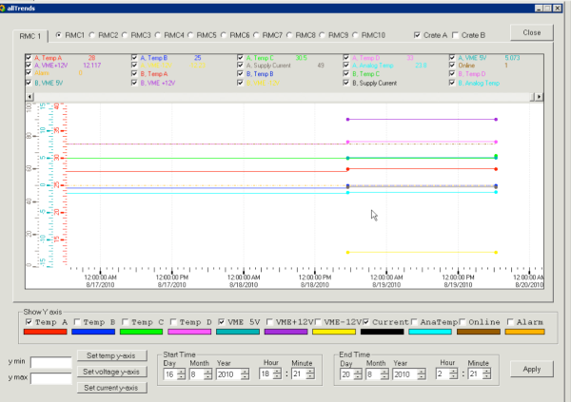
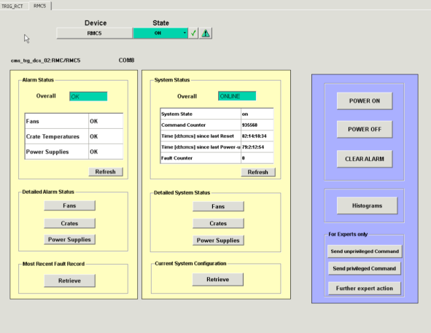
Detector Control System (DCS) Scientist M. Grothe, GS: K. Grogg, I. Ross
Main Panel
Histograms of Quantities Monitored
10 Rack Monitor Cards (RMCs)
Controls and monitors rack power, current, voltage, temps, and fans:
Auto-off for cooling, voltage, current failures, sends SMS/e-mail to experts.
Protects Electronics
Panel for each RMC

Slide 18
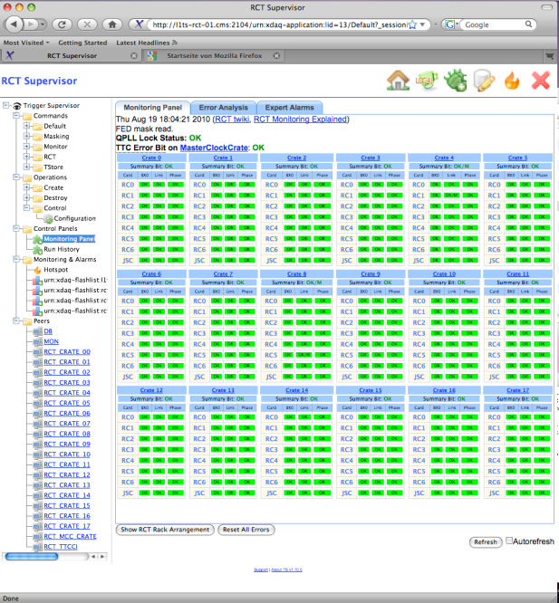
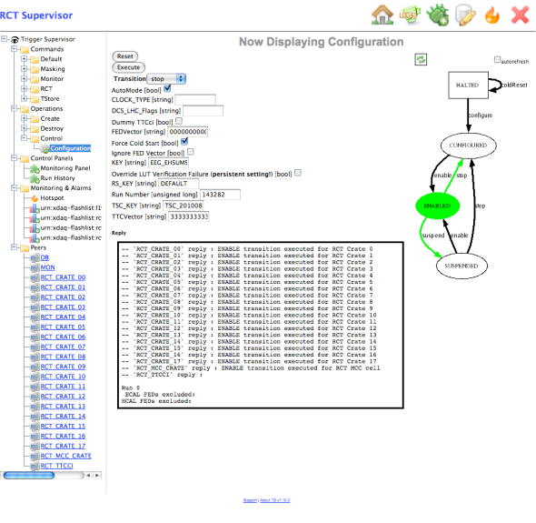
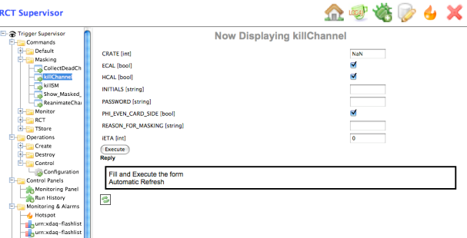
Trigger Supervisor (TS) Sci.: M. Grothe , PD: J. Efron, GS: C. Lazaridis, I. Ross
Configuration
Monitoring
Configures and monitors RCT &
interface to CMS Run Control
Can mask bad channels, monitor links and clocks, view current configuration
Masking

Slide 19
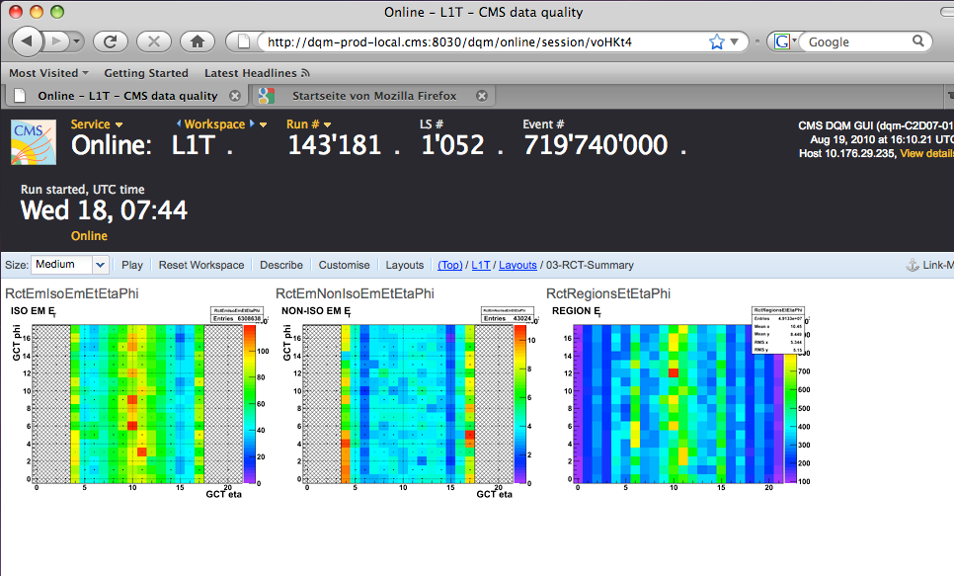
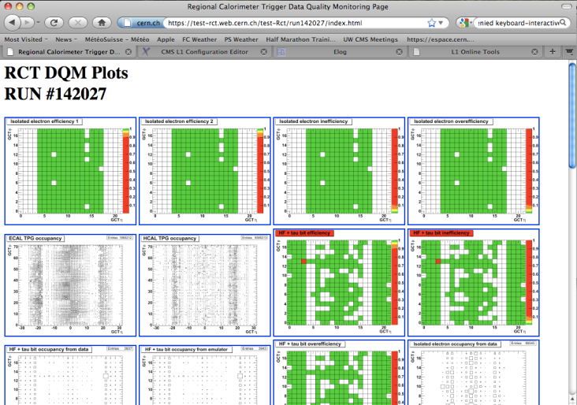
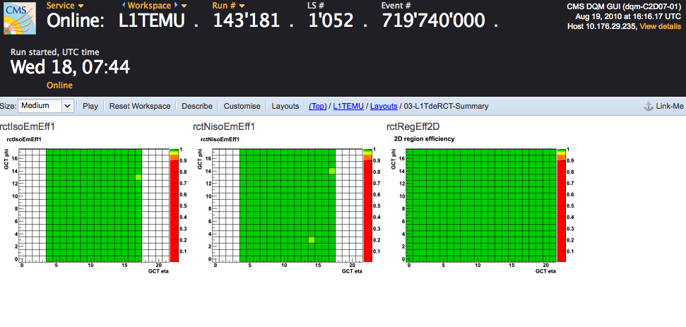
Data Quality Monitoring (DQM) Sci: A. Savin, GS: M. Weinberg, W. Parker
Online DQM – Live and Archived
Online DQM: current data to catch real-time problems (and archived)
Offline DQM: post-running, used for data certification (not shown)
Standalone: run by RCT on call, larger datasets possible
Rank and occupancy histograms
Standalone DQM
Real time data/emulator compare

Slide 20
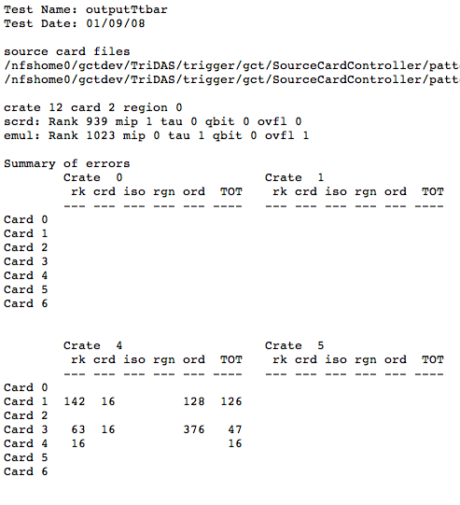
RCT Emulator and Pattern Testing PD: J. Efron, GS: K. Grogg, I. Ross
Emulator
Simulates all RCT data paths – Trigger Primitive input to GCT output
Part of CMSSW, used by DQM, pattern testing, etc.
Pattern tests use the input LUTs on the Receiver cards to send 64 BX
All 18 RCT crates + GCT Source Cards to capture output
Emulator predicts output
compared with captured data
Patterns
Walking zeros & ones, random, ttbar simulated data
ttbar: Partial output at right
Problems found and fixed
Checks RCT-GCT connections
Being integrated into Trigger Supervisor
Developing tests using patterns injected at TPG level
Tests SLB-RCT link, algos.

Slide 21


L1 e/γ Trigger Efficiency
Egamma 2 GeV trigger intrinsic efficiency for 7 TeV Data:
Require energy deposit in 2 towers of L1 Candidate
Remove effect of masked towers, out-of-time triggers
Barrel
Endcap

Slide 22

RCT Calibration
L1 physics object calibration for Electrons
Unified turn-on curve for electrons in barrel and endcap
Compensates for different amount of material in front of barrel and endcap
Working on hadrons
Sharpen Jet & Missing Energy threshold curves
Postdoc Jonathan Efron
8 GeV e/γ trigger
Barrel
Endcap

Slide 23
Physicist Trigger M&O Tasks (all from core program)
Change trigger Configuration
Respond to changing beam/detector conditions & physics priorities
Study new trigger configurations
Test runs, Monte Carlo studies, data studies
Trigger Physics Analysis
Understand detailed impact of trigger on physics
Preparation for luminosity increases
Monte Carlo studies of new conditions, validate with present data
Operations - 24x7 support during running
Rapid Response to problems at point 5
RCT is first to detect problems with ECAL, HCAL, HF
Write, test & maintain electronics test programs
Maintain & update bad channel list & run daily checking programs
Run Control maintenance
Trigger data validation and calibration
Online & Offline analysis of rates & efficiencies
Monte Carlo & data trigger simulation maintenance
Continuous validation of trigger using simulation & readout data

Slide 24
Higher Level Triggers
Reduce 50 kHz L1 output to 200 Hz running algorithms averaging 40 ms/event on event filter farm.
Responsibility of Trigger Coordinator (W. Smith)
Optimize HLT & L1 triggers for any given time/luminosity
Integration of algorithms and code provided by detector physics groups and physics object groups into the trigger code
Creation of trigger tables via representatives from each detector group, each physics group and run coordination
Monitoring of physics performance of the combined online selection
Photon Triggers: Prof. Dasu, GS: M. Anderson
Muon Triggers: Prof. Herndon, GS: J. Klukas
Tau Triggers: Prof. Dasu, Assoc. Sci. Savin, GS: M. Bachtis, J. Swanson
Operational Responsibilities
Study efficiency, purity, acceptance, execution time, data unpacking.
UW Scientist A. Savin is Co-Convener of Trigger Performance Group
Online Trigger DQM: Determine if actions needed to fix data-taking
Offline Trigger DQM: Certify trigger for each run usable for physics
Release Validation: Check HLT function in each new SW release
Algorithm Evaluation: Check physics performance, samples used for efficiency calculation, monitoring histograms, expected rates

Slide 25


Trigger Performance W. Smith Trig. Coor, A. Savin Trig. Performance Co-Convener
Smooth evolution of trigger menus with luminosity
Successfully deployed 2E29, 4E29, 8E29,1E30, 3E30 L1 & HLT menus
Rates reliably predicted with data extrapolation & MC within 20%
L1: 90 kHz (30 kHz physics), HLT: 200 - 400 Hz (50 msec CPU/evt)
High and well understood trigger efficiencies (L1 & HLT):
L1 & HLT Photon efficy. wrt RECO SuperCluster:
Barrel & Endcaps
Nearly 100% efficient.
Tag and Probe efficiency for L1 & HLT Muon Trig. for P_{T} > 3 GeV/c

Slide 26
Upgrade Trigger Strategy
Constraints
Output rate at 100 kHz
Input rate increases x2/x10 (Phase 1/Phase 2) over LHC design (10³⁴)
Same x2 if crossing freq/2, e.g. 25 ns spacing → 50 ns at 10³⁴
Number of interactions in a crossing (Pileup) goes up by x4/x20
Thresholds remain ~ same as physics interest does
Strategy for Phase 1 Calorimeter Trigger (operating 2016):
Present L1 algorithms inadequate above 10³⁴ or 10³⁴ w/ 50 ns spacing
Pileup degrades object isolation
More sophisticated clustering & isolation deal w/more busy events
Process with full granularity of calorimeter trigger information
Should suffice for x2 reduction in rate as shown with initial L1 Trigger studies & CMS HLT studies with L2 algorithms
Potential new handles at L1 needed for x10 (Phase 2: 2020)
Tracking to eliminate fakes, use track isolation.
Vertexing is useful to ensure that the multiple trigger objects come from the same interaction
Requires finer position resolution for calorimeter trigger objects for matching (provided by use of full granularity cal. trig. info.)

Slide 27
Upgrade Trigger Algorithm Development
- Prof. Dasu, Sci. Grothe, GS Michalis Bachtis & Ian Ross
η
HCAL
Δη x Δφ=0.087x0.087
Particle Cluster Finder
Applies tower thresholds to Calorimeter
Creates overlapped 2x2 clusters
Cluster Overlap Filter
Removes overlap between clusters
Identifies local maxima
Prunes low energy clusters
Cluster Isolation and Particle ID
Applied to local maxima
Calculates isolation deposits around 2x2,2x3 clusters
Identifies particles
Jet reconstruction
Applied on filtered clusters
Groups clusters to jets
Particle Sorter
Sorts particles & outputs the most energetic ones
MET,HT,MHT Calculation
Calculates Et Sums, Missing Et from clusters
Synthesize these algorithms in FPGA ➔
ECAL
φ
e/γ
η
HCAL
ECAL
φ
τ
η
HCAL
ECAL
φ
jet

Slide 28
FPGA Synthesis Results
Collaboration with group of UW EE Professors Katie Compton & Michael Schulte
Synthesis includes RocketIO, buffers, particle cluster finder, overlap filter, and cluster weighting for Xilinx Virtex 5 series TX240T FPGA. Resource usage & latency:
Resource | 8 x 8 Grid | 8 x 16 Grid | 16x 16 Grid
RocketIO Links | 25% | 46% | 83%
Virtex-5 Slices | 27% | 54% | 105%
Block RAMs | 14% | 27% | 53%
Component | Latency (cycles) | Latency (ns)
Input RocketIO and Buffers | 15 | 75
Particle Finder, Overlap Filter, Cluster Weighting | 12 | 60
Output Rocket IO and Buffers | 10 | 50
Total Estimated Latency | 37 | 185
Notes:
This slide shows the overall estimated resource utilization for input and output RocketIO and buffers, particle cluster finder, overlap filter, and cluster weighting.
If we implement an 8 x 8 grid of clusters, we have plenty of resources left and should be able to implement additional functionality on the same FPGA.
If we implement an 8 x 16 grid of clusters, then we use just over half of the Virtex-5 slices and just under half of the RocketIO links. This should still allow fairly significant upgrades to be made to the algorithms.
It does not seem like a good idea to implement a 16 x 16 grid of clusters on a single Virtex-5 TX240T FPGA, since this could impact upgradability. However, since high-end Virtex-6 FPGAs will have a larger number of Virtex Slices and RocketIO links, it may be feasible to implement a 16 x 16 grid on Virtex-6 FPGAs.
If each FPGA implements a 8 x 16 cluster grid, then this portion of the Calorimeter trigger would require roughly 36 FPGAs to implement to process the 2-dimensional array of 4096 towers.

Slide 29




Upgrade Algorithm Performance: Factor of 2 for Phase I
Prof. Dasu, Sci. Grothe, GS Michalis Bachtis & Ian Ross
Isolated electrons
Taus
QCD Rate (kHz)
QCD Rate (kHz)
Factor of 2 rate reduction
Isolated electrons
Taus
Efficiency
Efficiency
Higher Efficiency

Slide 30
Upgrade RCT Block Diagram (56η×12φ B/E slice + 24η×12φ HF Slice )
Output Links to GCT
TTC/DAQ Connections
2nd-Level Cnr/ Φ Sharing to other crates
Processing
Card
Processing
Card
Processing
Card
TTC/DAQ
Card
Clock and Control
Trigger
Partial-
Products
(Backplane)
Trigger
Data to
DAQ
Input Card
Input Card
Input Card
Input Card
Input Card
Input Card
Input Card
Input Card
η-sharing
Links
Inter-crate
Φ-sharing Links
HCAL/ECAL TPGs from oSLB Cards
Inter-crate Corner-sharing
Links
HF TPGs from oSLB Cards
- Engineer Tom Gorski (CMS Project)

Slide 31

First Prototype: Aux I/O Card
AMC Edge Connector (µTCA)
RS-232
TTS
S-Link Connectors
Pushbutton Reset
(for Microblaze)
TTCrx
- Engineer Tom Gorski

Slide 32

Trigger Algorithm R&D: 2x2 Firmware Test Bed
4 Aux Cards in a 2x2 test fabric
TTC-based timing and link synchronization test bed
Prototype Test Bed for Rocket I/O “Channel Bonding” for latency management
For Testing Trigger Algorithms with Data Sharing
C source code for test pattern generation
RS-232 Hyperterminal interface
- Engineer Tom Gorski

Slide 33
Upgrade Trigger FY11 Activities
- Engineer Tom Gorski, Tech. Bob Fobes, EE GS: Amin Farmahini-Farahani, Dan Seemuth (CMS Project Support)
Develop Trigger System & UTCA crate infra-structure to allow control & programming of trigger cards &FPGAs to distribute timing & control signals
Design Optical Serial Link Prototypes with Lisbon Group to transmit trigger data from ECAL & HCAL
System will also transmit data to present RCT through new mezzanine cards so old and new calorimeter triggers can operate in parallel.
Produce Calorimeter Trigger Prototype Board
Integrate & test with new link prototype
Continue detailed algorithm simulation & FPGA synthesis studies

Slide 34





Task T Physics Activities (Talk by S. Dasu)
Early CMS physics analyses
New energy regime ⇒ rapid discoveries (but, first re-establish SM at 7 TeV CMS)
Excellent Detector Response, Reconstruction and Analysis highlighted at ICHEP
Crucial UW contributions to electron trigger, PF/τ reconstruction, W, Z analyses …
muon
electron
Sample ICHEP Work
EWK boson cross section measured @ 7 TeV
UW Contributors to this Analysis: Lazaridis, Leonard, Grothe, Klabbers
W
Z

Slide 35





More ICHEP Examples
All senior students and scientists contributed to ICHEP analyses
Efron and Grogg studied W+Jets
Anderson measured isolated photon yield
Swanson, Bachtis and Savin determined τ fake rate from data
Weinberg measured jet trigger efficiency turn-on
M. Bachtis found the first Z→ττ→μτ_{h} candidate

Slide 36


UW Computing Activities (Talk by S. Dasu)
Rader, Radtke [DOE Univ.] & Bradley, Maier, and Mohapatra [NSF] Support
A CMS Tier-2 computer center from FY2005
Data-Intensive Science University Network (DISUN) institute
Leadership in Grid Community
OSG - Open Science Grid (develop tools and provide cycles)
GLOW - Grid Laboratory of Wisconsin (Lead role in development and implementation with CS Condor group to benefit entire UW campus: CMS, ATLAS, IceCube, CS, Genomics, Chem. Eng., Med. Phys., etc.)
Benefits both CMS and ATLAS + Computing support for all HEP tasks
Simulation production using local UW resources
UW is one of the largest CMS institutes producing MC events since 2002
>20 M CPU hours served since 2005, 500 GB CMS data hosted (refreshed regularly)
~ 5 B events produced with CMSSW since commissioning in 2008 (on OSG, ~1 B @ UW)
Rader: UW Physics Director of Computing >10 k HS06 CPU >1200 batch slots >1 PB raw storage 10 Gbps bandwidth 24h/7d operation ~200 user accounts Radtke: HEP desktop support Maier: Tier-2 systems support
Mohapatra : CMS MC production czar Bradley: Software expert
CMS Users
OSG
OSG CMS
UW
UWCMS
ATLAS

Slide 37
UW Software Activities (Talk by S. Dasu)
Trigger Controls SW
Prof. Dasu: Core VME software and framework
Dr. Klabbers: Testing and operations software
Dr. Grothe: Integration with CMS Trigger Supervisor
Trigger Emulator SW
UW Students: RCT emulator in new CMS software framework
Trigger Monitoring SW & Physics Studies
Dr. A. Savin and graduate students, Weinberg (RCT), Anderson (Photon), Klukas (Muon), Bachtis (Tau), Swanson (Tau) and Parker (Jet/MET)
Tau Trigger & Reconstruction SW Development (Particle Flow)
Graduate Student Bachtis
Upgrade SW Development
Dr. M. Grothe, Prof. S. Dasu and graduate students Bacthis and Ross
Computing Resources Management Software
SW Engineer Bradley (NSF): New scheduler, Scalability, Computing-On-Demand
Contributions to Condor, OSG and ROOT projects

Slide 38

Task T Endcap Muon Activities (Talk by R. Loveless)
Project Management: Dick Loveless
Construction, test, integrate, install & commission 468 CSCs, electronics & infrastructure
Endcap maintenance
UW responsibility -- led by UW scientist A. Lanaro, assisted by PSL engineering team
ME4/2 Upgrade
Editor of Muon Upgrade Proposal, Project Manager? -- R. Loveless
B904 Factory Manager – A. Lanaro
Parts procurement – led by Wisconsin
Beam Pipe Support & Shielding
Design & production of parts
Endcap Alignment
Alignment Reconstruction & Corrections -- D. Carlsmith, assisted by J. Bellinger

Slide 39
Wisconsin CMS Task Support (over past decade)
UW Computing Support
> $ 700K
5 Servers, 2 TB Disk, 1 GB/s network, Grad. Student RA
70 CPU system for simulation with Condor
10 Gbps WAN network upgrade
Two new Computer Rooms with power & AC
Matching for “GLOW” shared computing facility
Matching for “Tier-2”
Sabbaticals:
Dasu (2 Semesters), Carlsmith (1 Semester), Smith (3 Semesters*)
*Smith 3rd semester partially supported by DOE and UW
Graduate Student Support (07-10):
2 years RA support (Mike Anderson, Ian Ross)

