Slide 1
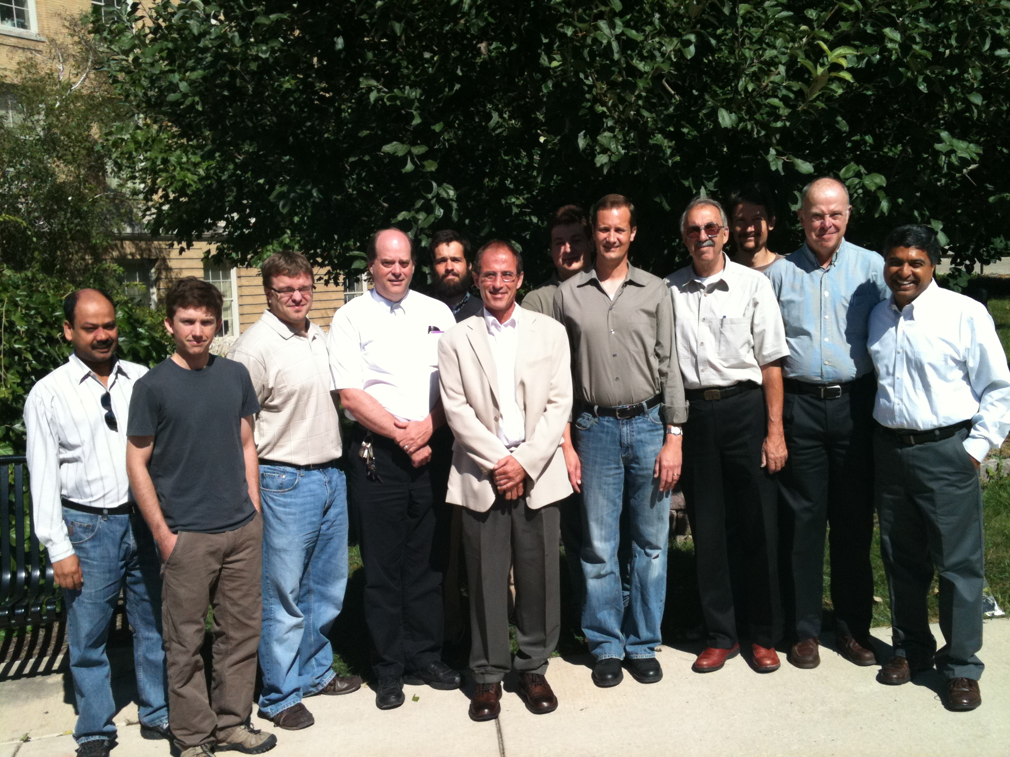
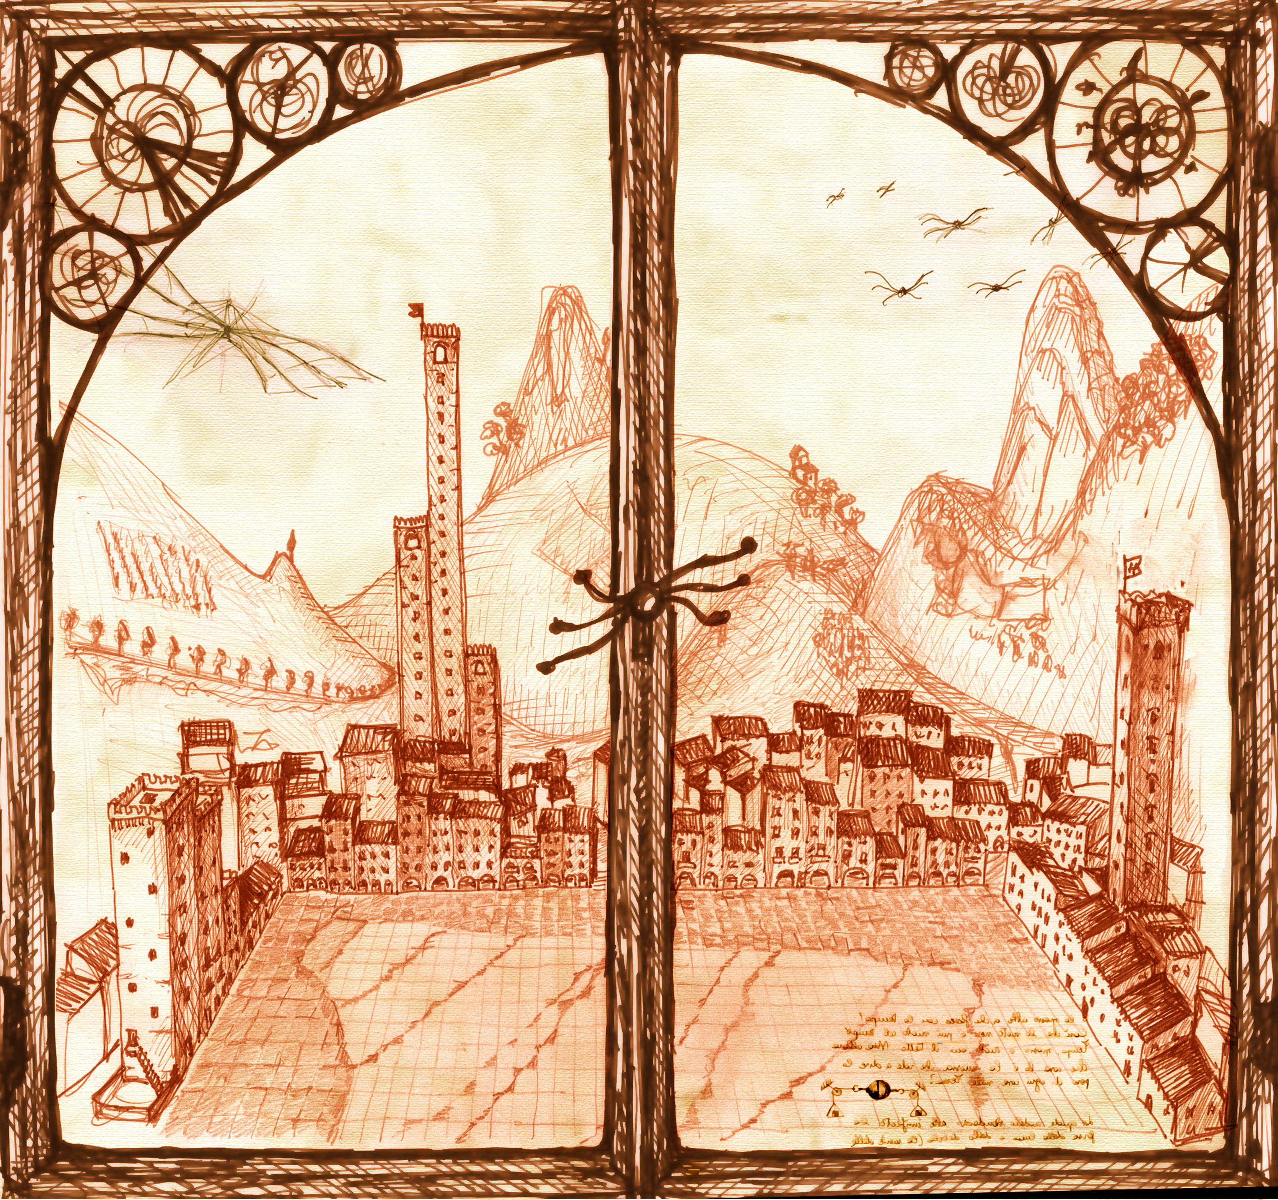
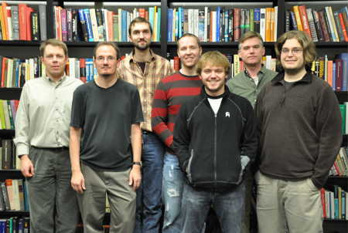
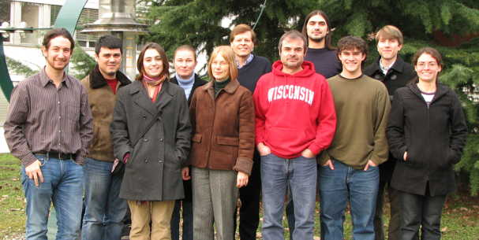
Wisconsin Task T Contributions to CMS Physics, Software & Computing

Slide 2
Task T: CMS Physics
Leadership and Responsibility for Early Physics with LHC
Supervision of a large group of postdocs & students across CMS (many institutes)
Physics Trigger Studies (CMS Trigger Coordinator: Prof. Smith)
Thresholds at L1T and object ID refinement at HLT determines physics reach
e/γ trigger validation and DQM (Leonard+Lazaridis+Anderson/Grothe+Klabbers)
τ trigger algorithm improvements and DQM (Bachtis+Swanson/Savin+Dasu)
μ trigger: HLT development, validation, and DQM (Klukas/Herndon)
Calorimeter Trigger Calibration (Efron)
EWK Physics Analyses (Past CMS EWK & Current Upgrade Physics Convener: Prof. Dasu)
W and Z reconstruction, especially with jet activity, key for new physics search
Drell-Yan e⁺-e– Production on & off Z peak (Leonard/Klabbers+Grothe)
γ+Jets Measurement (Anderson/Dasu)
W(→eν)+Jets Measurement (Grogg/Efron)
Z(→e⁺e–)+Jets Measurement (Lazaridis/Grothe+Klabbers)
Z(→ττ →μ⁺τ_{h}-jet) Measurement (Bachtis/Savin)
Z(→ττ →e⁺τ_{h}-jet) Measurement (Swanson/Savin)
SM Zγ Production and Search for Anomalous Couplings (Gray/Lanaro+Dasu)
SM Top Production and Search for SUSY in dilepton channel (Weinberg/Savin)
SM WZ Production and Search for W’→WZ, Technicolor (Klukas/Herndon)
SM ZZ Production and Upgrade Simulations (Ross/Grothe+Klabbers)
Forward Physics Analyses (Past CMS Forward Physics Convener: Dr. Grothe)
Completed Exclusive di-lepton (pp →ppl⁺l–)production (luminosity measurement) & Exclusive W production (collaboration with Electroweak)
Daily supervision of student work is provided by senior scientists
Notes:
2

Slide 3
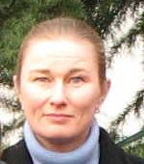
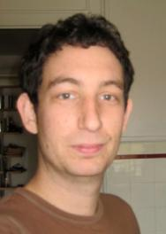
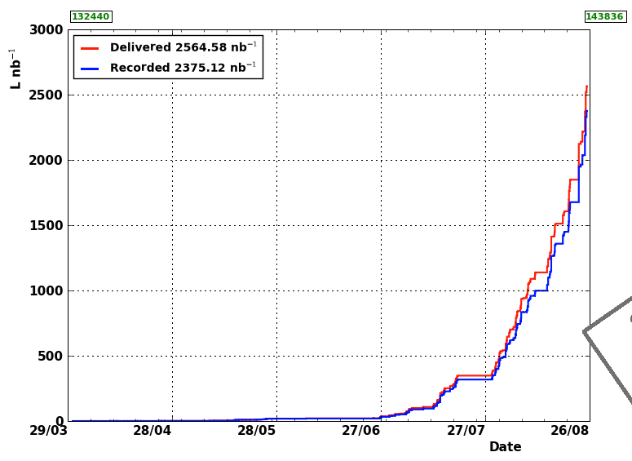
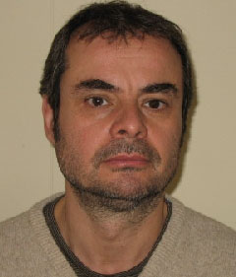
CMS Data @ 7 TeV
Key UW Personnel for data acquisition
Assoc. Sci. P. Klabbers (Trigger)
PostDoc J. Efron (Trigger)
Assoc. Sci. A. Lanaro (EMU)
+ Students, Shifters
ICHEP
Instantaneous luminosity reached 1 x 10³¹ cm^{–2} s^{–1}
Will outline significant progress in analysis since ICHEP

Slide 4
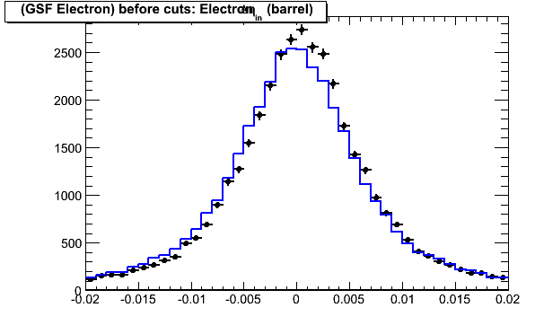
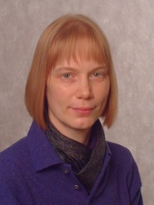
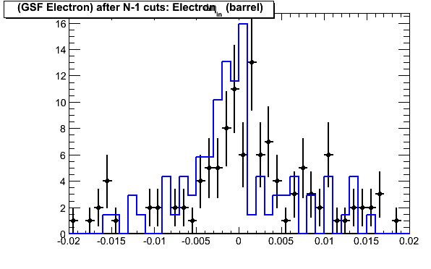
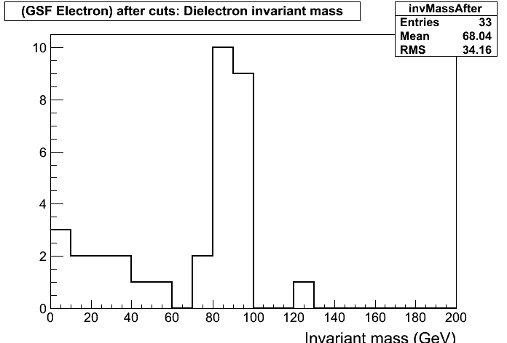
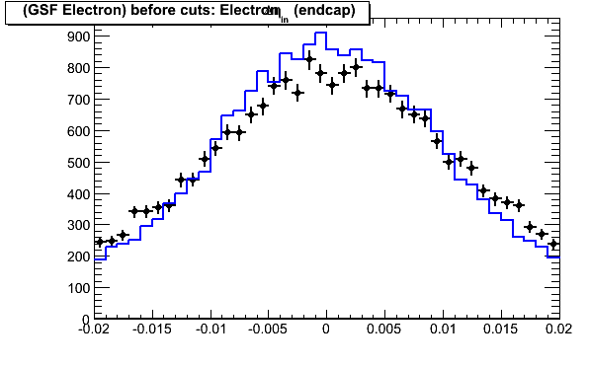
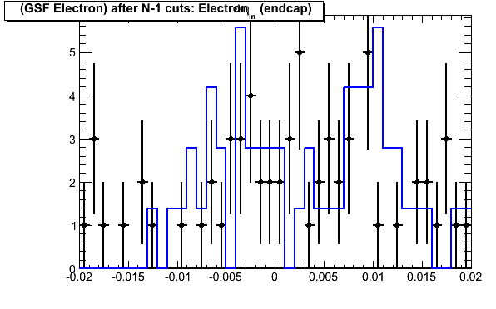
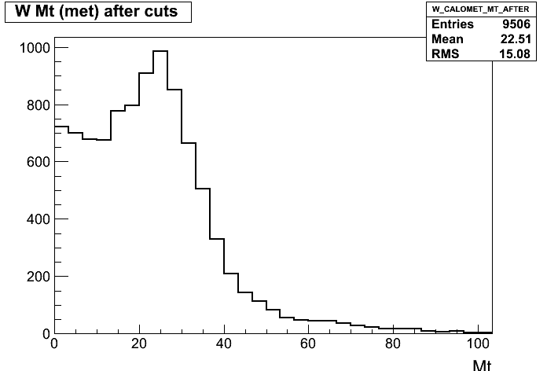
Online DQM for EWK Group
~20 (6 UW) Members
Asst. Sci. M. Grothe is in charge of Online DQM for EWK
Graduate Student Leonard developed modules for EWK-electron channel
Graduate Students Lazaridis, Grogg, Swanson & Bachtis also contributed
Run with largest lumi so far
After cuts
After cuts
M_{ee}
Before cuts
After cuts
After cuts
M_{Trans}
Before cuts Electron ID
Fairly good Data / MC agreement; Eventually useful for W and Z rate monitoring

Slide 5
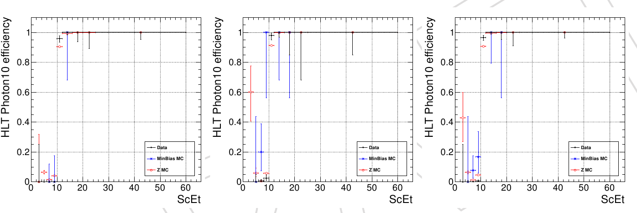
Trigger Efficiency for EWK-electron channels
10 (4 UW) Members
Important for W & Z cross section meas.
Determined using (prescaled) minimum bias and EM calorimeter activity triggers – significant computing effort
High efficiency above EWK selection point P_{T} > 20 GeV
Plots updated weekly to monitor triggers for EWK-electron channels
As more data is available use Z tag and probe
Students Lazaridis & Leonard + Scientists Grothe/Klabbers
EB
EE
EB+EE
Input to CMS-PAS-EWK-10-002 W/Z cross section measurement shown by Prof. Smith

Slide 6
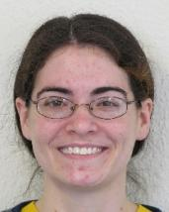
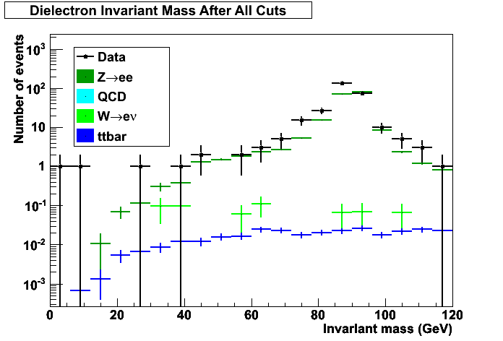
DY Z Production
~50 (5 UW) Members
Student Leonard + Scientists Grothe/Klabbers
256 Z candidates found in 822 nb^{–1}
Low background with loose selection, high efficiency
Updating inclusive Z cross section measurement
Leonard completes thesis with ~2-3 pb^{–1} August data
Initial ICHEP Contribution: CMS-PAS-EWK-10-002

Slide 7
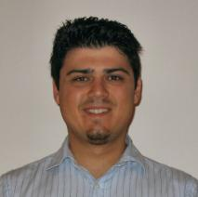
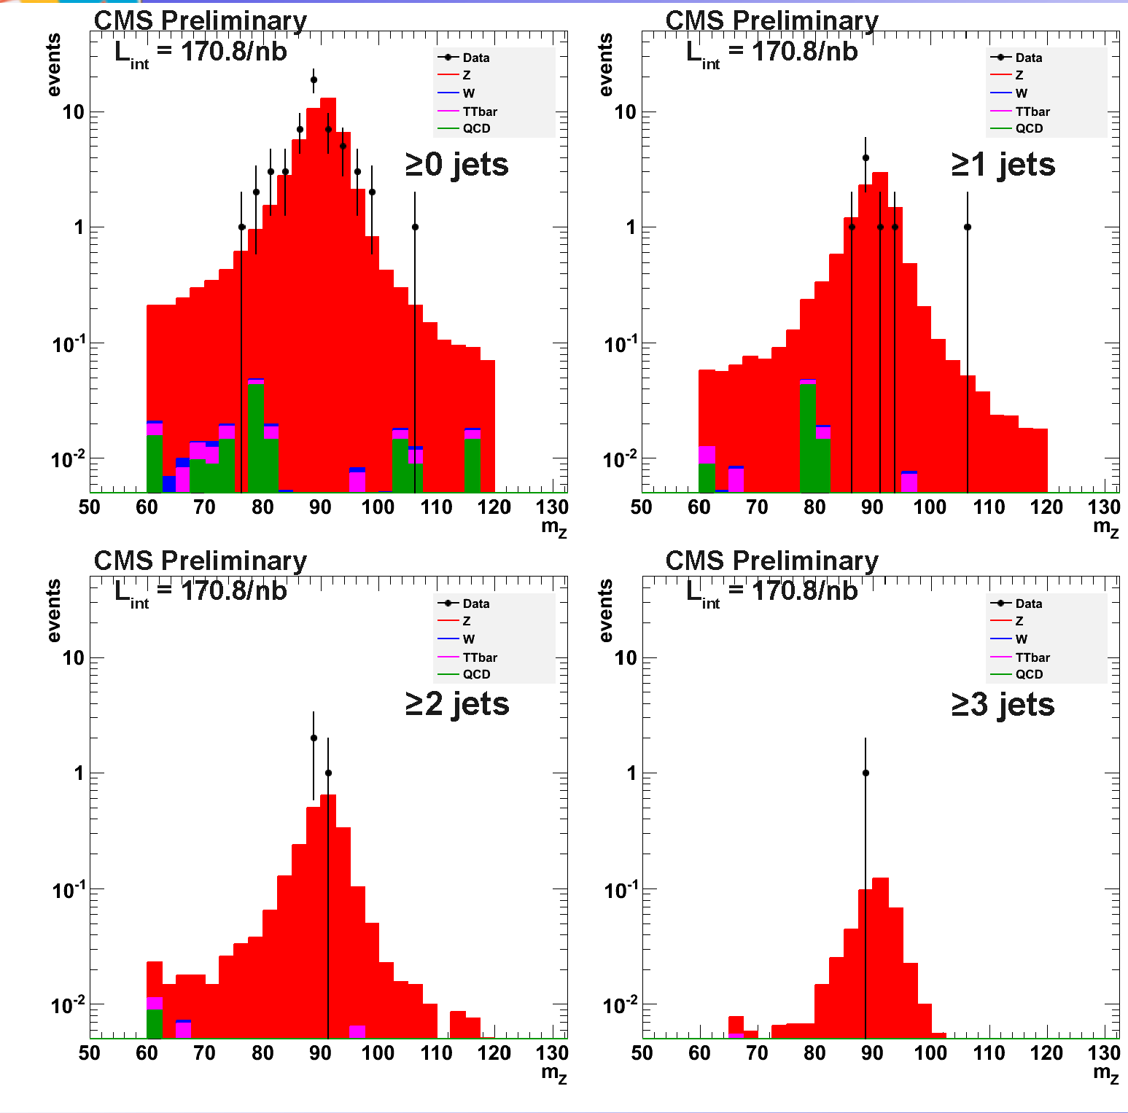
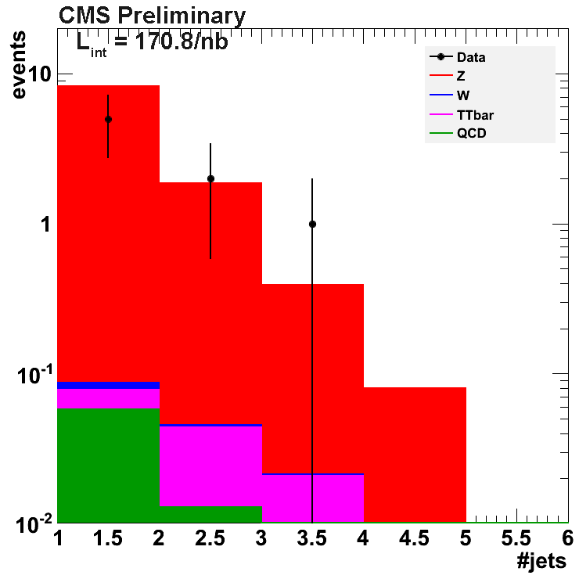
Z + Jets Production
~30 (4 UW) Members
Student Lazaridis + Scientists Grothe/Klabbers
Z + Jets already seen with ~200 nb^{–1}
Improving analysis with particle flow isolation and jets
Newly reprocessed data with latest reconstruction
O(10) pb^{–1} collected in 2010 will be sufficient for a thesis
Validate QCD NLO MCs

Slide 8
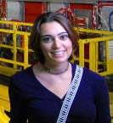
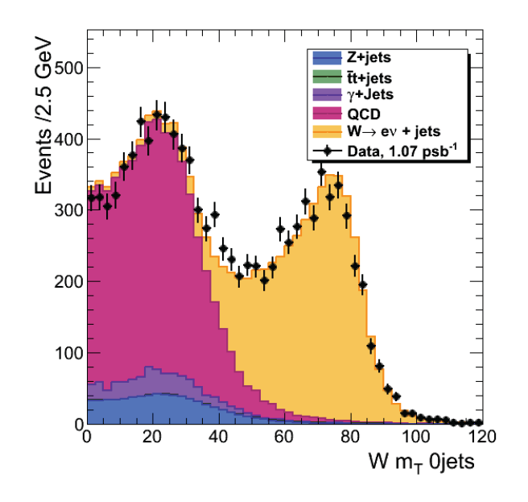
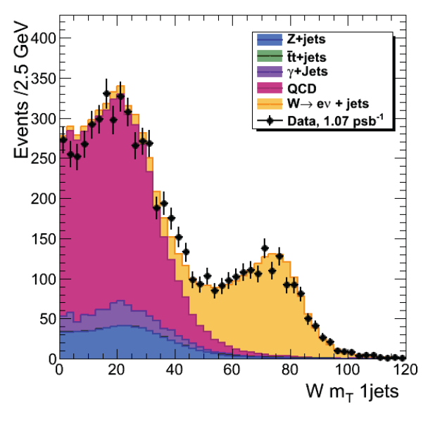
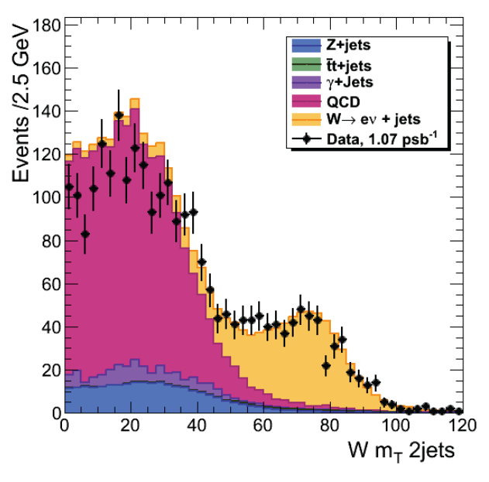
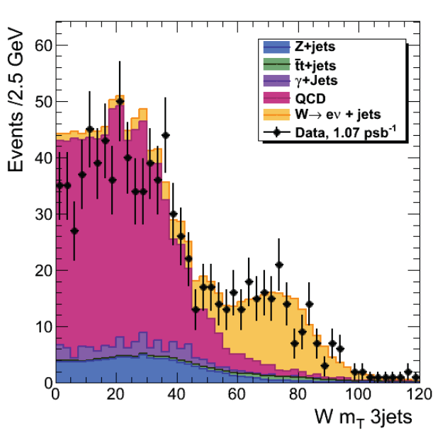
W + Jets Production
~30 (3 UW) Members
Student Grogg + Postdoc Efron
W + Jets with ~1 pb^{–1}
Improving analysis with particle flow isolation and jets
Improving background using data driven techniques
Developing fits to subtract QCD and Top background
Grogg’s thesis will report measurement of W+Jets cross section
Tune QCD NLO Monte Carlo programs
Very important to get this right to discover new physics contributions
≥0 jets
≥1 jets
≥2 jets
≥3 jets
Early W+Jets results included in CMS-PAS-EWK-10-002 sent to ICHEP

Slide 9
Photon DQM
~10 (2 UW) Members
Student Anderson + Prof.. Dasu
Anderson is responsible for photon DQM and HLT validation Routine monitoring of data as it is promptly reconstructed

Slide 10
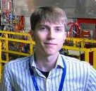
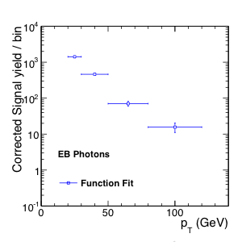
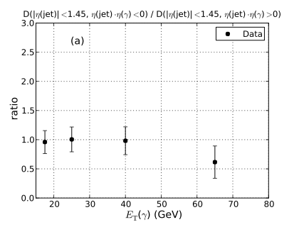
Photon + Jets Production
~10 (2 UW) Members
Student Anderson + Prof. Dasu
γ + Jets
Developed multivariate techniques for identifying photons
Developing data driven techniques to validate photon ID, e.g., W events treating electron as a photon …
Expect measurements with O(10) pb^{–1} data for tuning QCD and search for new physics
Ratios of yields at several different photon and jet orientations
Efficiency corrected inclusive photon yield
Analysis in approval process

Slide 11
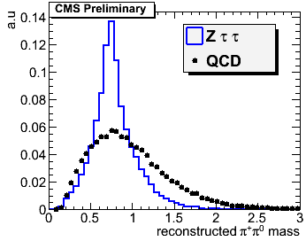
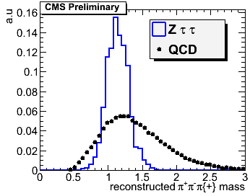
Tau Reconstruction
~6 (3 UW) Members
Student Bachtis, Scientist Savin & Prof. Dasu
Hadrons Plus Strips (HPS) Tau
Bachtis’s algorithm has become the main tau reconstruction tool
One and three charged prongs plus strips of neutral EM deposits
Tau mass compatibility and isolation
Goal is to establish W and Z signatures in tau mode
Important for Higgs searches later
h+strip
Charged Hadron
Hadron+Strip
Three Hadrons
three
hadrons

Slide 12
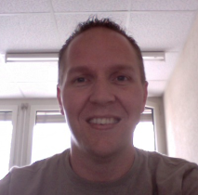
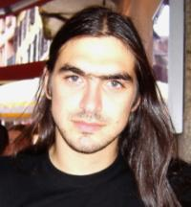
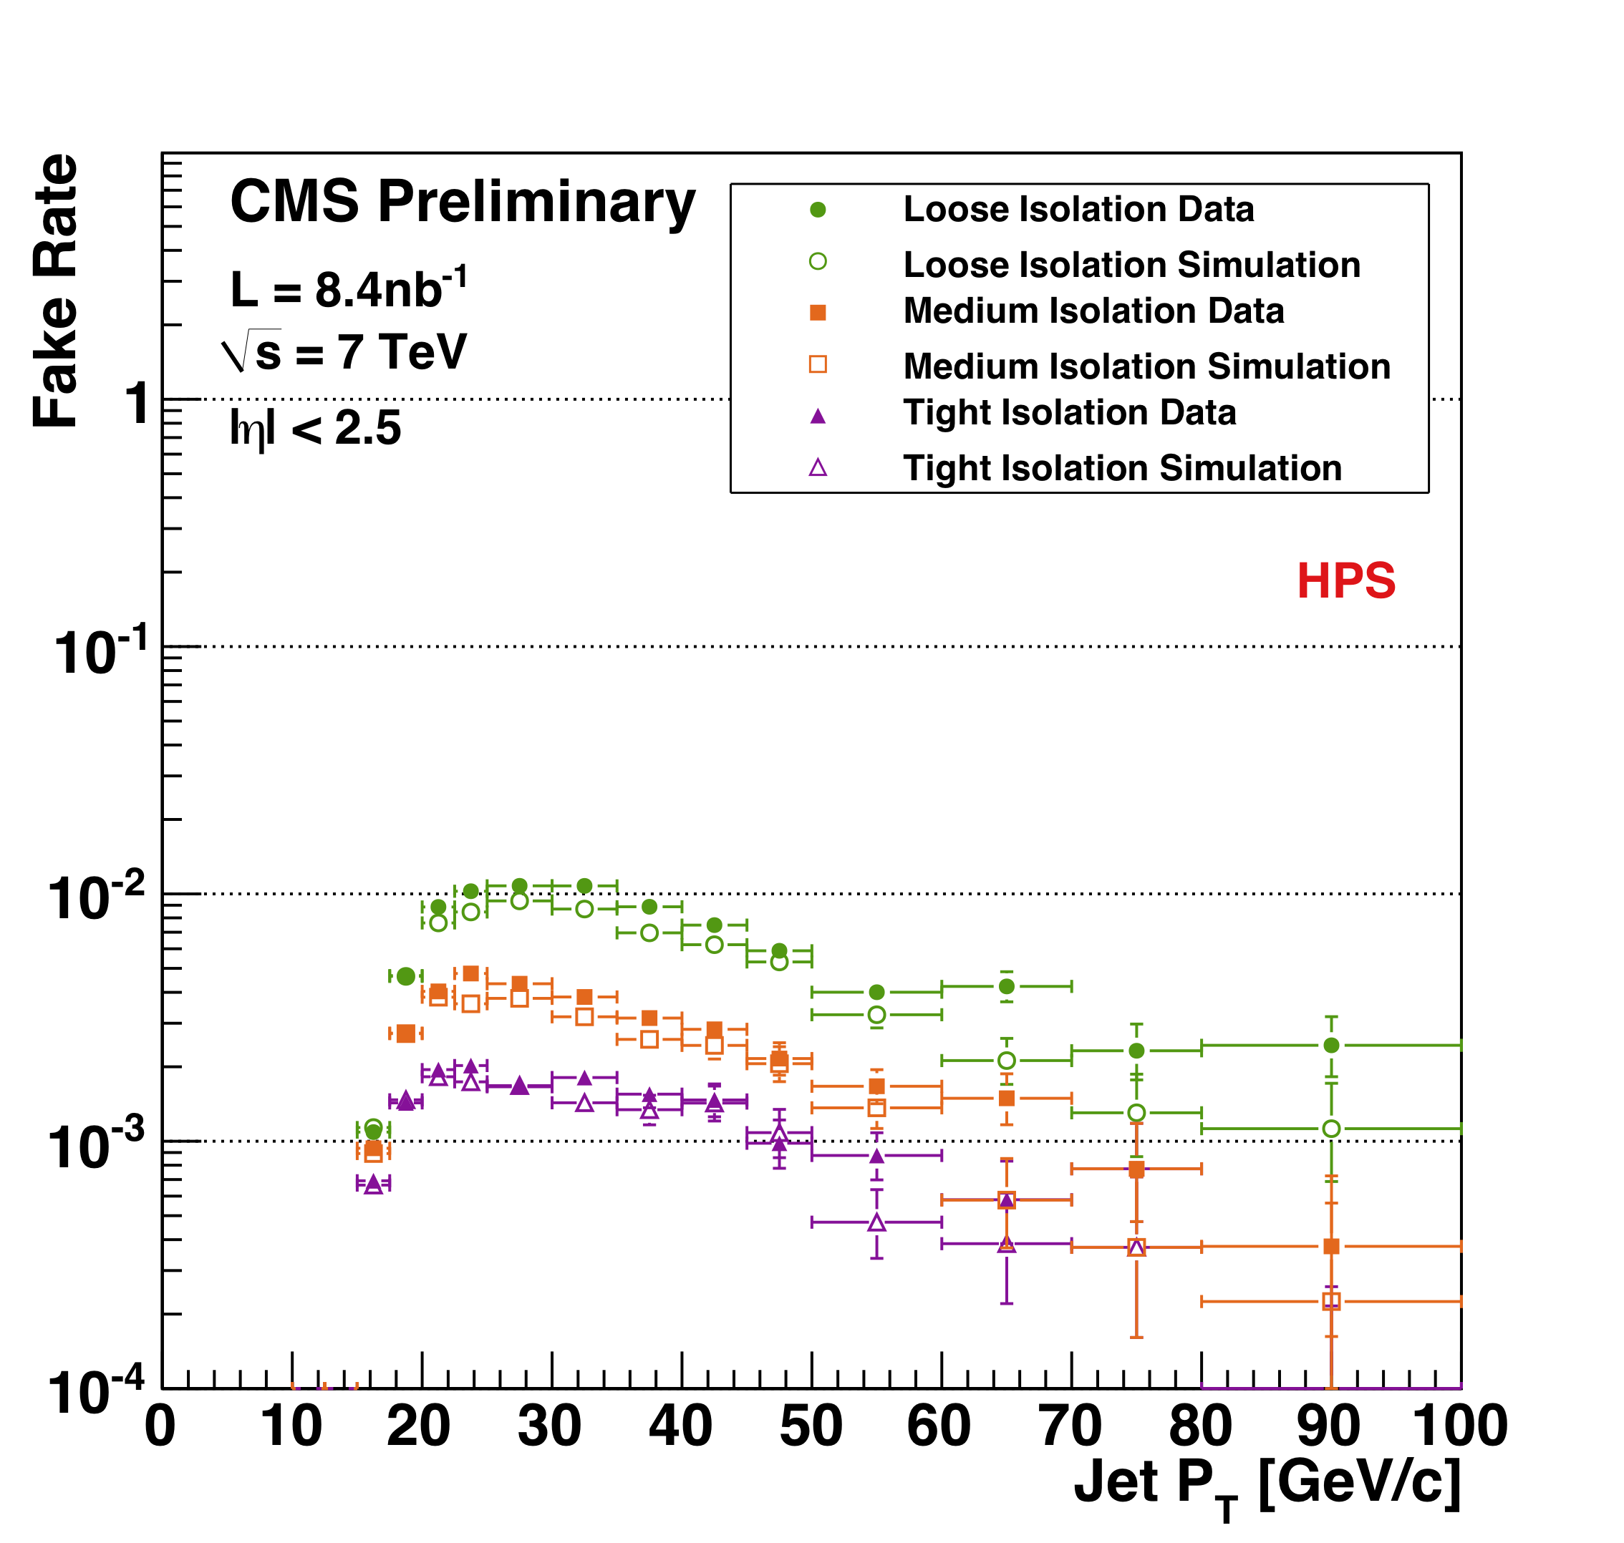
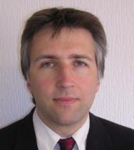
Tau Validation
~15 (3 UW) Members
Students Swanson, Bachtis with Scientist Savin
With early data as the first few signal events are just starting to come, concentrating on measuring the τ fake rate with data
CMS PAS PFT-10-004 (sent to ICHEP)
PAS Editor: Scientist Savin
HPS τ Fake rate Data vs. MC using first 8.4 nb⁻¹

Slide 13
EWK Tau DQM
5 (3 UW) Members
Students Swanson, Bachtis with Scientist Savin
Several useful histograms – luminosity is too low to see electron+tau candidates in single runs yet.

Slide 14
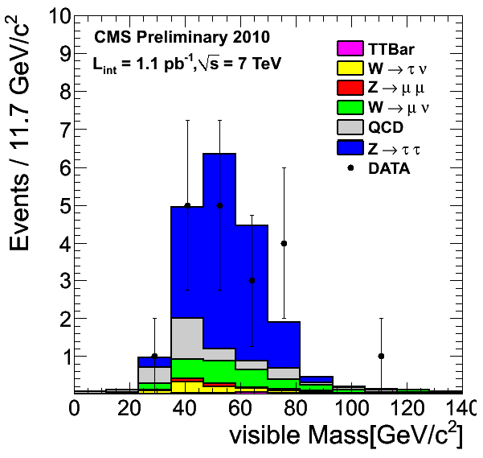
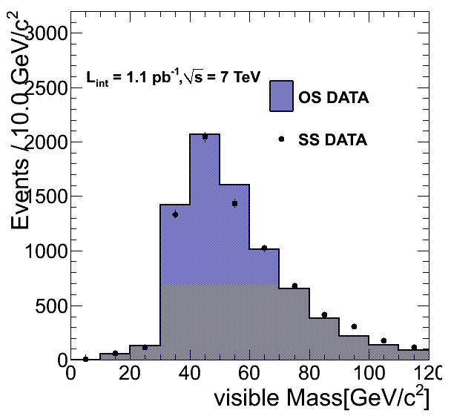
Z→ττ→μτ_{h}
~10 (3 UW) Members
Student Bachtis, Scientist Savin & Prof. Dasu
Benchmark channel for Higgs studies later
Update to 1 pb^{–1} yields several candidates
Preparing ~50 pb^{–1} analysis to measure cross section and use for tag and probe to study τ_{h} properties
Data-driven BG estimate
Relaxed cuts
Analysis in approval process First event picture sent to ICHEP

Slide 15
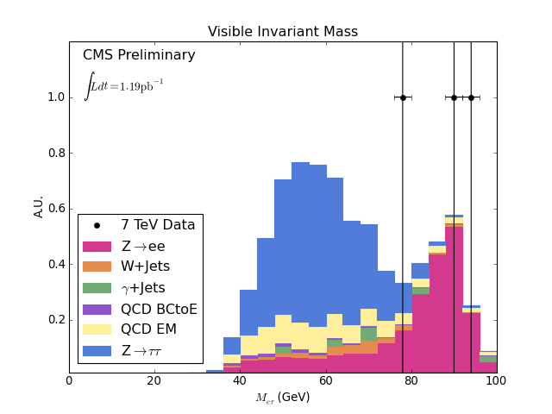
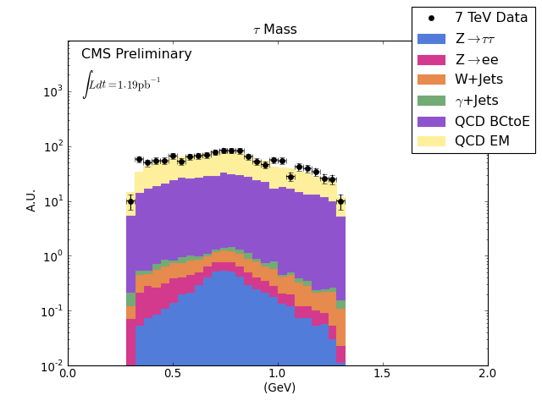
Z→ττ→eτ_{h}
~10 (4 UW) Members
Student Swanson & Scientist Savin
Benchmark channel for Higgs studies later
Update to 1 pb^{–1}; No candidates yet as electrons suffer from larger background than muons
Swanson thesis will be based on 2010-11 data
Reconstructed tau mass with relaxed cuts agrees with MC

Slide 16
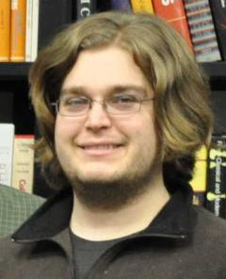
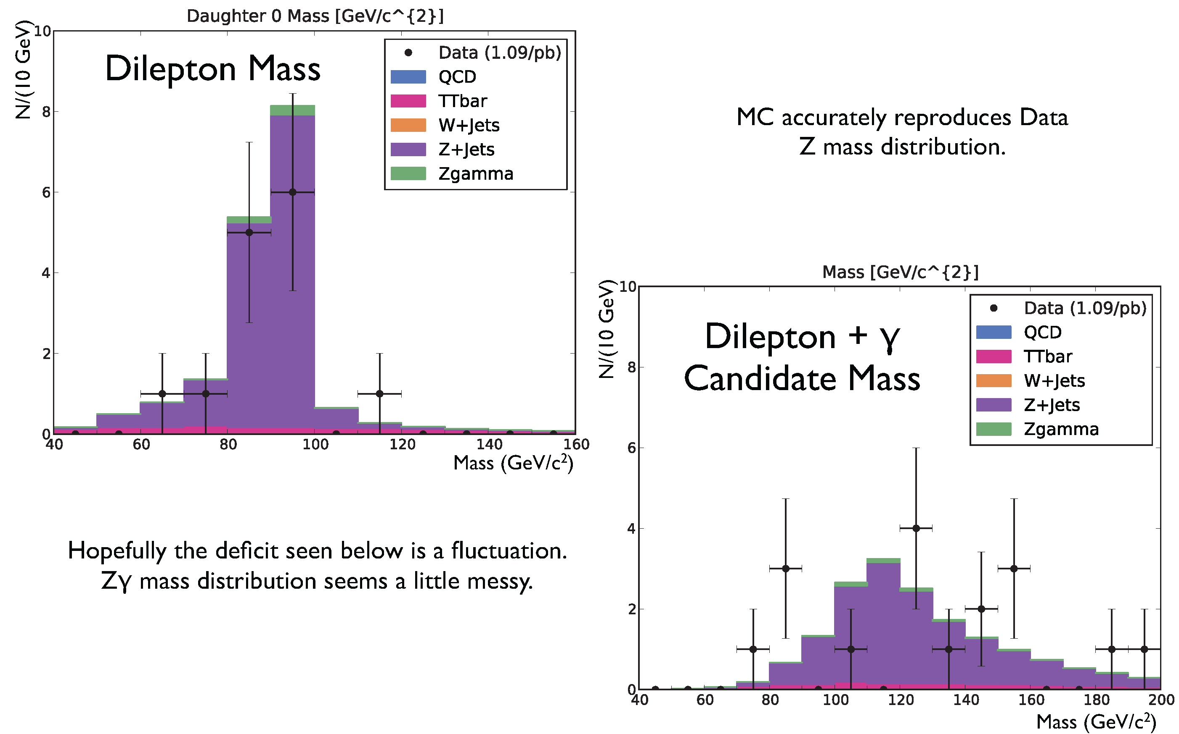
SM Zγ Production
~10 (3 UW) Members
Student Gray & Scientist Lanaro + Prof. Dasu
Responsible for Zγ software development for EWK multiboson group with Caltech postdoc
Implemented simple analysis framework
Improved luminosity book-keeping for analysis
Also working on adapting Bauer’s Zγ LO & NLO code to POWHEG event generator

Slide 17
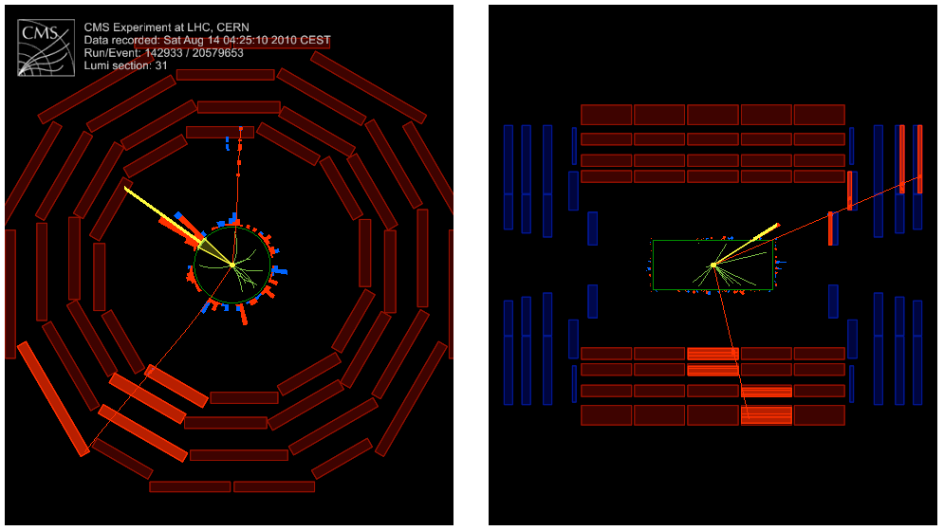
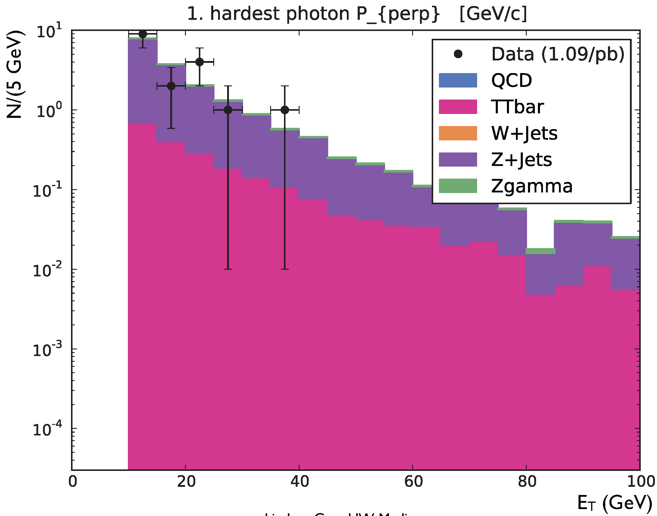
SM Zγ Production
~10 (3 UW) Members
Student Gray & Scientist Lanaro + Prof. Dasu
SM production due to radiation from quark legs
Search for anomalous direct Zγ coupling in BSM
Analysis based on EWK Z→μμ ICHEP selection
Single candidate (FSR, M_{μμγ}≈M_{Z}) survives
Spectrum of loose photons in association with Z→μμ

Slide 18
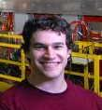
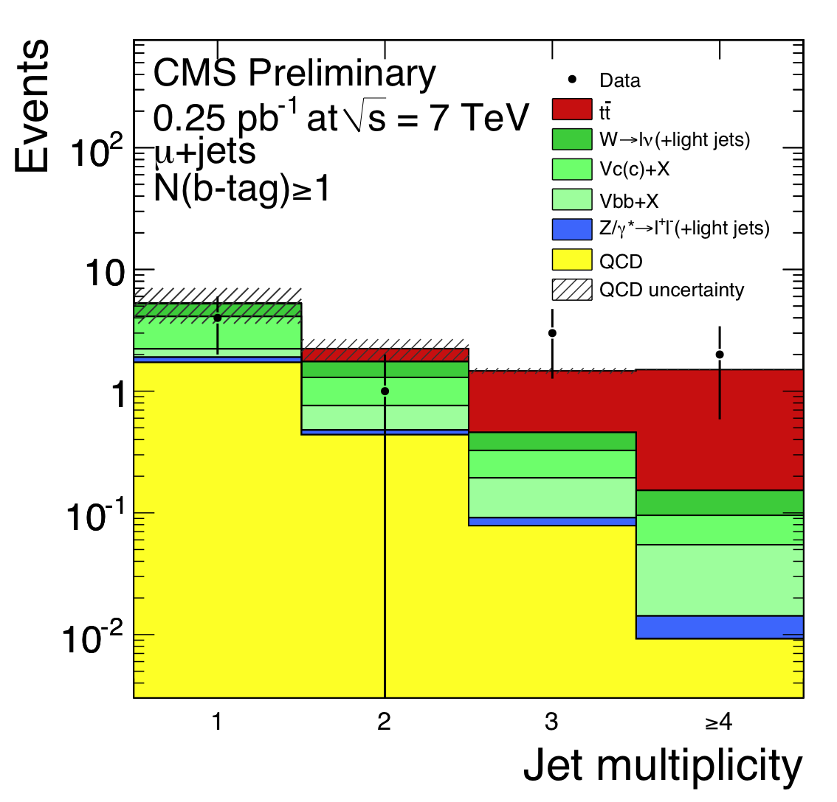
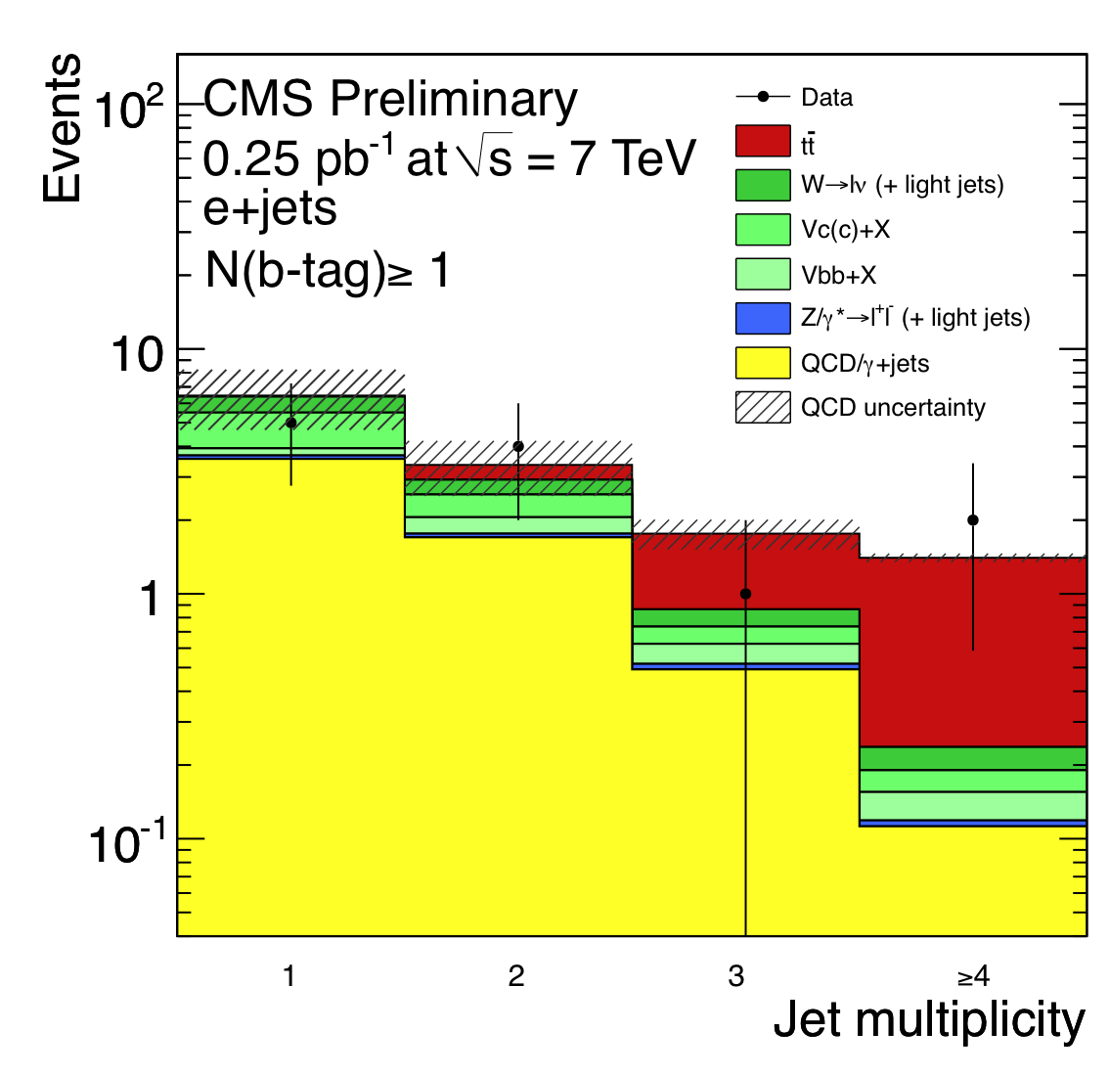
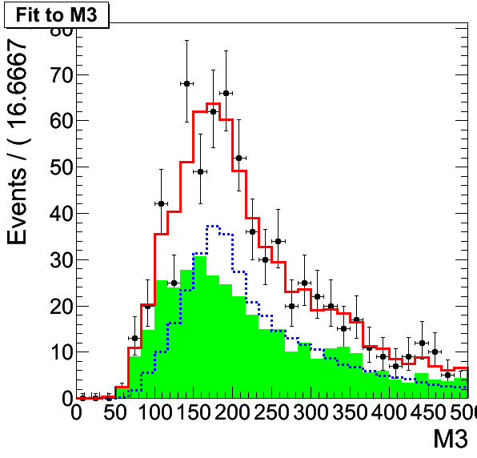
SM Top Production
~50 (2 UW) Members
Student Weinberg & Scientist Savin
Top production at LHC energies is rather large
Candidate events begin to appear ~0.2 pb–1
Large mass, MET, leptons in Top events … mimic SUSY
Full understanding of Top is a precursor to SUSY searches
Weinberg thesis will explore Top and lead to SUSY searches
Studying Top and SUSY triggers (using jets and H_{T})
Data driven QCD background estimates
Sample Fit value
---------- ----------
tt + jets 207
W/Z + jets 376
Fit to MC 583

Slide 19
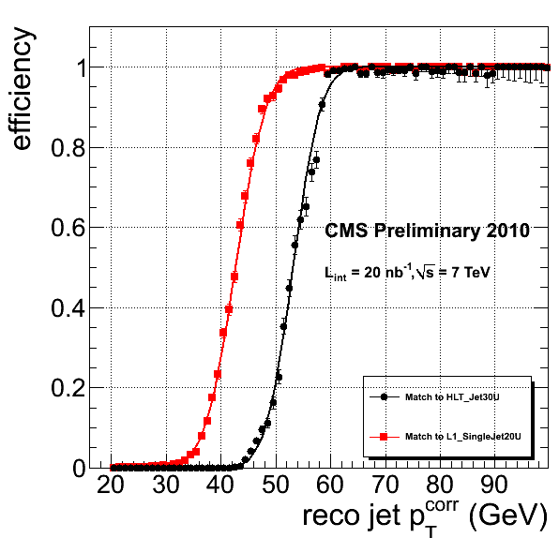
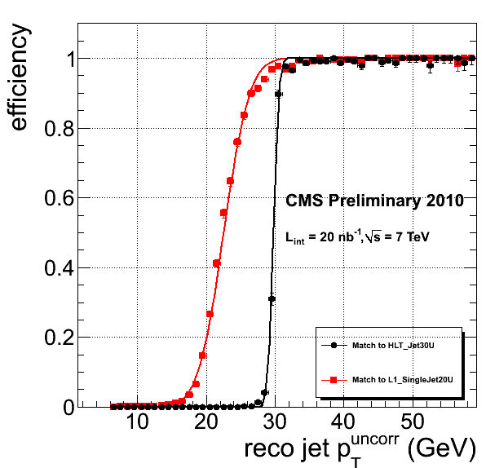
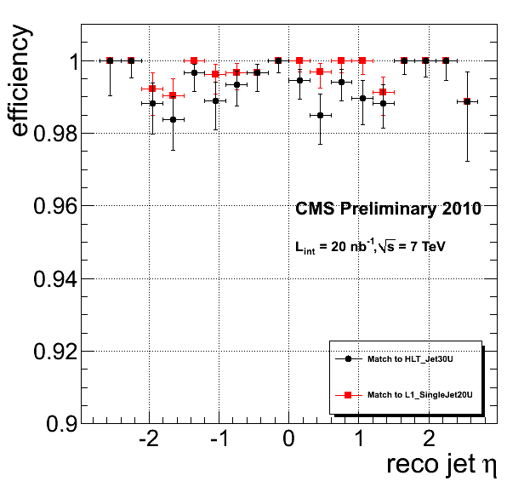
Triggers for Top and SUSY
<10 (2 UW) Members
Student Weinberg & Scientist Savin
Use Jets and MET for triggers
Studying efficiency turn-on
Calibration at HLT (now) and L1 (in future)
Sharpen turn-on curves
Ensure that the efficiency remains sharp and high as the trigger conditions evolve
Sample plots approved for ICHEP

Slide 20

Muon HLT & Reconstruction
~10 (2 UW) Members
Student Klukas & Prof. Herndon
Muon trigger validation is a responsibility of Klukas
Provide regular reports validating the performance of muon HLT with each new software release – Produce, examine and publish ~80 plots for each release
Diagnose when software changes cause changes in muon HLT performance
Improve performance of the muon trigger including isolation at L2
Monitoring performance with real data

Slide 21


SM WZ Production
~10 (2 UW) Members
Student Klukas & Prof. Herndon
SM WZ production cross section is possible to measure with ~1 fb^{–1}
Leptonic decay modes of W and Z used
Good laboratory to set baseline for searches
Example: W’ → WZ, technicolor models with resonant structures in M_{WZ}
MC analysis approved in 2009 – Beginning to look at multi-lepton CMS data

Slide 22
SM ZZ Production
Student Ross & Prof. Dasu
SM ZZ candidates should appear with ~1 fb^{–1}
Electron and muon decay modes of Z used so far – extend to τ and jets?
Good laboratory to set baseline for (high mass) higgs searches
MC analysis for Ross prelim exam – Beginning to look at multi-lepton CMS data
Experiment | Energy | Data | Signal Events | Background Events
CMS (MC Analysis) | 10 TeV | 1 fb⁻¹ | 6.2 | 1
CMS (Estimate) | 7 TeV | 1 fb⁻¹ | 4.4 | 0.7
D0 | 2 TeV | 1.7 fb⁻¹ | 3 | 0.2
CDF | 2 TeV | 4.8 fb⁻¹ | 5 | 0.04

Slide 23


Trigger Upgrade Simulations
~4 (4 UW) Members
Students Ross, Bachtis & Scientist Grothe + Prof. Dasu
Trigger upgrade improves physics reach, especially τ and μ
Develop emulator of upgraded algorithms and tune them
Compare to existing trigger
Emulation studies show that the proposed upgrades to the calorimeter trigger can function well in a high pileup environment
Upgrade decreases isolated EG trigger rate by 2-3x, while maintaining the efficiencies of current design

Slide 24


Trigger Upgrade Simulations
~4 (4 UW) Members
Students Ross, Bachtis & Scientist Grothe + Prof. Dasu
Isolated τ trigger performance with upgraded calorimeter trigger is significantly better
The algorithm uses local area, making it less sensitive to event pileup
Upgrade decreases isolated τ trigger rate by 2-3x, while significantly improving the efficiencies over the current design
Now studying improvement in physics reach

Slide 25

UW Computing Activities
Rader, Radtke (50% DOE, 50% University) for HEP Computing & Bradley, Maier, and Mohapatra [NSF CMS Project] for CMS Tier-2 GS Anderson (NSF), GS Reilly (DOE 6/2011) & Manager Dasu (1m DOE)
High throughput computing support for all of HEP group + CMS Tier-2
UW is a CMS Tier-2 computer center from FY2005
Data-Intensive Science University Network (DISUN) institute
Leadership in Grid Community [Collaboration with UW Condor Team]
OSG - Open Science Grid (develop tools and provide cycles)
GLOW - Grid Laboratory of Wisconsin (Lead role in development and implementation with CS Condor group to benefit entire UW campus: CMS, ATLAS, IceCube, CS, Genomics, Chem. Eng., Med. Phys., etc.)
Additional non HEP resources (NSF MRI and UW funding) brought to CMS and ATLAS
Benefits both CMS and ATLAS + Computing support for all HEP tasks

Slide 26
UW Computing Hardware
Rader: UW Physics Director of Computing Radtke: HEP desktop support Maier (NSF): CMS Tier-2 systems support
2 x 10 Gbps bandwidth (UW provided) 24h/7d operation ~250 user accounts (includes many guests)
Imminent additions
ARRA HEP servers ARRA ATLAS servers Last remnants of DISUN

Slide 27
UW Campus Grid & Middleware
Working under leadership of Prof. Miron Livny & ~20 Condor Team Research Staff Grid Laboratory Of Wisconsin (GLOW, NSF MRIs) Center for High Throughput Computing (CHTC, UW funded)
Additional computing resources brought to HEP (CMS, ATLAS, …)
Most importantly, Condor Team expertise brought to HEP Condor adaptation by US CMS, ATLAS and beyond Broader adaptation through Globus and other Grid Toolkits Close collaboration with Fermilab & CMS in DISUN & OSG
Key to success Dan Bradley (NSF, DISUN Support) from our group is embedded in Condor team + Mutually beneficial goals in high throughput computing research and usage

Slide 28

CMS Simulation & Operations
Mohapatra : CMS MC production czar Bradley: Software expert
Bradley (NSF - Software) & Mohapatra (NSF - Ops) + GS Anderson (NSF – Software and Operations) (DOE: Reilly from 6/2011 + summer students)
>20 M CPU hours served since 2005
Production, CMS Grid and Local Uses
500 TB CMS data hosted (refreshed regularly)
EWK, Trigger, Forward and Local groups
Simulation production
UW is one of the largest CMS institutes producing MC events since 2002
~ 5 B events produced with CMSSW since commissioning in 2008 (on OSG, ~1 B @ UW)
OSG
CMS Users
OSG
CMS
CMS
Others
ATLAS
UWCMS

