Slide 1
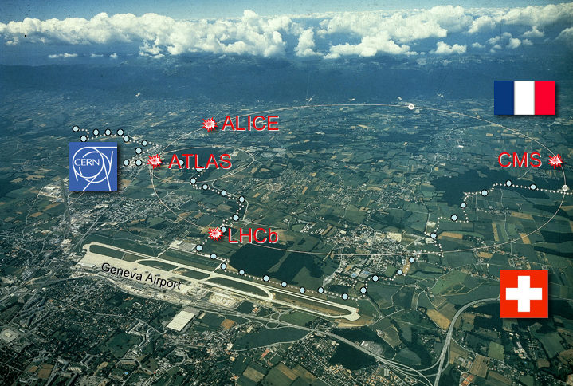
The LHC and Beyond
APS Meeting
Anaheim
May 2, 2011
Sergio Bertolucci
CERN
LHC

Slide 2
2011-2013: deciding years….
Experimental data will take the floor to drive the field to the next steps:
LHC and Tevatron results
θ₁₃ (T2K, DChooz, etc..)
ν masses (Cuore, Gerda, Nemo…)
Dark Matter searches
…….

Slide 3
Our Plans for LHC 2010
Lay foundations for the 2011 goal of 1 fb⁻¹. 2010 target: peak luminosity = 10³² cm⁻² s⁻¹.
Steady run around 1-2 MJ for an extended period of time.
Safe, phased increase up to ~ 30 MJ.
Gain a solid operational experience on the critical machine phases (injection, energy ramp, squeeze, collisions, ...).
✓
✓
✓
✓
30 MJ is equivalent to ~7 kg of TNT

Slide 4
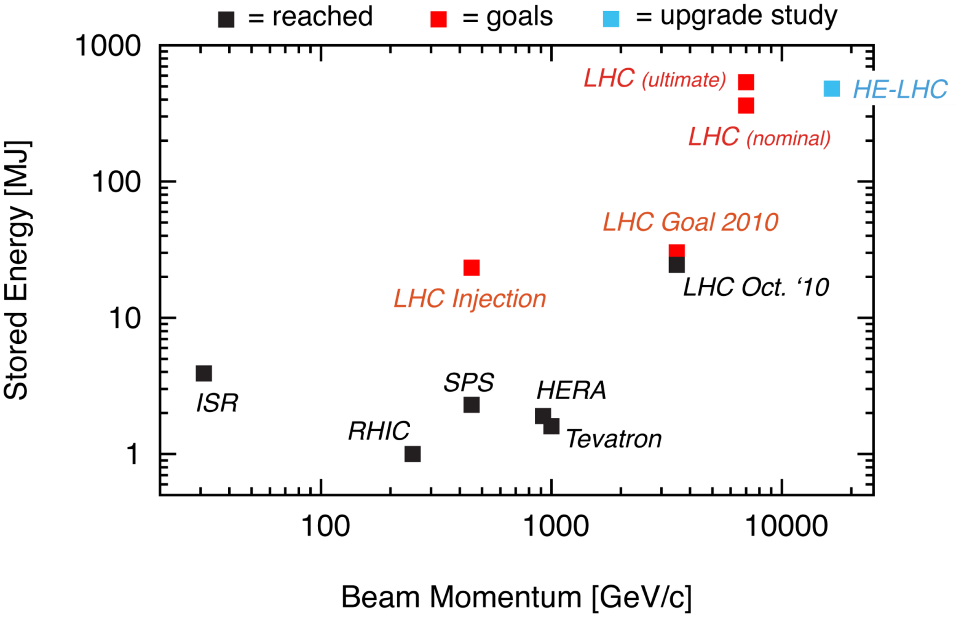
What does this means in practice?
80 kg TNT
28 MJ
R. Assmann
Achieved 28 MJ (24 MJ with collisions)!
In the first year of operation we needed to achieve:
Factor ~10 above state-of-the-art.
Factor ~15 above the Tevatron.

Slide 5
LHC 2010 Summary
Excellent single beam lifetime
Ramp & squeeze essentially without loss
No quenches with beam above 450 GeV
Excellent performance of Machine Protection
Optics close to model (and correctable)
Excellent reproducibility
Aperture (at least) as expected
Better than nominal from injectors
Emittances, bunch intensity
Beam-beam: can collide nominal bunch currents
With smaller that nominal emittances
And surprisingly good availability…

Slide 6
Overall LHC efficiency in 2010
65% availability!
Great achievement for the first year of operation!
W. Venturini

Slide 7
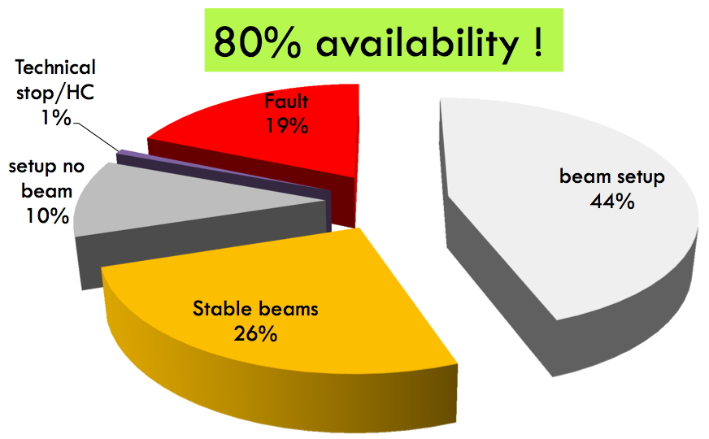
Best month: November (with ions)
Well-trained ion operation at the end of the proton run!
W. Venturini

Slide 8
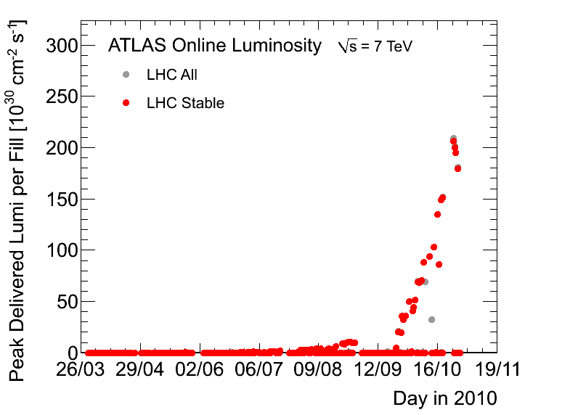
Peak luminosity performance
2 x goal!
2010 Goal
2010 goal:
10³² cm⁻²s⁻¹
Main parameters: 368 bunches of 1.2 x 10¹¹ protons. Colliding beam sizes = 40 microns.

Slide 9
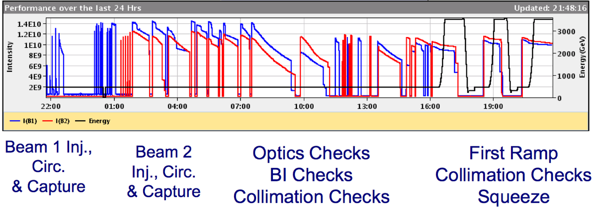
2010 Pb ion run - commissioning
1 day
Achieved ion collisions after 3 days of commissioning (impressively fast)!
This indicates the maturity and performance of controls, instrumentation, operational experience.

Slide 10
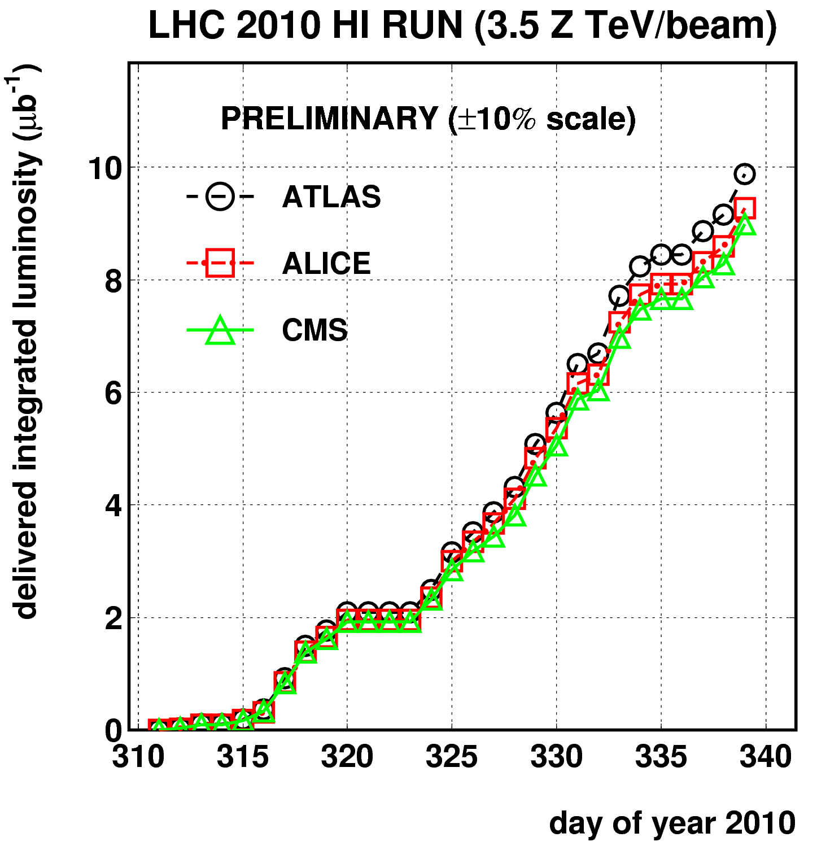
Ion luminosity performance
Gained a factor 100 of peak luminosity in 6 days!
M. Ferro-Luzzi
1 month

Slide 11
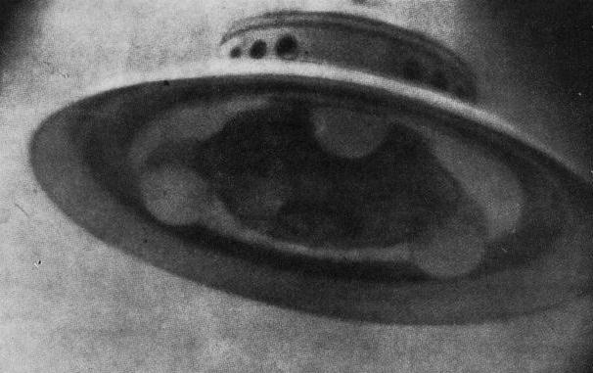
Outstanding problems encountered
(only mention potential performance limits for 2011)
UFOs - Unidentified FALLING objects Sudden fast losses (t < 0.001s). Potentially caused by falling dust particles. No danger for the super-conducting magnets, but trigger preventive beam dumps; More frequent with larger beam intensities!
Electron cloud “Clouds” of electrons generated in the vacuum pipe if the bunches are too close longitudinally. Can limit the total intensity (bunch num.): vacuum problems; instabilities; growth of the beam size. Can be cured by “scrubbing” the chamber.

Slide 12
And the experiments?
Experiment have shown an astounding readiness in making use of the collected luminosity, due to:
one year of cosmic rays (alignments, calibrations, people and systems training)
excellent performances of the WLCG
~ 2500 greedy PhD students!
A very important discovery in 2010: experiments have an higher physics reach (for a given luminosity) than predicted by simulations!

Slide 13
An example
Prospects for the Higgs Boson
at 7 TeV

Slide 14
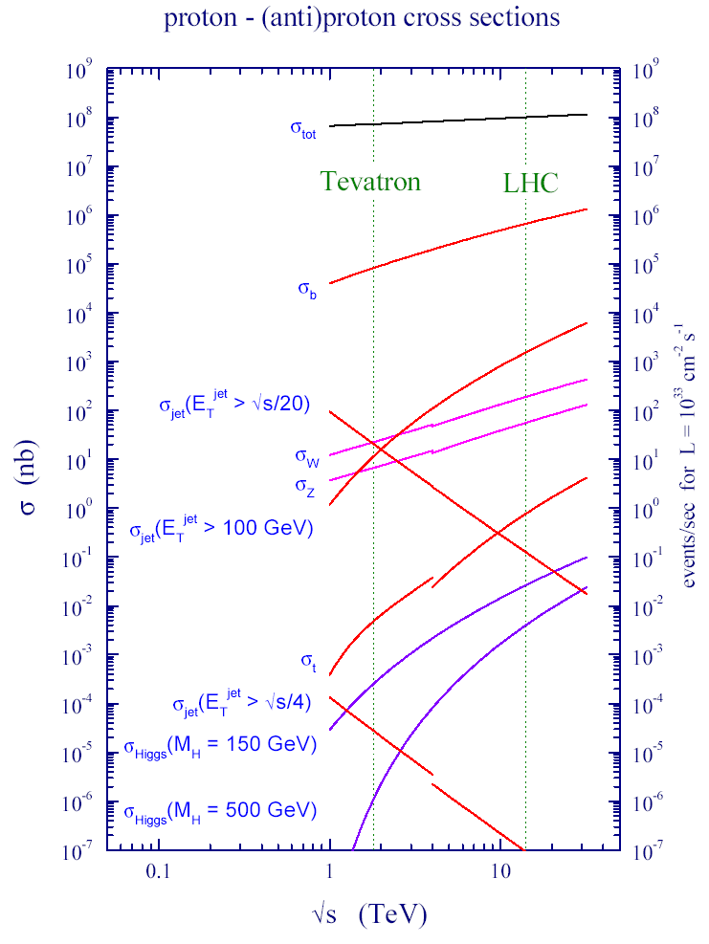
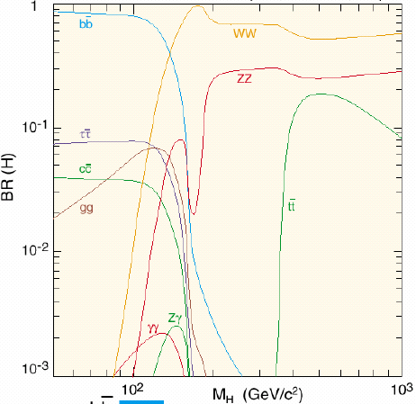
Search for the Higgs-Boson at the LHC
Production rate
of the Higgs-Bosons
depends on its mass
as well as its decay possibilities
(“Signature (or picture)”
as seen in the detector)

Slide 15
The Higgs Search Landscape: LHC Joins The Fray !
95% CL Excluded Mass range
LEP
+
Tevatron
Tevatron
158
173
0
100
200
300
400
500
600
114
Low Mass
( M_{H}≈ 120 GeV )
H→γγ
H → WW
qqH→ττ
V+ H→bb
qqH→bb
V+ H→WW
Mid Mass
( M_{H} ≈ 160 GeV )
H→WW
H→ZZ
High Mass
( M_{H}≈ 400 GeV )
H→ZZ
H→WW

Slide 16
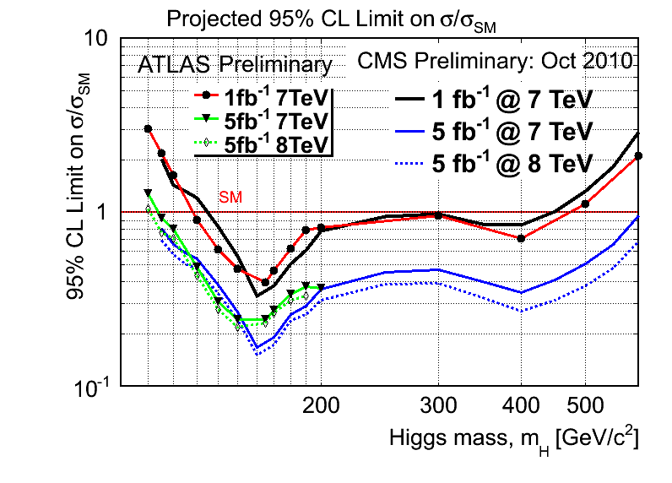
CMS & ATLAS Projections Compared

Slide 17
Experiments well prepared to exploit ALL decay channels accessible
Experiments are cross-checking each other
Experiments are preparing to combine their results

Slide 18
Summary of Prospects
Higgs Boson, if it exists between masses of (114 - 600 GeV) will either be discovered or ruled out in
≈ next two years
→ Decided to run in 2011 and 2012
Sergio Cittolin
SM Higgs Search Prospects (Mass in GeV)
ATLAS + CMS ≈ 2 x CMS | 95% CL exclusion | 3 σ sensitivity | 5 σ sensitivity
1 fb⁻¹ | 120 - 530 | 135 - 475 | 152 - 175
2 fb⁻¹ | 114 - 585 | 120 - 545 | 140 - 200
5 fb⁻¹ | 114 - 600 | 114 - 600 | 128 - 482
10 fb⁻¹ | 114 - 600 | 114 - 600 | 117 - 535

Slide 19
…not only searches
2010 LHCb results show exciting prospects for 2011-2012

Slide 22
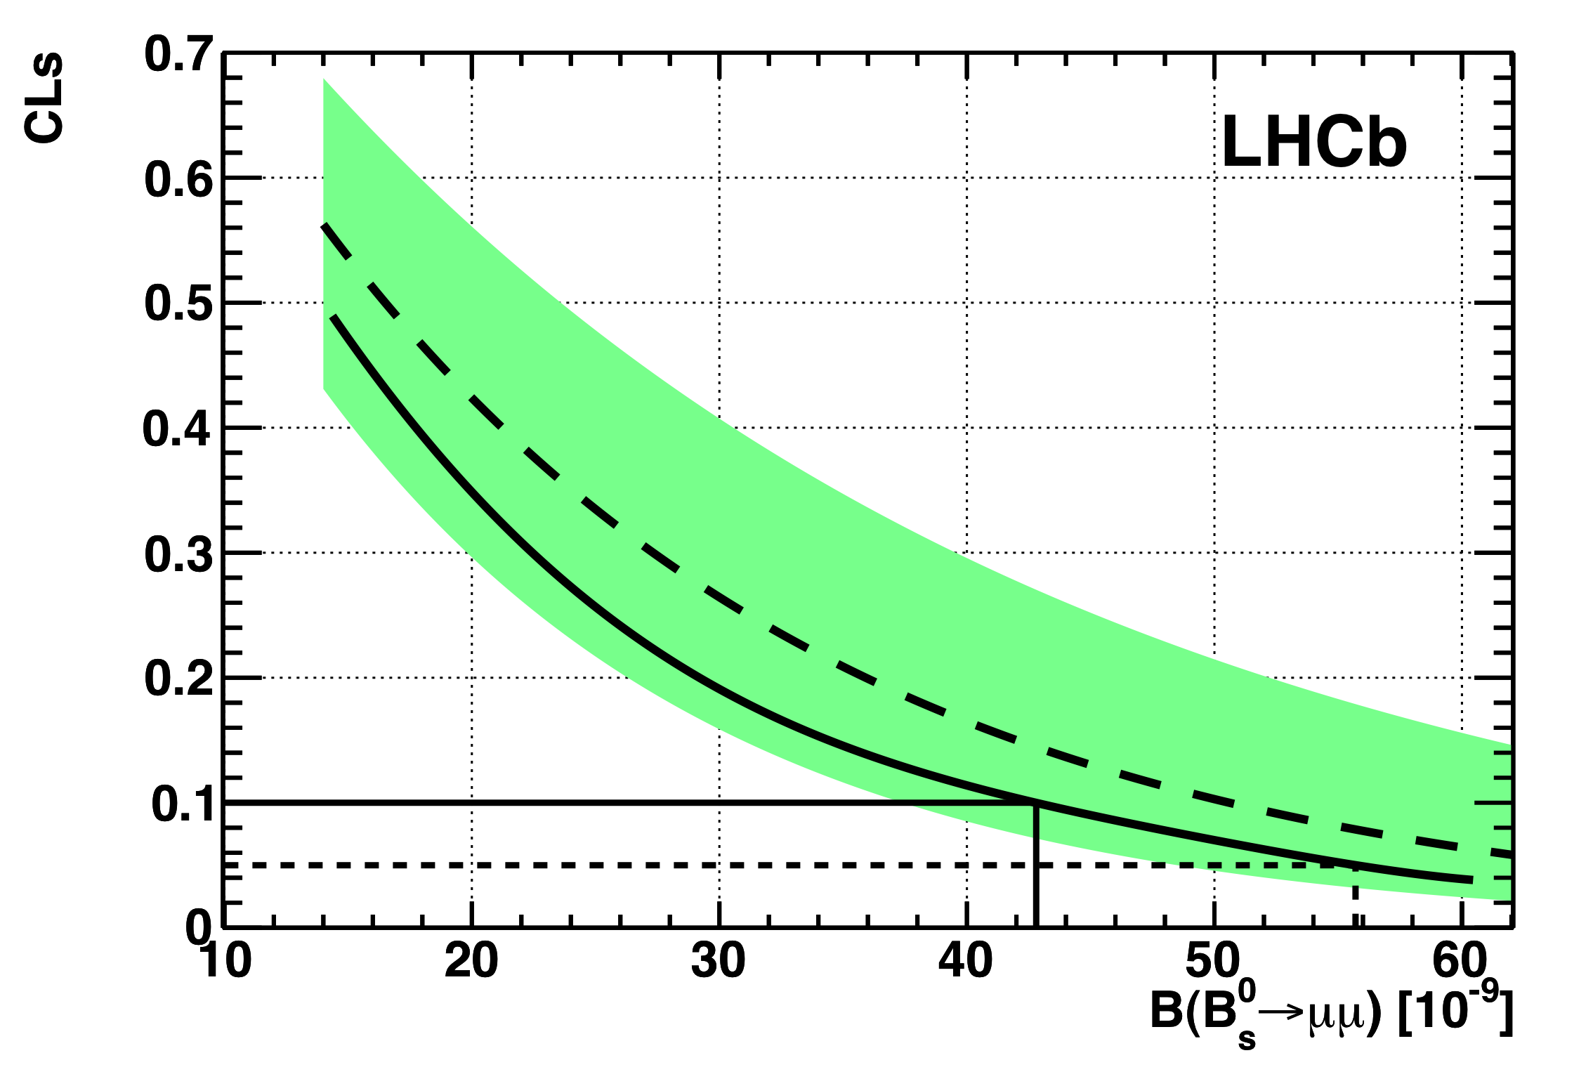
Search for B_{s} → μμ
Paper submitted to
Phys. Lett. B
Expected upper limit
68% of possible experiments
compatible with expected limit
Observed upper limit
90% exclusion
95% exclusion
 |  | @ 90% CL | @ 95% CL
LHCb | Today, 37 pb⁻¹ | < 43 x10⁻⁹ | < 56 x10⁻⁹
D0 | World best, 6.1 fb⁻¹ PLB 693 539 (2010) | < 42 x10⁻⁹ | < 51 x10⁻⁹
CDF | Preliminary, 3.7 fb⁻¹ Note 9892 | < 36 x10⁻⁹ | < 43 x 10⁻⁹

Slide 23
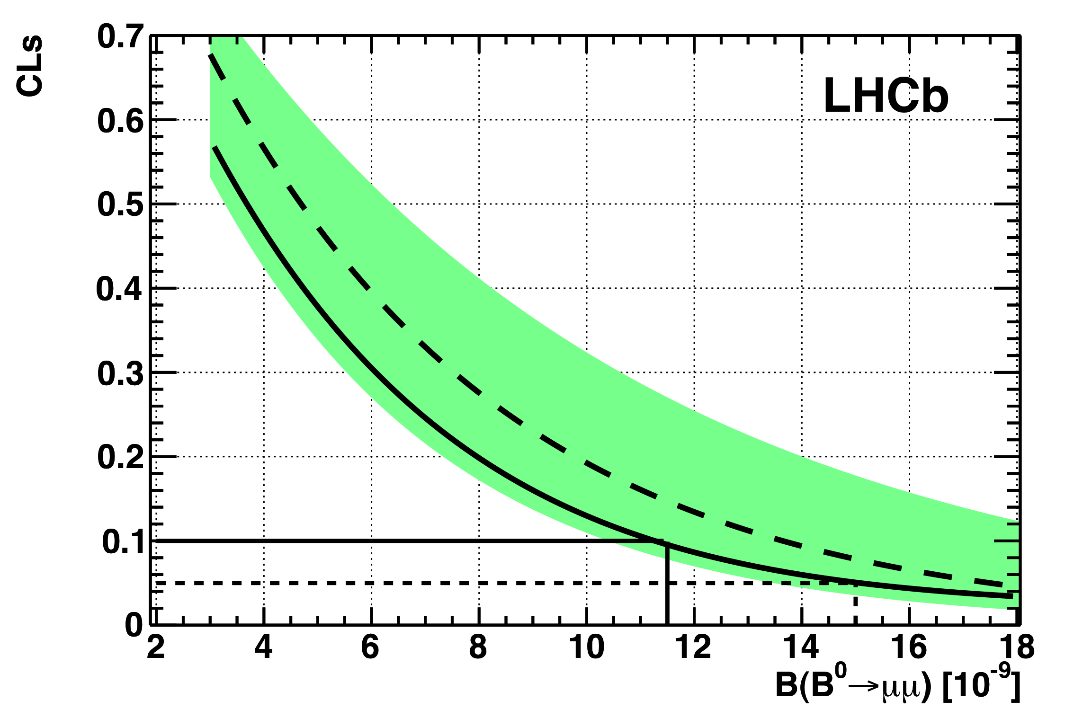
Search for B_{d} → μμ
Expected upper limit
68% of possible experiments
Compatible with expected limit
Observed upper limit
90% exclusion
95% exclusion
 |  | @ 90% CL | @ 95% CL
LHCb | Today, 37 pb⁻¹ | < 12 x10⁻⁹ | < 15 x10⁻⁹
CDF | World best, 2 fb⁻¹ PRL 100 101802 (2008) | < 15 x10⁻⁹ | < 18 x10⁻⁹
CDF | Preliminary, 3.7 fb⁻¹ Note 9892 | < 7.6 x10⁻⁹ | < 9.1 x 10⁻⁹

Slide 24
2011 potential
Energy: 3.5 TeV Chamonix workshop in Jan. 2011 – still splice concerns
Bunch intensity Baseline 1.2 x 10¹¹ protons, higher possible from injectors.
Number of bunches 450 to 930 bunches (75 ns spacing): potential factor 2. (possibly more with 50 ns spacing)
Colliding beam sizes Maintain excellent beams from injectors: 50% smaller than nominal “Squeeze” beams further: another factor 2
Working with beta* = 1.5 m in Atlas, CMS; 3 m in LHCb; 10 m in Alice

Slide 25
Estimated Peak and Integrated Luminosity
Energy | 3.5 TeV
Beta* | 1.5 m
Bunch spacing | 75 ns
Bunch intensity | 1.2 x 10¹¹
Stored beam energy | 75 MJ
Days at peak luminosity | 135
Hübner factor | 0.2
Emittance [mm.mrad] | Beam-beam parameter | Peak Luminosity [cm⁻² s⁻¹] | Integrated Luminosity [fb⁻¹]
2.5 | 0.006 | 1.3 x 10³³ | ~2.7
2.0 | 0.007 | 1.6 x 10³³ | ~3.3

Slide 26
2011 – so far
Beam commissioning: 3 weeks ✓
Exit - stable beams with low number of bunches
Ramp-up to ~200 bunches (75 ns): 2 weeks ✓
Multi-bunch injection commissioning continued
Stable beams
Intermediate energy run: 4 -5 days ✓
Technical Stop: 4+1 days✓
Scrubbing run: 10 days ✓
Decided to run at 50 ns spacing ✓
Resume operation for physics and increase number of ✓ bunches:
300 – 400 – 600 – 800 – 900 – …1400
Machine protection qualification at each step

Slide 27
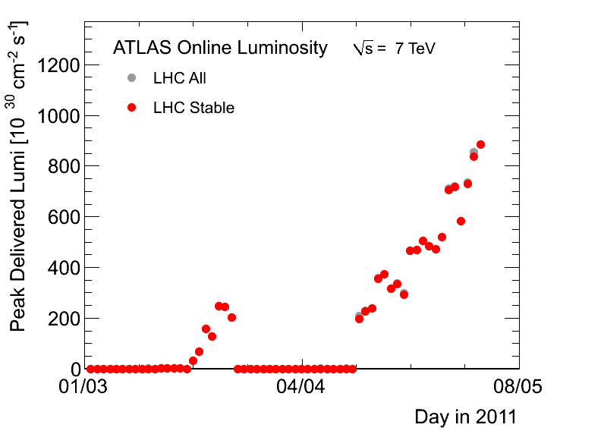
Peak luminosity 2011
8.84x 10³²
2010

Slide 28
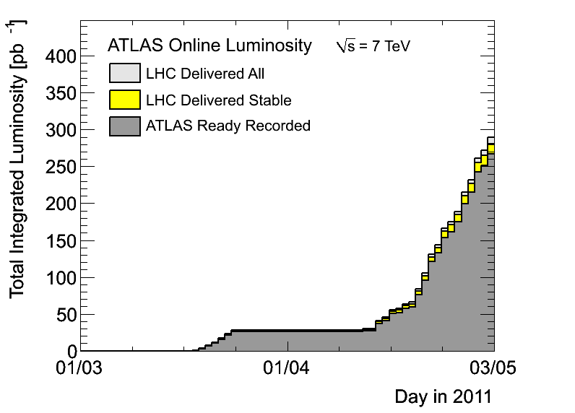
…and integrated luminosity 2011
6x L_{int}(2010)

Slide 29
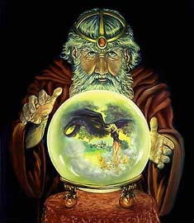
A LHC Time-line
2009
Start of LHC
Run 1: 7 TeV centre of mass energy, luminosity ramping up to few 10³³ cm⁻² s⁻¹, few fb⁻¹ delivered
LHC shut-down to prepare machine for design energy and nominal luminosity
2013/14
Run 2: Ramp up luminosity to nominal (10³⁴ cm⁻² s⁻¹), ~50 to 100 fb⁻¹
2017 or 18
Injector and LHC Phase-I upgrades to go to ultimate luminosity
Run 3: Ramp up luminosity to 2.2 x nominal, reaching ~100 fb⁻¹ / year accumulate few hundred fb⁻¹
~2021/22
Phase-II: High-luminosity LHC. New focussing magnets and CRAB cavities for very high luminosity with levelling
Run 4: Collect data until > 3000 fb⁻¹
2030
ILC, High energy LHC, ... ?

Slide 30
2011-2013: busy and exciting times for HEP
To:
Assess the implications of the emerging physics scenario for the next big thing
Deliver the ILC TDR (and the CLIC CDR)
Proceed towards a global vision of the HEP program, implementing new governance models and decision making mechanisms across the regions

Slide 31
What can you expect from CERN?
CERN as laboratory at the energy frontier
Active role in defining the governance of the next global project
Preparations to bid for hosting it, but also to participate to it elsewhere

Slide 32
CERN Opening (Council in June 2010)
CERN has made a substantial step into globalization by:
Geographical Enlargement/Opening
→ full and associate membership independent of geographical location
Participation in Global Projects
→ coordinate broad European participation in a future global accelerator project hosted elsewhere

Slide 33
Recalling the agenda
Important steps in the coming years
CDR for CLIC 2011/12
TDR for ILC 2012
LCWS in Granada in 2011
ICFA Seminar at CERN 3-6 October 2011
Update of European strategy for particle physics start: EPS 2011, finalize December 2012
IEEE 2012 special event to promote LC

Slide 34
In summary
By year 2013, experimental results will be dictating the agenda of the field.
Early discoveries will greatly accelerate the case for the construction of the next facilities (Linear Collider, ν-factory, HE-LHC…)
No time to idle: a lot of work has to be done in the meantime

Slide 35
In summary
We will need
Flexibility
Preparedness
Visionary global policies

Slide 36
...and a bit of luck!
Thank you!

