Slide 1
Double Parton Scattering
Varsha Ramakrishnan

Slide 2
Problem to Fix
Excess Seen in the Δφ(Electron,Leading) at ~ PI ONLY IN DATA
Possible Explanation:
Some of the electrons that fail some of the “Tight” Electron selection cuts are still sample.
Semi-leptonic decays and other such events that fake acutal Jets considered in the analysis
Effect is seen primarily in the Leading Jet Selection

Slide 3
“QCD-Electron” Sample
The QCd-Electron is reffered to those Triggered Electron that fail atleast two of the following cuts in the table below
E-HAD/E-EM<0.055+0.00045E
L-shr<0.2
qΔx>-3.0 cm OR qΔx<1.5cm
Δz<3.0cm

Slide 4
“QCD-Electron” Sample
The sample with above cuts are developed simultaneously with the “Tight Electron” sample
These following cuts are subject to the same Electron-Jet Removal and other W/Jet selections cuts/procedure as the “Tight-Electrons”
Plots of the Δφ(Electron,Leading) for this sample reveals as peak at PI starting from ~2.5 radians
Indicating that the cut of Δφ(Tight-Electron,∑Jet ET )<2.95 is to be apllied before the W selections cuts
This cut has been applied by All W+jets analysis irrespective of the Jet-Cut(recently Dales Stentz)

Slide 5
Cut Applied
Tight electron cuts applied to select the Electron from the Ntuple
Electron-Jet object removed form the Jets in the Ntuple
Jets with L5 JES corrected ET>10 GeV and |ETA| <2 selected
∆R(Electron,Closest-Jet)>0.92(1.3*radius of cone)
Δφ(Tight-Electron,∑Jet ET )<2.95
Missing ET corrected for Muons/Jets-Selected
ONLY ONE Tight-Electron,MET>30 GeV,Transverse Mass>50 GeV
Atleast TWO Jets (as selected above)
Above Leading/.Second Jet need to have atleast TWO TRACKS in them

Slide 6
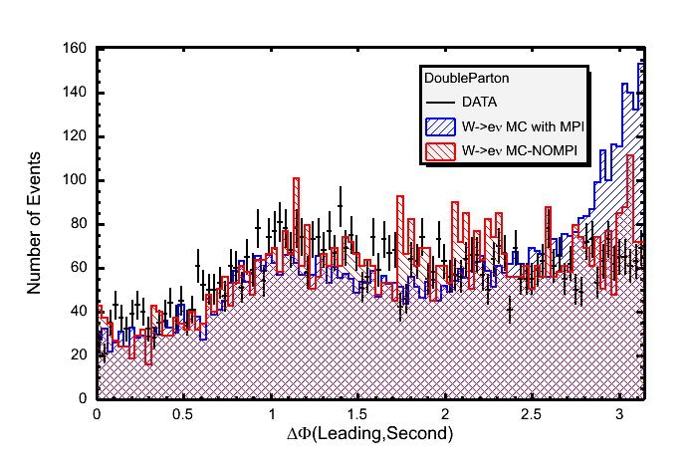
∆Z(Leading,Electron)<2*(Error on∆Z(Leading,Electron) AND ∆Z(Second,Electron)<2*(Error on ∆Z(Second,Electron)

Slide 7
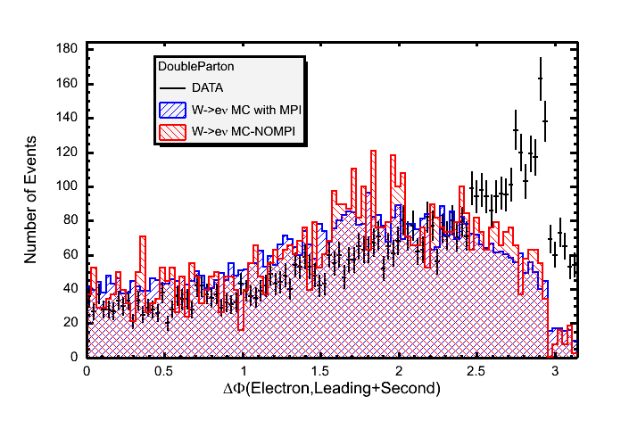
∆Z(Leading,Electron)<2*(Error on∆Z(Leading,Electron) AND ∆Z(Second,Electron)<2*(Error on ∆Z(Second,Electron)

Slide 8
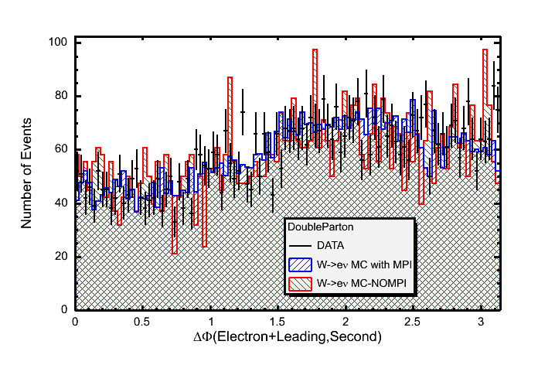
∆Z(Leading,Electron)<2*(Error on∆Z(Leading,Electron) AND ∆Z(Second,Electron)<2*(Error on ∆Z(Second,Electron)

Slide 9
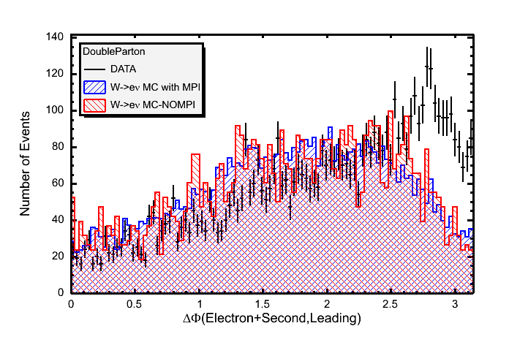
∆Z(Leading,Electron)<2*(Error on∆Z(Leading,Electron) AND ∆Z(Second,Electron)<2*(Error on ∆Z(Second,Electron)

Slide 10
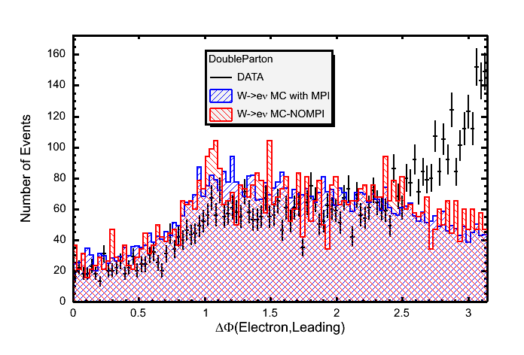
∆Z(Leading,Electron)<2*(Error on∆Z(Leading,Electron) AND ∆Z(Second,Electron)<2*(Error on ∆Z(Second,Electron)

Slide 11
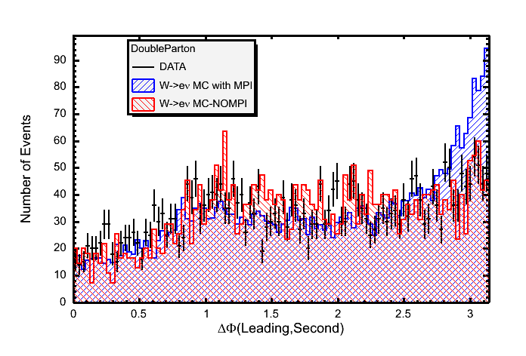
∆Z(Leading,Electron)<0.04 cm AND ∆Z(Second,Electron)<0.04 AND ONLY TWO JETS (Leading/Second)

Slide 12
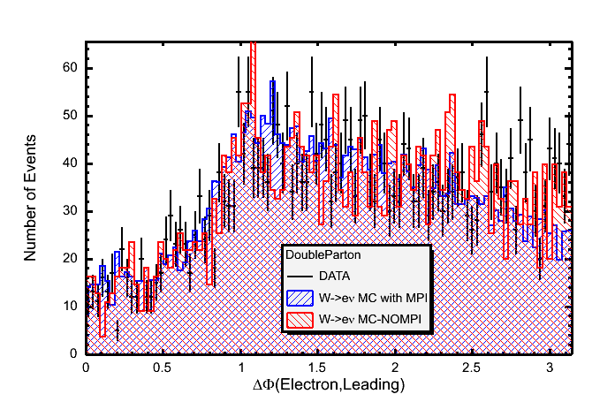
∆Z(Leading,Electron)<0.04 cm AND ∆Z(Second,Electron)<0.04 AND ONLY TWO JETS (Leading/Second)

Slide 13
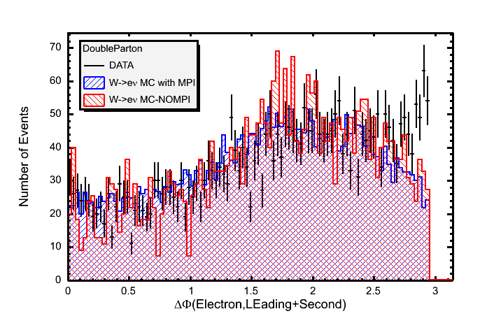
∆Z(Leading,Electron)<0.04 cm AND ∆Z(Second,Electron)<0.04 AND ONLY TWO JETS (Leading/Second)

Slide 14
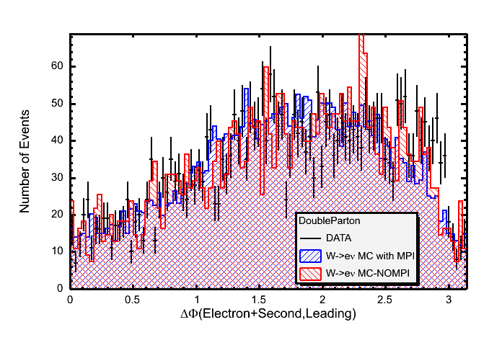
∆Z(Leading,Electron)<0.04 cm AND ∆Z(Second,Electron)<0.04 AND ONLY TWO JETS (Leading/Second)

Slide 15
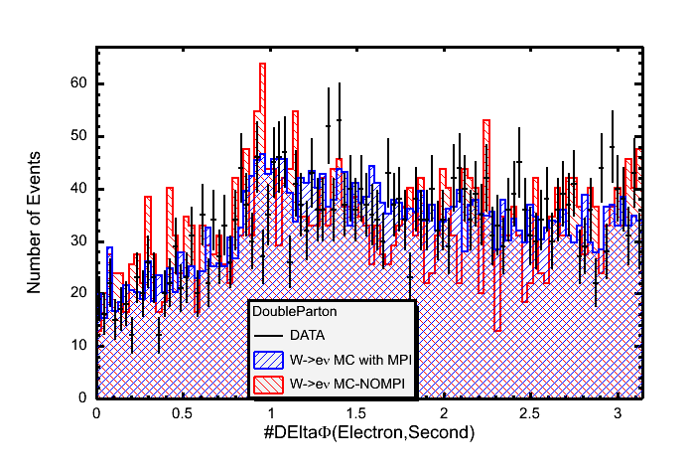
∆Z(Leading,Electron)<0.04 cm AND ∆Z(Second,Electron)<0.04 AND ONLY TWO JETS (Leading/Second)

