Slide 1
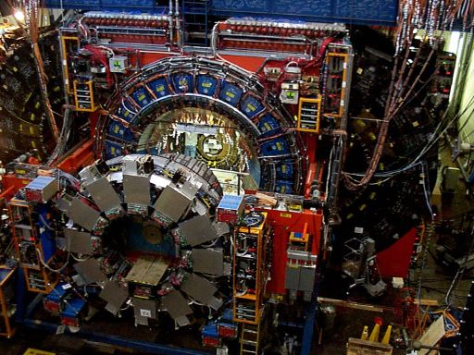
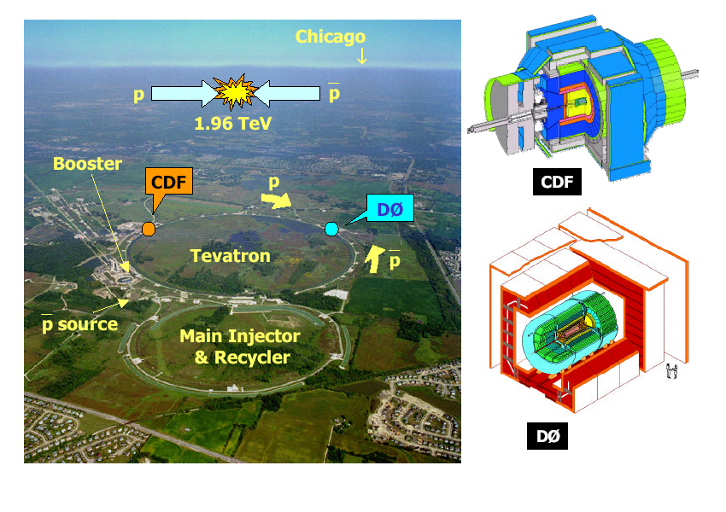
Task E
The CDF Experiment

Slide 2
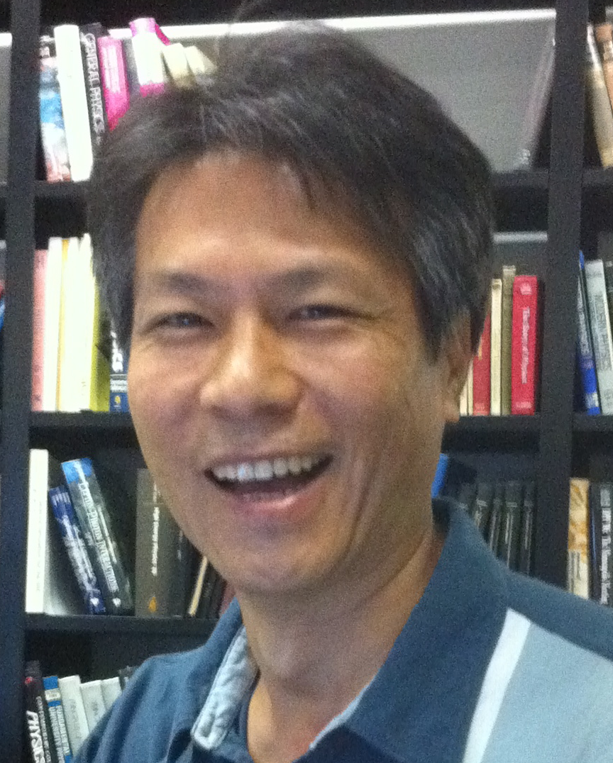
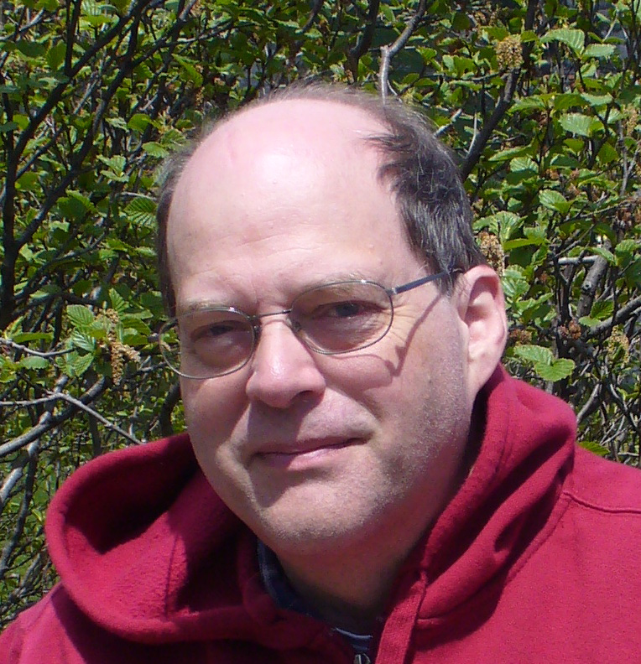





Overview
Wisconsin involved in BMU detector maintenance, software operations, tracking and BMU software, silicon and BMU muon data validation, shifts, GP, leadership, and physics!
Chung, Left UW
BMU M&O
Tracking and general CDF Software: silicon data validation and final CDF software release
B-physics
EW diboson physics and Higgs physics
QCD, Double Parton Physics
Bellinger, to Icecube
Herndon
Parker
Carlsmith
Ramakrishnan,
Graduated
Pondrom

Slide 3
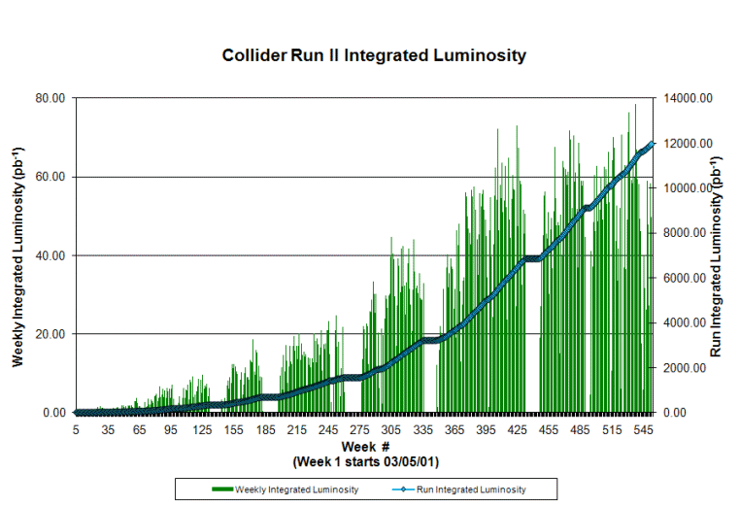

CDF/Tevatron Performance
Over 10 fb-1!
9.45-10/fb used in analysis

Slide 4
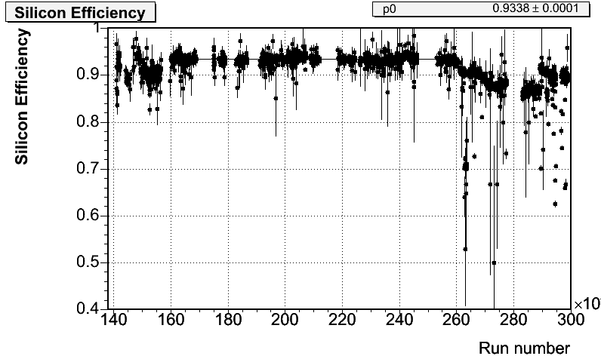
Operations and Software
BMU operations complete
  Smooth operations and high efficiency data taking throughout Run 2
Final release of CDF software
  Develope final CDF software version. Incorporate latest developments in reconstruction and simulation software in one release.
  Goal: A release robust enough for 5 years of data analysis with minimum support.
Carlsmith, Chung, Ramakrishnan
Bellinger
Data recovery
  Revisit all runs marked bad
  Recovered order 0.5 fb⁻¹
Silicon Performance Monitoring
  Through final data.
  Performance results used in final B_{s} → μ⁺μ⁻ analysis.
Herndon
Parker, Herndon

Slide 5
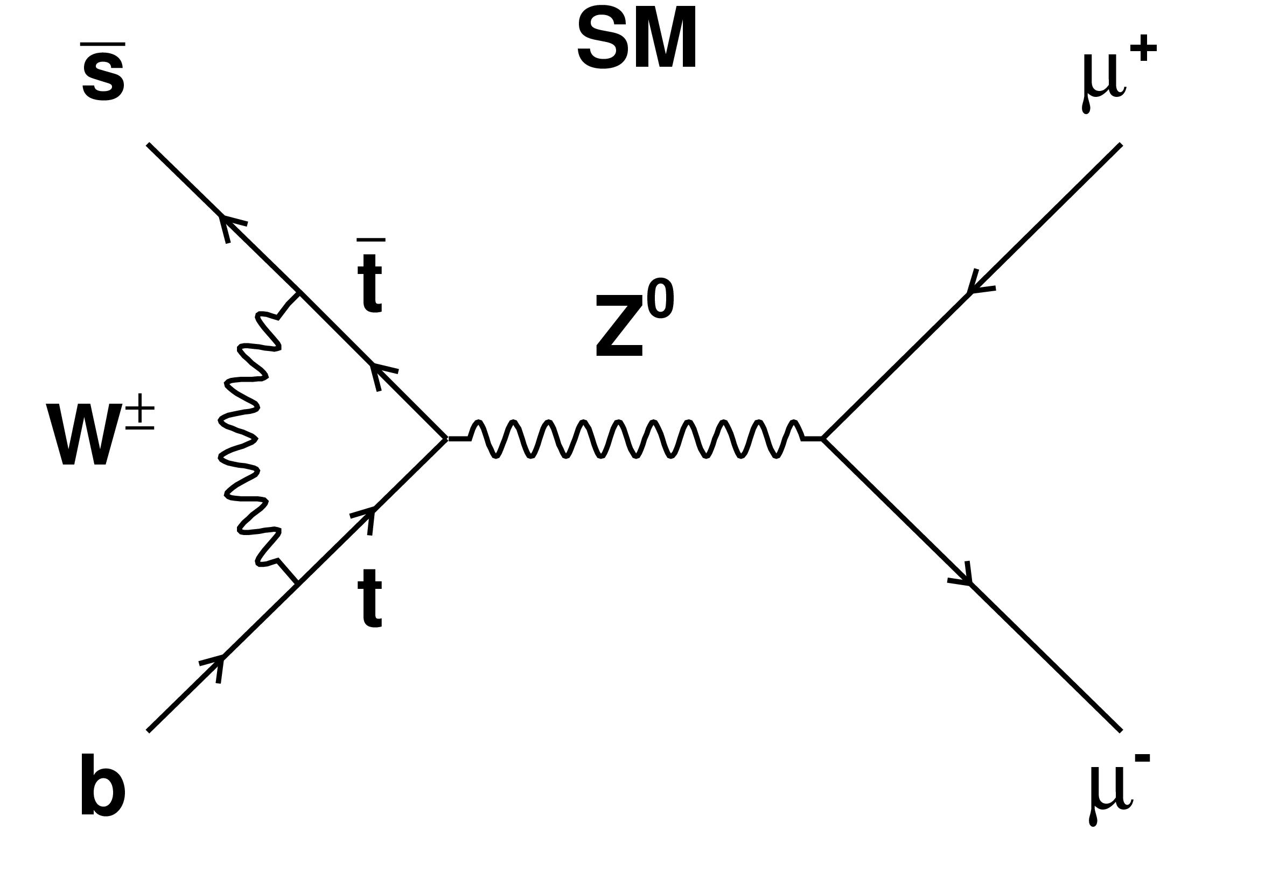
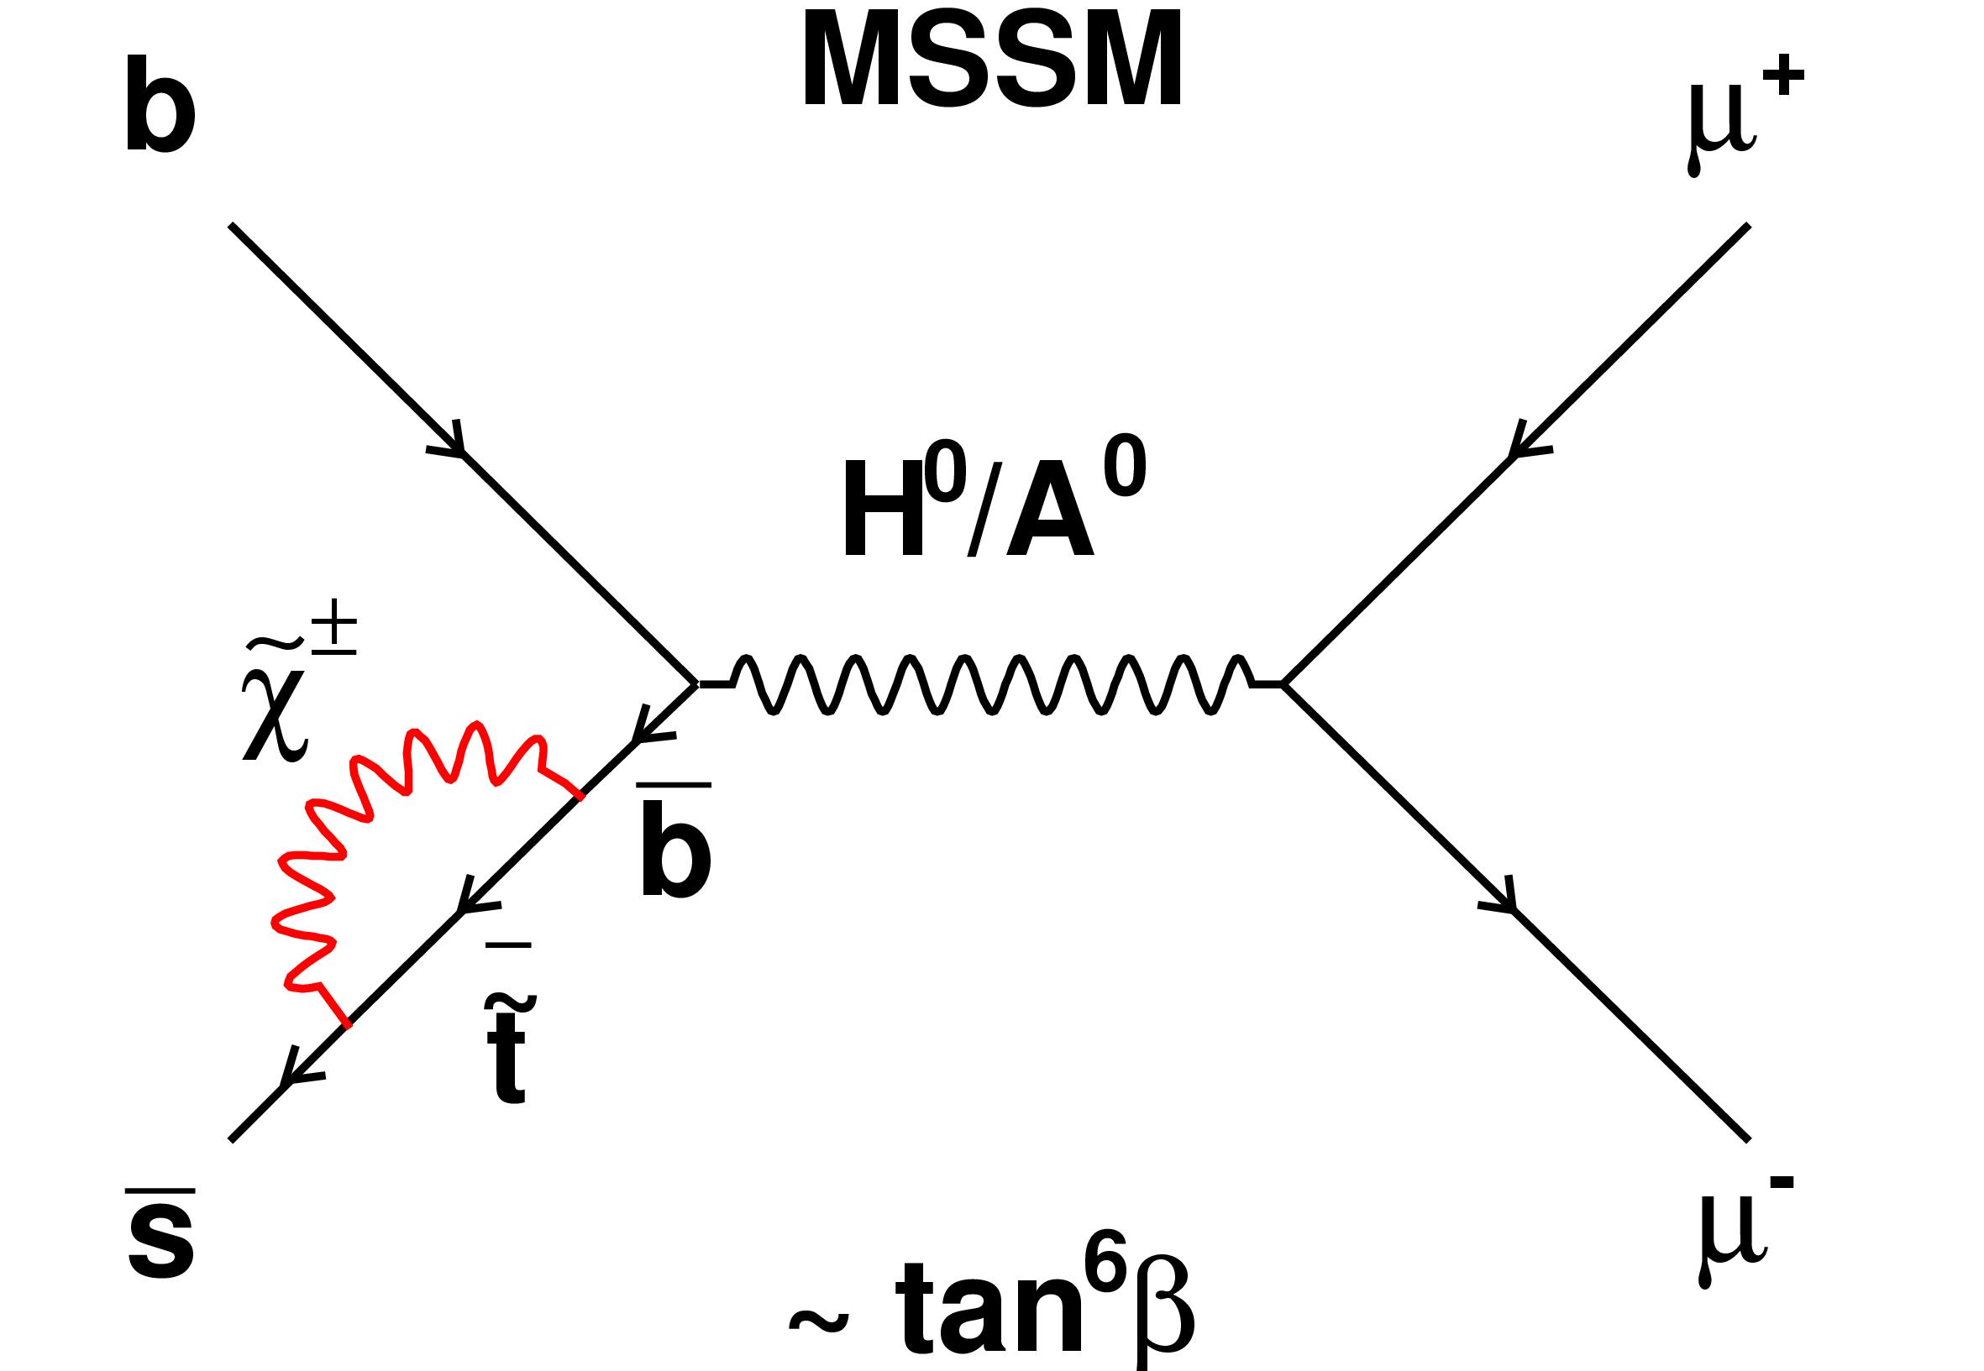
B_{s(d)} → μ⁺μ⁻ Beyond the SM
Look at processes that are suppressed in the SM
Excellent place to spot small contributions from non SM contributions
B_{s(d)} → μ⁺μ⁻
  SM: No tree level decay
    CKM ,GIM and helicity suppressed
    BF(B_{s} → μ⁺μ⁻) = 3.2x10⁻⁹
  New Physics:
    Tree (FV or RPV) and loop diagrams with new particles:
    Example: MSSM: 3 orders of magnitude enhancement possible
    Rate ∝tan⁶β/(M_{A})⁴
  Sensativity at 10⁻⁸ 10⁻⁹ Level
Herndon
M. Herndon

Slide 6
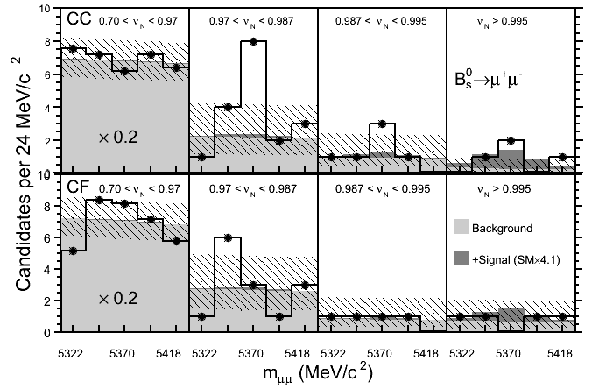
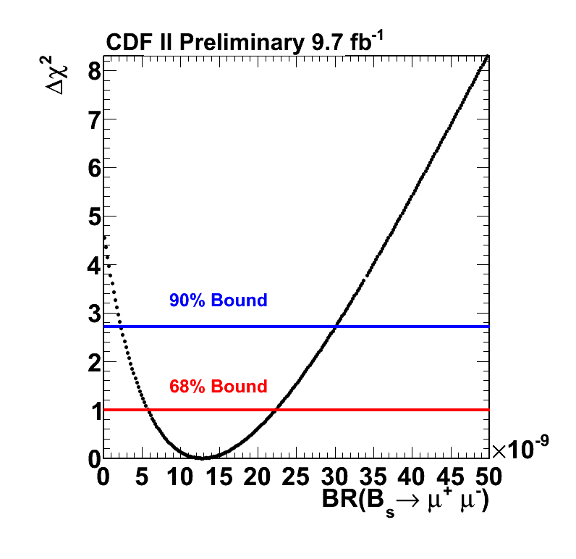
9.6fb⁻¹ B_{s(d)} → μ⁺μ⁻ Results
  Results in B_{d} search window consistent with background expectation.
  BF(B_{d} → μ⁺μ⁻ ) < 4.6x10⁻⁹ at 95% CL
  Significant excess seen in two
  highest bins of B_{s} search window!
  0.94% compatible with
  background hypothesis.
  7.1% compatible with expected
  rate of B_{s} → μ⁺μ⁻ in SM.
  BF(B_{d} → μ⁺μ⁻ ): 0.8-3.4x10⁻⁸
  at 95%C.L.
  PRD publication draft in review

Slide 7
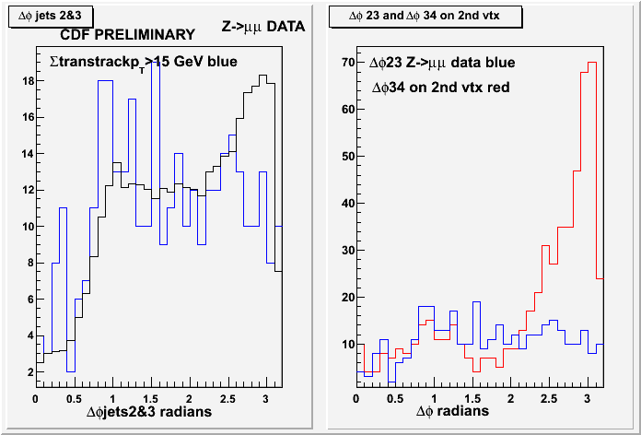
Multiparton interactions
Carlsmith, Pondrom
Ramakrishnan
Search for DPI in Z,W+jet and multijet events.

Slide 8
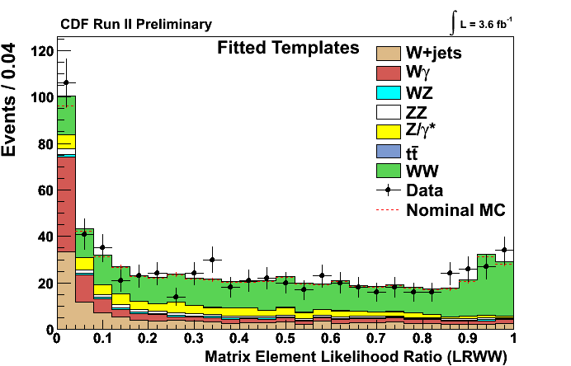
SM Diboson Production
Measurement of direct standard model WW,WZ Production.
  WW, Published Phys.Rev.Lett.104:201801,2010.
  WZ, Accepted by PRD RC
Pursley, Nett, Herndon
New WW measurment
  Differential vs. #jets, jet ET.
  Comparisons to MC@NLO, MadGraph, ALPGEN.
  Substantial recent theoretical work.
  Allowed optimization of H→WW +2jets analysis. Done!
  Powerful contributer at med. Mass.
  Working on using NN and multivariate b tagger to reduce ttbar background in events with 2 or more jets
Parker, Herndon Advisor

Slide 9
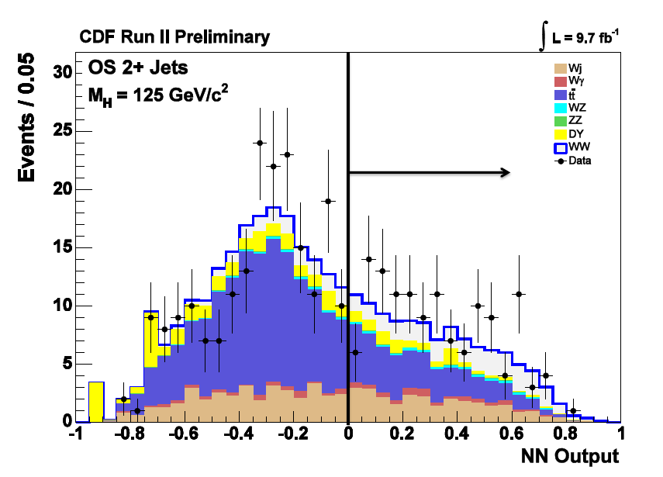
WW +jets Production
Differential WW vs. #jets, jet ET.
Process | Yield (events)
W + jets | 28.9
Wγ | 5.7
tt | 45.3
WZ | 3.0
ZZ | 0.8
DY | 9.7
Σ Bkgd. | 93.4
WW | 31.1
  3σ in the 2 jet bin.
MVA b tagger reduces top background, WW NN for final singal extraction
Parker, Herndon Advisor

Slide 10
9.7fb⁻¹ CDF Higgs Search
Wisconsin works on H→WW Higgs Search
Inclusive search for high mass Higgs production with H → WW
H→WW Channels: Exp. Limit σ/σ_{H} per channel and combined | Exp. Limit125 | Exp. Limit 165
gg→H: 0 Jets | 6.68 | 1.41
gg→H, VH, VBF: 2+ Jets | 7.83 | 1.89
gg→H: 1 Jet | 9.11 | 1.83
…
Combined | 3.08 | 0.69
H->WW Sensitivity at 125 as powerful as individual VH→ Vbb channels
  Research by Will Parker
  and Matt Herndon
  PRD publication draft in progress
10
Notes:
Like WH -> WWW like sign dilepton
ttH -> ttbb

Slide 11
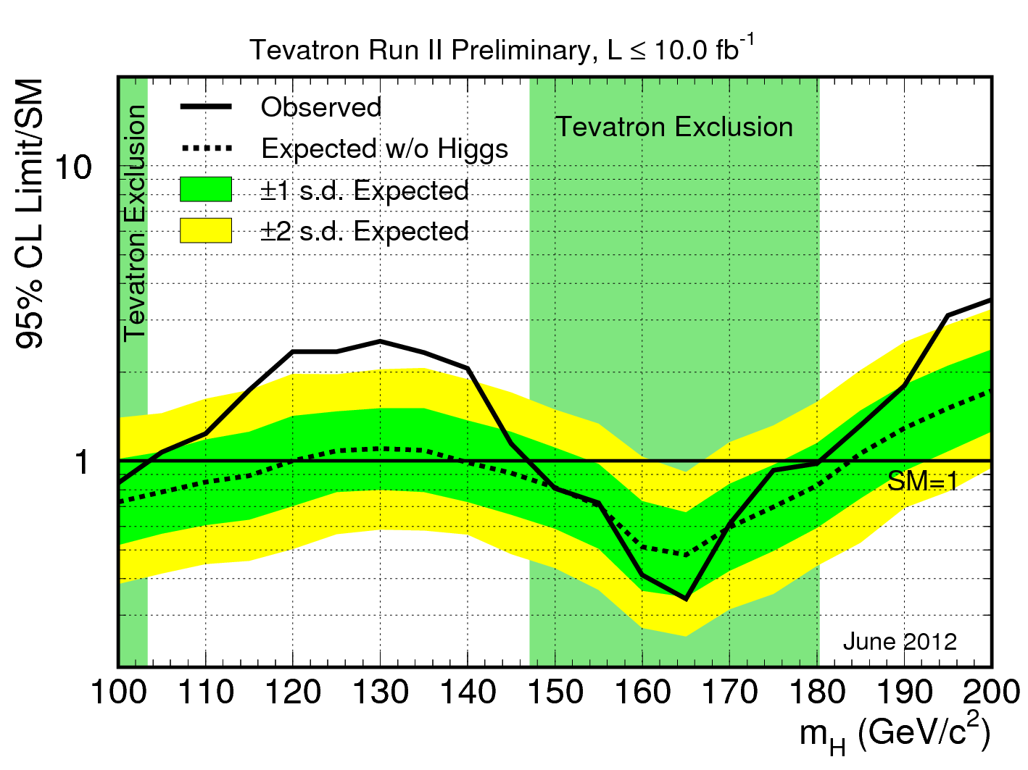
Tevatron: Higgs Search
Final status of the Tevatron Higgs search
  Higgs boson excluded:
    147-179 GeV!
  Sensitivity to set limits or see evidence of a signal at low mass
What’s This?
    UW Analysis:
      CDF H → WW → lνlν + 2jets
      gg → H, VBF, ZH and WH: H → WW
    Matt Herndon, Will Parker
    (Substantial sensitivity improvement at m_{H}=125GeV)

Slide 12
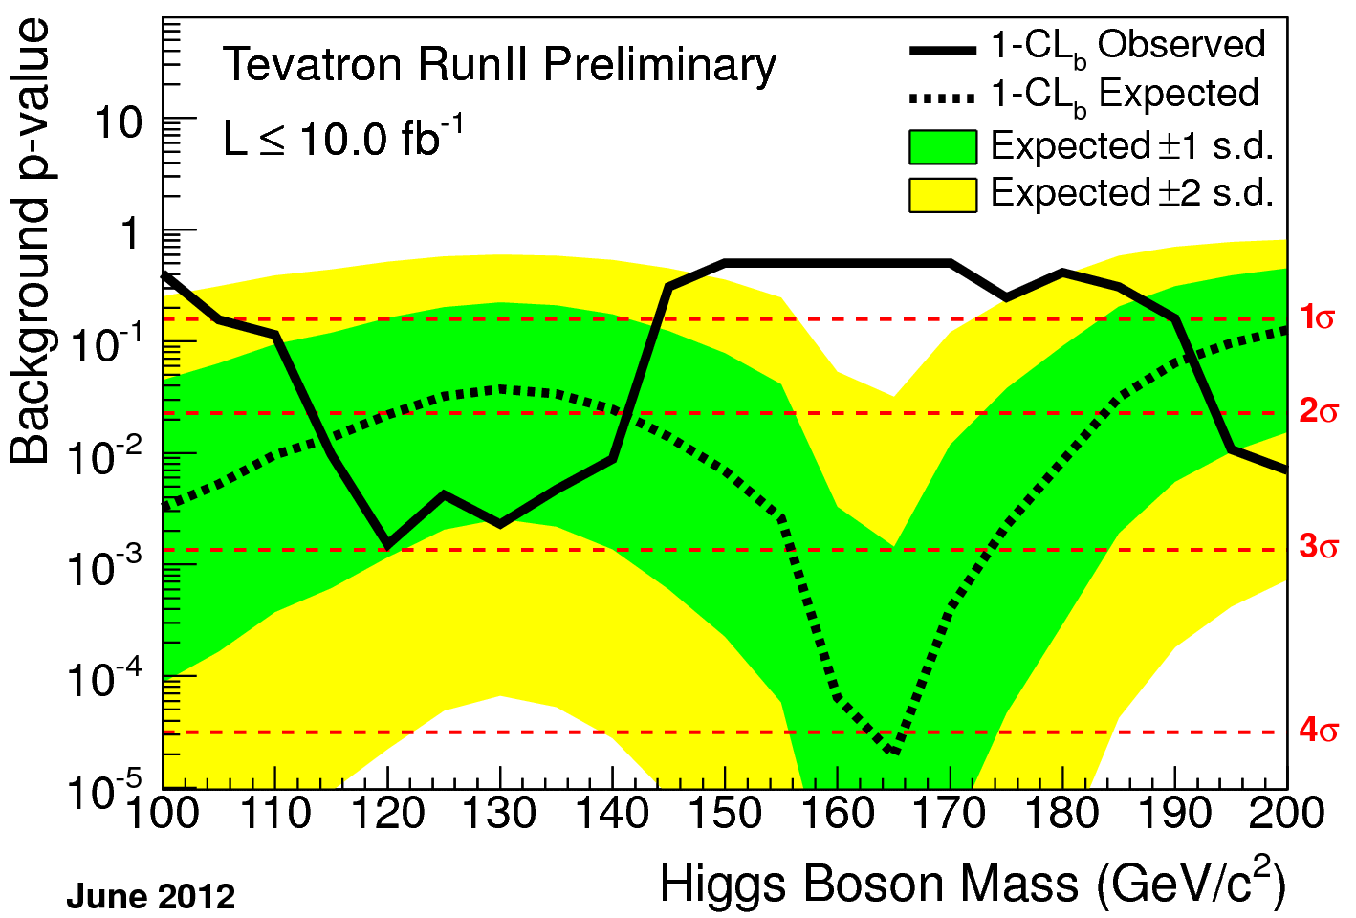
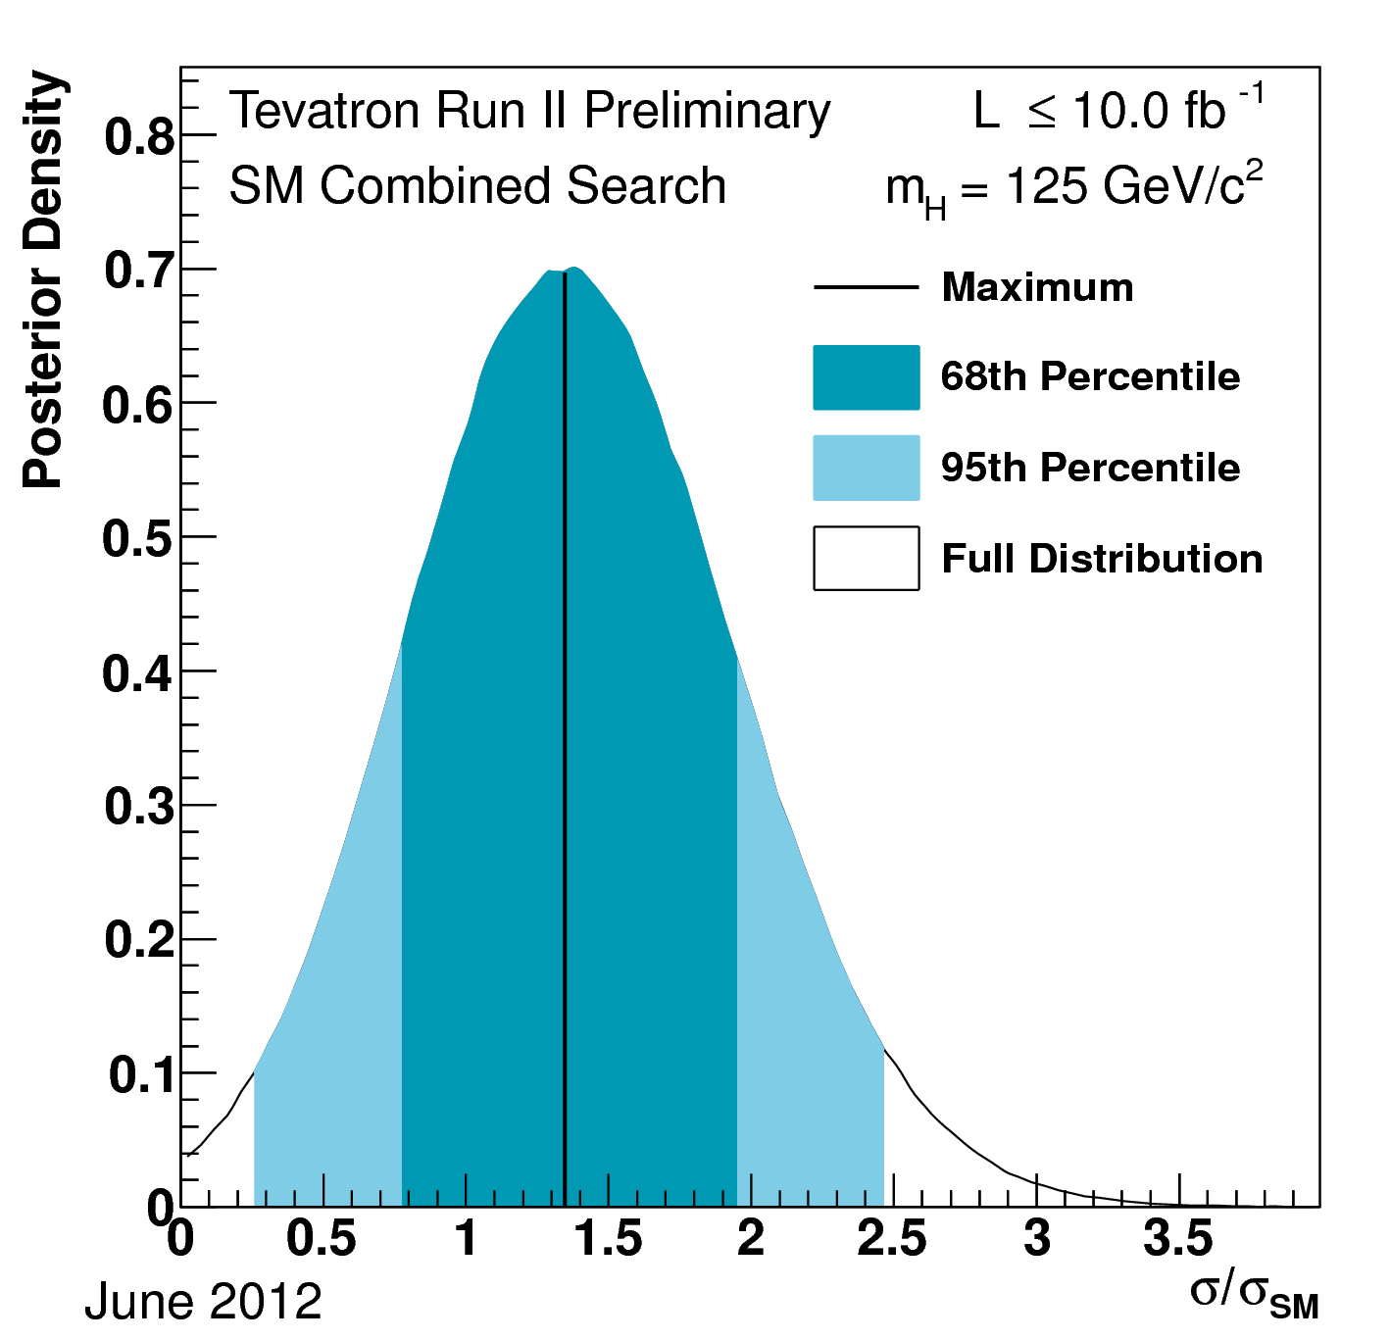
Tevatron: Higgs Search
Tevatron experiments sees a signal at the evidence level
  In H→bb channel global P value: 3.1σ
  Consistent with 125 GeV SM Higgs boson

Slide 13
Publication Overview
Publication in 2010-2012
Wisconsin B Physics Results:
  Search for B_{s} →μ⁺μ⁻ Prof. M. Herndon, PRL, 107, 191801, 2011 (4th)
Wisconsin Higgs Results
  Inclusive H → WW Prof. M. Herndon and Dr. J. Pursley PRL, 104, 061803, 2010(3rd)
  Tevatron H → WW Prof. M. Herndon and Dr. J. Pursley PRL, 104, 061802, 2010
  Cover of PRL, PRL suggested reading, PRL special spotlight article.
  H → WW 4th Gen Prof. M. Herndon and Dr. J. Pursley PRD 82, 011102(R) 2010.
  Higgs Boson Searches at the Tevatron, Herndon, Ann. Rev. Nucl. Part. Sci. 61 2011.
Wisconsin EW Physics Results:
  σ(WW) Dr. Jennifer Pursley PRL, 104, 201801, 2010 (2nd)
Publications in preparation: σ(WZ)(accepted by PRD RC), B_{s} →μ⁺μ⁻ PRD, Final Higgs PRD, Review article for RMP

Slide 14
Conclusions
The CDF experiment has concluded. The UW group is ramping down our activities though our physics results in progress are exciting.
We have one remaining active graduate student
  Will Parker with Prof. Herndon advising
In 2012-2013.
  Full dataset B_{s} →μ⁺μ⁻ and Higgs preliminary results released and PRDs in progress (Higgs portion of Parker thesis).
  Differential WW cross section measurement in progress (WW portion of Parker thesis).
  Ongoing work by Pondrom on double parton scattering.
  Expect 3 more publications from direct UW effort on CDF plus three or more papers from combinations and reviews.

Slide 15
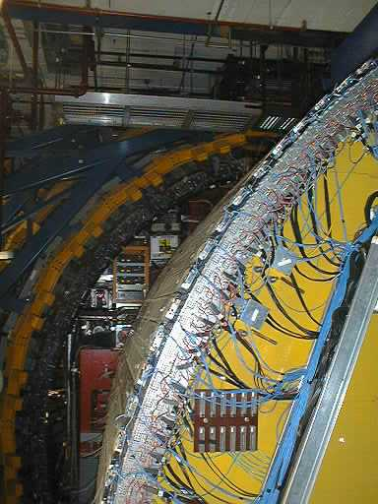
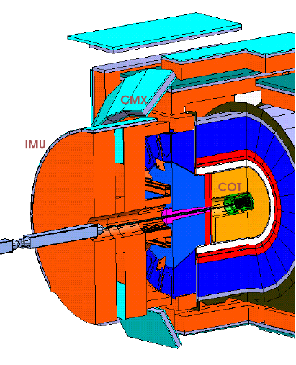
Intermediate Muon System
Detectors, preamps, amplifiers, TDCs, and trigger electronics. Excellent performance and smooth operation through all of run II.
1728 drift tubes (BMU), 432 scintillation counter (BSU)
Carlsmith
Chung
Ramakrishnan

Slide 16
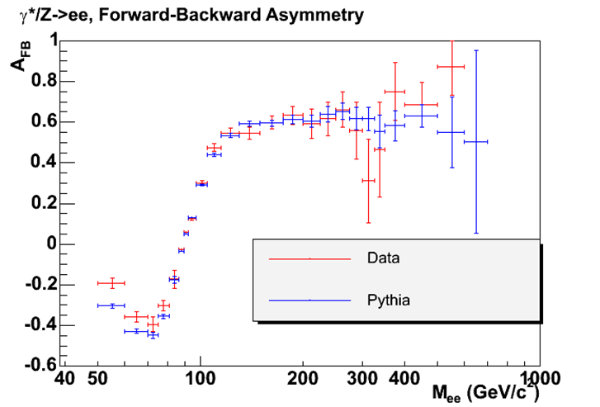
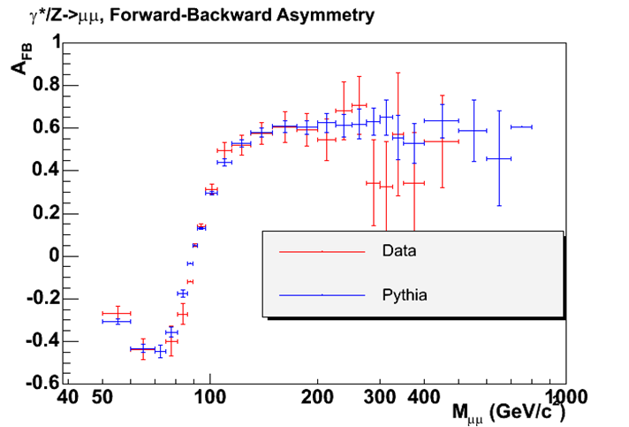
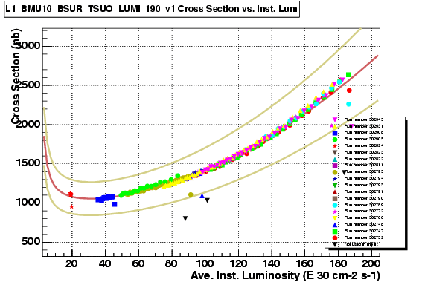
BMU: Physics and Trigger
Chung
Stable performance. Maintained less than 0.5% dead channels.
Extends pseudorapidity of W physics.

