Slide 1
The Troy Project
Anna Christenson
Bai Yang Wang

Slide 2
Troy Project
Goal: Obtain a tomographic map of an archeological site
Method: Muography

Slide 3
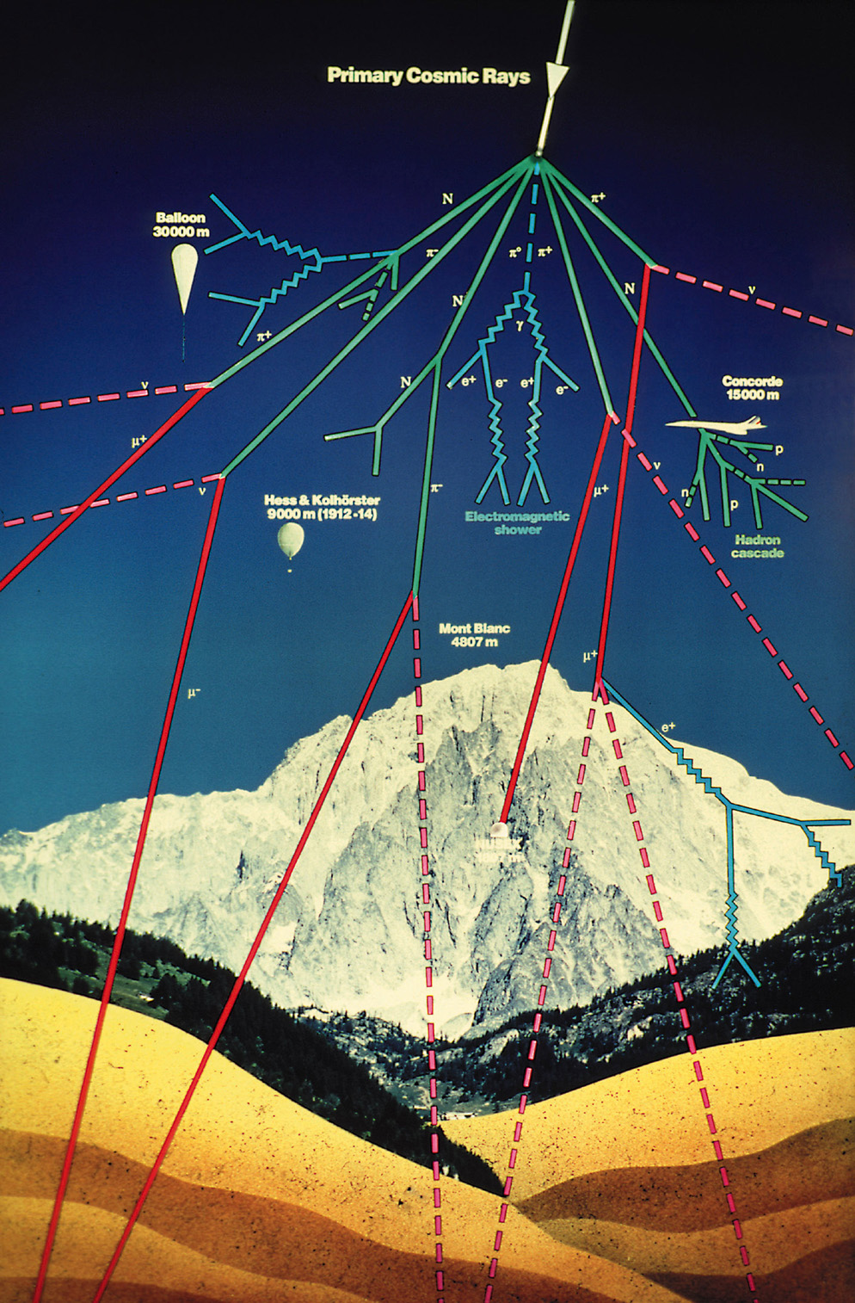
Cosmic Ray Muons
‪
What is a muon?
Where is it from?
Why is it suitable?
www.physi.uni-heidelberg.de
Notes:
Heavy electron-like particle
High penetration ability
Naturally produced
Not harmful to people or artifacts
1

Slide 4
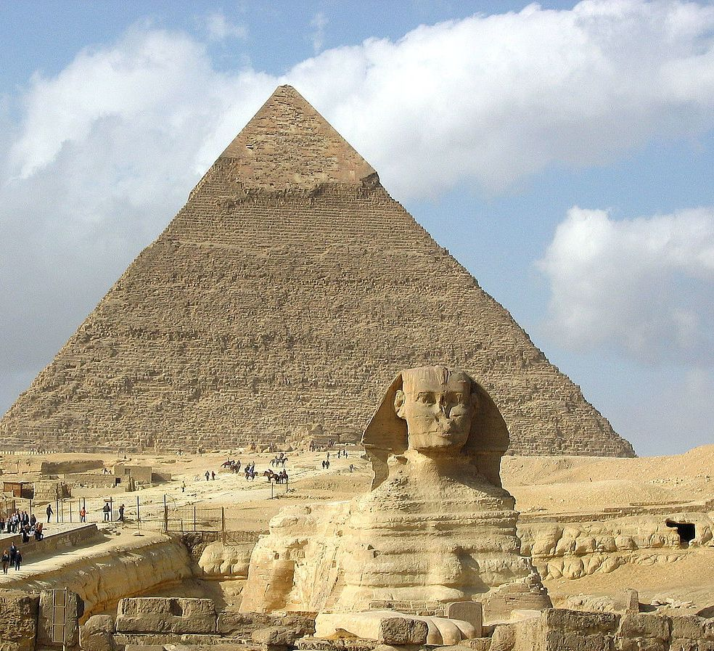
Muography
‪newscenter.lbl.gov
http://stardate.org/radio/program/muons-ii

Slide 5
The Detector

Slide 6
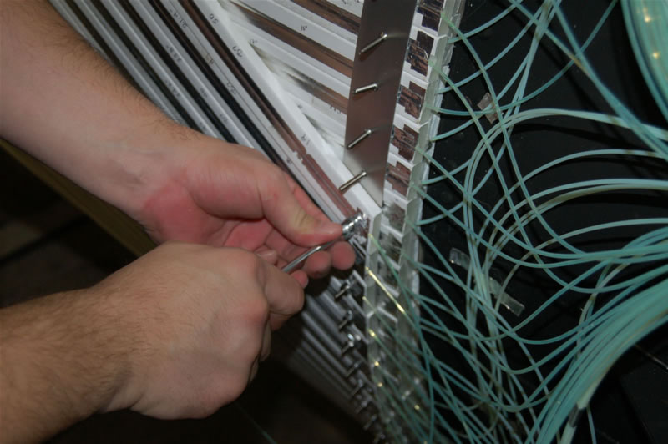

Slide 7
Current Algorithm

Slide 8
RTK
www.rtk.org
www.openitk.org

Slide 9
New Algorithm
Applications are built in and can be called in bash script
The back projection algorithm is voxel based. Oriented around grid points.
The algorithms are based on two major back projection algorithms:
Practical Cone Beam Algorithm. FeldKamp, Davis, and Kress.
Reprojecting rays algorithm. Joseph.

Slide 10
Sample script
# Create a simulated geometry
rtksimulatedgeometry -n 180 -o geometry.xml
# You may add "--arc 200" to make the scan short or "--proj_iso_x 200" to offset the detector
# Create projections of the phantom file
rtkprojectgeometricphantom -g geometry.xml -o projections.mha --spacing 2 --dimension 256 --phantomfile SheppLogan.txt
# Reconstruct
rtkfdk -p . -r projections.mha -o fdk.mha -g geometry.xml --spacing 2 --dimension 256
# Create a reference volume for comparison
rtkdrawgeometricphantom --spacing 2 --dimension 256 --phantomfile SheppLogan.txt -o ref.mha

Slide 11
New Algorithm test
The generated geometry
The reconstruction image

Slide 12
To Do
The algorithm is developed for CT scanning geometry setting.
The rotation matrices are stored in geometry.xml
We tried with fewer rotations.
We want to turn the rotation matrices into sheer matrices and test the performance.

Slide 13
conclusion
http://www.une.edu.au

Slide 14
Thank you
Wisconsin Institutes of Discovery Frontier Fellowship
Wisconsin Space Grant Consortium
University of Wisconsin Physics Department
Morgridge Institute for Research, Medical Physics

