Slide 1
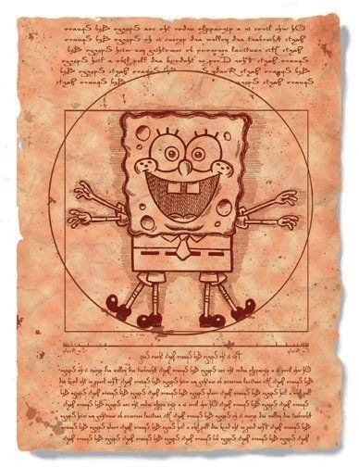
Maggie Wu
May 8th
Notes:
Before I start talking about my project, I want to share with you my own story. Last semester, I was often late for my English writing class. And the reason is that, every time before class I often needed to print my paper and I rushed to the library, I found a lot of students were waiting to use the printer. That makes me frustrated and at that moment, I started to think, Why do we use printer?

Slide 2
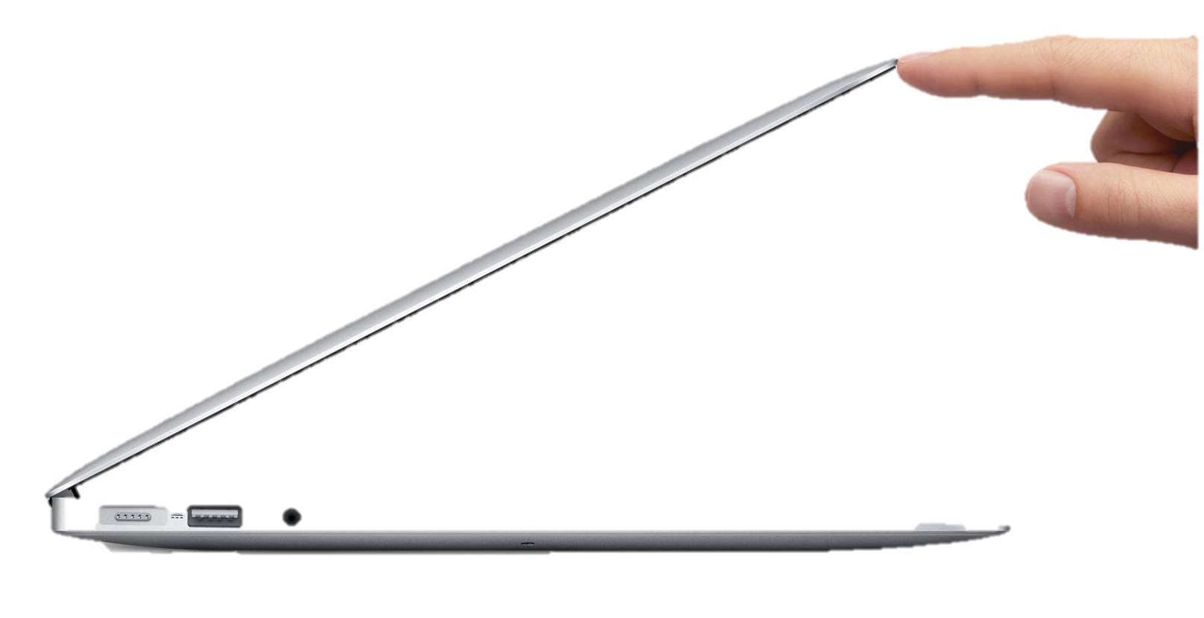
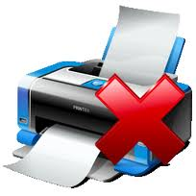
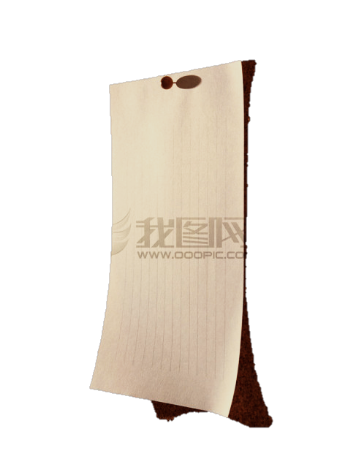
Thickness:1.7 cm
Height:
34-40 cm
Thickness:0.0103cm
Notes:
It is a machine: heavy and not portable. the most important information carriers, paper and laptop, are portable, but the intermediary between the two, printer, is not. It therefore causes a lot of inconvenience in our daily life.

Slide 3
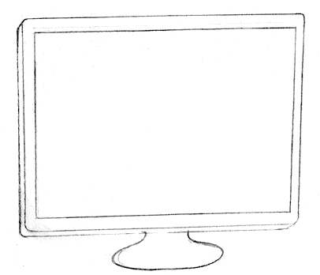
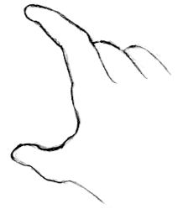
Notes:
I then started to figure out a better way to transform the digital information to physical version. This is my solution.

Slide 4
Why ?!
Convenient
Habit change
Environmental-friendly
Notes:
Why do I design in this way? Why? First, as I said before, it is portable and convenient, which allows you to print anywhere and anytime. Second, people have changed the way they use paper; In the past, people use paper cause they want to know the information. But now, as more and more information are born in digital format, like google drive, ebooks. people use paper primarily to keeping the important information. This means the necessity for making multiple copies and multiple pages has decreased. Last but not least, the most important motivation is for environmental improvement.

Slide 5
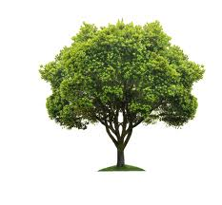
12,000,000,000 paper used / year *25% * % unnecessary printing *1/3000 *tree/paper
= 1,000,000 trees/year
@UK, 2007
12,000,000,000
22 / employee/day
25% unnecessary print
Notes:
According to the research, in 2007, in the united kingdom, 12 billion pieces of paper were used in the office; this means 22 pieces per employee per day. The most serious fact is that 25% is unnecessary print. My design is, actually, to encourage people to read the information on computer screen first and choose only the key information to make physical copy. If we could save the unnecessary part of paper used, we could have saved 1 million tress in a year, just in the UK.

Slide 6
How?
Notes:
Then I would talk about how I develop this model technically?

Slide 7
light
Computer screen
paper
Turn On
Finger
Pressure-Transparency Coating
React
Light
Photosensitive Layer
Turn Off
Finger
Notes:
First, It is naturally to think about using light to transfer the image from computer screen onto paper. Next, considering that every human interaction with objects has three major steps, turn on , react, and turn off. Put light here, When you sit in front of the laptop, in which way would you like to interact with you laptop and paper. Finger.

Slide 8
light
Computer screen
paper
Pressure-Transparency Coating
Turn On
Finger
Indirect Pressure
Record
Light
Photosensitive Layer
Turn Off
Finger
Direct Pressure
Notes:
Another important consideration is that how may I slide just once but use the finger pressure for twice. How? I observe that when you press on the article, it not only deforms at the pressing point, but also in the neighbor area.

Slide 9
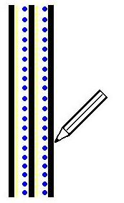
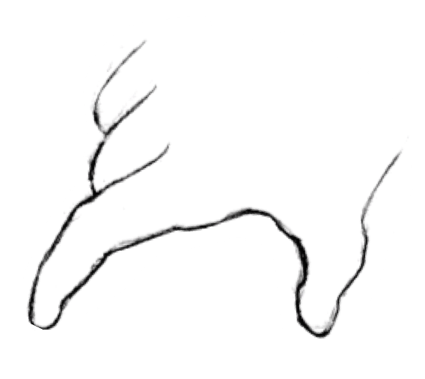
Model similar to
Carbonless copy paper
A
B
C
Notes:
And it turns out the final model is similar to carbonless copy paper. This is carbonless copy paper, when you write upon it, the force from the pen would ruptures the microcapsules underneath, and the chromogenic material release and forms color by reacting with the developer underneath. My model changes the material inside the microcapsules to be photosensitive and add the pressure-induced transparent layer.

Slide 10
How it Works?
Notes:
Let us watch the whole process.

Slide 11
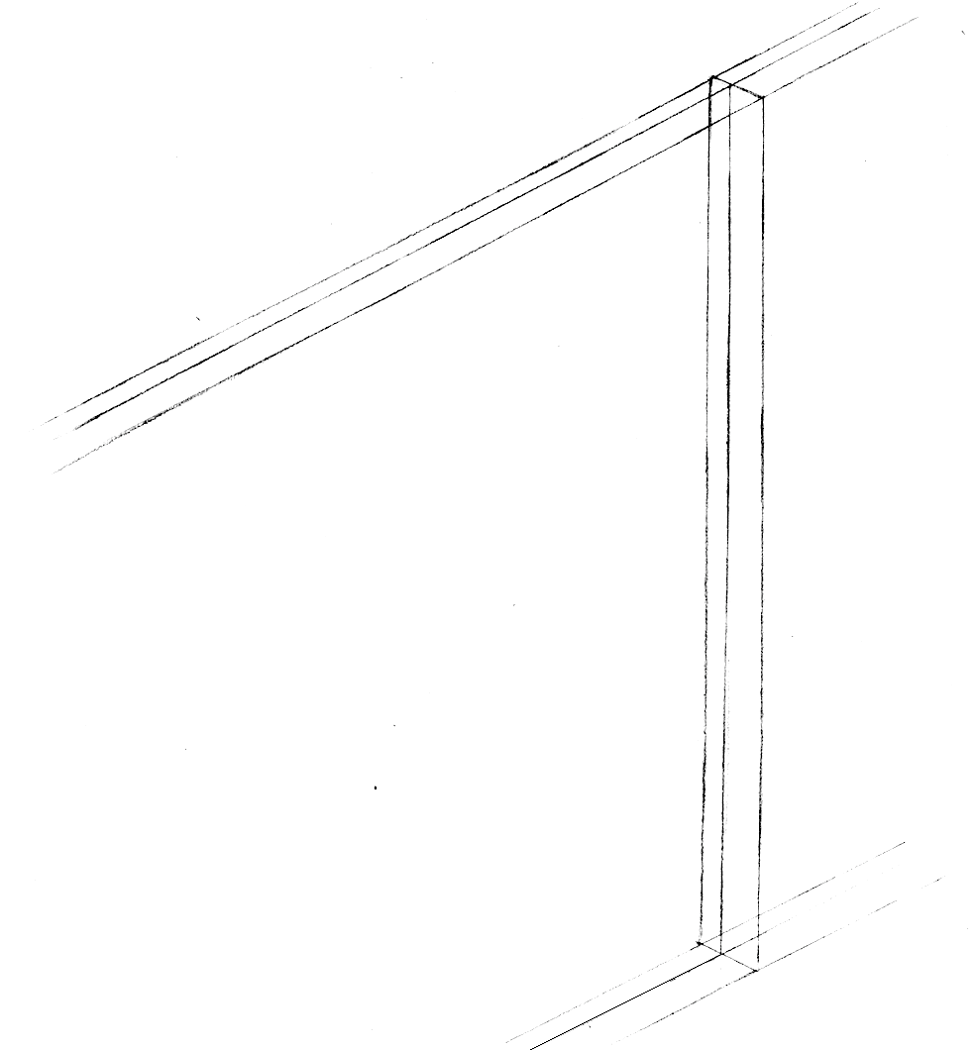
A
B

Slide 13
Slide | External | Internal
Deform | Indirect Finger Press | Deformed | Transparent
Cure | Light Transmit | Hardened
Press | Direct Finger Press | Rupture | Release
React | Image Formed | Color Contrast
Notes:
These are the major steps.

Slide 14
Slide | External | Internal
Deform | Indirect Finger Press | Deformed | Transparent
Cure | Light Transmit | Hardened
Press | Direct Finger Press | Rupture | Release
React | Image Formed | Color Contrast
Strain-Stress
Young’s Modulus
Surface Tension
Transparency
Photon Energy
Curing Degree
Efficiency (Time)
Hardness
Rupturing Point
Surface Tension
Strain-Stress
Curing Degree
Resolution
Stability
Discoloration
Reaction Rate
Notes:
And related key parameters. Let us dig into the first step.

Slide 15
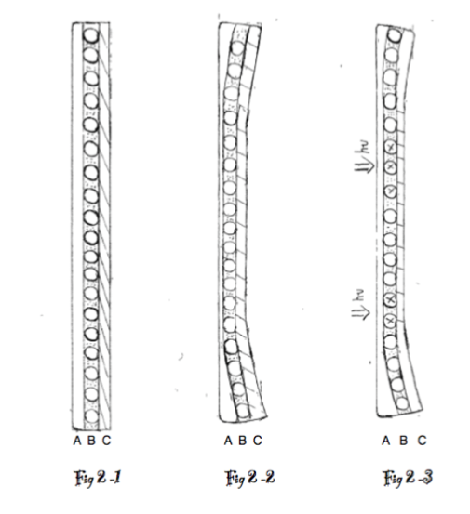
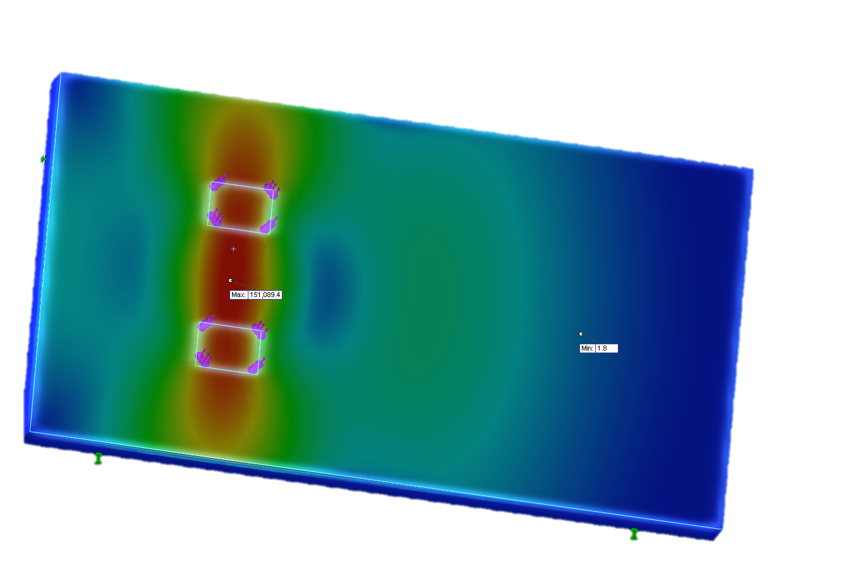
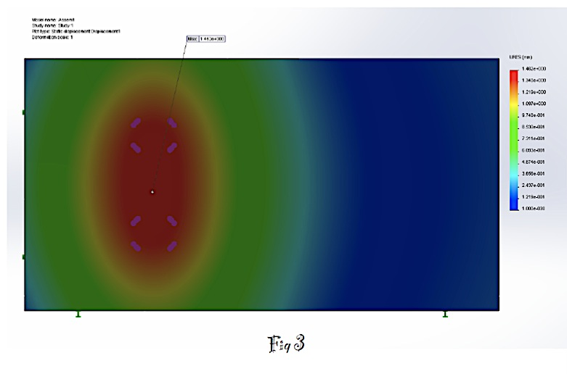
Deformation

Slide 16
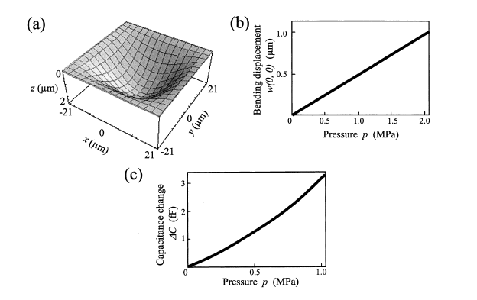
Deformation
Finger Pressure^{[1]}
Deformation of Layer A
Stiffness | Compressive Force (F) | Deformation x | Hooke’s Law
Surface Tension | X axis | Y axis | Young–Laplace equation

Slide 17
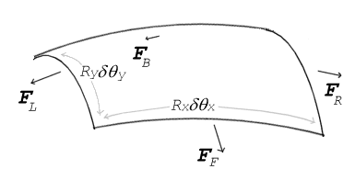
Hooke’s Law^{[2]}
A transversely isotropic material is symmetric with respect to a rotation about an axis of symmetry. For such a material, if e3 is the axis of symmetry, Hooke's law can be expressed as
Young–Laplace equation
where:
Δp is the pressure difference, known as the Laplace pressure.^{[8]}
is surface tension.
R_{x} and R_{y} are radii of curvature in each of the axes that are parallel to the surface.

Slide 18
Slide | External | Internal
Deform | Indirect Finger Press | Deformed | Transparent
Cure | Light Transmit | Hardened
Press | Direct Finger Press | Rupture | Release
React | Image Formed | Color Contrast
Strain-Stress
Young’s Modulus
Surface Tension
Transparency
Photon Energy
Curing Degree
Efficiency (Time)
Hardness
Rupturing Point
Surface Tension
Strain-Stress
Curing Degree
Resolution
Stability
Discoloration
Reaction Efficiency

Slide 19
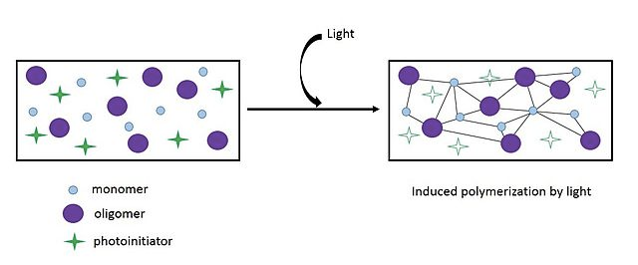
Upon radiation, oligomers are cross-linked and form a polymer network, usually requiring photo initiator to start the reaction.
Cure
Notes:
A photopolymer is a polymer that changes its properties when exposed to light, often in the ultraviolet or visible region of the electromagnetic spectrum. These changes are often manifested structurally, for example hardening of the material occurs as a result of cross-linking when exposed to light.

Slide 20
Mac Computer Display
Pixels: 220 ppi
Resolutions: 2880*1880
Largest Brightness: 325 cd/m^2
Lowest Brightness: 0.61 cd/m^2
Auto Brightness Adjustment

Slide 21
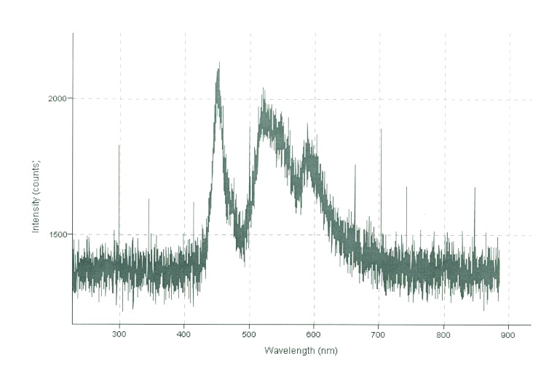
Mac Display Spectrum
blue: 475 427.5-522.5
green: 510 459-561
red: 650 585-715

Slide 22
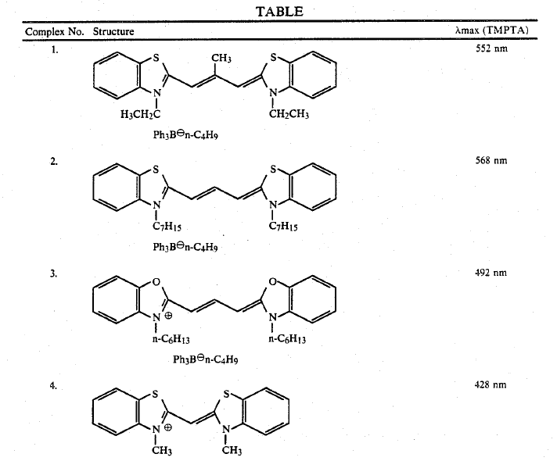
Suitable Photocurable Materials

Slide 23
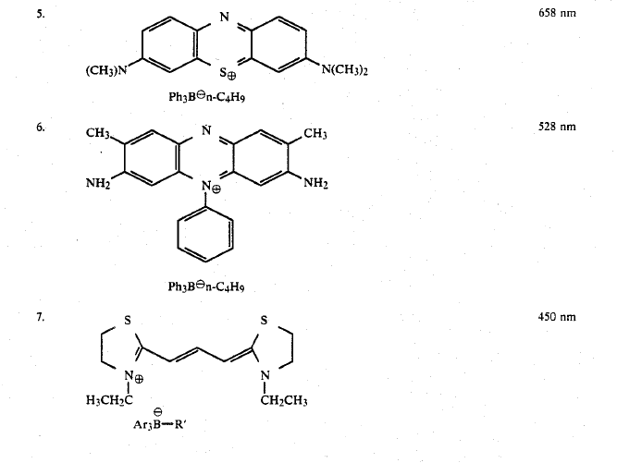

Slide 24
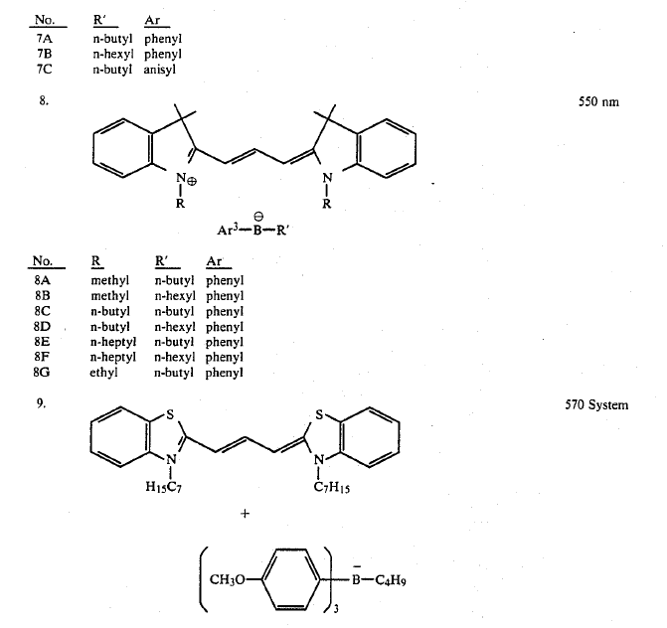

Slide 25
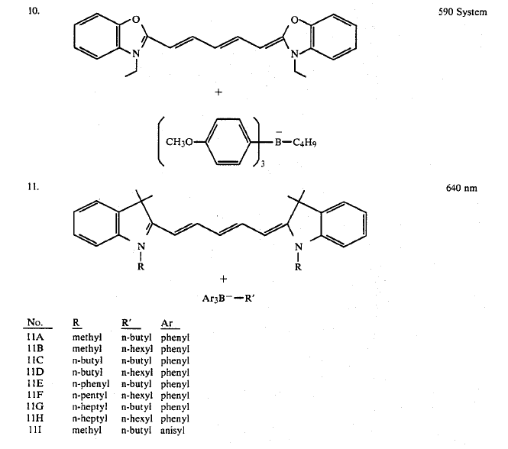

Slide 26
Slide | External | Internal
Deform | Indirect Finger Press | Deformed | Transparent
Cure | Light Transmit | Hardened
Press | Direct Finger Press | Rupture | Release
React | Image Formed | Color Contrast
Strain-Stress
Young’s Modulus
Surface Tension
Transparency
Photon Energy
Curing Degree
Efficiency (Time)
Hardness
Rupturing Point
Surface Tension
Strain-Stress
Curing Degree
Resolution
Stability
Discoloration
Reaction Efficiency

Slide 27
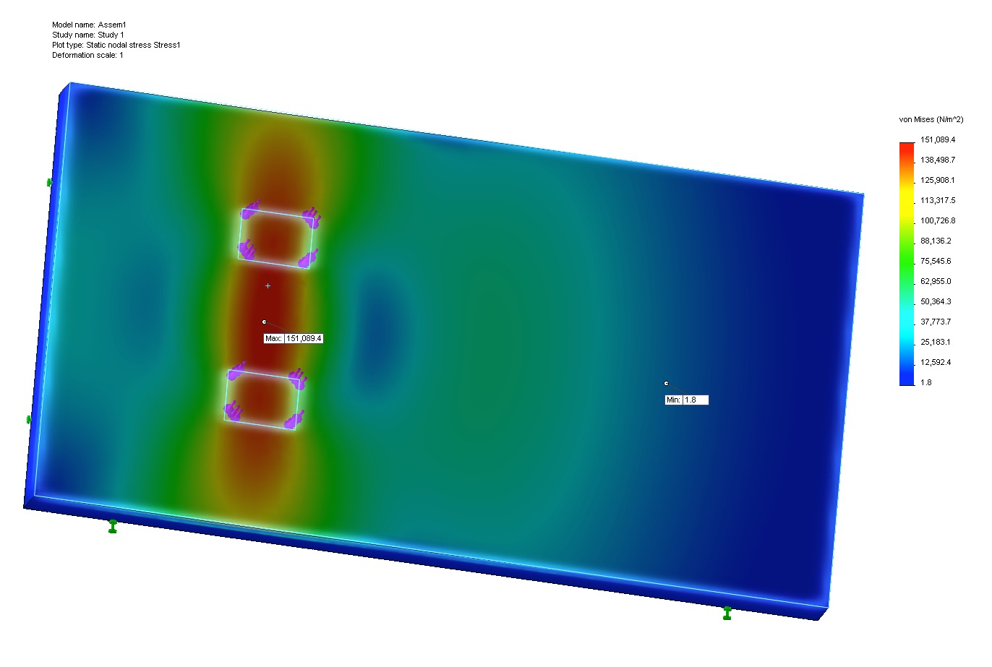
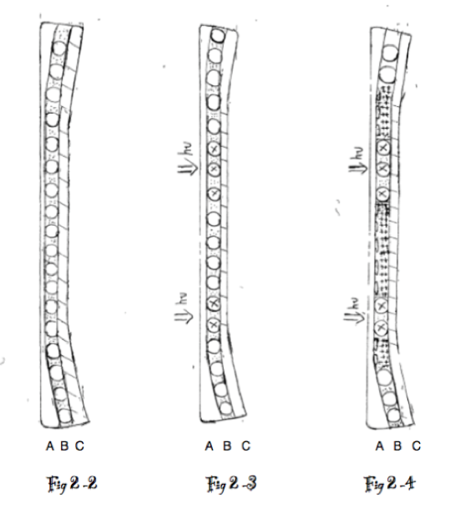
Rupture

Slide 28
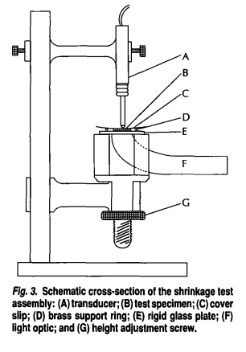
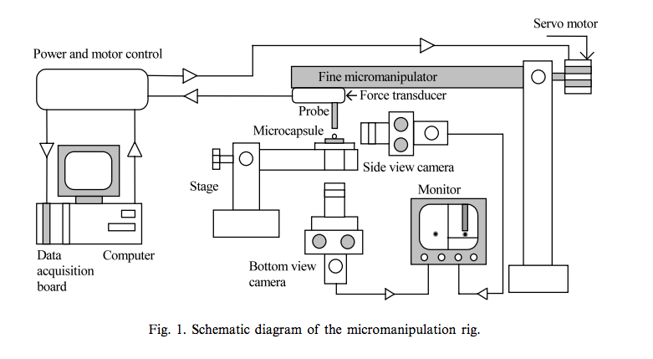
Experiments
1. Photocuring
a. exposure time vs. curing ratio
b.light energy vs. image density
apparatus: deflecting disk technique
2.mechanical strength of microcapsules
deformation vs. compressive force (rupturing point)
apparatus: micromanipulation

Slide 29
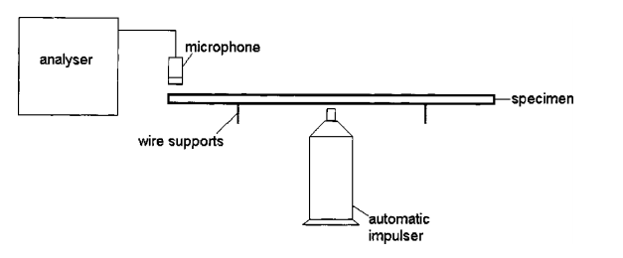
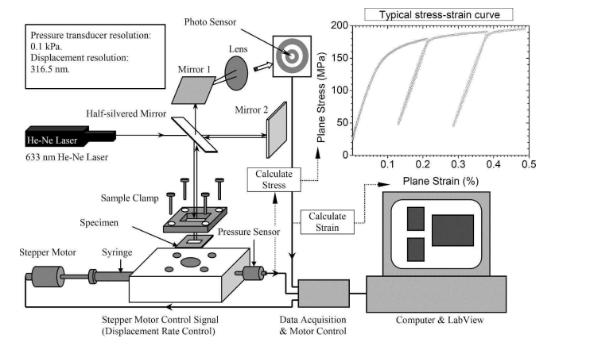
3. compression-induced mechanical response of each layer
young’s modulus
surface tension
apparatus: Plane-strain bulge test, depth-sensing indentation
4. sealing
testing the mechanical properties and imaging properties for the whole article.

Slide 30
Making Prototype
Stage #1
Stage #2
Mechanical Properties of Layer A
Mechanical Properties of Layer B, C
Photo-curing Effect of Layer B
Sealing
Mechanical Response of Whole Article
Mechanical Strength of Microcapsules
Stage #3
Stage 1
Stage 2
Stage 3
B&W → Color Imaging
Improve Imaging Quality
Improve Paper Quality
Sep, 2014
Jan, 2015
Mar, 2014

Slide 31
Anticipated Result
Imaging time: 0.2-0.3 s
Resolution: higher than human eye
Colorful: yes
Thickness: ~ 3 times of normal A4 printing paper
Cost: < $0.034 for A4 size
Recyclable: yes.

Slide 32
Motivation
Design
Parameters
Experiments
Prototype stage
References
Sato, Norio, et al. "MEMS fingerprint sensor immune to various finger surface conditions." Electron Devices, IEEE Transactions on 50.4 (2003): 1109-1116.
http://en.wikipedia.org/wiki/Hooke's_law
http://www.google.com/patents/US5686220
polymerization kinetics
http://www.biofizyka.cm-uj.krakow.pl/en/dds/labs/Polymerization_kinetics.pdf
Liu, K. K., Williams, D. R., & Briscoe, B. J. (1996). Compressive deformation of a single microcapsule. Physical
Review E, 54(6), 6673.
Sun, G., & Zhang, Z. (2002). 4p, 242(1), 307-311.
Xiang, Y., Chen, X., & Vlassak, J. J. (2005). Plane-strain bulge test for thin films. Journal of materials research, 20(9), 2360-2370. Retrieved from
http://vlassakgroup.seas.harvard.edu/files/vlassakgroup/files/35-bulge-xiang-jmr2005.pdf
Maxwell, A. S., Owen-Jones, S., & Jennett, N. M. (2004). Measurement of Young’s modulus and Poisson’s ratio of thin coatings using impact excitation and depth-sensing indentation. Review of scientific instruments, 75(4), 970-975.
Hofmann, N., Hugo, B., & Klaiber, B. (2002). Effect of irradiation type (LED or QTH) on photo‐activated composite shrinkage strain kinetics, temperature rise, and hardness. European journal of oral sciences, 110(6), 471-479.
Whitworth, J. M., Makhani, S. H. S., & McCabe, J. F. (1999). Cure behaviour of visible light‐activated pattern materials. International endodontic journal, 32(3), 191-196.
Watts, D. C., & Cash, A. J. (1991). Determination of polymerization shrinkage kinetics in visible-light-cured materials: methods development. Dental Materials, 7(4), 281-287.

Slide 33
“There are no limitations to the mind except those we acknowledge.”
--Napoleon Hill(American Author, 1883-1970)

Slide 34
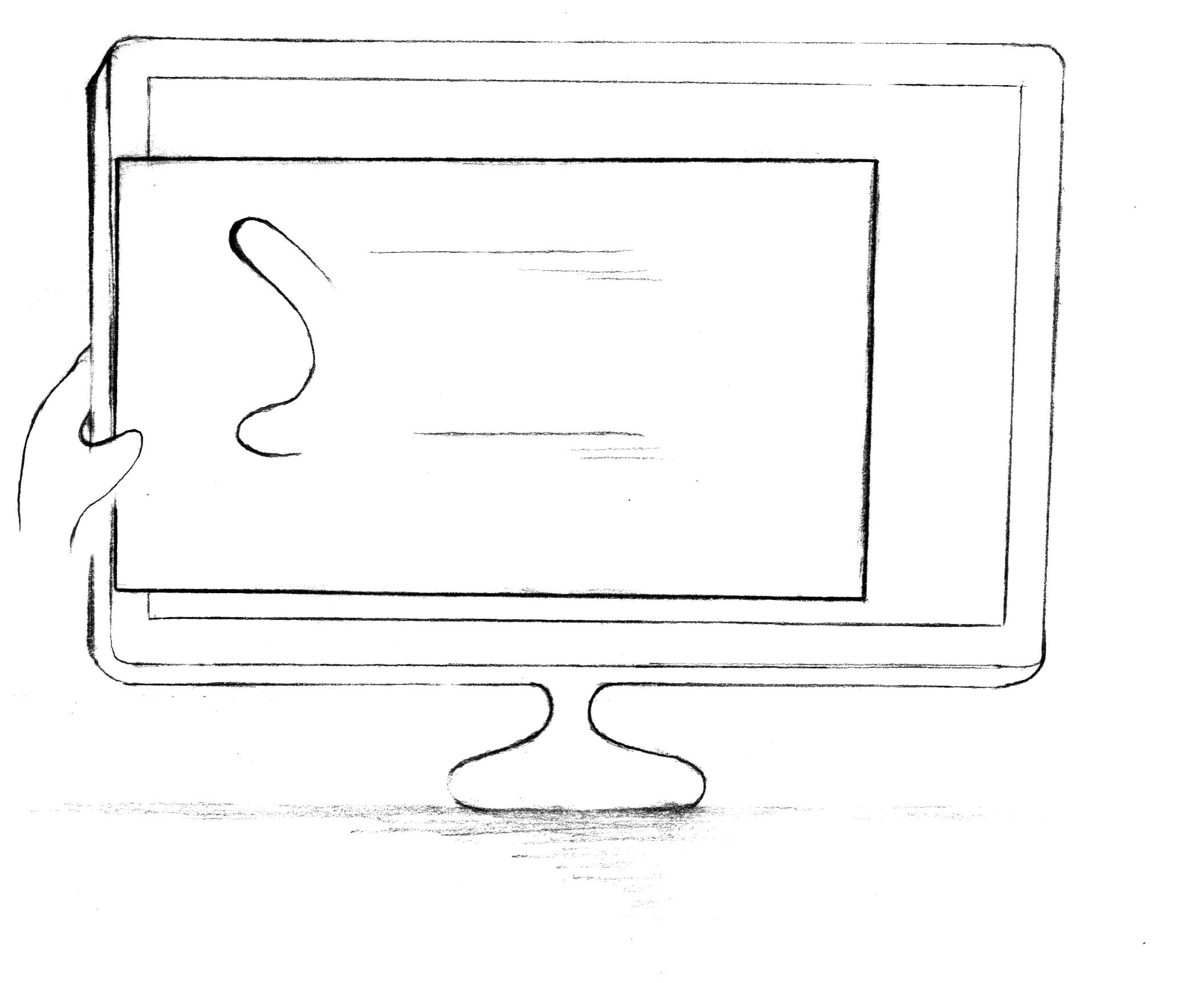
Questions？

