Slide 1
Troy Project Update
Anna Christenson
Bai Yang Wang

Slide 2
Simulation
Current Algorithm: back projection
Simulation Study
3.4E6 muons penetrate and hit detector (~6hours simulation time)
Mound of rock 7m X 2m X 2m
Hole in mound at center 0.5m X 0.5m X 2m

Slide 3
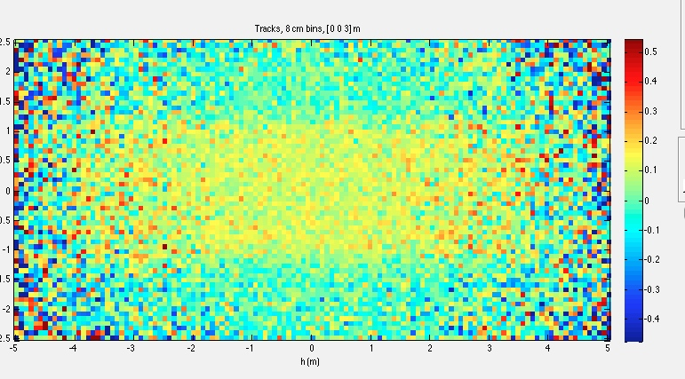
Simulation Studies

Slide 4
RTK
FDK cone beam algorithm
convolves the projection profile with a convolution kernel first.
Testing Result:
Starting from left: 180 rotations, 20 rotations, 10 rotations

Slide 5
Future Algorithm
GPU based Total Variation
Ground truth image
Fidelity term
consistency between the image and the physics and prior knowledge
Total Variation term
analogous to a least square fit term
This algorithm is especially powerful in reducing noises while preserving actual structures, with undersampled projection profile

