Slide 1
Foucault Pendulum
To develop an ongoing, interactive experiment to demonstrate the Earth’s rotation.
Acquired more accurate data on the pendulum’s damping and period. Began working on the Driving mechanism with Paul Nonn.
The main focus now is to create an effective driving mechanism.

Slide 2
Vital Facts and Activities
Used a Pasco photogate to make an accurate measurement of the period
Used a Pasco motion sensor to obtain a position vs time graph of the pendulum’s motion to see the damping
Attended a meeting with Paul Nonn to develop ideas for the electromagnetic driving mechanism.

Slide 3
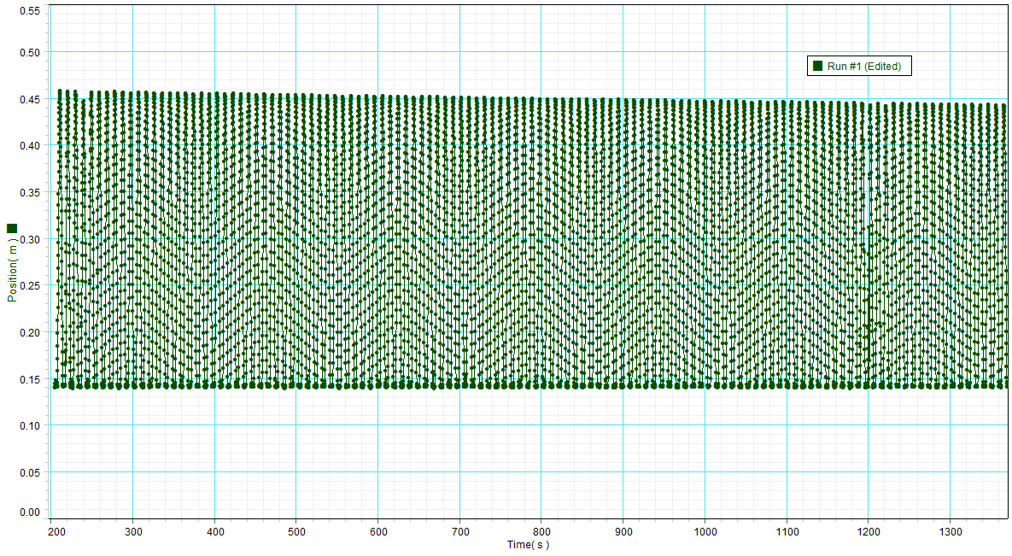
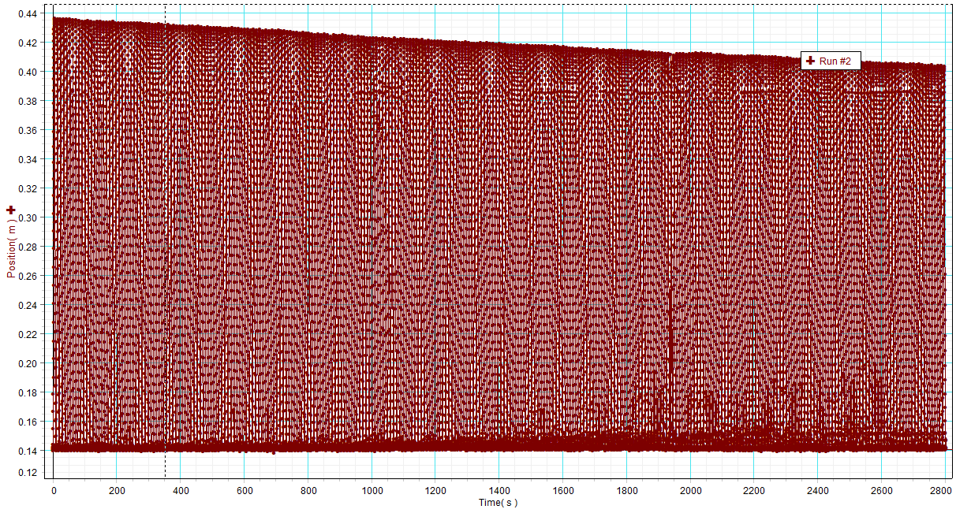
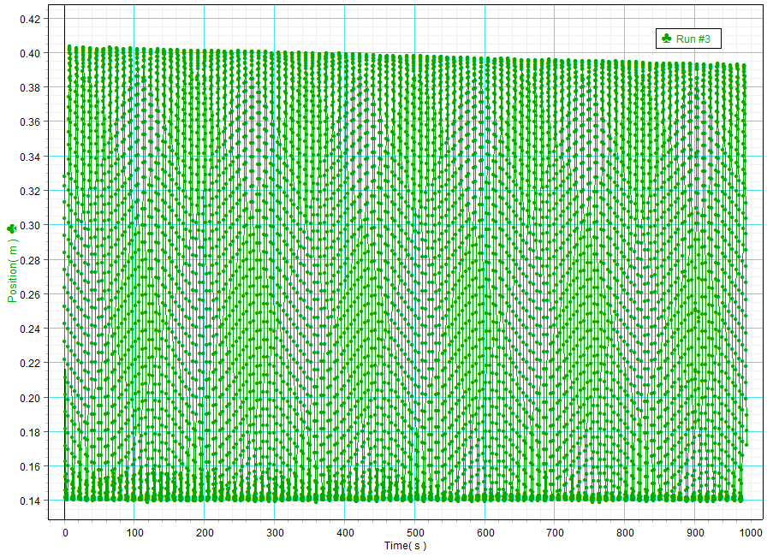
Results/Accomplishments/Progress
Position vs time graphs for the pendulum

Slide 4
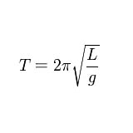
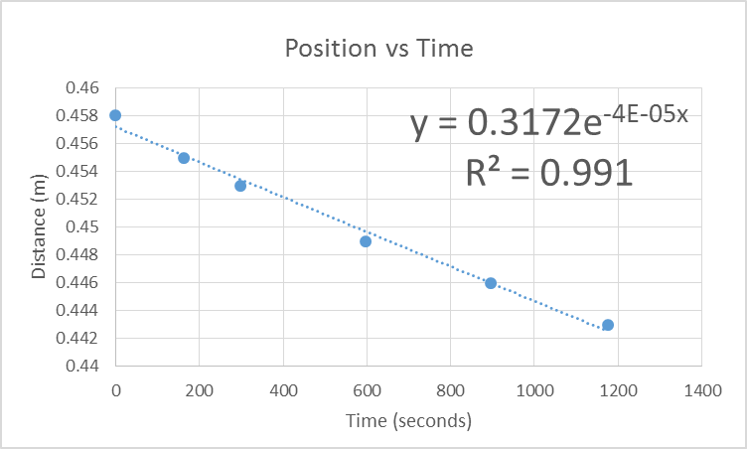
Results/Accomplishments/Progress
Period from photogate is 9.6212 seconds
A graph of the max amplitudes (over about 3-5 minute intervals) for the first 20 minutes the pendulum ran.
Local gravitational field (g) in Chamberlin Hall is 9.803636 m/s²
Length of the pendulum is 23.12 meters
Calculated period is 9.648 seconds
Percent error is .2778 %

Slide 5
Issues and Needs
Best way to create a driving mechanism for our pendulum?
Using Paul’s plan
Using a circuit contained of MOSFETS, Arduino or timer, power supplies, and an electromagnet.
How to track precession and elliptical motion of the pendulum?
Stopping elliptical motion

Slide 6
Action Items and Plans
Test Paul’s driving mechanism
If that doesn’t work then begin working on Arduino method, or another method
Use video cameras and a video tracking software to get data on precession and elliptical motion.
Create a Charon ring

