Slide 1
EEG brain computer interface

Slide 2
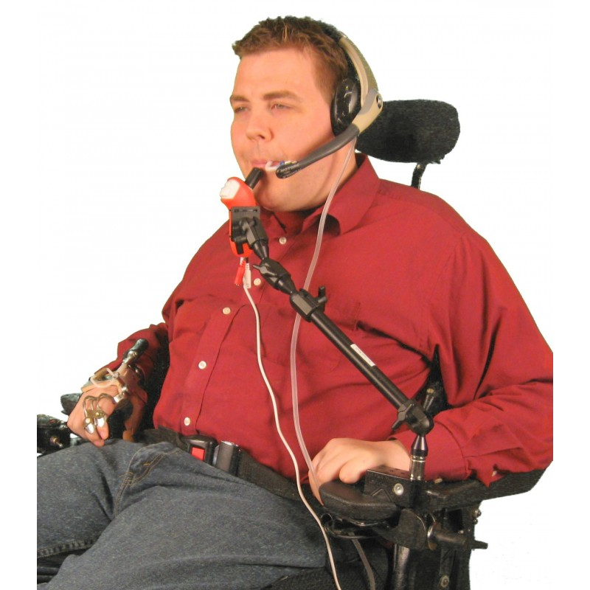
ALS Patient
Notes:
Story about Joe
Joe suffers from ALS. He currently has no motor control from the neck down. He is currently using a sip and puff system to control his wheelchair. Joe is dependent on a nurse to help him use a computer, as sip and puff does not allow him to control it. As Joe’s condition worsens, he finds it more and more difficult to use sip and puff, as his ability to breath effectively worsens. He is running out of options, and does not have the money to pay for more expensive equipment.

Slide 3
The Problem
People with ALS have limited options
The elderly
Current technologies
Notes:
19% (31.7 million) of working-age adults have a mild dexterity difficulty or impairment, and 7% (12.0 million) of working-age adults have a severe dexterity difficulty or impairment.
Nearly one in four (24%) computer users have a dexterity difficulty or impairment.
patients with severely limited communication conditions, including Traumatic Brain Injury (TBI), Cerebral Palsy (CP), Multiple Sclerosis (MS), Amyotrophic Lateral Sclerosis (ALS)

Slide 4
Solution
HIVEMIND: A novel way to interface with devices requiring minimal motor control.
Notes:
Industry: Assistive technology

Slide 5
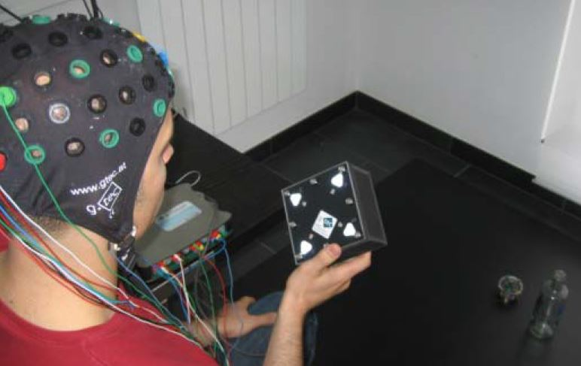
Technology
Electroencephalogram (EEG)
Steady State Evoked Potentials (SSVEP)

Slide 6
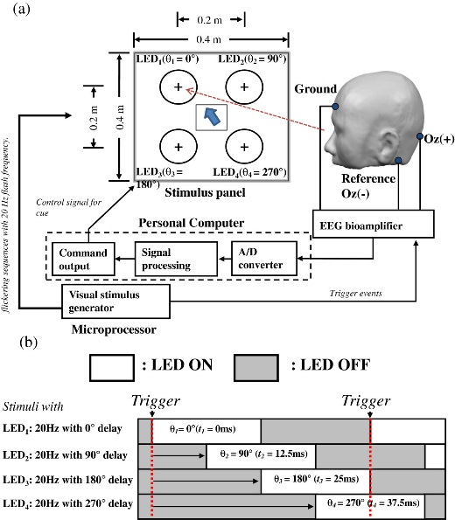
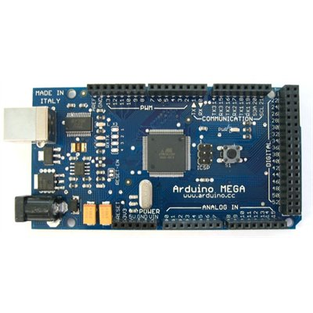
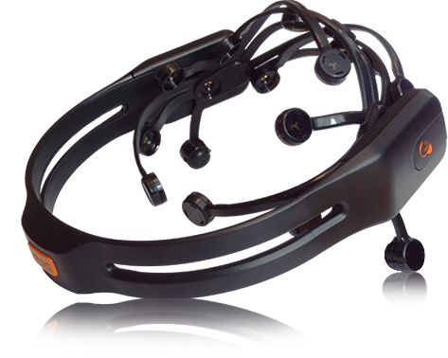
MVP
Arduino Microcontroller
Emotive EPOC
SSVEP Algorithm

Slide 7
Advantages
Minimal motor control required
Low cost
Adaptable

Slide 8
Target Market
ALS Patients
Disabled and Paralyzed
Elderly
Notes:
30,000 Americans have ALS, with 5,600 diagnosed every year
There are 5,596,000 paralysis patients in America
patients with severely limited communication conditions, including Traumatic Brain Injury (TBI), Cerebral Palsy (CP), Multiple Sclerosis (MS), Amyotrophic Lateral Sclerosis (ALS)
40 million Americans are over the age of 65, projected to be 89 million by 2050

Slide 9
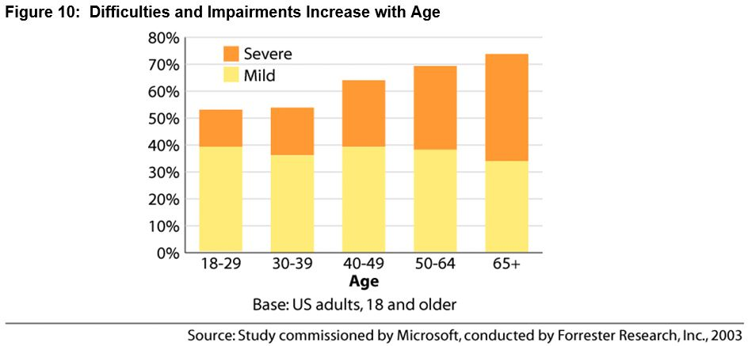
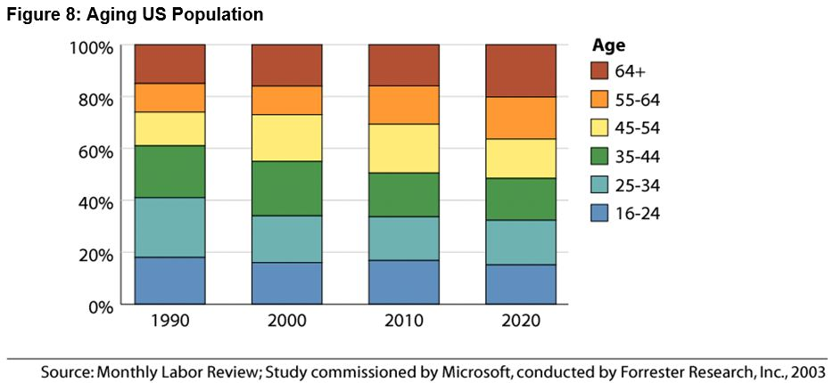
Aging Population
Notes:
By 2020, one in five workers will be 55 years and older. This represents a more than 50% increase over 2000, in which 13% of the labor force was made up of the 55-and-older age group. The aging labor force is likely to mean greater pressure from businesses to help keep their aging employees as productive as possible throughout their careers.
As current 55- to 64-year-olds mature into their 60s and 70s, they will continue to use computers. Therefore, in 10 years, there will be 2.5 times as many adults who range from 65 to 74 years old using computers as there are today.
First, as people age, existing mild difficulties and impairments can become more severe. Second, people are likely to develop new difficulties and impairments as they age.

Slide 10
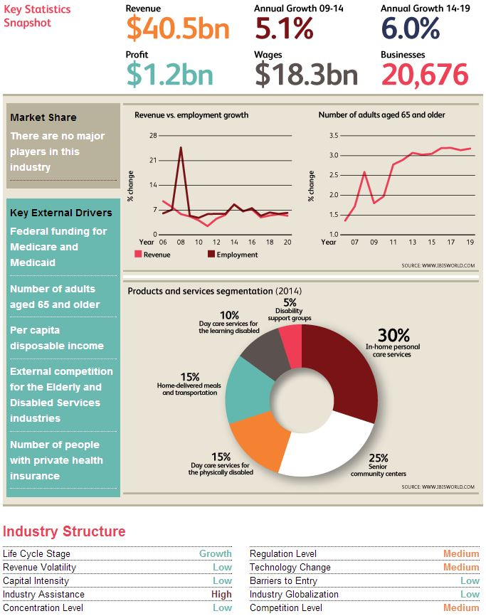
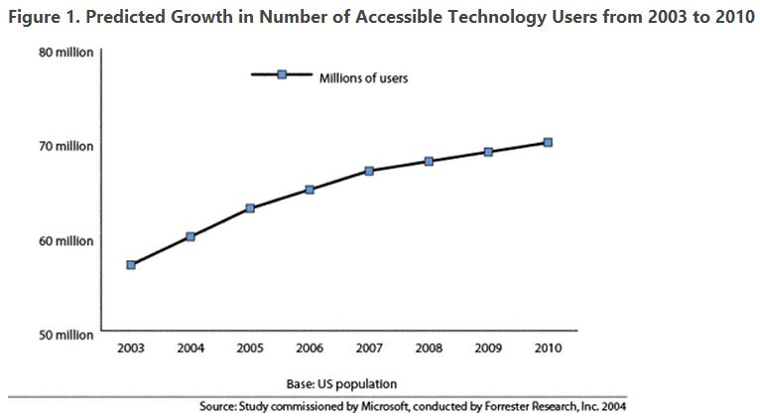
Market Size
Notes:
Elderly and disabled services: During the five years to 2014, industry revenue is still expected to increase an average of 5.1% annually to $40.5 billion as the economy moves further from its recessionary low. In 2014 alone, revenue is expected to soar at a rate of 8.7%.
Over the five years to 2019, industry revenue is expected to grow significantly, primarily due to the continued aging of the population. Over this period, revenue is expected to increase at an average annual rate of 6.0% to $54.3 billion.

Slide 11
Applications
Wheelchair control
Computer Interface
Video games

Slide 12
Development
More controls
Read thoughts

Slide 13
Competitors
Sip and Puff
Eyegaze
Voice recognition
Notes:
No companies currently offer this specific technology
Sip and puff: a device used to power wheel chairs or other technology by inhaling/exhaling in a pneumatic tube. Speed is controlled by sharp sips and puffs, steering is controlled by lower power SNPs.
Cost: $3-10K for Snp wheelchair
Cost for sip and puff switch ($173.95)
Problem: ALS patients have increasing difficulty breathing. Inability to move a sufficient amount of air in and out of lungs due to muscle weakness
Eye Tracking: often, eye muscles remain intact even when ALS patient’s body is paralyzed
Eyegaze Edge basic ($8,700)
Not easily portable, expensive

Slide 14
Revenue Model
Variable Cost: $320
Price: $499
Margin: 36%
Notes:
Year 1:
Units: 1000
Revenue: $499,000
Year 2:
Units: 1300
Revenue: $648,700
Year 3:
Units: 2080
Revenue: $1,037,920
Year 4:
Units: 3328
Revenue: $595,712
Year 5:
Units: 5658
Revenue: $1,012,710
CAGR: 30%

Slide 15
Revenue Model
Notes:
Year 1:
Units: 1000
Revenue: $499,000
Year 2:
Units: 1300
Revenue: $648,700
Year 3:
Units: 2080
Revenue: $1,037,920
Year 4:
Units: 3328
Revenue: $595,712
Year 5:
Units: 5658
Revenue: $1,012,710
CAGR: 30%

Slide 16
Marketing
Online Marketing
Strategic
Partnerships
Inbound Marketing
Social Media
Content Marketing
Email Marketing
Advertising
EEG manufacturers
Assistive technology (wheelchair) manufacturers
Assisted Living Support groups and communities
Notes:
Plan to market directly to people suffering from ALS. The main channel will be through our website, which will be advertised on ALS forums.

Slide 17
Founding Team
Ahmed Saif: Chief Engineer
Tenzin Wangdhen: Business and Operations

Slide 18
Questions

