Slide 1
Utilizing Recycling for 3D Printing
William Milner
Professor Duncan Carlsmith
Garage Physics

Slide 2
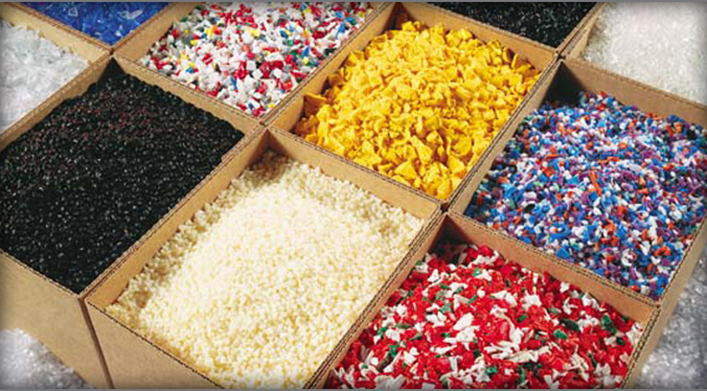
Background
Plastics can be broken into two larger subgroups: Thermoplastics and Thermosetting polymers.
Thermoplastics are suitable for recycling due to maintaining chemical properties when changing states.
The goal of the project is to create a recycled Bucky Badger from university plastic.

Slide 3
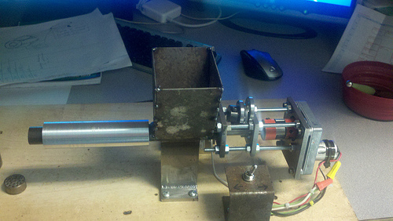
Filabot
The Filabot is a machine designed to turn plastic into 3D printable filament.
Shown right, the highly geared motor pushes plastic out at a constant torque.
The metal ring on the left is responsible for being heated and making the filament hot enough to be pushed out the dye.

Slide 4
Current Progress
Filabot is fully constructed and capable of recycling plastic.
Preliminary tests were done with ABS pellets, with mixed results. Initially, the extrusion temperature was too high and smoke was seen in the filament.
This was likely due to the temperature being too high as our temperature control is more accurate.
Better results came when the temperature was lowered and the filament was crudely spooled.
Improvements can be made to the Filabot.

Slide 5
Current Progress
Results varied from 1.7 to 1.85 mm diameter. The Replicator filament is 1.75 mm and showed little variation. (Measured using micrometer)
Additionally, the consistency of the filament changed over time. As we lowered the temperature, the filament became more consistent.
The temperature of the filament when it exits the Filabot is important. The filament must be hot enough that it can be spooled but not so hot that it stretches.
Before we print with the recycled filament, we need to ensure that the recycled filament is consistent.

Slide 6
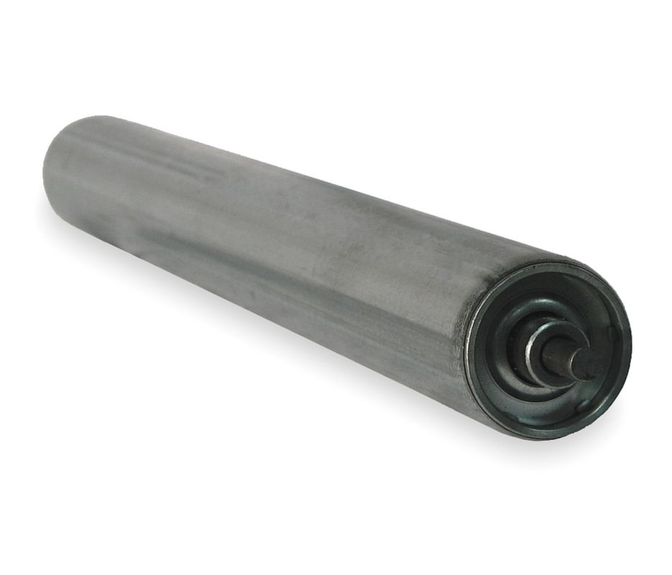
Issues and Needs
Due to the mass of the filament below it and the heat of the filament exiting, the diameter of the filament is variable.
To counter this, we ordered some metal conveyer rollers to be attached to a motor.
This would keep the filament at a constant torque, while also spooling it up.
Additions can be made to the design.

Slide 7
Future Work
When the rollers arrive, (within the week), an assembly will be built to attach the roller to a motor.
Considerations to be made: What is the ideal extruding temperature for our build?
How rapidly do we need to cool the filament once it leaves the Filabot?
Trials need to be conducted with PLA scraps instead of ABS pellets.

