Slide 2
C++
Basic Control flow
If statements
Gotos
Various loops
Arrays
Pointers
References
Function features
Passing/returning values, references, or addresses
Inlines
Overloading
Default parameters
Recursion

Slide 3
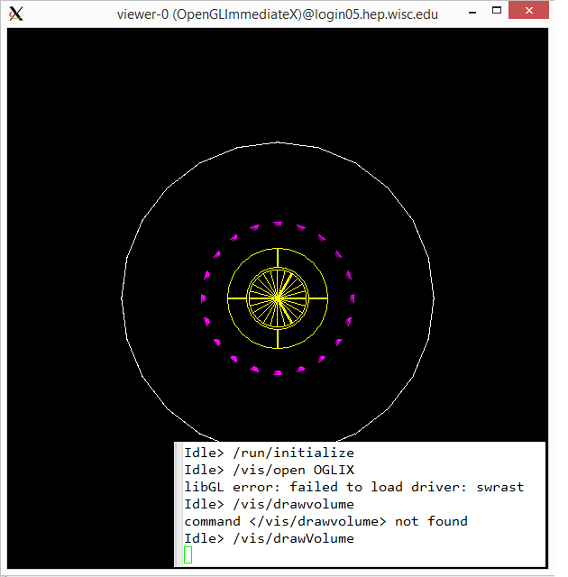
LUXSim
Got it to run
Tried visual stuff, seems to hang up when I do /vis/drawVolume (after drawing the volume)

Slide 4
Astronomy
Asteroids
Comets
Trans-Neptunians
Kuiper Belt
Oort cloud
Meteors

Slide 5
Feb. 23

Slide 6
C++
Classes
Public vs Private
Access functions
Constructors

Slide 7
Simulation Progress
Wrote simple macro to create scintillation light and absorb/record the light in PMTs.
Set recordLevel to 1 on all PMT windows (just for now to see how many make it there, should probably do something else in the long run).
/LUXSim/detector/recordLevel Top_PMT_Window 1
/LUXSim/detector/recordLevel Bottom_PMT_Window 1
2 options to initiate light
/gps/particle gamma
/gps/energy 7.0 eV
/gps/position (loop through grid in detector and record all results)
/gps/ang/type iso
/LUXSim/source/set LiquidXenon ScintPhotons 1 Bq

Slide 8
Astronomy
Solar system formation
The Sun

